Slide 1
Is our QSAR modeling of growth inhibition any good?
Egon Willighagen
2011-05-30

Slide 2
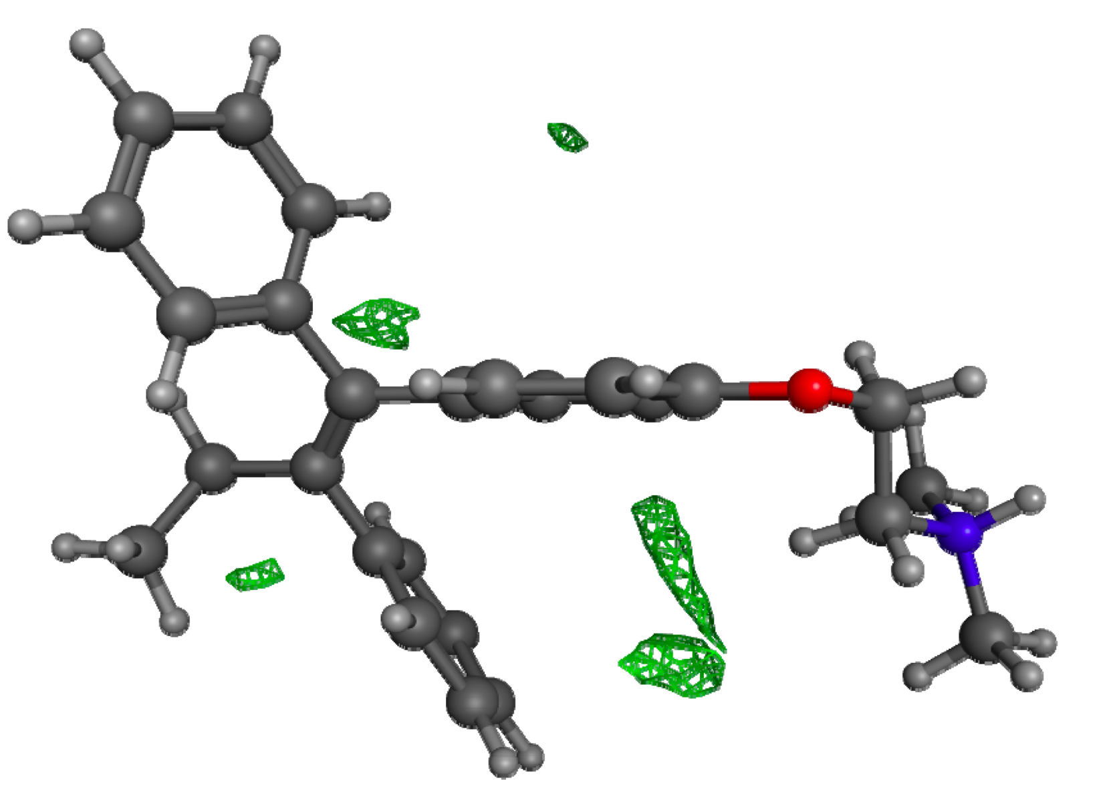
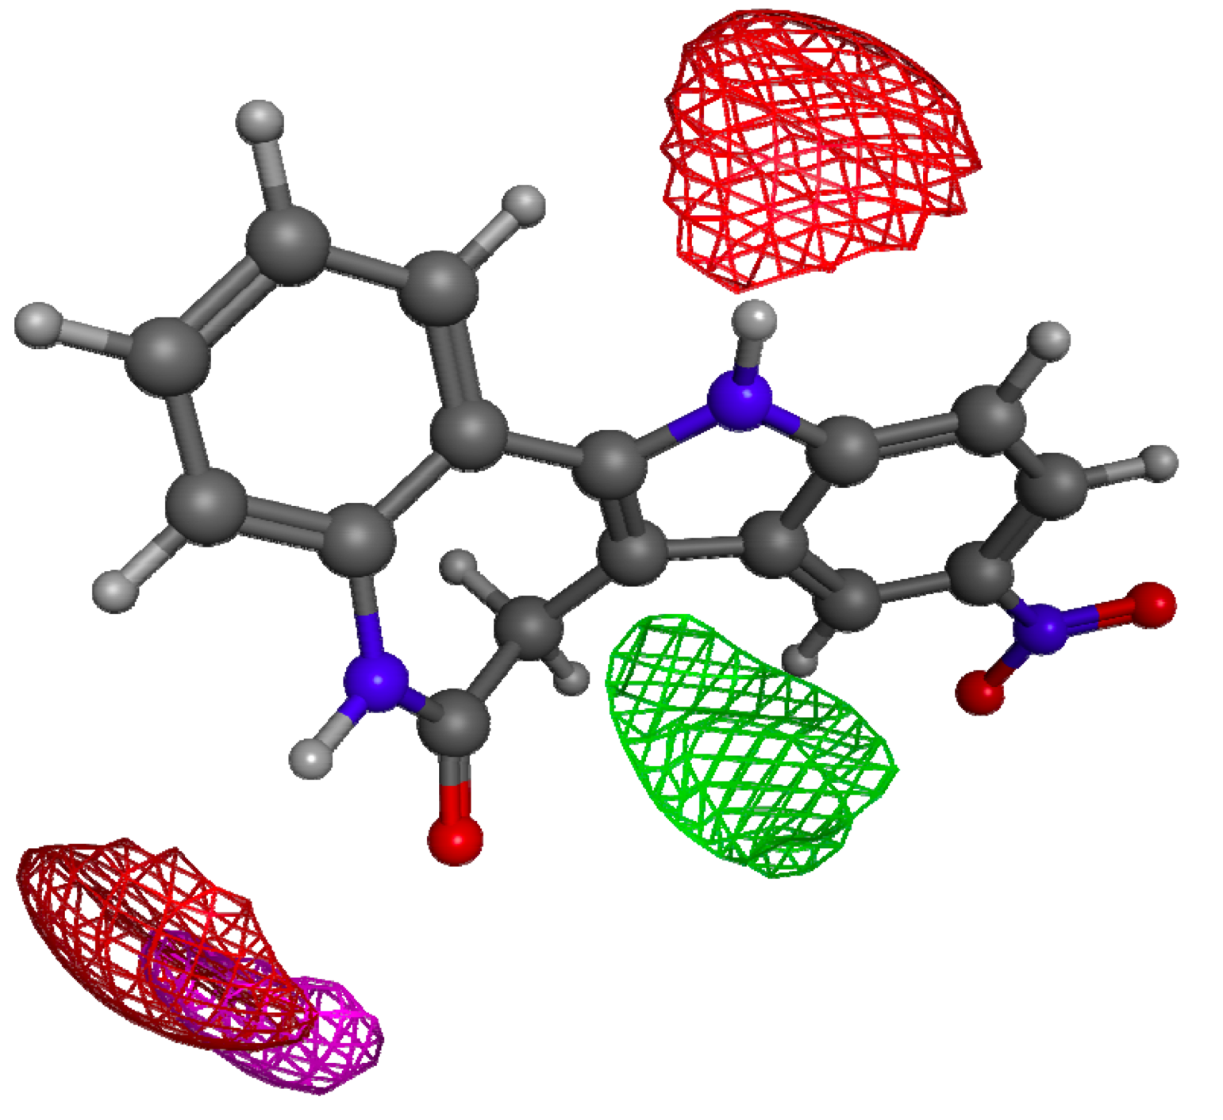
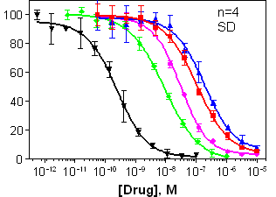
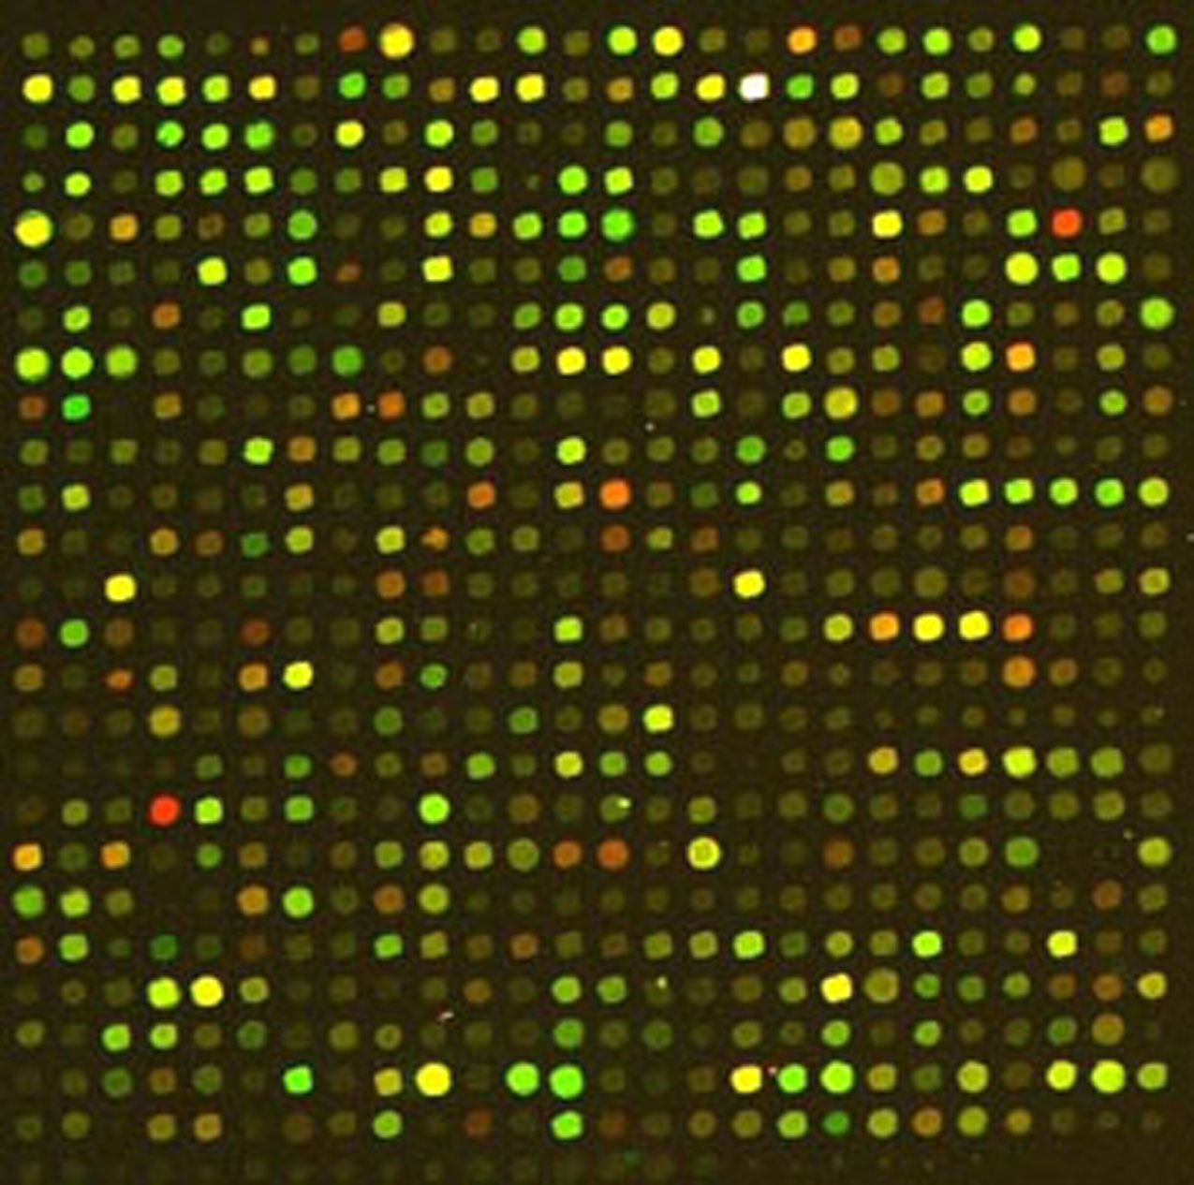
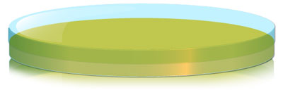
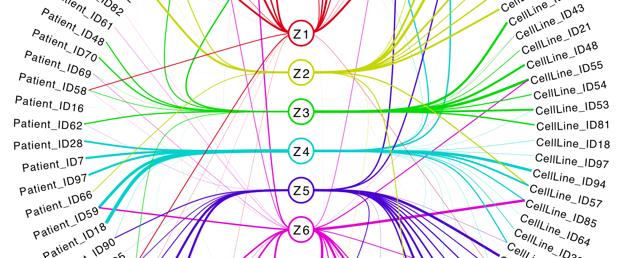
Goal: predict growth inhibition from molecular structures
Molecular descriptors
Drug responses (GI50)
Regression
Gene expression
Regression
Genesets
- Downstream biological profiling
Toxicity prediction
Biomarker discovery
Probabilistic component model
Interpretation

Slide 3
Data and Goal
Compounds
  230 drugs → molecular descriptors
    logP, number of acidic groups, etc
Activities
  log GI50 values (between -7 and -2), where GI₅₀ is in molar
    GI₅₀ is the dose where the growth is inhibited 50%
  Three cell lines: HL60, PC3, MCF7
Understand why some molecules have higher GI50 values

Slide 4
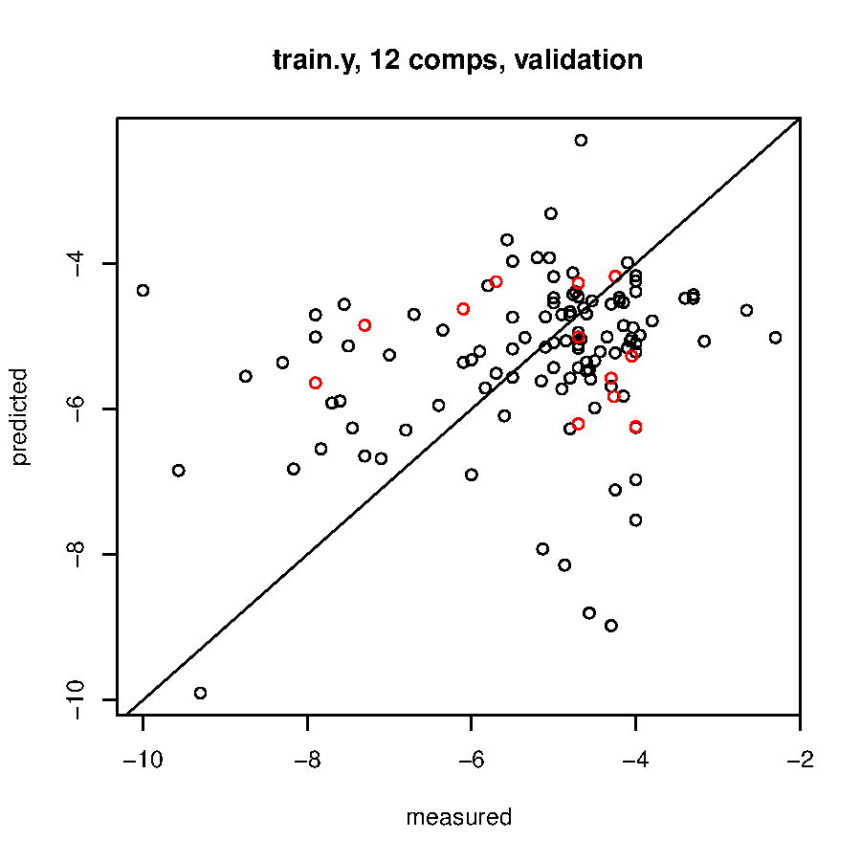
GI₅₀ cannot be predicted from molecular structures
(Non-)linear
regression methods
cannot predict the
GI₅₀ values from the
molecular structures
using ~290 QSAR
descriptors, like logP,
number of hydrogen
donors, etc.

Slide 5
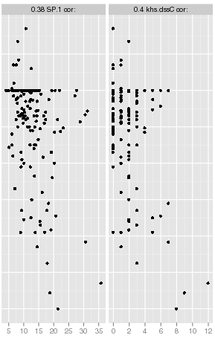
The “best” descriptors...
Even the best QSAR
descriptors show little
correlation (0.38 and 0.4).
and they do not
complement.
Skeletal
variation
Number of
double bonded
carbons

Slide 6
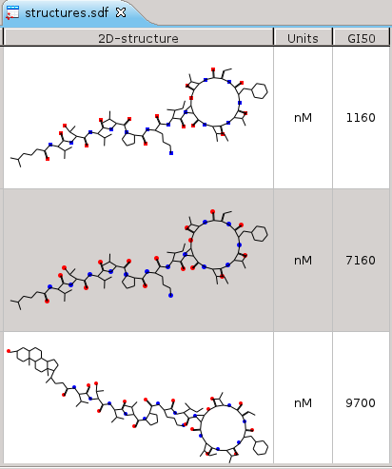
What about published GI₅₀ QSAR models?
ChEMBL database
  > 50000 GI₅₀ values from literature (GI₅₀, log GI₅₀, …)
  Largest studies have < 120 structures
  7 largest study of one paper, with highly congeneric kahalalide F compounds (see screenshot)
  Next study has only 78 structures
(No specs on how GI values are counted.)
Jiménez, J.C., et al. J. Med. Chem. 2008. 51(16):4920-4931.

Slide 7
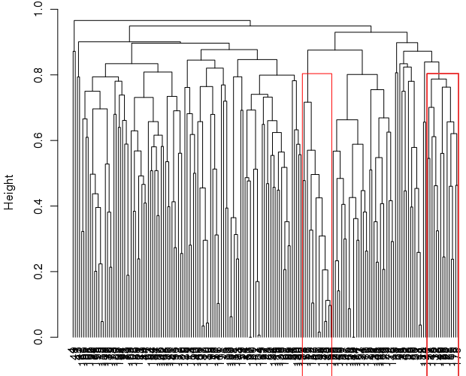
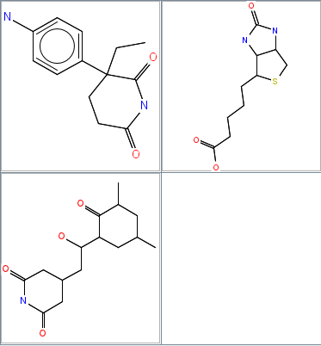
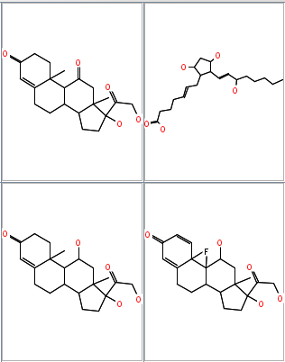
Hierarchical clustering of compounds
Dissimilar
compounds
Similar
compounds
The high diversity of molecules makes it harder for the QSAR modeling to find patterns.

Slide 8
OECD QSAR Guidelines
 | OECD Principles | ChemBioMod implementation
1 | Defined endpoint | GI₅₀
2 | Unambiguous algorithm | CDK + Bioclipse (input validation, ...)
3 | Defined applicability domain
4 | Goodness-of-fit, robustness, predictivity | No predictivity found
5 | Mechanistic interpretation (if possible) | Skeletal variety, number of double bonded carbons

Slide 9
Conclusions
Our data is more complex than QSAR studies for GI50 in literature
  Clusters too diverse, too many modes of action(?)
  Statistical method cannot find any significant patterns
  Correlation found is hard to interpret (at best)
Bad for our paper? No.
  For data sets with high diversity we propose gene expression as alternative

