Slide 1
data item
is a
chemical
descriptor
conforms to
chemical data
format specification
is descriptor of
has attribute
quality or
realizable
inheres in
chemical
entity

Slide 2
data item
has input
has specified
input
has specified
output
is specified
by
data
transformation
descriptor
algorithm
is specified by
has output
software
has agent
has output

Slide 3
process
is a
software execution
is a
parameter data item
has
input
parameterized software execution
has
output
data item
is a
parameterized data
transformation

Slide 4
data item
is a
is a
textual data item
numeric data item
conforms to
conforms to
textual data format specification
numeric data format specification
is a
is a
data format specification

Slide 5
chemical descriptor
has specified
output
algorithm to calculate a chemical descriptor
parameter data item
has specified
input
conforms to
software module to calculate a chemical descriptor
software method
has specified
output
software message
has part
has specified
output
is a
error message
warning message
data item

Slide 6
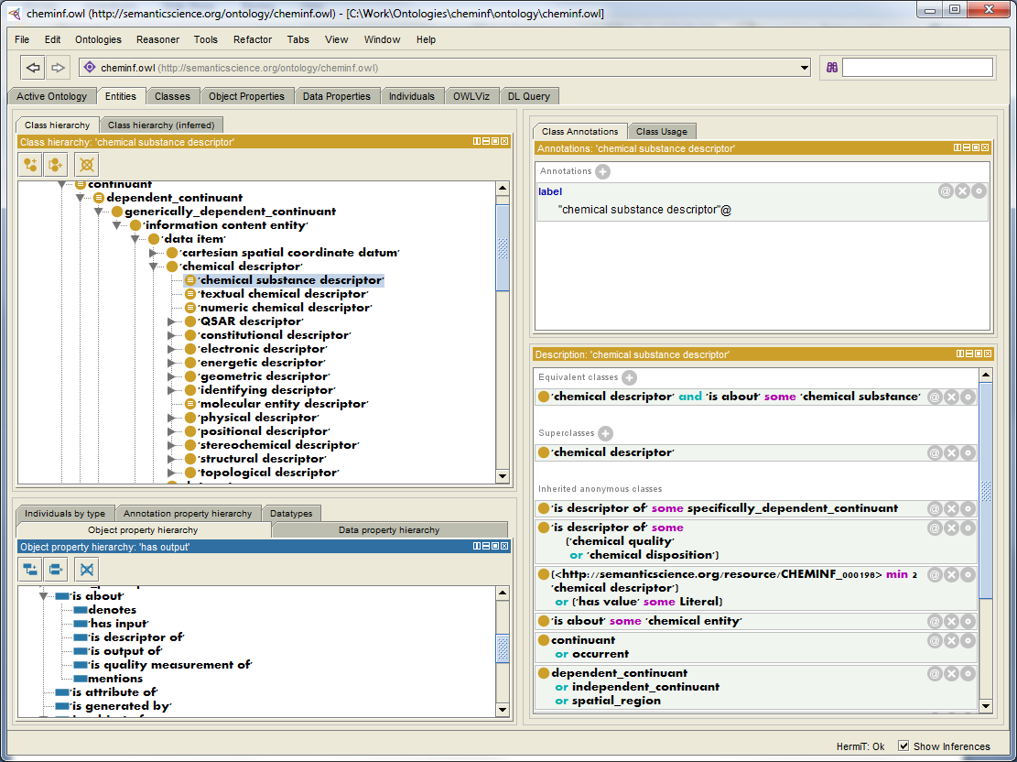
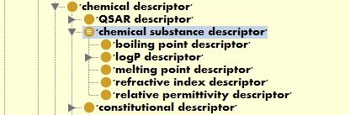
after executing a reasoner for classification

