Slide 1
An Analysis of SNOMED CT
Using Structural Symmetry
Presentation by:
Emilio Gonzalez
BMCC Fall 2015
Emilio Gonzalez, Yan Chen – An Analysis of SNOMED CT Using Structural Symmetry – December 2015

Slide 2







What is SNOMED-CT
Systematized Nomenclature of Medicine – Clinical Terms
It is the most comprehensive multilingual clinical terminology.
Managed by IHTSDO
New versions release every six months.
SNOMED-CT Stats:
Over 311,000 active concepts in 19 hierarchies.
Over 1 million descriptions with synonyms that link to concepts.
Over 900,000 semantic relationships (links) between concepts.
Emilio Gonzalez, Yan Chen – An Analysis of SNOMED CT Using Structural Symmetry – December 2015
Notes:
- SNOMED-CT stands for the Systematized Nomenclature of Medicine - Clinical Terms
- It is the most comprehensive and multilingual terminology in the world with over 311,000 active concepts, a million descriptions and 900,000 semantic relationships.
- A new version is released about every six months by the organization that owns it, the IHTSDO.

Slide 3
Benefits of SNOMED-CT
Enhances overall patient care.
Helps monitor and respond to health problems in populations.
Cost-effective due to the elimination of redundant testing.
Narrows down patients that are eligible to receive vaccines.
Expands knowledge of diseases, treatments & outcomes.
Emilio Gonzalez, Yan Chen – An Analysis of SNOMED CT Using Structural Symmetry – December 2015
Notes:
SNOMED CT is extremely beneficial in many ways, for instance patient care.
- This is done through keeping a safe and appropriate exchange of clinical information.
- It can be used to monitor trending health problems throughout the world, and even narrow down populations or people that are eligible to receive a vaccine.
- SNOMED allows us to catalog all known diseases, treatments and outcomes and even expand on them.
- We can also use SNOMED conduct research, statistical reports and decision support in the world of medicine.

Slide 4
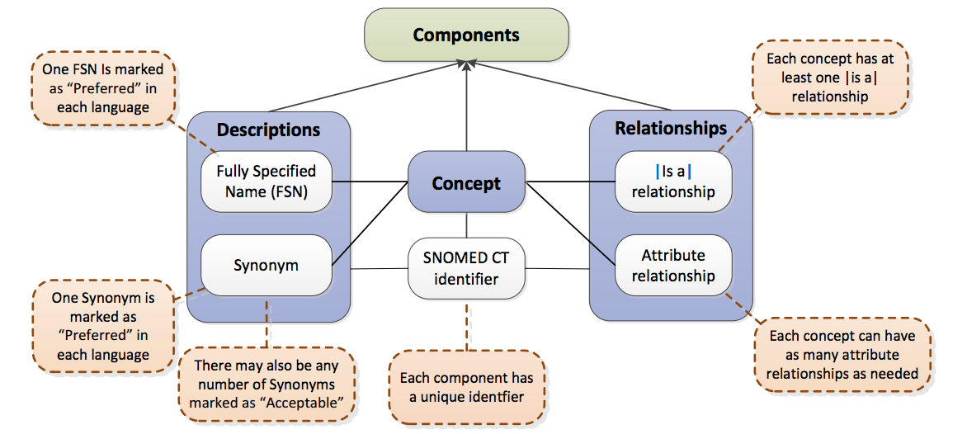
SNOMED-CT Concept Logical Model
Emilio Gonzalez, Yan Chen – An Analysis of SNOMED CT Using Structural Symmetry – December 2015
Notes:
SNOMED-CT’s components have a fairly simple data-structure, where a concept has a Description, Concept Identifier and a Relationship.
Concepts also include a Concept Identifier. These work a lot like ID numbers.
Descriptions have Fully Specified Names (or preferred names) along with a synonym. In any concept, you need at least one FSN and as many synonyms as you want.
Relationships include at least on |is a| relationship, along with as many Attribute Relationships that can exist.

Slide 5
Concepts, Descriptions & Relationships
A core component must include a Concept, Description and a Relationship.
Concept
Clinical meaning that is organized into hierarchies
Description
Link concepts to human readable terms
Relationship
Links a concept to other related concepts
Emilio Gonzalez, Yan Chen – An Analysis of SNOMED CT Using Structural Symmetry – December 2015
Notes:
Concepts have 3 parts to them like described before,
CONCEPT
clinical meaning that is organized into hierarchies
Description
Link concepts to human readable terms
Relationship
Links a concept to other related concepts

Slide 6
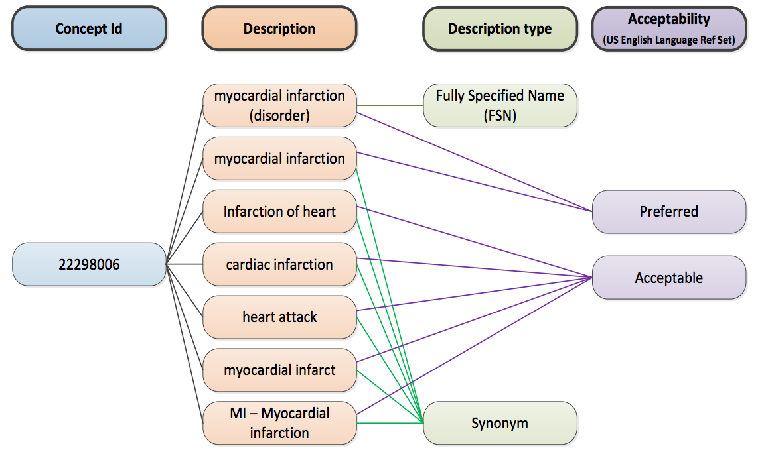

Concept Codes, Descriptions and Acceptability
Concept-code Design Structure:
String of digits, 6-18 characters in size.
One code per meaning, one meaning per code.
Concepts are in peoples head, code is in the terminology.
Note:
Each Description Synonym/FSN has it’s own concept code/id.
Emilio Gonzalez, Yan Chen – An Analysis of SNOMED CT Using Structural Symmetry – December 2015
Notes:
Here we have an example of a concept , ‘22298006’
Concept codes are structured as the following:
String of digits, 6-18 characters in size.
One code per meaning, one meaning per code.
Concepts are in peoples head, code is in the terminology.

Slide 7
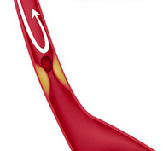
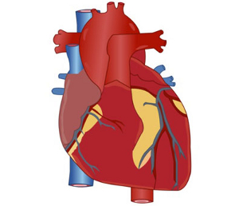
Relationships Links concepts to other related concepts
55641003
Infarction
ASSOCIATED MORPHOLOGY
FINDING SITE
22298006
Myocardial Infarction
(disorder)
74281007
Myocardial Structure
Types of Relationships
Definitional: Necessarily true about the concept.
Qualifiers: May be added to specialize the concept.
Historical: Provides a pointer to current concepts from retired concepts.
Additional: Allows non-definitional information to be distributed.
Emilio Gonzalez, Yan Chen – An Analysis of SNOMED CT Using Structural Symmetry – December 2015
Notes:
Using Myocardial Infarction as in the previous examples, we can now define it’s relationships. We see that Myocardial Infarction |is a| Infarction.
We can also see one Attribute relationship, where the finding site is the Myocardial Structure.
Explain the relationships

Slide 8
Inconsistencies within SNOMED-CT
Due to SNOMED’s broad scope and inherent complexity, it is unavoidable that inconsistency and errors will find their way into SNOMED’s knowledge content, particularly as it continues to expand.
It is common to see that most concepts are lacking sufficient synonyms both in inferred mode & stated mode.
Some concepts have the wrong parents or don’t even have a linked parent. These cause huge hieratical organization errors.
Important relationships between concepts are missing or are incorrect.
Duplicate concepts exist within the knowledge base.
/
Emilio Gonzalez, Yan Chen – An Analysis of SNOMED CT Using Structural Symmetry – December 2015
Notes:
Due to SNOMED’s broad scope and complexity, inconsistencies will find their way onto the SNOMED knowledge base.
It is common to see that many concepts lack or don’t have synonyms,
have the wrong or no parents,
have the wrong or no children.
duplicate entries within knowledge base
Relationships are missing
Methods to accomplish this: Lexical Matching, Whole Word Matching, Prefix Matching, Snippet Matching, Sentence Matching, Suffix Matching, NHS Extension Matching, SubSet Matching, Ancestor Matching, Descendant Matching and Neighbour Matching.

Slide 9
Consistency Analysis Using Structural Symmetry
Two concepts C1 and C2 are symmetric if concept C1 can be obtained from concept C2 by replacing a single modifier such as “left” with “right”, or “acute” with “chronic”.
The modifier pairs that will be studied in this research include:
(acute, chronic) (acquired, congenital) (primary, secondary) (unilateral, bilateral) (first, second) (upper, lower) (superior, inferior) (left, right) (anterior, posterior) (ascending, descending)
Emilio Gonzalez, Yan Chen – An Analysis of SNOMED CT Using Structural Symmetry – December 2015
Notes:
In this research, we will analyze the consistency of SNOMED CT by automatically generating symmetric concept pairs by using linguistic structure in the concepts names.
This will help us identify missing parents, children and concepts.
Similarly, Structural Informatics Group, University of Washington, Seattle, USA analyzed the FMA ontology using structural symmetry and they concluded that this algorithm is a valuable method to ensure quality assurance. The difference between my work and their work will be the fact that my code will be used for all 19 hierarchies of SNOMED CT and will be more efficient and highly customizable.

Slide 10
Consistency Analysis Using Structural Symmetry
Consistency examples:
Concepts Active upper limb movements and Active lower limb movements are both children of Active joint movements.
Concepts Anterior perineal hernia and posterior perineal hernia are both children of Perineal hernia
inconsistency examples:
Concept congenital pneumonia is a child of pneumonia.
However, there is no concept named as acquired pneumonia.
Concept Chronic peptic ulcer with hemorrhage AND with perforation but without obstruction is a child of peptic ulcer with hemorrhage AND with perforation but without obstruction.
However, Acute peptic ulcer with hemorrhage AND with perforation but without obstruction is missing.
Emilio Gonzalez, Yan Chen – An Analysis of SNOMED CT Using Structural Symmetry – December 2015
Notes:
In this research, we will analyze the consistency of SNOMED CT by automatically generating symmetric concept pairs by using linguistic structure in the concepts names.
Any inconsistency identified will reveal misaligned concepts or missing concepts.
For example, we replaced the modifiers in the following examples -

Slide 11
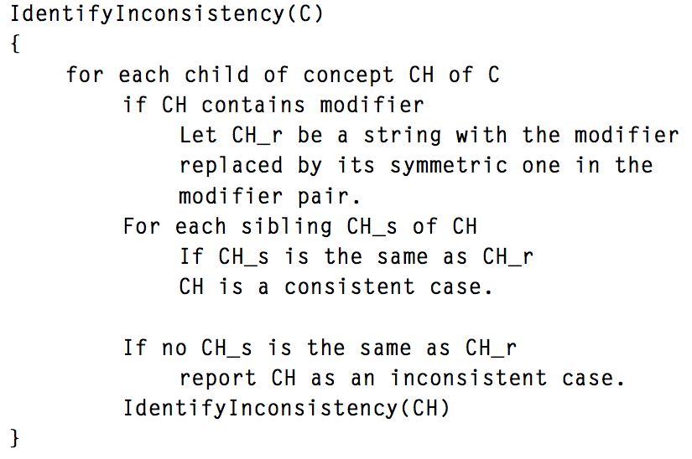
Abstract Pseudocode
The algorithm I have designed is described as the following, where C is a concept to start with.
Emilio Gonzalez, Yan Chen – An Analysis of SNOMED CT Using Structural Symmetry – December 2015

Slide 12
Abstract Pseudocode
The algorithm can be applied to any SNOMED CT hierarchy.
If the whole hierarchy needs to be audited, then the algorithm can be called from the root concept. For example: the Clinical Finding hierarchy.
It can also be applied to a specific area that a researcher is interested in, for example, the sub-hierarchy rooted at “bleeding”.
Emilio Gonzalez, Yan Chen – An Analysis of SNOMED CT Using Structural Symmetry – December 2015

Slide 13
Why Structural Symmetry?
A Structural Informatics Group (SIG) at the University of Washington analyzed the FMA ontology using Structural Symmetry and concluded that this approach to auditing inconsistencies within a database is a very valuable method to ensure quality assurance efficiently and effectively.
The difference between my work and the work of SIG is that my code will work for SNOMED CT. It is made to be very efficient, effective and highly customizable. My code can proactively:
Add, remove and even switch the modifier pairs
Can be used with any language
Can search for missing or inaccurate parent and/or children
Report misspelled concepts
Report non-existent concepts that should exist
Report missing relationships and descriptions
Report duplicate concept entries
For this research we will only look for missing modifier pairs.
Emilio Gonzalez, Yan Chen – An Analysis of SNOMED CT Using Structural Symmetry – December 2015

Slide 14
Auditing SNOMED-CT Using My Program
To test my algorithm, I chose a relatively small sub-hierarchy that has ideal conditions to test with. I chose to audit “Disorder of Skull” which is a sub-hierarchy of the main hierarchy “Disorder”.
Starting Concept: Disorder of Skull (disorder) [SNOMED-CT ID: 118945006]
Running Total of Concepts Scanned: 732
Running Total of Consistencies: 643
Running Total of Inconsistencies: 89
Total of Modifiers found within Concepts: 92
------------------------------------------------------------------------------------------------
Percent Consistency of Audit: 87.84%
Percent Inconsistency of Audit: 12.16%
-------- Breakdown ------------------------------- Amount of Error 0: 0
Amount of Error 1: 29
Amount of Error 2: 57
Amount of Error 3: 3
Amount of Error 4: 0
---------------------------------------------
Amount of Error Total: 89
Error 0: No information for this error.
Error 1: Modifier pair does not exist.
Error 2: Parent mismatch.
Error 3: Modifier pair does not exist or might be mistyped.
Error 4: Parent for one or more concepts do not exist.
The results concluded that most of the errors were caused by missing modifier pairs and parent mismatches. This shows that my method of auditing SNOMED is valuable for quality assurance.
Emilio Gonzalez, Yan Chen – An Analysis of SNOMED CT Using Structural Symmetry – December 2015

Slide 15
Acknowledgements & References
A huge thanks to the NYC LS-AMP program, Dr. Brathwaite, Professor Chen, Jenny Paredes, Nia Rene, Helene Bach as well as the National Science Foundation.
[1] Bodenreider, Olivier, Anita Burgun, and Thomas Rindflesch. "Assessing the Consistency of a Biomedical Terminology through Lexical Knowledge." PubMed. National Library of Medicine,, 4 Dec. 2002. Web. 11 Nov. 2015. <http://www.ncbi.nlm.nih.gov/pubmed/12460634>.
[2] Fenton, Susan, Kathy Giannangelo, Crystal Kallem, and Rita Scichilone. "Data Standards, Data Quality, and Interoperability (Updated)." American Health Information Management Association, 2013. Web. <http://library.ahima.org/xpedio/groups/public/documents/ahima/bok1_050482.hcsp?dDocName=bok1_050482>.
[3] Luo, Lingyun, Jose L.V. Mejino JR, and Guo-Qiang Zhang. "An Analysis of FMA Using Structural Self-Bisimilarity." PubMed. The National Center for Biotechnology, 2 Apr. 2013. Web. 11 Nov. 2015. <http://www.ncbi.nlm.nih.gov/pmc/articles/PMC3690136/>.
[4] "IHTSDO Members." The International Health Terminology Standards Development Organisation, 2015. Web. <http://www.ihtsdo.org/members/>.
[5] "SNOMED Clinical Terms (SNOMED CT)." Unified Medical Language System. U.S. National Library of Medicine, 2007. Web. 11 Nov. 2015. <https://www.nlm.nih.gov/research/umls/Snomed/snomed_main.html>.
[6] "SNOMED CT Starter Guide." International Health Terminology Standards Development Organisation, 1 Feb. 2014. Web. <http://ihtsdo.org/fileadmin/user_upload/doc/download/doc_StarterGuide_Current-en-US_INT_20140222.pdf>.
[7] "Summary of SNOMED CT Benefits." International Health Terminology Standards Development Organisation. Web. <http://ihtsdo.org/index.php?id=853>.
[8] "What Is SNOMED-CT." International Health Terminology Standards Development Organisation (IHTSDO), 2004. Web. 11 Nov. 2015. <http://www.ihtsdo.org/snomed-ct/what-is-snomed-ct>.
Emilio Gonzalez, Yan Chen – An Analysis of SNOMED CT Using Structural Symmetry – December 2015

