Slide 1
Assessing comparability in single-arm trials for rare diseases, with time-to-event endpoints
Elia Gonzato, PhD Candidate
Department of Epidemiology and Data Science, Vrije Universiteit, Amsterdam, NL
Department of Pediatric Neurology, Emma Children's Hospital, Amsterdam, NL
e.gonzato@amsterdamumc.nl
47th Annual Conference of the International Society for Clinical Biostatistics (ISCB), Freiburg, 27th September – 1st October 2026

Slide 2
Introduction

Slide 3
Introduction

Slide 4
Introduction
A
B

Slide 5
Introduction
A
B

Slide 6
Introduction
A
B

Slide 7
Introduction
A
B
2000
1990
200
199
2010
201
2020
202

Slide 8
Introduction
A
B
2000
1990
200
199
2010
201
2020
202

Slide 9
Introduction
A
B
2000
1990
200
2010
201
2020
202

Slide 10
Time related bias
Eligibility

Slide 11
Time related bias
End of follow-up
Eligibility

Slide 12
Time related bias
End of follow-up
Eligibility
Time since eligibility

Slide 13
Time related bias
End of follow-up
Eligibility
Time since eligibility
Beginning of treatment
End of follow-up
Eligibility
Notes:
The problem here is that certain people may think that this is not particularly different from TTE, but efficiency and the estimand is the key.

Slide 14
Time related bias
End of follow-up
Eligibility
Time since eligibility
Time zero
Beginning of treatment
End of follow-up
Immortal time

Slide 15
Time related bias
End of follow-up
Eligibility
Time since eligibility
Time zero
Beginning of treatment
End of follow-up

Slide 16
Time related bias
End of follow-up
Eligibility
Time since eligibility
End of follow-up
Time zero

Slide 17
Time related bias
?
End of follow-up
Eligibility
End of follow-up
Time zero

Slide 18
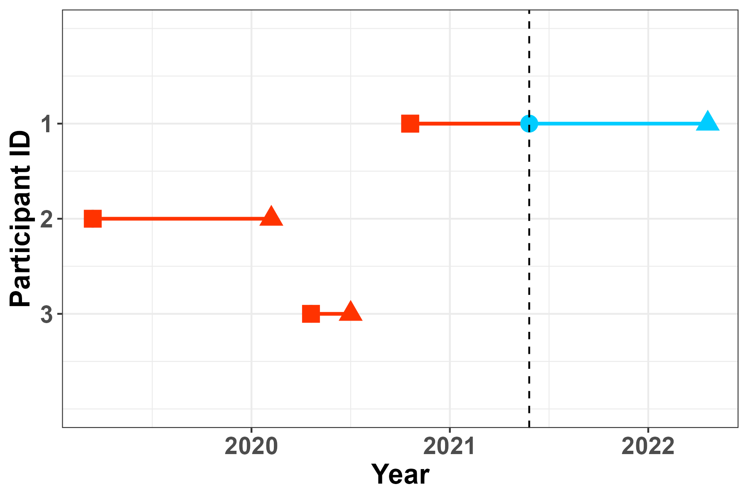
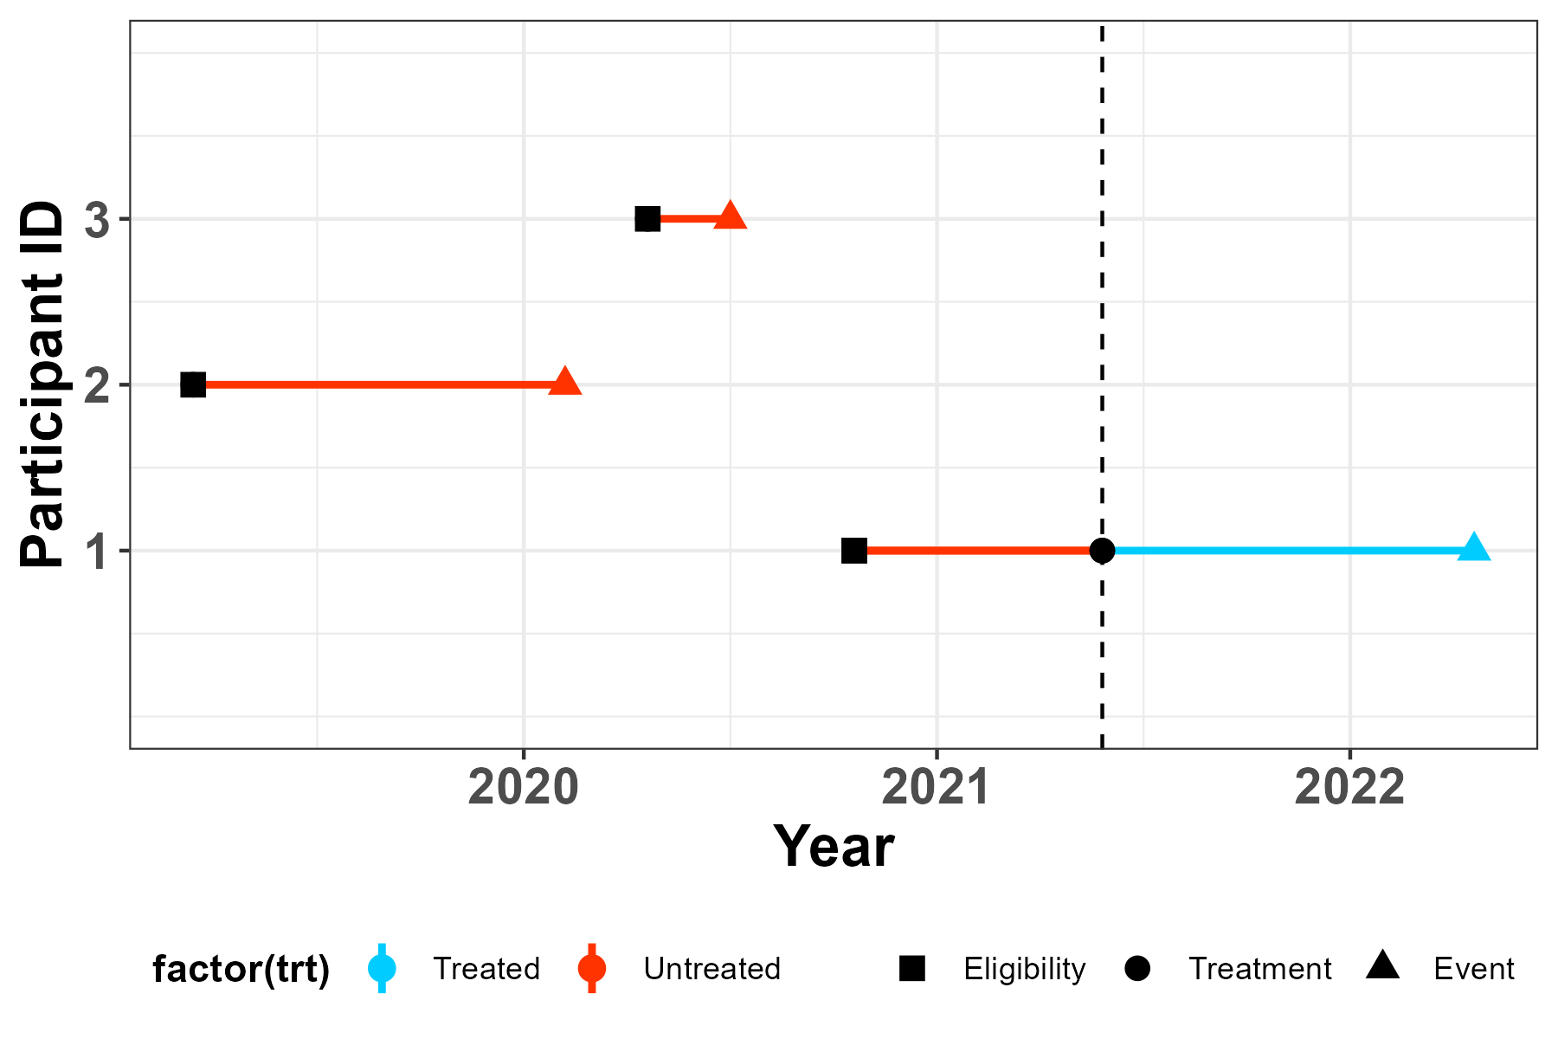
Time alignment
Database timeline

Slide 19
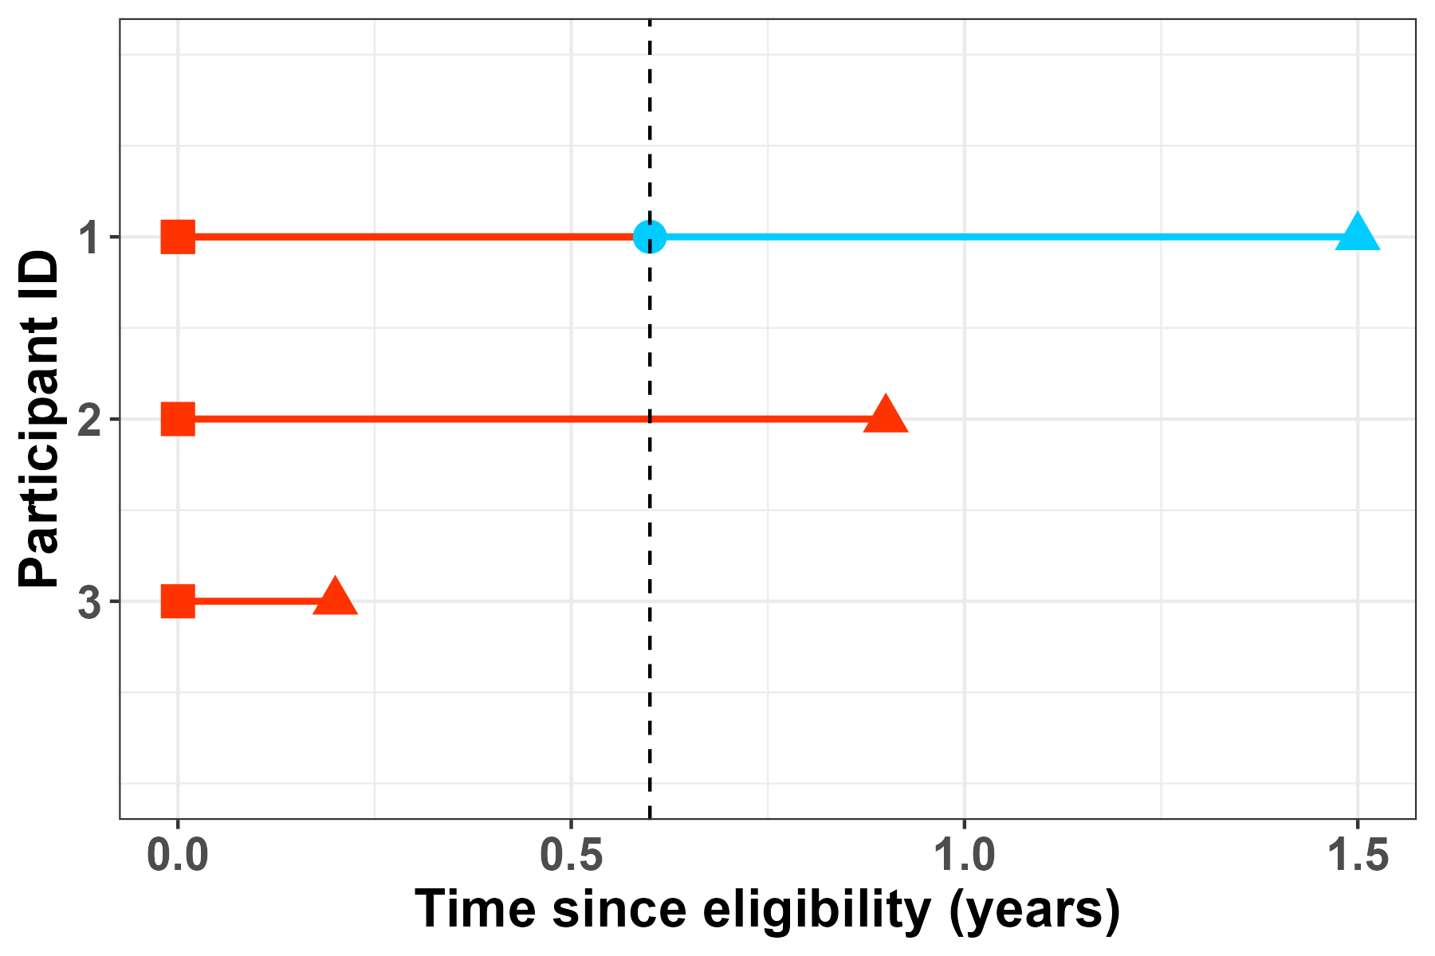
Time alignment
Database timeline
Time since eligibility timeline

Slide 20
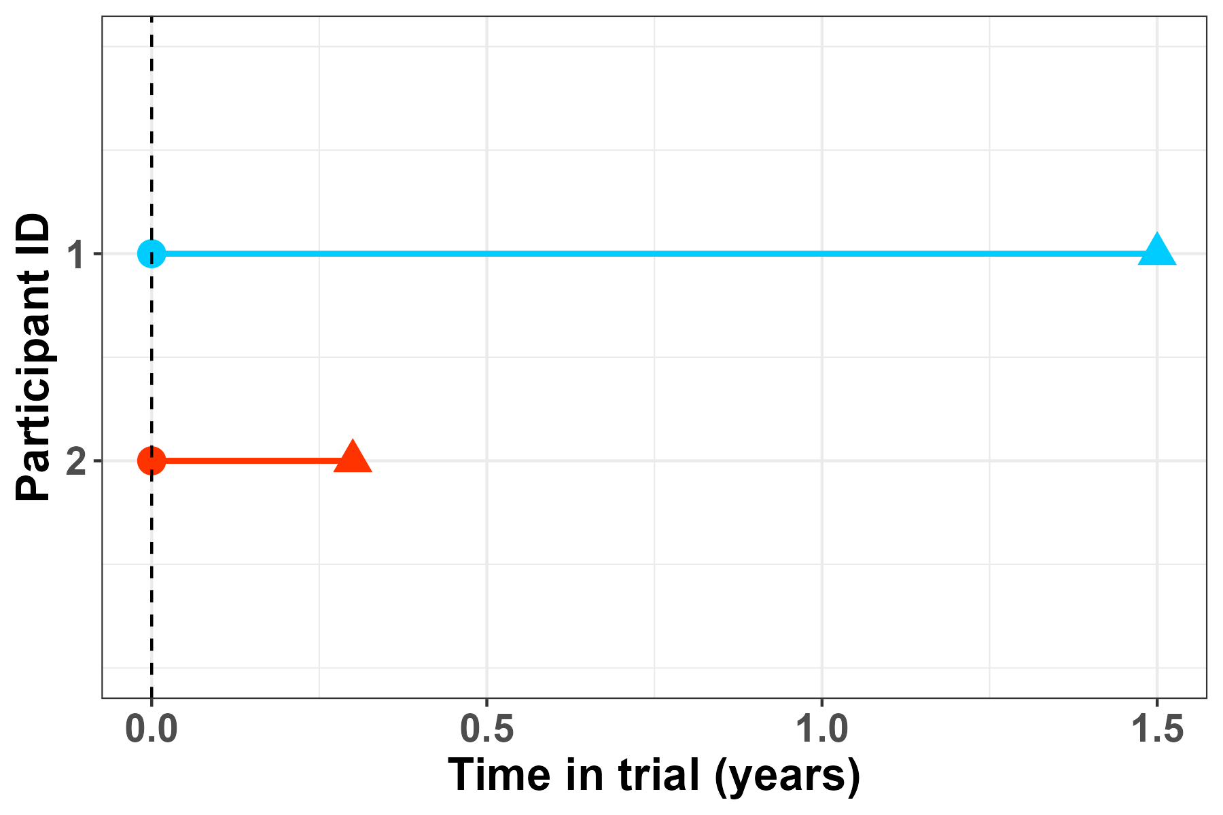
Time alignment
Database timeline
Time since eligibility timeline
Re-definition of time axis

Slide 21
Matching procedure
d=5; t=4
d=3; t=4
d=6
d=1; t=4
d=time since eligibility; t=time in trial

Slide 22
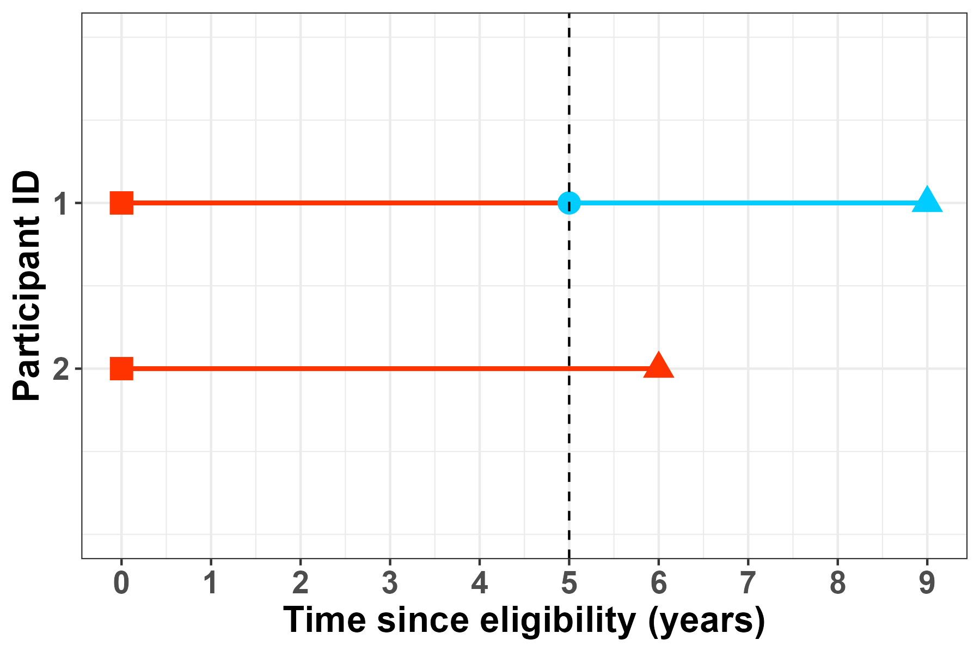
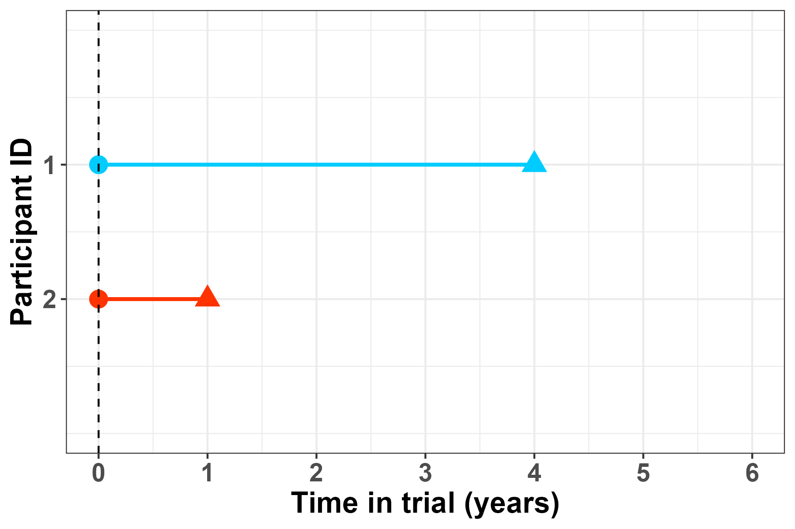
Time alignment
Re-definition of time axis
Matching procedure
d=5; t=4
d=3; t=4
d=6
d=1; t=4
d=time since eligibility; t=time in trial

Slide 23
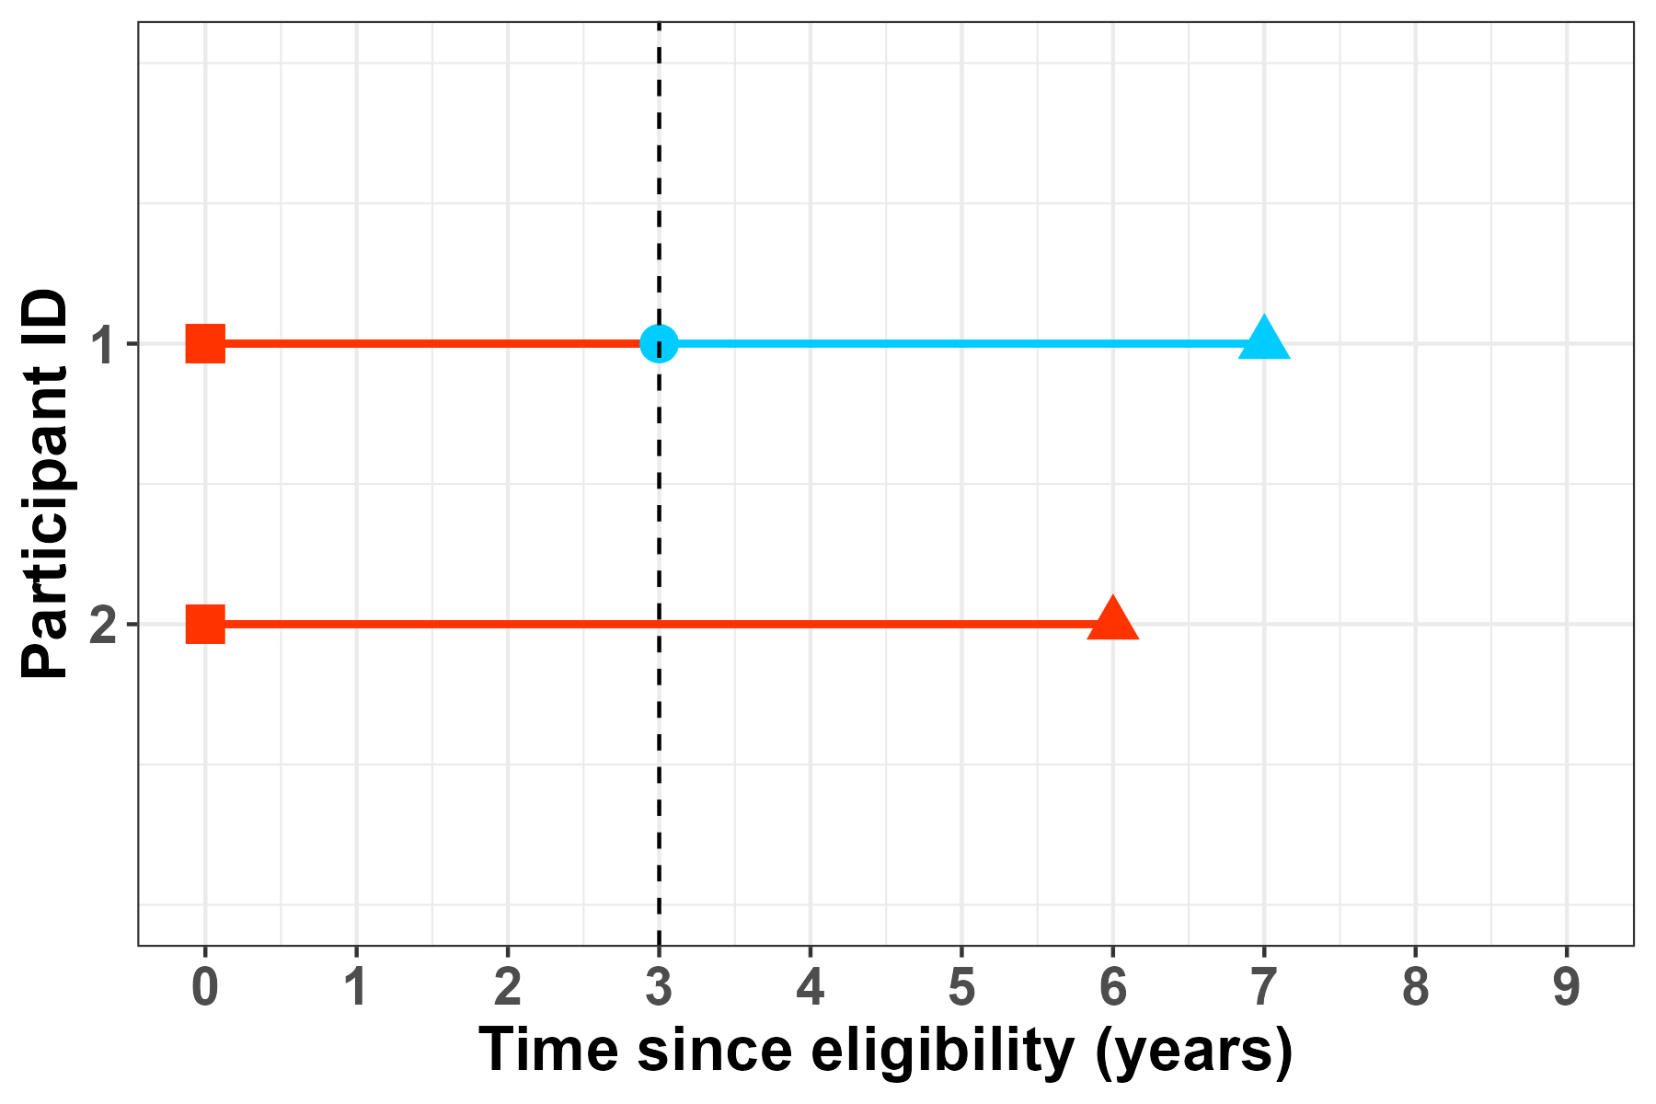
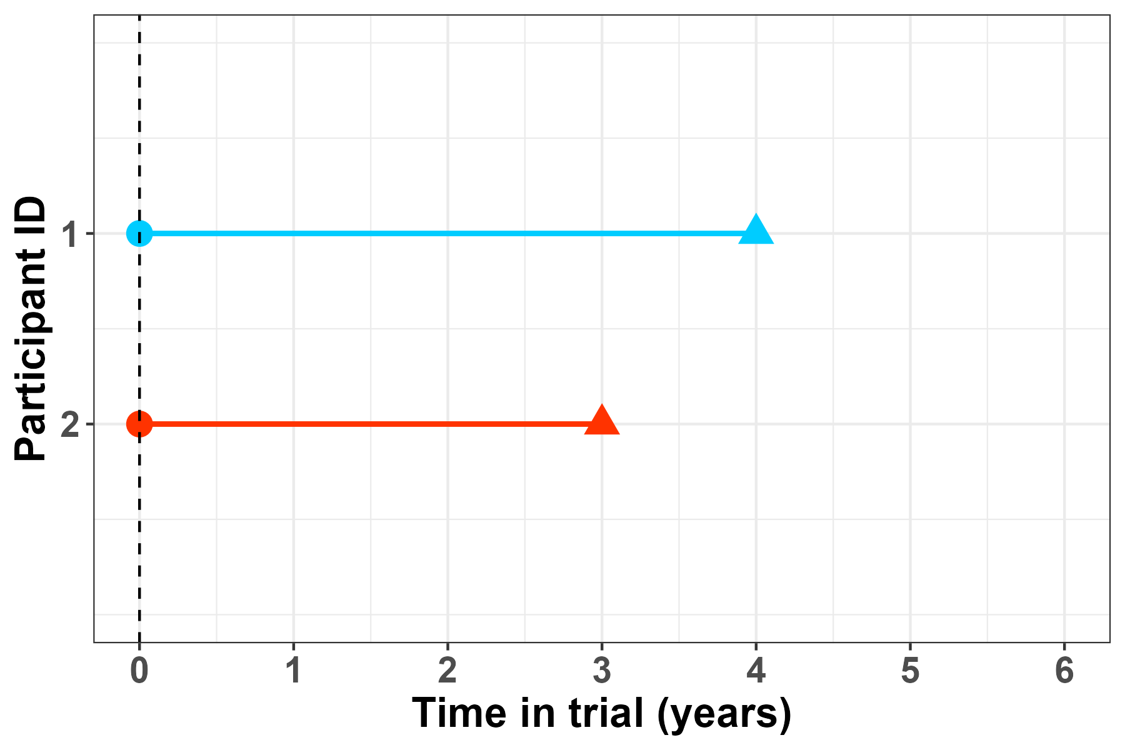
Time alignment
Re-definition of time axis
Matching procedure
d=5; t=4
d=3; t=4
d=6
d=1; t=4
d=time since eligibility; t=time in trial

Slide 24
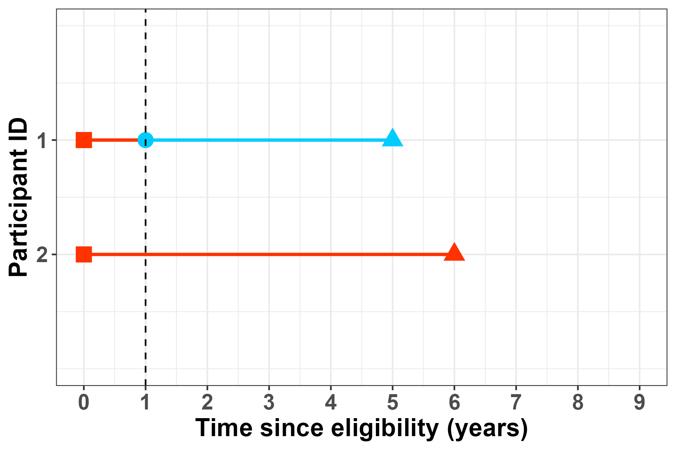
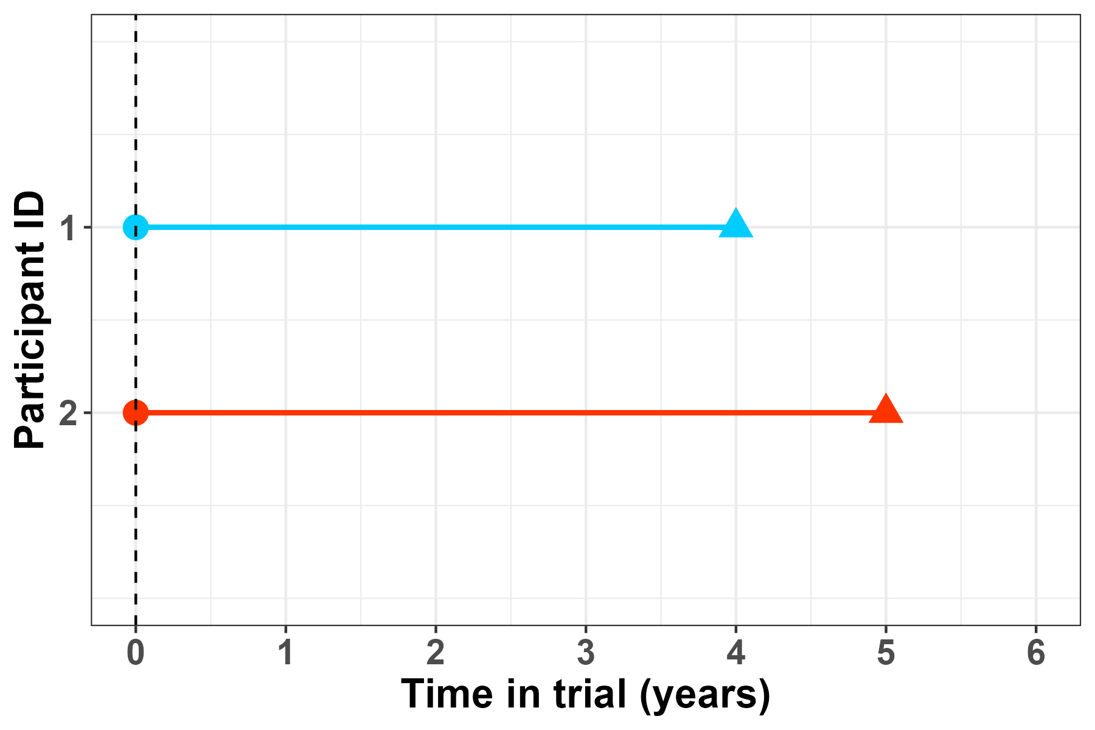
Time alignment
Re-definition of time axis
Matching procedure
d=5; t=4
d=3; t=4
d=6
d=1; t=4
d=time since eligibility; t=time in trial

Slide 25
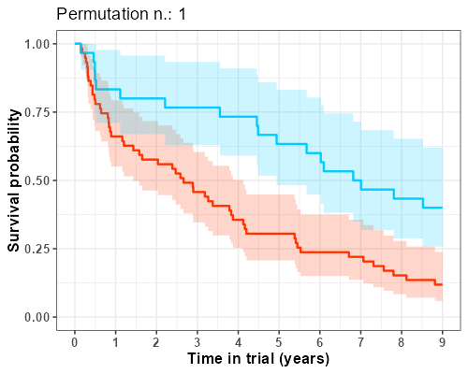
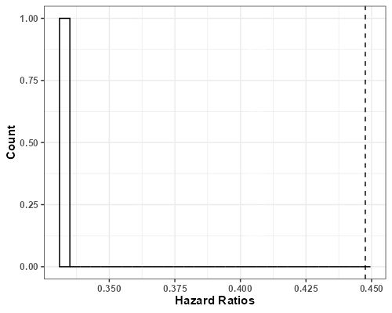

Matching procedure
egonzato/visualising_km_matching

Slide 26
Bottom line
In time-to-event endpoints, time alignment for treatment groups is crucial (but not always straightforward)

Slide 27
Bottom line
In time-to-event endpoints, time alignment for treatment groups is crucial (but not always straightforward)
For our ATT approach, this alignment is embedded in the matching procedure

Slide 28
Bottom line
In time-to-event endpoints, time alignment for treatment groups is crucial (but not always straightforward)
For our ATT approach, this alignment is embedded in the matching procedure
Matching without replacement inherently results in variability, which should be explored and reported

Slide 29

Thank you to the VWM trial & VWM registry team:
Questions
Marjo van der Knaap
Romy van Voorst
Rik van Eekelen
Johannes Berkhof
Merel Postema
Marjan Steenweg
Eline Hamilton
Renate Verbeek
Marije Voermans
Nicole Wolf
Scan to see the results!

Slide 30
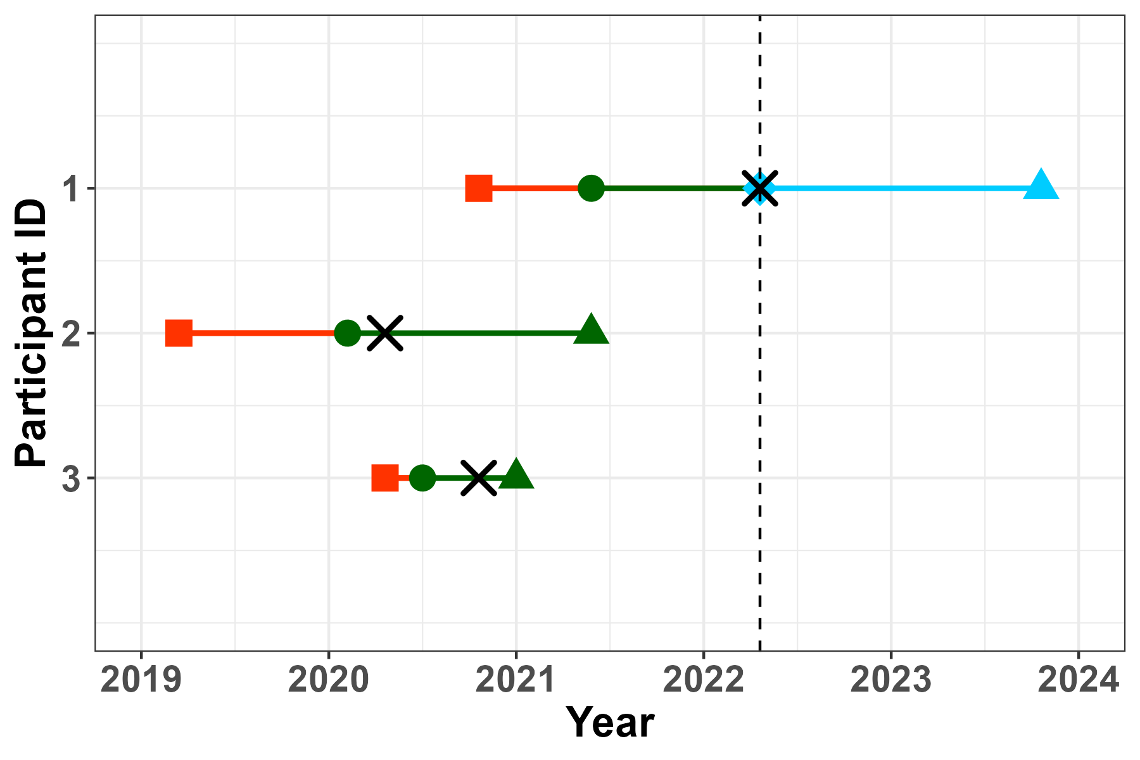
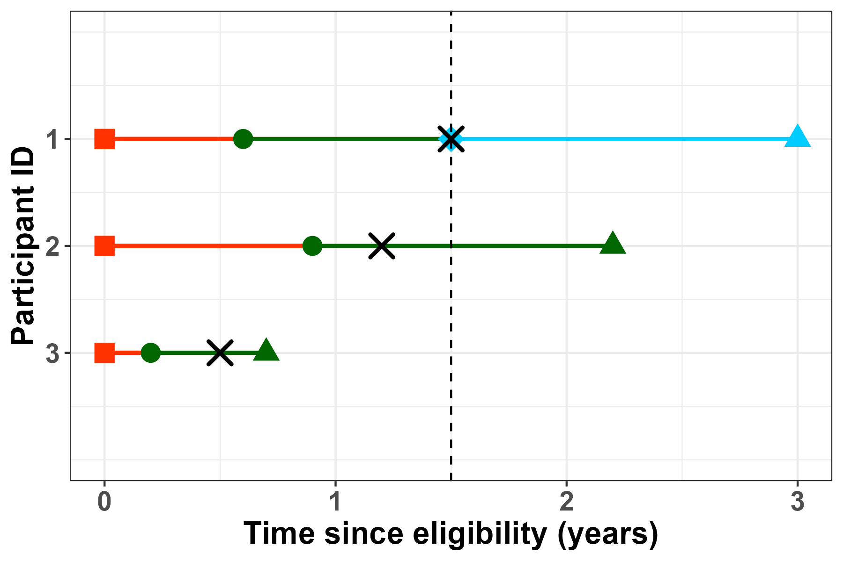
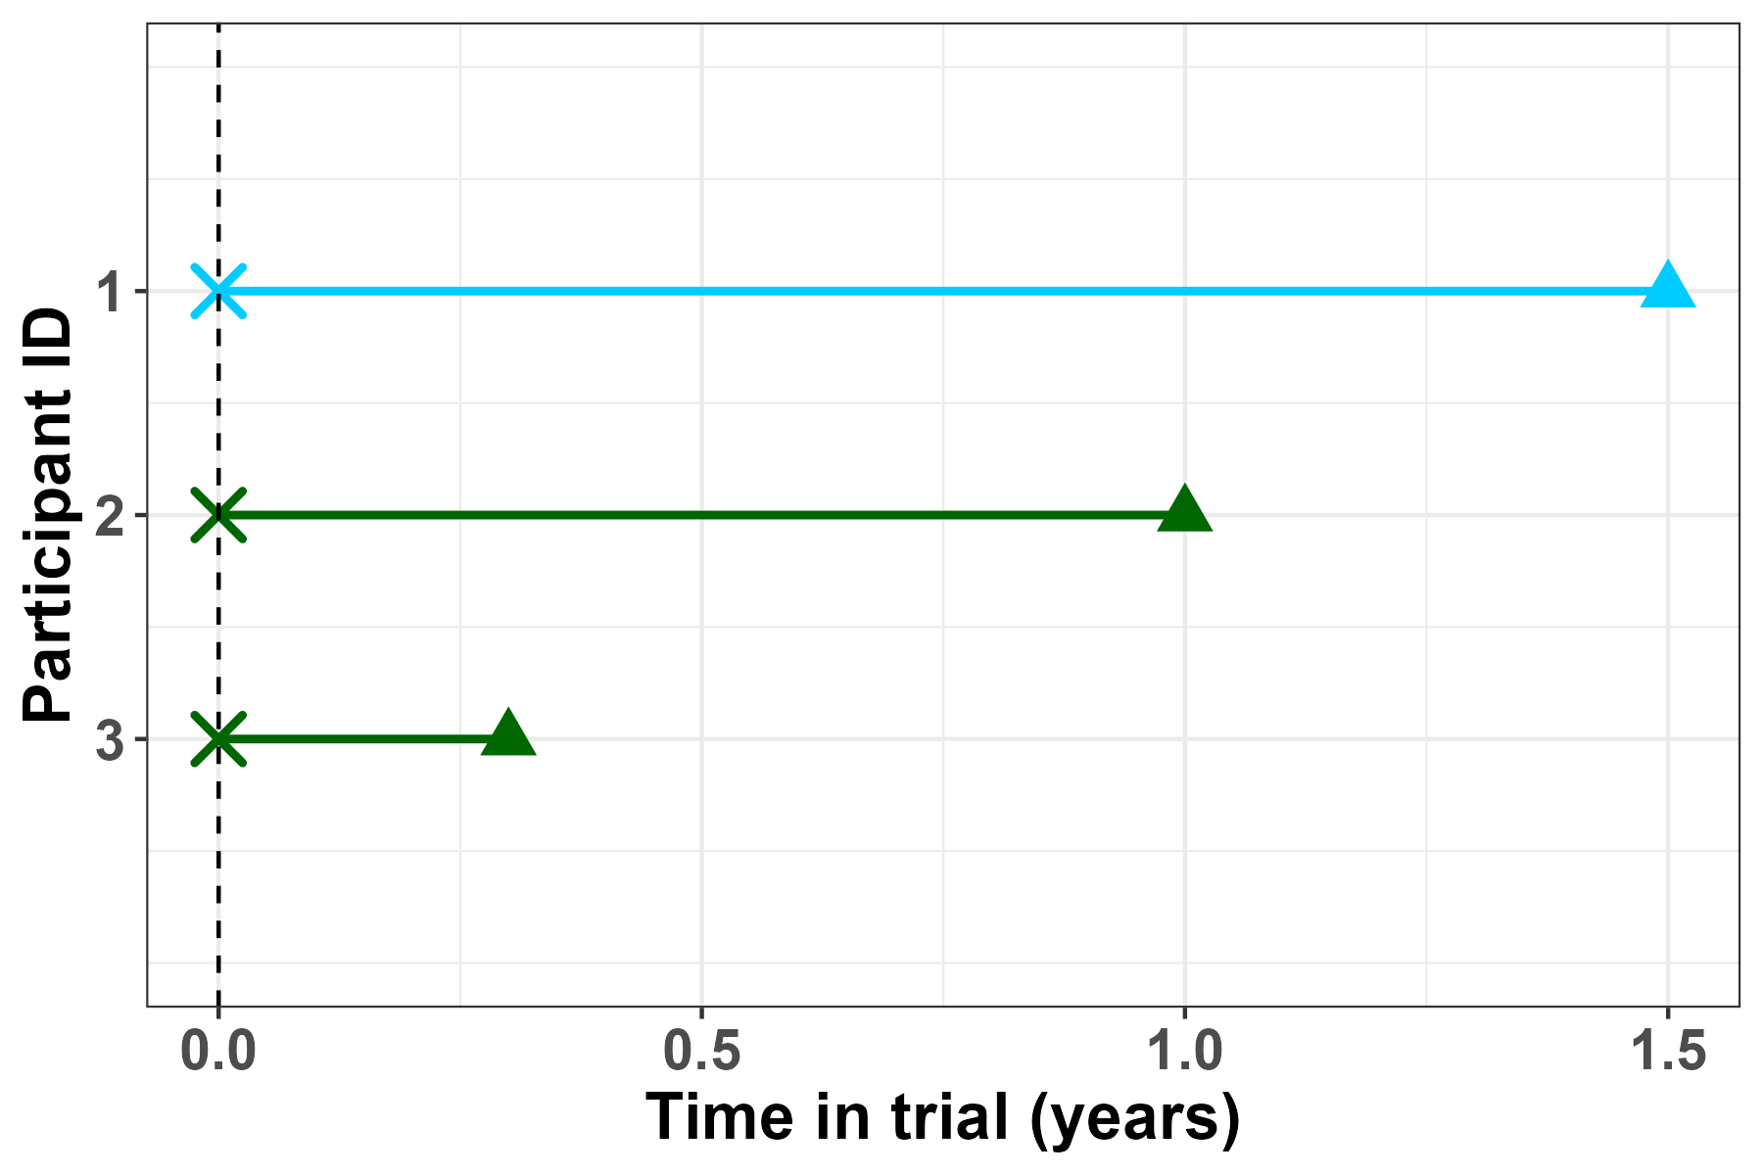
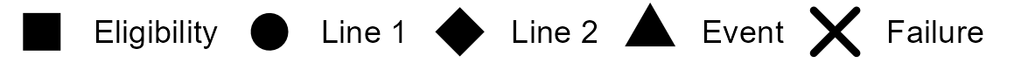
A
B
Database timeline
Time since eligibility timeline
C
Re-definition of time axis

Slide 31
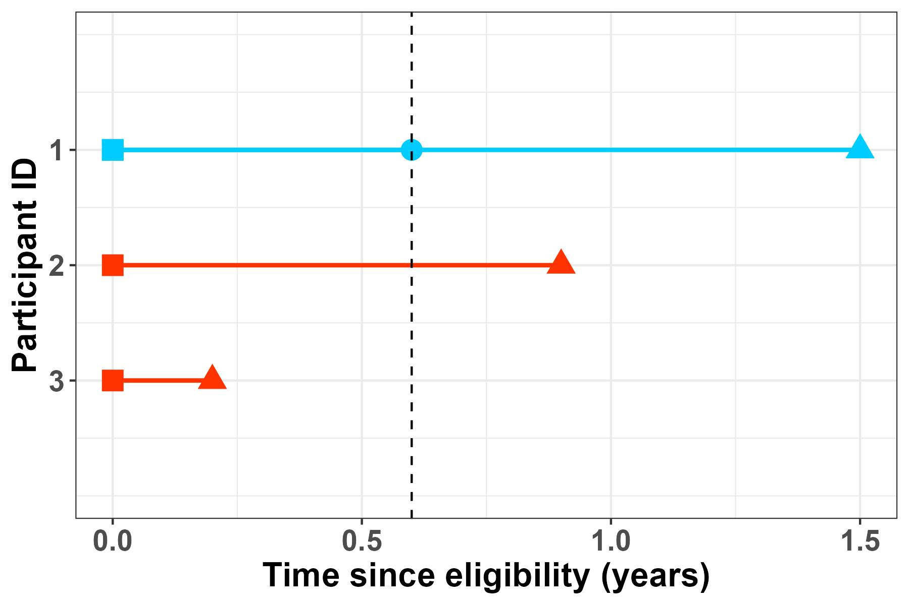
A
B
Database timeline
Time since eligibility timeline
C
D
Re-definition of time axis
Immortal-time bias

