Slide 1
Assessing comparability in single-arm trials for rare diseases, with time-to-event endpoints
Elia Gonzato, PhD Candidate
Department of Epidemiology and Data Science, Vrije Universiteit, Amsterdam, NL
Department of Pediatric Neurology, Emma Children's Hospital, Amsterdam, NL
e.gonzato@amsterdamumc.nl
11th Survival Analysis for Junior Researchers Conference, Amsterdam, 25-27 March 2026

Slide 2






Introduction
A
B

Slide 3




Introduction
A
B

Slide 4
Introduction
A
B

Slide 5
Introduction
A
B
2000
1990
200
199
2010
201
2020
202

Slide 6


Introduction
A
B
2000
1990
200
199
2010
201
2020
202

Slide 7
Introduction
A
B
2000
1990
200
2010
201
2020
202

Slide 8
Time related bias
Disease onset

Slide 9
Time related bias
End of follow-up
Disease onset

Slide 10
Time related bias
End of follow-up
Disease onset
Disease duration

Slide 11
Time related bias
End of follow-up
Disease onset
Disease duration
Beginning of treatment
End of follow-up
Disease onset

Slide 12
Time related bias
End of follow-up
Disease onset
Disease duration
Beginning of treatment
End of follow-up
Disease onset
Immortal time

Slide 13
Time related bias
End of follow-up
Disease onset
Disease duration
End of follow-up
Time zero

Slide 14
Time related bias
?
End of follow-up
Disease onset
End of follow-up
Time zero

Slide 15
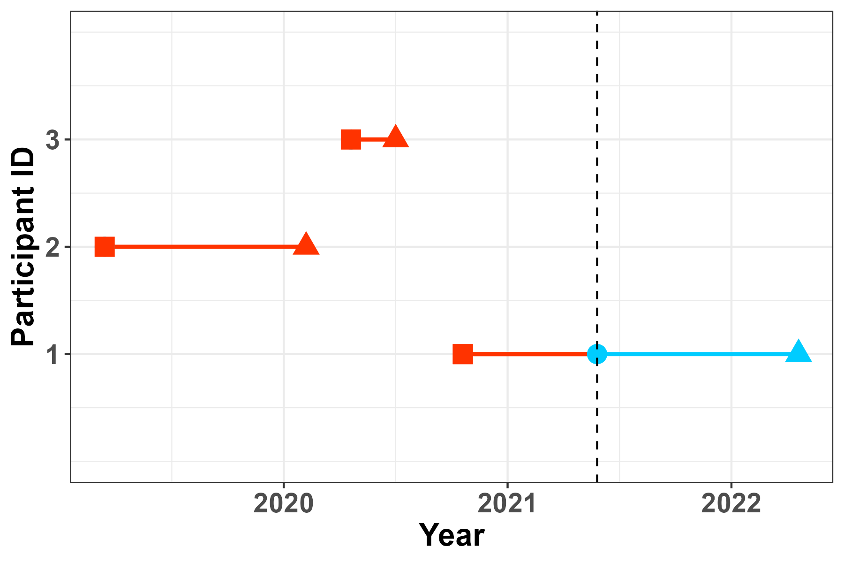
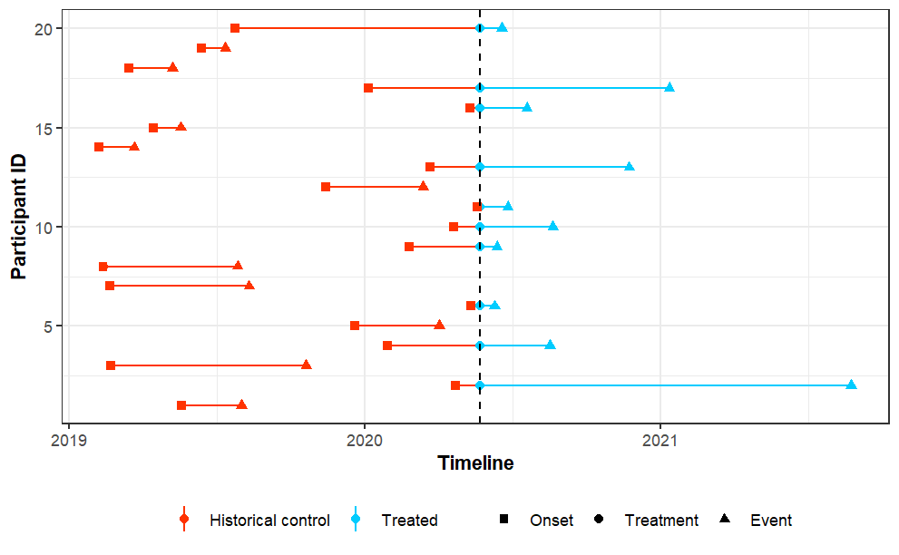
Time alignment
Database timeline

Slide 16
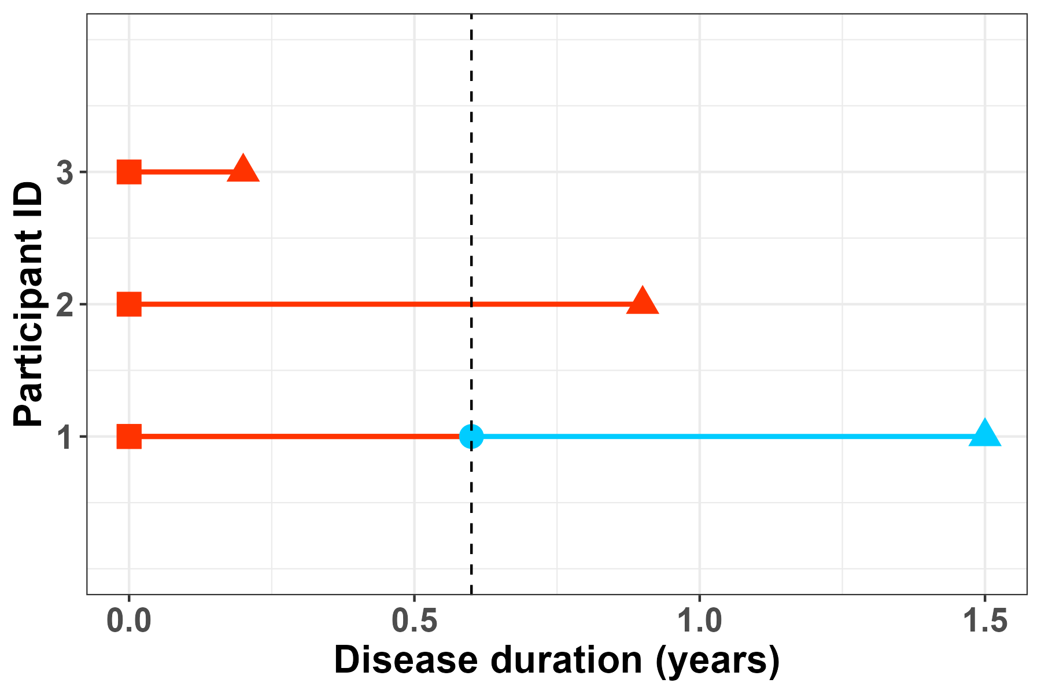
Time alignment
Database timeline
Disease duration timeline

Slide 17
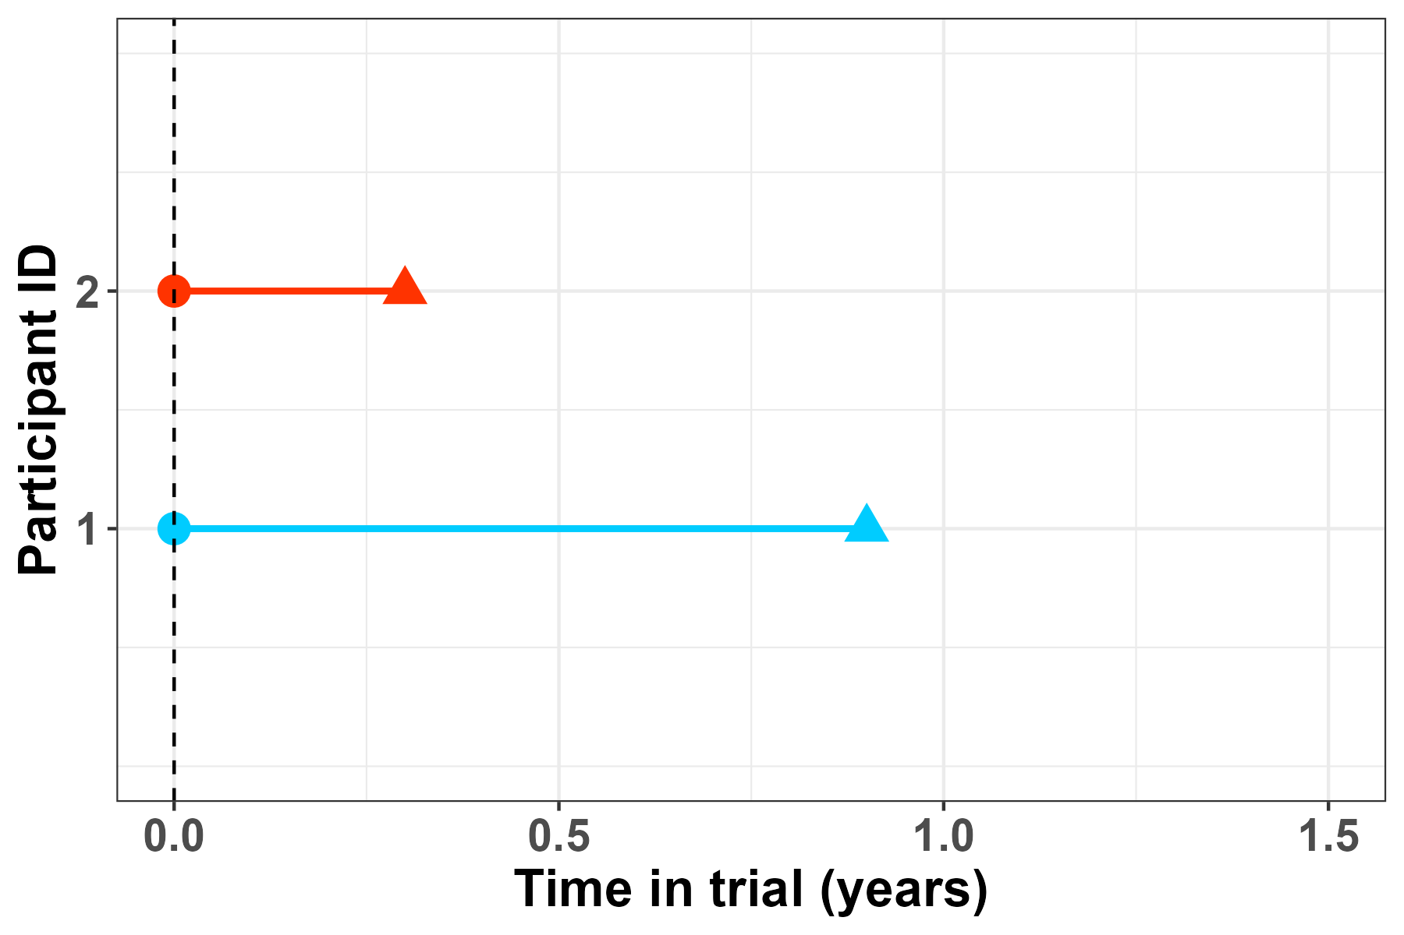
Time alignment
Database timeline
Disease duration timeline
Re-definition of time axis

Slide 18
Matching procedure
d=5; t=2
d=3; t=1.5
d=6
d=4; t=3
d=disease duration; t=time in trial

Slide 19
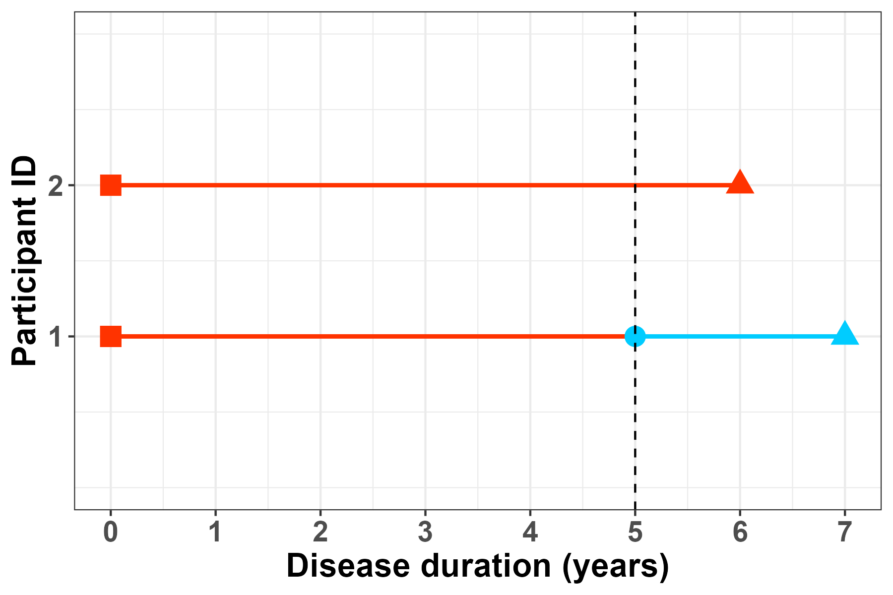
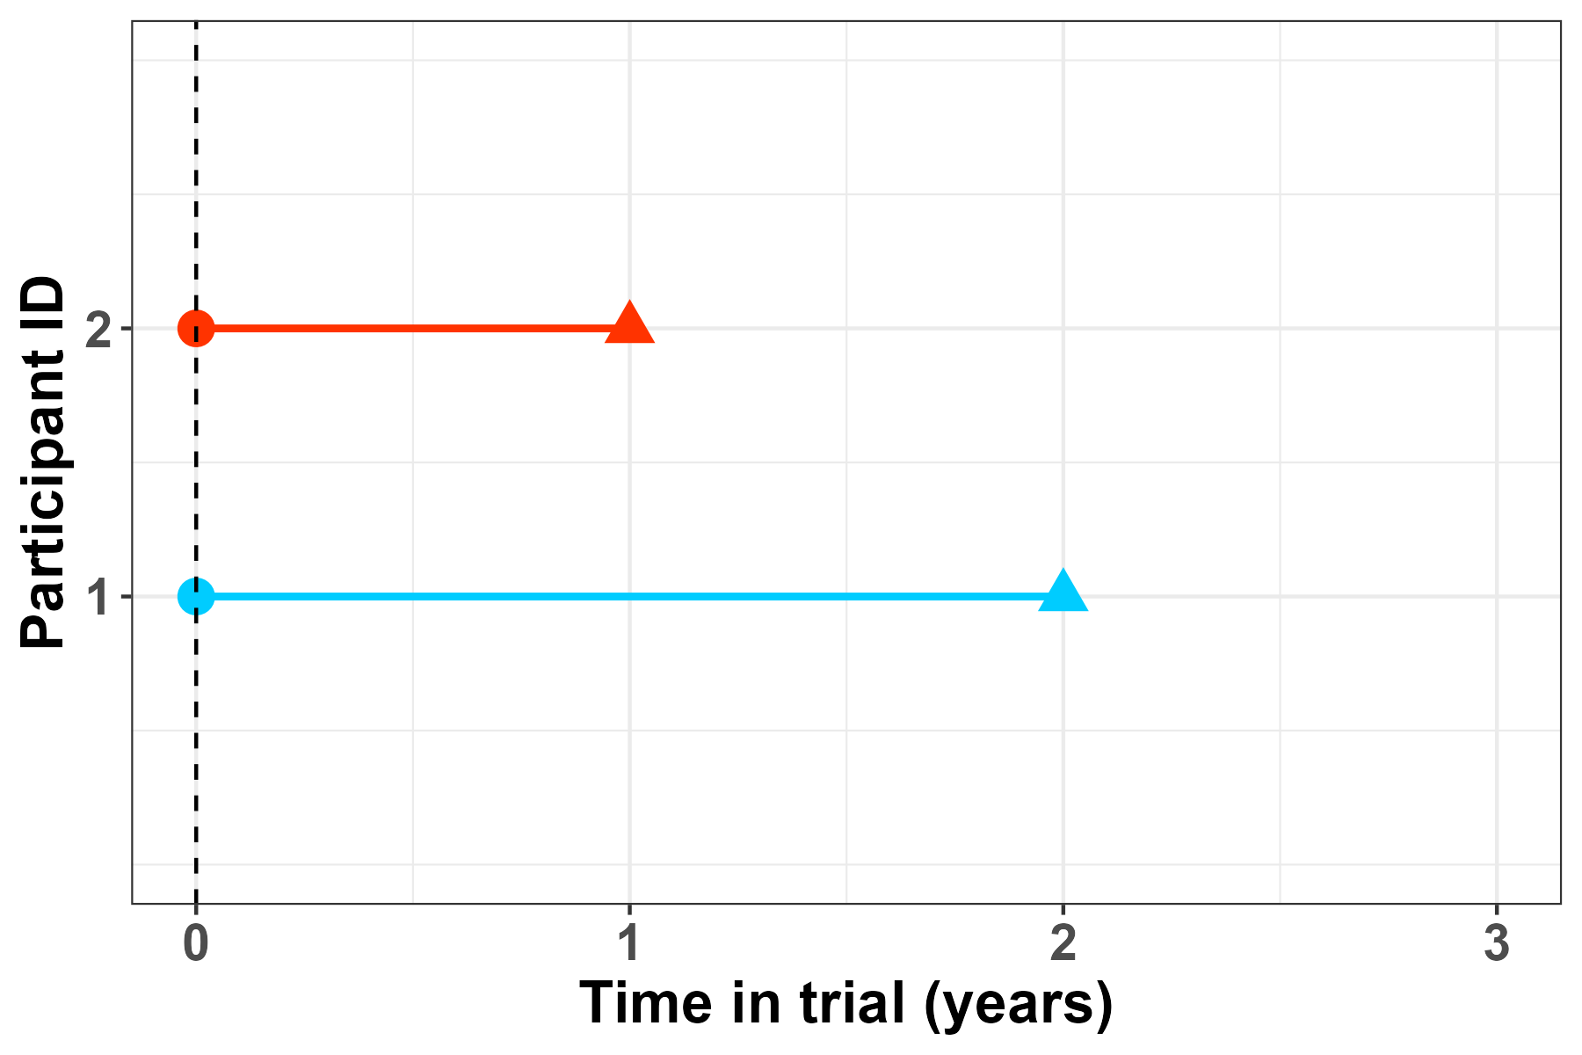
Time alignment
Re-definition of time axis
Matching procedure
d=5; t=2
d=3; t=1.5
d=6
d=4; t=3
d=disease duration; t=time in trial

Slide 20
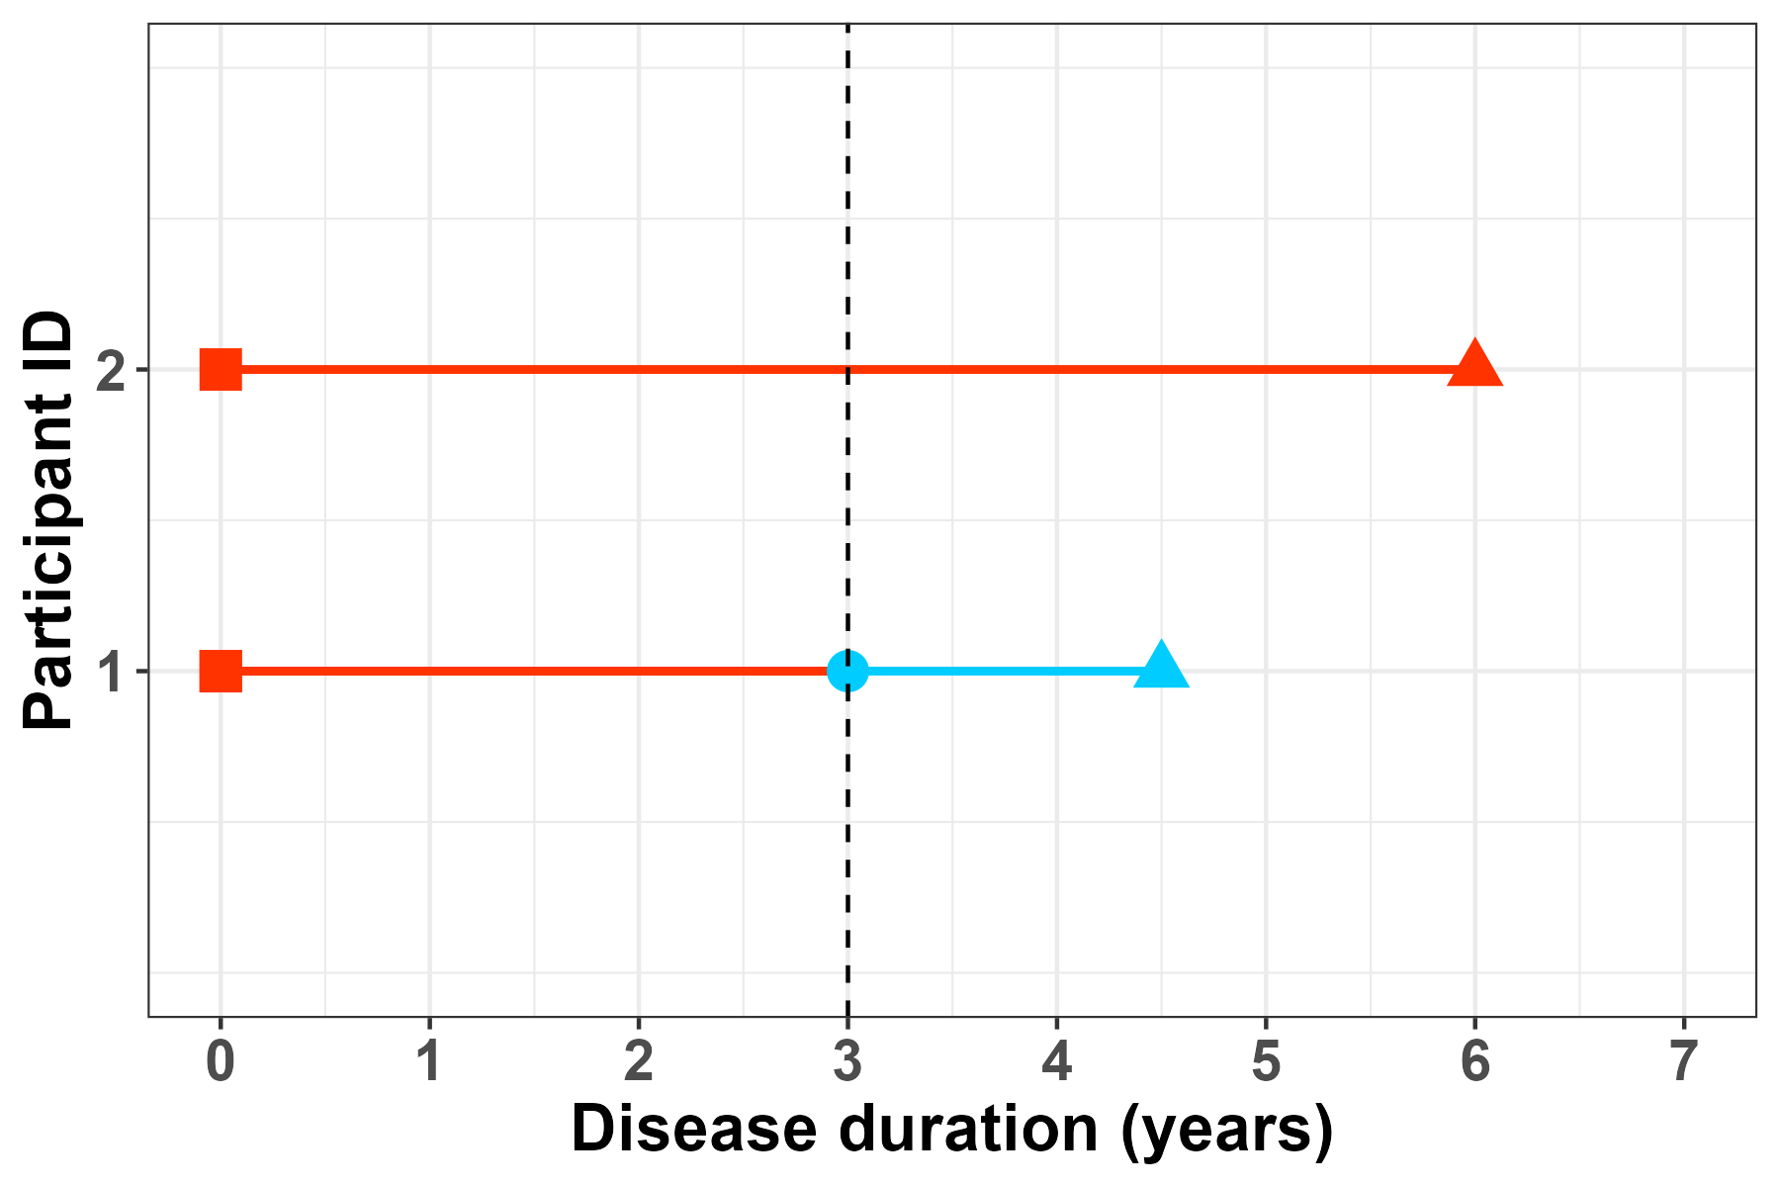
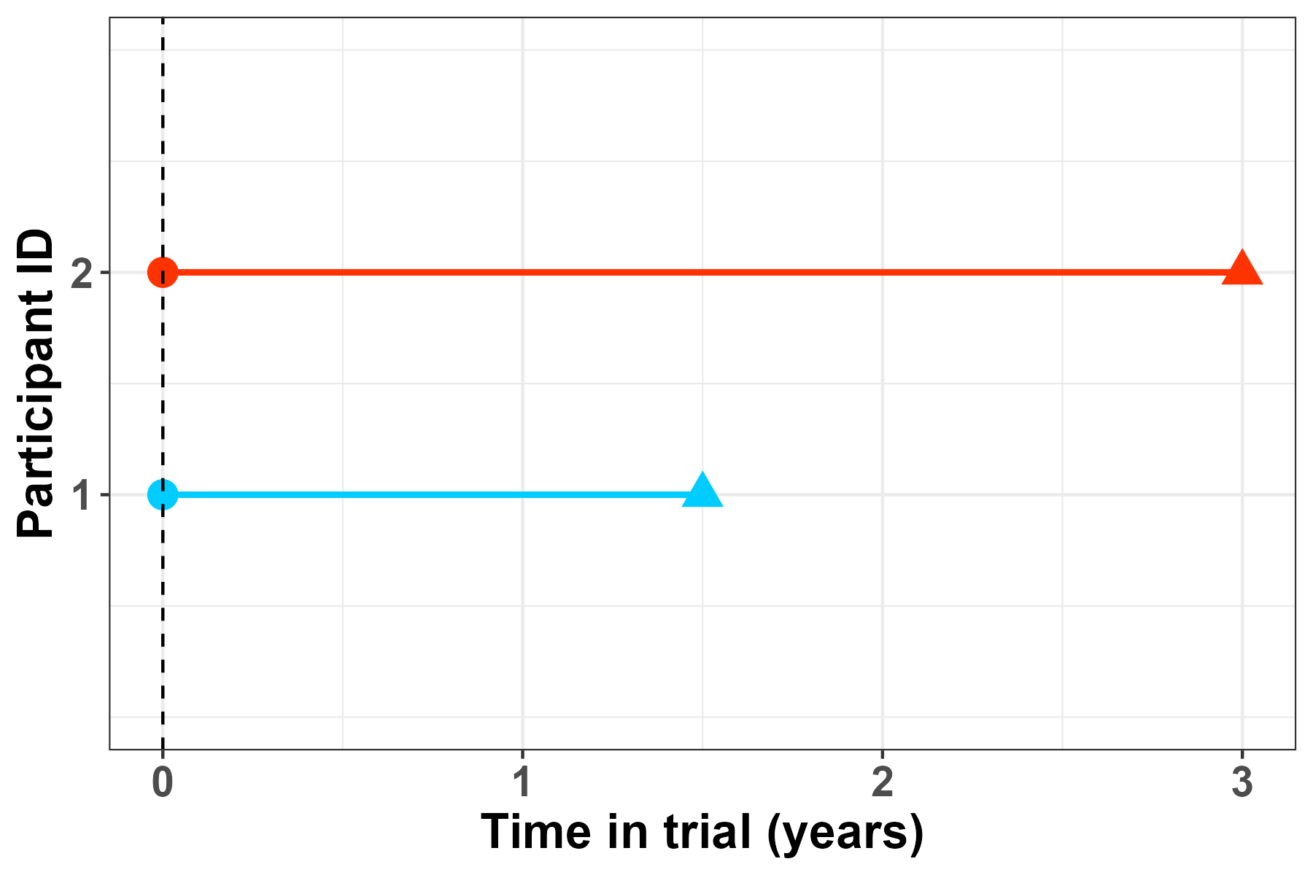
Time alignment
Re-definition of time axis
Matching procedure
d=5; t=2
d=3; t=1.5
d=6
d=4; t=3
d=disease duration; t=time in trial

Slide 21
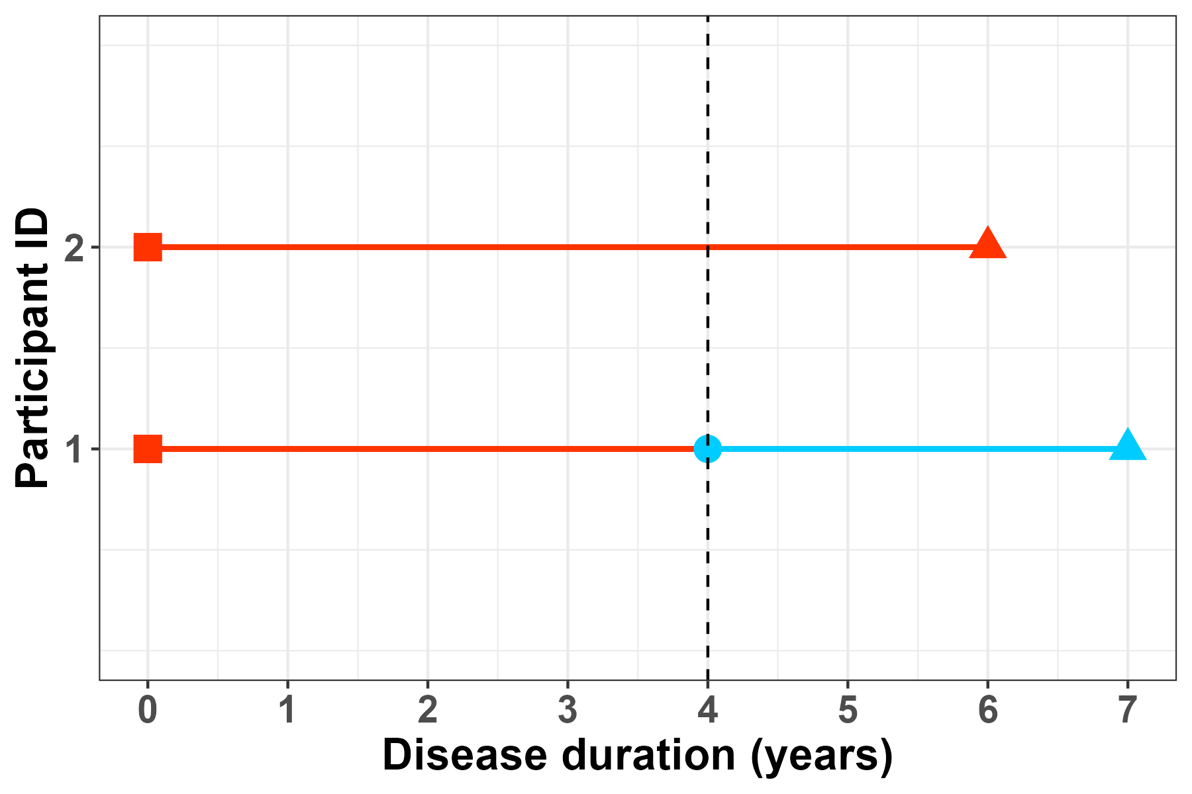
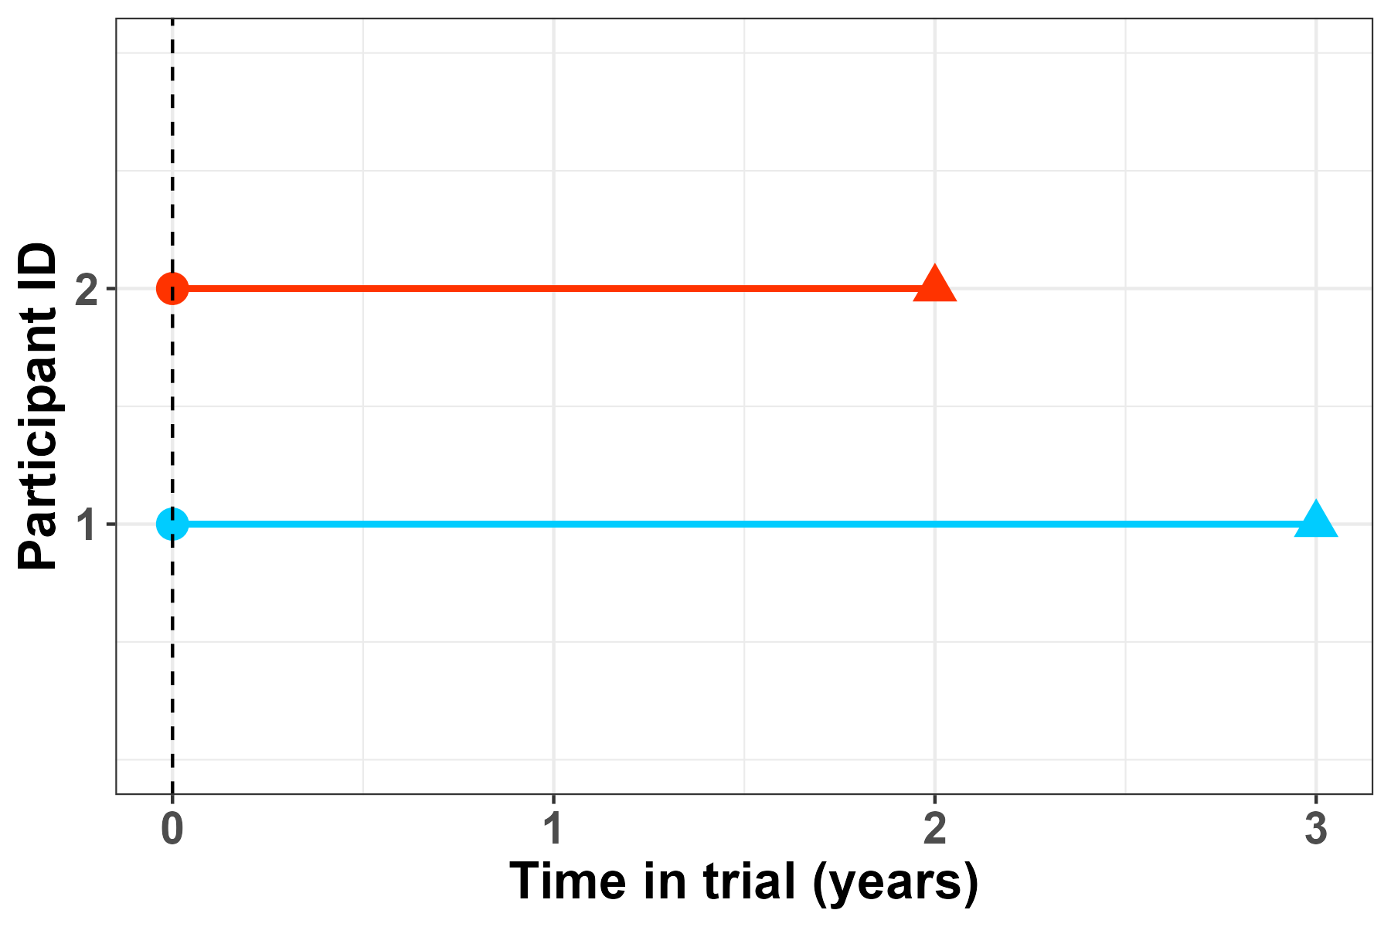
Time alignment
Re-definition of time axis
Matching procedure
d=5; t=2
d=3; t=1.5
d=6
d=4; t=3
d=disease duration; t=time in trial

Slide 22

Matching procedure
egonzato/visualising_km_matching

Slide 23
Bottom line
In time-to-event endpoints, time alignment for treatment groups is crucial (but not always straightforward)

Slide 24
Bottom line
In time-to-event endpoints, time alignment for treatment groups is crucial (but not always straightforward)
For our ATT approach, this alignment is embedded in the matching procedure

Slide 25
Bottom line
In time-to-event endpoints, time alignment for treatment groups is crucial (but not always straightforward)
For our ATT approach, this alignment is embedded in the matching procedure
Matching without replacement inherently results in variability, which should be explored and reported

Slide 26
Thank you to the VWM trial & VWM registry team:
Questions
Marjo van der Knaap
Romy van Voorst
Rik van Eekelen
Johannes Berkhof
Merel Postema
Marjan Steenweg
Eline Hamilton
Renate Verbeek
Marije Voermans
Nicole Wolf

Slide 27
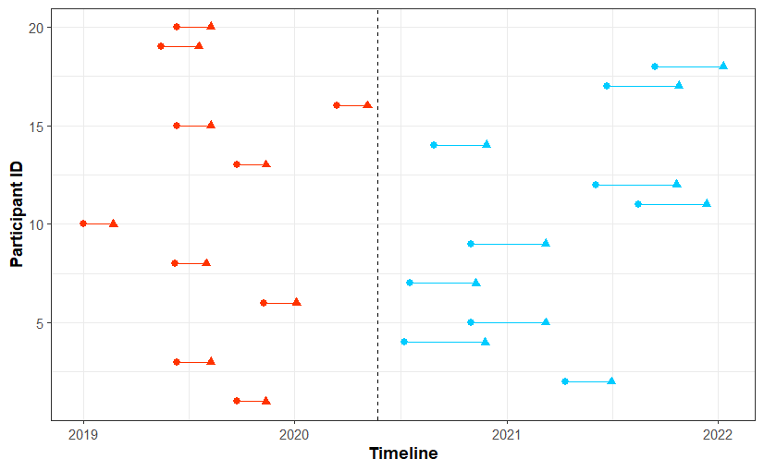
Two different scenarios
Short duration

Slide 28
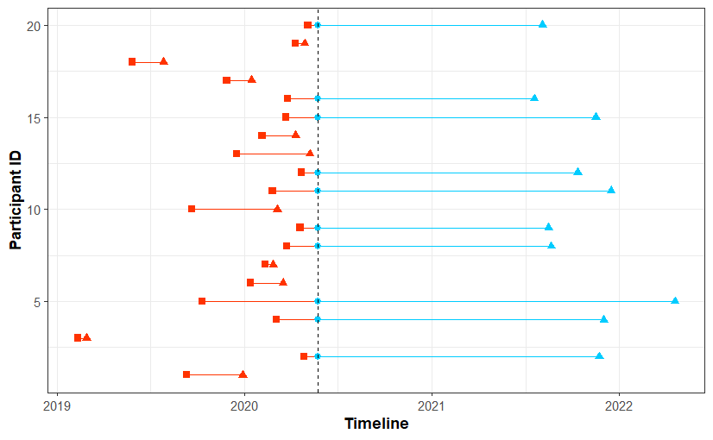
Two different scenarios
Short duration
Long duration

