Slide 1
Accelerometer signal classification

Slide 2
Targets
Prepare data
Extract features
Find out optimal model by
Time
Size
Accuracy
Conclusion

Slide 3
Problems to cover
Activity time
Healthcare
Sports
Minimize device congestion
Application size
Application performance
Device battery life

Slide 4

Data structure
X, Y, Z cartesian axis
14 hours of activities
8 users
4 different positions of device

Slide 5
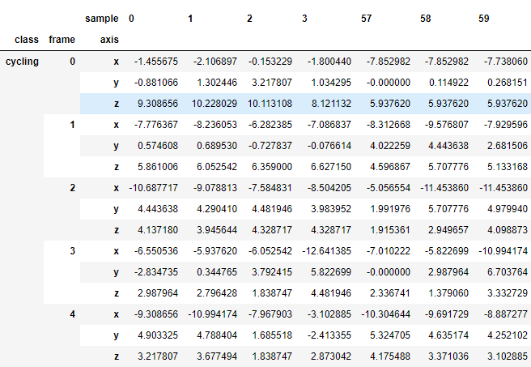
Data table
All measurements were sliced by 60 frames chunks. The final dataset has 14030 samples which were sliced in 4:1 proportion for testing.

Slide 6
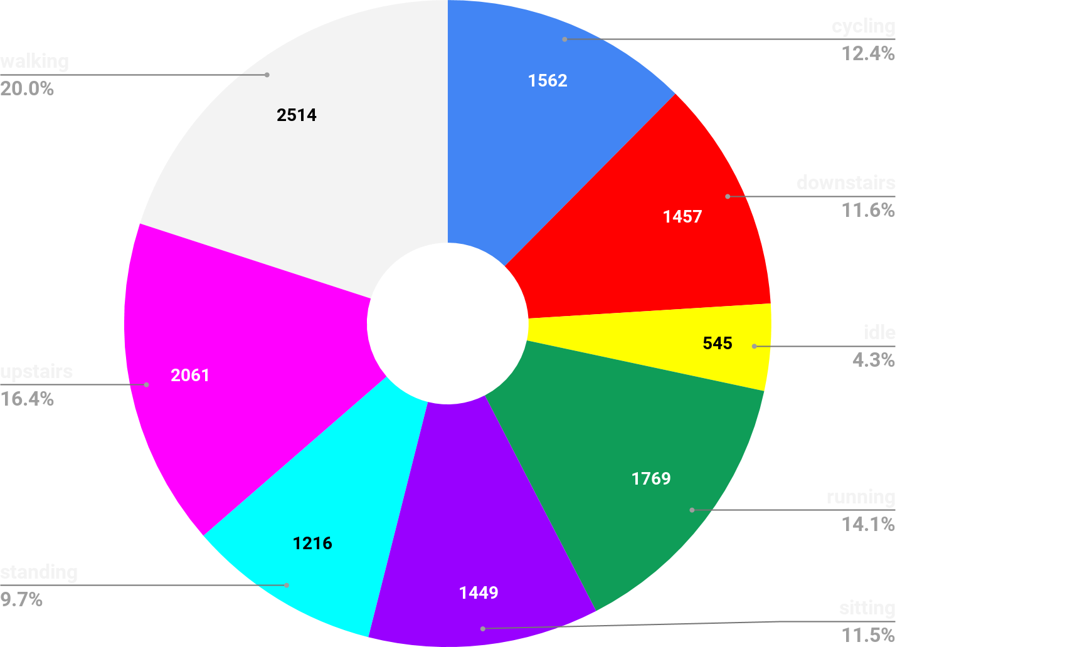
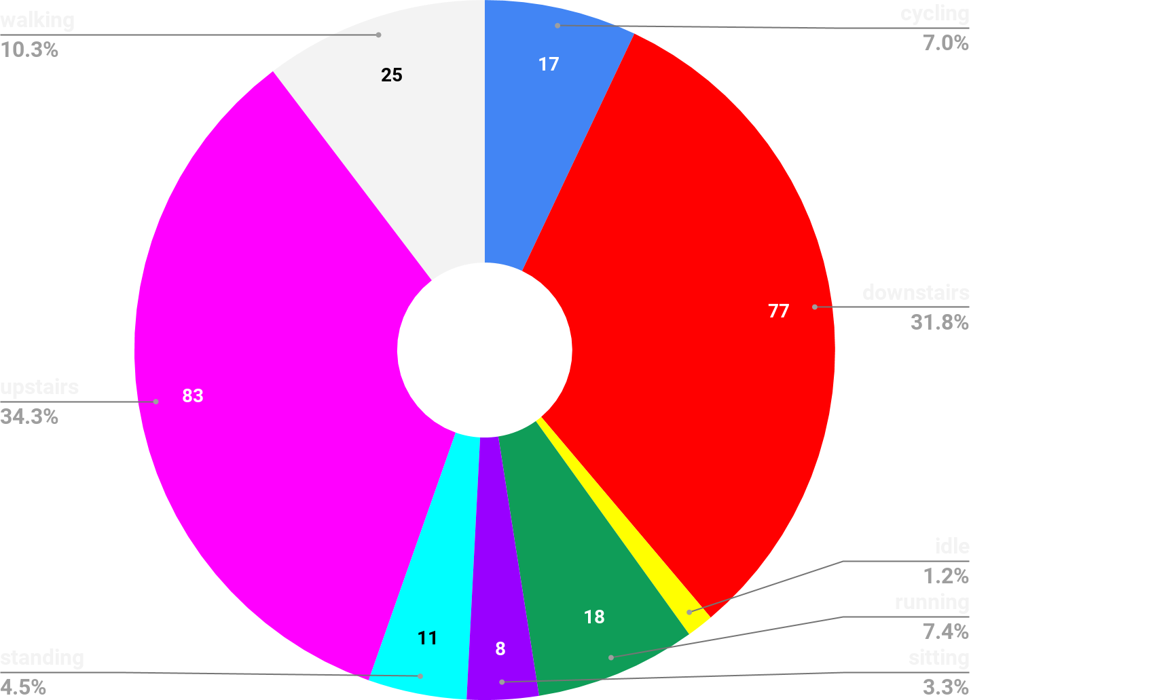
Samples and experiments distribution
12573
242

Slide 7








Feature extraction - original signal

Slide 8


Feature extraction - statistics

Slide 9
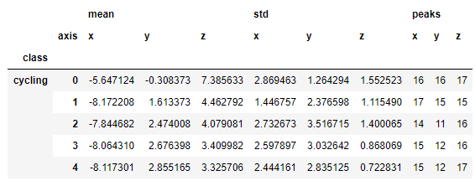
Feature extraction - statistics & peaks

Slide 10








Feature extraction - FFT

Slide 11
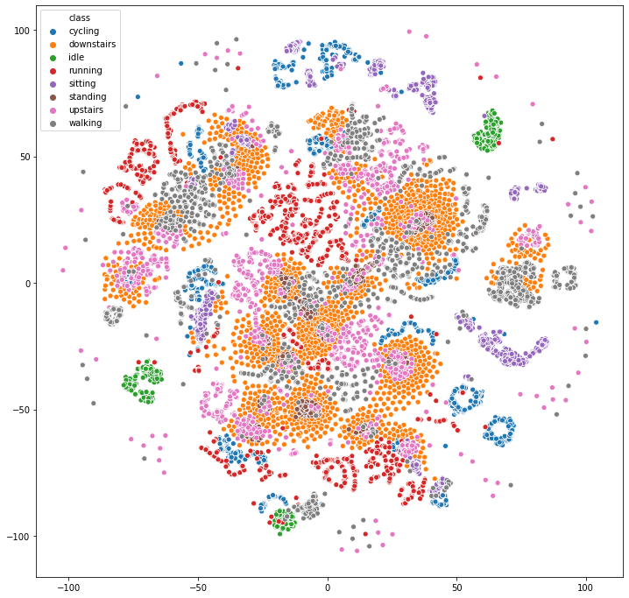
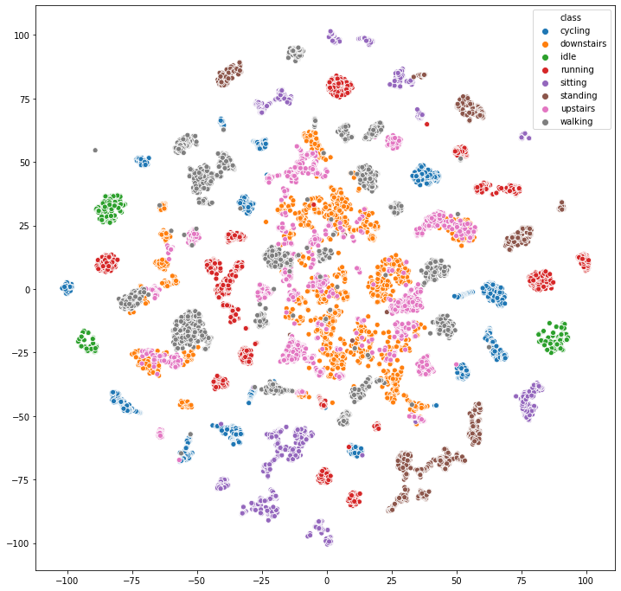
Features distribution
Original signal
Statistics

Slide 12
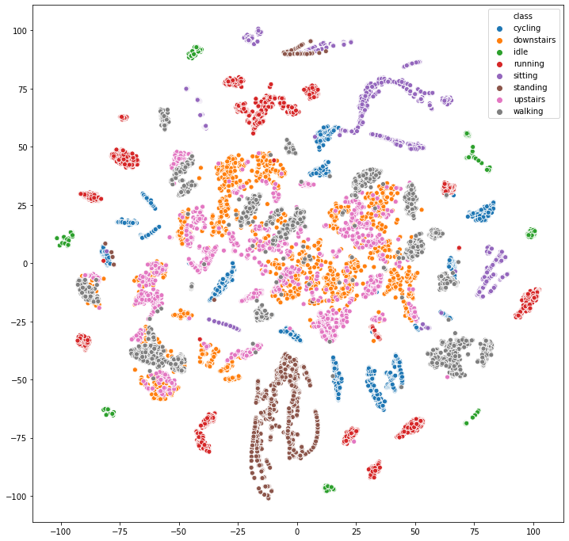
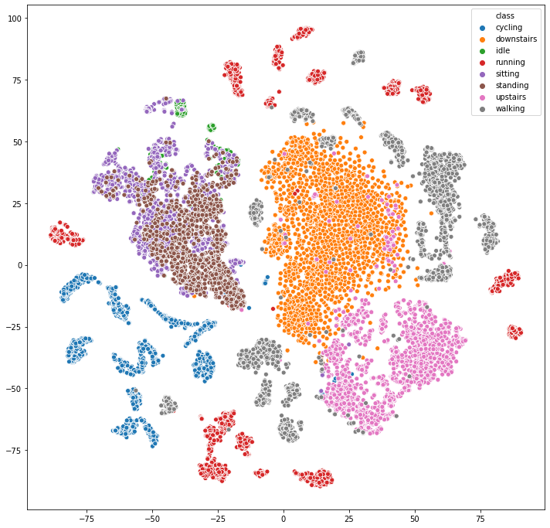
Features distribution
Statistics & peaks
FFT

Slide 13
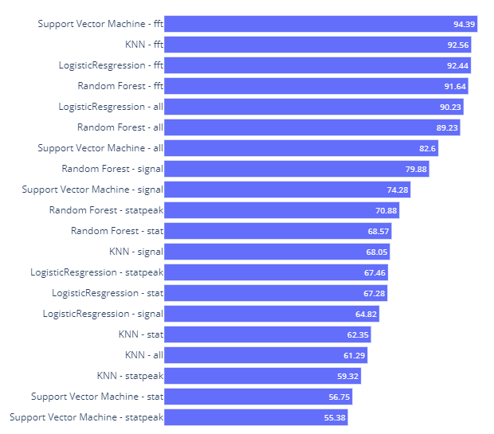
Models
Logistic regression
KNN
SVM (RBF kernel)
Random Forest

Slide 14
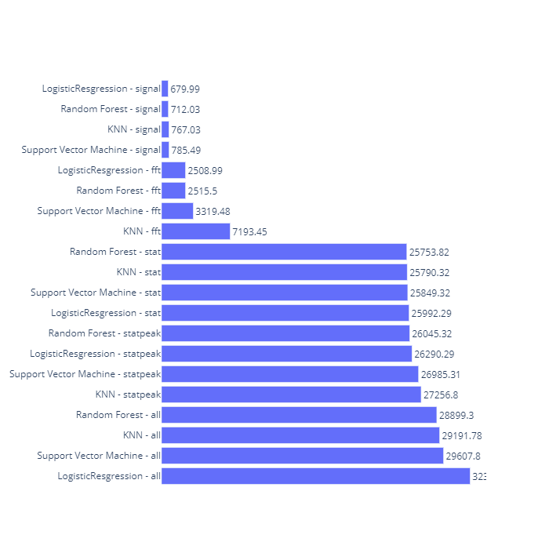
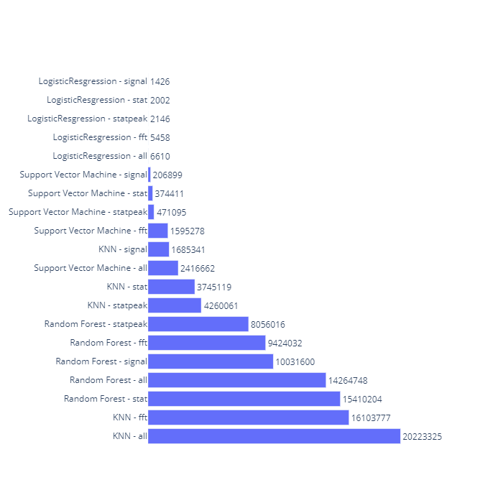
Performance
Time
Size

Slide 15
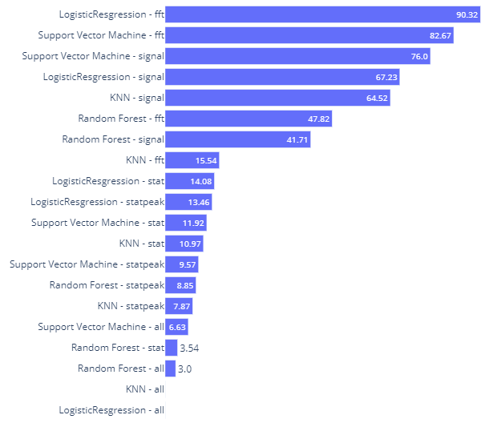
Common rating
Accuracy
Time
Size

Slide 16
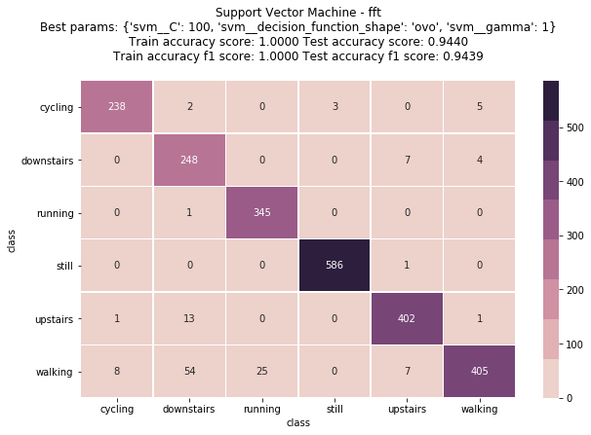
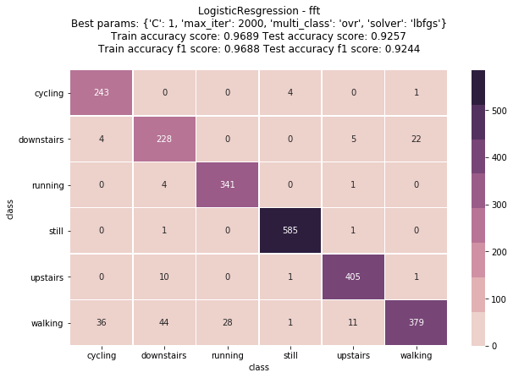
Optimal Model-Feature pairs

Slide 17
The end

