Slide 1
Lombok
make classes not boilerplate

Slide 2
What is Lombok?

Slide 3
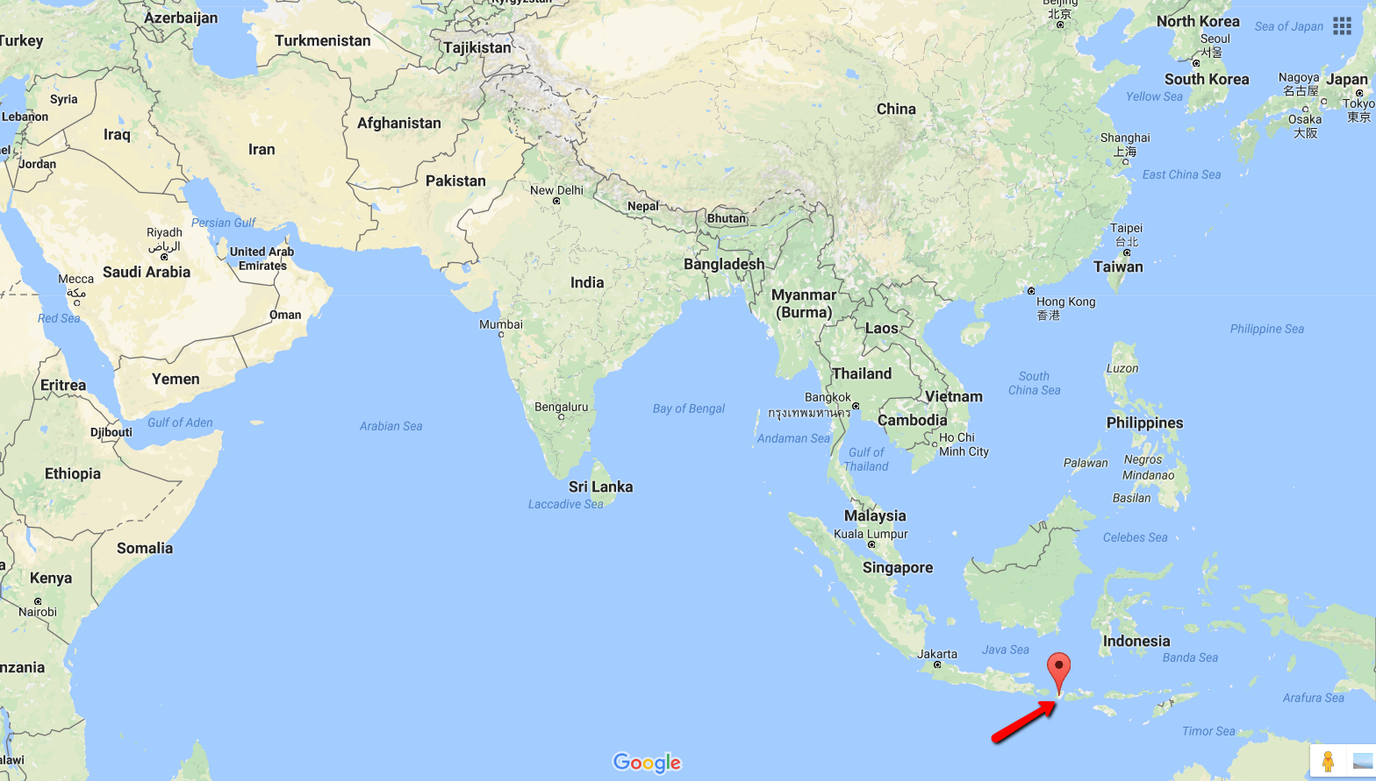
Lombok is an island!

Slide 4
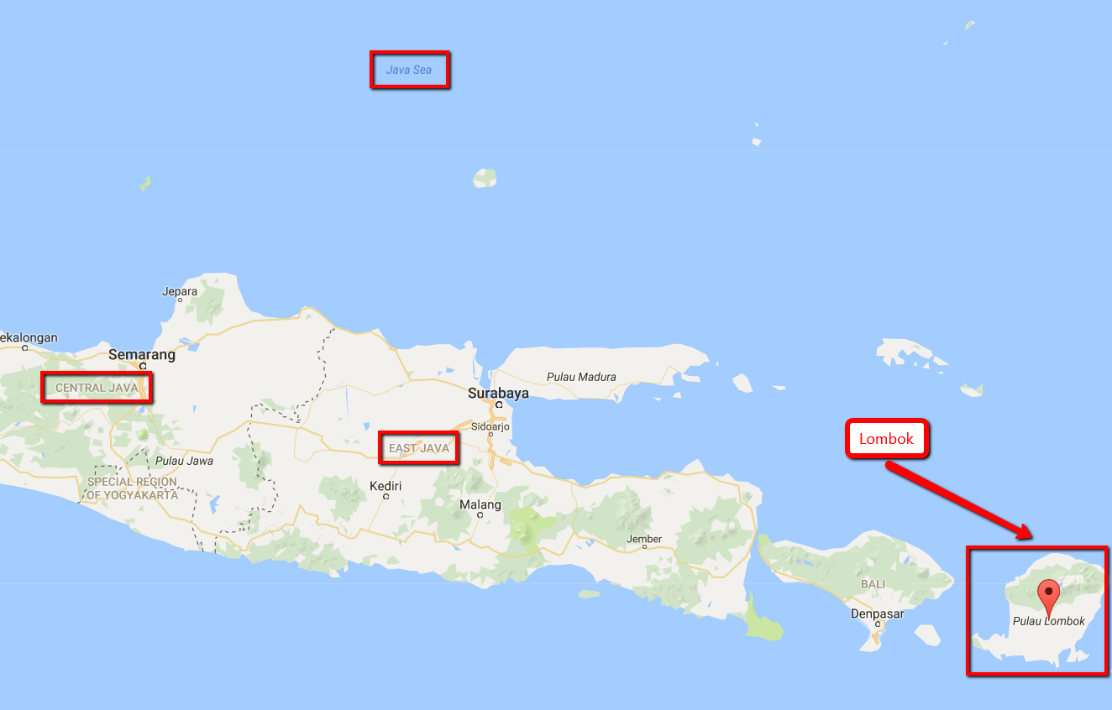

Slide 5
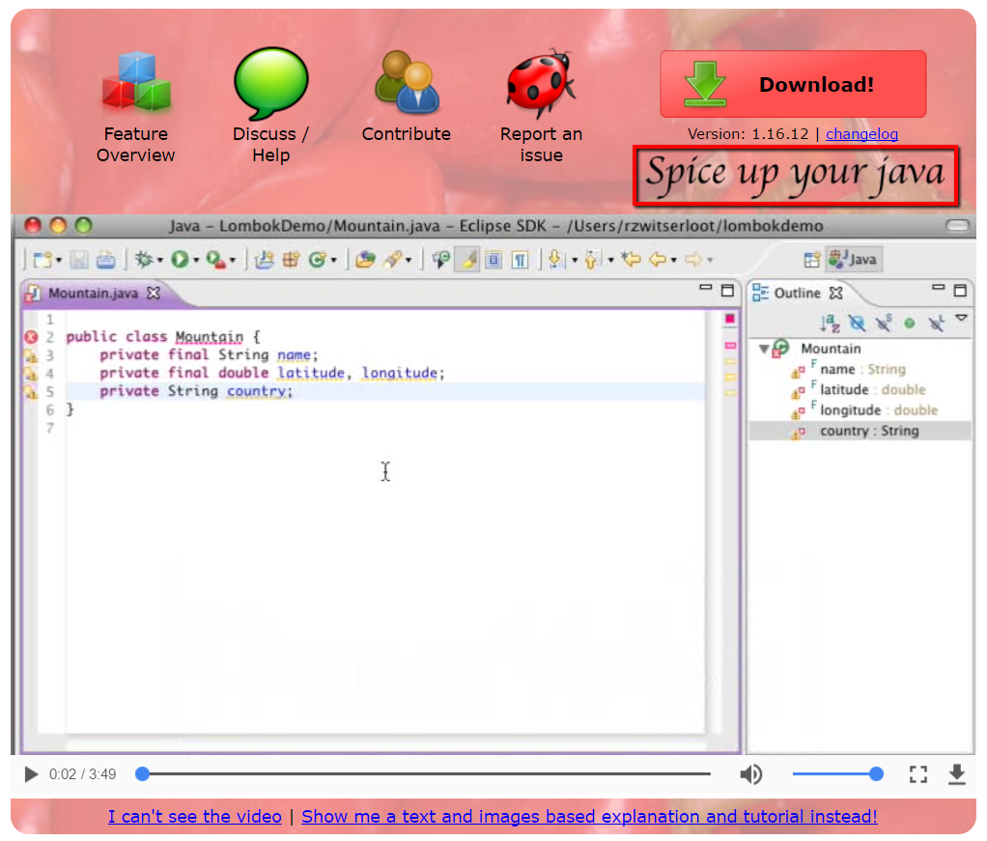

Slide 6
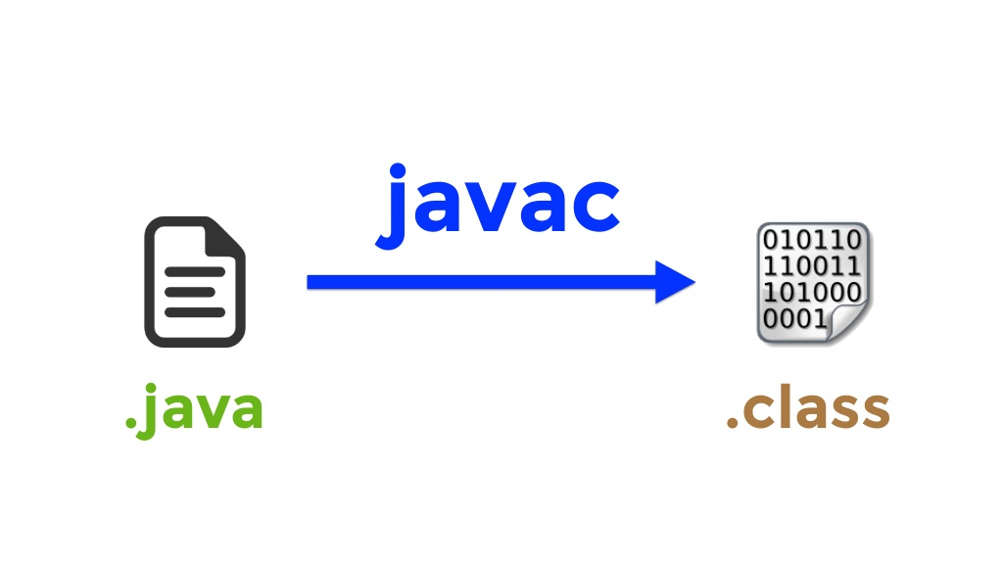
Compilation

Slide 7
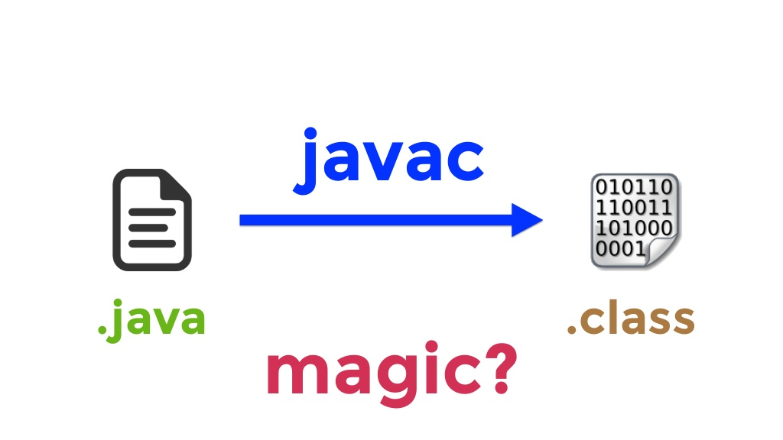
Compilation

Slide 8
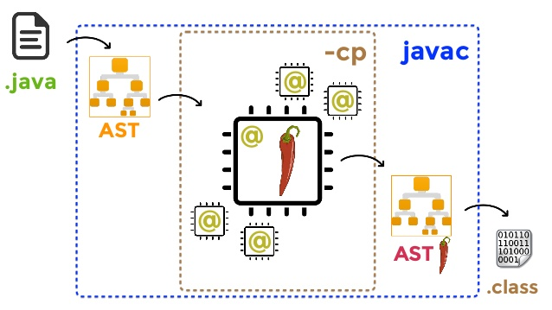
Compilation

Slide 9
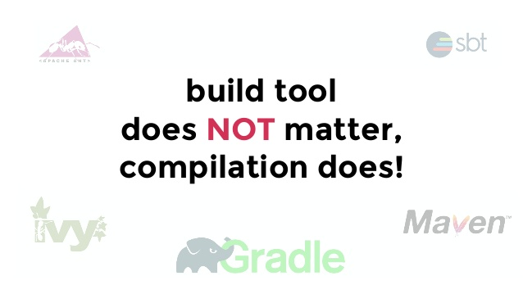

Slide 10


Slide 11
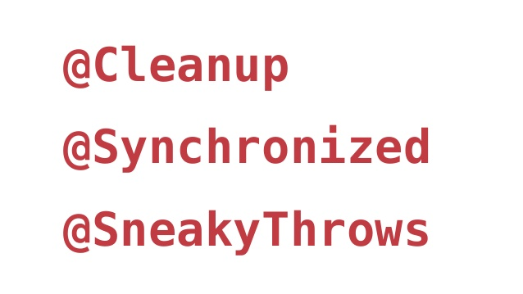

Slide 12
No pain, no gain
Less boilerplate
Easy to use
Min debug impact
Extensible
WYSIWYG
Refactoring
Easy to misuse
Extensions’ support

Slide 13


Slide 14
Thank you for your kind attention!
https://projectlombok.org/
https://github.com/rzwitserloot/lombok

