Slide 1

AI agents for research: simulations, experimental automation, and visualisation
Egor Manuylovich
Aston Institute of Photonic Technologies
Aston University

Slide 2
What this talk is about
01
Introduction to coding agents
02
Scientific simulations
03
Experimental automation
04
Scientific visualisation

Slide 3
What are AI coding agents?
Type
What it does
Example
Chatbot
Answers questions and generates code snippets on demand.
ChatGPT, Claude, Gemini…
Autocomplete
Suggests code while typing, one line or block at a time.
GitHub Copilot, Cursor
Agent
Reads files, edits codebases, runs tests, sees errors, iterates.
Claude Code, Codex, Gemini, Cursor
Key thing: agents can inspect files, modify codebases, write/execute tests, and iterate autonomously.

Slide 4
AI-assisted simulations: what changes?
Before
After
Slow, manual simulation setup
Fragmented scripts per use-case
Manual plotting and formatting
Limited parameter-space exploration
Documentation as an afterthought
Parameter sweeps generated quickly
Plotting pipelines automated end-to-end
Tests and docs added early in the cycle
Faster hypothesis iteration
Modular, reusable simulation components
Examples:
Adopting OOP style and feeling its benefits
Mapping photonic devices to NN layers
Procedural plots
Mode decomposition with orthogonality constraints
Optical interferometer phase simulator with analytical benchmarks
(my own coding skills improved so much after I started using LLMs for coding!)

Slide 5
The research bottleneck is shifting
Idea
Model
Code
Experiment
Data
Figure
Paper
→
→
→
→
→
→
Highlighted stages: the software bottlenecks where agents can help most.
Research is increasingly software-heavy
Researchers spend significant time on glue code, plotting, automation, UI, debugging, and data wrangling — not just science.
AI agents reduce software friction
Agents can generate, test, refactor, and document software far faster than writing it from scratch.
You can now develop things which would take too long to be feasible
From "writing code" to "specifying and validating systems."
“Computer simulation is the third branch of science, complementing theory and experiment.”
Robert E. Caflisch, “Monte Carlo and quasi-Monte Carlo methods”, Acta Numerica, 1998.
Many things are easy to verify and much harder to solve.

Slide 6
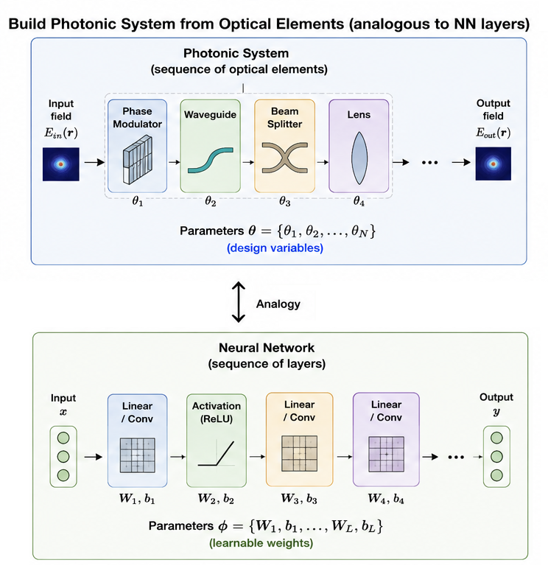
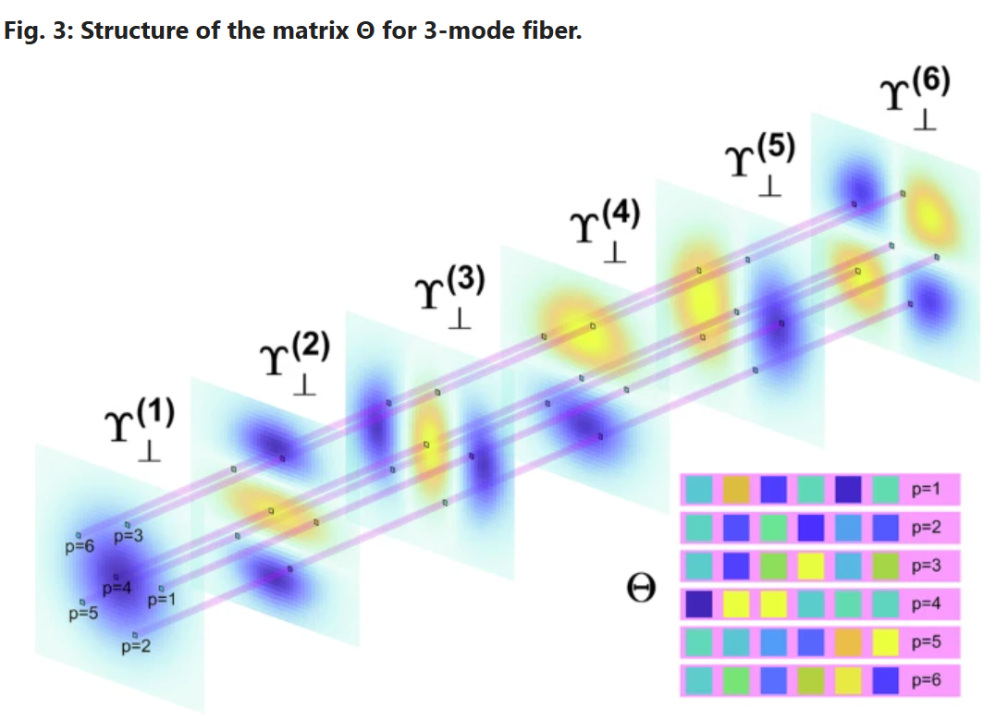
Examples
Many things are easy to verify and much harder to solve.

Slide 7
Vibe coding
Fast prompting with minimal planning — "make me a simulator" — and iterating until it looks right.
Good for
Risk
One-off scripts and quick plots
Educational demos and toy simulations
Small GUIs and data explorers
Fast hypothesis sketching
Hard to maintain
Hidden bugs that look fine
Progressively harder to modify
Poor reproducibility (same prompt -> different results)
Difficult to extend or validate
DEMO 0
Simple optical simulation from a single prompt
https://chatgpt.com/c/6a08dde5-6b70-83eb-8f60-b04852f85e8c

Slide 8
What agents are good at — and not
Good at
Weak at
APIs, wrappers, boilerplate/templates
Plotting and interactive dashboards
File handling and data pipelines
Refactoring and documentation
Connecting vendor SDKs
Writing and running tests
Scientific correctness
Hidden physical assumptions
Numerical validity and stability
Physical intuition
Domain-specific conventions
Reproducibility (without constraints)
The researcher remains the scientific authority (i.e. is responsible for the result!)

Slide 9
Vibe coding -> spec-driven development
Treat the AI agent as a junior research software engineer.
Requirements
Equations / Physics
Architecture
Tests
Implementation
Validation
›
›
›
›
›
agent.md
Project instruction file: physics, architecture, tests, conventions.
Acceptance tests
Define what correct output looks like before you start coding (e.g. check energy conservation, edge cases, etc.)
Project structure
Modular design allows agents to work on isolated components.
Reproducibility
Specs make it possible to re-run, audit, and extend the project.

Slide 10
Why specs and tests matter in science
In research, "looks correct" is not sufficient.
Physical assumptions
Interferometer phase
Steady-state vs dynamic assumptions must be explicit; Orthogonality from
Sign convention for reflection vs transmission matters.
Propagation operator
Energy conservation
Phase accumulation direction determines physical meaning: Raman shift is to longer wavelengths
Orthogonality constraint must be built into the implementation.

Slide 11
Human-agent research loop
Human
Agent
Defines the physics and mathematics
Writes the specification (agent.md/spec.md)
Sets acceptance criteria and tests
Validates outputs against theory/edge cases
Checks physical meaning of results
Creates project structure
Implements modules from the spec
Writes tests and runs sweeps
Refactors and documents code
Builds plots and dashboards
You do the science, and agent is your hard-working buddy. You check each step and specify the tests!
Iteration is useful only if each cycle includes explicit validation

Slide 12
Example simulation workflow
Stage 1 Physics specification
Stage 2 Implementation & tests
Stage 3 Plots & interpretation
→
→
Define governing equations
Physical assumptions (State gain saturation model/steady state/dynamical)
Specify conventions (FFT sign, phase conventions)
List known edge cases to test against
Agent creates module structure
Implements operators from spec
Writes unit tests for each module
Writes physical tests (energy/momentum conservation, photon number conservation…)
Runs limiting-case checks
Agent generates parameter sweeps
Plots transfer functions
Human interprets results
Revise spec if needed

Slide 13
Debugging with agents
Typical subtle bugs in AI-generated scientific software:
Wrong beamsplitter convention
Reflection and transmission phases differ by π which is easy to miss.
Arm-length sum vs. difference
The phase depends on the difference, not the sum of arm lengths.
Propagation sign error
Sign convention in e^{ikz} changes whether wave converges or diverges.
Numerical instability
Can be hidden by plotting and only revealed by edge case tests.
Unit mismatch
Mixing radians and degrees, or nm and μm, in intermediate variables.
Agents speed up debugging and testing, but they also generate subtle scientific bugs.

Slide 14
Testing scientific software
Test types
Science-specific examples
Unit tests per module
Physical limiting cases/edge cases
Conservation law checks
Symmetry and reciprocity tests
Analytical benchmark comparisons
Parameter sensitivity scans
Zero nonlinearity → linear propagation
Zero length → identity transfer matrix
Lossless system → energy conservation
Symmetric beamsplitter → equal splitting
Phase wrap at 2π → field continuity
Degenerate modes → orthogonal eigenfunctions
"If you cannot define a test, you probably do not yet understand the system."

Slide 15
Live demo 1
LIVE DEMO 1
AI-assisted simulation: Optical Circuit Lab

Slide 16
The traditional lab software problem
Researchers often juggle separate software for every instrument:
Laser
Oscilloscope
SLM
Camera
Motion stage
Power meter
Pain points:
Manual clicking with no scripting
Poor reproducibility between sessions
No synchronisation between devices
Every new experiment needs custom tooling

Slide 17
AI-generated lab orchestration software
Modern instruments expose programmable interfaces:
SCPI
VISA
Serial / RS-232
Python SDKs
REST APIs
USB HID
How agents help:
Read vendor examples and docs and write device wrappers automatically
Connect multiple device wrappers into a unified Python backend
Generate a dashboard (FastAPI + PyQt / Streamlit) in a single session
Write automated experiment sequences with logging and error handling

Slide 18
From orchestration to closed-loop experiments
Instrument control
Measurement
Analysis
Optimiser
Updated control
→
→
→
→
(closed loop: output of analysis feeds back into instrument control)
Closed-loop possibilities:
Phase stabilisation and active correction
Adaptive measurement: focus where variance is highest
Bayesian optimisation of experimental parameters
Autonomous photonics experiments with minimal human intervention
Reinforcement learning for alignment or mode matching

Slide 19
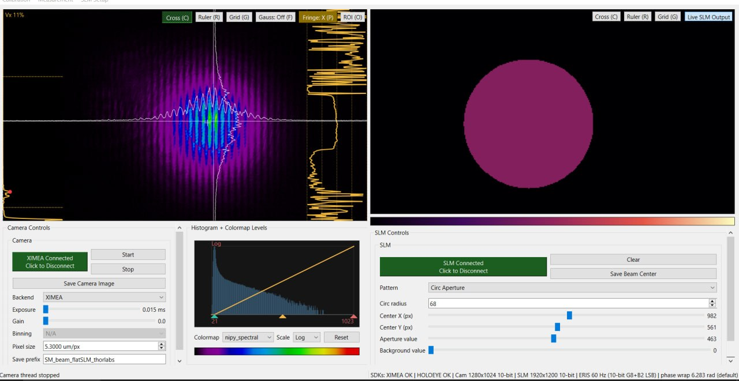
Example: SLM and camera control software
Custom software for SLM-camera calibration and automatic dataset acquisition | Callouts: live camera · SLM pattern

Slide 20
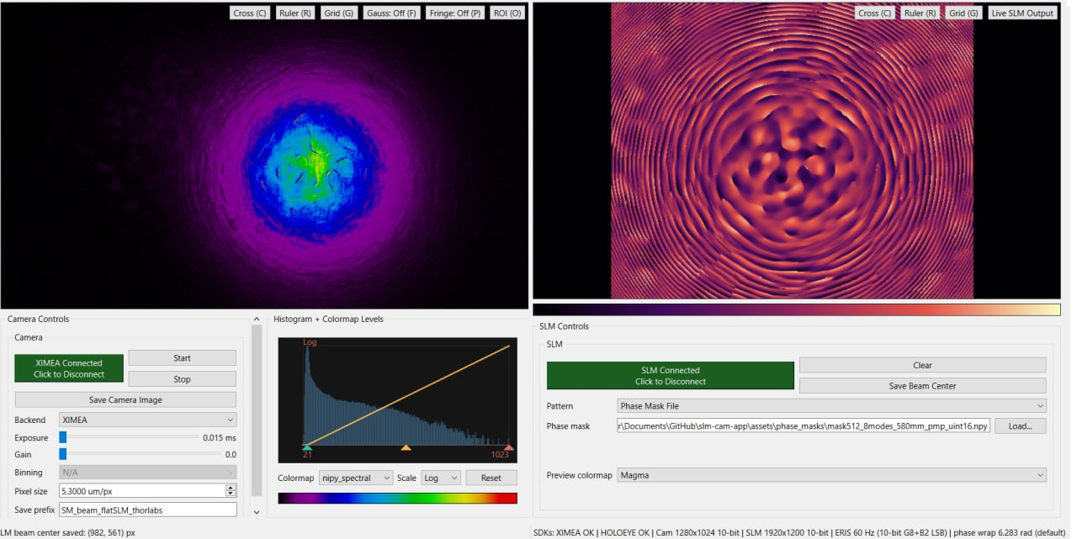
Real example: phase masks and calibration
From manual alignment to reproducible dataset generation | Callouts: measured optical field · generated phase mask

Slide 21
Live demo 2
LIVE DEMO 2
Custom SLM-camera control and lab orchestration software

Slide 22

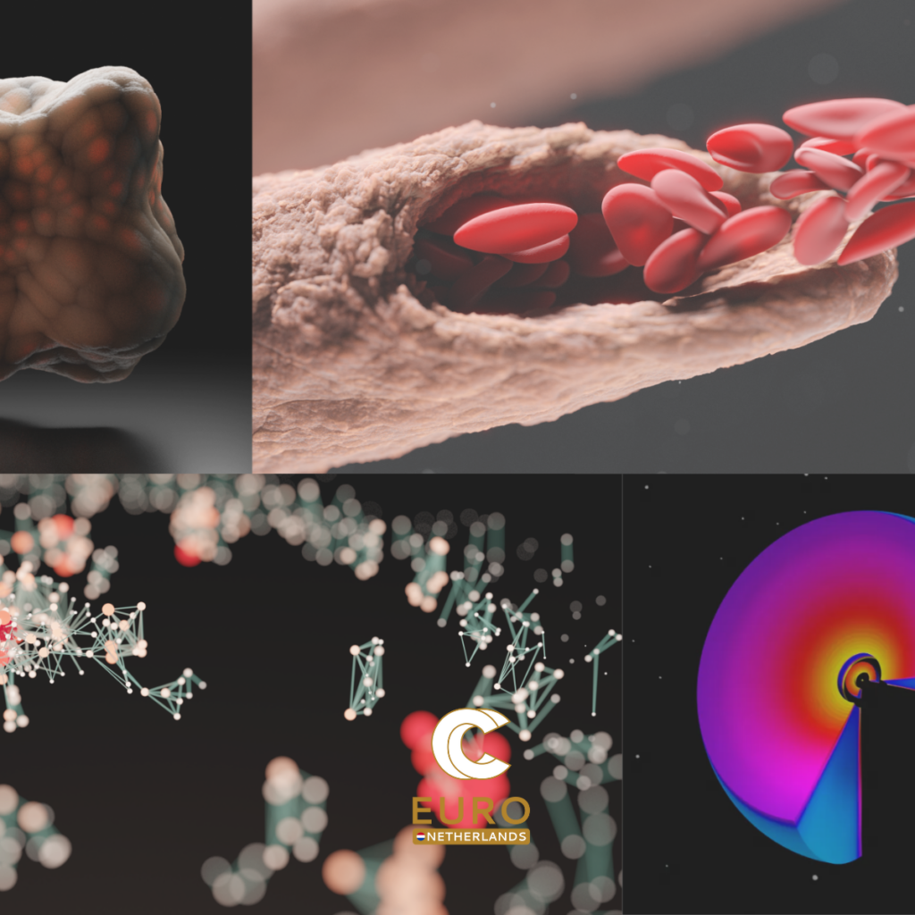
Scientific visualisation matters
Publication-quality figures require(d) a completely different skill: 3D modelling
Top-journal figures must
The problem
Communicate the physical mechanism
Guide the reader's intuition
Look nice, deliberate and unambiguous
Be reproducible from the source files
Blender is perfect but the learning curve is steep
Photorealistic ≠ scientifically correct
Revisions require re-doing geometry
Researchers often lack 3D modelling expertise
Solution: AI agents controlling Blender via the Model Context Protocol (MCP).

Slide 23


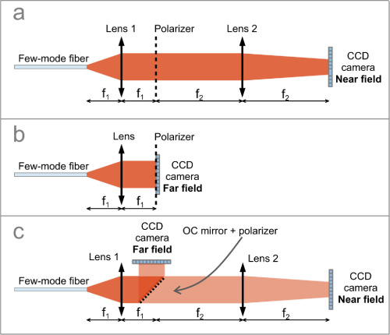
The good, the bad and the ugly
Good
Bad
Ugly

Slide 24

Blender MCP + agents
Text specification
Agent (Codex/Claude/...)
Blender MCP (Python API)
Scene + Render
Final Figure
→
→
→
→
What the agent controls in Blender:
Geometry
Meshes, curves, arrays, boolean operations: build yours using a text description.
Materials
PBR shaders, emission, glass, subsurface: all physically based by default.
Lighting
HDRI environments, area lights, point lights
Camera
Field of view, depth of field, focal plane. Easier to set yourself: choose one you like!
Animation
Keyframes, physics sims, camera paths: for figures and supplementary material
Blender MCP

Slide 25
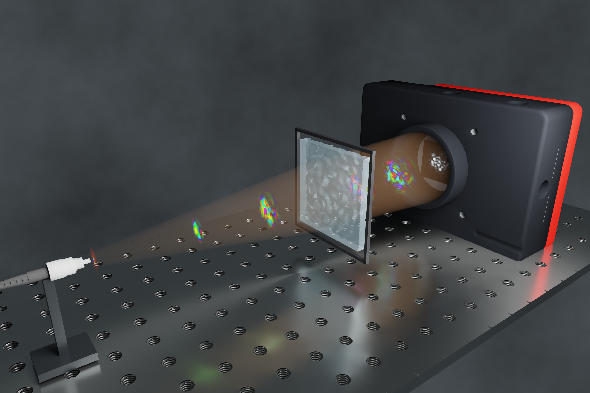
Example visualisation pipeline
1 Describe physical scene
2 Generate geometry
3 Check scientific correctness
4 Render and refine
→
→
→
You write a clear text spec: geometry, scale, material, camera angle.
Agent writes Blender Python script, creates objects, applies materials.
YOU verify the geometry, proportions, and physical conventions.
Iterate on lighting and camera; export final PNG / animation.
Example from my work:
Multimode fibre propagation: field intensity visualised in 3D
Phase-mask geometry: actual SLM pixel structure is rendered
Optical table system: full bench layout for a methods figure
Speckle-to-speckle transformation: real wavefront evolution
You can do so much more, including scripted 3D animations, guided by real physics, just put the right data to the agent and verify the result.

Slide 26
Practical advice for PhD students
Six habits that separate rigorous agent use from vibe coding:
1
Learn basic Python and Git first
You need to read and review agent output. You cannot do that without basics.
2
Start with small, well-defined tools
A single-device wrapper or a plotting script is the right first project.
3
Write agent.md files
Write the spec before prompting. It forces you to think about the problem (you can use LLM but DO validate it)
4
Always ask for tests, not just code
"Write tests for the edge cases you just specified" is a powerful prompt.
5
Validate output. Always!
Try to break the output. Compare with known limits or analytical results (same as for your own code).
6
Keep reproducible records
Always use git, log the spec, the agent session, and the validation results together.

Slide 27
Limits and pitfalls
Plausible wrongness is more dangerous than obvious failure.
Risks
Mitigation
Plausible but incorrect code
Hidden physical assumptions
Geometrically convincing but wrong figures
Weak reproducibility without version control
Over-trust in demo outputs
Spec-less "vibe" coding for production use
Write specs before coding
Define tests that can fail
Validate against analytical limits
Commit everything to version control
Human reviews every output
Treat agent output as a first draft

Slide 28
Recommended stack
A practical starting point — not the only path:
Coding foundation
AI agents
Python
VS Code / JupyterLab
Git + GitHub
NumPy · SciPy · Matplotlib
Claude Code (CLI)
Cursor (IDE)
GitHub Copilot
OpenAI Codex CLI
Apps & automation
Visualisation
FastAPI + PyQt / Streamlit
Docker
NumPy pipelines
Blender + Blender MCP
Matplotlib / Plotly
Napari (microscopy)

Slide 29
The future researcher skillset: takeaways
AI does not remove the need for expertise, it raises its value.
Agents amplify whatever skill level the researcher brings.
Domain expertise
Deep knowledge of your field is non-negotiable — agents cannot substitute it.
Specification thinking
Ability to describe precisely what a system should do, at the level of equations and tests.
Validation mindset
Healthy scepticism toward any output. Ask "how would I know if this is wrong?".
Software architecture
Basic understanding of modular design, interfaces, and testability.
AI collaboration skills
Knowing what to delegate, how to check, and when to take back control.
Notes:
Close with the main message. AI does not remove the need for expertise. It increases the value of precise scientific judgement. Agents amplify whatever skill level the researcher brings.

