Slide 1
Investigating Integrated Single-Photon Optics for Power-Efficient Quantum Randomness
Ethan Gordon, Daniel Stanley

Slide 2
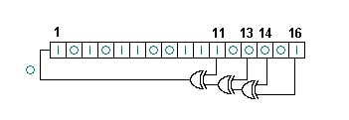
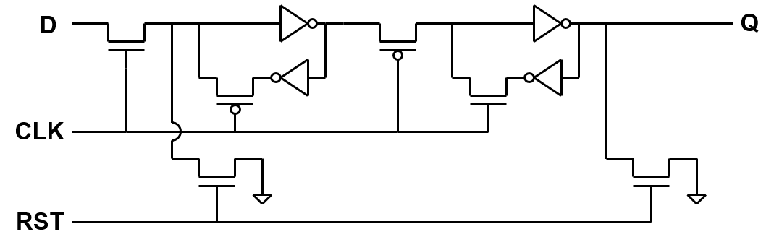
Pseudo-Randomness in Circuity: LFSR
Notes:
Design of an LFSR
Benefits: Cheap and Easy
Describe Schematic
Downsides: Finite Period Length, Fixed Function prone to Discovery

Slide 3
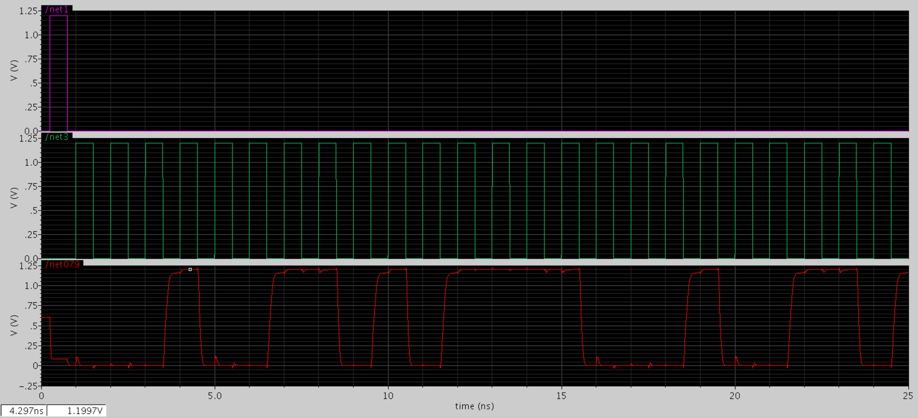
4-bit LFSR in Cadence

Slide 4
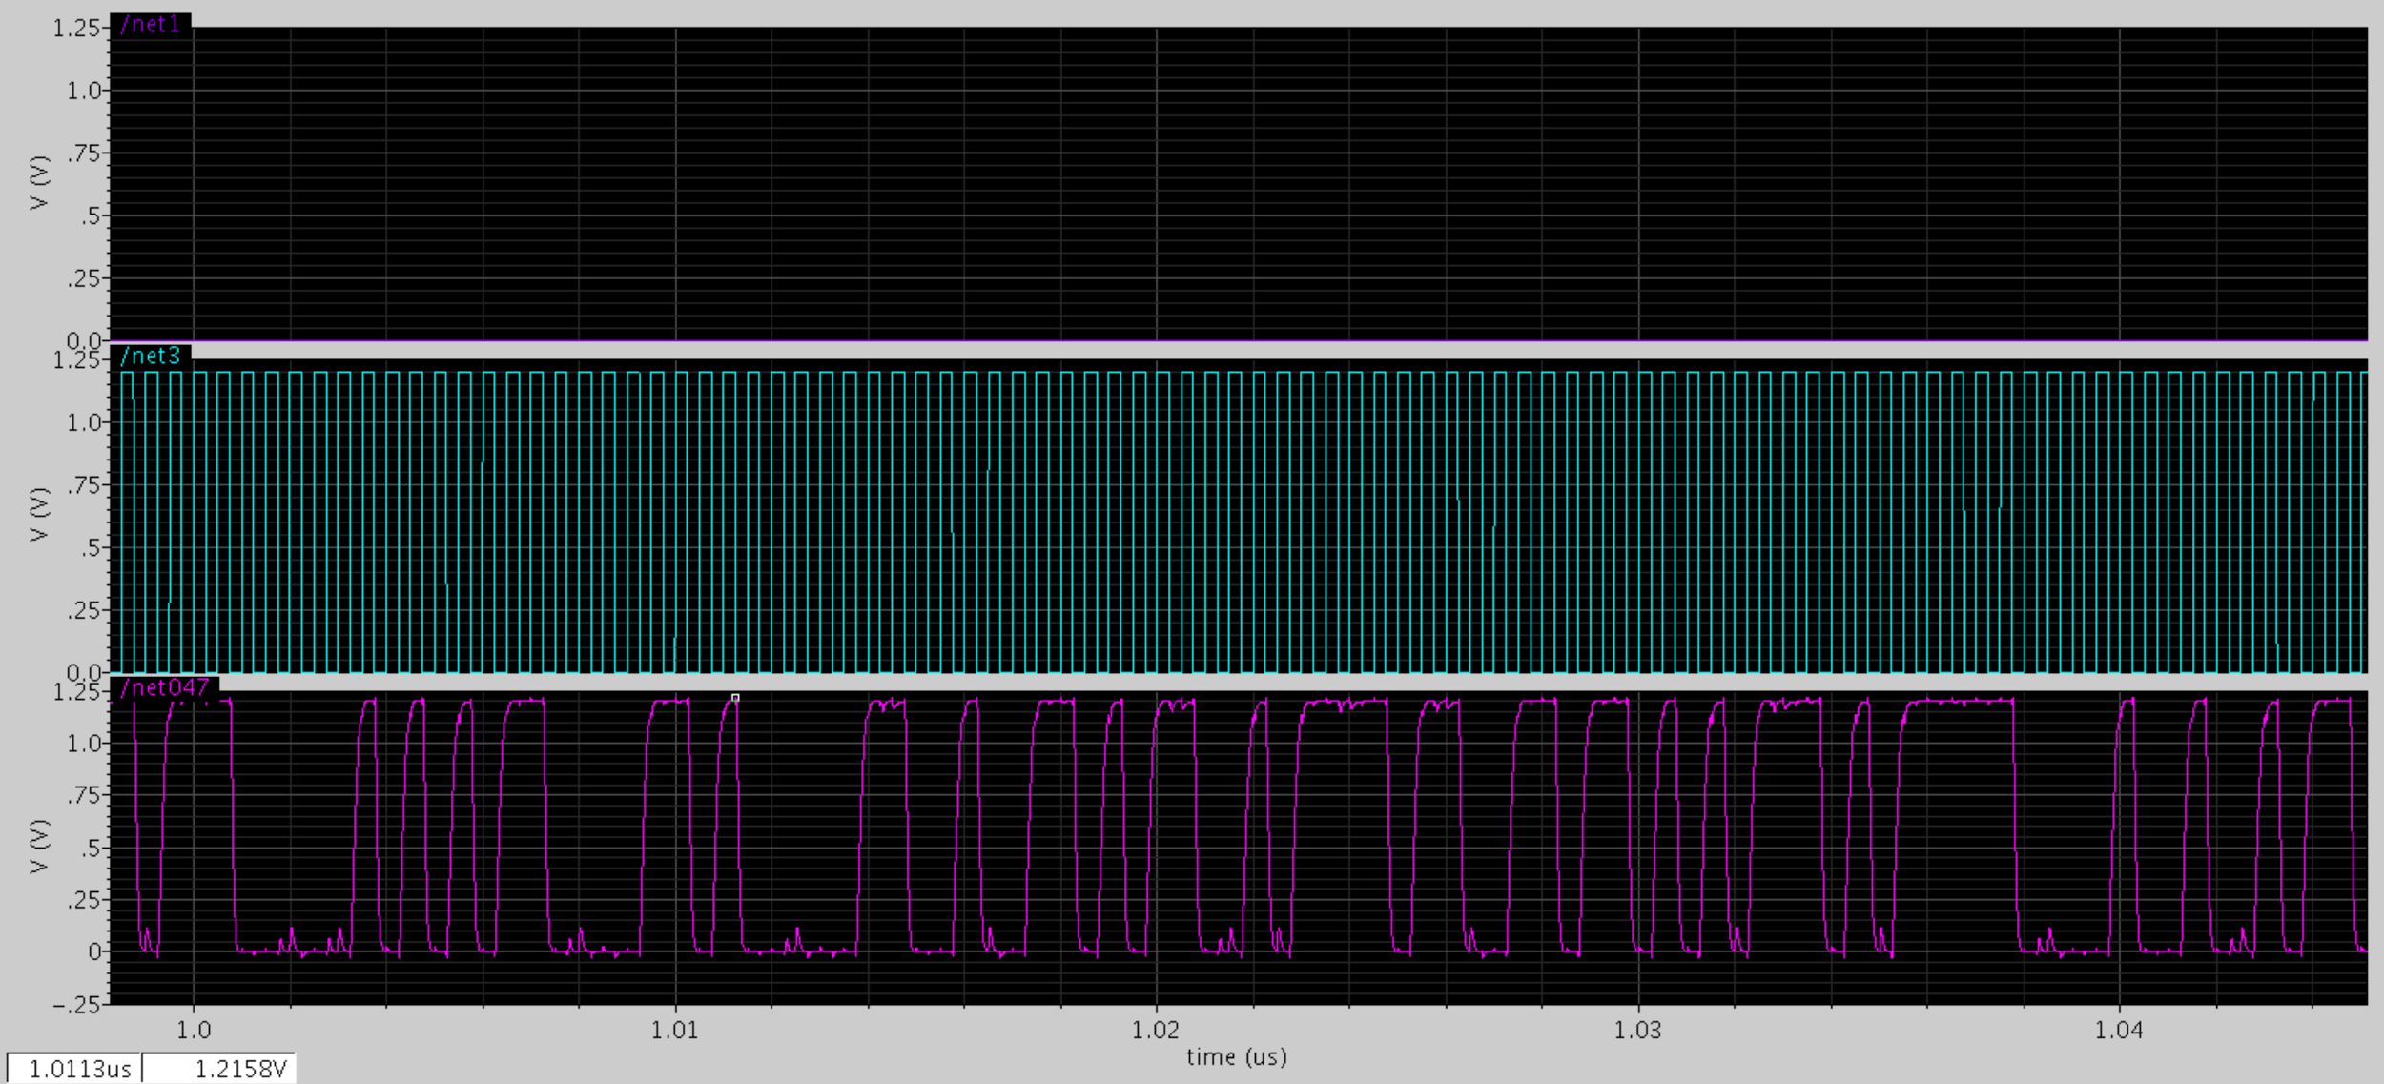
17-bit LFSR in Cadence

Slide 5
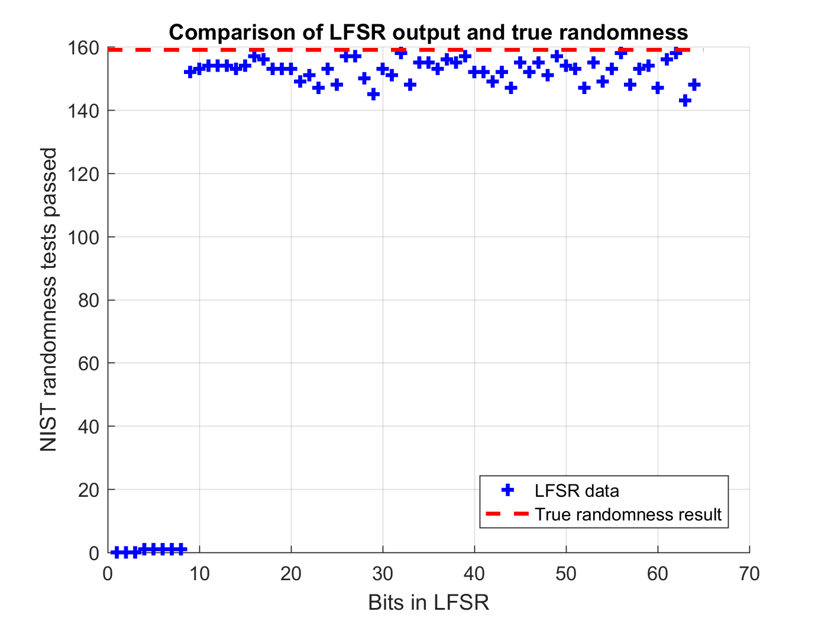
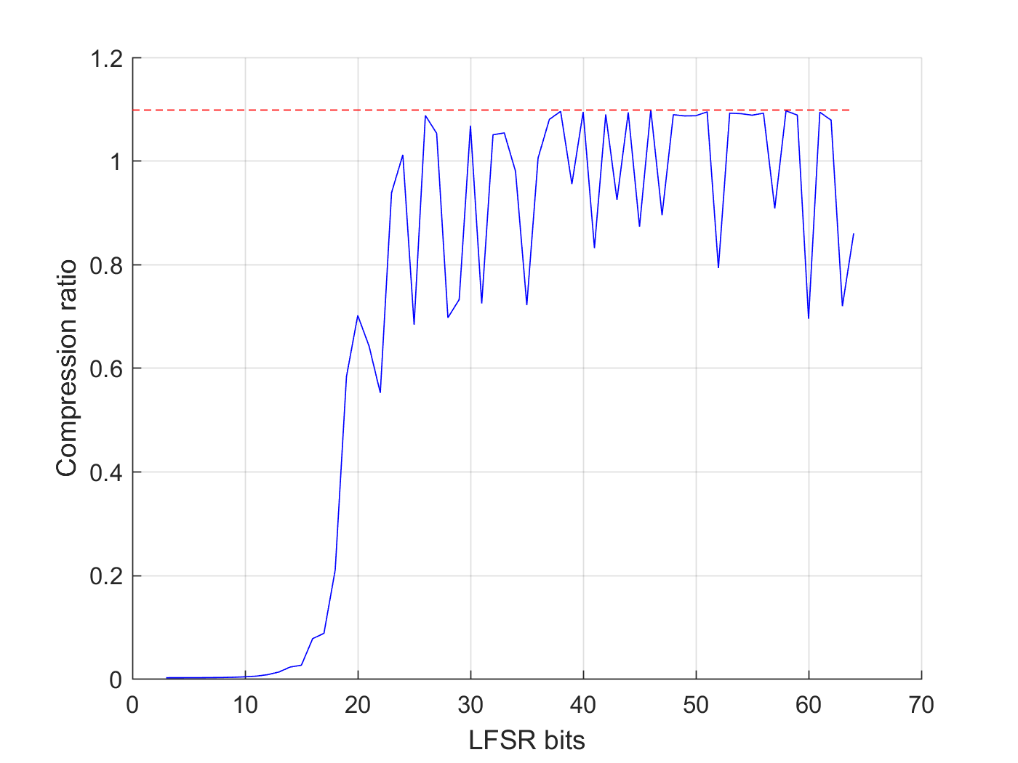
LFSR Limitations

Slide 6
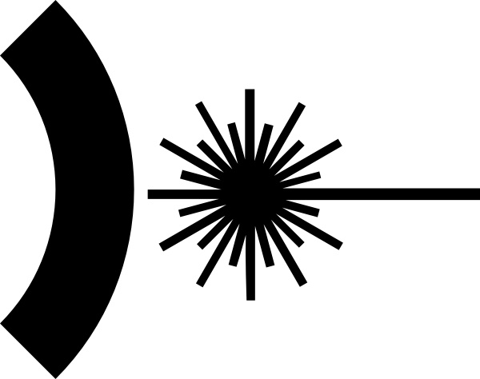
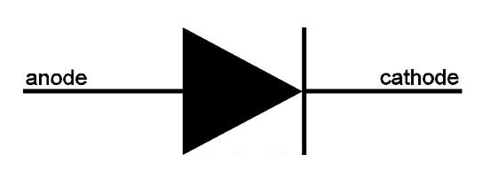
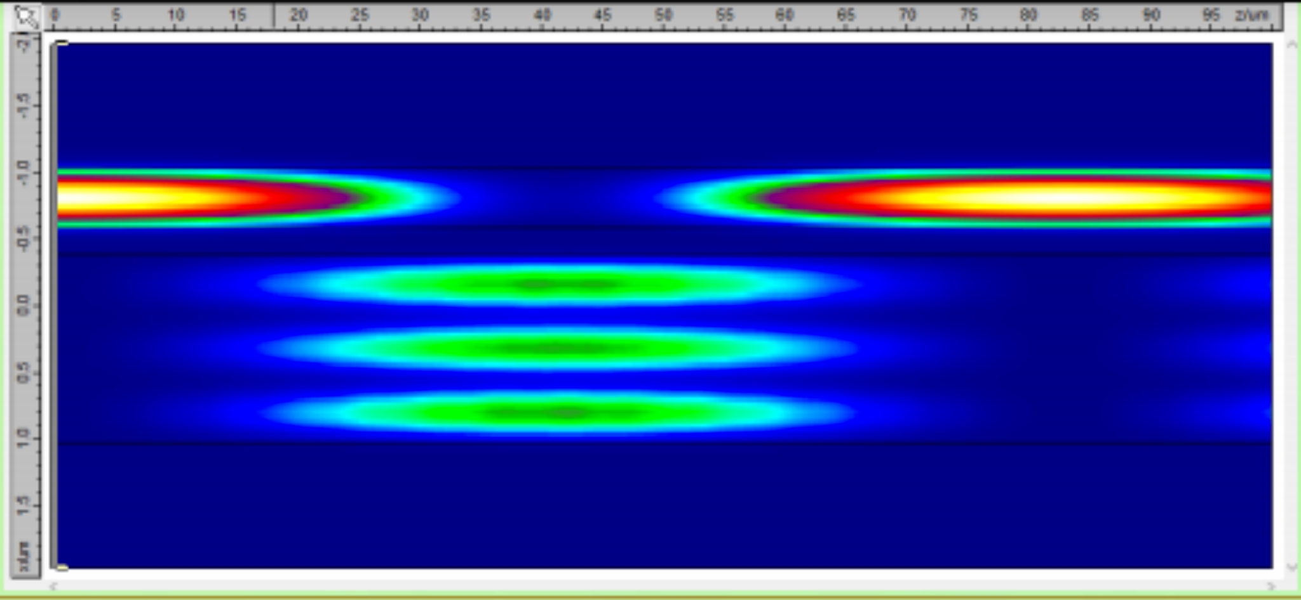
Quantum Randomness in Single-Photon Optics
50/50
Notes:
Principle of Quantum Randomness: Need to create a superposition of states and resolve that superposition.
With multiple photons, the 50/50 coupler becomes

Slide 7
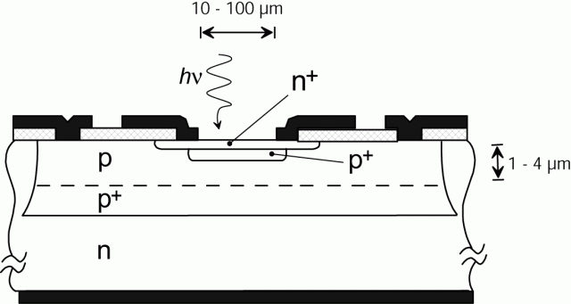
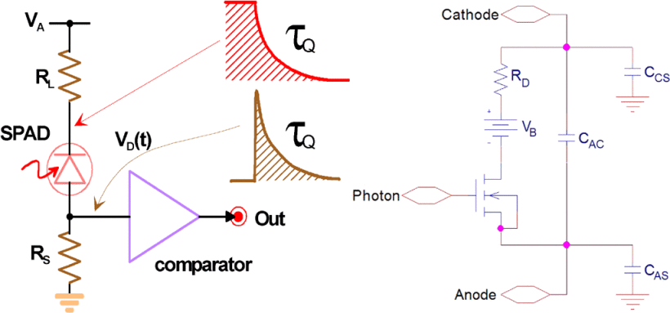
Single-Photon Avalanche Diode
Notes:
Operating Principle: Held in reverse bias beyond the break-down voltage, but n+ is so thin that it is depleted of carriers.
Single free carrier from

Slide 8
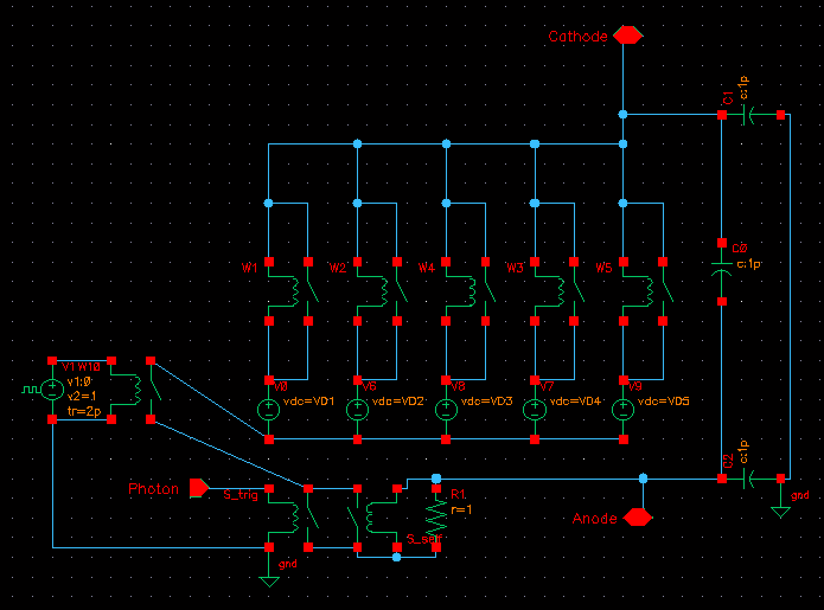
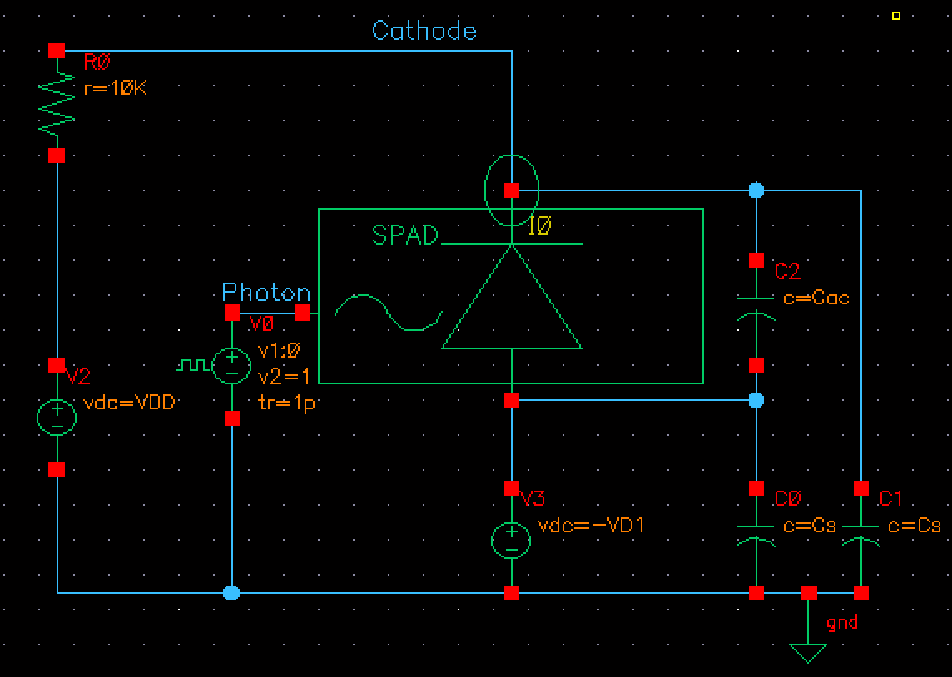
SPAD in Cadence: Passive Quenching
Variable Resistor
Photon Trigger
Self-Sustain
Notes:
Verification of Model

Slide 9
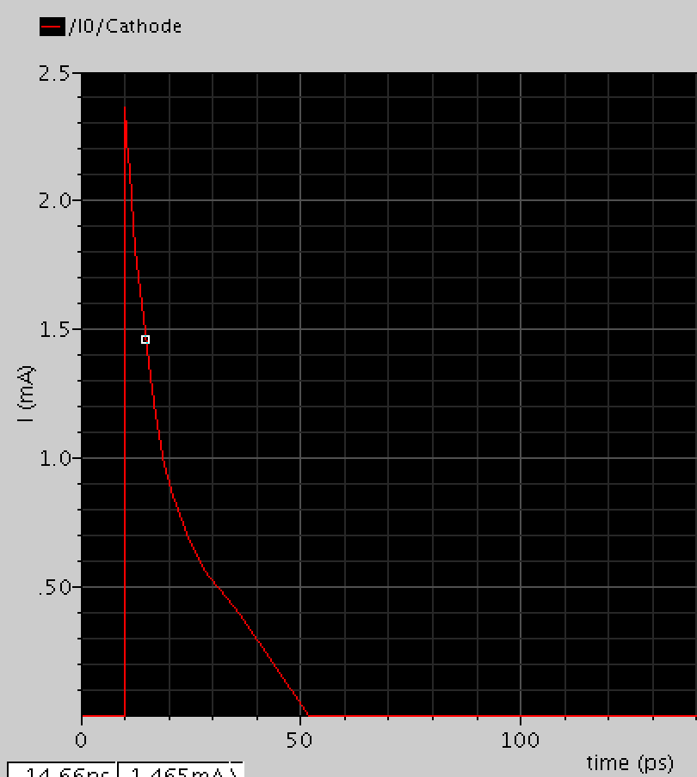
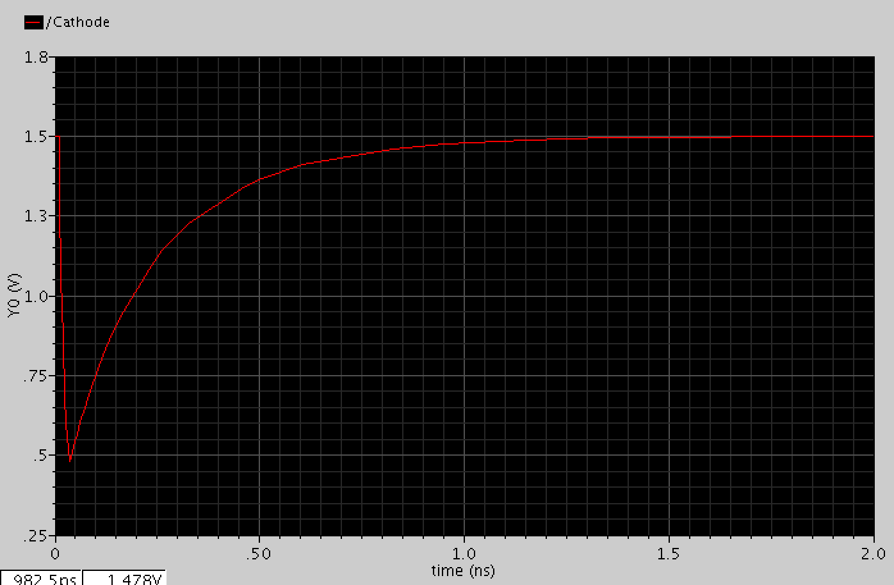
SPAD in Cadence: Passive Quenching
Self-Quench
Notes:
Verification of Model

Slide 10
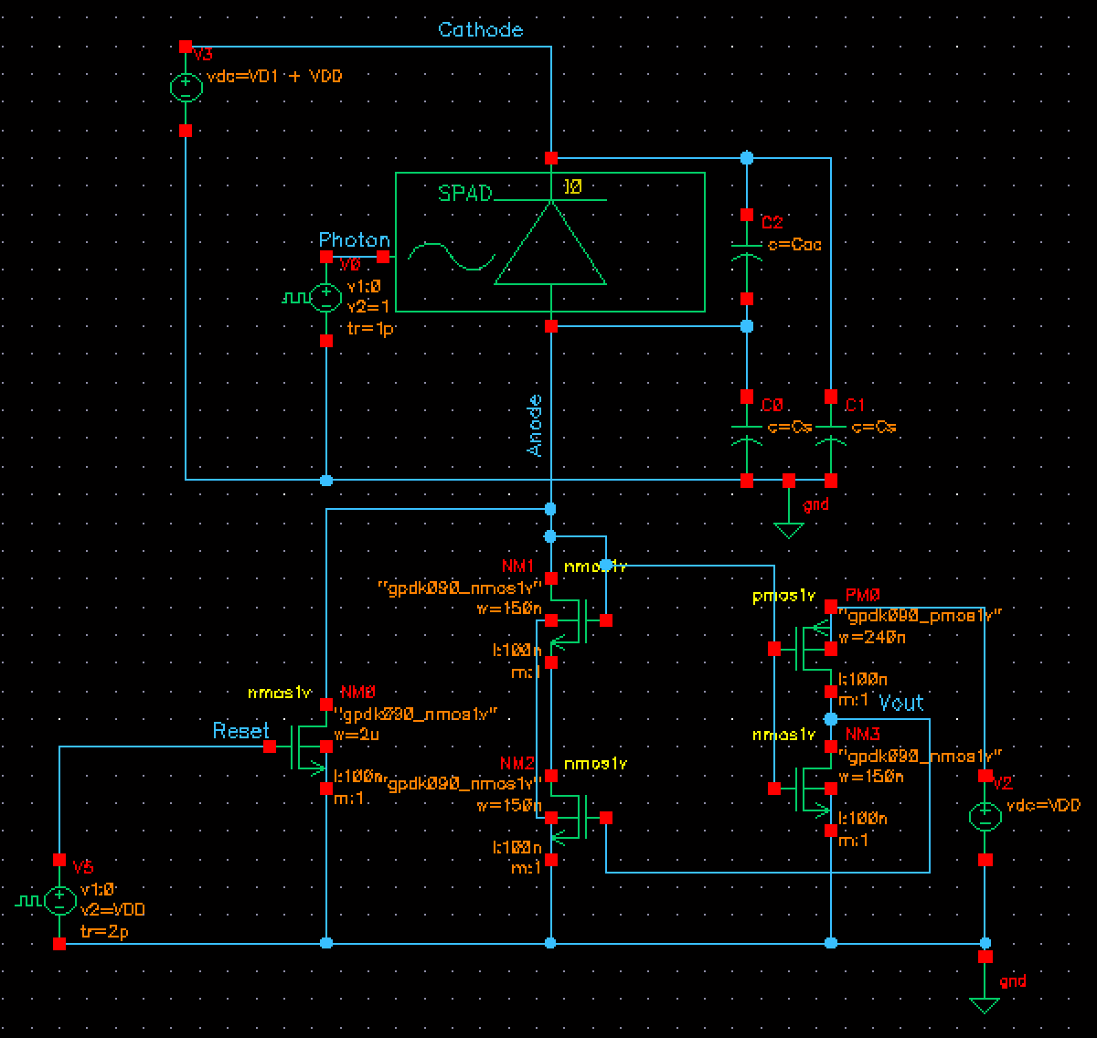
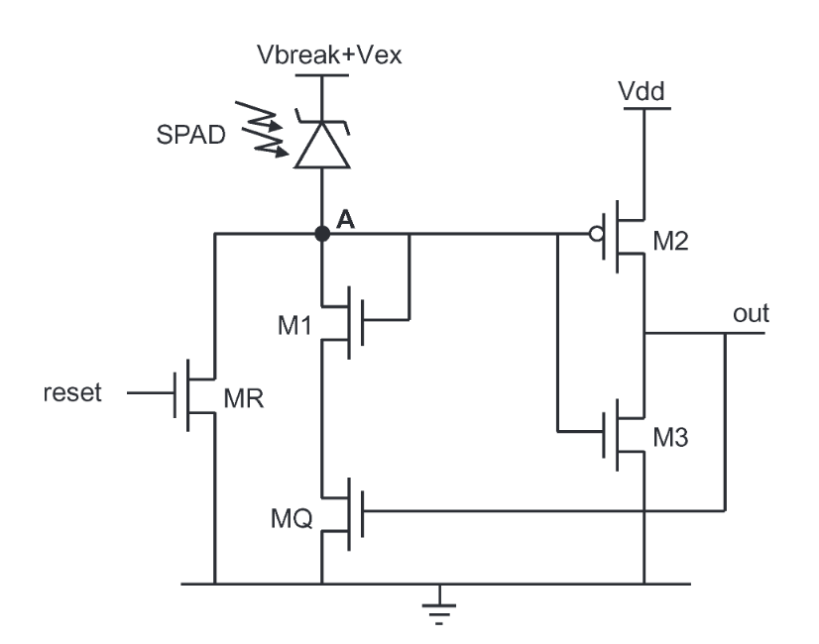
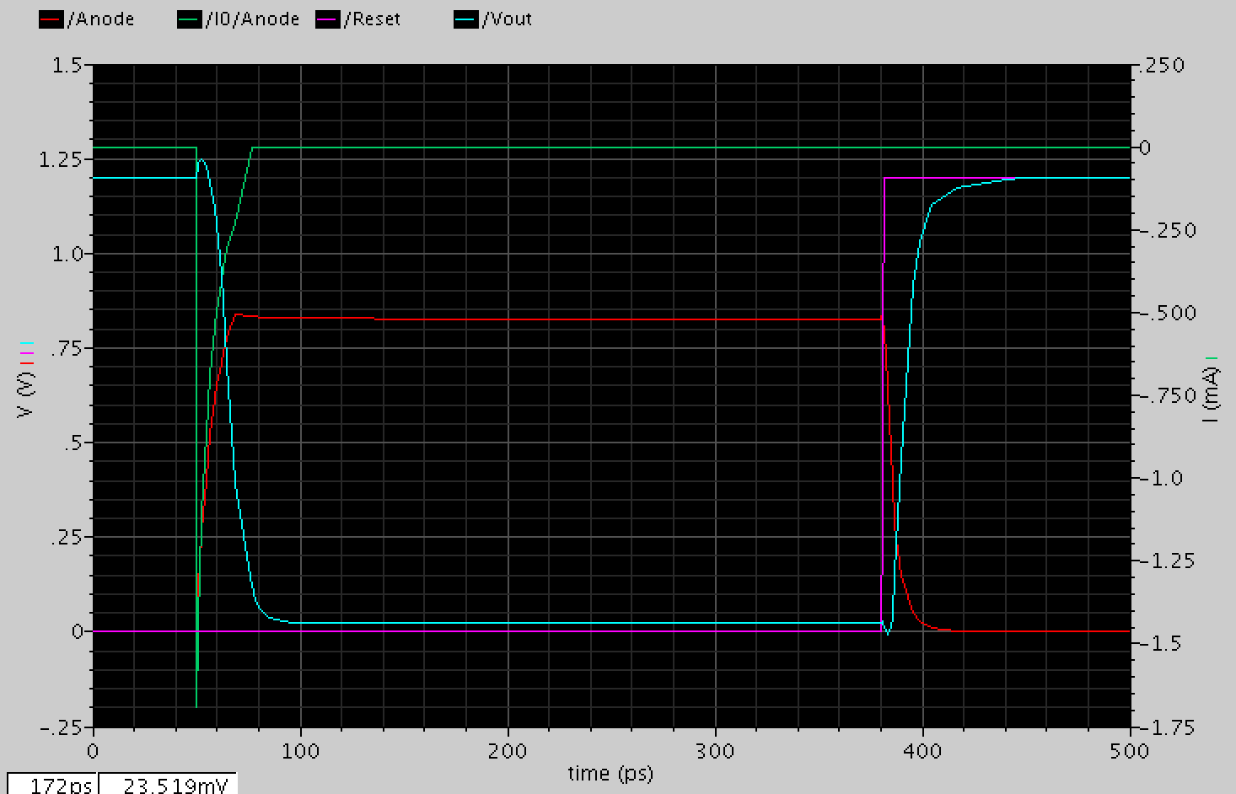
SPAD in Cadence: Active Quenching
Notes:
Verification of Model

Slide 11
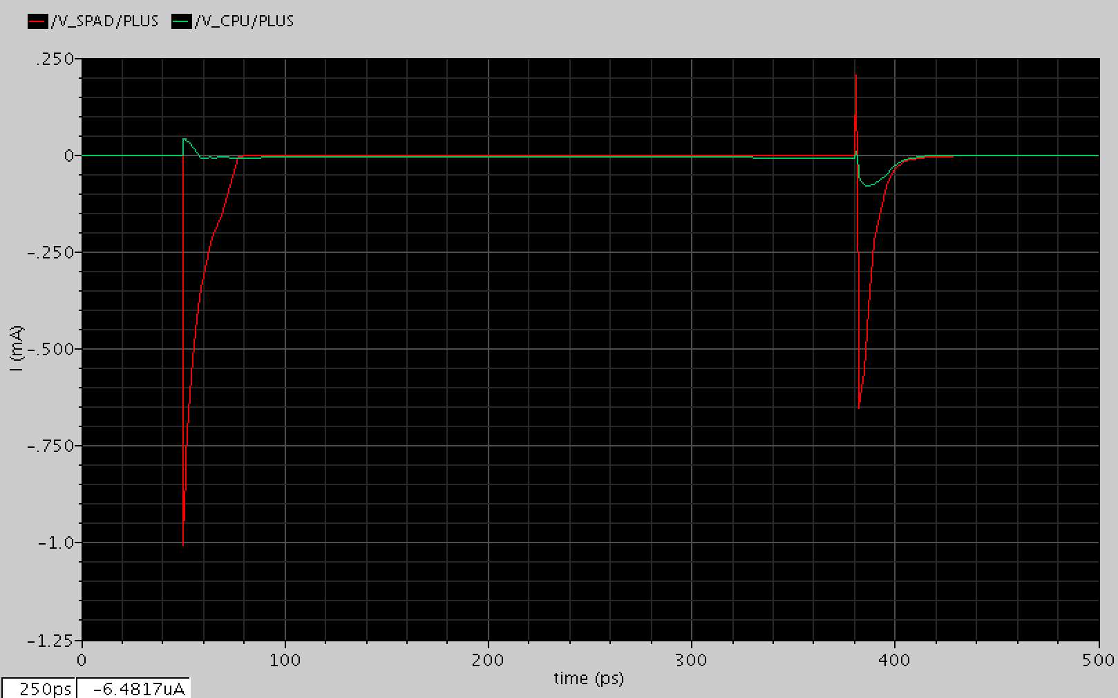
SPAD in Cadence: Power Consumption
Computation (Green):
8.88𝝁W
SPAD Recharge (Red):
592.1𝝁W
Optical Power Estimate:
~10𝝁W
Notes:
Voltage had to be < 10
Lowest capacitance for smallest SPAD

Slide 12
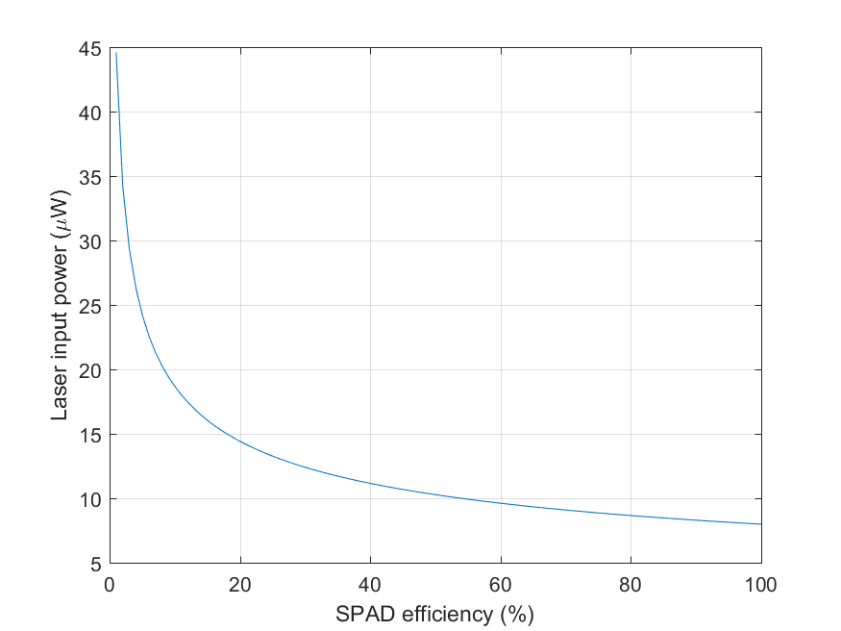
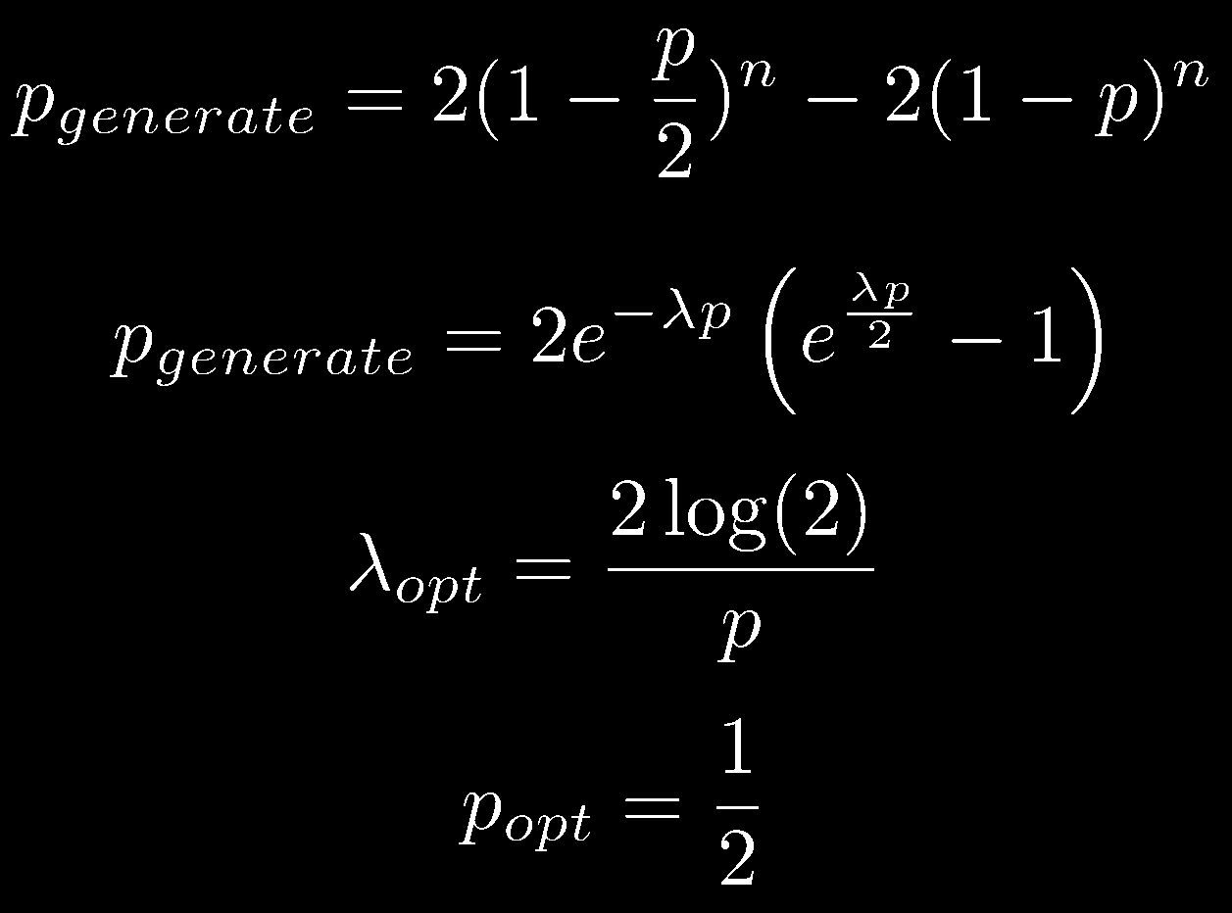
Optical Power Estimation
Notes:
Verification of Model

Slide 13
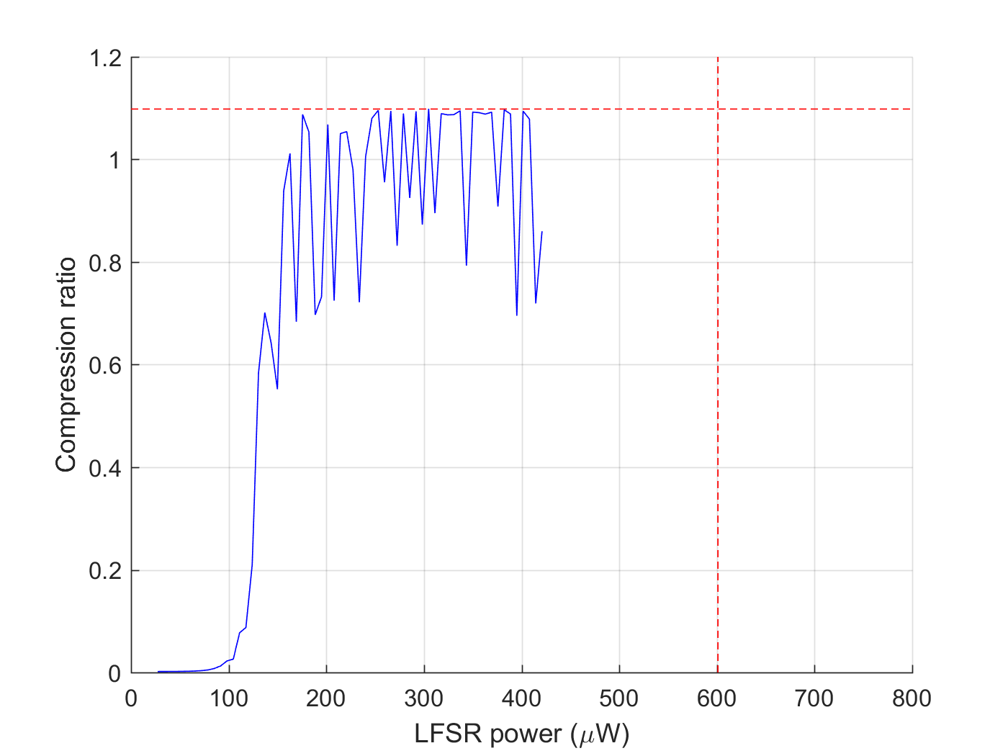
Comparison

Slide 14
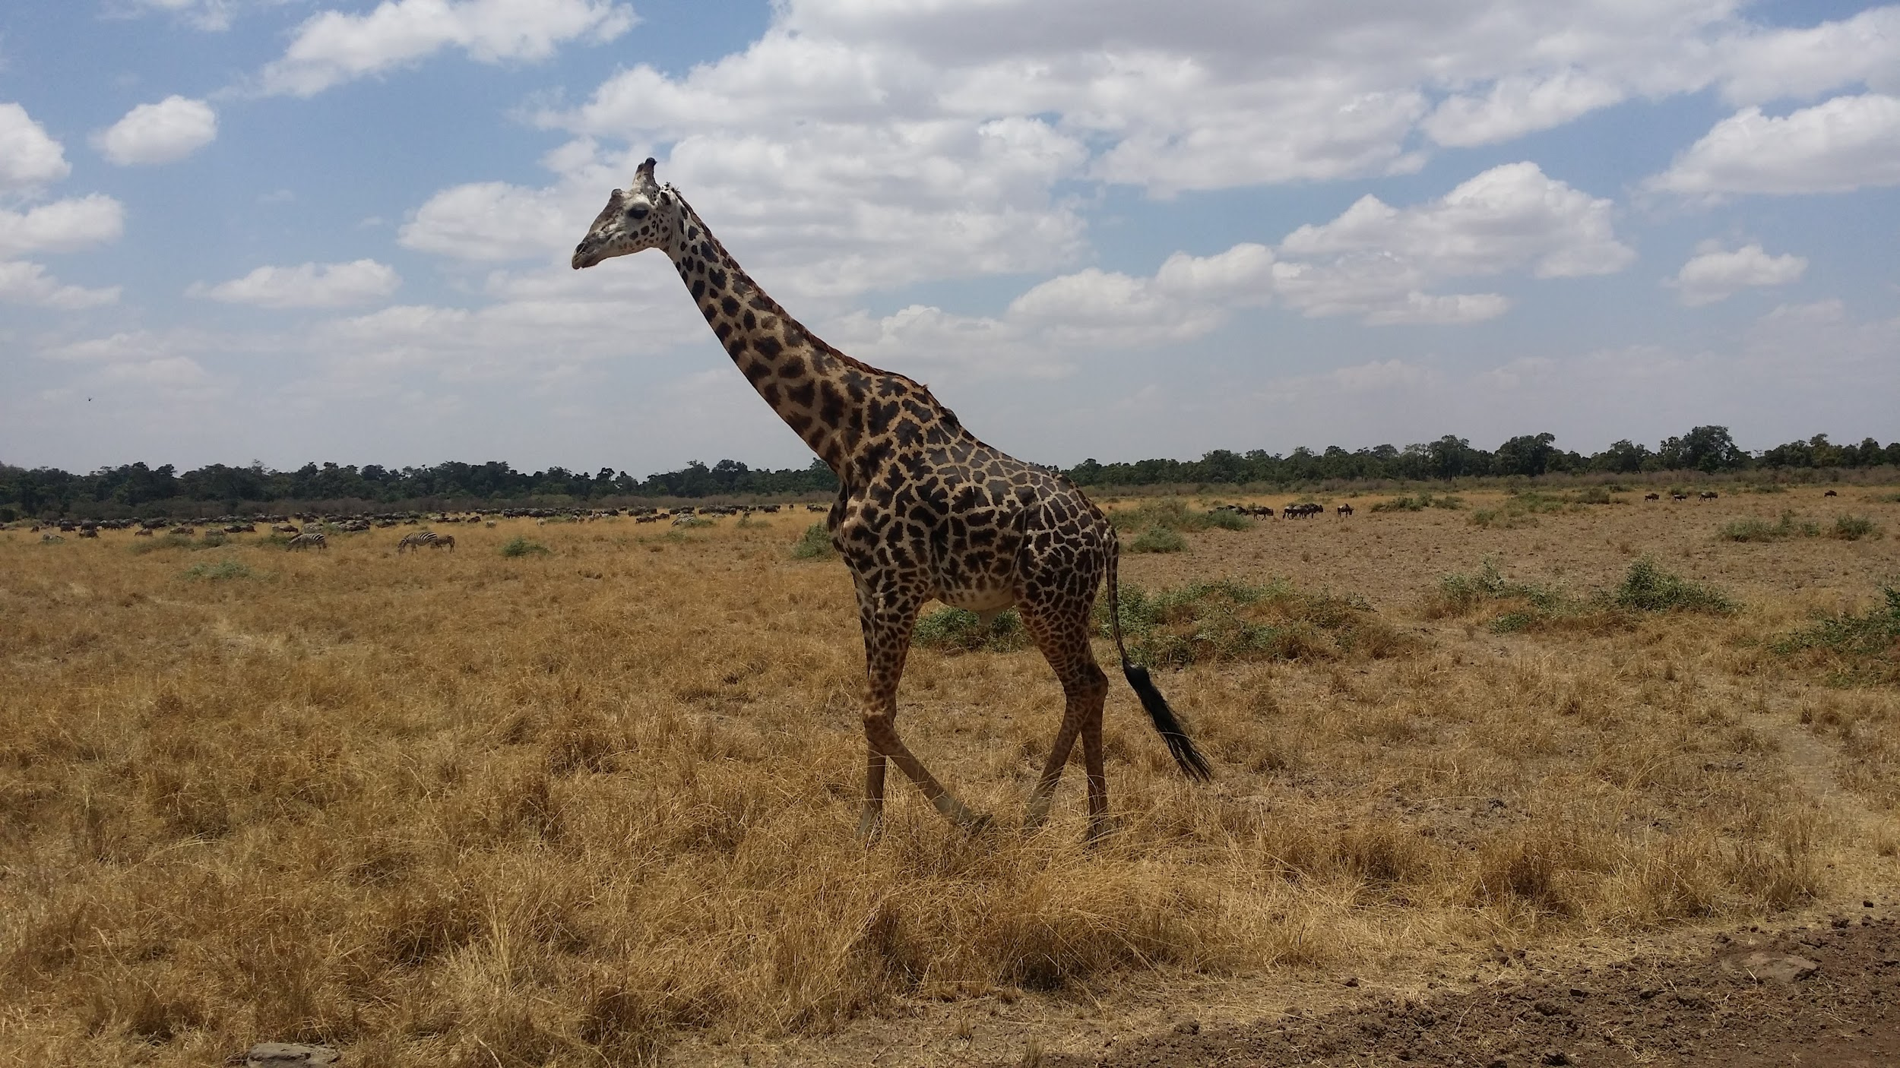
Tired of Graphs?
Here’s a Giraffe!
He’s here to answer questions...

