Slide 1
Automatic Feature Generation for Setting Compiler Heuristics
  Hugh Leather*, Elad Yom-Tov**,
  Mircea Namolaru**, Ari Freund**
* Institute for Computing Systems Architecture, University of Edinburgh, UK
** IBM Haifa Research Lab, Israel

Slide 2
Overview
Simplified view of ML in compilers
Input projection problem
Features for a toy compiler
Features for GCC
Results
Further and on going work

Slide 3
Overview
Simplified view of ML in compilers
Input projection problem
Features for a toy compiler
Features for GCC
Results
Further and on going work

Slide 4
Simplified view of ML in compilers
Goal:
  Replace an heuristic with a Machine Learned one
For example, learn better loop unrolling for GCC

Slide 5
Simplified view of ML in compilers
Start with compiler data structures
AST, RTL, SSA, CFG, DDG, etc.
Human expert determines a mapping
to a feature vector
number of instructions
mean dependency depth
branch count
loop nest level
...
trip count

Slide 6
Simplified view of ML in compilers
Execute the programs with different compilation
strategies and find the best for each
Now collect many examples of programs, determining
their feature values
...

Slide 7
Simplified view of ML in compilers
Now give these examples to a machine learner
It learns a model
Examples
Supervised
Machine Learner
Model
Features
...
Desired Outputs

Slide 8
Simplified view of ML in compilers
This model can then be used to predict the best
compiler strategy from the features of a new program
Our heuristic is replaced
Model
Desired Outputs
Features

Slide 9
Overview
Simplified view of ML in compilers
Input projection problem
Features for a toy compiler
Features for GCC
Results
Further and on going work

Slide 10
Input projection problem
The expert must do a good job of projecting down to features
amount of white space
average identifier length
age of programmer
name of program
...
...

Slide 11
Input projection problem
Earlier work¹ showed that both positive and negative classification examples can receive the same feature values
Machine learning works well when all examples associated with one feature value have the same type
Machine learning doesn't work if the features don't distinguish the examples
Feature 1
0
1
0
Feature 2
1
  ¹ Rene Quiniou Antoine Monsifrot, Francois Bodin. A machine learning approach to automatic production of compiler heuristics, 2002.

Slide 12
Input projection problem
Better features might allow classification
Feature 3 = 0
Feature 3 = 1
Feature 1
Feature 1
0
1
0
1
0
0
Feature 2
Feature 2
1
1

Slide 13
Input projection problem
But, there is an existence proof of better features
Execute the program and decide the strategy
Strategy becomes the feature (ML is identity)
Not very practical

Slide 14
Input projection problem
There are much more subtle interactions between features and induction algorithm
There is an infinite number of possible features
Suppose the expert thinks of feature:
  Number of addition nodes
Perhaps this is better:
  Number of addition nodes whose left child is a constant

Slide 15
Overview
Simplified view of ML in compilers
Input projection problem
Features for a toy compiler
Features for GCC
Results
Further and on going work

Slide 16
A feature language for a toy compiler
Toy language the compiler accepts:
  Variables, integers, '+', '*', parentheses
Examples:
  a = 10
  b = 20
  c = a * b + 12
  d = a * (( b + c * c ) * ( 2 + 3 ))

Slide 17
A feature language for a toy compiler
What type of features might we want?
a = ((b+c)*2 + d) * 9 + (b+2)*4
count−nodes−matching(
is−times &&
left−child−matches(
is−plus
)&&
right−child−matches(
is−constant
)
)
=
var
+
*
*
+
const
+
const
*
var
var
const
+
const
Value = 3
var
var

Slide 18
A feature language for a toy compiler
Define a simple feature language:
<feature> ::= ”count−nodes−matching(” <matches> ”)”
<matches> ::= ”is−constant”
| ”is−variable”
| ”is−any−type”
| ( ”is−plus” | ”is−times” )
( ”&& left−child−matches(” <matches> ”)” ) ?
( ”&& right−child−matches(” <matches> ”)” ) ?

Slide 19
A feature language for a toy compiler
Now generate sentences from the grammar to give features
Start with the root non-terminal
Choose randomly among productions and replace
Repeat for each non-terminal still in the sentence
Continue until there are no more non-terminals
Grammar
<A> ::= <A><A><A>
| “b”
Sentence
AAA
bbbbb
A
bAAAb

Slide 20
A feature language for a toy compiler
Be careful about non-termination and runaway expansion
The sentence AAA has only 1/8 chance of containing fewer non-terminals after expansion
Add probabilities to productions to fix runaways
Grammar
<A> ::= <A><A><A>
| “b”
Sentence
AAA

Slide 21
A feature language for a toy compiler
Grammars can be arbitrarily complex
Produce sentences in any language
Use 'semantic actions' and dynamic terminals
Feature languages can easily include
  Conjunctive and disjunctive forms
  Tests for attribute values
  Follow graph structures
  etc., etc.

Slide 22
Overview
Simplified view of ML in compilers
Input projection problem
Features for a toy compiler
Features for GCC
Results
Further and on going work

Slide 23
Features for GCC
Diagram of the tool chain
GCC Exports Data Structures to XML
Structure Analysed
Grammar
Created
Sentence Generator Compiled
Random Features Generated
Feature Values Computed
Grammar
Stylesheet
Benchmarks
.xsl
.c
.xml
XSL
Engine
.bnf
XSL +
JavaC
.class
.xql
GCC
Structure
Grammar
Sentence
Generator
Random Features
Generated
Program Data
XQuery
Engine
.xml
.csv
Feature Values
as Matrix

Slide 24

Features for GCC
Start by dumping data structures to XML
GCC Exports Data Structures to XML
Structure Analysed
Grammar
Created
Sentence Generator Compiled
Random Features Generated
Feature Values Computed
Grammar
Stylesheet
Benchmarks
.xsl
.c
.xml
XSL
Engine
.bnf
XSL +
JavaC
.class
.xql
GCC
Structure
Grammar
Sentence
Generator
Random Features
Generated
Program Data
XQuery
Engine
.xml
.csv
Feature Values
as Matrix

Slide 25
Features for GCC
Start by dumping data structures to XML
<loop name=”UTDSP.fft1024.fft.3” ... insns=”28” expected−iter=”11”>
<basic−block index=”10” ... frequency=”9100” loop−depth=”3”>
...
<insn ...>
...
<set ...>
<reg ... mode=”SF”>
<int>112</int>
...
</reg>
<mult ... mode=”SF”>
<reg mode=”SF”>
<int>94</int>
...
</reg>
<reg volatile=”true” mode=”SF”>
<int>84</int>
..
</reg>
</mult>
</set>
</insn>

Slide 26
Features for GCC
Find out the structure found in the benchmarks
Allows system to know data format without hard coding
GCC Exports Data Structures to XML
Structure Analysed
Grammar
Created
Sentence Generator Compiled
Random Features Generated
Feature Values Computed
Grammar
Stylesheet
Benchmarks
.xsl
.c
.xml
XSL
Engine
.bnf
XSL +
JavaC
.class
.xql
GCC
Structure
Grammar
Sentence
Generator
Random Features
Generated
Program Data
XQuery
Engine
.xml
.csv
Feature Values
as Matrix

Slide 27
Features for GCC
Grammar is constructed from structure
GCC Exports Data Structures to XML
Structure Analysed
Grammar
Created
Sentence Generator Compiled
Random Features Generated
Feature Values Computed
Grammar
Stylesheet
Benchmarks
.xsl
.c
XSL
Engine
.xml
.bnf
XSL +
JavaC
.class
.xql
GCC
Structure
Grammar
Sentence
Generator
Random Features
Generated
Program Data
XQuery
Engine
.xml
.csv
Feature Values
as Matrix

Slide 28
Features for GCC
Grammar is constructed from structure
Creates a huge grammar
Features are in Xquery; features like:
// Count the number of ’label_expr’s followed by a ’cond_expr’ whose first
// child was a ’neexpr’
sum(bb/stmts/count(∗[name()=”labelexpr”]
[following−sibling::∗[1][name()=”condexpr”]
[∗[1][name()=”neexpr”]]]
))
// Take the average of the number of ’realcst ’nodes in each basic block
avg(bb/stmts//count(∗[name()=”realcst”]))
// Take the minimum number of predecessors across the basic blocks with the
// ’fallthru’ flag set but not the ’exec’ flag
min(bb/preds/count(∗[@fallthru=”true”][not(@exec)]))

Slide 29
Features for GCC
Grammar compiled down to Java
GCC Exports Data Structures to XML
Structure Analysed
Grammar
Created
Sentence Generator Compiled
Random Features Generated
Feature Values Computed
Grammar
Stylesheet
Benchmarks
.xsl
.c
.xml
XSL
Engine
.bnf
XSL +
JavaC
.class
.xql
GCC
Structure
Grammar
Sentence
Generator
Random Features
Generated
Program Data
XQuery
Engine
.xml
.csv
Feature Values
as Matrix

Slide 30
Features for GCC
Thousands of random Xquery features generated
GCC Exports Data Structures to XML
Structure Analysed
Grammar
Created
Sentence Generator Compiled
Random Features Generated
Feature Values Computed
Grammar
Stylesheet
Benchmarks
.xsl
.c
.xml
XSL
Engine
.bnf
XSL +
JavaC
.class
.xql
GCC
Structure
Grammar
Sentence
Generator
Random Features
Generated
Program Data
XQuery
Engine
.xml
.csv
Feature Values
as Matrix

Slide 31
Features for GCC
Features are evaluated over benchmark data
GCC Exports Data Structures to XML
Structure Analysed
Grammar
Created
Sentence Generator Compiled
Random Features Generated
Feature Values Computed
Grammar
Stylesheet
Benchmarks
.xsl
.c
.xml
XSL
Engine
.bnf
XSL +
JavaC
.class
.xql
GCC
Structure
Grammar
Sentence
Generator
Random Features
Generated
Program Data
XQuery
Engine
.xml
.csv
Feature Values
as Matrix

Slide 32
Overview
Simplified view of ML in compilers
Input projection problem
Features for a toy compiler
Features for GCC
Results
Further and on going work

Slide 33
Results - GCC loop unrolling
Set up
  Modified GCC 4.2
  23 benchmarks from UTDSP and MediaBench
  Pentium 4; 2.8GHz; 512Mb RAM
  Benchmarks run in RamDisk to reduce IO variability
  Found best unroll factor for each loop in [0-16]

Slide 34
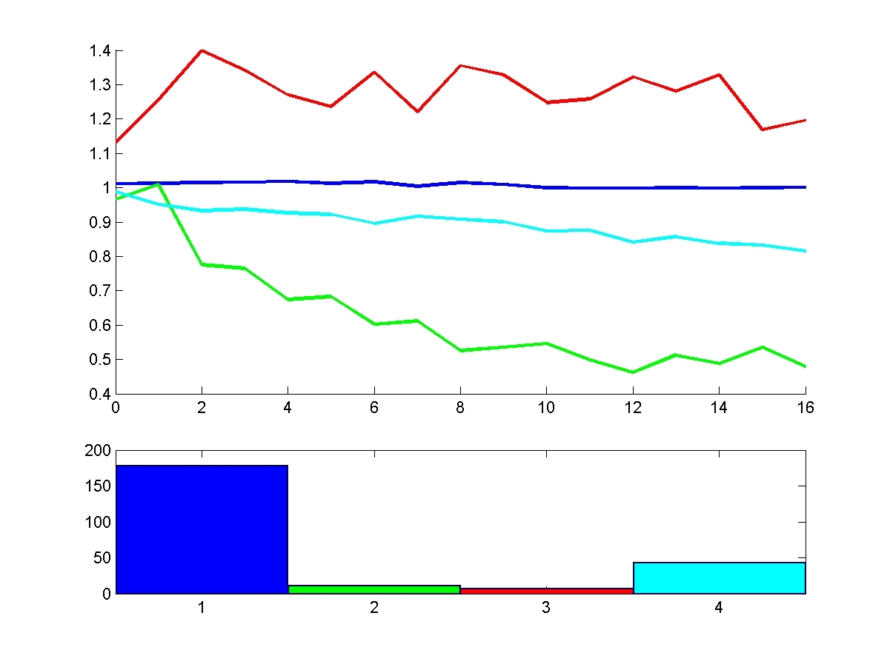
Results - GCC loop unrolling
Loops grouped according to K-means method
Average speed up (compared to GCC default)
Unroll factor
Group size
179
12
8
44
Group

Slide 35
Results - GCC loop unrolling
Decision tree (C4.5) maps loop to K-Means group
If not in improved group then
  Unroll by GCC heuristic
Else
  Unroll by 2 (best factor across improved group)

Slide 36
Results – GCC loop unrolling
Feature 1 : Count the number of ”plus” nodes whose first operand is a ”reg” node with both
”volatile” and ”frame−related” flags set
count( descendant−or−self::∗[name()=”plus”]
[∗[1][name()=”reg”][@volatile=”true”][@frame−related=”true”]])
Feature 2 : Count the number of ”set” nodes whose source operand is ”mult” nodes for which
the first operand is a ”reg” node
count( descendant−or−self::∗[name()=”set”]
[∗[2][name()=”mult”]
[∗[1][name()=”reg”]]])
Feature 3 : Count ”compare” nodes whose first child is a ”reg” node which has its
”frame−related” flag set and has”mode=SI”
count( descendant−or−self::∗[name()=”compare”]
[∗[1][name()=”reg”][@frame−related=”true”][@mode=”SI”]])
Feature 4 : Count instructions that set a register to the value of a comparison against a register
count( descendant−or−self::∗[name()=”insn”]
[∗[6][name()=”set”]
[∗[1][name()=”reg”]]
[∗[2][name()=”compare”]
[∗[2][name()=”reg”]]]])
Feature 5 : Count the number of basic−blocks that might be hot and have estimated frequency
less than 5426. They must also contain a call instruction whose last field is null.
count( descendant−or−self::∗[name()=”basic−block”]
[@may−be−hot=”true”][number(@frequency) lt 5426]
[∗[name()=”call_insn”]
[∗[10][name()=”null”]]])
Top features of the decision tree

Slide 37
Results – GCC loop unrolling
Average speedup 1.8%
Best speedup 5.3%
Expect better when more data (DDG, etc) made available

Slide 38
Results - GCC pass reordering
Set up
  Modified GCC 4.2
  11 benchmarks from Spec Int 2000
  PowerPC 5; 1.5GHz; 4-core
  Executed each benchmark with 1956 different orders of
    Constant propagation
    Partial redundancy elimination
    Dead code elimination
    Forward propagation
    Copy propagation
    Merge phi node

Slide 39
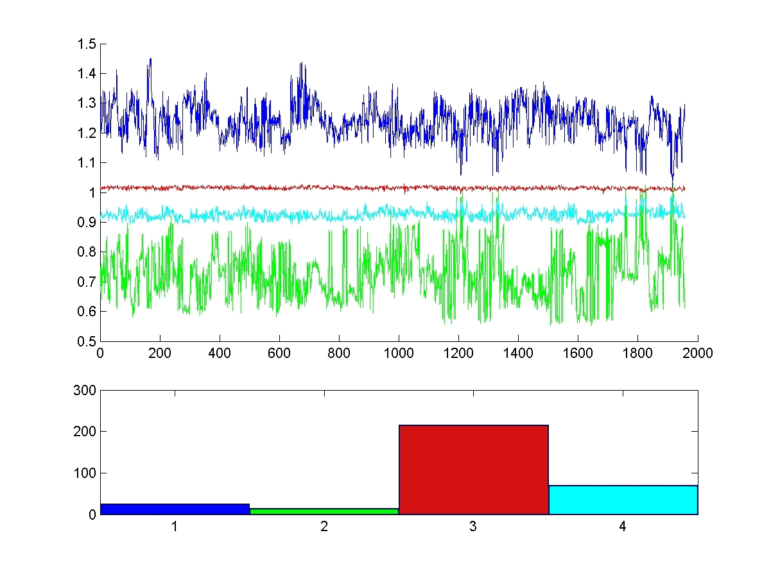
Results - GCC pass reordering
Loops grouped according to K-means method
Average speed up (compared to GCC default)
Variation number
Group size
25
14
216
71
Group

Slide 40
Results - GCC pass reordering
Looked at 326 functions with runtime > 0.1 sec
Decision tree (C4.5) maps loop to K-Means group
If not in improved group then
  Unroll by GCC default pass order
Else
  Use maximal pass order

Slide 41
Results – GCC pass reordering
Top features of the decision tree
Feature 1 : Count the number of ”indirect_ref”s of ”pointer_type” anywhere in each basic block and then take the average across all basic blocks in the function.
avg(bb/stmts//count(∗[name()=”indirect_ref”][@type=”pointer_type”]))
Feature 2 : Count ”cond_expr”s anywhere in each basic block whose condition is greater than expressions whose second operand is a constant, invariant address expression
avg(
bb/stmts//count(∗[name()=”cond_expr”]
[∗[1][name()=”gt_expr”][@type=”boolean_type”]
[∗[2][name()=”addr_expr”][@invariant=”true”][@constant=”true”]]
]
)
)

Slide 42
Results – GCC pass reordering
Average speedup 4.0%
Best speedup 36.4%
Expect better when more data (DDG, etc) made available
Expect better when predicting precise pass order, not just K-means group (needs more examples)

Slide 43
Overview
Simplified view of ML in compilers
Input projection problem
Features for a toy compiler
Features for GCC
Results
Further and on going work

Slide 44
Further and on going work
Add more data – include DDG, CFG, etc.
Enable searching over the grammar
Explore graph structures

Slide 45
Questions?
Thank you

