Slide 1

Automatic Feature Generation for Machine Learning Based Optimizing Compilation
  Hugh Leather, Edwin Bonilla,
  Michael O'Boyle
  Institute for Computing Systems Architecture
  University of Edinburgh, UK

Slide 2
Overview
Introduction to machine learning in compilers
Difficulties choosing features
A feature space for a motivating example
Searching the feature space
Features for GCC
Results
Further and on going work

Slide 3
Introduction to machine learning in compilers
Problem:
  Tuning heuristics is hard
  Architectures and compilers keep changing
Goal:
  Replace an heuristic with a Machine Learned one
  ML performs very well

Slide 4
Introduction to machine learning in compilers
How it works
  Summarise data before heuristic (features)
  Collect examples
  Learn a model
  Model predicts heuristic for new program

Slide 5
Introduction to machine learning in compilers
Start with compiler data structures
AST, RTL, SSA, CFG, DDG, etc.
Human expert determines a mapping
to a feature vector
number of instructions
mean dependency depth
branch count
loop nest level
...
trip count

Slide 6
Introduction to machine learning in compilers
Execute the programs with different compilation
strategies and find the best for each
Now collect many examples of programs, determining
their feature values
Features
...
Best Heuristic Value

Slide 7
Introduction to machine learning in compilers
Now give these examples to a machine learner
It learns a model
Examples
Supervised
Machine Learner
Model
Features
...
Best Heuristic Value

Slide 8
Introduction to machine learning in compilers
This model can then be used to predict the best
compiler strategy from the features of a new program
Our heuristic is replaced
Model
Features
Predicted Heuristic Value
New Program

Slide 9
Overview
Introduction to machine learning in compilers
Difficulties choosing features
A feature space for a motivating example
Searching the feature space
Features for GCC
Results
Further and on going work

Slide 10
Difficulties choosing features
The expert must do a good job of projecting down to features
amount of white space
average identifier length
age of programmer
name of program
...
...

Slide 11
Difficulties choosing features
Machine learning works well when all examples associated with one feature value have the same type
Feature 1
0
1
0
Feature 2
1

Slide 12
Difficulties choosing features
Machine learning doesn't work if the features don't distinguish the examples
Feature 1
0
1
0
Feature 2
1

Slide 13
Difficulties choosing features
Better features might allow classification
Feature 3 = 0
Feature 3 = 1
Feature 1
Feature 1
0
1
0
1
0
0
Feature 2
Feature 2
1
1

Slide 14
Difficulties choosing features
There are much more subtle interactions between features and ML algorithm
  Sometimes adding a feature makes things worse
  A feature might be copies of existing features
There is an infinite number of possible features

Slide 15
Overview
Introduction to machine learning in compilers
Difficulties choosing features
A feature space for a motivating example
Searching the feature space
Features for GCC
Results
Further and on going work

Slide 16
A feature space for a motivating example
Simple language the compiler accepts:
  Variables, integers, '+', '*', parentheses
Examples:
  a = 10
  b = 20
  c = a * b + 12
  d = a * (( b + c * c ) * ( 2 + 3 ))

Slide 17
A feature space for a motivating example
What type of features might we want?
a = ((b+c)*2 + d) * 9 + (b+2)*4
count−nodes−matching(
is−times &&
left−child−matches(
is−plus
)&&
right−child−matches(
is−constant
)
)
=
var
+
*
*
+
const
+
const
*
var
var
const
+
const
Value = 3
var
var

Slide 18
A feature space for a motivating example
Define a simple feature language:
<feature> ::= ”count−nodes−matching(” <matches> ”)”
<matches> ::= ”is−constant”
| ”is−variable”
| ”is−any−type”
| ( ”is−plus” | ”is−times” )
( ”&& left−child−matches(” <matches> ”)” ) ?
( ”&& right−child−matches(” <matches> ”)” ) ?

Slide 19
A feature space for a motivating example
Now generate sentences from the grammar to give features
Start with the root non-terminal
Grammar
<A> ::= <A><A><A>
| “b”
Sentence
A

Slide 20
A feature space for a motivating example
Now generate sentences from the grammar to give features
Choose randomly among productions and replace
Grammar
<A> ::= <A><A><A>
| “b”
Sentence
AAA

Slide 21
A feature space for a motivating example
Now generate sentences from the grammar to give features
Repeat for each non-terminal still in the sentence
Grammar
<A> ::= <A><A><A>
| “b”
Sentence
bAAAb

Slide 22
A feature space for a motivating example
Now generate sentences from the grammar to give features
Continue until there are no more non-terminals
Grammar
<A> ::= <A><A><A>
| “b”
Sentence
bbbbb

Slide 23
Overview
Introduction to machine learning in compilers
Difficulties choosing features
A feature space for a motivating example
Searching the feature space
Features for GCC
Results
Further and on going work

Slide 24
Searching the Feature Space
Search space is parse trees of features
Genetic programming searches over feature parse trees
Features which help machine learning are better

Slide 25
Searching the Feature Space
Overview of searching
Data
Generation
Genetic Programming Search
Feature
Evaluator
Feature Values
Benchmarks
ML
Tool
Data
Extractor
Prediction
Quality
Program Data
Prediction
Best Heuristic
Values

Slide 26
Searching the Feature Space
Data structures extracted from benchmarks
Data
Generation
Genetic Programming Search
Feature
Evaluator
Feature Values
Benchmarks
ML
Tool
Data
Extractor
Prediction
Quality
Program Data
Prediction
Best Heuristic
Values

Slide 27
Searching the Feature Space
Population of parse trees evolved with genetic programming
Data
Generation
Genetic Programming Search
Feature
Evaluator
Feature Values
Benchmarks
ML
Tool
Data
Extractor
Prediction
Quality
Program Data
Prediction
Best Heuristic
Values

Slide 28
Searching the Feature Space
Parse trees are interpreted over program data giving feature values
Data
Generation
Genetic Programming Search
Feature
Evaluator
Feature Values
Benchmarks
ML
Tool
Data
Extractor
Prediction
Quality
Program Data
Prediction
Best Heuristic
Values

Slide 29
Searching the Feature Space
ML tool learns model using feature values and target heuristic values
Data
Generation
Genetic Programming Search
Feature
Evaluator
Feature Values
Benchmarks
ML
Tool
Data
Extractor
Prediction
Quality
Program Data
Prediction
Best Heuristic
Values

Slide 30
Searching the Feature Space
Model predicts heuristic with cross validation
Quality found (accuracy or speedup)
Data
Generation
Genetic Programming Search
Feature
Evaluator
Feature Values
Benchmarks
ML
Tool
Data
Extractor
Prediction
Quality
Program Data
Prediction
Best Heuristic
Values

Slide 31
Searching the Feature Space
After some generations first feature fixed
Used when learning model for next feature
Data
Generation
Genetic Programming Search
Feature
Evaluator
Feature Values
Benchmarks
ML
Tool
Data
Extractor
Prediction
Quality
Program Data
Prediction
Best Heuristic
Values

Slide 32
Searching the Feature Space
Build up features, one at a time
Stop when no improvement
Data
Generation
Genetic Programming Search
Feature
Evaluator
Feature Values
Benchmarks
ML
Tool
Data
Extractor
Prediction
Quality
Program Data
Prediction
Best Heuristic
Values

Slide 33
Overview
Introduction to machine learning in compilers
Difficulties choosing features
A feature space for a motivating example
Searching the feature space
Features for GCC
Results
Further and on going work

Slide 34

Features for GCC
Start by dumping data structures to XML
GCC Exports Data Structures to XML
Structure Analysed
Grammar
Created
Sentence Generator Compiled
Feature
Search
Final Features
Produced
Target Heuristic
Values
ML
Grammar
Stylesheet
Benchmarks
.xsl
.c
GP Search
.xml
XSL
Engine
.bnf
XSL +
JavaC
.class
Final
Features
GCC
Structure
Grammar
Sentence
Generator
Program Data
Feature
Interpreter
.xml

Slide 35
Features for GCC
Start by dumping data structures to XML
GCC Exports Data Structures to XML
Structure Analysed
Grammar
Created
Sentence Generator Compiled
Feature
Search
Final Features
Produced
Target Heuristic
Values
ML
Grammar
Stylesheet
Benchmarks
.xsl
.c
GP Search
.xml
XSL
Engine
.bnf
XSL +
JavaC
.class
Final
Features
GCC
Structure
Grammar
Sentence
Generator
Program Data
Feature
Interpreter
.xml

Slide 36
Features for GCC
Find out the structure found in the benchmarks
Allows system to know data format without hard coding
GCC Exports Data Structures to XML
Structure Analysed
Grammar
Created
Sentence Generator Compiled
Feature
Search
Final Features
Produced
Target Heuristic
Values
ML
Grammar
Stylesheet
Benchmarks
.xsl
.c
GP Search
.xml
XSL
Engine
.bnf
XSL +
JavaC
.class
Final
Features
GCC
Structure
Grammar
Sentence
Generator
Program Data
Feature
Interpreter
.xml

Slide 37
Features for GCC
Grammar is constructed from structure
GCC Exports Data Structures to XML
Structure Analysed
Grammar
Created
Sentence Generator Compiled
Feature
Search
Final Features
Produced
Target Heuristic
Values
ML
Grammar
Stylesheet
Benchmarks
.xsl
.c
GP Search
.xml
XSL
Engine
.bnf
XSL +
JavaC
.class
Final
Features
GCC
Structure
Grammar
Sentence
Generator
Program Data
Feature
Interpreter
.xml

Slide 38
Features for GCC
Grammar is constructed from structure
  Huge grammar > 160kb
  Ensures minimal useless features
  Update easy if GCC changes
Features are in interpreted language

Slide 39
Features for GCC
Grammar compiled down to Java
GCC Exports Data Structures to XML
Structure Analysed
Grammar
Created
Sentence Generator Compiled
Feature
Search
Final Features
Produced
Target Heuristic
Values
ML
Grammar
Stylesheet
Benchmarks
.xsl
.c
GP Search
.xml
XSL
Engine
.bnf
XSL +
JavaC
.class
Final
Features
GCC
Structure
Grammar
Sentence
Generator
Program Data
Feature
Interpreter
.xml

Slide 40
Features for GCC
Feature search
Features are evaluated over benchmark data
GCC Exports Data Structures to XML
Structure Analysed
Grammar
Created
Sentence Generator Compiled
Feature
Search
Final Features
Produced
Target Heuristic
Values
ML
Grammar
Stylesheet
Benchmarks
.xsl
.c
GP Search
.xml
XSL
Engine
.bnf
XSL +
JavaC
.class
Final
Features
GCC
Structure
Grammar
Sentence
Generator
Program Data
Feature
Interpreter
.xml

Slide 41
Features for GCC
Final features outputted
GCC Exports Data Structures to XML
Structure Analysed
Grammar
Created
Sentence Generator Compiled
Feature
Search
Final Features
Produced
Target Heuristic
Values
ML
Grammar
Stylesheet
Benchmarks
.xsl
.c
GP Search
.xml
XSL
Engine
.bnf
XSL +
JavaC
.class
Final
Features
GCC
Structure
Grammar
Sentence
Generator
Program Data
Feature
Interpreter
.xml

Slide 42
Overview
Introduction to machine learning in compilers
Difficulties choosing features
A feature space for a motivating example
Searching the feature space
Features for GCC
Results
Further and on going work

Slide 43
Results
Set up
  Modified GCC 4.3.1
  57 benchmarks from MiBench, MediaBench and UTDSP
  Pentium 6; 2.8GHz; 512Mb RAM
  Benchmarks run in RamDisk to reduce IO variability
  Found best unroll factor for each loop in [0-16]

Slide 44
Results
Search set up
  100 parse trees per generation
  Stop at 200 generations or 15 without change
  Double Cross Validation
Machine learning
  Decision Trees (C4.5)

Slide 45
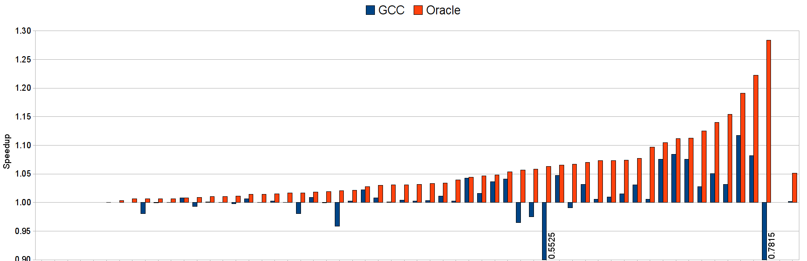
Results
GCC default heuristic vs. oracle
GCC gets 3% of maximum (1.05 speedup)
On average mostly not worth unrolling

Slide 46
Results
State of the art technique – Stephenson
Hand designed features
Uses support vector machine

Slide 47
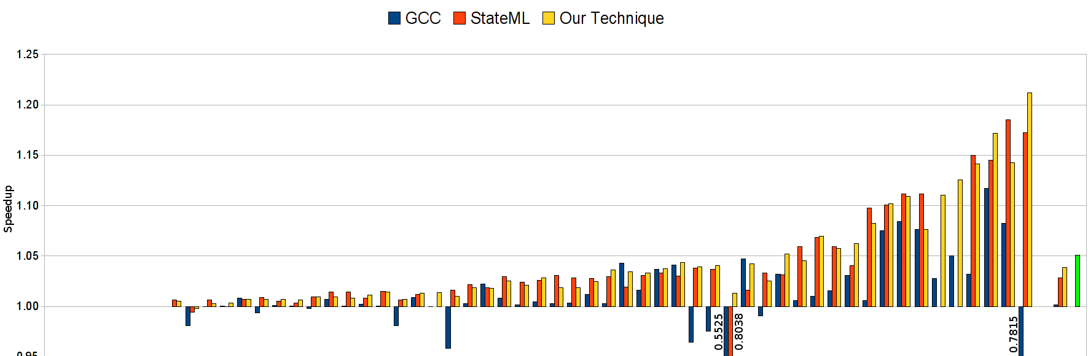
Results
GCC vs. state of the art vs. ours
GCC 3% Stephenson 59% Ours 75%
Automated features outperform human ones

Slide 48
Results
Compare all with same machine learning
  All with C4.5 decision trees
  Level playing field
  GCC 'features' are data used to compute heuristic

Slide 49
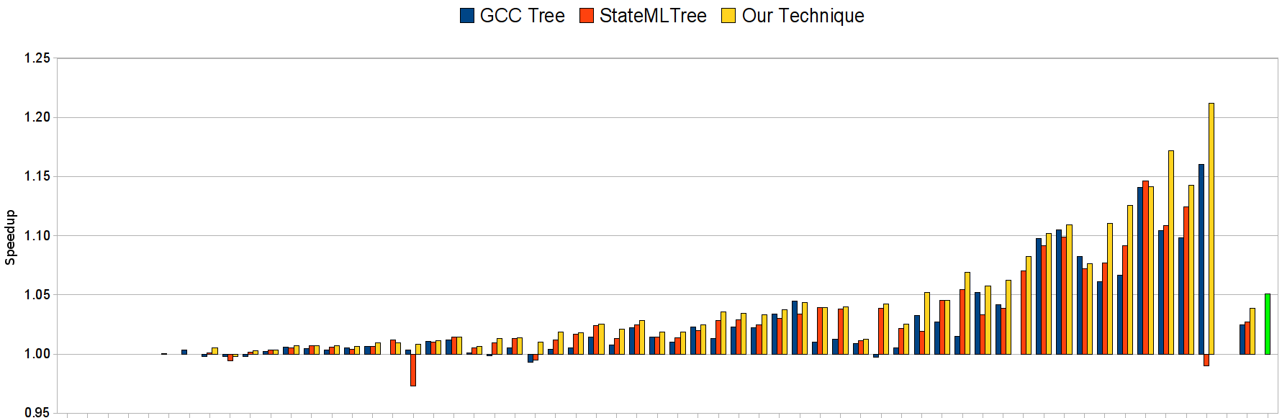
Results
Decision Trees
GCC 48% Stephenson 53% Ours 75%
Automated features outperform human ones

Slide 50
Results
Top Features Found
  get-attr(@num-iter)
  count(filter(//*, !(is-type(wide-int) || (is-type(float extend) &&[(is-type(reg)]/count(filter(//*,is-type(int))))) || is-type(union type))))
  count(filter(/*, (is-type(basic-block) && (
    !@loop-depth==2 ||
    (0.0 > (
      (count(filter(//*, is-type(var decl))) -
      (count(filter(//*, (is-type(xor) && @mode==HI))) +
      sum(
        filter(/*, (is-type(call insn) && has-attr(@unchanging))),
        count(filter(//*, is-type(real type)))))) /
        count(filter(/*, is-type(code label)))))))))

Slide 51
Overview
Introduction to machine learning in compilers
Difficulties choosing features
A feature space for a motivating example
Searching the feature space
Features for GCC
Results
Further and on going work

Slide 52
Further and on going work
Make all GCC's internals available
Integrate to Milepost GCC plug-in system and open source it
Features for multi-core optimisation
http://www.milepost.eu

Slide 53
Conclusion
Shown a system which automatically finds good features
  Searches a huge set of features
  Allows greater experimentation in 'feature ideas'
More flexible
  A few feature grammars should service many heuristics
  Retune features as well as heuristic
Out performs expert features

