Slide 1

MILEPOST
Machine learning in compilers:
The Future of Optimisation
Hugh Leather
University of Edinburgh

Slide 2
Overview
Milepost members
The problem
Machine learning in compilers
Iterative compilation
Machine learning to focus iterative search
Machine learning for multi-cores
Automatic Feature Generation
Conclusion

Slide 3
Overview
Milepost members
The problem
Machine learning in compilers
Iterative compilation
Machine learning to focus iterative search
Machine learning for multi-cores
Automatic Feature Generation
Conclusion

Slide 4






Milepost members
Funded by:
Information Society Technologies (IST) of the
European Union under 6th FWP

Slide 5
Overview
Milepost members
The problem
Machine learning in compilers
Iterative compilation
Machine learning to focus iterative search
Machine learning for multi-cores
Automatic Feature Generation
Conclusion

Slide 6
The problem
Writing compiler heuristics is hard
  Huge number of variables
  Analytical models difficult
  Architectures change
  Other bits of the compiler change
Computers are no longer deterministic
  E.g. Caches, O-O execution
  Simple components are complex together

Slide 7
The problem
Q: If your cache changed from LRU to Random replacement, how would you rewrite your code?
Most compilers are
  Out of date or
  Ignore architectural differences
We want to automatically tune the compiler

Slide 8
Overview
Milepost members
The problem
Machine learning in compilers
Iterative compilation
Machine learning to focus iterative search
Machine learning for multi-cores
Automatic Feature Generation
Conclusion

Slide 9
Machine learning in compilers
How it works
  Summarise data before heuristic (features)
  Collect examples
  Learn a model
  Model predicts heuristic for new program

Slide 10
Machine learning in compilers
Start with compiler data structures
AST, RTL, SSA, CFG, DDG, etc.
Human expert determines a mapping
to a feature vector
number of instructions
mean dependency depth
branch count
loop nest level
...
trip count

Slide 11
Machine learning in compilers
Execute the programs with different compilation
strategies and find the best for each
Now collect many examples of programs, determining
their feature values
Features
...
Best Heuristic Value

Slide 12
Machine learning in compilers
Now give these examples to a machine learner
It learns a model
Examples
Supervised
Machine Learner
Model
Features
...
Best Heuristic Value

Slide 13
Machine learning in compilers
This model can then be used to predict the best
compiler strategy from the features of a new program
Our heuristic is replaced
Model
Features
Predicted Heuristic Value
New Program

Slide 14
Machine learning in compilers
A model is really just a way of fitting a curve to data
Heuristic
Features

Slide 15
Machine learning in compilers
A model is really just a way of fitting a curve to data
Heuristic
Features

Slide 16
Machine learning in compilers
Gives heuristic for unseen points
Best Heuristic Value
Features

Slide 17
Machine learning in compilers
Automatic tool chain
  Determines benchmark features
  Compiles benchmarks with different heuristic values
  Runs benchmark versions to get execution time
  Gives feature x best heuristic to machine learning
  Model updated in compiler

Slide 18
Overview
Milepost members
The problem
Machine learning in compilers
Iterative compilation
Machine learning to focus iterative search
Machine learning for multi-cores
Automatic Feature Generation
Conclusion

Slide 19
Iterative compilation (1998)
Very simple idea
  Don't get best heuristic analytically
  Try many versions of heuristic and choose best
Advantages
  Platform blind
  Adapts to every change
  Always based on evidence not belief
Iterative Compilation in a Non-Linear Optimisation Space
F. Bodin, T. Kisuki, P.M.W. Knijnenburg, M.F.P. O'Boyle, and E. Rohou
Proceedings of the Workshop on Profile Directed Feedback-Compilation, PACT October 1998

Slide 20
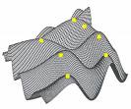



Iterative compilation (1998)
Search Engine
Best
Heuristic
Values
.c
.exe
Execution
Time
Program
Compiler
Executable
Machine

Slide 21
Iterative compilation (1998)
Could Matrix Multiplication be improved?
  By empirical observation, not analytical
2 optimisation parameters
  Unroll factor
  Tile size
4 machines, try many values of the parameters

Slide 22
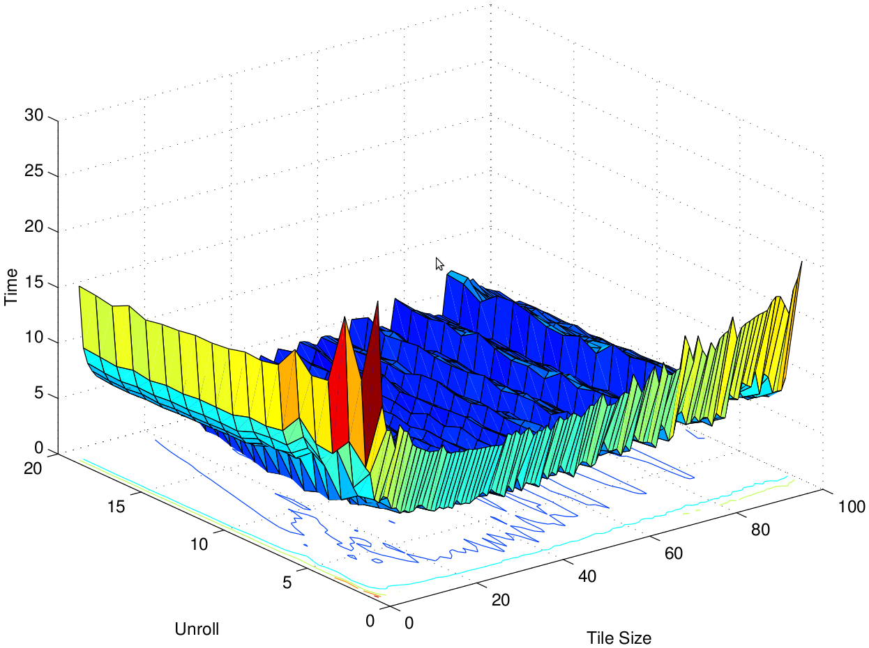
Iterative compilation (1998)
UltraSparc N=512

Slide 23
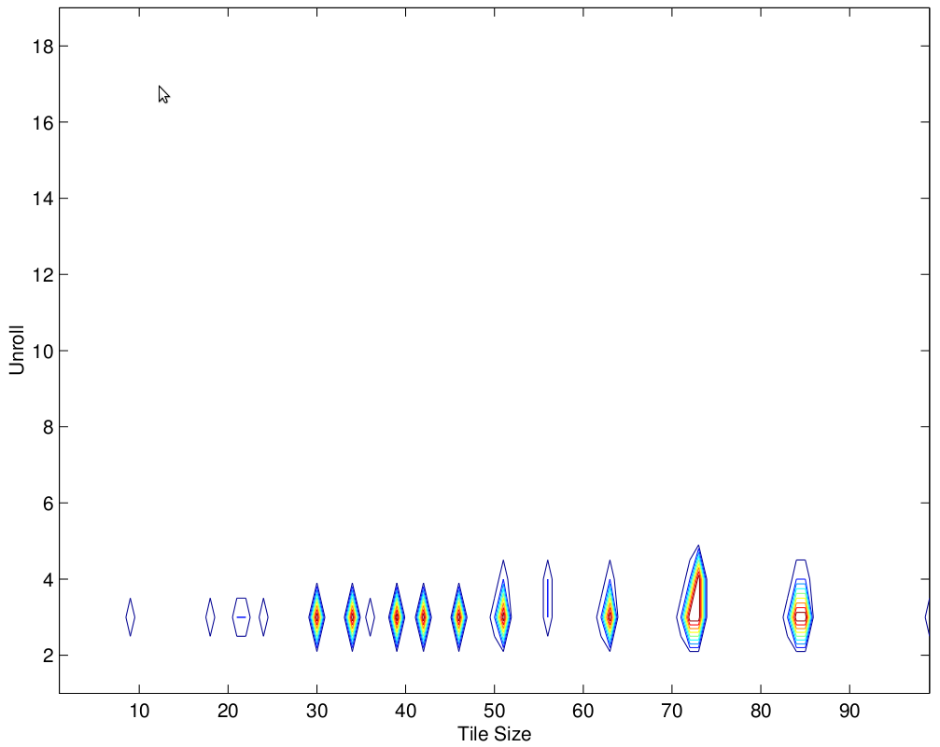
Iterative compilation (1998)
UltraSparc (N=512) – Within 20% of minimum
  Near minimum: 1.5%. Original 11.53, Minimum 1.54
Minimum (Tile=73,Unroll=3)

Slide 24
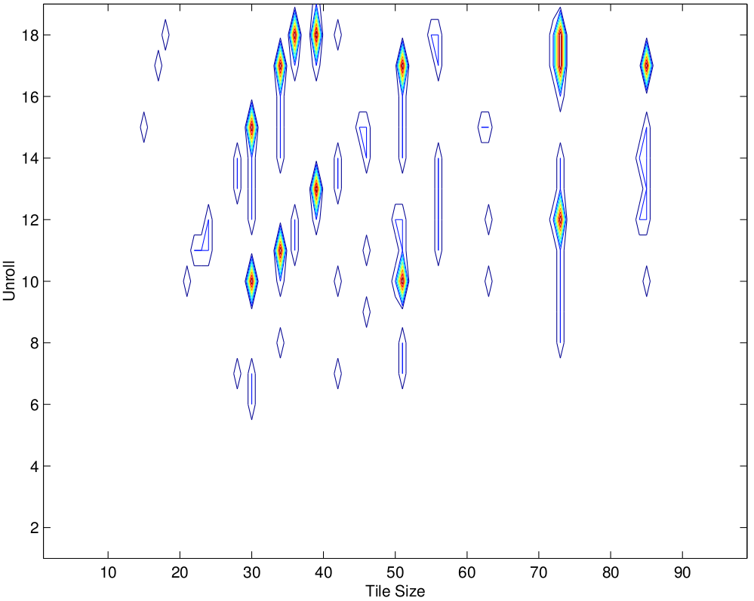
Iterative compilation (1998)
PentiumPro (N=512) – Within 20% of minimum
  Near minimum: 4.6%. Original 30.93, Minimum 3.34
Minimum (Tile=51,Unroll=17)

Slide 25
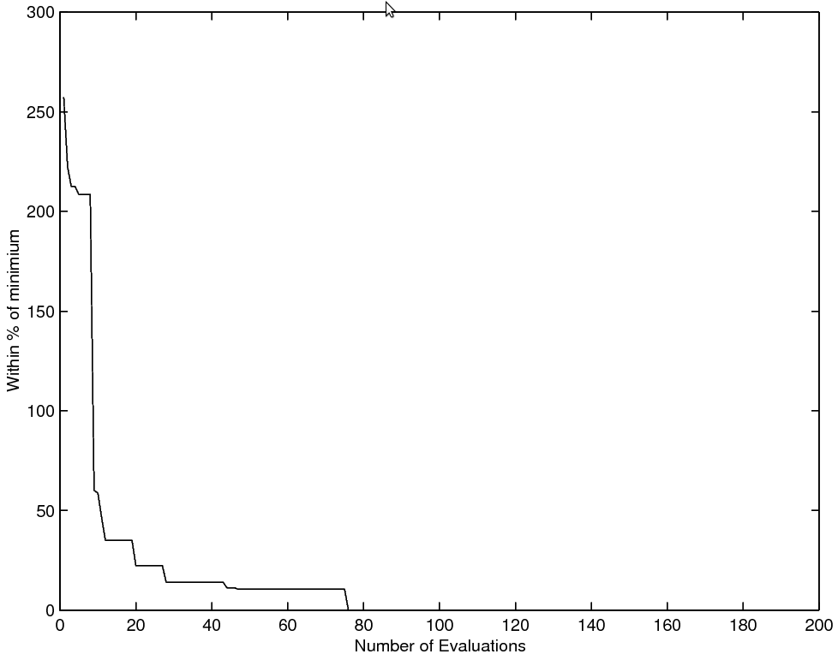
Iterative compilation (1998)
PentiumPro (N=512) – Simple grid search
1 step: 2.5x worse than min. 20 steps: 22.37%. 50 steps: 10.48%.

Slide 26
Overview
Milepost members
The problem
Machine learning in compilers
Iterative compilation
Machine learning to focus iterative search
Machine learning for multi-cores
Automatic Feature Generation
Conclusion

Slide 27
Machine learning to focus iterative search (2006)
Iterative compilation works but
  Very slow (many compile/execute cycles)
Can we use machine learning to focus on areas that might be good?
Using machine learning to focus iterative optimization
F Agakov, E Bonilla, J Cavazos, G Fursin, B Franke, M O'Boyle, M Toussant, J Thomson, C Williams
ACM Code Generations and Optimization, New York, March 2006

Slide 28
Machine learning to focus iterative search (2006)
Exhaustively enumerate search space
  Short sequences of length 5
  14 optimisations from GCC
  UTDSP benchmarks on AMD Au1500 and TI C6713

Slide 29
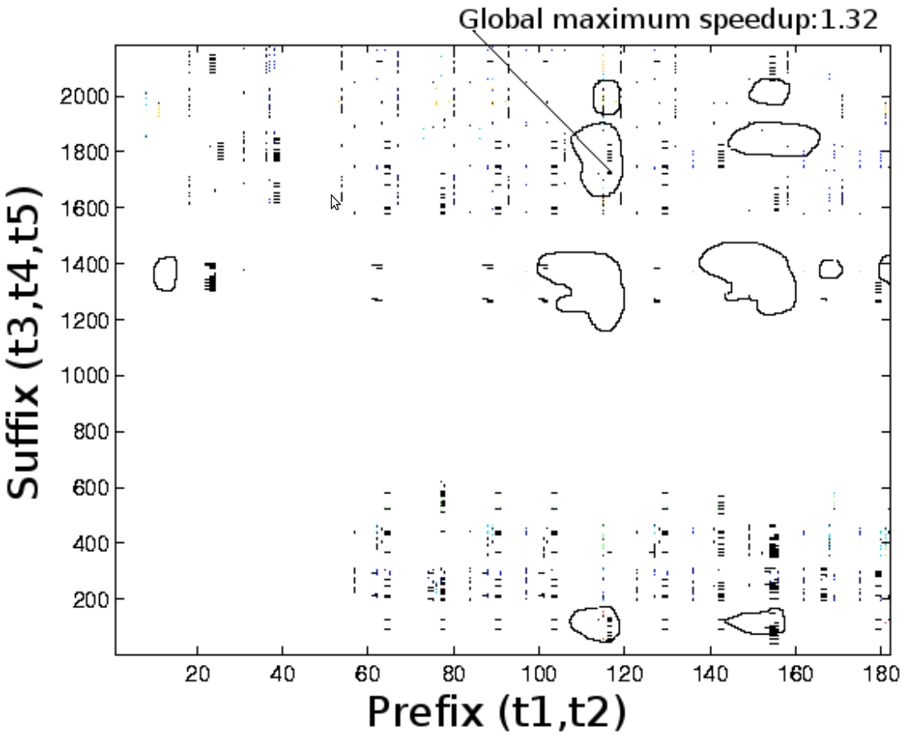
Machine Learning to Focus Iterative Search (2006)
ADPCM on TI C6713
  Contours are points within 5% of best

Slide 30
Machine learning to focus iterative search (2006)
 | TI |  | AMD
Program | Improvement | Sequence | Improvement | Sequence
fft | 3.64% | {3nm} | 4.49% | {4hns}
fir | 45.5% | {4} | 26.7% | {3}
iir | 16.3% | {3h} | 29.5% | {h4}
latnrm | 0.34% | {nsch} | 27.1% | {csh4}
lmsfir | 0.39% | {1s} | 30.3% | {s3}
mult | 0.00% | {} | 30.5% | {4}
adpcm | 24.0% | {1ish} | 0.75% | {ism}
compress | 39.1% | {4s} | 24.0% | {hs4}
edge | 5.06% | {3} | 23.1% | {ch4}
histogram | 0.00% | {} | 24.7% | {4}
lpc | 10.7% | {sn2} | 6.01% | {h4cnm}
spectral | 7.46% | {n4} | 8.53% | {sh4}
Mean | 12.7% |  | 13.8%

Slide 31
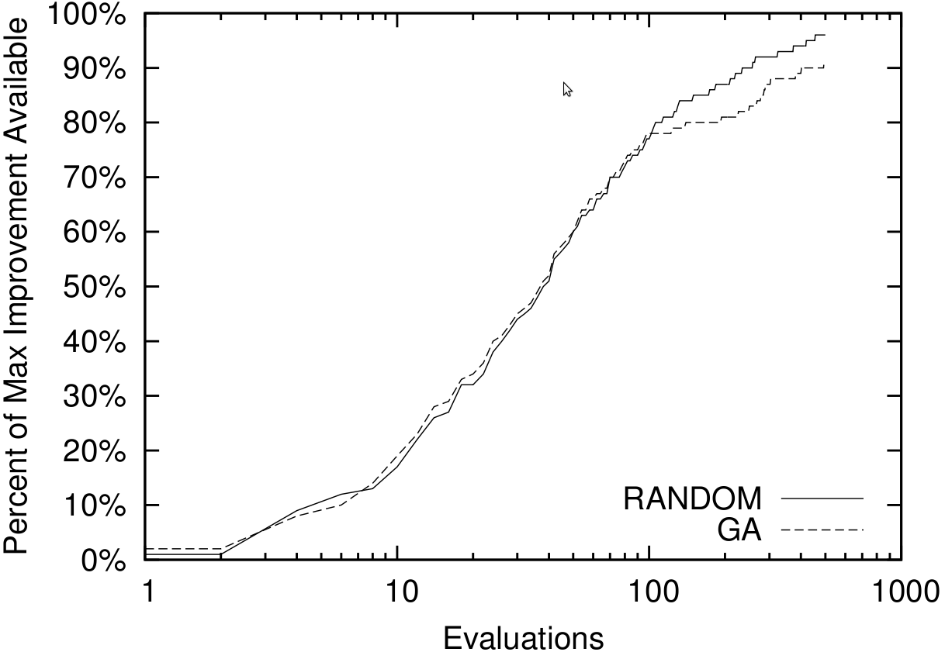
Machine learning to focus iterative search (2006)
Blind iterative compilation of TI space

Slide 32
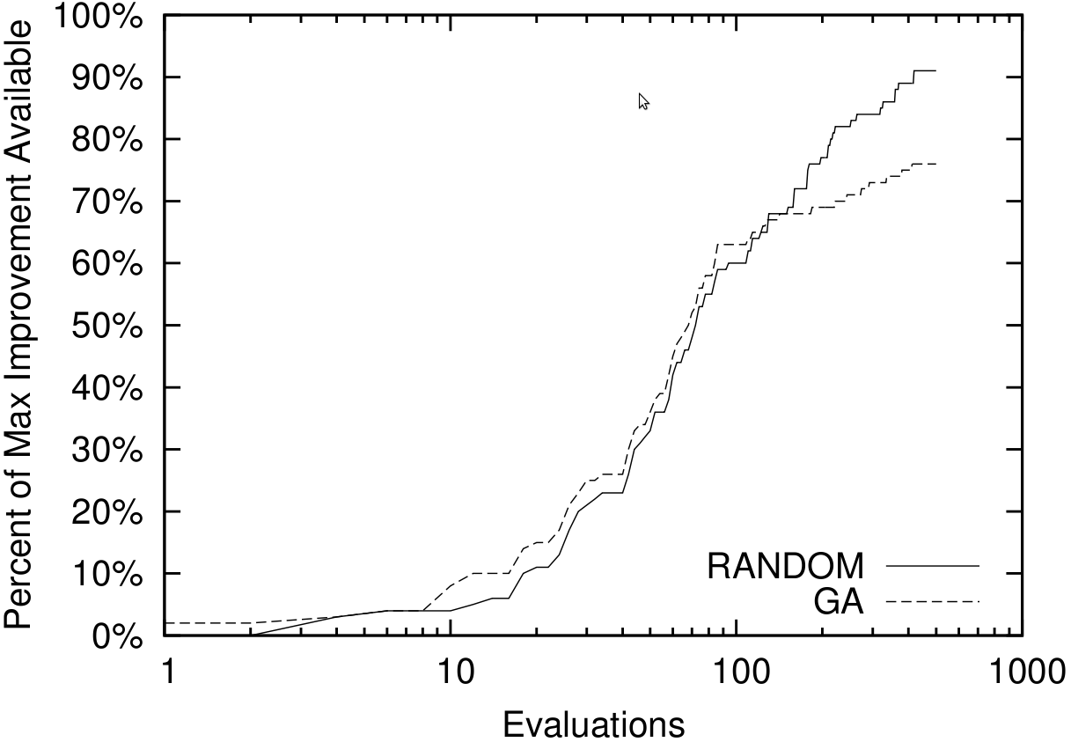
Machine learning to focus iterative search (2006)
Blind iterative compilation of AMD space

Slide 33
Machine learning to focus iterative search (2006)
Can we beat random iterative search?
Design models for each benchmark that:
  Describe the sequence space
  Predict if sequence is within 5% of best
Identically independent distribution
  Count how often a transform appears in good sequence
Markov model
  Considers interactions

Slide 34
Machine learning to focus iterative search (2006)
30 features describe programs
  Reduced by PCA to 5
Nearest neighbour selects closest benchmark to new program
  Use the learned models from that to predict area that might be good to focus search on
Randomly search in focus area

Slide 35
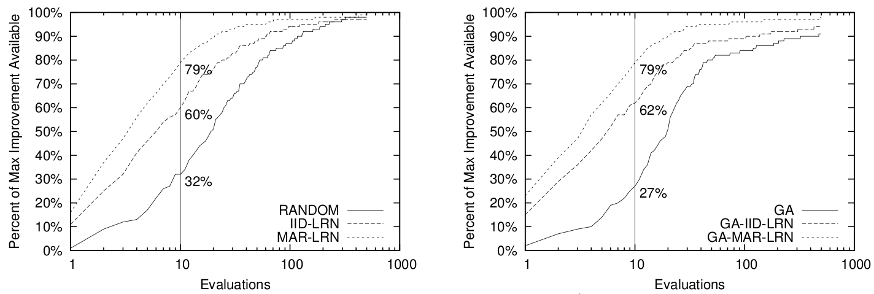
Machine learning to focus iterative search (2006)
Both focussed models improve over GA & Rand
  Markov is best

Slide 36
Machine learning to focus iterative search (2006)
Also tried on big space 80²⁰
  Learnt on 1000 random examples
  Tested after 50 evaluations
Does very well in only 2 evaluations
  1 order of magnitude better than random
 | 2 Evaluations |  |  | 5 Evaluations |  |  | 50 Evaluations
 | Rand | Markov | IID | Rand | Markov | IID | Rand | Markov | IID
TI | 1.10 | 1.25 | 1.26 | 1.15 | 1.26 | 1.30 | 1.29 | 1.32 | 1.35
AMD | 1.08 | 1.24 | 1.27 | 1.17 | 1.33 | 1.31 | 1.32 | 1.41 | 1.44

Slide 37
Overview
Milepost members
The problem
Machine learning in compilers
Iterative compilation
Machine learning to focus iterative search
Machine learning for multi-cores
Automatic Feature Generation
Conclusion

Slide 38
Machine learning for multi-cores (2009)
Multi-cores going to be the next big problem
How to auto-parallelise programs very hard
  Can machine learning help?
Towards a Holistic Approach to Auto-Parallelization: Integrating Profile-Driven Parallelism Detection and Machine-Learning Based Mapping
Georgios Tournavitis, Zheng Wang, Björn Franke and Michael O'Boyle
Proceedings of the ACM SIGPLAN 2009 Conference on Programming Language Design and Implementation (PLDI '09), June 2009

Slide 39
Machine learning for multi-cores (2009)
Loops
Static analysis
Profile analysis
Provably not
parallelisable
Conflicts seen in memory dependence from profile
Uncertain
User must
Confirm
Safety
Provably
parallelisable
No Conflicts seen in profile

Slide 40
Machine learning for multi-cores (2009)
Machine learning determines fate of each loop
User safety confirmation on uncertain loops
  In tests, all suggested loops were safe
Features
Machine Learning
Heuristic values
Support
Vector
Machine
Static Features | IR instruction count IR load/store count IR branch count Iteration count
Dynamic Features | Data access count Instruction count Branch count
Should parallelise
Number of threads
Scheduling { CYCLIC, DYNAMIC, GUIDED, STATIC }

Slide 41
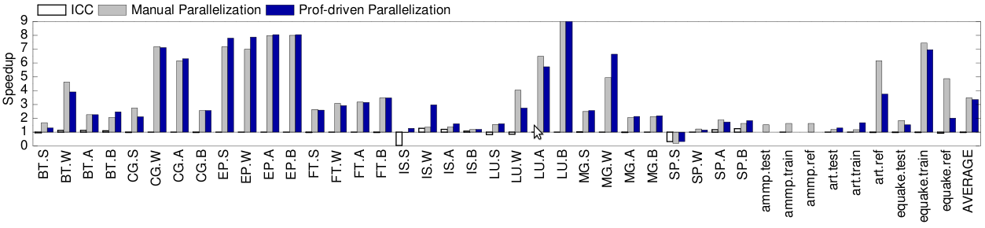
Machine learning for multi-cores (2009)
NAS and SPEC OMP benchmarks
  8 core Intel Xeon
Compare against
  ICC default parallelisation
  Hand parallelised
Gets 96% of hand tuned performance

Slide 42
Overview
Milepost members
The problem
Machine learning in compilers
Iterative compilation
Machine learning to focus iterative search
Machine learning for multi-cores
Automatic Feature Generation
Conclusion

Slide 43
Automatic Feature Generation
(2009)
A major requirement of human involvement is determining features
  Can we automatically generate them instead?
Automatic Feature Generation for Machine Learning Based Optimizing Compilation
Hugh Leather, Edwin Bonilla and Michael O'Boyle
Proceedings of the International Symposium on Code Generation and Optimization, CGO March 2009

Slide 44
Automatic Feature Generation (2009)
The expert must do a good job of projecting down to features
amount of white space
average identifier length
age of programmer
name of program
...
...

Slide 45
Automatic Feature Generation (2009)
Machine learning works well when all examples associated with one feature value have the same type
Feature 1
0
1
0
Feature 2
1

Slide 46
Automatic Feature Generation (2009)
Machine learning doesn't work if the features don't distinguish the examples
Feature 1
0
1
0
Feature 2
1

Slide 47
Automatic Feature Generation (2009)
Better features might allow classification
Feature 3 = 0
Feature 3 = 1
Feature 1
Feature 1
0
1
0
1
0
0
Feature 2
Feature 2
1
1

Slide 48
Automatic Feature Generation (2009)
There are much more subtle interactions between features and ML algorithm
  Sometimes adding a feature makes things worse
  A feature might be copies of existing features
There is an infinite number of possible features

Slide 49
Automatic Feature Generation (2009)
Simple language the compiler accepts:
  Variables, integers, '+', '*', parentheses
Examples:
  a = 10
  b = 20
  c = a * b + 12
  d = a * (( b + c * c ) * ( 2 + 3 ))

Slide 50
Automatic Feature Generation (2009)
What type of features might we want?
a = ((b+c)*2 + d) * 9 + (b+2)*4
count−nodes−matching(
is−times &&
left−child−matches(
is−plus
)&&
right−child−matches(
is−constant
)
)
=
var
+
*
*
+
const
+
const
*
var
var
const
+
const
Value = 3
var
var

Slide 51
Automatic Feature Generation (2009)
Define a simple feature language:
<feature> ::= ”count−nodes−matching(” <matches> ”)”
<matches> ::= ”is−constant”
| ”is−variable”
| ”is−any−type”
| ( ”is−plus” | ”is−times” )
( ”&& left−child−matches(” <matches> ”)” ) ?
( ”&& right−child−matches(” <matches> ”)” ) ?

Slide 52
Automatic Feature Generation (2009)
Now generate sentences from the grammar to give features
Start with the root non-terminal
Grammar
<A> ::= <A><A><A>
| “b”
Sentence
A

Slide 53
Automatic Feature Generation (2009)
Now generate sentences from the grammar to give features
Choose randomly among productions and replace
Grammar
<A> ::= <A><A><A>
| “b”
Sentence
AAA

Slide 54
Automatic Feature Generation (2009)
Now generate sentences from the grammar to give features
Repeat for each non-terminal still in the sentence
Grammar
<A> ::= <A><A><A>
| “b”
Sentence
bAAAb

Slide 55
Automatic Feature Generation (2009)
Now generate sentences from the grammar to give features
Continue until there are no more non-terminals
Grammar
<A> ::= <A><A><A>
| “b”
Sentence
bbbbb

Slide 56
Automatic Feature Generation (2009)
Search space is parse trees of features
Genetic programming searches over feature parse trees
Features which help machine learning are better

Slide 57
Automatic Feature Generation (2009)
Overview of searching
Data
Generation
Genetic Programming Search
Feature
Evaluator
Feature Values
Benchmarks
ML
Tool
Data
Extractor
Prediction
Quality
Program Data
Prediction
Best Heuristic
Values

Slide 58
Automatic Feature Generation (2009)
Data structures extracted from benchmarks
Data
Generation
Genetic Programming Search
Feature
Evaluator
Feature Values
Benchmarks
ML
Tool
Data
Extractor
Prediction
Quality
Program Data
Prediction
Best Heuristic
Values

Slide 59
Automatic Feature Generation (2009)
Population of parse trees evolved with genetic programming
Data
Generation
Genetic Programming Search
Feature
Evaluator
Feature Values
Benchmarks
ML
Tool
Data
Extractor
Prediction
Quality
Program Data
Prediction
Best Heuristic
Values

Slide 60
Automatic Feature Generation (2009)
Parse trees are interpreted over program data giving feature values
Data
Generation
Genetic Programming Search
Feature
Evaluator
Feature Values
Benchmarks
ML
Tool
Data
Extractor
Prediction
Quality
Program Data
Prediction
Best Heuristic
Values

Slide 61
Automatic Feature Generation (2009)
ML tool learns model using feature values and target heuristic values
Data
Generation
Genetic Programming Search
Feature
Evaluator
Feature Values
Benchmarks
ML
Tool
Data
Extractor
Prediction
Quality
Program Data
Prediction
Best Heuristic
Values

Slide 62
Automatic Feature Generation (2009)
Model predicts heuristic with cross validation
Quality found (accuracy or speedup)
Data
Generation
Genetic Programming Search
Feature
Evaluator
Feature Values
Benchmarks
ML
Tool
Data
Extractor
Prediction
Quality
Program Data
Prediction
Best Heuristic
Values

Slide 63
Automatic Feature Generation (2009)
After some generations first feature fixed
Used when learning model for next feature
Data
Generation
Genetic Programming Search
Feature
Evaluator
Feature Values
Benchmarks
ML
Tool
Data
Extractor
Prediction
Quality
Program Data
Prediction
Best Heuristic
Values

Slide 64
Automatic Feature Generation (2009)
Build up features, one at a time
Stop when no improvement
Data
Generation
Genetic Programming Search
Feature
Evaluator
Feature Values
Benchmarks
ML
Tool
Data
Extractor
Prediction
Quality
Program Data
Prediction
Best Heuristic
Values

Slide 65
Automatic Feature Generation (2009)
Set up
  Modified GCC 4.3.1
  57 benchmarks from MiBench, MediaBench and UTDSP
  Pentium 6; 2.8GHz; 512Mb RAM
  Benchmarks run in RamDisk to reduce IO variability
  Found best unroll factor for each loop in [0-16]

Slide 66
Automatic Feature Generation (2009)
Search set up
  100 parse trees per generation
  Stop at 200 generations or 15 without change
  Double Cross Validation
Machine learning
  Decision Trees (C4.5)

Slide 67
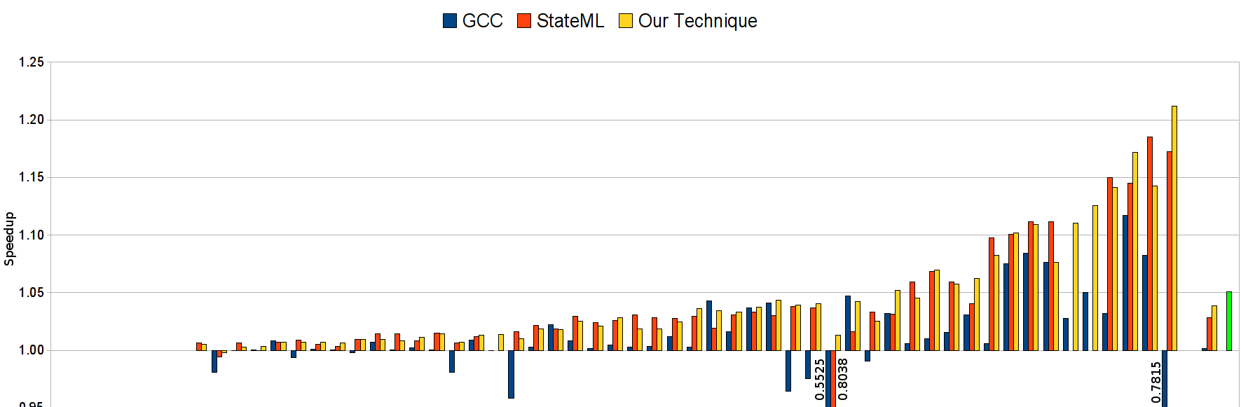
Automatic Feature Generation (2009)
GCC vs. state of the art vs. ours
GCC 3% Stephenson 59% Ours 75%
Automated features outperform human ones

Slide 68
Automatic Feature Generation (2009)
Top Features Found
  get-attr(@num-iter)
  count(filter(//*, !(is-type(wide-int) || (is-type(float extend) &&[(is-type(reg)]/count(filter(//*,is-type(int))))) || is-type(union type))))
  count(filter(/*, (is-type(basic-block) && (
!@loop-depth==2 ||
(0.0 > (
(count(filter(//*, is-type(var decl))) -
(count(filter(//*, (is-type(xor) && @mode==HI))) +
sum(
filter(/*, (is-type(call insn) && has-attr(@unchanging))),
count(filter(//*, is-type(real type)))))) /
count(filter(/*, is-type(code label)))))))))

Slide 69
Overview
Milepost members
The problem
Machine learning in compilers
Iterative compilation
Machine learning to focus iterative search
Machine learning for multi-cores
Automatic Feature Generation
Conclusion

Slide 70
Conclusion
Analytic approaches no longer working
Iterative compilation
  Empirical and good but too slow
Machine learning here to stay
  Outperforming human heuristics
  Very fast development time
Multi core offers lots of scope for research
  Exciting times for compiler folk!

