Slide 1

Raced Profiles:Efficient Selection of Competing Compiler Optimizations
Hugh Leather, Bruce Worton,
Michael O'Boyle
Institute for Computing Systems Architecture
University of Edinburgh, UK

Slide 2
Overview
The problem
Profile Races
Results
Conclusion

Slide 3
Overview
The problem
Profile Races
Results
Conclusion

Slide 4
The problem
Iterative compilation finds best way to compile a program
  Very expensive (Compare 10s or 1000s of program versions)
  Machine learning an extreme case
Must ensure clean data
  Run versions many times to overcome noise
Risks
  Too few times → bad data
  Too many times → wasted effort
How do we run just enough times?

Slide 5
The problem
Computers are non deterministic and noisy
  Other processes
  OS interaction
  CPU temperature
Cannot tell ahead of time how noisy a program will be

Slide 6
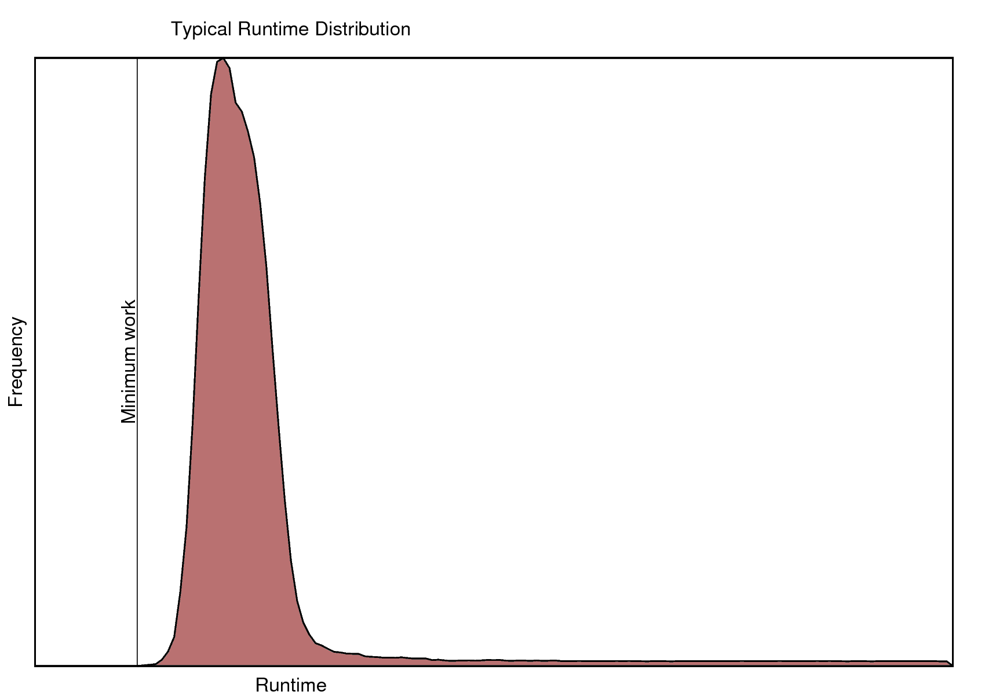
The problem

Slide 7
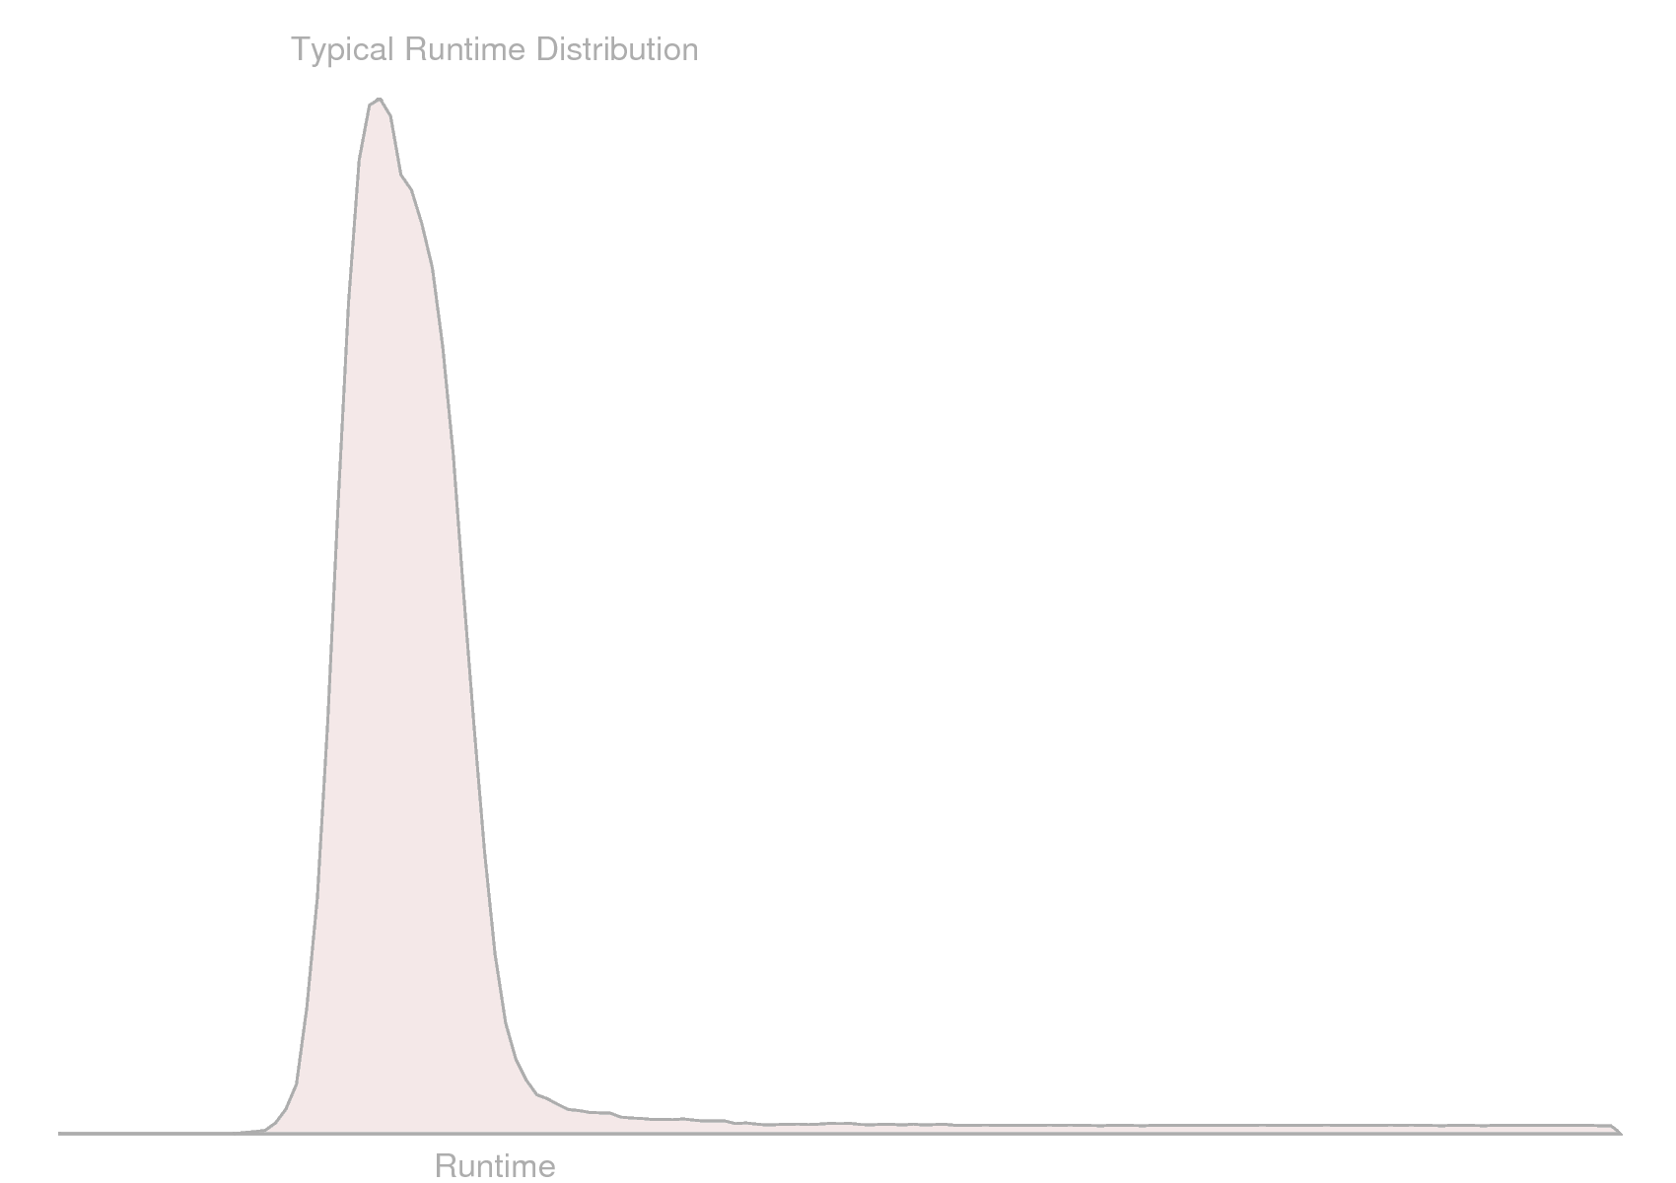
The problem
μ

Slide 8
The problem
μ

Slide 9
The problem
Pretty sure the true mean
is somewhere in here

Slide 10
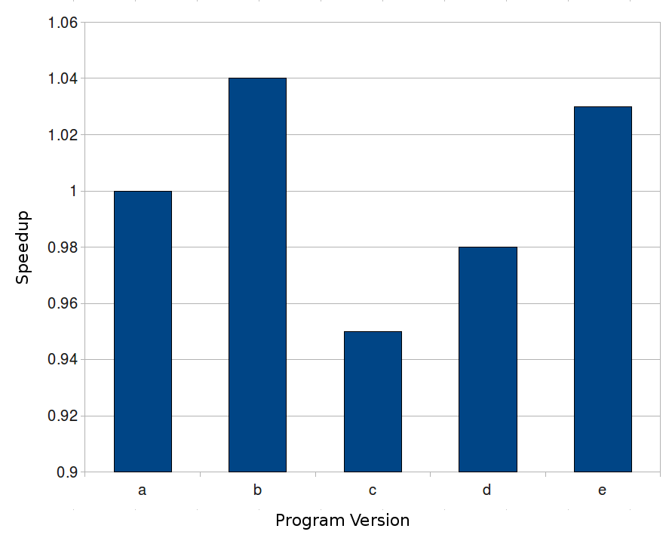
The problem
Runtime
Verdict – Version 'c' is best

Slide 11
The problem
Runtime
Verdict – Umm, help?

Slide 12
The problem
Runtime
True means might look quite different

Slide 13
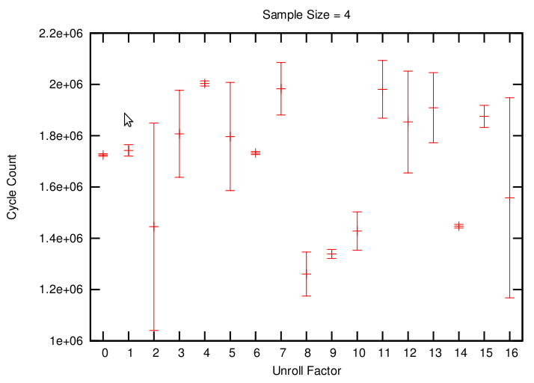
The problem
Many already 'worse' but no clear winner

Slide 14
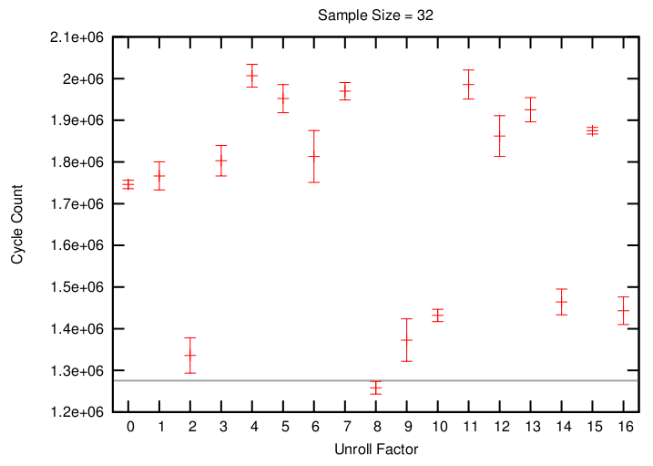
The problem
Unroll factor 8 wins

Slide 15
The problem
Does this happen in practice?
  Find best unroll factor [0-16] for each loop
  See how often small samples choose different unroll factor compared to big sample (size=1000)
  Consider a failure if small sample choice is >0.5% worse than big sample choice

Slide 16
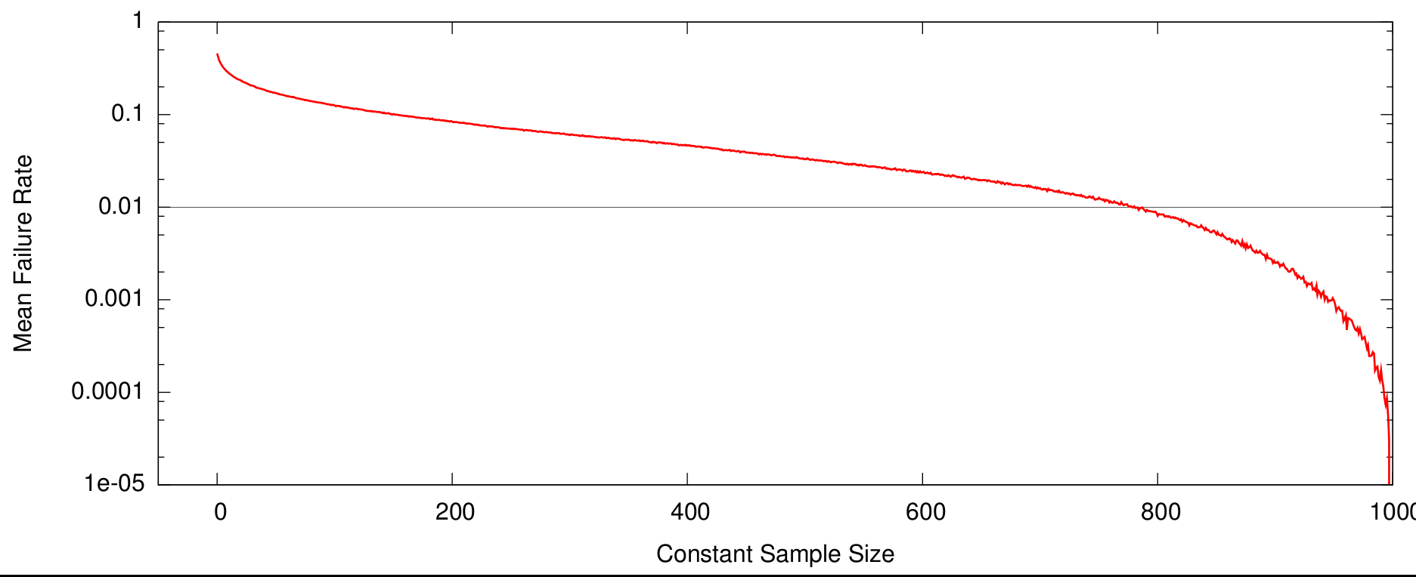
The problem
Sometimes the number of samples has to be huge

Slide 17
Overview
The problem
Profile Races
Results
Conclusion

Slide 18
Profile Races
Simple adaptive method
Run each program version until
  Some other one provably better
  Remaining program versions equivalent

Slide 19
Profile Races
Small samples of each
Compilation
1
2
3
4
...
n-2
n-1
n

Slide 20
Profile Races
Small samples of each
All equal? yes - stop
Compilation
1
2
3
4
...
n-2
n-1
n

Slide 21
Equality testing
Statistical tests only say two means are different
Equality testing says two means are the same
Researcher defines an 'indifference region'
+θ
0
-θ

Slide 22
Equality testing
If two confidence intervals are completely inside the indifference region they are sufficiently equal
=
+θ
0
-θ

Slide 23
Equality testing
If either is outside then there is not enough information yet
Two parameters:
  θ - indifference region
  α_{EQ} - confidence level
=
≠?
+θ
0
-θ

Slide 24
Profile Races
Small samples of each
All equal? yes – stop
Remove losers
Compilation
1
2
3
4
...
n-2
n-1
n

Slide 25
Removing Losers
Confidence intervals visualise statistical significance
Non overlapping → significant
  Mean of A is lower than mean of B
A
B

Slide 26
Removing Losers
Confidence intervals visualise statistical significance
Non overlapping → significant
  Mean of A is lower than mean of B
Overlapping → NOT significant
  Can say nothing about means of A,B
A
B

Slide 27
Removing Losers
Confidence intervals visualise statistical significance
Non overlapping → significant
  Mean of A is lower than mean of B
Overlapping → NOT significant
  Can say nothing about means of A,B
Significance tests formalise this
  e.g. Student's t-test
  Parameter α_{LT} – confidence level
A
B

Slide 28
Profile Races
Small samples of each
All equal? yes – stop
Remove losers
Increase survivor sample sizes
Compilation
1
2
3
4
...
n-2
n-1
n

Slide 29
Profile Races
Small samples of each
All equal? yes – stop
Remove less than any other
Increase survivor sample sizes
Repeat
Compilation
1
2
3
4
...
n-2
n-1
n

Slide 30
Overview
The problem
Profile Races
Results
Conclusion

Slide 31
Results – Unrolling
Loop unrolling
  Find best unroll factor [0-16] for each loop
22 benchmarks from UTDSP and MediaBench
Core duo, 2.8GHz, 2Gb RAM
  Unloaded, headless
Cycle counts from 1000 runs

Slide 32
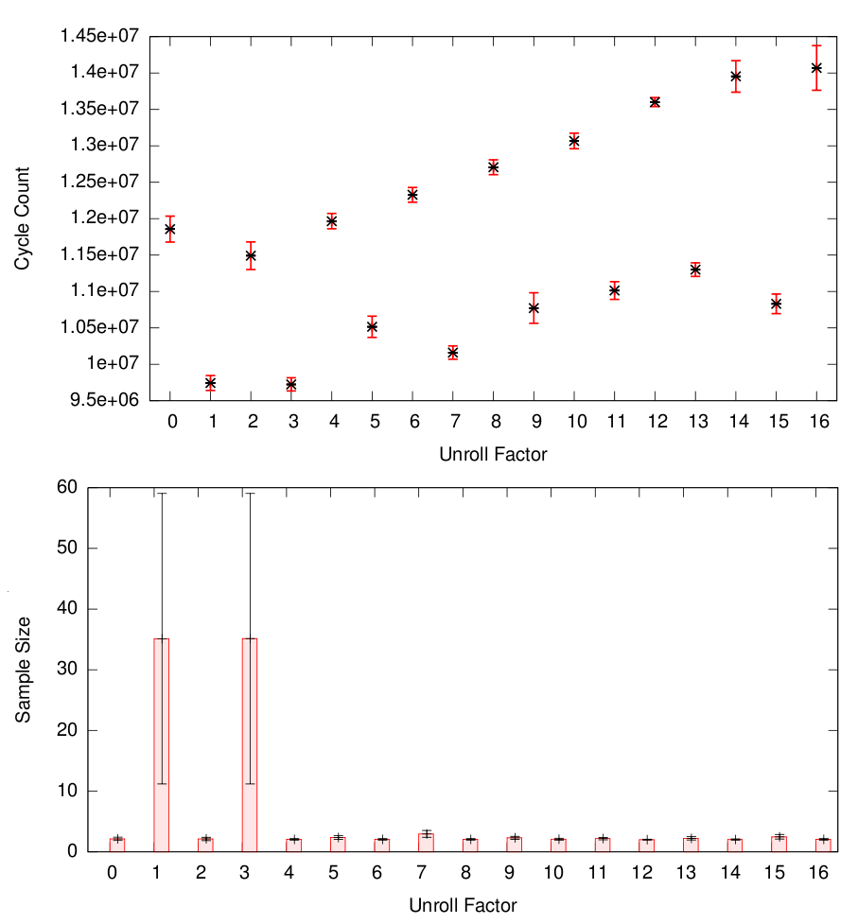
Results – Unrolling - Easy case
Low noise
Most loops clearly worse
Effort only on possible winners

Slide 33
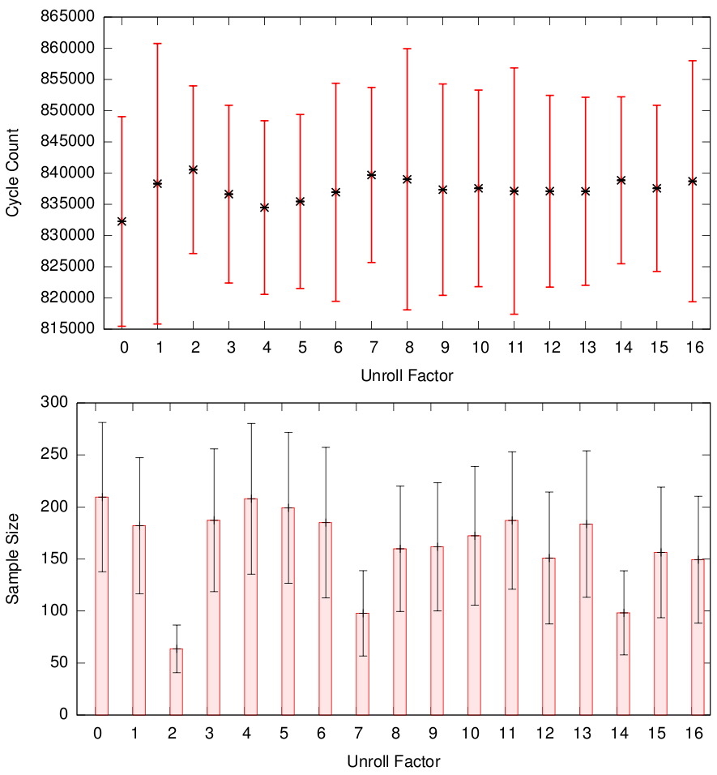
Results – Unrolling - Hard case
High noise
No clear winners
More samples to combat noise

Slide 34
Results – Unrolling - Comparison
Compare against
  Constant sampling plan
  JavaSTATS
    Run each program version until ratio of CI : mean is sufficiently small
    Each version considered independently
    Losers not weeded out

Slide 35
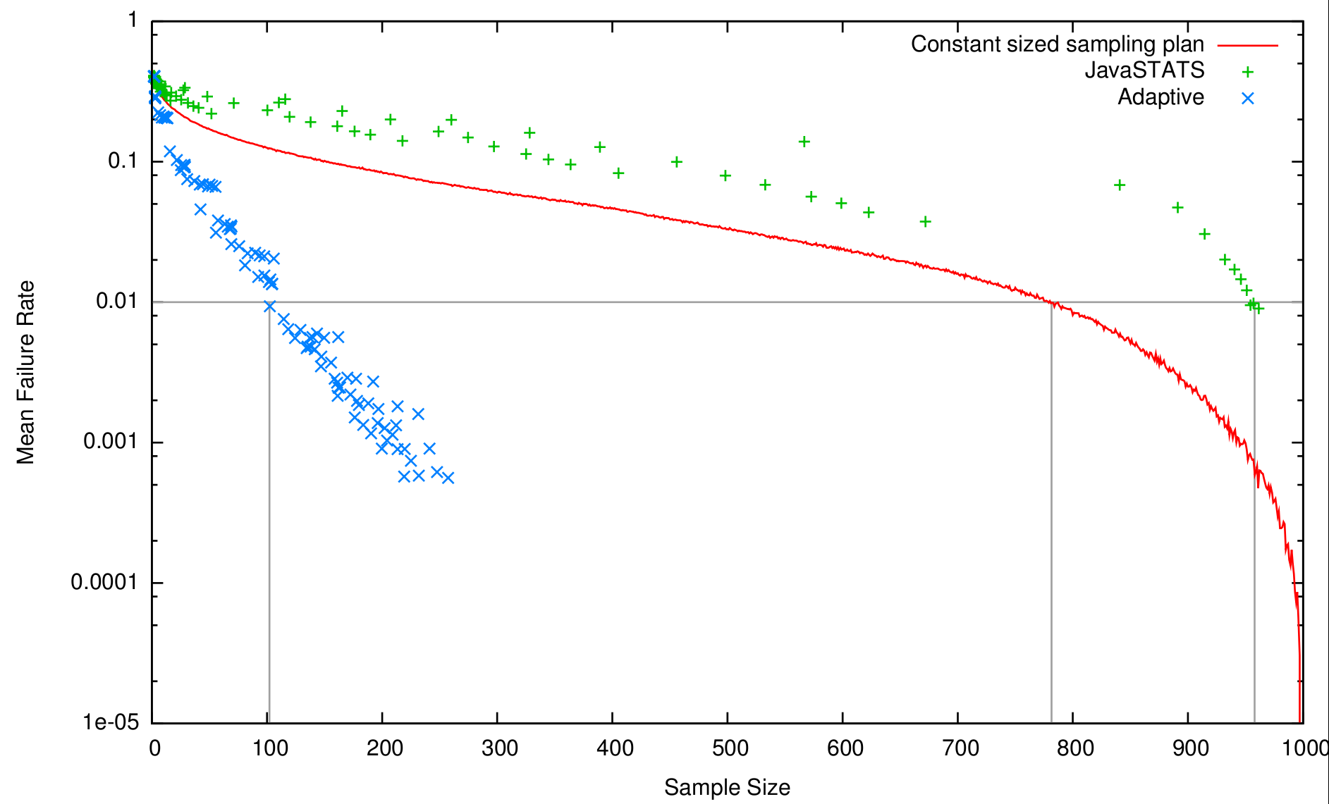
Results – Unrolling - Comparison
Profile races are an order of magnitude better

Slide 36
Results – Compiler flags
Compiler flags
  Find best compiler flags for each benchmark
  57 benchmarks from UTDSP, MediaBench, MiBench
Core duo, 2.8GHz, 2Gb RAM
  Unloaded, headless
Cycle counts from 100 runs

Slide 37
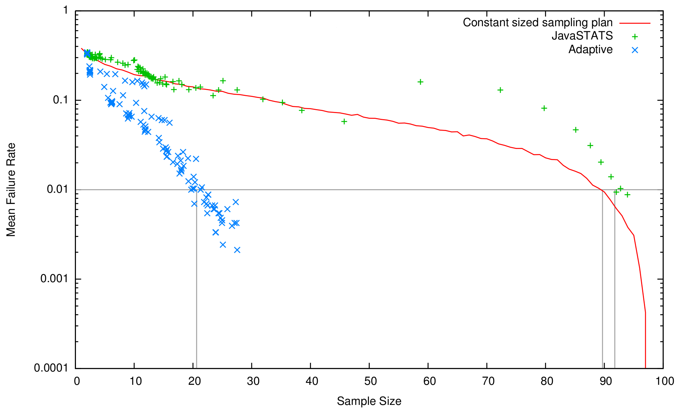
Results – Compiler flags
Profile races are an order of magnitude better

Slide 38
Overview
The problem
Profile Races
Results
Conclusion

Slide 39
Conclusion
Profile races
  Produce statistically sound data
  Reduce cost of iterative compilation (~10x)
  Easy to select parameters

Slide 41
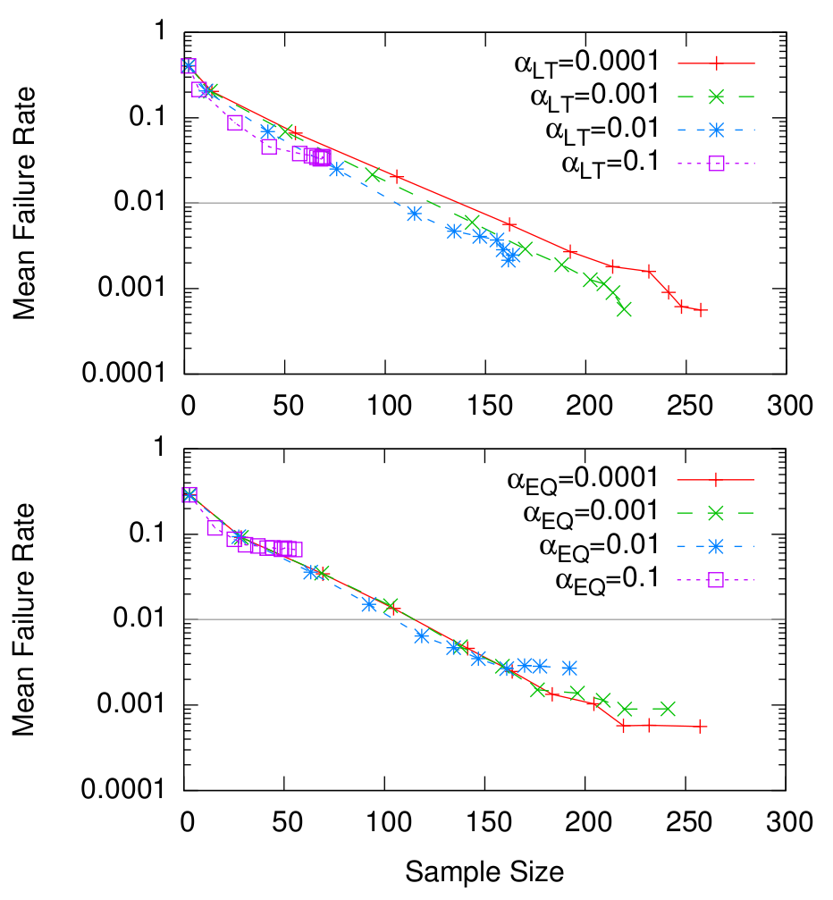
Results – Parameter contours

Slide 42
Confidence intervals
Statisticians have measures for sample quality

Slide 43
Confidence intervals
Confidence interval is a region where the true mean is likely to be
  Symmetric around sample mean
  Confidence level says how sure we are true mean is in the region
95% CI

Slide 44
Confidence intervals
As you require less certainty, the interval shrinks
10% CI

Slide 45
Confidence intervals
∞+
Complete certainty gives an infinite interval
100% CI
-∞

Slide 46
Confidence intervals
More data means we can be more sure where the true mean is
  The interval shrinks
95% CI

