Slide 1
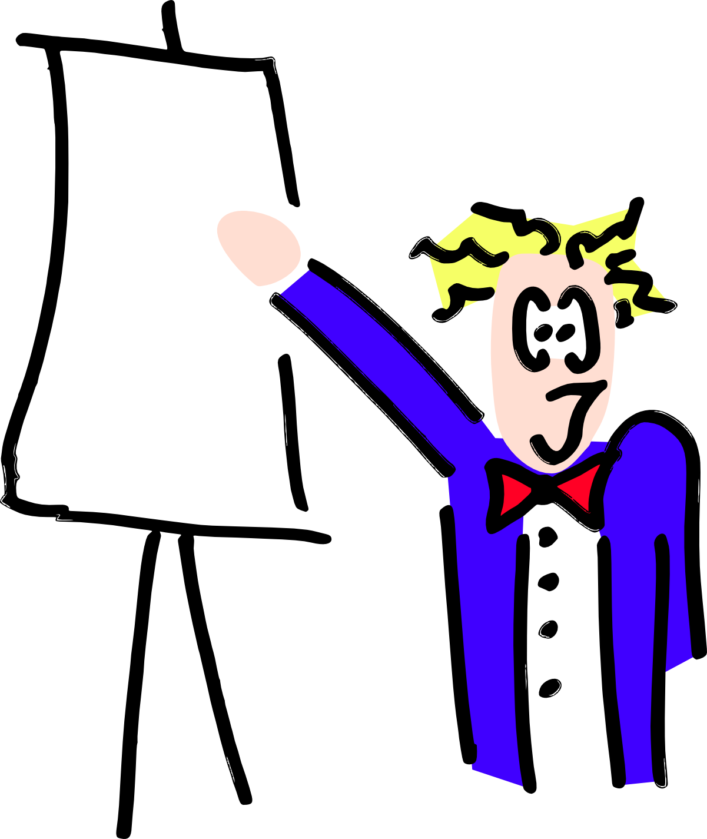
Research Presentation Skills
How to give a conference presentation
Hugh Leather

Slide 2
What is a conference presentation?
A chance to promote your research
Get feedback from others
Helps with networking
It is an advert for the paper
A punishment from the boss

Slide 3
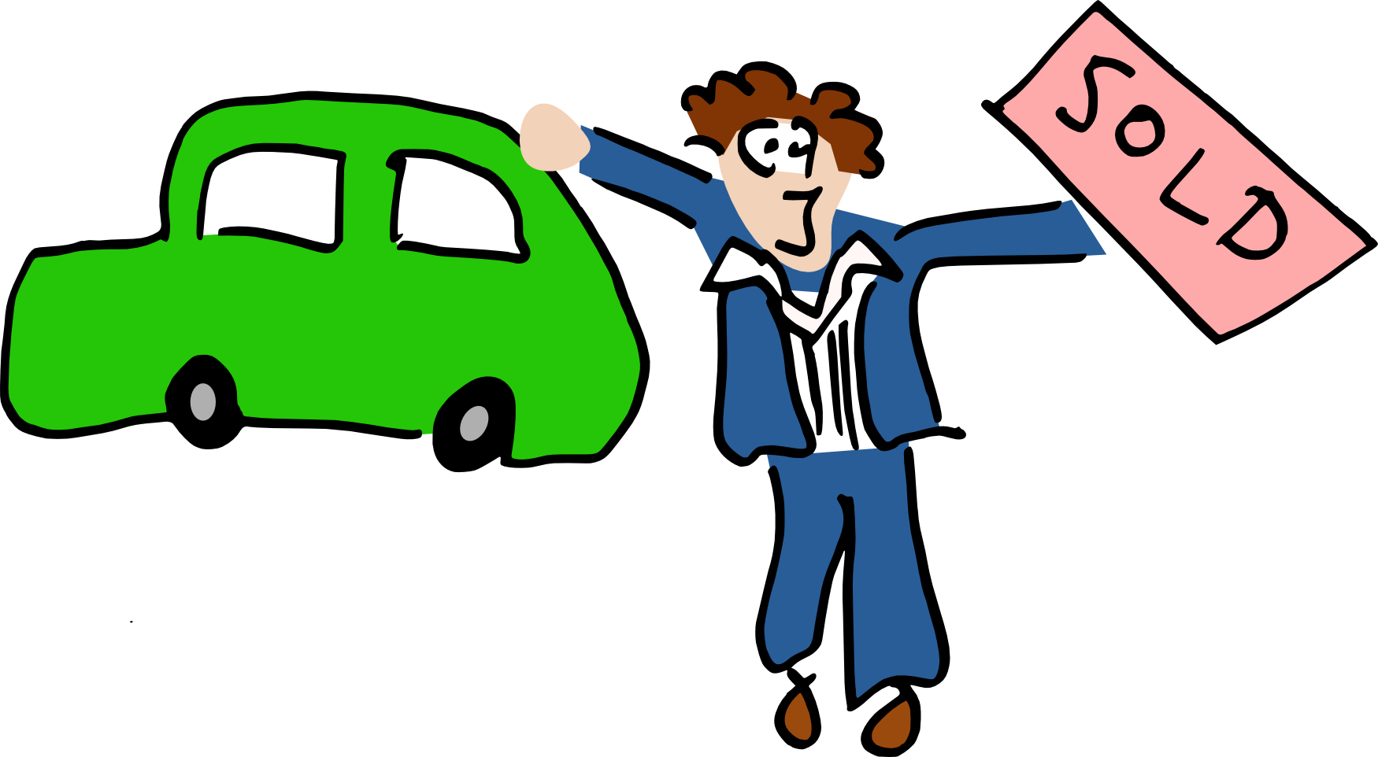
An advert for the paper
Get bored conference attendees to read it
A much simpler message than paper
More exciting – just the best bits
A repeat of everything in your paper

Slide 4
Don't think of is as derived from the paper
Presentation
Paper
Experiments

Slide 5
But as derived from the work
Paper
Presentation
Experiments

Slide 6
The story
Concentrate on the main points
It should flow like a good story
Lead people where you want them to go
People will think you're clever because you can explain complex things simply
Simply do not show them the complexity

Slide 7
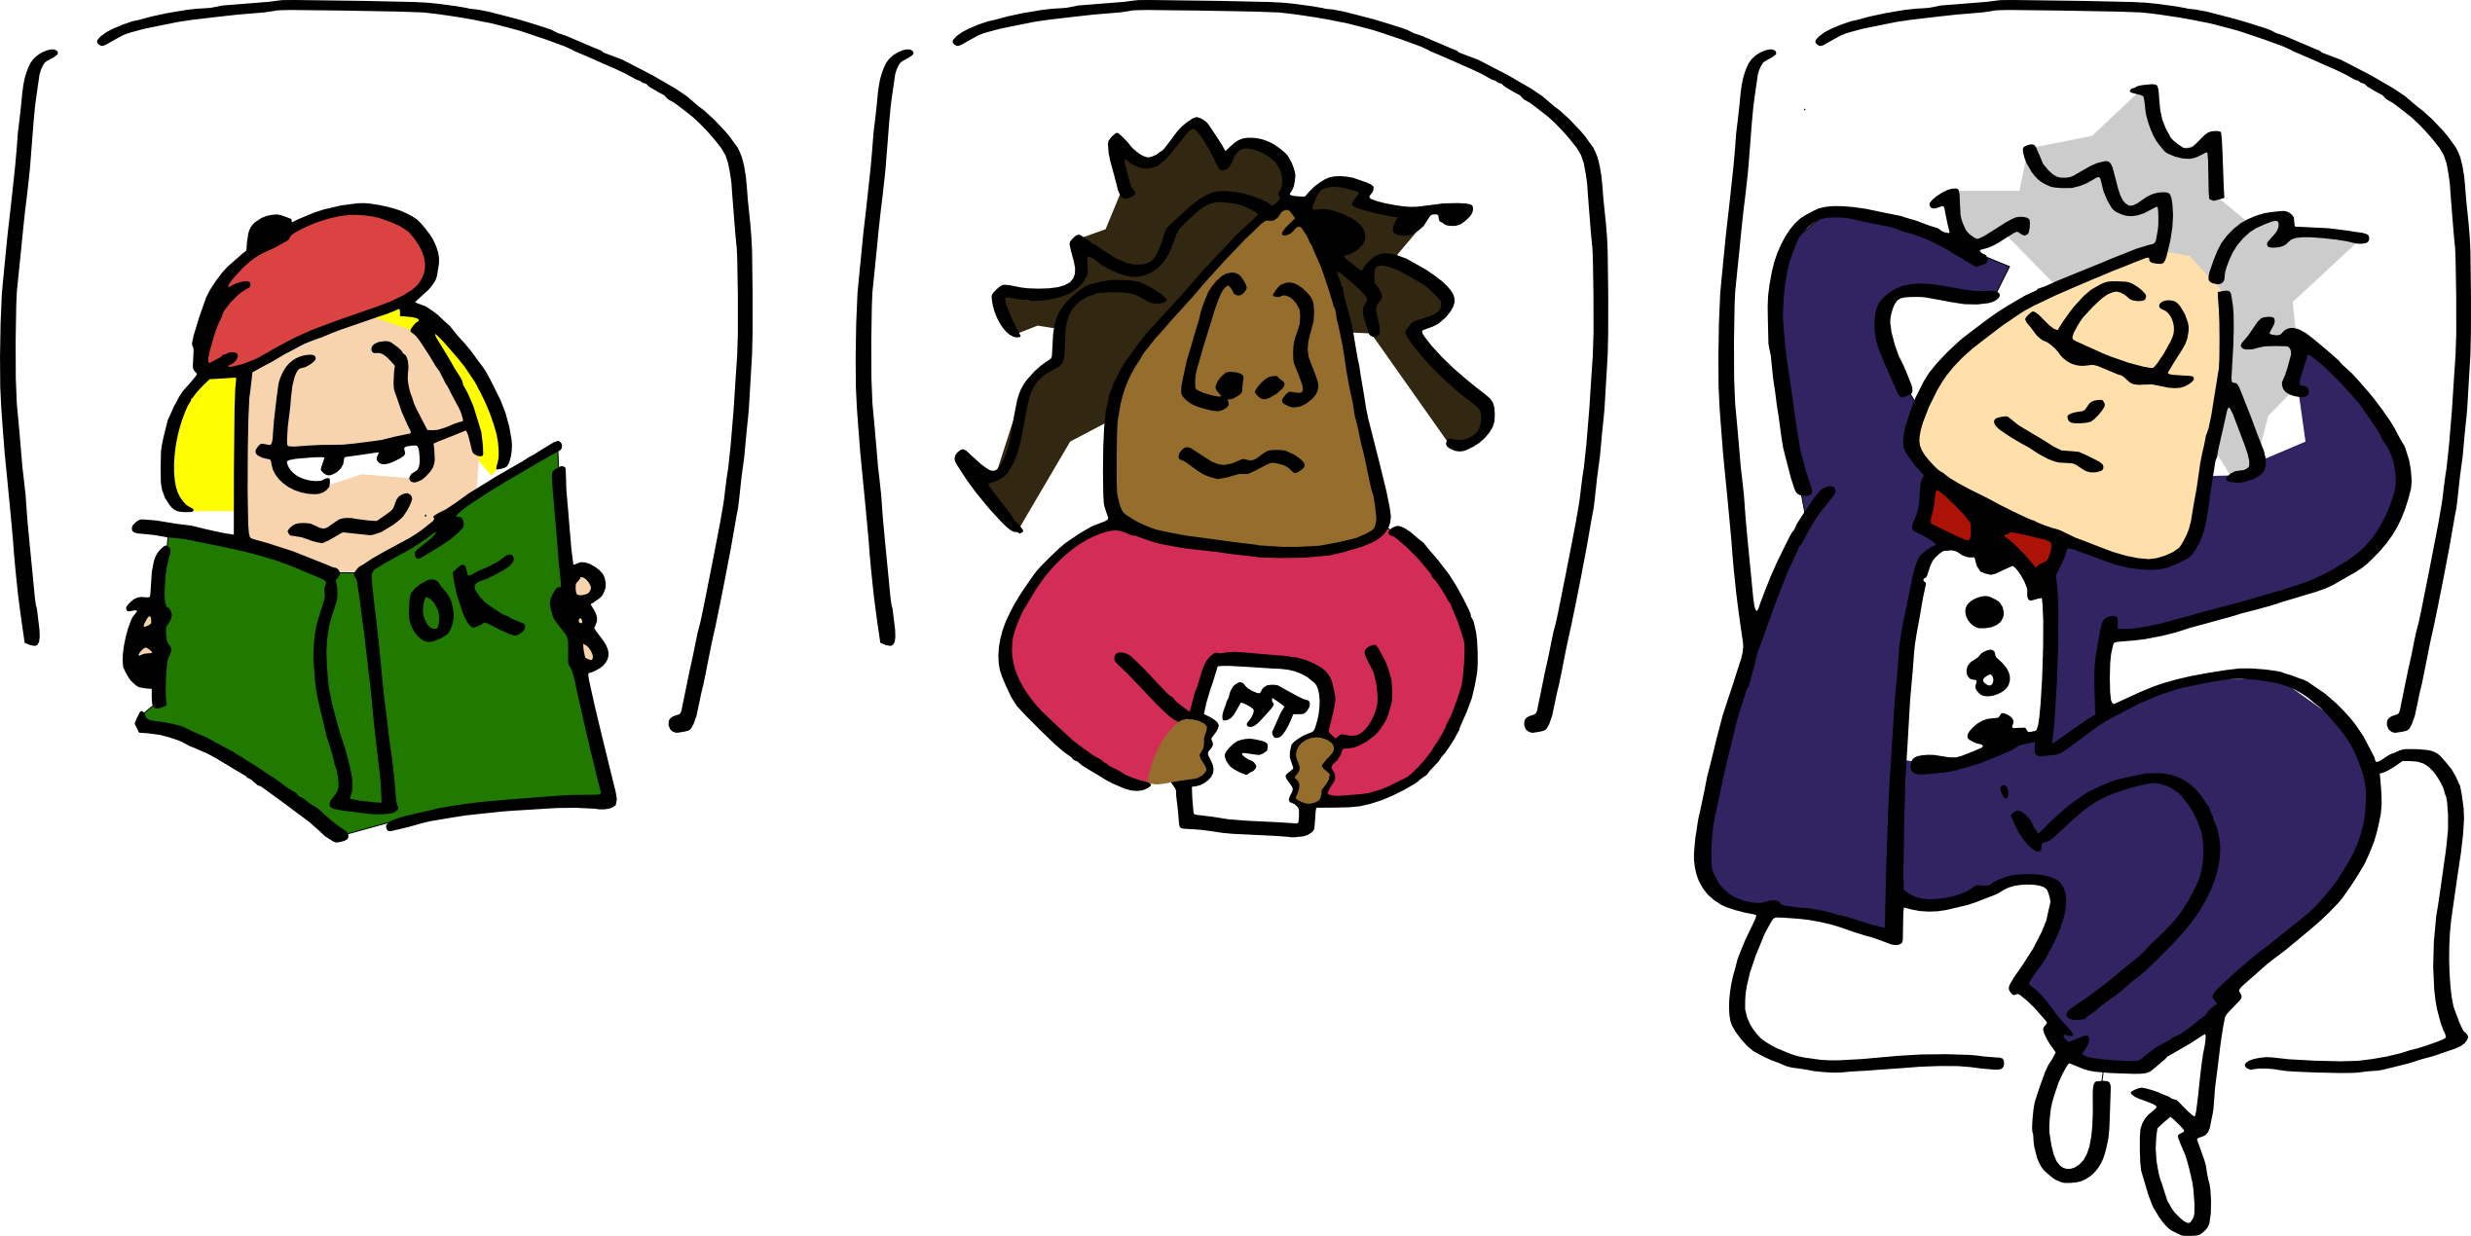
The audience
Half asleep
Half reading their email
Some preparing for their own presentation
A few nodding politely thinking something else

Slide 8
What they like
To hear about great ideas
Technical depth
Proof that it worked

Slide 9
What is in your presentation?
Intro - What you are going to do
Motivation – Why do what you did
Body – What you did
Results – How what you did worked
Conclusion – What you did

Slide 10
Intro
Summarise what you are going to do
Sets the context
If you don't, they won't know what to listen to and what to ignore
Do not wait until half way through!
“We use genetic programming to search a space of compiler optimisation, finding the best in terms of program performance”

Slide 11
Motivation
Explain why it's important
Examples, Examples, Examples!
“Look, we exhaustively tried a compiler optimisations and found that -O3 was rubbish. But the space is way to big to do that way and isn't flat. GAs looked suitable.”

Slide 12
Body
Explain your idea and what's sexy about it
Show them the good stuff
Ignore the tedious (which has to be in the paper)
“Here is the form of genetic programming we used. It fits so well with the problem. Here's how we drive it.”

Slide 13
Results
Show them it worked
Maybe doesn't need all 600 graphs from the paper
  Can have back up slides for less interesting graphs
“Check out these genetic programs we found. They achieve 50% more performance than -O3 and 30% more than Joe Bloggs, the previous state of the art”

Slide 14
Conclusion
You want them to remember what you did
Repeat it! It works for advertisers
“We used genetic programming to search for compiler optimisations. We beat -O3 by 50% and Bloggs by 30%”

Slide 15
Structure – If you forget all else
Tell them what you are going to tell them
Tell them the story
Tell them what you have told them

Slide 16
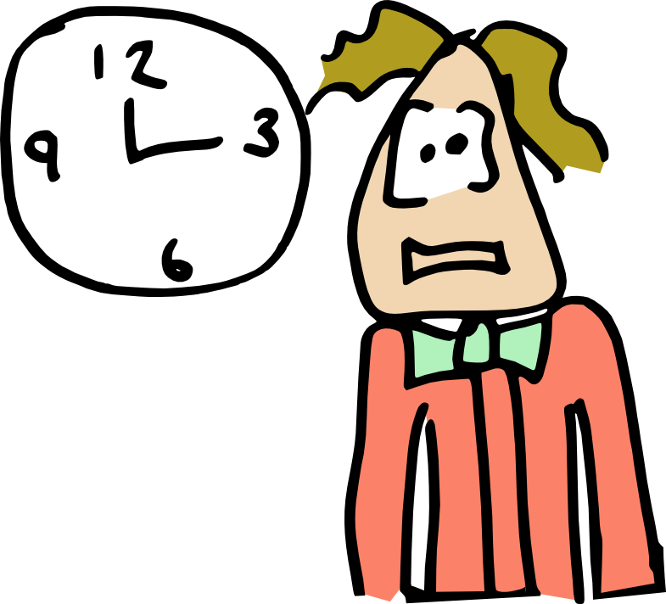
Timing
Do not overrun your timing
The audience gets itchy feet after they expect you to finish
It's rude
No one ever got criticised
for finishing early

Slide 17
Timing
More slides than minutes → warning bells
2-3 minutes per slide
Remember question time
Practice with a stopwatch

Slide 18

Questions
Question are good
No questions means either:
  Presentation so perfect it covered everything, ever
  You made it, yea!
  Everyone asleep
  No one understood anything at all

Slide 19
Why do people ask questions?
Genuine curiosity/clarification
Politeness from the convener
To show how clever they are

Slide 20
How not to answer questions
Tell them it's a stupid question
Look pained (sigh a lot)
Never admit weakness

Slide 21
How to answer questions
“That's a very interesting question...”
  Even if it's the dumbest thing you've ever heard
“We hadn't thought of that...”
“We realised that was a limitation...”
Clarify:
  “Do you mean, 'does the x widget connect to y'?”
  “Did I answer your question?”
“I think this answer may take a while, can we talk off-line?”

Slide 22
Attitude
It's no good if they fall asleep
It's no good if they can't hear you
It's no good if they don't understand you
It's no good if you talk so fast no one can follow
It's no good if they don't remember your points

Slide 23
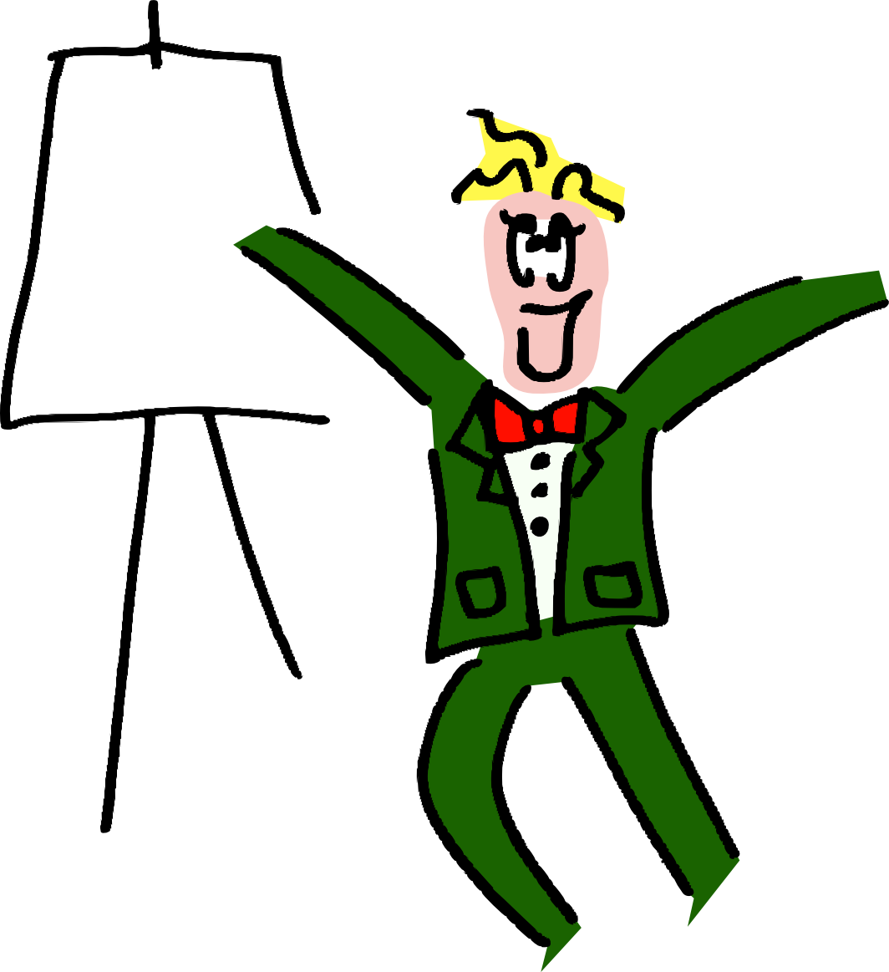
Excitement!
Who should be most excited by your work?
YOU!
You must engage your audience
Move around, gesticulate,
show it in your voice
Keep eye contact

Slide 24
Being heard
Speak loudly – Do not mumble
  Much louder than you're used to
Speak to the back of the room
  Even with microphone
Speak slooowly
  Stress makes you speed up

Slide 25
The pack smells fear
Do not sigh like you hate doing this
Do not apologise
  “I didn't have time to prepare this”
  “I didn't get the data I was hoping for”

Slide 26
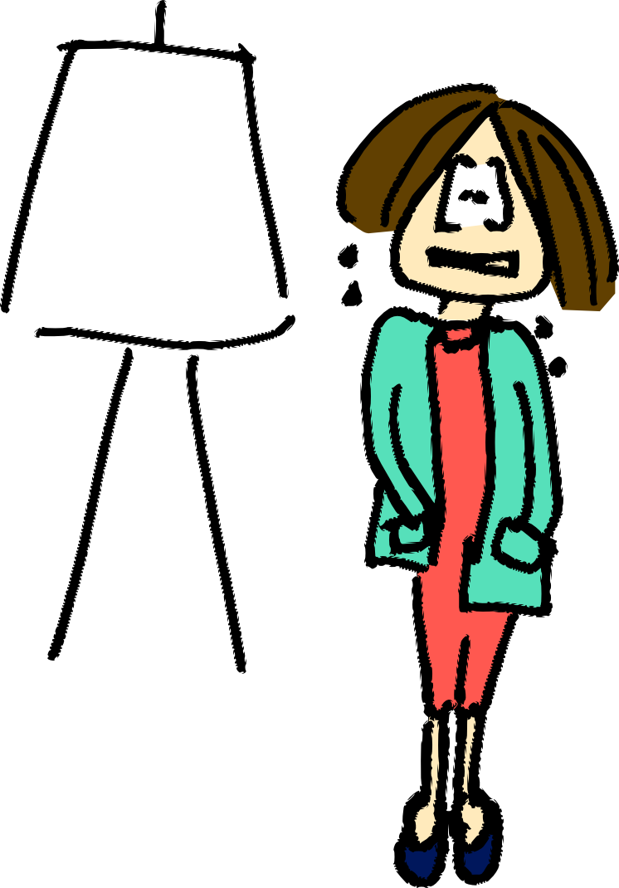
Nerves
Everyone gets nervous
A little nervousness helps you to sound excited
It gets much, much
easier with practice

Slide 27
Bad nerves
Practice – a lot
Learn speech for first few slides
Focus on a couple of 'nodders'
Remember how bad most presentations are

Slide 28
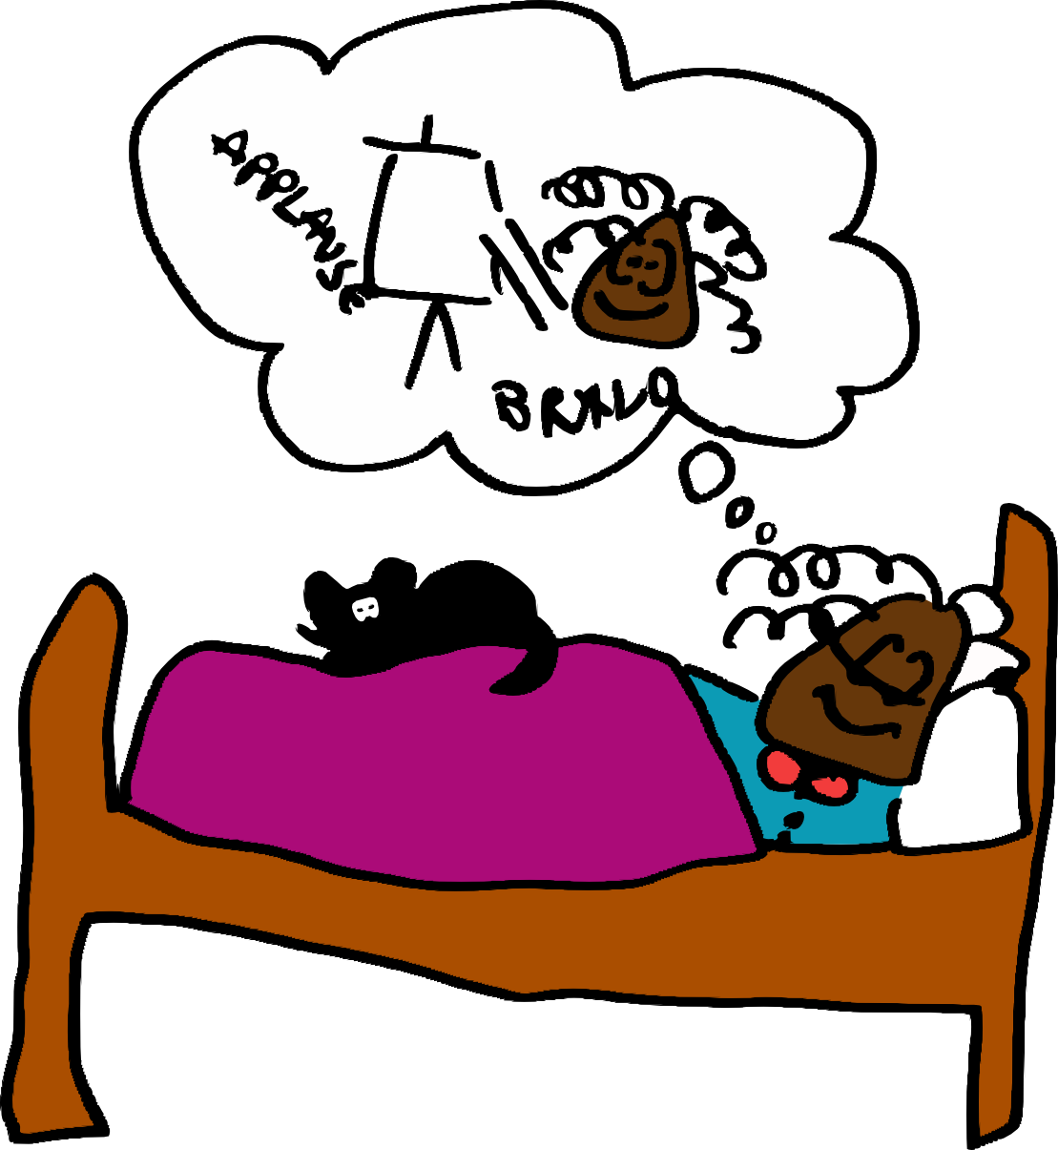
Practice, Practice, Practice
Dry run in your hotel room the night before
Speak out loud and time it
You will find holes
Your brain will think on it
while you sleep

Slide 29
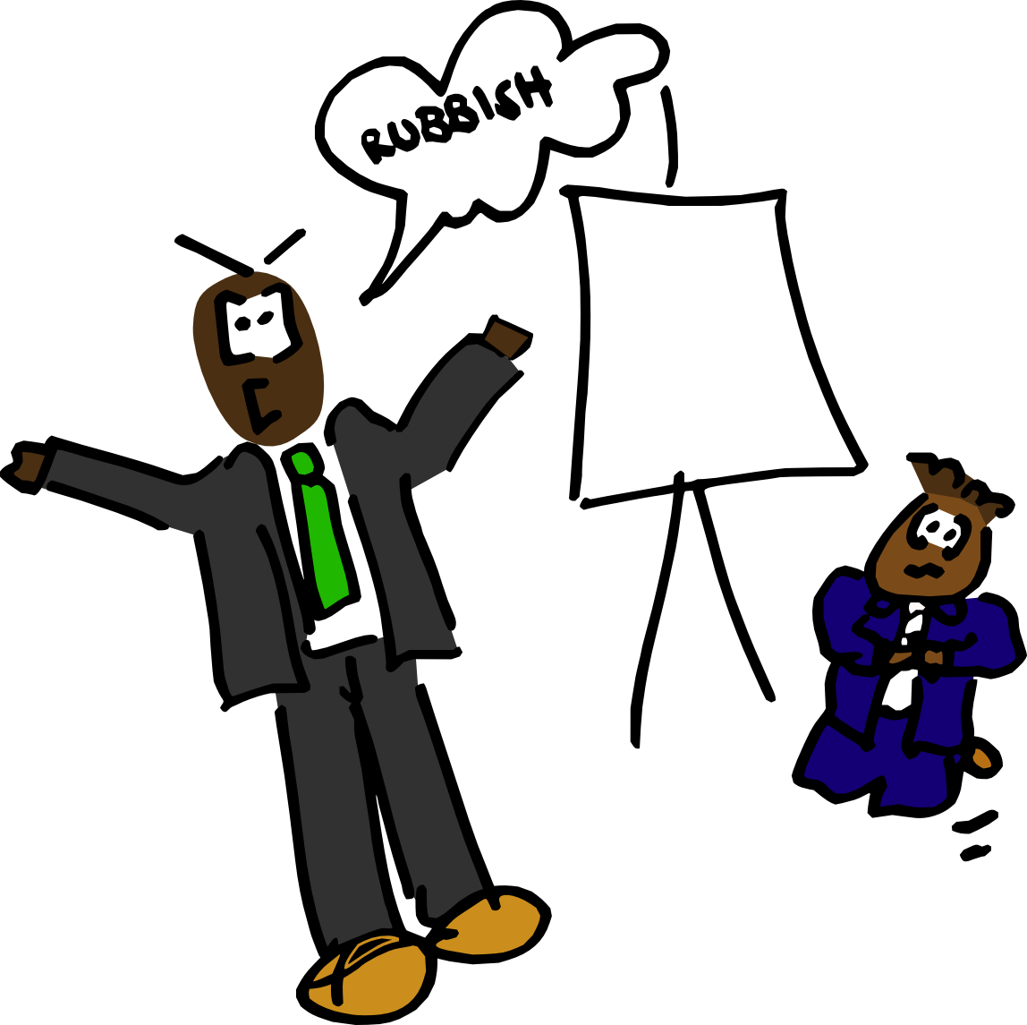
Getting advice
Other people will find the gaps more easily than you
Present to your colleagues
  Ask them to be brutal
Fix the holes
Present to them again
Remember every presentation you didn't like

Slide 30
Bad things to do
Some things rarely work
  But no hard and fast rules

Slide 31
Bad things to do
It is usually bad if you read out every word of each bullet point of each slide.
That way the audience doesn't really need you.
They have probably read well ahead of you and are now bored.

Slide 32
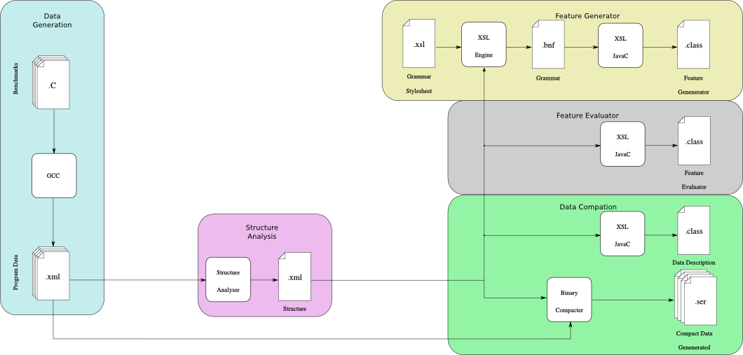
Bad things to do
Use tiny fonts
If your audience can read this they're too close
And if they can read this then they probably have binoculars
Including diagrams and graphs

Slide 33
Bad things to do
Cram too much information in one slide
People get weary reading one bullet point
After another, forever, ad infinitum
This is worse with some presentation programs
That automatically reduce the font size
When you need to add more which makes you
Think it's ok.
It's not ok.
You should aim to have 3-6 bullet points only

Slide 34
Bad things to do
Use long quotations
“More software projects have gone awry for lack of calendar time than for all other causes combined. Why is this cause of disaster so common? First, our techniques of estimating are poorly developed. More seriously, they reflect an unvoiced assumption which is quite untrue, i.e., that all will go well. Second, our estimating techniques fallaciously confuse effort with progress, hiding the assumption that men and months are interchangeable. Third, because we are uncertain of our estimates, software managers often lack the courteous stubbornness of Antoine's chef. Fourth, schedule progress is poorly monitored. Techniques proven and routine in other engineering disciplines are considered radical innovations in software engineering. Fifth, when schedule slippage is recognized, the natural (and traditional) response is to add manpower. Like dousing a fire with gasoline, this makes matters worse, much worse. More fire requires more gasoline, and thus begins a regenerative cycle which ends in disaster.”
Fred Brookes – The Mythical Man-Month

Slide 35

Bad things to do
Use distracting backgrounds

Slide 36
Bad things to do
Animations
Just make it hard to follow
The point of the slide

Slide 37

Bad things to do
Put in equations
Latex users beware!

Slide 38
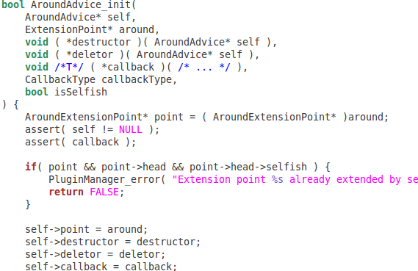
Bad things to do
Put in code
Unless your talk is about APIs, etc.

Slide 39
Bad things to do
Put in related work
[HJL05] The invention of widgets
[ABC06] Widgets and the Curry-Howard ismorphism
[XYZ08] Widgets cure measels
This is what your paper is for

Slide 40
Bad things to do
Structure slides telling you nothing
My Presentation
  Introduction
  Motivation
  My Idea
  Results
  Conclusion

Slide 41
Bad things to do
“Questions?” Slide
Leave the conclusion instead
Any Questions?

Slide 42
Conclusion
It's an advert – tell a story
Enjoy it, relax
Be excited

