Slide 1
Machine Learning, Compilers and Mobile Systems
Institute for Computing Systems Architecture
University of Edinburgh, UK
Hugh Leather

Slide 2
Introduction
Mobile is the next big thing
Machine learning key to power and performance
Prior work making machine learning in compilers practical at scale

Slide 3
Machine Learning in Compilers

Slide 4
Machine learning in compilers
Problem:
  Tuning heuristics is hard
  Architectures and compilers keep changing
Goal:
  Replace an heuristic with a Machine Learned one
  ML performs very well

Slide 5
Machine learning in compilers
Start with compiler data structures
AST, RTL, SSA, CFG, DDG, etc.
Predicted Optimisation
Parameter
Unroll factor?
Scheduling priority?
Inline?
Compiler flags?

Slide 6
Machine learning in compilers
Human expert determines a mapping
to a feature vector
number of instructions
mean dependency depth
branch count
loop nest level
...
trip count

Slide 7
Machine learning in compilers
Now collect many examples of programs, determining
their feature values
Execute the programs with different compilation
strategies and find the best for each
Features
...
Best Optimisation Parameters

Slide 8
Machine learning in compilers
Now give these examples to a machine learner
It learns a model
Examples
Supervised
Machine Learner
Model
Features
...
Best Heuristic Value

Slide 9
Machine learning in compilers
This model can then be used to predict the best
compiler strategy from the features of a new program
Our heuristic is replaced
Model
Features
Predicted Optimisation
Parameter
New Program

Slide 10
Machine learning in compilers
Fit a curve (model) to data
Look new point on curve for prediction
Best Optimisation Parameter
Features

Slide 11


The pillars of machine learning in compilers
Need to make practical at scale
Compiler Internals Access
libPlugin
Sourceforge – 400+ downloads
Cost of Iterative Compilation
Profile Races
LCTES 09
Enough Benchmarks
Automatic Benchmark Generation
In preparation
.c
Choosing the Features
Automatic Feature Generation
CGO 09

Slide 12
Automatic Feature Generation

Slide 13
Choosing Features
Problem
  ML relies on good features
  Subtle interaction between features and ML
  Infinite number of features to choose from
Solution
  Automatically search for good features!

Slide 14
An example – Loop unrolling
Set up
  57 benchmarks from MiBench, MediaBench and UTDSP
  Found best unroll factor for each loop in [0-16]
  Exhaustive evaluation to find oracle

Slide 15
An example – Loop unrolling
Original Loop
for( i = 0; i < n; i = i ++ ) {
c[i] = a[i] * b[i];
}
Unrolled 5 times
for( i = 0; i < n; i = i + k ) {
c[i+0] = a[i+0] * b[i+0];
c[i+1] = a[i+1] * b[i+1];
c[i+2] = a[i+2] * b[i+2];
c[i+3] = a[i+3] * b[i+3];
c[i+4] = a[i+4] * b[i+4];
c[i+5] = a[i+5] * b[i+5];
}

Slide 16
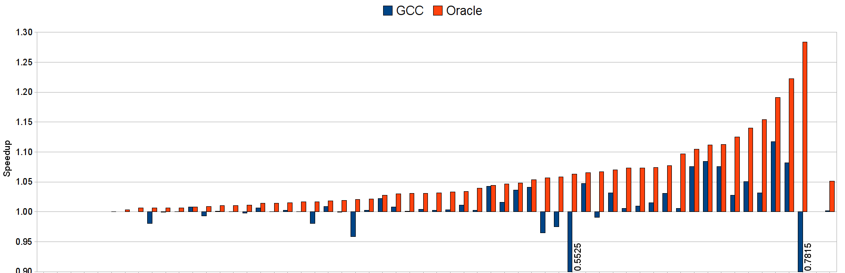
GCC vs Oracle
GCC gets 3% of maximum
On average mostly not worth unrolling

Slide 17
State of the art features
Lots of good work with hand-built features
  Dubach, Cavazos, etc
Stephenson was state of the art
  Tackled loop unrolling heuristic
  Spent some months designing features
  Multiple iterations to get right

Slide 18
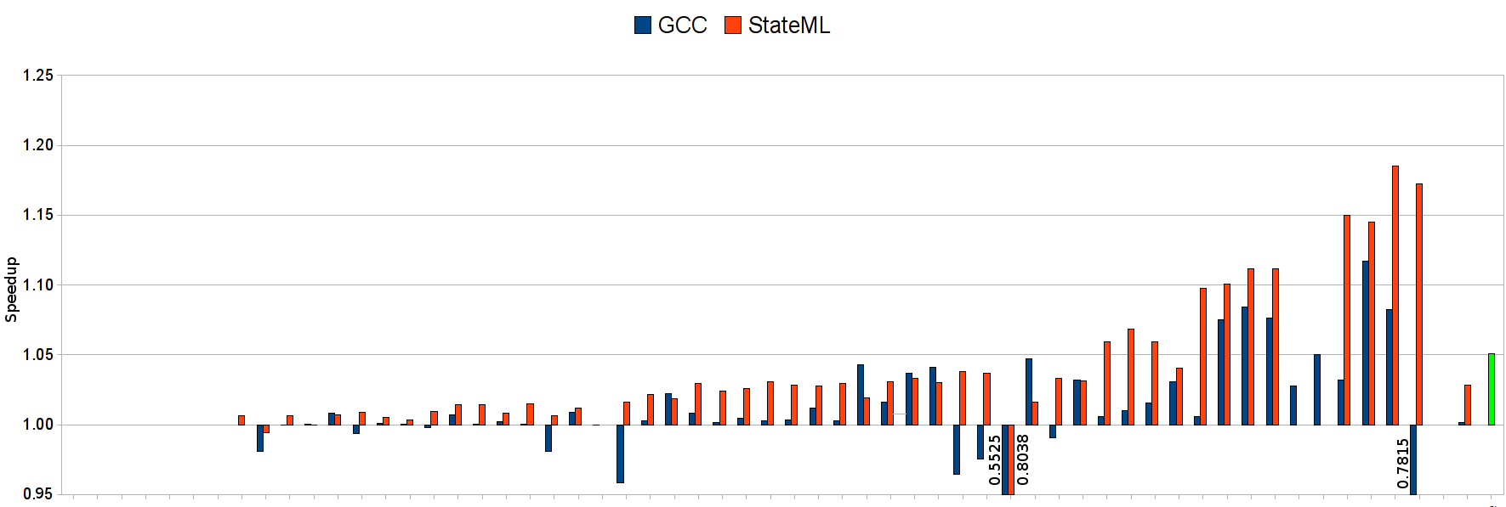
GCC vs Stephenson
Gets 59% of maximum!
Machine learning does well

Slide 19
GCC vs Stephenson
 | GCC | Stephenson
Heuristic | Months
Features | - | Months
Training | - | Days
Learning | - | Seconds
Results | 3% | 59%
To scale up, must reduce feature development time

Slide 20
A feature space for a motivating example
Simple language the compiler accepts:
  Variables, integers, '+', '*', parentheses
Examples:
  a = 10
  b = 20
  c = a * b + 12
  d = a * (( b + c * c ) * ( 2 + 3 ))

Slide 21
A feature space for a motivating example
What type of features might we want?
a = ((b+c)*2 + d) * 9 + (b+2)*4

Slide 22
A feature space for a motivating example
What type of features might we want?
a = ((b+c)*2 + d) * 9 + (b+2)*4
=
var
+
*
*
+
const
+
const
*
var
var
const
+
const
var
var

Slide 23
A feature space for a motivating example
What type of features might we want?
a = ((b+c)*2 + d) * 9 + (b+2)*4
=
var
+
*
*
+
const
+
const
*
var
var
const
+
const
var
var

Slide 24
A feature space for a motivating example
What type of features might we want?
a = ((b+c)*2 + d) * 9 + (b+2)*4
count−nodes−matching(
is−times &&
left−child−matches(
is−plus
)&&
right−child−matches(
is−constant
)
)
=
var
+
*
*
+
const
+
const
*
var
var
const
+
const
Value = 3
var
var

Slide 25
A feature space for a motivating example
Define a simple feature language:
GCC grammar is huge >160kb
Genetic search for features that improve machine learning prediction
<feature> ::= ”count−nodes−matching(” <matches> ”)”
<matches> ::= ”is−constant”
| ”is−variable”
| ”is−any−type”
| ( ”is−plus” | ”is−times” )
( ”&& left−child−matches(” <matches> ”)” ) ?
( ”&& right−child−matches(” <matches> ”)” ) ?

Slide 26
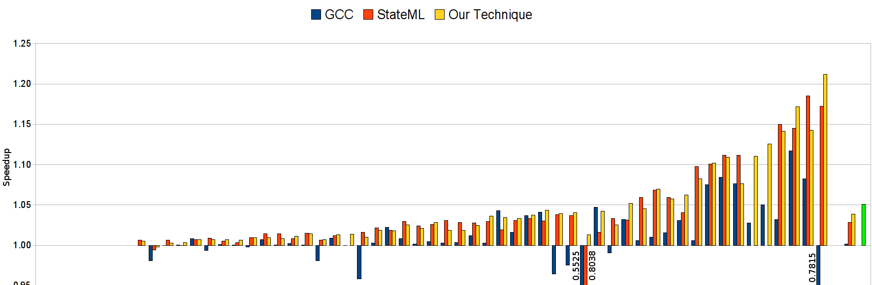
Results
GCC 3% Stephenson 59% Ours 75%
Automated features outperform human ones

Slide 27
Results
Top Features Found
  get-attr(@num-iter)
39%

Slide 28
Results
Top Features Found
  get-attr(@num-iter)
  count(filter(//*, !(is-type(wide-int) || (is-type(float extend) &&[(is-type(reg)]/count(filter(//*,is-type(int))))) || is-type(union type))))
39%
14%

Slide 29
Results
Top Features Found
  get-attr(@num-iter)
  count(filter(//*, !(is-type(wide-int) || (is-type(float extend) &&[(is-type(reg)]/count(filter(//*,is-type(int))))) || is-type(union type))))
  count(filter(/*, (is-type(basic-block) && (
!@loop-depth==2 ||
(0.0 > (
(count(filter(//*, is-type(var decl))) -
(count(filter(//*, (is-type(xor) && @mode==HI))) +
sum(
filter(/*, (is-type(call insn) && has-attr(@unchanging))),
count(filter(//*, is-type(real type)))))) /
count(filter(/*, is-type(code label)))))))))
39%
14%
8%

Slide 30
GCC vs Stephenson vs Ours
 | GCC | Stephenson | Ours
Heuristic | Months | - | -
Features | - | Months | -
Training | - | Days | Days
Learning | - | Seconds | Hours
Results | 3% | 59% | 75%

Slide 31
Machine Learning for Mobile Systems

Slide 32
Mobiles
Mobile devices will become THE consumer computing platform
Need to make mobile devices faster
  Quad cores here already
  Increased power demand
Need to make mobile devices lower power
  Battery life measured in hours
  Battery capacity not improving

Slide 33
Desktop vs Mobile
Mobile is a different beast
  Application characteristics
  Customers
  Information available
Needs different techniques

Slide 34
Desktop vs Mobile
Desktop
Applications
  No app store
  Many languages
  Opaque binaries
Mobile (Android)
Applications
  Central app store
  Mostly Java
  Recompilable classes

Slide 35
Desktop vs Mobile
Desktop
Customers = Devs
  Training in lab
  Few benchmarks
  Bad points OK
Mobile
Customers = Users
  Training in wild
  All applications
  Bad points, umm, bad

Slide 36
Desktop vs Mobile
Desktop
No user knowledge
  Static code features
Mobile
User knowledge
  Static code features
  Application history
  Geographical
  Temporal
  OS states
  Usage patterns

Slide 37
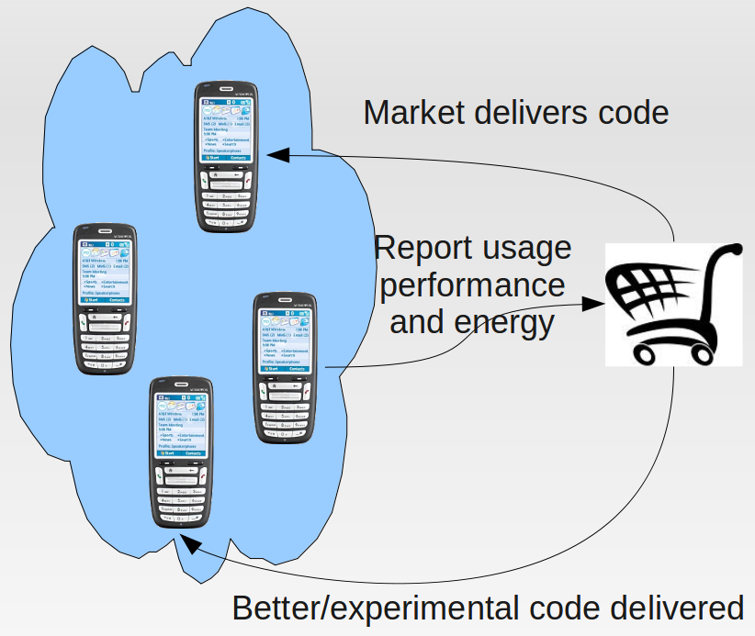
Optimise applications
All Android programs use Dalvik JIT - very slow
Create a market replacement
Light-weight profiling identifies hot methods
Updates get experimental code
System learns how to optimise similar apps for similar users

Slide 38
Optimise applications
Needs zero user impact
  ML directed profiling
  ML guided iterative compilation
  ML guided version selection
Huge scope for research

Slide 39
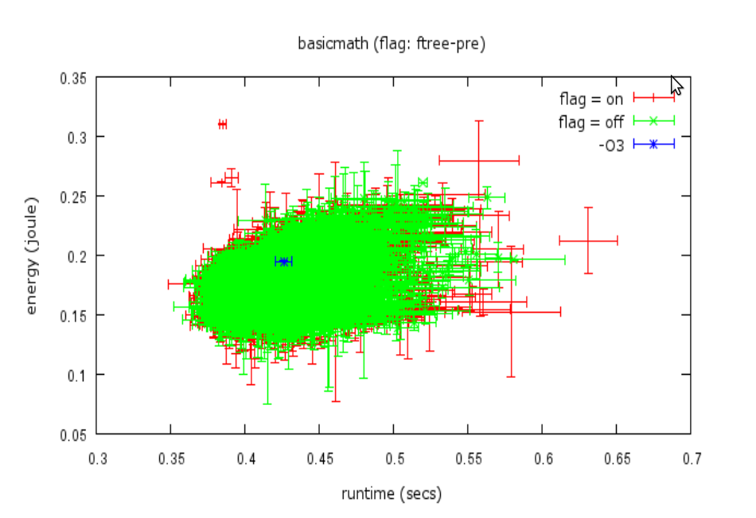
Optimise power
Recharge prediction allows power choices

Slide 40
Other topics
Optimise communications
Power modelling
Scheduling heterogeneous multi-cores
JIT optimisation

Slide 41
Conclusion
Machine learning in compilers
  Choosing Features
  Enough Benchmarks
  Cost of Iterative Compilation
  Compiler Internals
Machine learning the key to mobile systems
Mobile is the next big thing
Huge scope for research

Slide 42
Backup Slides

Slide 43
Compiler internals
Problem
  Compilers not built for ML
  Must access all internals
  Prior approach was to hack the source
Solution
  libPlugin
  Opens up GCC internals
  Modern software engineering
  Cooperative, extensible plug-ins, with AOP
  Plug-ins now adopted in GCC

Slide 44
Cost of iterative compilation
Problem
  Gathering training data can take months
  Statistical soundness often overlooked
Solution
  Profile Races (H.Leather, B.Worton, M.O'Boyle)
  Program version race each other, losers quit early
  Reduces training time by order of magnitude
  Ensures statistically sound data

Slide 45
Enough benchmarks
Problem
  ML would like 10^5 examples
  Only got a few dozen benchmarks
Solution
  Automatic Benchmark Generation (H.Leather,Z.Wang,A.Magni,C.Thompson - In preparation)
  Genetic programming + constraint satisfaction to make 'human like' programs
  Active learning to cover the training space

Slide 46
Difficulties choosing features
The expert must do a good job of projecting down to features
amount of white space
average identifier length
age of programmer
name of program
...
number of comments

Slide 47
Difficulties choosing features
Machine learning doesn't work if the features don't distinguish the examples
Feature 1
0
1
0
Feature 2
1

Slide 48
Difficulties choosing features
Better features might allow classification
Feature 3 = 0
Feature 3 = 1
Feature 1
Feature 1
0
1
0
1
0
0
Feature 2
Feature 2
1
1

Slide 49
Searching the Feature Space
Overview of searching
Data
Generation
Genetic Programming Search
Feature
Evaluator
Feature Values
Benchmarks
ML
Tool
Data
Extractor
Prediction
Quality
Program Data
Prediction
Best Heuristic
Values

Slide 50
Features for GCC
Overview of grammar production
GCC Exports Data Structures to XML
Structure Analysed
Grammar
Created
Sentence Generator Compiled
Feature
Search
Final Features
Produced
Target Heuristic
Values
ML
Grammar
Stylesheet
Benchmarks
.xsl
.c
GP Search
.xml
XSL
Engine
.bnf
XSL +
JavaC
.class
Final
Features
GCC
Structure
Grammar
Sentence
Generator
Program Data
Feature
Interpreter
.xml

Slide 51
ML for Mobile
Server side native compilation of hot methods
APK
classes
.jpg
Developer
Developer
Analysis
To C
Translate
.so
APK
.c
classes
.jpg
User
.so
GCC
.so

Slide 52
ML for Mobile - Downsizing Down Sides
Experiments on real users’ phones
What about the bad search points?
Multiple versions - known good and experimental
P(experimental) ∝ confidence(experimental)
f(...)
P(good)
P(experimental)
Original or Good
Experimental

Slide 53
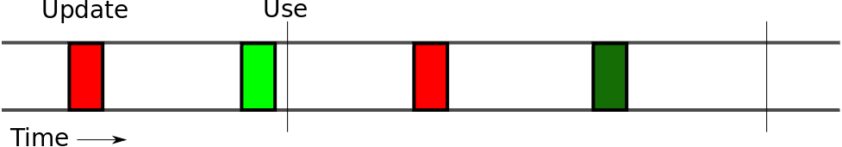
Optimise communications
Comms updates are expensive
Updates need to be fresh and not wasted
Build cost models
Predictor 'use' times
Schedule updates for predicted lowest cost

Slide 54
Power models
Need power models
  Energy sensors are low fidelity
  Batteries non-linear
  Allow relaxation
  Lowest power solution may not give longest battery life
Power aware workloads needed

Slide 55
Heterogeneous multi-cores
Simple heterogeneous multi-cores here now
Scheduling is NP-hard
  Even when application characteristics known
Use ML to tune scheduling heuristics for power and performance

Slide 56
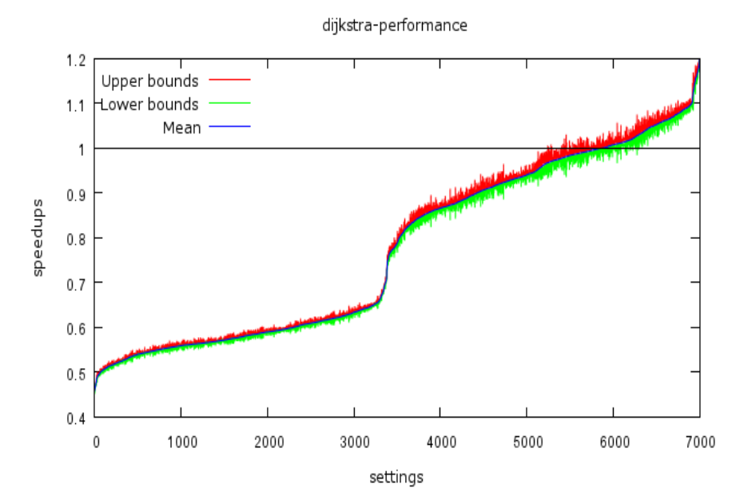
Performance - Dijkstra

Slide 57
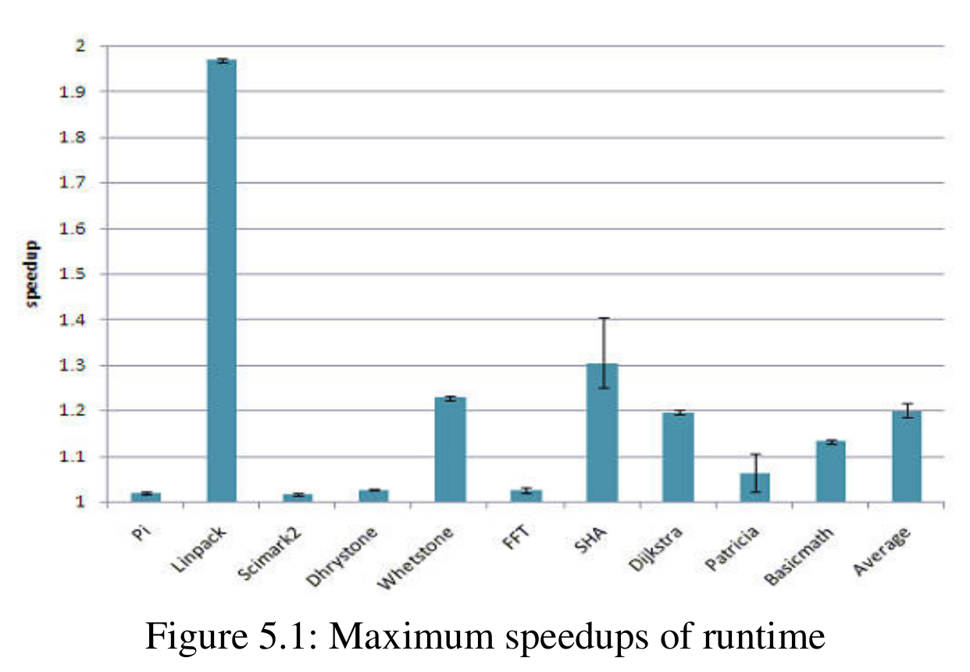
Performance

Slide 58
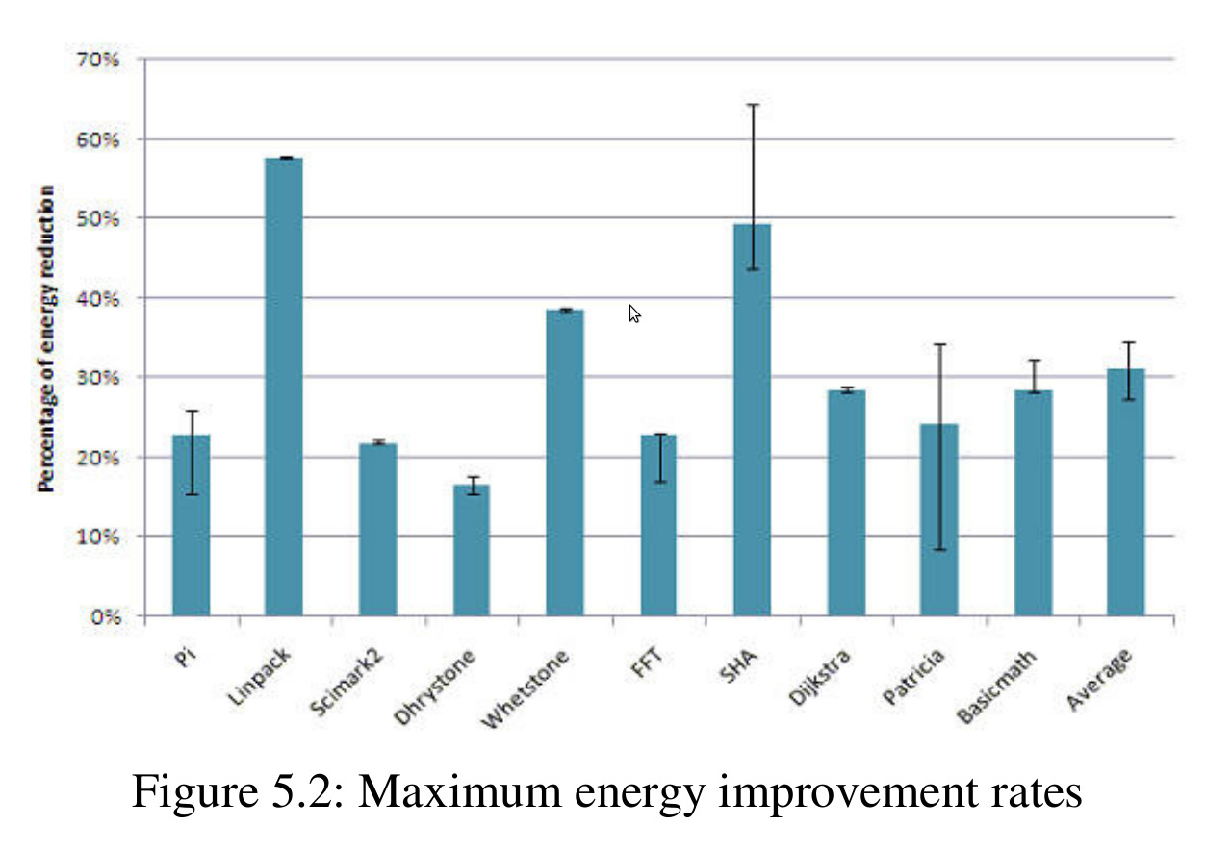
Energy

Slide 59
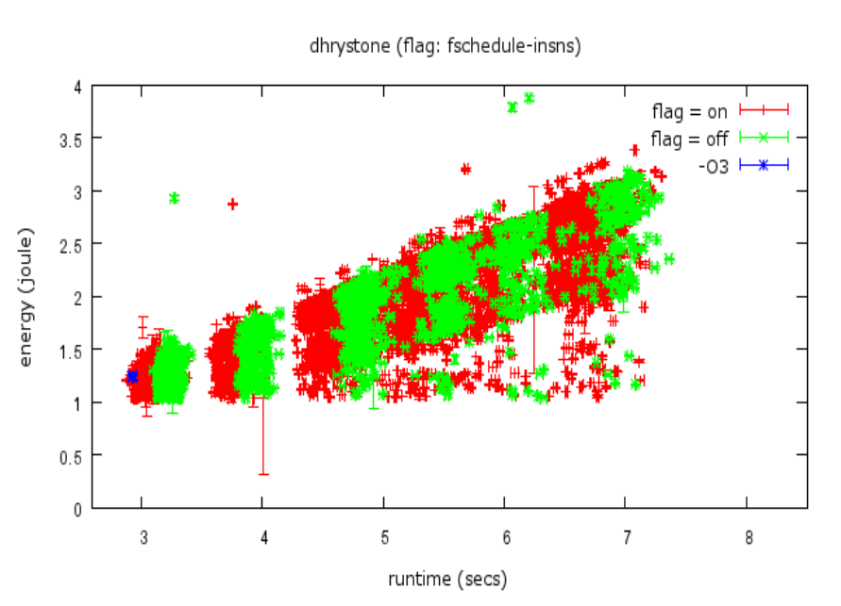
Energy vs Performance
Are energy and performance correlated?
Not really! Why?
If could predict recharge time, change version

