Slide 1


Measuring QoE of Interactive Workloads and Characterising Frequency Governors on Mobile Devices
Compiler and Architecture Design Group
Institute for Computing Systems Architecture
University of Edinburgh, United Kingdom
IISWC 2014
Volker Seeker
Pavlos Petoumenos, Hugh Leather, Björn Franke

Slide 2

Problem Statement
heterogeneous workload
interactive workload
battery constraints
...
Responsive
Trade-Off
Energy Efficient
Execution Delay
Energy Consumption
How can I measure satisfaction?
Satisfied User
Notes:
When you as a system designer work today’s modern mobile devices, you need to deal with things such as ...
So no matter which part of the system you are currently working on, maybe memory management policy, scheduling policy, network protocols, ...
You want the system to be responsive and energy efficient
Contradicting goals, Tradeoff between responsiveness and energy efficiency
The final metric you want to optimise your system for: user satisfaction
When I chose a point in the graph, how do I know if the user is happy with what I picked?
Usually this is more closely related to responsiveness, since the user gets a more direct feedback here.
How can I measure if the user is satisfied with the system??

Slide 3
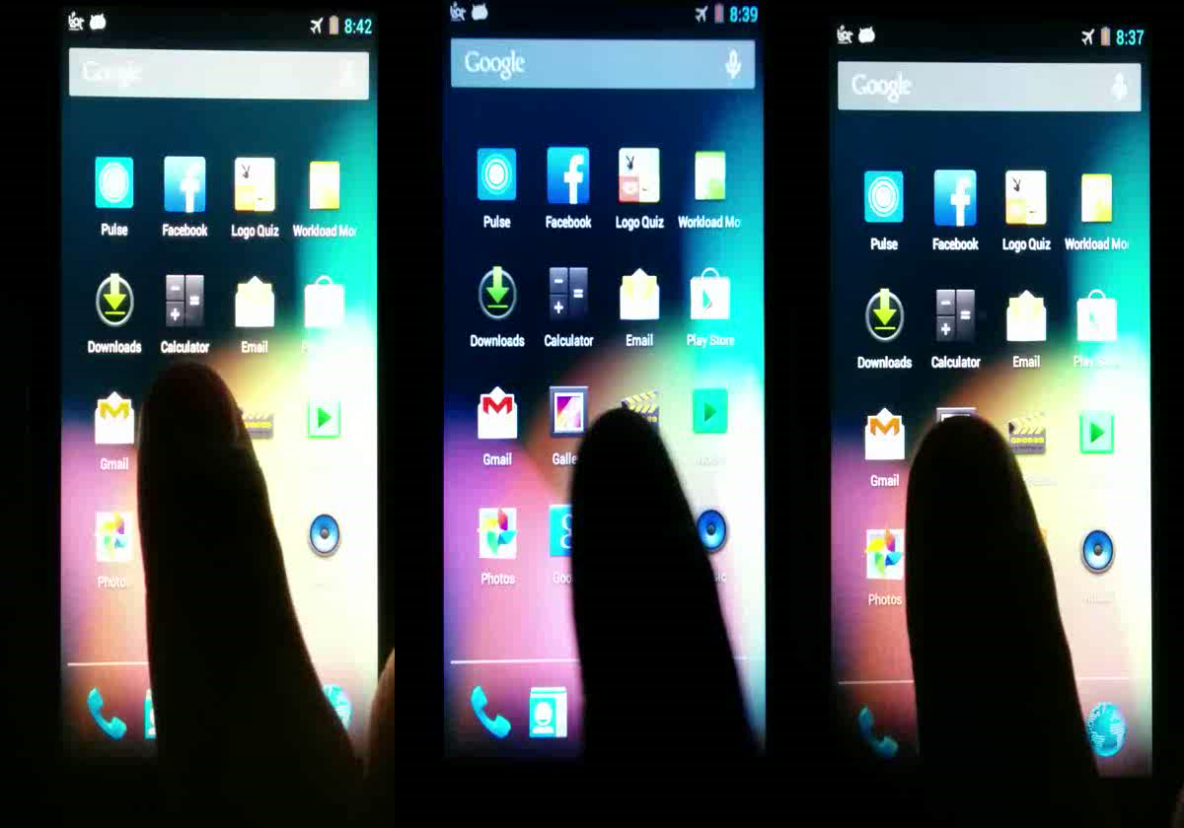
Workload Scenario
Frequency
Governor
0.3 GHz
1.2 GHz
2.2 GHz
Notes:
Consider the following scenario with the frequency governor as system aspect under investigation
Three times the same workload with different frequencies → You can see differences in the response time
Two on the right are similar

Slide 4
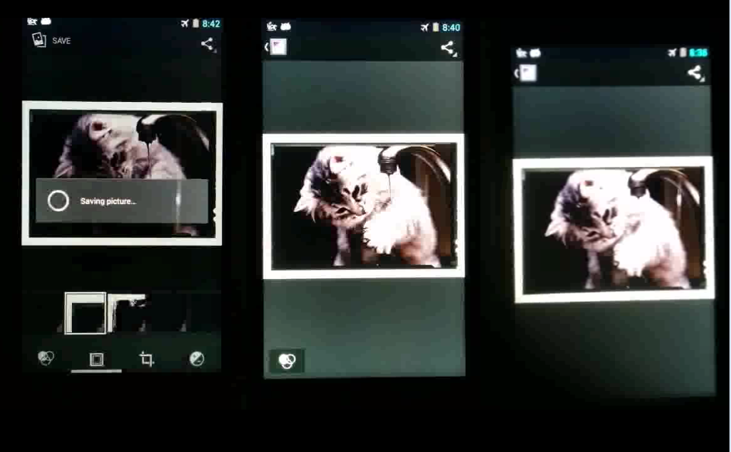
Workload Scenario
too slow
sweet spot
wasting energy
Frequency
Governor
How do we find the sweet spot?
Consider the User’s Perspective!
Questionaires are cost intensive
0.3 GHz
1.2 GHz
2.2 GHz
Notes:
How do we find the sweet spot?
In our work we say: Look with the user’s eyes. See what the user cares about and then make a decision.
→ Not only fixed but also at the right time!
When does the user care about responsiveness and when does he not?
Only then I can say that I have done a good job in tweaking the system.
→ Classic approach is using questionaires

Slide 5

What we need!
Rate Trade-Off considering
User Satisfaction
Interactive Mobile Workload
Distance to sweet spot
Notes:
What would be great to have is a system that takes an interactive mobile workload
Analyses it considering the user’s perspective
And rates the trade-off that we made when tweaking the current part of the system we are working
And tells us the distance to the sweet spot
Where the user is happiest with our chosen energy efficiency and execution delay for this workload
Then we already have a very good idea

Slide 6
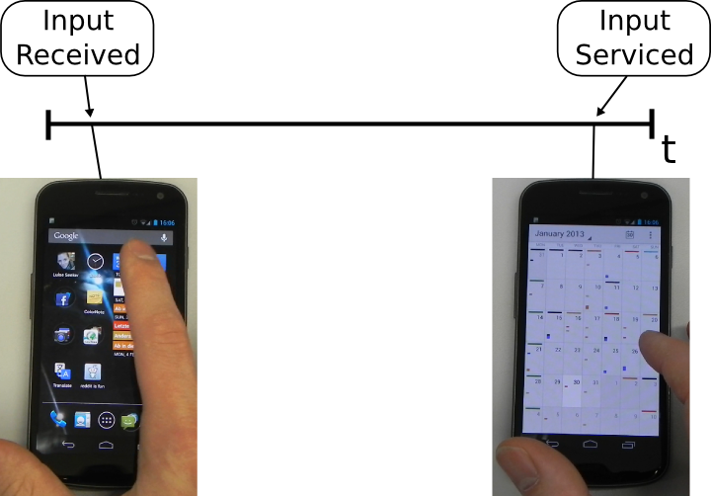
What Does The User Care About?
Timespan between user input and user feels input has been serviced
Interaction Lag
Click Calendar
Calendar Loaded
Notes:
Also Jank lags but not in this study

Slide 7
Research Goals
Rate Trade-Off considering
User Satisfaction
Interactive Mobile Workload
Distance to sweet spot
Methodology must ...
... deal with interactive workloads
... execute repeatable workloads
... execute workloads automatically
... identify interaction lags
... automatically rate user satisfaction
Not possible with current mobile benchmarks!
Notes:
What we want is a methodology that tells us if we have done a good job in finding this sweet spot for a certain system aspect.
Providing a method to rate the response time and energy efficiency of an interactive system considering user perception

Slide 8


Executing Mobile Workloads
Record
Input Event
Trace
Automatic
Realistic
Interactive
Repeatable
Replay
Notes:
We do not run a set of automated apps or a scripted interactions
We directly record the input, a user is issuing and automatically replay it with the exact same timing from the exact same origin point
That way we make sure that we have a realistic and interactive workload,
that we can replay repeatedly
in its original environment
as close as possible to the original execution

Slide 9
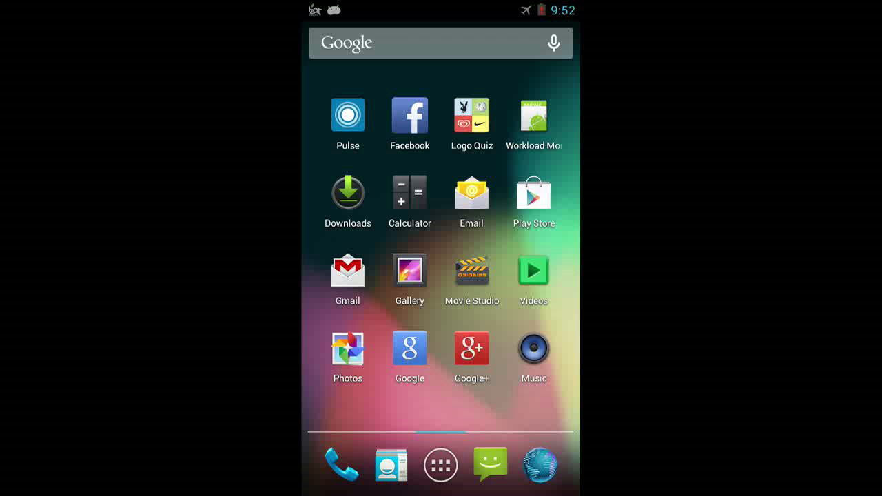
Automatic Workload Execution

Slide 10

Research Goals
Rate Trade-Off considering
User Satisfaction
Interactive Mobile Workload
Distance to sweet spot
Methodology must ...
... deal with interactive workloads
... execute repeatable workloads
... execute workloads automatically
... identify interaction lags
... automatically rate user satisfaction
Notes:
Half way through identification

Slide 11


Considering the User’s Perspective Concept
Execute mobile workload and capture a video
Review the video and mark interaction lags
Compare lag lengths to different system configurations
Interaction Lag
Timespan between user input and user feels input has been serviced
Notes:
An optimal approach is to execute a mobile workload
Observe the user while doing it
Mark each time the user has to wait for a system response and measure the time it takes

Slide 12
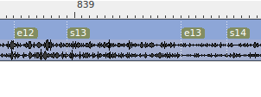
Interaction Lag Markup
1104 Frames
22 Lags
36 Seconds
Markup Time: 15:15 Minutes
Notes:
Interaction lag example as a reminder

Slide 13

Markup Costs
Markup lags in each video manually
Markup Time:
360 hours
or 9 working weeks
Workload
10 Minutes Length
17 System Configurations
5 Iterations
➔ 85 Videos

Slide 14

Markup Costs
Markup lags in each video manually
Markup Time:
1800 hours
or 1 working year
5 Workloads
10 Minutes each
17 System Configurations
5 Iterations
➔ 425 Videos

Slide 15
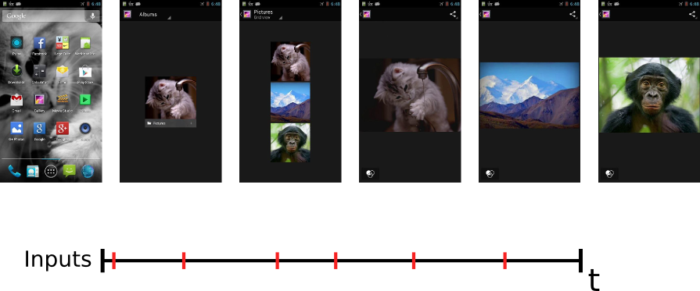
Reusing a Video Markup
Images of Lag Endings
Start
End
Use an image of the lag ending to find it again in a different video

Slide 16
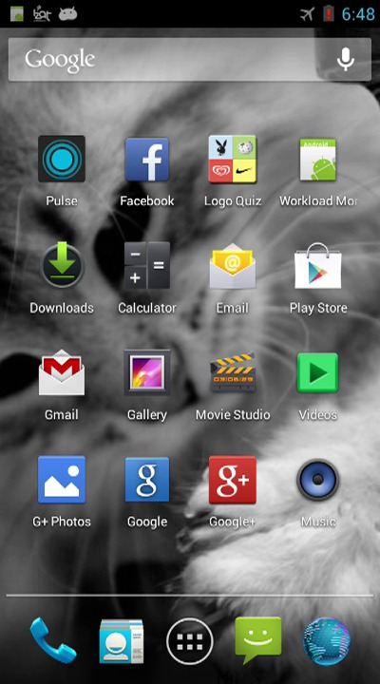
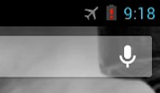
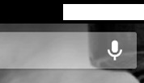
Dealing with Non-Determinism
Image 1
Image 2
Masked Image
Mask out non deterministic areas to compare images.
Notes:
Other techniques ignored pixels

Slide 17
Markup Costs
Find Lag Endings in
a single video of the recorded workload.
Still requires 5 hours of manual work
Speedup of 85x
Workload
10 Minute Workload
17 System Configurations
5 Iterations
➔ 85 Videos

Slide 18
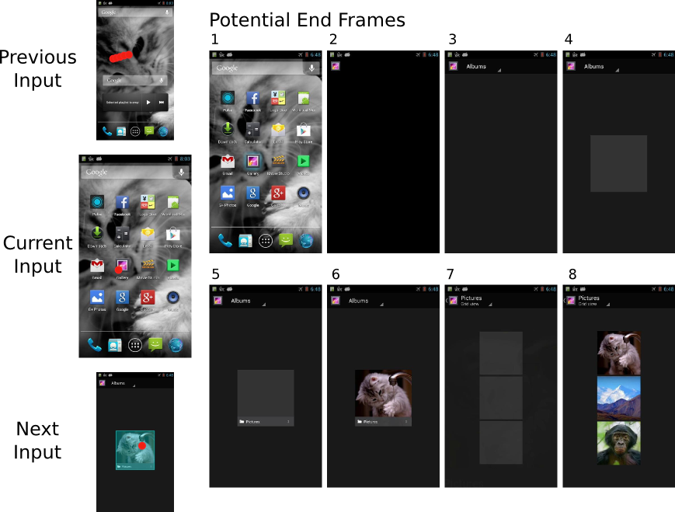
Finding Potential Lag Endings
Pick a lag ending from a selection of potential ending frames rather than looking at every single one.
Looking at 8 rather than 191
Notes:
How can I reduce the amount of frames I have to look at to select lag ending images
What If I gave you these? How long would it take you to find the lag ending?

Slide 19
Suggesting Potential Lag Endings
1
2
3
4
5
6
Start
Suggester
Suggestions
per lag
Collection of selected Endings
1
2
3
4
5

Slide 20
Markup Costs
Pick lag endings from suggested selection.
16:02 Minutes
Manual Markup Work
Speedup of 1347x
Workload
10 Minute Workload
17 System Configurations
5 Iterations
➔ 85 Videos

Slide 21
Research Goals
Rate Trade-Off considering
User Satisfaction
Interactive Mobile Workload
Distance to sweet spot
Methodology must ...
... deal with interactive workloads
... execute repeatable workloads
... execute workloads automatically
... identify interaction lags
... automatically rate user satisfaction
Notes:
Half way through identification

Slide 22
User Irritation Metric
Lag begin
Irritation Threshold
1
2
3
4
5
6
t
x
Lag ending of system configuration x
Calculate User Irritation
Set a user irritation threshold for each lag
If the length of a lag stays below the threshold, it counts as not irritating
If the length of a lag exceeds the threshold, a penalty is applied
Compare different system configurations in terms of user irritation
Notes:
Different companies have different threshold models → our proposed system is configurable

Slide 23
Irritation Thresholds
Rate Trade-Off considering
User Satisfaction
Setting Thresholds per lag in a workload
1
t
2
t
3
t
4
t
5
t
6
t
Threshold Policy
A
Notes:
Half way through identification

Slide 24
Irritation Thresholds
Rate Trade-Off considering
User Satisfaction
Setting Thresholds per lag in a workload
1
t
2
t
3
t
4
t
5
t
6
t
Threshold Policy
B
Notes:
Mention case study!

Slide 25
Research Goals
Rate Trade-Off considering
User Satisfaction
Interactive Mobile Workload
Distance to sweet spot
Methodology must ...
... deal with interactive workloads
... execute repeatable workloads
... execute workloads automatically
... identify interaction lags
... automatically rate user satisfaction
Notes:
Half way through identification

Slide 26
Final Methodology
Ending Images
Execute prerecorded mobile workload and capture a video
Pick lag endings from suggested selection
Run
once
Execute prerecorded mobile workload and capture a video
Detect lag endings using annotations
Compare lag lengths to different system configurations
Run
arbitrary number of times

Slide 27
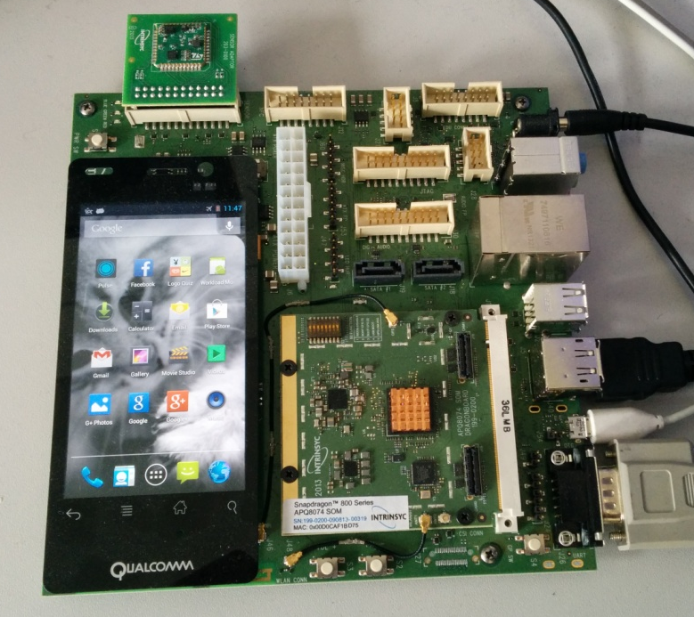
Frequency Governor Case Study
How close are Linux governors to the sweet spot?
Qualcomm Dragonboard 8074
Snapdragon 800 Processor
4.3’’ qHD 540x960 LCD
Android 4.3 Jelly Bean
Linux Governors
Conservative
Interactive
Ondemand
Notes:
We look at the governors Ondemand, Interactive and Conservative
Oracle is the sweet spot

Slide 28
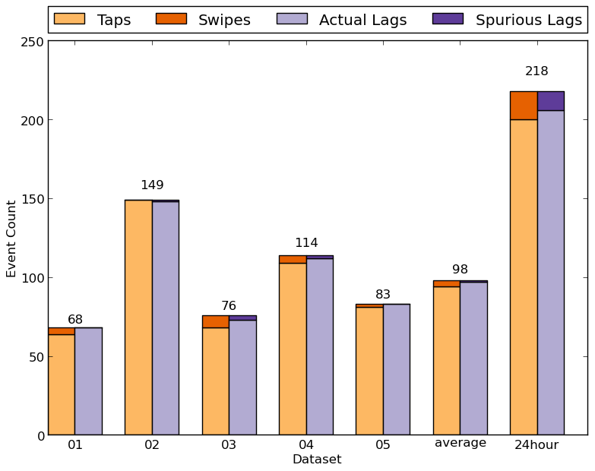
Workload Input Classification
5 Workloads
recorded from 5 Users
Each Workload:
10 Minutes
14 Fixed Frequencies
3 Standard Governors
5 Iterations
➔ 85 Runs
P1

Slide 29
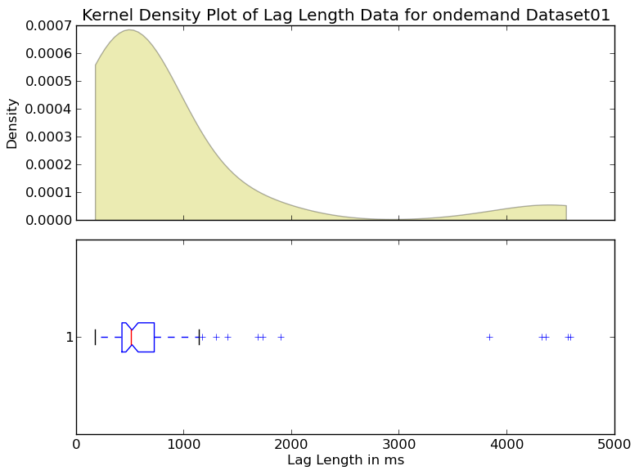
Lag Length of each Lag for Ondemand
Workload 01
Most Interaction Lags cluster around a 500ms length.
P1

Slide 30
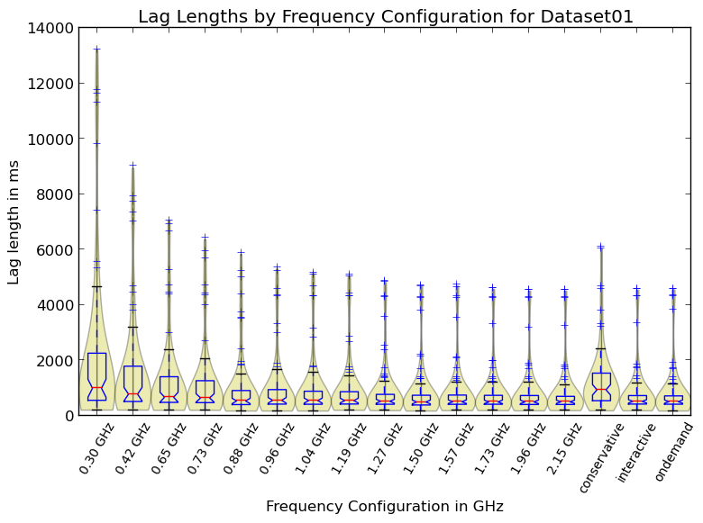
Lag Length of each Lag for all Frequency Configurations and Governors
Workload 01
For fixed Frequencies, the graphs do not change much the higher the frequency
→ Saturation?
P1

Slide 31
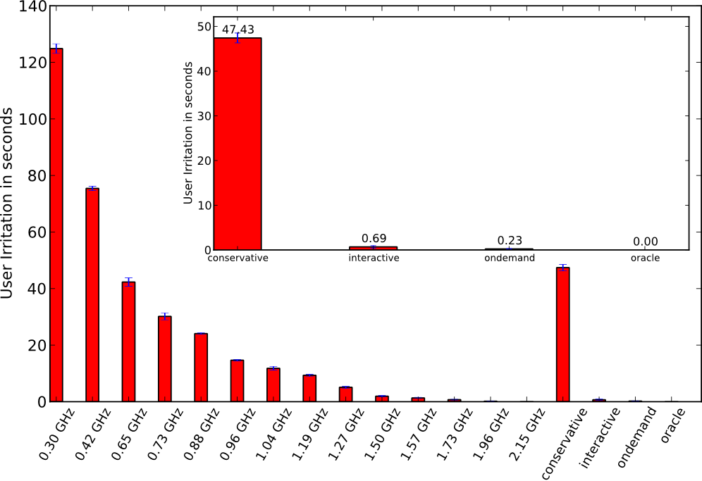
User Irritation
Workload 02
Irritation Threshold
110% of the lag length of the fastest frequency
→ Everything below this threshold does not count as irritating
Oracle Governor
Assume for each lag the lowest frequency that is still below the irritation threshold
Assume the least energy consuming frequency for all other periods.
P1
Lag begin
Irritation Threshold
1
2
3
4
5
6
t
Notes:
User irritated for that many seconds

Slide 32
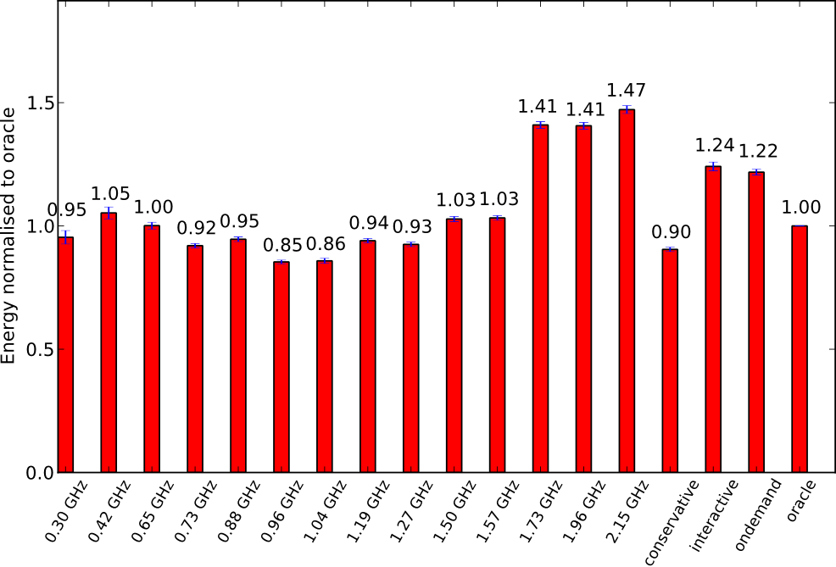
Energy Consumption
Workload 02
Power Model
Run a CPU intensive artificial micro benchmark with each available frequency fixed.
Calculate average power for each frequency and subtract idle state power.
P1

Slide 33
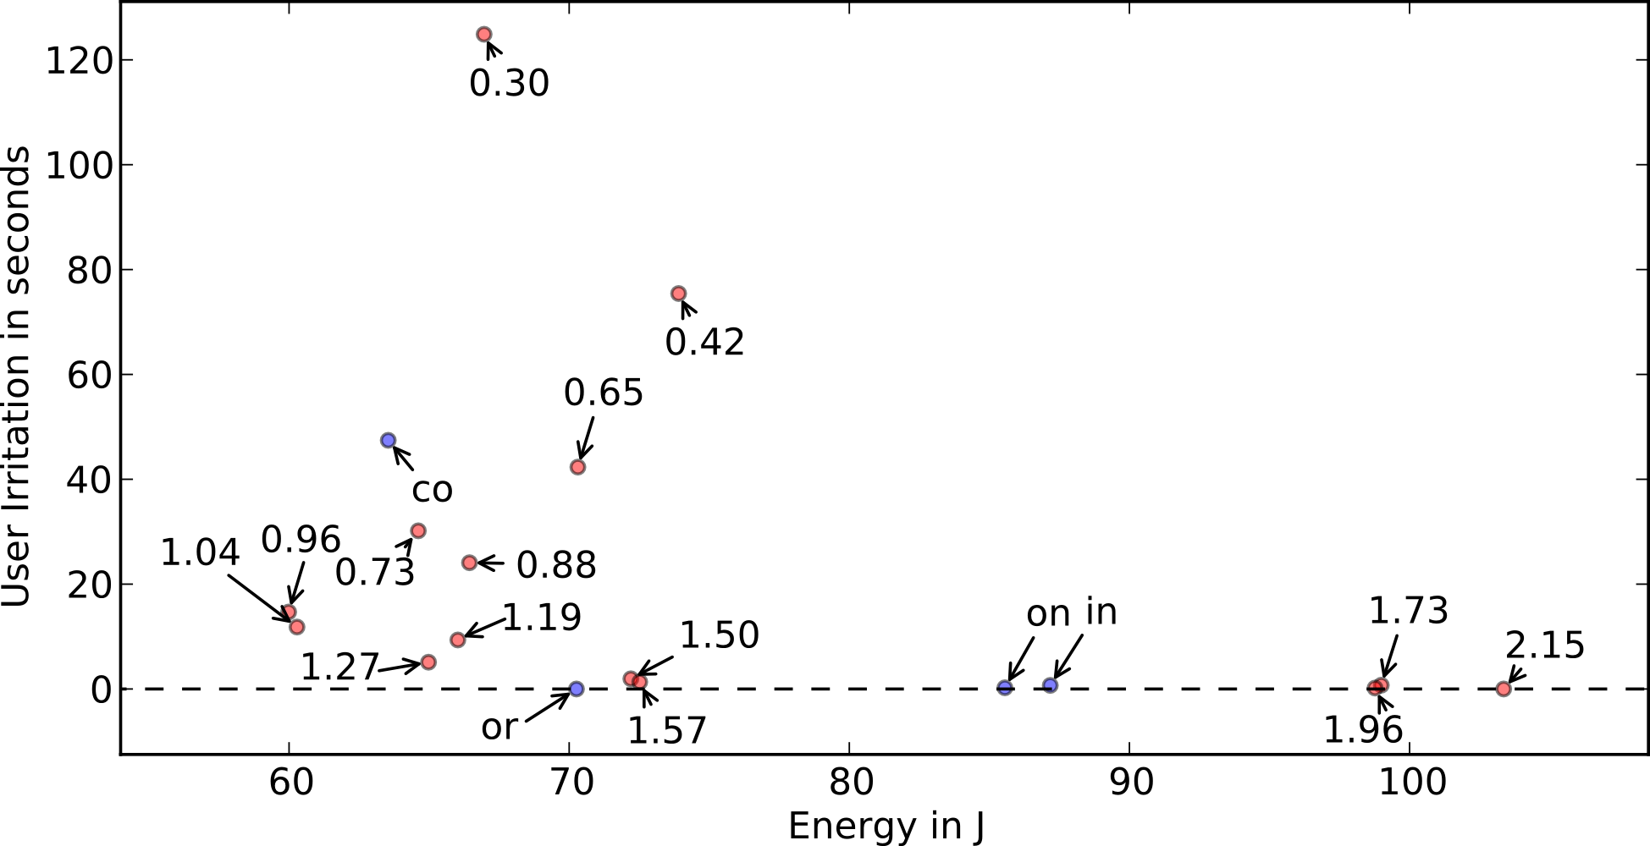
Energy and User Irritation
Workload 02
P1

Slide 34
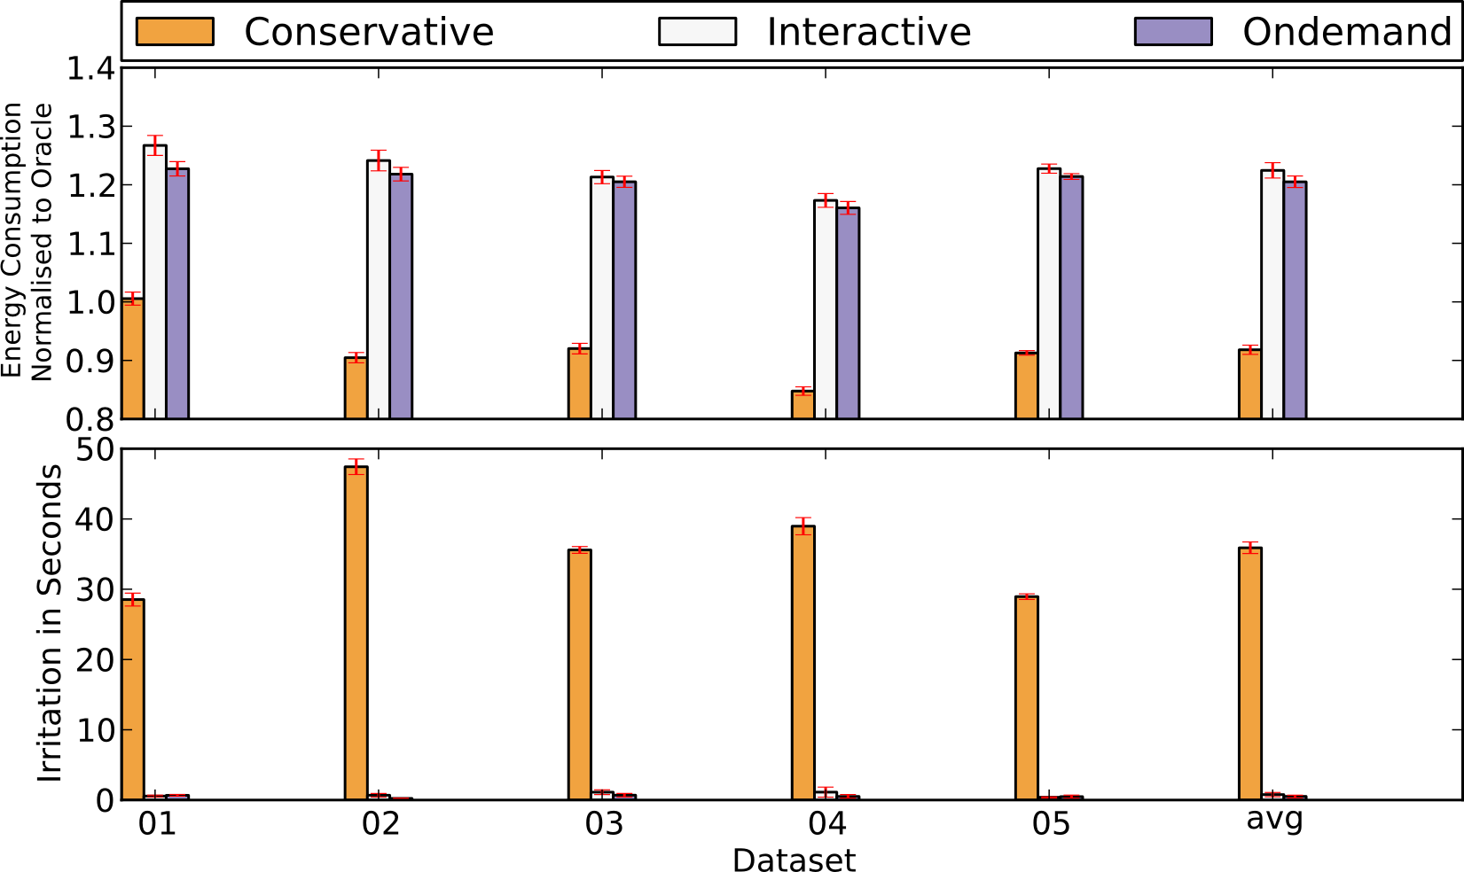
Energy and User Irritation
1.22
1.20
0.92
36
P1

Slide 35
Summary and Future Work
Rate Trade-Off considering
User Satisfaction
Interactive Mobile Workload
Distance to sweet spot
Automation of proposed method to a high degree (1347x speedup)
Demonstration of method feasibility for standard frequency governors compared to an oracle (up to 22% less energy)
Future Work
Apply methodology to big.LITTLE type heterogeneous processors
Integrate methodology into OS to make live decisions

