Slide 1

Spotify Track Recommender System
Patrick Ellison, Efat Gorji, Victoria Villani
April 12, 2024
1

Slide 2
Outline
Introduction
Background
Methodology
Implementation
Results & Evaluations
Conclusions
2

Slide 3

Introduction
In 2022, 589 million people utilized paid music streaming subscription services¹
Streaming services like Spotify posses over 100 million tracks available²
Vast music selections on streaming platforms makes it challenging to discover new songs.
Our project aims to create a content-based music recommendation system that leverages clustering techniques to identify similar tracks. By clustering tracks, cosine similarity can be computed within 1 specific cluster, enabling tailored song suggestions based on user preferences
3
Notes:
So why do we believe an accurate track recommender system can provide value?
In 2022, close to 600 million people subscribed to paid music streaming services.
These services, such as Spotify, possess over 100 million songs on their platforms.
The ever-increasing, and extensive music selection makes it very challenging to find personalized music and discover new songs.
Recognizing this challenge, our project aims to create a music recommender system that caters to users' preferences, thereby suggesting songs better tailored to their preferences.
To understand our users, we employed content-based filtering and analyzed track metadata. Using this information, we then employed similarity techniques to generate a list of recommended tracks.

Slide 4
Background
Implementing a recommendation system can significantly impact the music industry by increasing music streaming service engagement and user retention. It can provide exposure for artists to a broader audience and offer valuable insights into listener preferences and demographics, influencing future marketing.
The Spotify_1Million_Tracks dataset contains over 1 million tracks from 60 thousand artists, spanning a wide range of genres from 2000 to 2023. Its rich metadata serves as the foundation for building our recommendation system.
Cosine Similarity will be utilized to measure the similarity between tracks. By calculating the cosine of the angle between two vectors representing tracks, our system can determine the degree of similarity, potentially enabling accurate recommendations.
KMeans Clustering will be employed to group similar tracks together based on their similar features, possibly improving our recommendation system.
4

Slide 5
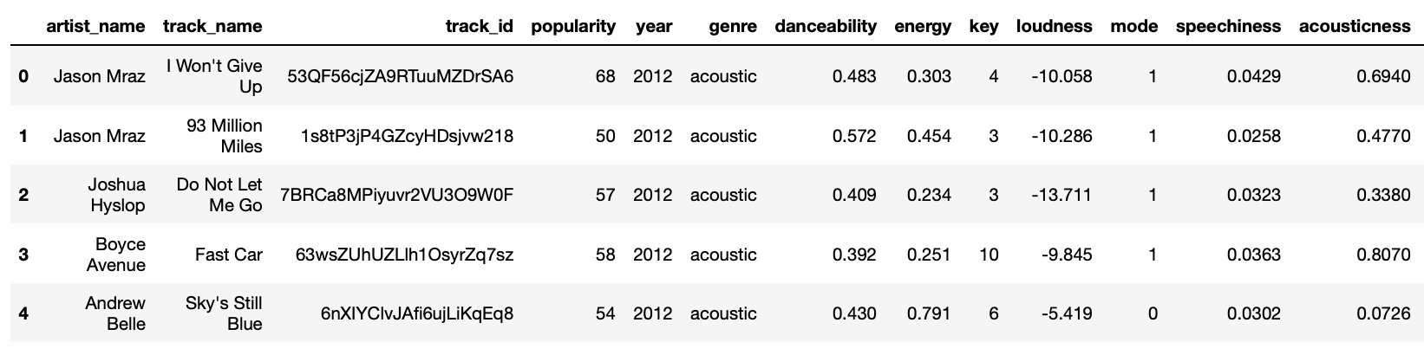
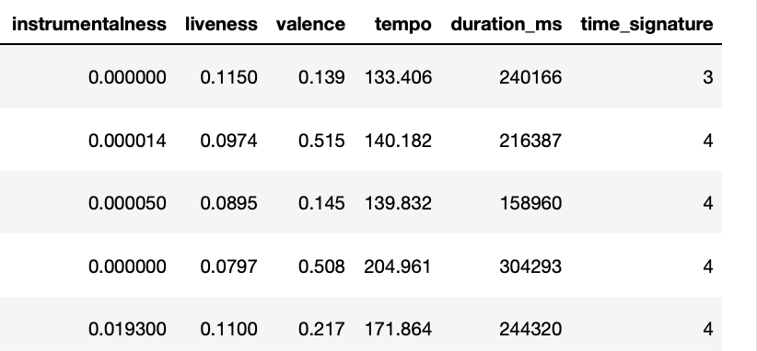
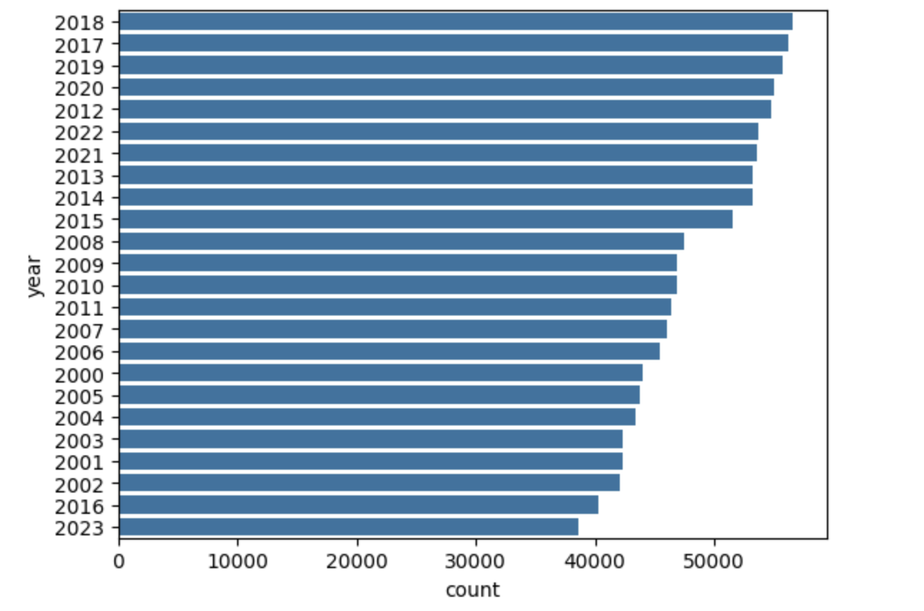
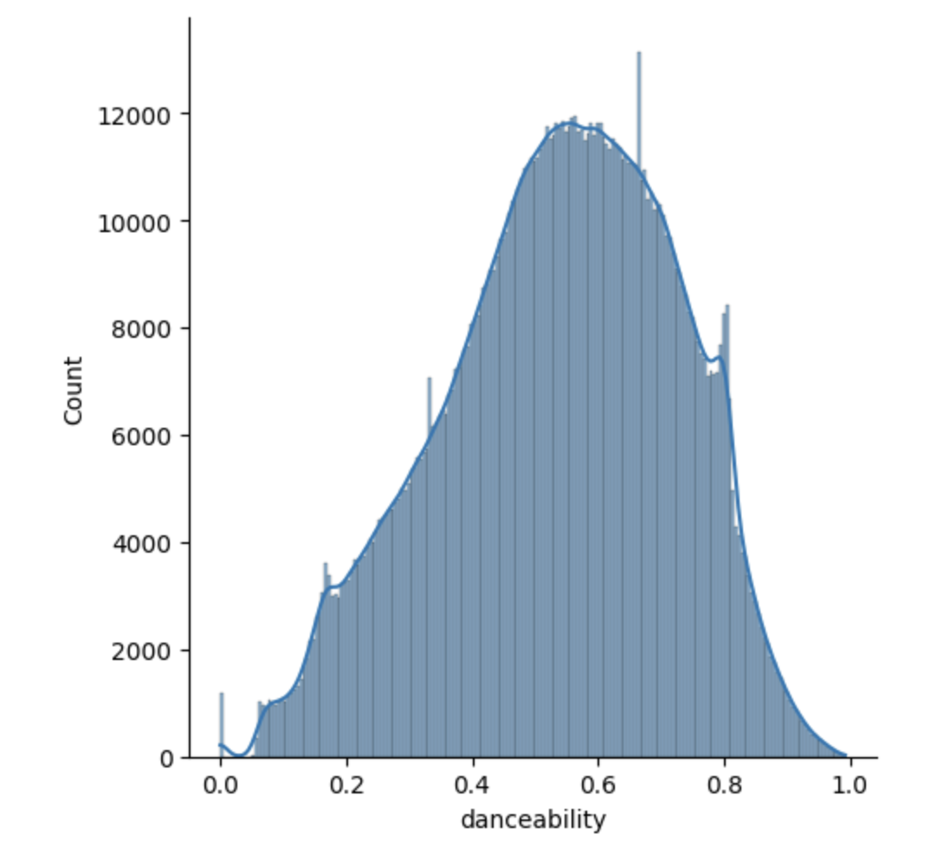
Methodology: Data Collection & Exploratory Data Analysis
Data collected from Kaggle - Spotify_1Million_Tracks
1,159,764 rows x 20 columns
Missing value & duplicate check
Removal of redundant columns
Descriptive statistics for continuous data to understand value ranges
Frequency visualizations for categorical data, histograms for continuous data
5
Notes:
Our Spotify track dataset was downloaded from Kaggle.
It contained over 1 millions songs, with metadata on each song. This included artist name, track name, genre, and a number of numerical measures such as popularity, energy, and danceability.
We removed 1 redundant column, an unnamed column that was equal to the index
There were no empty fields, and all tracks were unique, as indicated by no duplicate track IDs
We analyzed the frequencies of all ordinal and categorical features. Once significant finding was that our dataset contained the fewest number of songs in 2023 and the genres black-metal and gospel contained the most songs.
We also created histograms on all numerical features, noting the distributions for each. This showed us that some features such as danceability displayed normal distributions, while others such as acousticness and loudness did not.

Slide 6
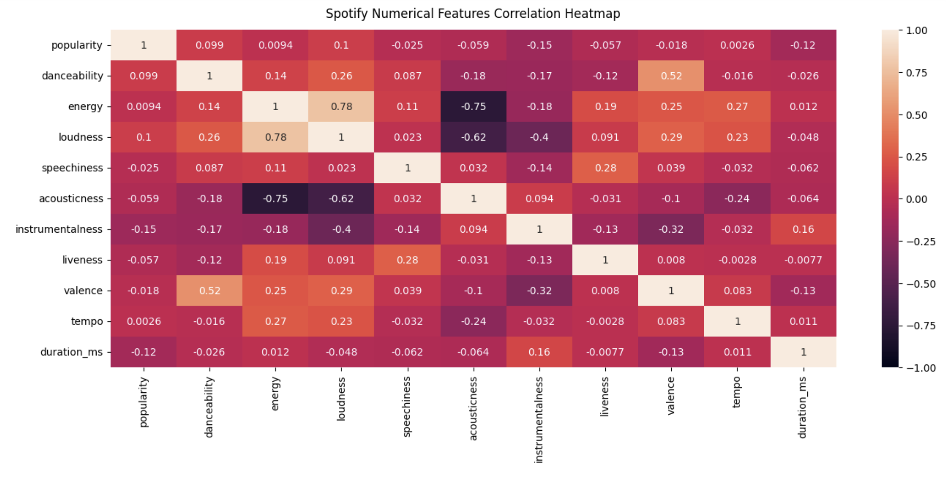
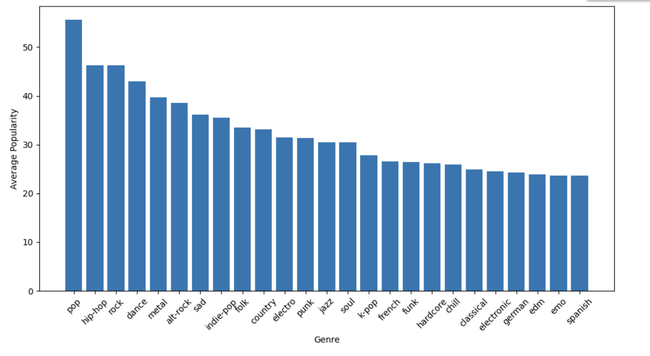
Methodology: Exploratory Data Analysis
Correlation Analysis for continuous data
Track popularity analysis: avg. popularity by year, avg. popularity by top 25 genres, etc.
Boxplots used to detect outliers
6
Notes:
We created a correlation heat map to investigate possible relationships between variables:
This visualization showed that some variables were more correlated with others, which may be obvious to some.
Danceability and energy seemed to be related to genre.
Energy was positively correlated with loudness, while also being negatively correlated with acousticness.
We also analyzed popularity with other variables and found some interesting trends:
With 2023 being the exception, as the years became were more recent, the average popularity of songs increased.
Average popularity was noticeably higher in certain genres, such as pop and hip hop, while significantly lower in others, such as electronic dance and Spanish music.
To detect outliers, we created box plots on all numeric variables:
We noticed some features, such as speechiness and liveliness, have an extremely high number of outliers.
We decided not to remove any because of the similarity algorithm we are employing. Cosine Similarity is not sensitive to outliers.
We also did not want to lose any songs, and by normalizing these variables, we believe the outlier issue will be mitigated.

Slide 7
Implementation: High Level
Cosign Similarity Implementation with KMeans Clustering
Pre-process Spotify Data
Vectorize: Bin popularity; Scale numerical features; Encode genre
Cluster: Train a cluster model; Assign clusters
Pickle dataset
Prepare Spotify Data
Unpickle
Filter for predicted cluster
Calculate Recommendations
Calculate Cosine Similarities
Extract the 10 most similar tracks
Display Recommended Tracks
Get features for a Track
Select a track from a Spotify playlist
Extract the same Spotify Data features
Prepare Track Data
Vectorize
Predict a cluster
7

Slide 8
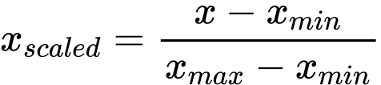
Implementation: Dataset Vectorization
Genre Encoding: Create dummy variables out of the track genres.
Numerical Features Scaling: Utilize MinMax Scaler to normalize the numeric features.
genre
breakbeat
blues
ambient
Genre_breakbeat | Genre_blues | Genre_ambient
1 | 0 | 0
0 | 1 | 0
0 | 0 | 1
8

Slide 9

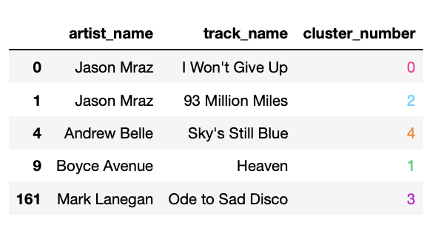



Implementation: Clustering
Normalized Spotify 1 Million Dataset
K-means clustering model
Sample cluster assignment to Spotify 1 Million dataset tracks
User selected track vector
User track assigned cluster
Trained K-means clustering model
9

Slide 10


Implementation: Cosine Similarity
Subset of Spotify_1Million Tracks Dataset Corresponding to User Selected Track Cluster
Track(n) | Track_feature1 | Track_feature2 | Track_feature3 | …
0 | Value₀ | Value₀ | Value₀ | Value₀
1 | Value₁ | Value₁ | Value₁ | Value₁
2 | Value₂ | Value₂ | Value₂ | Value₂
… | … | … | … | …
User Selected Track Vector
Applied cosine similarity between the user-selected track and the subset of the data frame corresponding to the user selected selected track cluster to retrieve the 10 most similar songs
User Selected track
Track n
$$θ$$
$$\cos\left(θ\right)= \frac{A⋅B}{∥A∥ ∥B∥}$$
10

Slide 11
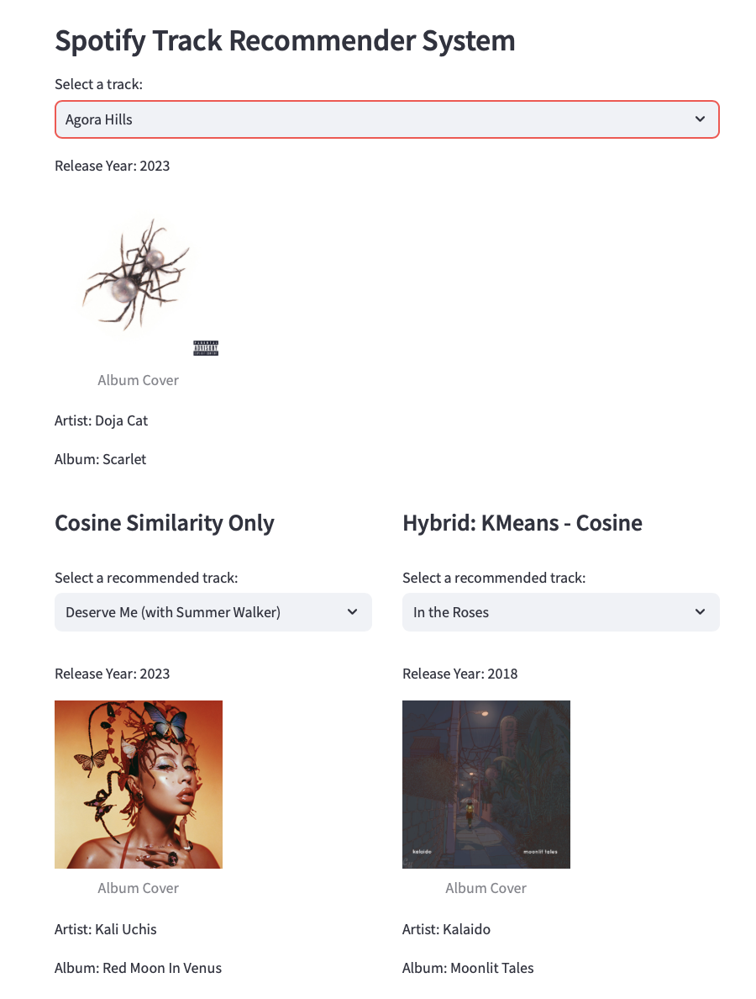
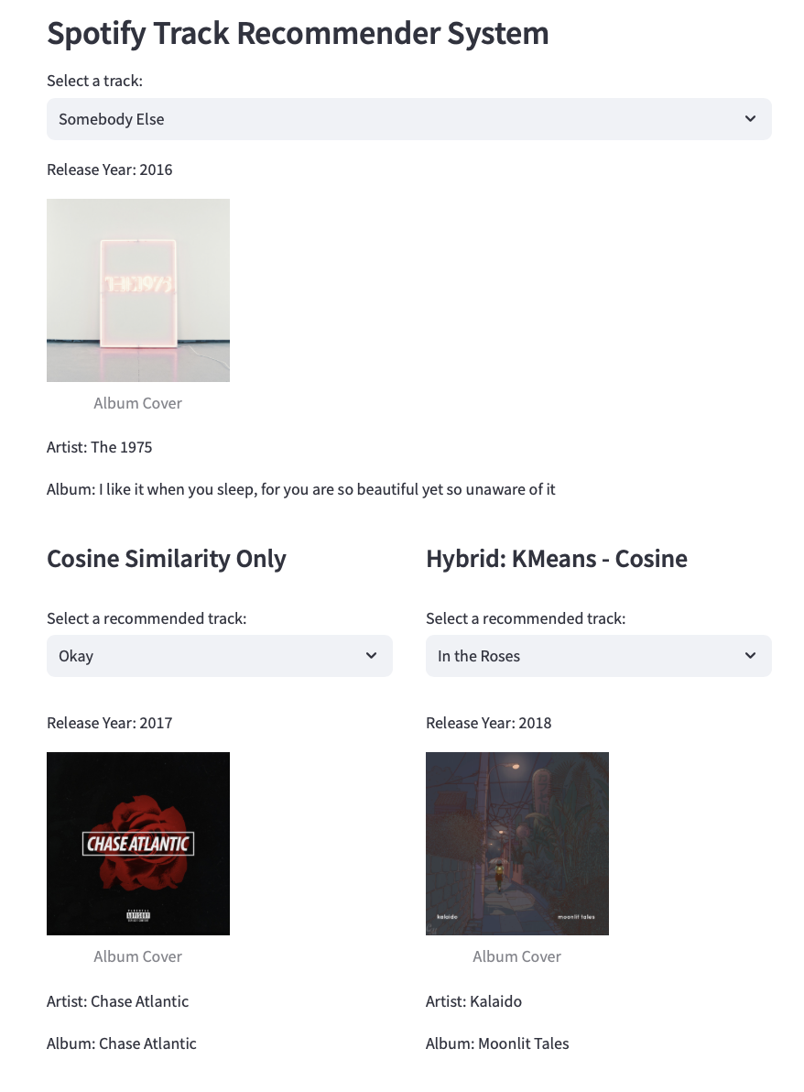
Result: Sample UI Recommendations for User Selected Track
11

Slide 12
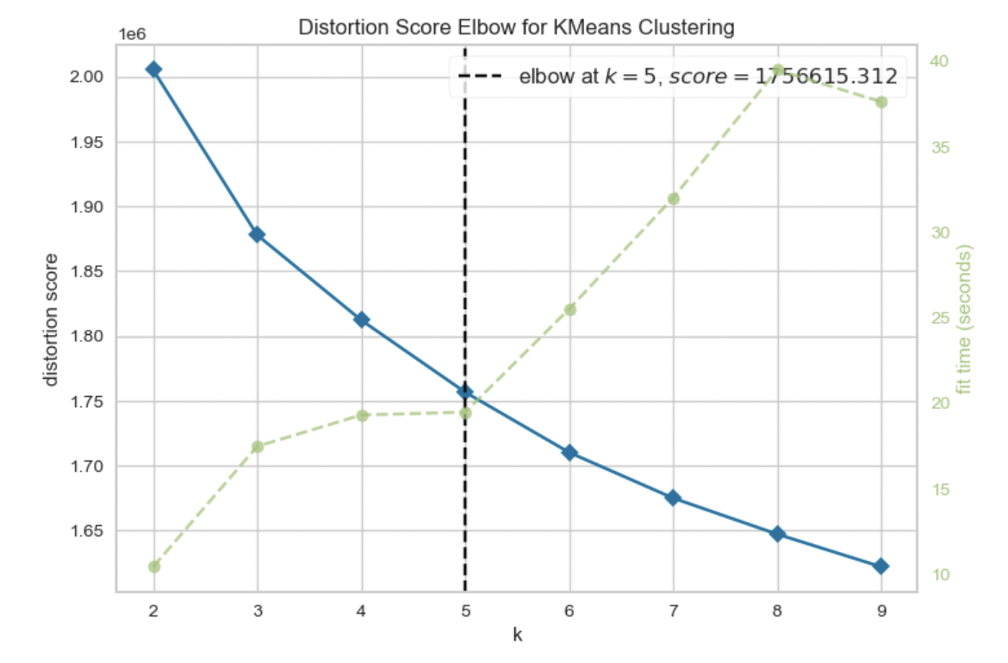

Evaluations
Clustering Evaluation
Recommendations Evaluation
R-precision = $\frac{|G∩R_{1:\left|G\right|}|}{|G|}$
Method | Average R-Precision
Cosine Similarity | ~0.32
K-Means + Cosine Similarity | ~0.14
12

Slide 13
Conclusions
The recommender system utilized both cosine similarity and clustering for music recommendations.
The system experienced challenges in balancing computational efficiency and quality when comparing average R-precision scores.
This project sets a foundation for future improvements, with collaborative-filtering techniques³ recommended for more personalized recommendations.
13

Slide 14
References
IFIP. (2023). Global music report 2023. https://globalmusicreport.ifpi.org
Spotify. (2024). About spotify. https://newsroom.spotify.com/company-info/
Sánchez-Moreno, D., González, A. B. G., Vicente, M. D. M., Batista, V. F. L., & García, M. N. M. (2016). A collaborative filtering method for music recommendation using playing coefficients for artists and users. Expert Systems with Applications, 66, 234-244.
14

