Slide 1


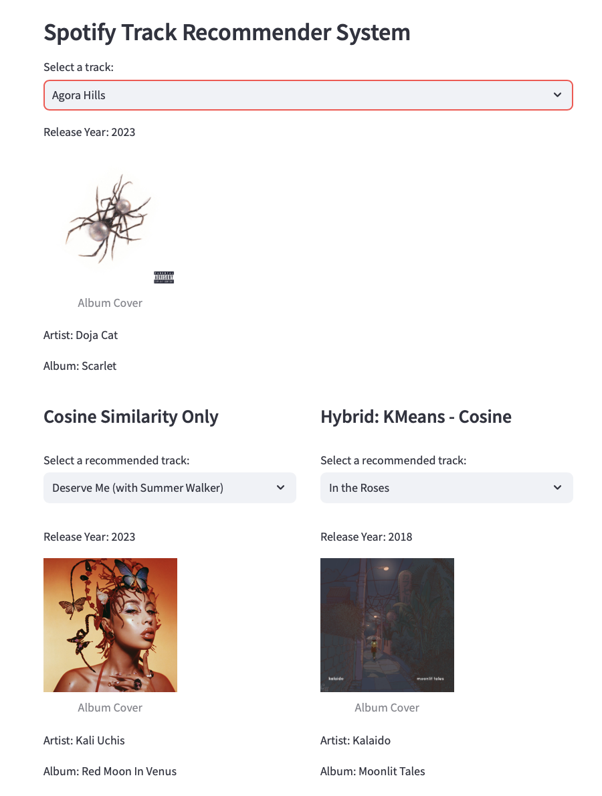
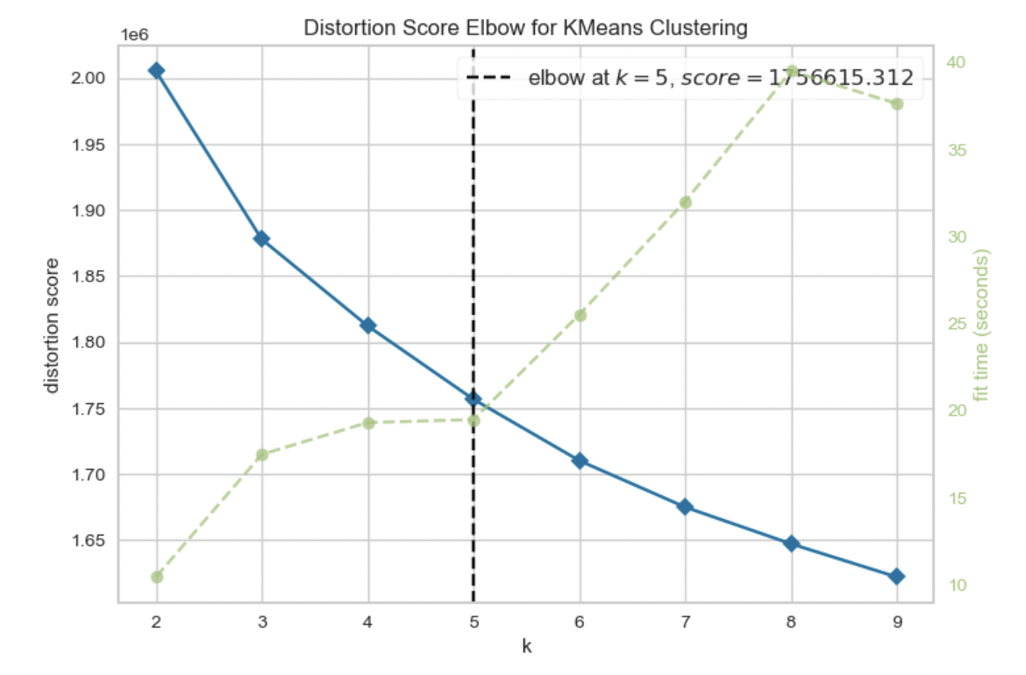
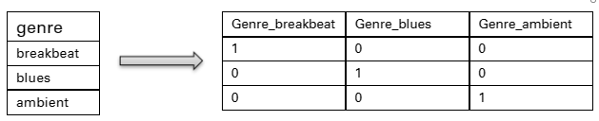

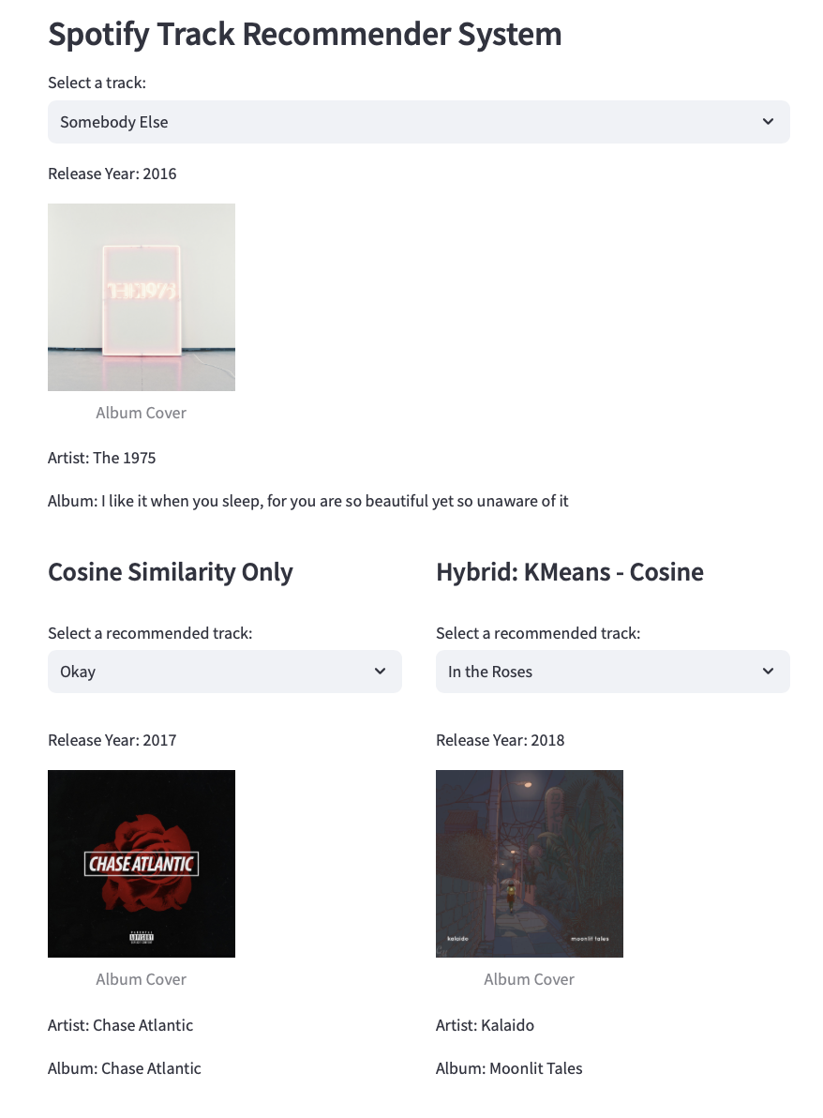
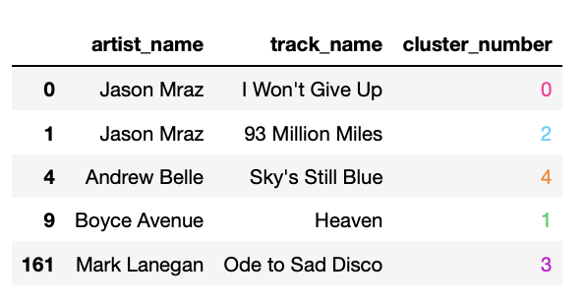

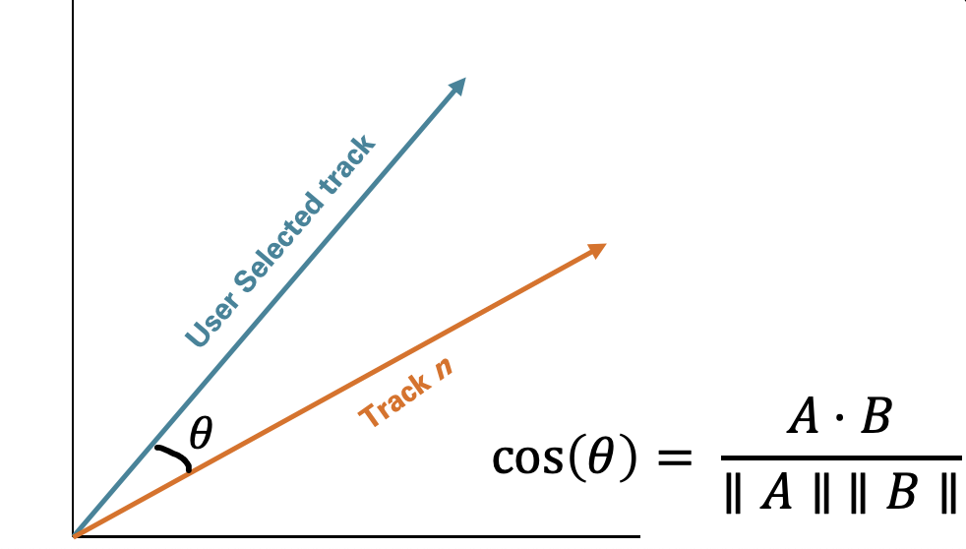

Spotify Recommender System
Victoria Villani, Patrick Ellison, Efat Gorji
vvillani1@myseneca.ca, pellison1@myseneca.ca, egorji1@myseneca.ca
Seneca Polytechnic
Abstract
Challenges
Examples
Evaluations
\
As music streaming subscriptions rise¹, this project aims to enhance user music discovery through personalized recommendations using content-based filtering techniques. By analyzing Spotify's music dataset with cosine similarity and clustering, the system suggests tracks aligning with user preferences, while balancing recommendation quality and computational efficiency.
Balancing recommendation quality and computational efficiency.
Incorporating artist names into the recommendation system effectively.
Addressing memory limitations and encoding issues.
Optimizing clustering techniques for organizing music data.
Clustering Evaluation
Elbow Method
Recommendations Evaluation
R-precision: $\frac{|G ∩R_{1:|G|}}{|G|}$
Framework
Converting Songs to Vectors
Encoding genre:
Scaling numeric features:
Clustering vectors (5 Clusters)
Assigning a cluster to the user track
Extracting recommendations from the cluster via cosine similarity
Method | Average R-precision
Cosine Similarity | ~0.32
K-Means + Cosine Similarity | ~0.14
Objectives
Develop a Spotify Recommender System to provide personalized song recommendations.
Utilize cosine similarity and clustering techniques to analyze Spotify's music dataset.
Balance recommendation quality and computational efficiency.
Enhance user music discovery and engagement through tailored recommendations.
Consolidate coding in a user-friendly graphic interface (UI)
Conclusions
The Recommender System utilized cosine similarity and clustering for music recommendations, navigating challenges in balancing computational efficiency and quality. This project sets a foundation for future improvements, with collaborative-filtering techniques recommended for more personalized recommendations².
References
IFIP. (2023). Global music report 2023. https://globalmusicreport.ifpi.org
Sánchez-Moreno, D., González, A. B. G., Vicente, M. D. M., Batista, V. F. L., & García, M. N. M. (2016). A collaborative filtering method for music recommendation using playing coefficients for artists and users. Expert Systems with Applications, 66, 234-244.

