Slide 1
Reconstruct and Decompose: Extracting and Sonifying Rhythmic, Melodic and Spectral Patterns for Analytical and Creative Use
Dr. phil. Egor Polyakov
egor.poliakov@hmt-leipzig.de

Slide 2
Personal Background
Post-doc researcher: HMT Leipzig
Specialization:
Electroacoustic composition
Computer-assisted music analysis
Roles:
Lecturer: Music analysis, informatics, acoustics
Personal tutoring: Realizing live-electronics & fixed media compositions
Software Proficiency:
Max/MSP, Open Music, Audiosculpt, Csound
Programming: Python

Slide 3
Teaching Emphasis
Core focus: Spectral analysis & FFT-based sound processing
=> Many students lack programming experience!
Solution: Emphasis on accessible and user-friendly tools
Favorite tool: IRCAM Audiosculpt
Pros: Reputable for spectral analysis & sound resynthesis
Cons: Not open-source or cross-platform
Addressing Audiosculpt limitations:
Secured volume license
Ensured OSX computer access for students

Slide 4
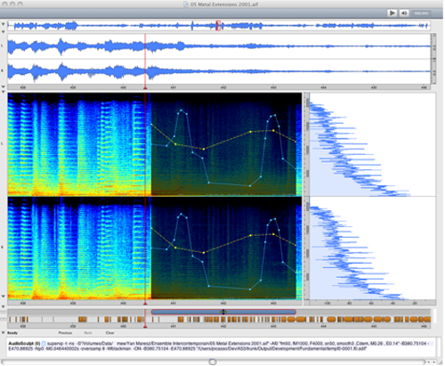
Waveform
FFT Analysis/Manipulations
Command line input (supervp)
Audiosculpt (1993-2019)

Slide 5
FFT-based Resynthesis Method by Marco Stroppa (IRCAM)
Analyze using Audiosculpt, then save as SDIF
Load the SDIF in OM and resynthesize using OM2Csound/OMChroma
An alternative: Utilize SuperVP as a command line tool for both analysis and resynthesis
Challenges
The sonification and resynthesis processes of analyzed material in these environments were tedious, necessitating the use of several software platforms:
Requires familiarity with three distinct environments: Audiosculpt, OM, and Csound
Limited tutorials available, making it impractical for instructional use

Slide 6
Issues with Audiosculpt:
Limited to 32-bit; IRCAM did not update to a 64-bit version
Not compatible with OSX version 10.15, introduced in 2019
Implication: Post-OSX 10.15 Apple computers couldn't run Audiosculpt
Audiosculpt Alternatives:
Spear
Faced several bugs during use
Design revolves around partial tracking and linear prediction
Sonic Visualizer
Absence of SDIF support; cannot be merged with the OM setup

Slide 7
Max/Max for Live Patches:
Developed various patches specifically for FFT-Resynthesis, including pitch and freeze effects
Pros: Well-suited for real-time processing
Cons:
Lacks detailed signal and spectrum visualization
No support for signal related offline calculations
Not open-source

Slide 8
Towards a Unified Solution:
Initial Engagement: Delved into Python in 2020, deepening my expertise with symbolic music representations during the CAMAT project at HfM Weimar (2021-2022)
Inspiration: Heavily influenced by the FMP Notebooks by Meinard Müller
The Objective: Set out to devise a Python-based solution, echoing Stroppa's techniques. The goal: A unified tool eradicating the need to navigate three separate environments
Features and Vision:
Emphasizing extensive visualizations with Plotly/Bokeh to foster accessibility and enhance the learning experience
Leveraging pandas data frames as the core container for FFT/DFT values.
Employing LilyPond and Verovio for symbolic notation

Slide 9
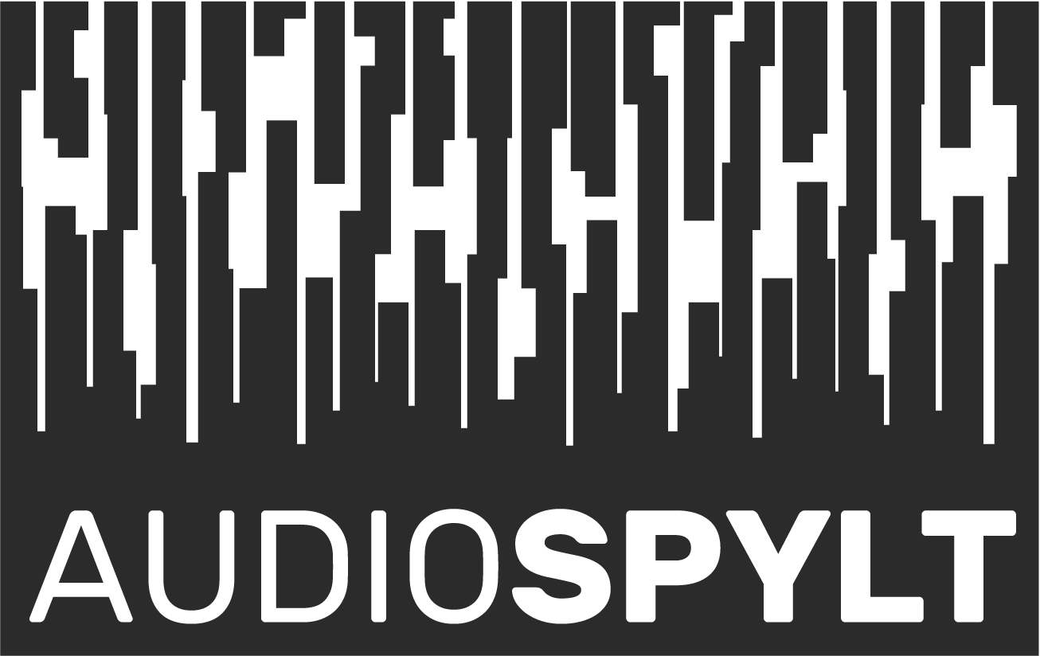
AudioSpylt
Python-based toolbox tailored for sound analysis, re/synthesis, and diverse visual & symbolic sound representations
Operates within the Jupyter Notebooks environment
Predominantly designed for instructional use, emphasizing varied resynthesis patterns. Initially developed for composition students I mentored last year.
Alpha version available on GitHub
Notes:
(not a real toolbox but rather a collection of educational material)

Slide 10
Audio Generation with Python: The Basics
Visual Analogy: Generating audio can be likened to plotting a waveform
Think of the audio waveform as a visual plot where time is on the x-axis and amplitude is on the y-axis
Sampling Rate: Consider it as the "resolution" of your canvas
Higher sampling rates provide more detailed audio representation, similar to how high-resolution images are more detailed
Amplitude Representation: Python uses IEEE 754 double-precision binary floating-point format by default
In layman's terms: This precision is more than adequate for representing audio, even at 32 bits
Complex Spectra Creation: By summing multiple sine waves, you can create more intricate audio spectra
Each sine wave can represent a distinct frequency component. When they're combined, they form a complex audio signal

Slide 11
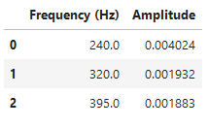
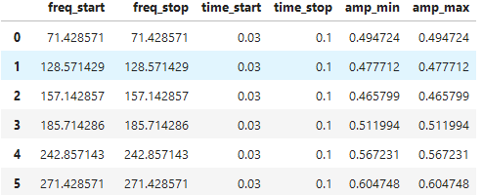
Basic Representation: Frequencies and their corresponding amplitudes can be tabled
This table serves as a fundamental blueprint of the audio's spectral content
without time domain
with time domain

Slide 12
Toolbox overview
Instructional Notebooks: Designed to provide comprehensive explanations and demonstrations on core audio concepts
wave_sampling_window:
Covers sampling rate, Nyquist Frequency, window functions, and implications of sampled material length on frequency resolution
wave_vs_dft_3d:
Displays 2D and 3D representations of DFT spectra, emphasizing sine/cosine component visuals

Slide 13
2. Analysis Notebooks:
audio_load_dft:
Incorporates basic audio editing functions such as trim and fade
Offers customizable peak detection methods
Features thresholding functions and split analysed data into multiple DFTs
3. Visualizations and Symbolic Rendering:
visual_tsv:
plotting scripts for TSV/data frames
symbolic_mei:
symbolic visualizations tailored for data frames

Slide 14
4. TSV Manipulations and Resynthesis:
df_pitch_stretch:
Implement pitch/stretch alterations on TSVs with time domain data
2df_copypaste, 2df_merge:
Execute freeze effects and various kinds of spectral interpolation
resynth:
Resynthesize based on TSVs containing time domain data

Slide 15
Why Verovio?
Limited Rendering Options in Python:
Python presents limited choices when it comes to sheet music rendering
Limitations of Music21:
Music21 relies on external programs such as LilyPond or MuseScore for rendering MusicXML data
The rendering process results only in PDF or PNG formats
Verovio's Native Python Integration:
Verovio can operate as a native package within the Python environment
Support for MEI, MusicXML, Humdrum
Rendering directly as SVG, providing scalable and high-quality sheet music graphics

Slide 16
Issues with Current Symbolic Music Formats
Lack of Modern Notation Support:
Current symbolic music formats largely cater to traditional notation techniques
Modern notation, particularly those employed in contemporary, experimental, and electroacoustic genres, often isn't adequately represented
LilyPond's Limited Scope:
While LilyPond stands out by offering some degree of support for unconventional notation techniques, it only has a brief section dedicated to these
Increasing Demand for Modern Notation:
As music from the 20th century enters the public domain, there's an influx of compositions using graphic or microtonal notation
Urgent need for updated symbolic music formats that can accommodate these notations
Transcription and Annotation Needs:
The rise of live-electronics and acousmatic music genres necessitates accurate transcription and annotation tools

Slide 17
"The sonogram, a graphic spectral analysis by computer, has been regarded as a solution to the visual representation of electroacoustic music. I regard it as a very useful aid rather than a solution. A sonogram is a type of literal spectral analysis at a chosen resolution: at too high a resolution detail becomes lost in a blur; at too low a resolution there is insufficient detail. But a sonogram is not a representation of the music as perceived by a human ear – in a sense it is too objective. Its shapes therefore have to be interpreted and reduced to perceptual essentials. In other words, someone has to decide what to retain and discard from the representation, and more particularly, try and determine how much detail is pertinent to the alert listener. … How much is too much, and how much is not enough?" (p. 108).
Smalley, D. (1997). Spectromorphology: explaining sound-shapes. Organised Sound, 2, 107 - 126.
"Sonograms are undoubtedly very useful images when used in analysis, particularly when dealing with complex spectra found in some sound-based compositions. The issue to be raised here is: can we hear everything that we see in these images? Of the information we cannot perceive, how relevant is it in the end?" (p. 203).
Landy, L. (2007). Understanding the Art of Sound Organization. MIT Press.

Slide 18
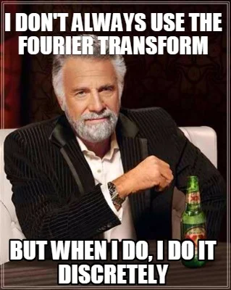
Thank you!
AudioSpylt alpha:
https://github.com/klirr2007/audiospylt
E-Mail: egor.poliakov@hmt-leipzig.de

