Slide 1
Machine Learning (25SC2107E)
Insider Threat Detection Using Elastic Net Regularized Logistic Regression
Team Members
2520030436 – G. Eesha Yuktha
2520030258 – B. Sai Saranya
Under the Esteemed Guidance of
Name of the Machine Learning faculty name with designation and department

Slide 2
Contents
Abstract
Introduction
Literature survey
Problem Statement and Objectives
Flow Chart
Results
Hardware and Software requirements
Conclusion
Future Scope

Slide 3
Abstract
Problem: Insider threats occur when authorized users misuse their legitimate access to steal sensitive information or damage organizational systems.
Approach: An Insider Threat Detection System is proposed using Elastic Net Regularized Logistic Regression to classify user activity as normal or potentially malicious.
Features used: Behavioral and security-related signals are analyzed — login patterns, file access, access frequency, and unusual user behavior.
Why Elastic Net: Elastic Net combines L1 and L2 penalties, enabling automatic feature selection while reducing overfitting on correlated behavioral data.
Evaluation: The model is trained and evaluated using accuracy, precision, recall, F1-score, and ROC-AUC.
Impact: Demonstrates how ML can help cybersecurity teams flag suspicious behavior early and reduce the risk of insider attacks.
Project Snapshot
1500 event records, 23 features
250 unique users, 7 departments
Model: Elastic Net Logistic Regression
Metrics: Accuracy, Precision, Recall, F1, ROC-AUC

Slide 4
Introduction
Insiders are employees, contractors, or partners who already hold legitimate access — they don't need to break in, they can simply misuse the access they have.
Perimeter defenses such as firewalls and intrusion-detection systems are built to catch outside attackers, so they largely miss valid credentials being used for malicious purposes.
Behavioral analytics offers a way forward: monitoring login times, file access volume, downloads, and device usage can reveal patterns that don't fit a user's normal routine.
This project applies Elastic Net regularized Logistic Regression to structured behavioral log data — 1500 events across 23 login, file-access, and device-usage features.
Goal: build an interpretable, regularized classifier that flags suspicious activity early, even when the underlying features are highly correlated with one another.
23
Behavioral features tracked
250
Unique users monitored
7
Departments covered

Slide 5
Literature Survey
Rule-based / SIEM systems: Rule-based & SIEM systems apply static thresholds and known-misuse signatures; effective for known patterns but blind to novel behavior and prone to high false-positive rates.
Unsupervised anomaly detection: Clustering, PCA and isolation-forest methods flag outlier sessions without needing labeled attacks, but struggle to separate genuine anomalies from true insider threats.
Supervised ML classifiers: Logistic regression, random forest and SVM trained on labeled behavioral logs perform well, but plain (unregularized) models can overfit or mis-weight correlated features.
Deep learning / sequence models: LSTMs and autoencoders capture temporal user behavior and are powerful, but need large labeled datasets and are harder to interpret for security audits.
This project's direction — regularized linear models: Elastic Net logistic regression balances feature selection (L1) with stability under correlated inputs (L2) — a strong, interpretable fit given the highly correlated behavioral features observed in this dataset (e.g. file_access_count and unique_files_accessed, r ≈ 0.90).

Slide 6
Problem Statement and Objectives
Problem Statement
Malicious insiders act using valid credentials, so their activity blends into normal traffic and manual log review doesn't scale. Unregularized models further struggle with the many correlated behavioral features (e.g. file access and download volume) and the roughly 4:1 imbalance between normal and threat events.
Objectives
Perform structural EDA and data-quality checks on the 1500-record insider-threat log dataset.
Engineer and encode behavioral and categorical features (department, role, device type) for modeling.
Handle the 80:20 class imbalance via class-weighting or resampling.
Train an Elastic Net regularized Logistic Regression classifier that selects relevant features and controls multicollinearity.
Evaluate the model using accuracy, precision, recall, F1-score, and ROC-AUC.
Deliver an interpretable, deployable screening tool for security analysts.

Slide 7
Flow Chart
1. Data Collection (raw behavioral logs)
↓
2. Data Quality Checks (missing values & duplicates)
↓
3. Exploratory Data Analysis (EDA)
↓
4. Feature Engineering & Encoding
↓
5. Train / Test Split + Class-Imbalance Handling
↓
6. Elastic Net Logistic Regression Training
↓
7. Model Evaluation & Threat Classification Output

Slide 8
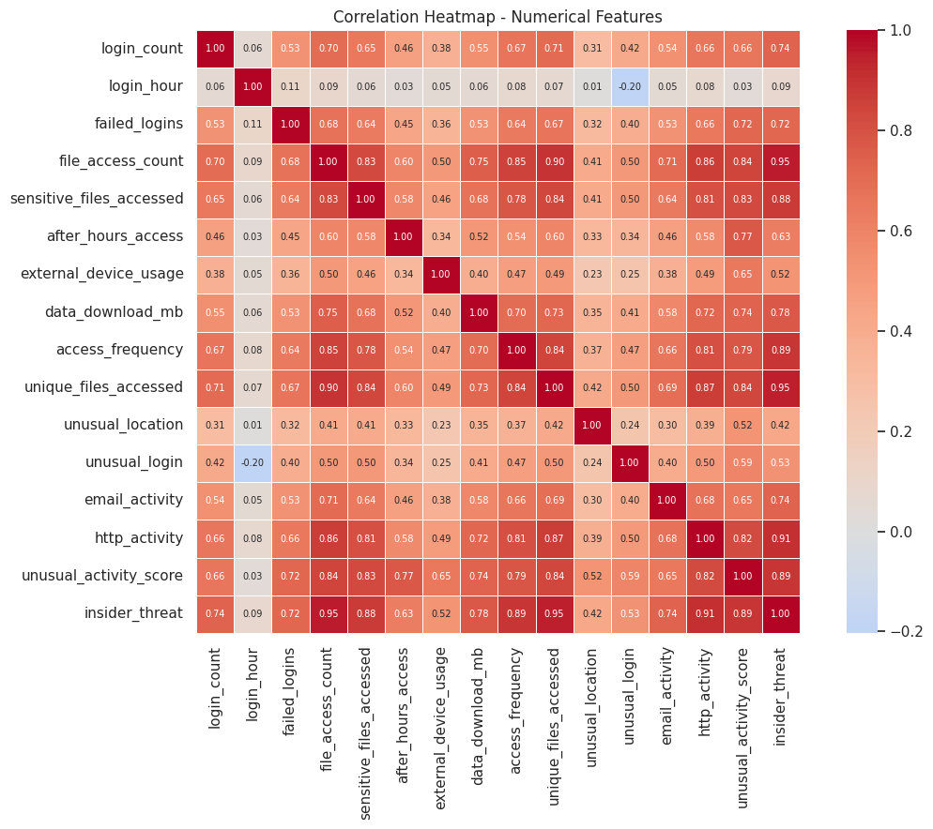
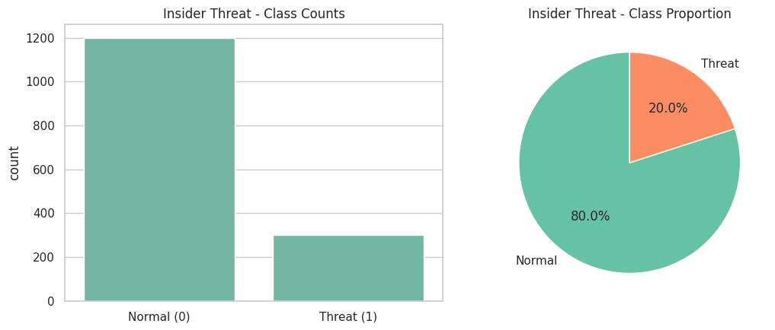
Results
Phase 1 — Exploratory Data Analysis (model training & metrics: next phase)
1500
Event records
23
Features
0
Missing / duplicate values
80:20
Normal : Threat ratio
Correlation heatmap — numerical features
Class distribution — Normal vs Threat (80% / 20%)
Sensitive-file access, after-hours access & data downloads are markedly higher for threat events.
file_access_count, unique_files_accessed & http_activity correlate most with insider_threat (r > 0.9).
Many features are highly correlated (r > 0.7) — motivating Elastic Net's combined L1/L2 penalty.

Slide 9
Hardware and Software requirements
Hardware Requirements
Software Requirements
Processor: Intel i5 / AMD Ryzen 5 or higher
RAM: 8 GB minimum (16 GB recommended)
Storage: 5 GB free disk space
GPU: not required (optional for future deep-learning extensions)
Internet connection (for Colab / package installs)
Python 3.9 or higher
Jupyter Notebook / Google Colab
Libraries: pandas, NumPy, scikit-learn
Libraries: matplotlib, seaborn (visualization)
OS: Windows, Linux, or macOS

Slide 10
Conclusion
EDA on the 1500-record, 23-feature dataset confirmed clean data — no missing values or duplicates — alongside a notable 80:20 class imbalance.
Behavioral features such as sensitive-file access, after-hours access, and data-download volume clearly separate threat from normal activity.
Several features are highly correlated with one another, a strong motivation for Elastic Net's combined L1/L2 regularization.
These findings validate the project's choice of an Elastic Net regularized Logistic Regression model — able to select informative signals while staying robust to multicollinearity.
The next phase will encode categorical features, handle class imbalance, train the model, and evaluate it with accuracy, precision, recall, F1-score, and ROC-AUC.

Slide 11
Future Scope
Train and tune the Elastic Net Logistic Regression model (regularization strength, l1_ratio) and benchmark against Random Forest, XGBoost and SVM baselines.
Address the class imbalance with class-weighting, SMOTE, or threshold tuning.
Extend features with temporal / session-level behavior for earlier warning detection.
Integrate the model into a real-time monitoring dashboard for security teams with automated alerting.
Explore deep learning (LSTM / autoencoder) approaches as more labeled data becomes available.
Add explainability (e.g. SHAP) so analysts can audit why an event was flagged.

Slide 12
Thank you

