Slide 1
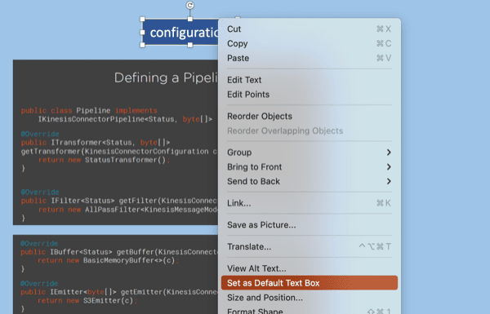
Default Textbox
Hello World

Slide 2
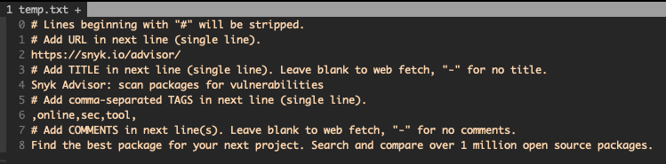
Semantic Search.
Embeddings relevant:
TITLE, TAGS, COMMENTS

