Slide 1
Kateryna Hrebeniuk
Santander Customer Satisfaction
Kaggle competition
General Assembly
DS-BOS-08
April 25, 2016

Slide 2
Problem statement
From frontline support teams to C-suites, customer satisfaction is a key measure of success. Unhappy customers don't stick around. What's more, unhappy customers rarely voice their dissatisfaction before leaving.
Santander Bank is asking to help them identify dissatisfied customers early in their relationship. Doing so would allow Santander to take proactive steps to improve a customer's happiness before it's too late.
The competition provides dataset with hundreds of anonymized features to predict if a customer is satisfied or dissatisfied with their banking experience.
It is supervised learning binary classification task. My goal is to learn training data and predict the categorical class labels of new instances based on past observations.

Slide 3
DATA
Train and test datasets are provided by Kaggle. An anonymized datasets contain large number of numeric variables. "ID" column shows the customer’s identifier. The "TARGET" column is the variable to predict. It equals 1 for unsatisfied customer and 0 for satisfied customer.
File descriptions:
train.csv - the training set including the target (76020 rows x 371 columns)
test.csv - the test set without the target (75818 rows x 370 columns)

Slide 4
Outcome
Output file should contain two columns – "ID" and "TARGET". "ID" column should show the customer’s identifier from test dataset and "TARGET" column should show probabilities for each observation.
There are 5,125 teams that participate this competition. The best public AUC score, that is calculated on approximately 50% of data, is 0.844134 and the worst AUC score is 0.296686. The goal is to find the best score using different algorithms but try not to overfit the model.

Slide 5
Data Exploration
Train dataset
Shape of dataset: 76020 x 371
There are 0 row(s) out of 76020 have missing values.
Counts by satisfaction:
Satisfied customers: 73012 ( 96.0 % )
Unsatisfied customers: 3008 ( 4.0 % )
Test dataset:
Shape of dataset: 75818 x 370
There are 0 row(s) out of 75818 have missing values.

Slide 6
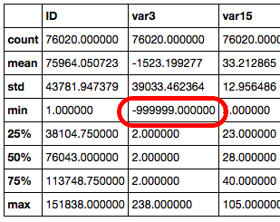
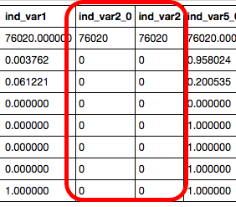
Data cleaning
Descriptive statistics
34 columns out of 371 are empty and 29 columns are duplicated!

Slide 7
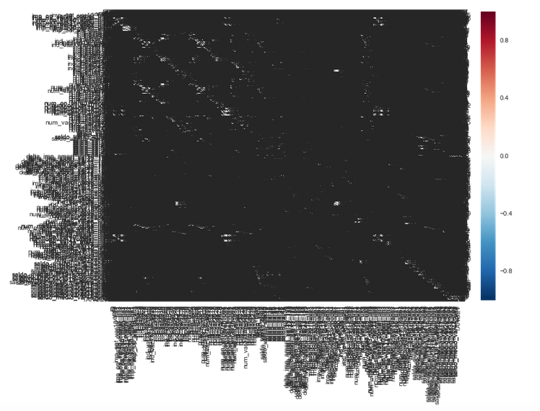
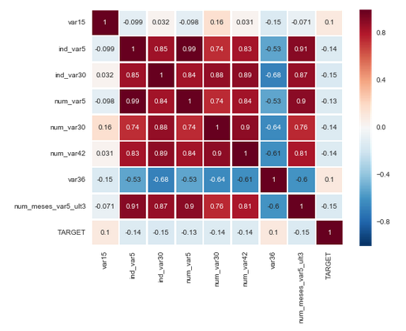
Data mining
Explore correlations
all feaures vs most correlated with target

Slide 8
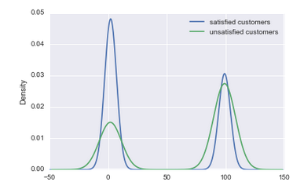
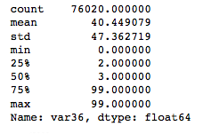
Data mining
var36 exploration
According to density chart above customers with values of 0,1,2 or 3 in var36 are less unhappy than those who has 99.

Slide 9
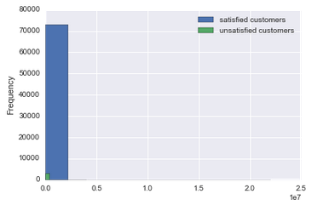
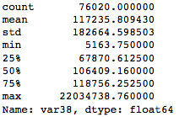
Data mining
var38 exploration
It seems that var38 is customer's account balance. And I wanted to see if there is relationship between customer's satisfaction and account balance.

Slide 10
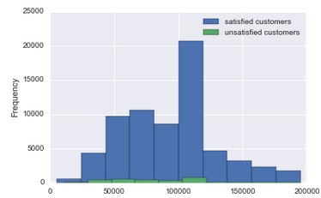
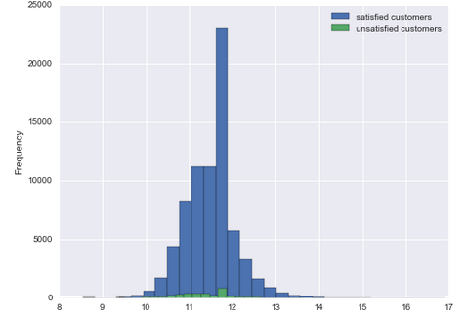
Data mining
var38 exploration
removed outliers vs logarithmic

Slide 11
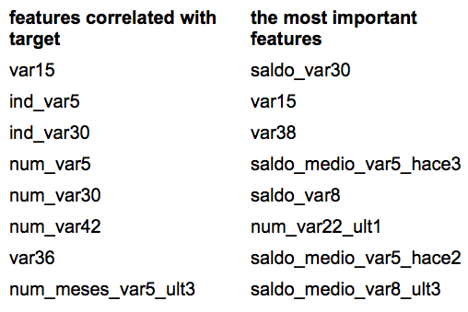
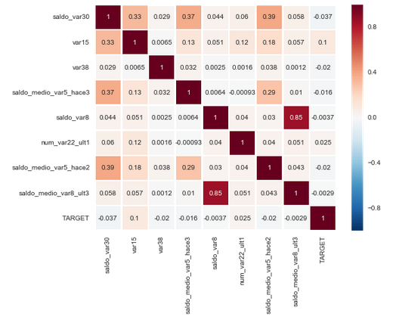
Feature Selection
I used GradientBoostingClassifier() to find important features

Slide 12
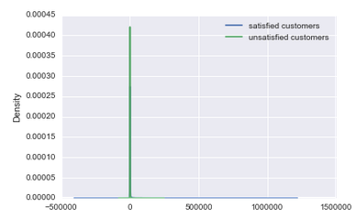
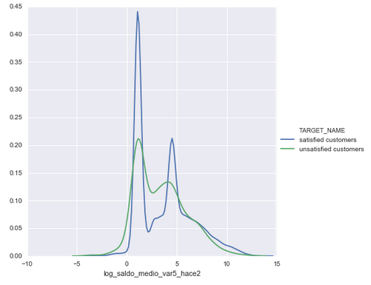
Feature Selection
saldo_medio_var5_hace2 exploration
original vs logarithmic

Slide 13
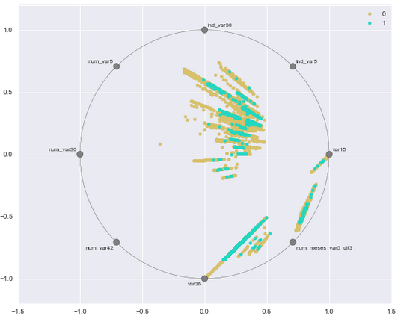
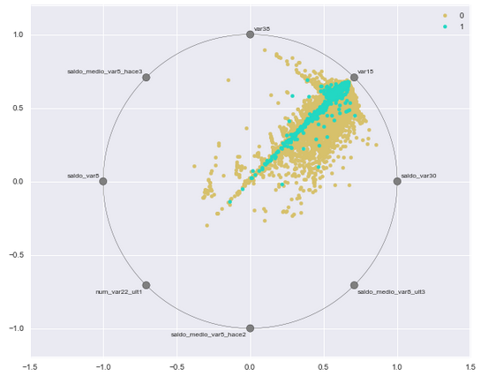
RadViz vizualization
features correlated with target
the most important features
RadViz is a way of visualizing multi-variate data. It is based on a simple spring tension minimization algorithm. Basically you set up a bunch of points in a plane. In our case they are equally spaced on a unit circle. Depending on which class that sample belongs it will be colored differently.

Slide 14
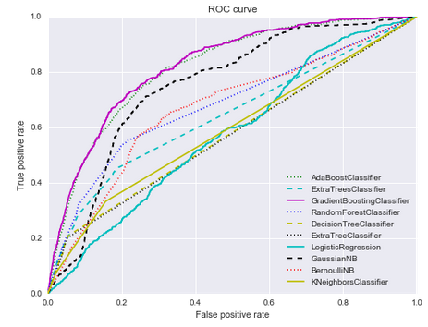
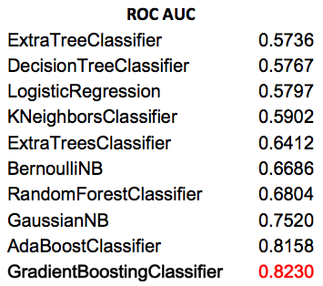
Modeling

Slide 15
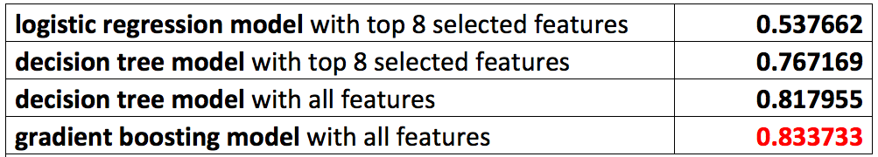
Results
Public Leaderboard
(calculated on approximately 50% of the test data)

Slide 16
Conclusions
It was a very interesting project and experience. The data was pretty clean and I spent my time exploring the features and comparing different prediction algorithms. From the data exploration, I have found that satisfied and dissatisfied customer data is mostly overlapped. I have tried various models and found that the Gradient Boosting ensemble model from scikit-learn package works the best for this data set.
My AUC score on public board is 0.833 and the best score in the Kaggle competition is 0.844. According to Kaggle forum the highest scores were obtained using the XGboosting (Extreme Gradient Boosting) algorithm.
Another way to get better performance can be achieved by using automated parameter tuning.

Slide 17
Kateryna Hrebeniuk
Thank you!
General Assembly
DS-BOS-08
April 25, 2016

