Slide 1

MMP305 Midterm Project
Spencer Evan Alex

Slide 2

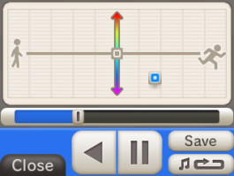
3DS Audio recorder
This info is from Nintendo’s website
There are 12 Sound Filters to modify your voice:
Robot
Tunnel
Low Harmony
Helium
Transceiver
High Harmony
Budgie
Whistle
Synth Harmony
Electric Fan
Buzzer
Trumpet

Slide 3
notes
General
Need to detect formants, amplitude, pitch information
Will need noise gate to filter out unwanted sounds
Record in reactor
Use tape module
Use real time input device
For trumpet
Use trumpet sample and modulate it with voice info
Modal bank could be used
Or sampler
For Tunnel
Use simple echo/delay with feedback loop
For Robot
Could use flanger
Maybe some echo
For Harmony
Make synth polyphonic
Must have stable way to detect pitch
Recording Quality
8 bit audio
32KHz

Slide 4
11/5/24
Work on pitch and envelope detection

