Slide 1
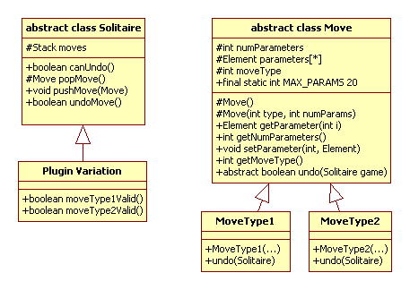
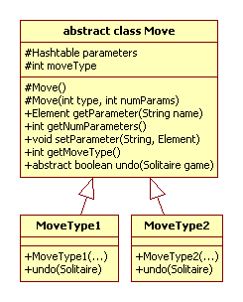
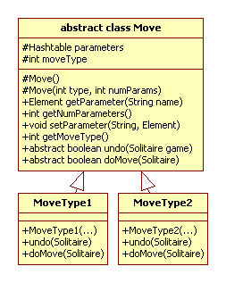
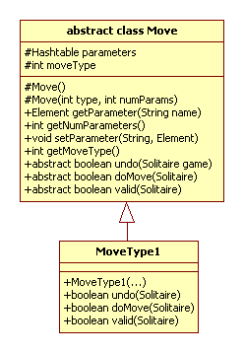
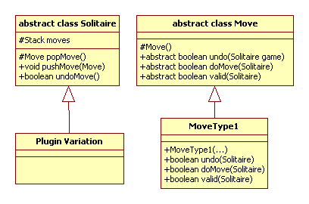
Design Criteria
Flexibility It should be possible for any move to be undone. A solitaire variation may decide on a move-by-move basis, which moves can be undone.
Single point of control Each move must conform to specific logic, based upon the existing board state. We will be ruthless in our attempt to have only one piece of code responsible for the following decisions: (1) validating that a move is legal; (2) executing the move; (3) undoing a move.
Version V1
Version V1.1
Version V1.2
Version V1.3
Final Version

Slide 2
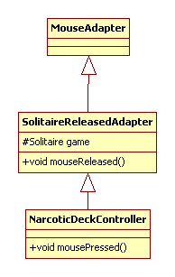
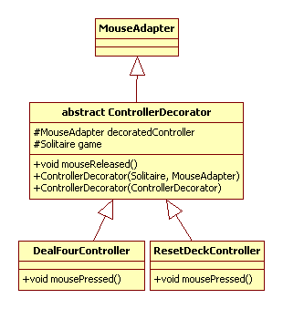
Design Criteria
Independence Enable independent controllers to be written for independent moves
// Initialize Controllers for DeckView
deckView.setMouseAdapter(new NarcoticDeckController (this));
// Initialize Controllers for DeckView
deckView.setMouseAdapter(
new ResetDeckController (
new DealFourController (this, new SolitaireReleasedAdapter(this))));
public class NarcoticDeckController extends SolitaireReleasedAdapter {
Solitaire narcoticGame = null;
public NarcoticDeckController(Solitaire game) {
super(game);
narcoticGame = game;
}
public void mousePressed (java.awt.event.MouseEvent me) {
// Find the deck from our model
Deck d = (Deck) narcoticGame.getModelElement("deck");
Pile p1 = (Pile) narcoticGame.getModelElement("pile1");
Pile p2 = (Pile) narcoticGame.getModelElement("pile2");
Pile p3 = (Pile) narcoticGame.getModelElement("pile3");
Pile p4 = (Pile) narcoticGame.getModelElement("pile4");
if (!d.empty()) {
// Deal four cards
Move m = new DealFourMove(d, p1, p2, p3, p4);
if (m.doMove(narcoticGame)) {
// SUCCESS: have solitaire game store this move
narcoticGame.pushMove(m);
// have solitaire game refresh widgets that were affected
narcoticGame.refreshWidgets();
}
} else {
// Must be a request to reset the deck.
Move m = new ResetDeckMove (d, p1, p2, p3, p4);
if (m.doMove(narcoticGame)) {
// SUCCESS
narcoticGame.pushMove (m);
// refresh all widgets that were affected by this move.
narcoticGame.refreshWidgets();
}
}
}
}
Original
Decorated Design

