Slide 1
Online Retail Marketing
Emily Greff

Slide 2

The Problem
The marketing team at a UK based online retail store needed help understanding their customers.
They needed to analyze customer behaviors to determine the customers they should target for marketing.
They did not have a way of grouping similar customers together so that they could make that determination.

Slide 3
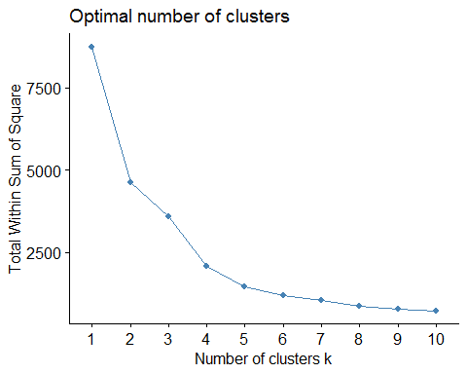
The Approach
The approach is to create clusters of customers to determine the group considered the target.
Group customers based on frequency of purchases and total amount spent using k-means clustering.
Use the Elbow method to determine the optimal number of clusters.
Optimal number of clusters is 4.

Slide 4
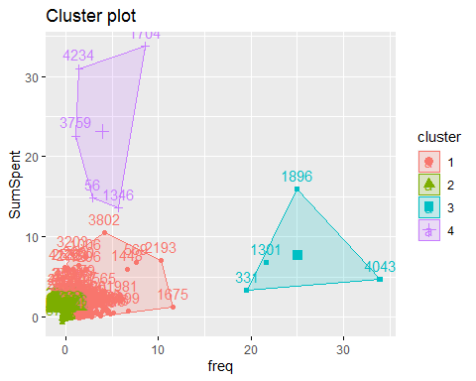
The Results
Cluster 1 - Low frequency and low amount spent
Cluster 2 – Very low frequency and Very low amount spent
Cluster 3 – Very high frequency and high amount spent
Cluster 4 – Low frequency and very high amount spent
Marketing team should focus more on cluster 3, which is their target customers.
Marketing team should focus less on cluster 2 customers since they are not their target.

