Slide 1
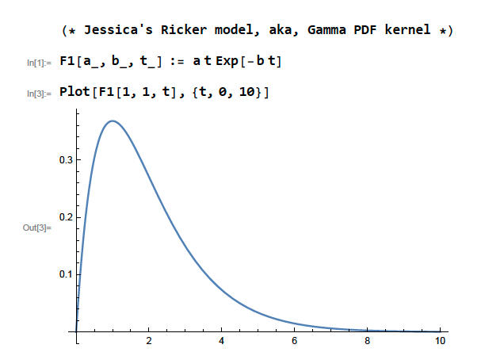
Extracted data
Step 1: Bayesian meta-analysis
Step 2: Determine pulse category
Step 3: Post-analysis (four GLMs)
Combine models
w CI above 0.5: classic pulse response
Response variables
Mixture model
Pulse response (yes/no) (answers Q1, Q3)
w CI contains 0.5 intermediate pulse response
Timing of peak (Q2, Q3)
w CI below 0.5 & m CI does not contain 0: linear pulse response
Magnitude of peak (Q2, Q3)
Ricker model
Individual model fits
Linear model
w CI below 0.5 & m CI contains 0: no pulse response
Slope/speed of linear response (Q2, Q3)
Intercept
Slope (m)
w = 1
Linear
Covariates
Weight (w)
Posterior estimates
Spatial scale
MAP and MAT
Pulse amount
Response group (carbon- or water-related)
Pulse amount × response group
MAP × MAT (answers Q3)
MAP × response group (Q3)
MAT × response group (Q3)
Magnitude of response
Magnitude of peak response (y_{peak})
Mixture weight, w
w = 1
Ricker
Time of peak, t_{peak}
Time since pulse
Magnitude of peak, y_{peak}
Time of peak response (t_{peak})
Slope of linear response, m

Slide 2
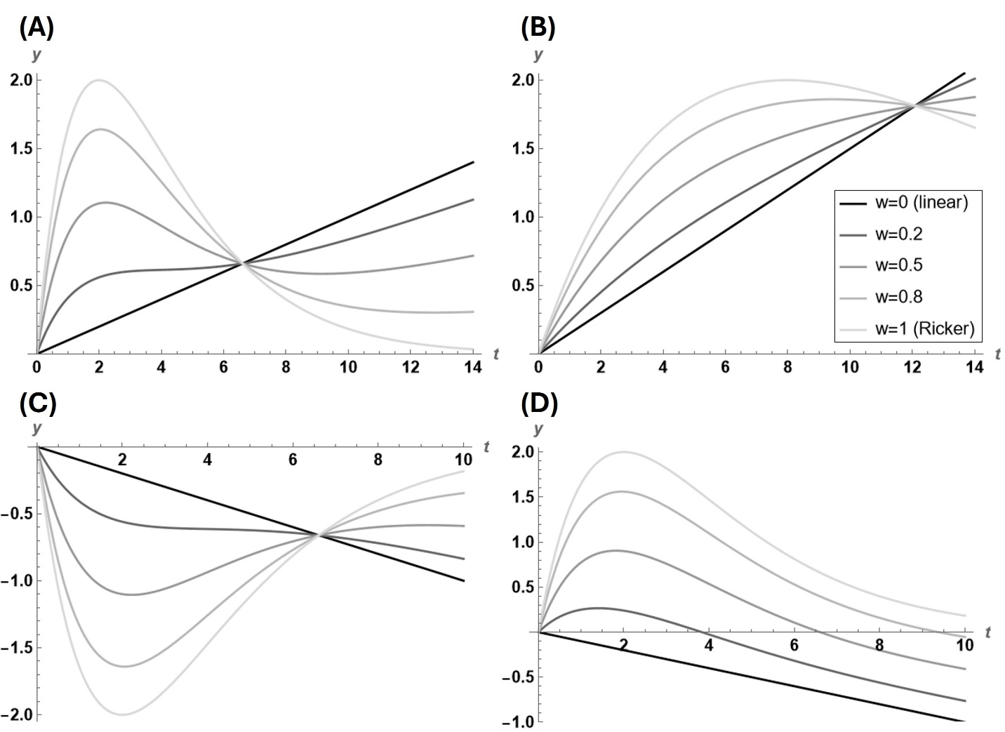

Slide 3
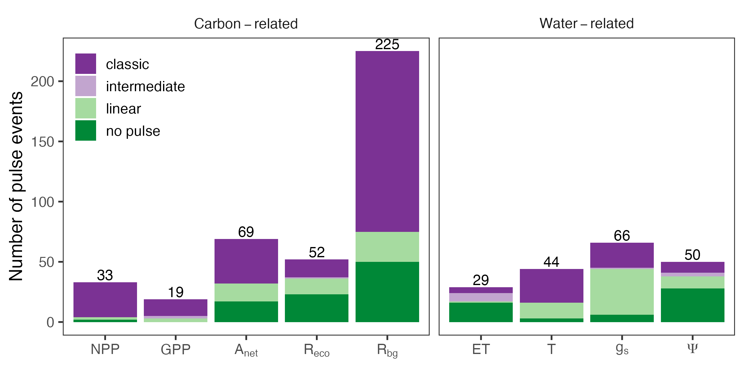
A)
B)

Slide 4
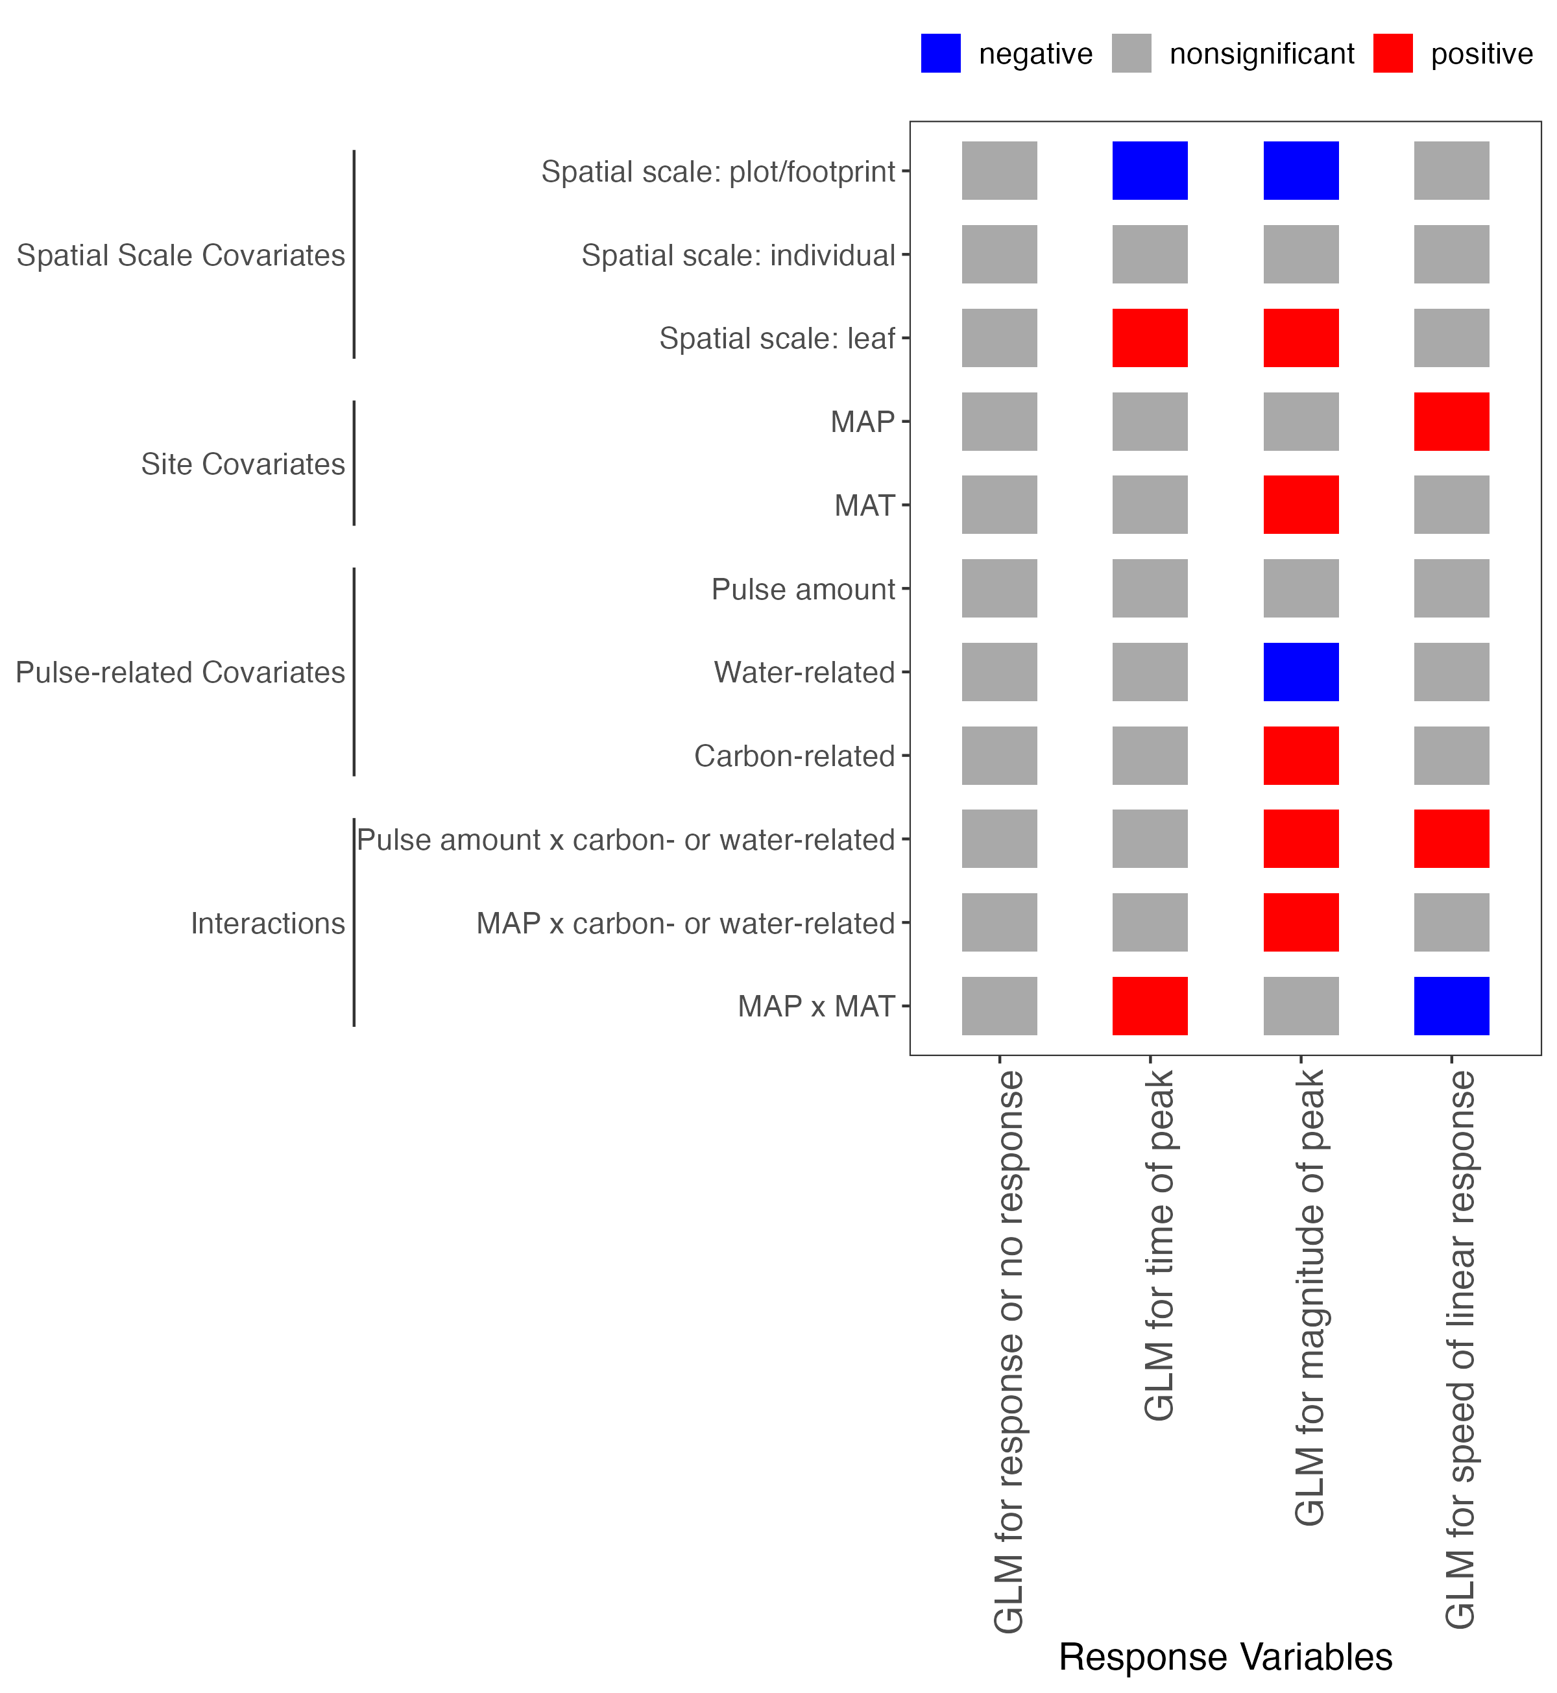
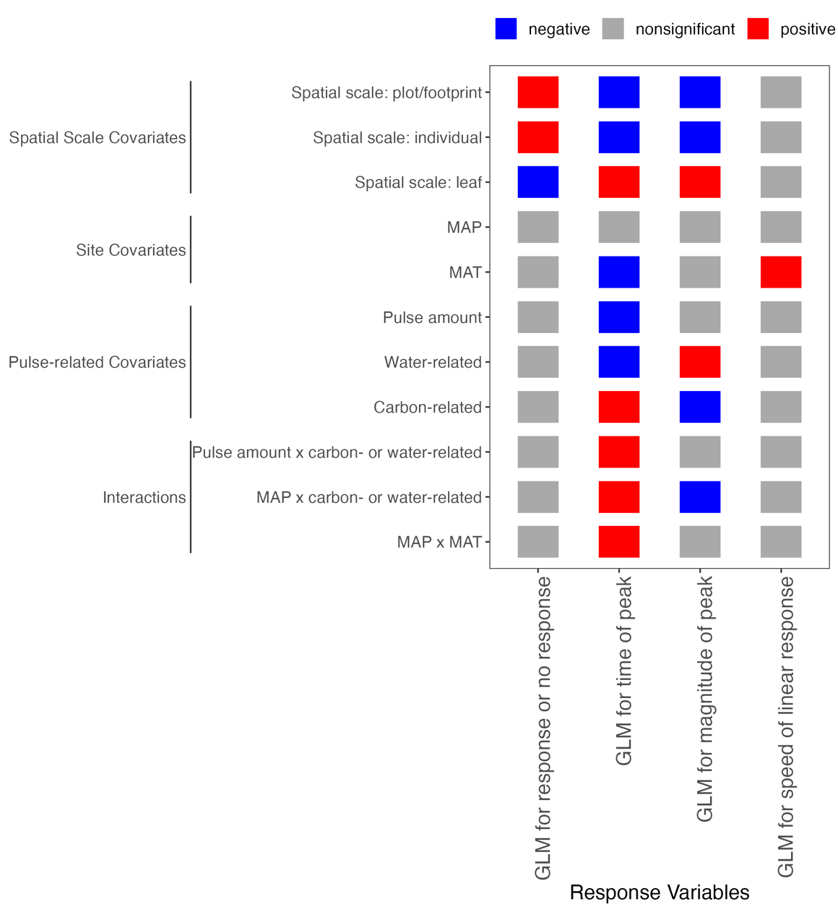
Plot/footprint
Individual
Leaf
MAP
Covariates
MAT
Pulse amount
Water-related
Carbon-related
Pulse amount × water- or carbon- related
MAP × water- or carbon- related
MAP × MAT
Negative
Speed (linear response slope)
Time of peak
Nonsignificant
Magnitude of peak
Response or no response
Positive
Response Variables
Notes:
Pulse-level covariates

Slide 5
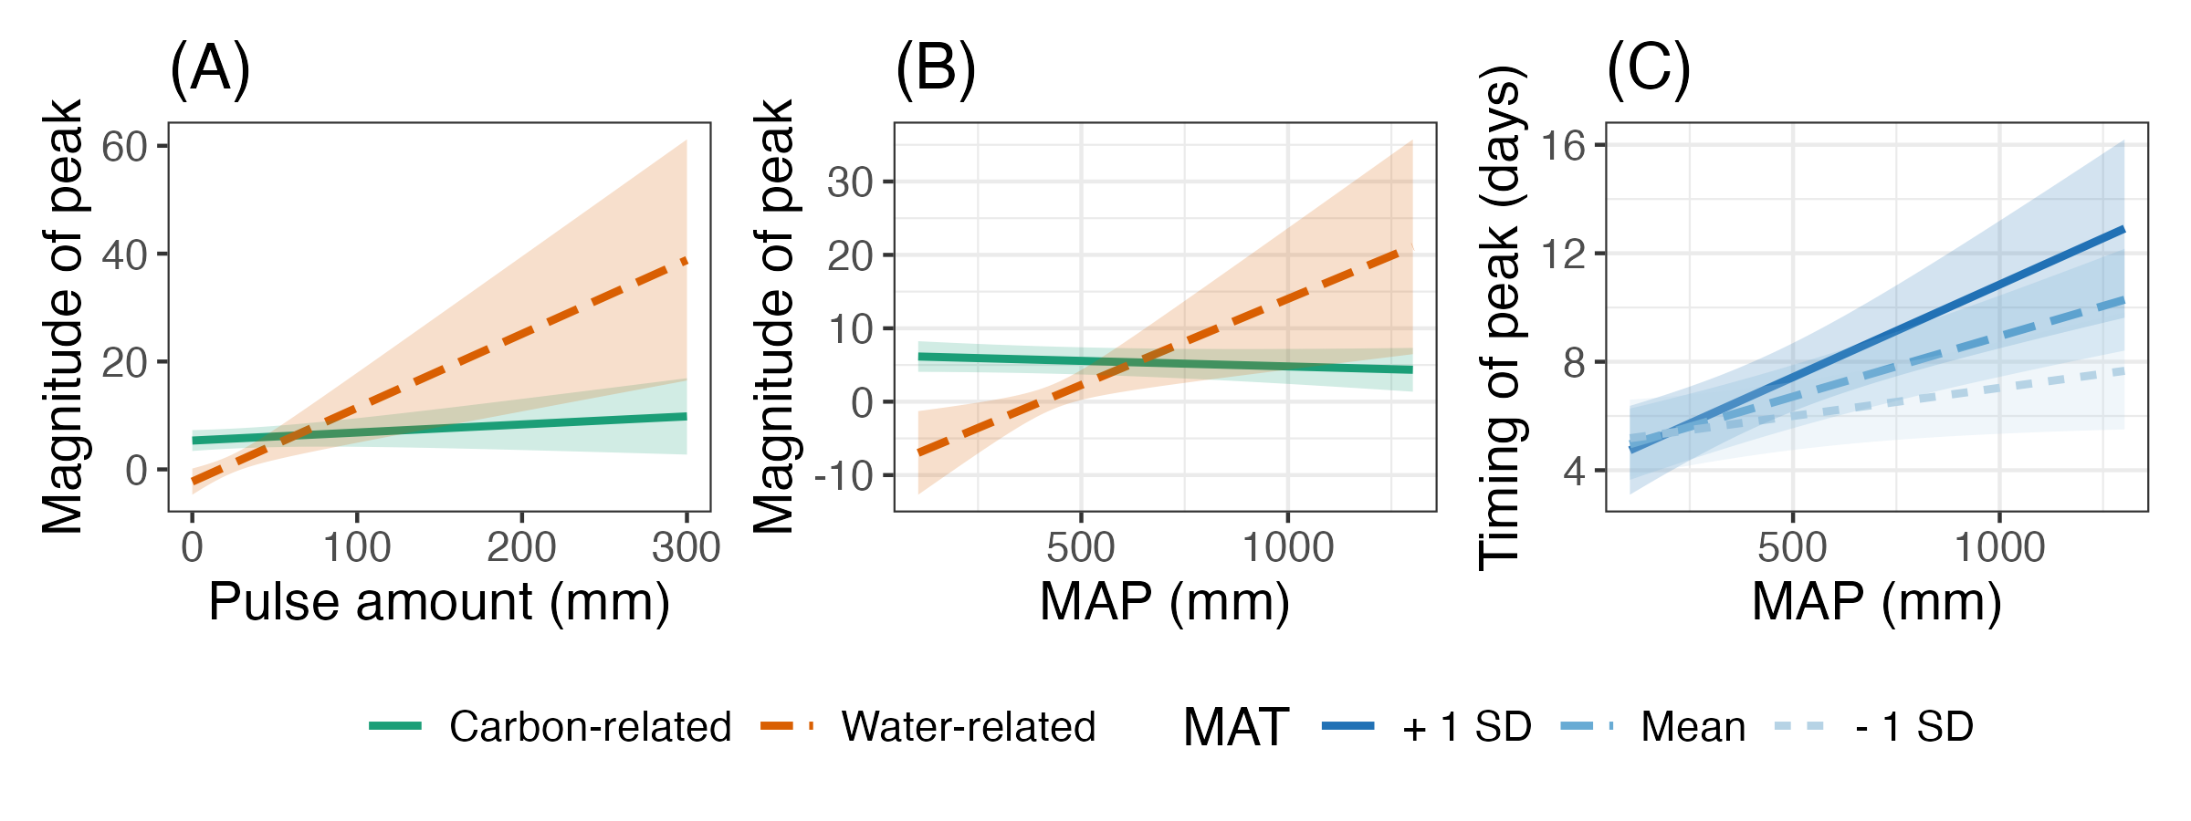
(D)
Water
Carbon
Water
Carbon
Peak magnitude shift under future precipitation intensification:
Wet
Wet+cold: Carbon responses are smaller than water responses. All responses are faster than in hot conditions, but slower than in dry conditions.
Wet+hot: Carbon responses are smaller than water responses. All responses are slower than in dry conditions.
Water responses will be larger
MAP
Water
Carbon
Water
Carbon
Carbon responses will be smaller
Dry
Dry+cold: Water responses are smaller than carbon responses. All responses are faster than in wetter or hotter conditions.
Dry+hot: Water responses are smaller than carbon responses. All responses are slower than in colder conditions, but faster than in wet conditions .
Cold
Hot
MAT

