Slide 1
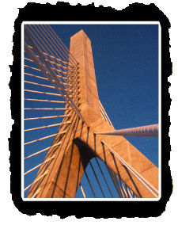
Chapter 4
Network Layer
A note on the use of these ppt slides:
We’re making these slides freely available to all (faculty, students, readers). They’re in powerpoint form so you can add, modify, and delete slides (including this one) and slide content to suit your needs. They obviously represent a lot of work on our part. In return for use, we only ask the following:
If you use these slides (e.g., in a class) in substantially unaltered form, that you mention their source (after all, we’d like people to use our book!)
If you post any slides in substantially unaltered form on a www site, that you note that they are adapted from (or perhaps identical to) our slides, and note our copyright of this material.
Thanks and enjoy! JFK/KWR
All material copyright 1996-2002
J.F Kurose and K.W. Ross, All Rights Reserved
Computer Networking: A Top Down Approach Featuring the Internet,
2nd edition.
Jim Kurose, Keith Ross
Addison-Wesley, July 2002.

Slide 2
Chapter 4: Network Layer
Chapter goals:
understand principles behind network layer services:
  routing (path selection)
  dealing with scale
  how a router works
  advanced topics: IPv6, mobility
instantiation and implementation in the Internet
Overview:
network layer services
routing principles: path selection
hierarchical routing
IP
Internet routing protocols
  intra-domain
  inter-domain
what’s inside a router?
IPv6
mobility

Slide 3
Chapter 4 roadmap
4.1 Introduction and Network Service Models
4.2 Routing Principles
4.3 Hierarchical Routing
4.4 The Internet (IP) Protocol
4.5 Routing in the Internet
4.6 What’s Inside a Router
4.7 IPv6
4.8 Multicast Routing
4.9 Mobility

Slide 4





Network layer functions
transport packet from sending to receiving hosts
network layer protocols in every host, router
three important functions:
path determination: route taken by packets from source to dest. Routing algorithms
forwarding: move packets from router’s input to appropriate router output
call setup: some network architectures require router call setup along path before data flows
application
transport
network
data link
physical
network
data link
physical
network
data link
physical
network
data link
physical
network
data link
physical
network
data link
physical
network
data link
physical
network
data link
physical
network
data link
physical
application
transport
network
data link
physical

Slide 5
Network service model
Q: What service model for “channel” transporting packets from sender to receiver?
guaranteed bandwidth?
preservation of inter-packet timing (no jitter)?
loss-free delivery?
in-order delivery?
congestion feedback to sender?
The most important
abstraction provided
by network layer:
?
?
virtual circuit
or
datagram?
?
service abstraction

Slide 6
Virtual circuits
“source-to-dest path behaves much like telephone circuit”
  performance-wise
  network actions along source-to-dest path
call setup, teardown for each call before data can flow
each packet carries VC identifier (not destination host ID)
every router on source-dest path maintains “state” for each passing connection
  transport-layer connection only involved two end systems
link, router resources (bandwidth, buffers) may be allocated to VC
  to get circuit-like perf.

Slide 7
Virtual circuits: signaling protocols
used to setup, maintain teardown VC
used in ATM, frame-relay, X.25
not used in today’s Internet
application
transport
network
data link
physical
5. Data flow begins
6. Receive data
application
transport
network
data link
physical
4. Call connected
3. Accept call
1. Initiate call
2. incoming call

Slide 8
Datagram networks: the Internet model
no call setup at network layer
routers: no state about end-to-end connections
  no network-level concept of “connection”
packets forwarded using destination host address
  packets between same source-dest pair may take different paths
application
transport
network
data link
physical
application
transport
network
data link
physical
1. Send data
2. Receive data

Slide 9
Network layer service models:
Network
Architecture
Internet
ATM
ATM
ATM
ATM
Service
Model
best effort
CBR
VBR
ABR
UBR
Guarantees ?
Congestion
feedback
no (inferred
via loss)
no
congestion
no
congestion
yes
no
Bandwidth
none
constant
rate
guaranteed
rate
guaranteed
minimum
none
Loss
no
yes
yes
no
no
Order
no
yes
yes
yes
yes
Timing
no
yes
yes
no
no
Internet model being extended: Intserv, Diffserv
  Chapter 6

Slide 10
Datagram or VC network: why?
Internet
data exchange among computers
  “elastic” service, no strict timing req.
“smart” end systems (computers)
  can adapt, perform control, error recovery
  simple inside network, complexity at “edge”
many link types
  different characteristics
  uniform service difficult
ATM
evolved from telephony
human conversation:
  strict timing, reliability requirements
  need for guaranteed service
“dumb” end systems
  telephones
  complexity inside network

Slide 11
Chapter 4 roadmap
4.1 Introduction and Network Service Models
4.2 Routing Principles
  Link state routing
  Distance vector routing
4.3 Hierarchical Routing
4.4 The Internet (IP) Protocol
4.5 Routing in the Internet
4.6 What’s Inside a Router
4.7 IPv6
4.8 Multicast Routing
4.9 Mobility

Slide 12
Routing
Routing protocol
Goal: determine “good” path
(sequence of routers) thru
network from source to dest.
5
B
3
C
2
5
A
2
1
F
Graph abstraction for routing algorithms:
graph nodes are routers
graph edges are physical links
  link cost: delay, $ cost, or congestion level
3
1
2
D
E
1
“good” path:
  typically means minimum cost path
  other def’s possible

Slide 13
Routing Algorithm classification
Global or decentralized information?
Global:
all routers have complete topology, link cost info
“link state” algorithms
Decentralized:
router knows physically-connected neighbors, link costs to neighbors
iterative process of computation, exchange of info with neighbors
“distance vector” algorithms
Static or dynamic?
Static:
routes change slowly over time
Dynamic:
routes change more quickly
  periodic update
  in response to link cost changes

Slide 14
A Link-State Routing Algorithm
Dijkstra’s algorithm
net topology, link costs known to all nodes
  accomplished via “link state broadcast”
  all nodes have same info
computes least cost paths from one node (‘source”) to all other nodes
  gives routing table for that node
iterative: after k iterations, know least cost path to k dest.’s
Notation:
c(i,j): link cost from node i to j. cost infinite if not direct neighbors
D(v): current value of cost of path from source to dest. V
p(v): predecessor node along path from source to v, that is next v
N: set of nodes whose least cost path definitively known

Slide 15
Dijsktra’s Algorithm
1 Initialization:
2 N = {A}
3 for all nodes v
4 if v adjacent to A
5 then D(v) = c(A,v)
6 else D(v) = infinity
7
8 Loop
9 find w not in N such that D(w) is a minimum
10 add w to N
11 update D(v) for all v adjacent to w and not in N:
12 D(v) = min( D(v), D(w) + c(w,v) )
13 /* new cost to v is either old cost to v or known
14 shortest path cost to w plus cost from w to v */
15 until all nodes in N

Slide 16
Dijkstra’s algorithm: example
Step
0
1
2
3
4
5
start N
A
AD
ADE
ADEB
ADEBC
ADEBCF
D(B),p(B)
2,A
2,A
2,A
D(C),p(C)
5,A
4,D
3,E
3,E
D(D),p(D)
1,A
D(E),p(E)
infinity
2,D
D(F),p(F)
infinity
infinity
4,E
4,E
4,E
5
B
3
C
2
5
A
2
1
F
3
1
2
D
E
1

Slide 17
Dijkstra’s algorithm, discussion
Algorithm complexity: n nodes
each iteration: need to check all nodes, w, not in N
n*(n+1)/2 comparisons: O(n**2)
more efficient implementations possible: O(nlogn)
Oscillations possible:
e.g., link cost = amount of carried traffic
1
A
A
A
A
1+e
2+e
0
0
2+e
2+e
0
D
0
0
B
D
B
D
B
D
B
1+e
1
0
0
1+e
1
0
e
0
0
1
1+e
0
e
C
C
C
C
1
1
e
… recompute
routing
… recompute
… recompute
initially

Slide 18
Distance Vector Routing Algorithm
iterative:
continues until no nodes exchange info.
self-terminating: no “signal” to stop
asynchronous:
nodes need not exchange info/iterate in lock step!
distributed:
each node communicates only with directly-attached neighbors
Distance Table data structure
each node has its own
row for each possible destination
column for each directly-attached neighbor to node
example: in node X, for dest. Y via neighbor Z:
distance from X to
Y, via Z as next hop
X
=
D (Y,Z)
Z
=
c(X,Z) + min {D (Y,w)}
w

Slide 19
Distance Table: example
1
cost to destination via
B
C
E
7
D ()
A
B
C
D
A
1
7
6
4
B
14
8
9
11
D
5
5
4
2
A
8
2
1
E
D
2
E
D
D (C,D)
=
c(E,D) + min {D (C,w)}
destination
w
=
2+2 = 4
E
D
D (A,D)
=
c(E,D) + min {D (A,w)}
w
=
2+3 = 5
loop!
E
B
D (A,B)
=
c(E,B) + min {D (A,w)}
w
=
8+6 = 14
loop!

Slide 20
Distance table gives routing table
cost to destination via
E
Outgoing link
to use, cost
D ()
A
B
C
D
A
1
7
6
4
B
14
8
9
11
D
5
5
4
2
A
B
C
D
A,1
D,5
D,4
D,4
destination
destination
Distance table
Routing table

Slide 21
Distance Vector Routing: overview
Iterative, asynchronous: each local iteration caused by:
local link cost change
message from neighbor: its least cost path change from neighbor
Distributed:
each node notifies neighbors only when its least cost path to any destination changes
  neighbors then notify their neighbors if necessary
Each node:
wait for (change in local link cost of msg from neighbor)
recompute distance table
if least cost path to any dest has changed, notify neighbors

Slide 22
Distance Vector Algorithm:
At all nodes, X:
1 Initialization:
2 for all adjacent nodes v:
3 D (*,v) = infinity /* the * operator means "for all rows" */
4 D (v,v) = c(X,v)
5 for all destinations, y
6 send min D (y,w) to each neighbor /* w over all X's neighbors */
X
X
X
w

Slide 23
Distance Vector Algorithm (cont.):
8 loop
9 wait (until I see a link cost change to neighbor V
10 or until I receive update from neighbor V)
11
12 if (c(X,V) changes by d)
13 /* change cost to all dest's via neighbor v by d */
14 /* note: d could be positive or negative */
15 for all destinations y: D (y,V) = D (y,V) + d
16
17 else if (update received from V wrt destination Y)
18 /* shortest path from V to some Y has changed */
19 /* V has sent a new value for its min DV(Y,w) */
20 /* call this received new value is "newval" */
21 for the single destination y: D (Y,V) = c(X,V) + newval
22
23 if we have a new min D (Y,w)for any destination Y
24 send new value of min D (Y,w) to all neighbors
25
26 forever
X
X
w
X
X
w
X
w

Slide 24
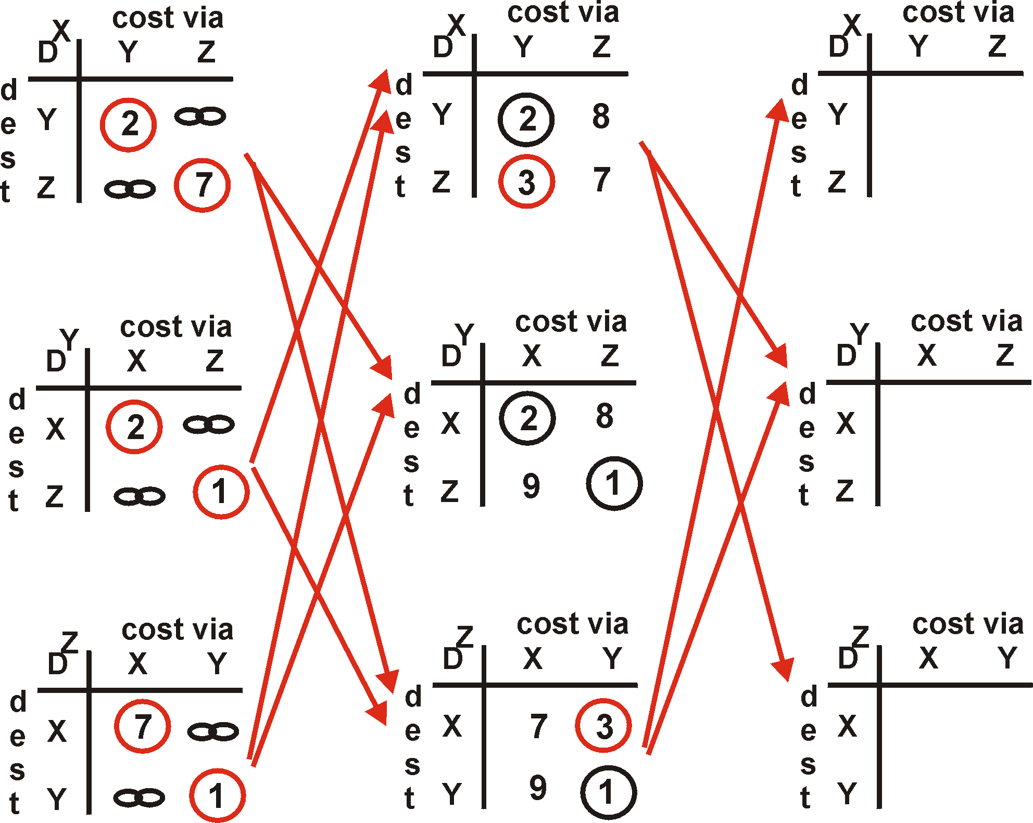
Distance Vector Algorithm: example
Y
2
1
X
Z
7

Slide 25
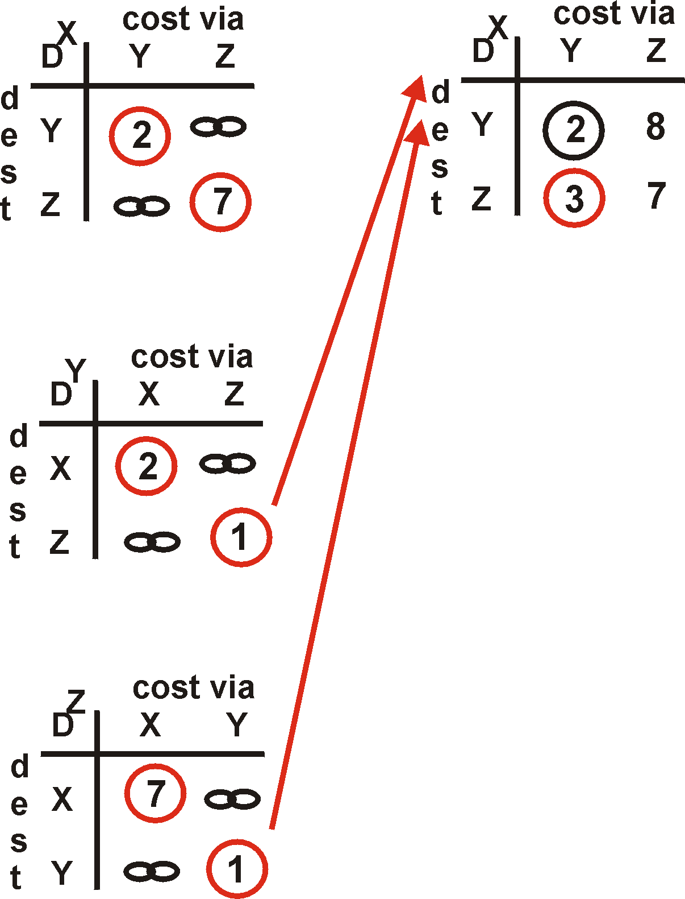
Distance Vector Algorithm: example
Y
2
1
X
Z
X
Z
7
D (Y,Z)
=
c(X,Z) + min {D (Y,w)}
w
=
7+1 = 8
X
Y
D (Z,Y)
=
c(X,Y) + min {D (Z,w)}
w
=
2+1 = 3

Slide 26
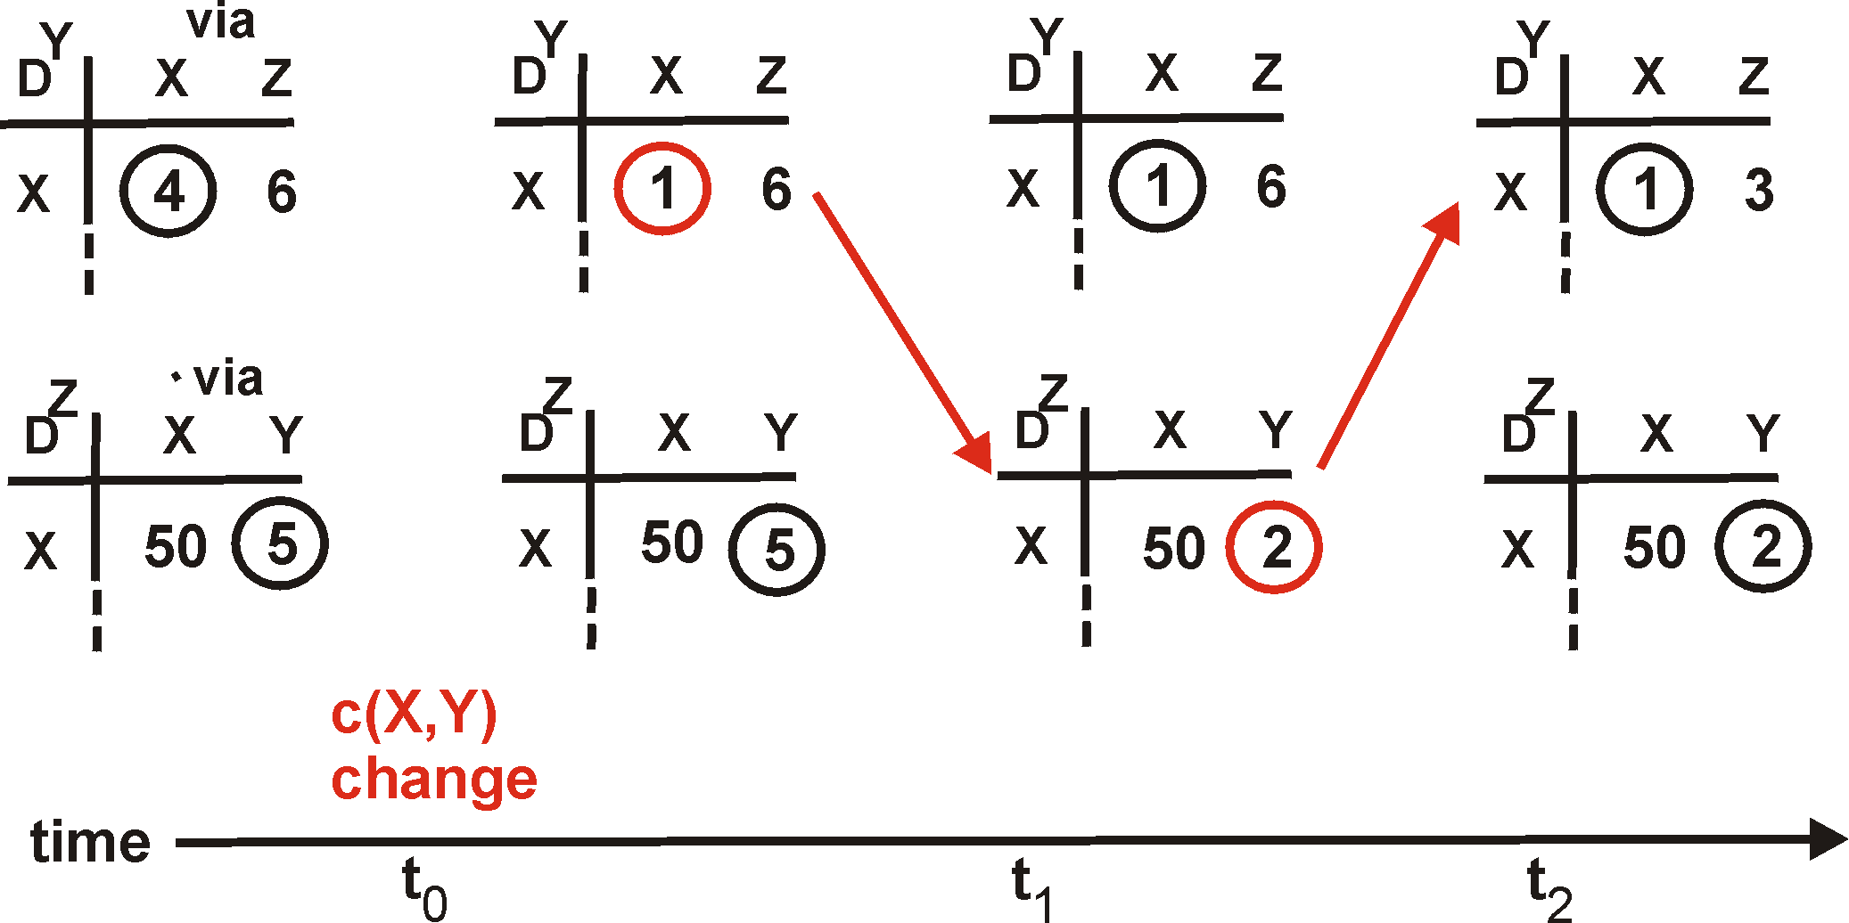
Distance Vector: link cost changes
Link cost changes:
node detects local link cost change
updates distance table (line 15)
if cost change in least cost path, notify neighbors (lines 23,24)
1
Y
4
1
X
Z
50
algorithm
terminates
“good
news
travels
fast”

Slide 27
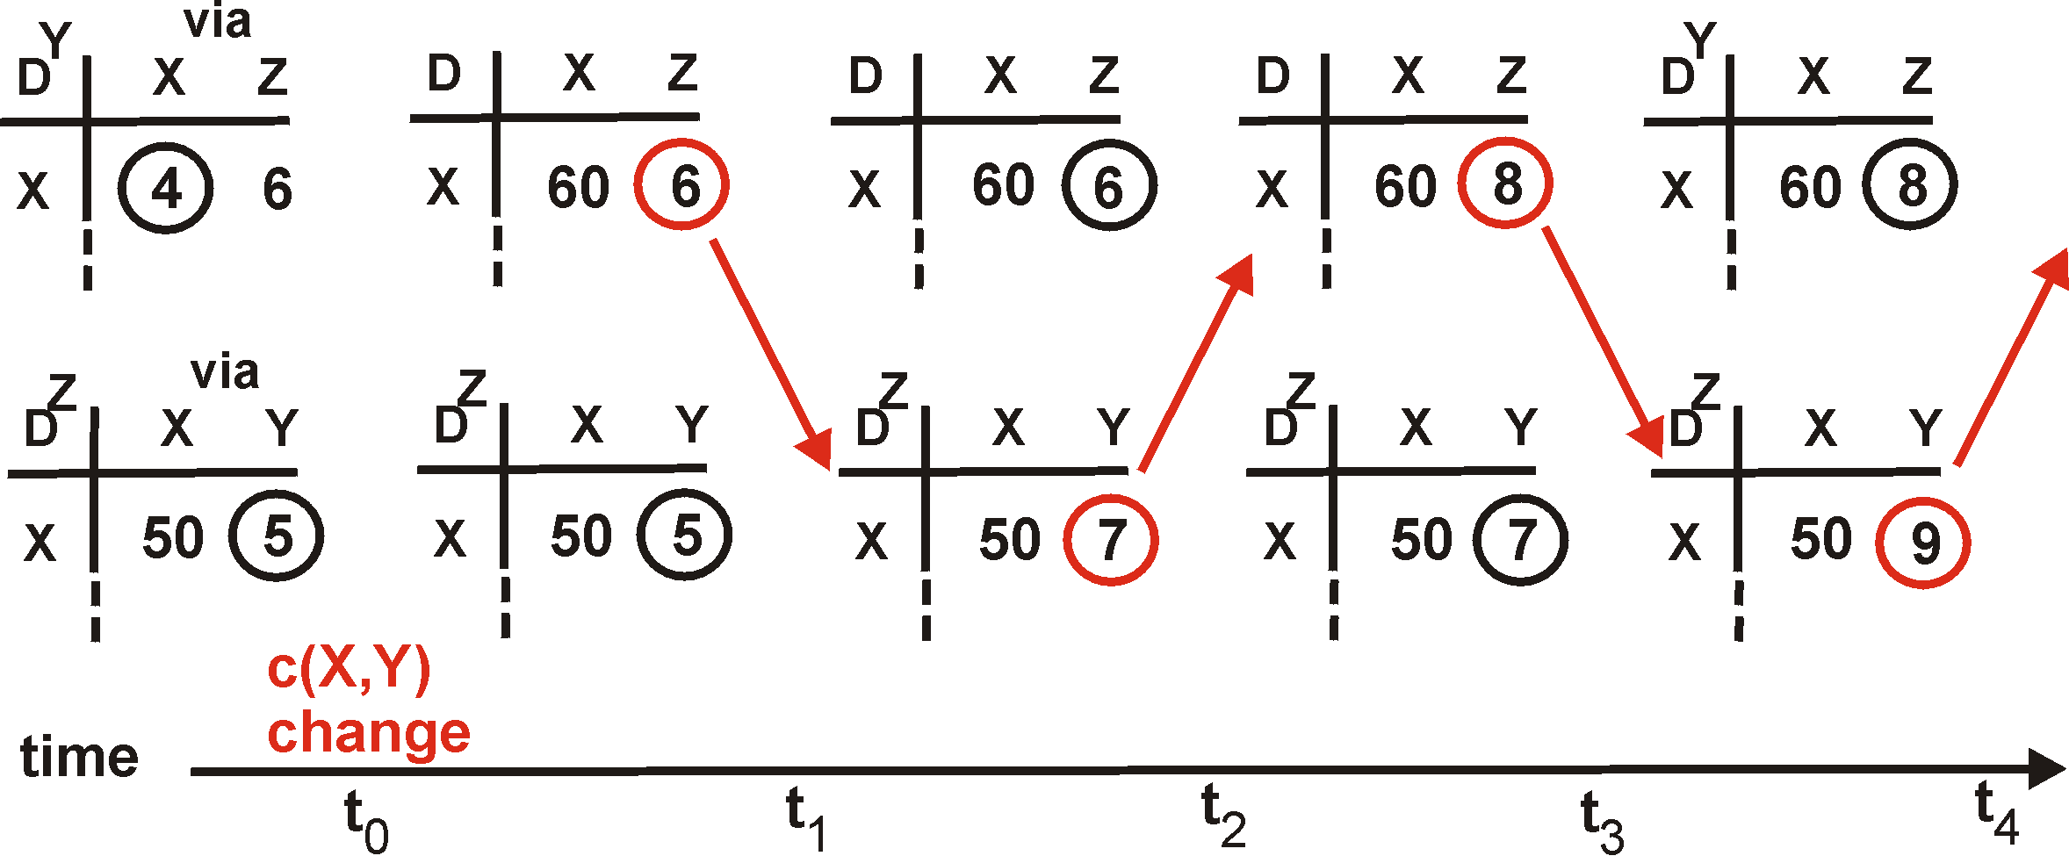
Distance Vector: link cost changes
Link cost changes:
good news travels fast
bad news travels slow - “count to infinity” problem!
60
Y
4
1
X
Z
50
algorithm
continues
on!

Slide 28
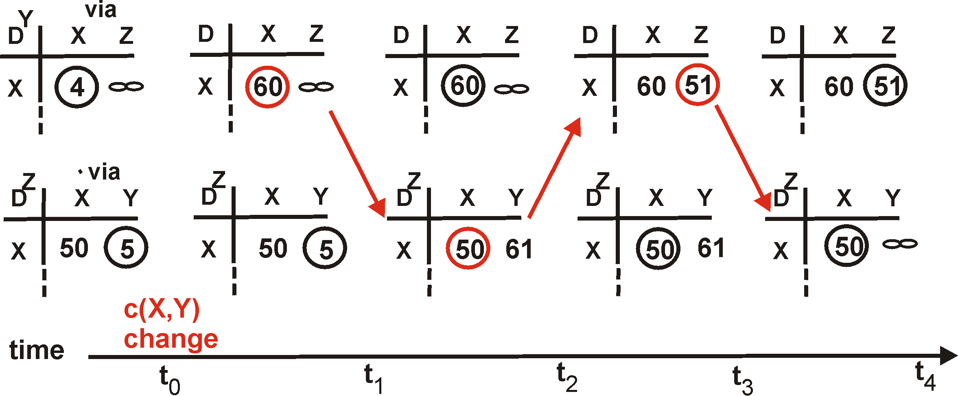
Distance Vector: poisoned reverse
If Z routes through Y to get to X :
Z tells Y its (Z’s) distance to X is infinite (so Y won’t route to X via Z)
will this completely solve count to infinity problem?
60
Y
4
1
X
Z
50
algorithm
terminates

Slide 29
Comparison of LS and DV algorithms
Message complexity
LS: with n nodes, E links, O(nE) msgs sent each
DV: exchange between neighbors only
  convergence time varies
Speed of Convergence
LS: O(n²) algorithm requires O(nE) msgs
  may have oscillations
DV: convergence time varies
  may be routing loops
  count-to-infinity problem
Robustness: what happens if router malfunctions?
LS:
  node can advertise incorrect link cost
  each node computes only its own table
DV:
  DV node can advertise incorrect path cost
  each node’s table used by others
    error propagate thru network

Slide 30
Chapter 4 roadmap
4.1 Introduction and Network Service Models
4.2 Routing Principles
4.3 Hierarchical Routing
4.4 The Internet (IP) Protocol
4.5 Routing in the Internet
4.6 What’s Inside a Router
4.7 IPv6
4.8 Multicast Routing
4.9 Mobility

Slide 31
Hierarchical Routing
Our routing study thus far - idealization
all routers identical
network “flat”
… not true in practice
scale: with 200 million destinations:
can’t store all dest’s in routing tables!
routing table exchange would swamp links!
administrative autonomy
internet = network of networks
each network admin may want to control routing in its own network

Slide 32
Hierarchical Routing
aggregate routers into regions, “autonomous systems” (AS)
routers in same AS run same routing protocol
  “intra-AS” routing protocol
  routers in different AS can run different intra-AS routing protocol
gateway routers
special routers in AS
run intra-AS routing protocol with all other routers in AS
also responsible for routing to destinations outside AS
  run inter-AS routing protocol with other gateway routers

Slide 33
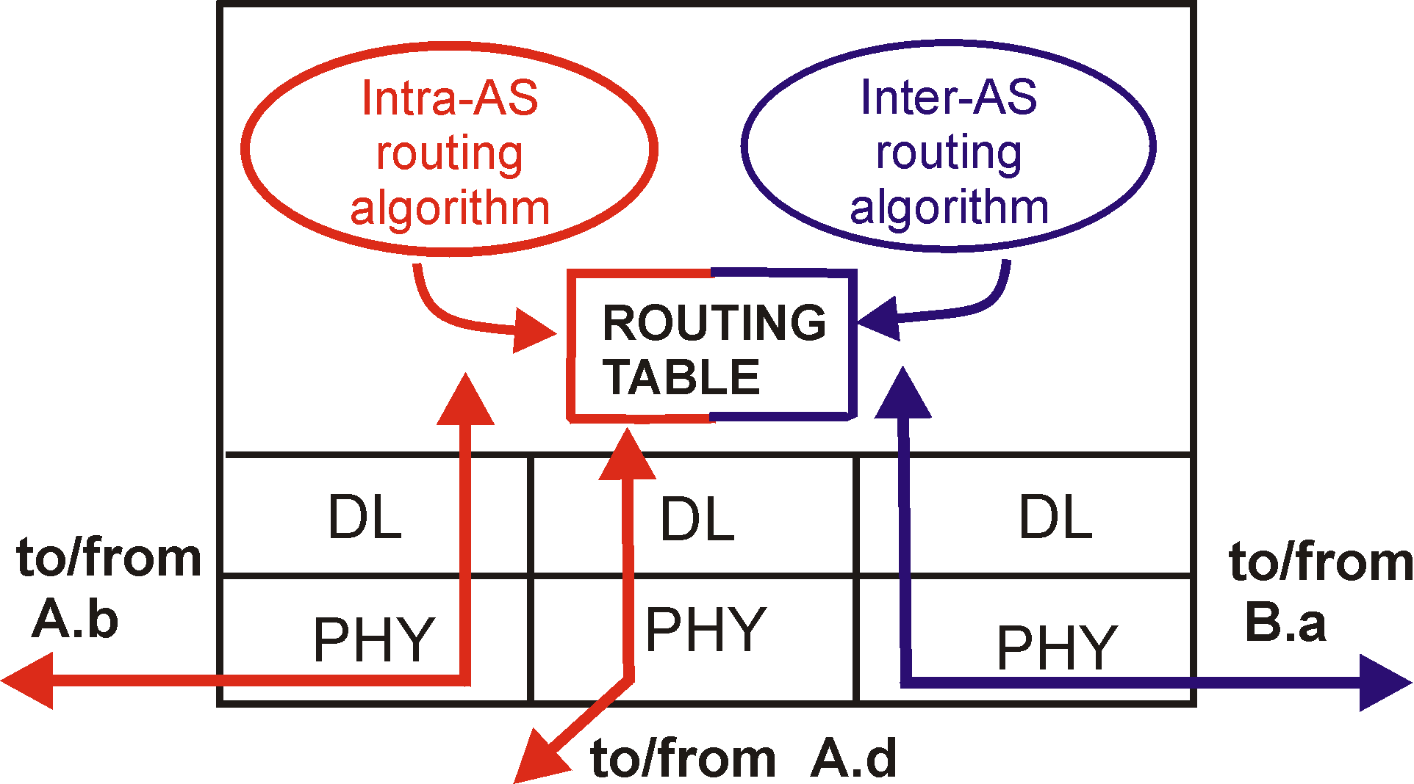
Intra-AS and Inter-AS routing
C.b
Gateways:
  perform inter-AS routing amongst themselves
  perform intra-AS routers with other routers in their AS
B.a
A.a
b
A.c
c
a
C
a
b
a
B
d
c
A
b
network layer
inter-AS, intra-AS routing in
gateway A.c
link layer
physical layer

Slide 34
Intra-AS and Inter-AS routing
Inter-AS
routing
between
A and B
C.b
B.a
A.a
Host
h2
b
A.c
c
a
C
a
b
a
B
Host
h1
d
c
Intra-AS routing
within AS B
A
b
Intra-AS routing
within AS A
We’ll examine specific inter-AS and intra-AS Internet routing protocols shortly

Slide 35
Chapter 4 roadmap
4.1 Introduction and Network Service Models
4.2 Routing Principles
4.3 Hierarchical Routing
4.4 The Internet (IP) Protocol
  4.4.1 IPv4 addressing
  4.4.2 Moving a datagram from source to destination
  4.4.3 Datagram format
  4.4.4 IP fragmentation
  4.4.5 ICMP: Internet Control Message Protocol
  4.4.6 DHCP: Dynamic Host Configuration Protocol
  4.4.7 NAT: Network Address Translation
4.5 Routing in the Internet
4.6 What’s Inside a Router
4.7 IPv6
4.8 Multicast Routing
4.9 Mobility

Slide 36
The Internet Network layer
Host, router network layer functions:
Transport layer: TCP, UDP
Routing protocols
path selection
RIP, OSPF, BGP
IP protocol
addressing conventions
datagram format
packet handling conventions
Network
layer
forwarding
table
ICMP protocol
error reporting
router “signaling”
Link layer
physical layer

Slide 37
IP Addressing: introduction
IP address: 32-bit identifier for host, router interface
interface: connection between host/router and physical link
  router’s typically have multiple interfaces
  host may have multiple interfaces
  IP addresses associated with each interface
223.1.1.1
223.1.2.1
223.1.1.2
223.1.1.4
223.1.2.9
223.1.2.2
223.1.1.3
223.1.3.27
223.1.3.1
223.1.3.2
223.1.1.1 = 11011111 00000001 00000001 00000001
223
1
1
1

Slide 38
IP Addressing
IP address:
  network part (high order bits)
  host part (low order bits)
What’s a network ? (from IP address perspective)
  device interfaces with same network part of IP address
  can physically reach each other without intervening router
223.1.1.1
223.1.2.1
223.1.1.2
223.1.1.4
223.1.2.9
223.1.1.3
223.1.2.2
223.1.3.27
LAN
223.1.3.1
223.1.3.2
network consisting of 3 IP networks
(for IP addresses starting with 223,
first 24 bits are network address)

Slide 39
IP Addressing
223.1.1.2
How to find the networks?
Detach each interface from router, host
create “islands of isolated networks
223.1.1.1
223.1.1.4
223.1.1.3
223.1.9.2
223.1.7.0
223.1.9.1
223.1.7.1
223.1.8.1
223.1.8.0
223.1.2.6
223.1.3.27
Interconnected
system consisting
of six networks
223.1.2.1
223.1.2.2
223.1.3.1
223.1.3.2

Slide 40
IP Addresses
given notion of “network”, let’s re-examine IP addresses:
“class-full” addressing:
class
A
network
1.0.0.0 to
127.255.255.255
0
host
B
10
network
host
128.0.0.0 to
191.255.255.255
C
110
network
host
192.0.0.0 to
223.255.255.255
D
1110
multicast address
224.0.0.0 to
239.255.255.255
32 bits

Slide 41
IP addressing: CIDR
Classful addressing:
  inefficient use of address space, address space exhaustion
  e.g., class B net allocated enough addresses for 65K hosts, even if only 2K hosts in that network
CIDR: Classless InterDomain Routing
  network portion of address of arbitrary length
  address format: a.b.c.d/x, where x is # bits in network portion of address
network
part
host
part
11001000 00010111 00010000 00000000
200.23.16.0/23

Slide 42
IP addresses: how to get one?
Q: How does host get IP address?
hard-coded by system admin in a file
  Wintel: control-panel->network->configuration->tcp/ip->properties
  UNIX: /etc/rc.config
DHCP: Dynamic Host Configuration Protocol: dynamically get address from as server
  “plug-and-play”
(more shortly)

Slide 43
IP addresses: how to get one?
Q: How does network get network part of IP addr?
A: gets allocated portion of its provider ISP’s address space
ISP's block 11001000 00010111 00010000 00000000 200.23.16.0/20
Organization 0 11001000 00010111 00010000 00000000 200.23.16.0/23
Organization 1 11001000 00010111 00010010 00000000 200.23.18.0/23
Organization 2 11001000 00010111 00010100 00000000 200.23.20.0/23
... ….. …. ….
Organization 7 11001000 00010111 00011110 00000000 200.23.30.0/23

Slide 44
Hierarchical addressing: route aggregation
Hierarchical addressing allows efficient advertisement of routing
information:
Organization 0
200.23.16.0/23
Organization 1
200.23.18.0/23
“Send me anything
with addresses
beginning
200.23.16.0/20”
Organization 2
200.23.20.0/23
.
Fly-By-Night-ISP
.
.
.
.
Internet
Organization 7
.
200.23.30.0/23
ISPs-R-Us
“Send me anything
with addresses
beginning
199.31.0.0/16”

Slide 45
Hierarchical addressing: more specific routes
ISPs-R-Us has a more specific route to Organization 1
Organization 0
200.23.16.0/23
“Send me anything
with addresses
beginning
200.23.16.0/20”
Organization 2
200.23.20.0/23
.
Fly-By-Night-ISP
.
.
.
.
Internet
Organization 7
.
200.23.30.0/23
ISPs-R-Us
“Send me anything
with addresses
beginning 199.31.0.0/16
or 200.23.18.0/23”
Organization 1
200.23.18.0/23

Slide 46
IP addressing: the last word...
Q: How does an ISP get block of addresses?
A: ICANN: Internet Corporation for Assigned
Names and Numbers
  allocates addresses
  manages DNS
  assigns domain names, resolves disputes

Slide 47
Getting a datagram from source to dest.
forwarding table in A
Dest. Net. next router Nhops
223.1.1 1
223.1.2 223.1.1.4 2
IP datagram:
223.1.3 223.1.1.4 2
misc
fields
source
IP addr
dest
IP addr
data
A
223.1.1.1
datagram remains unchanged, as it travels source to destination
addr fields of interest here
223.1.2.1
223.1.1.2
223.1.1.4
223.1.2.9
B
223.1.2.2
E
223.1.1.3
223.1.3.27
223.1.3.1
223.1.3.2

Slide 48
Getting a datagram from source to dest.
forwarding table in A
misc
fields
Dest. Net. next router Nhops
223.1.1.1
223.1.1.3
data
223.1.1 1
Starting at A, send IP datagram addressed to B:
look up net. address of B in forwarding table
find B is on same net. as A
link layer will send datagram directly to B inside link-layer frame
  B and A are directly connected
223.1.2 223.1.1.4 2
223.1.3 223.1.1.4 2
A
223.1.1.1
223.1.2.1
223.1.1.2
223.1.1.4
223.1.2.9
B
223.1.2.2
E
223.1.1.3
223.1.3.27
223.1.3.1
223.1.3.2

Slide 49
Getting a datagram from source to dest.
forwarding table in A
misc
fields
Dest. Net. next router Nhops
223.1.1.1
223.1.2.3
data
223.1.1 1
Starting at A, dest. E:
look up network address of E in forwarding table
E on different network
  A, E not directly attached
routing table: next hop router to E is 223.1.1.4
link layer sends datagram to router 223.1.1.4 inside link-layer frame
datagram arrives at 223.1.1.4
continued…..
223.1.2 223.1.1.4 2
223.1.3 223.1.1.4 2
A
223.1.1.1
223.1.2.1
223.1.1.2
223.1.1.4
223.1.2.9
B
223.1.2.2
E
223.1.1.3
223.1.3.27
223.1.3.1
223.1.3.2

Slide 50
Getting a datagram from source to dest.
forwarding table in router
misc
fields
Dest. Net router Nhops interface
223.1.1.1
223.1.2.3
data
223.1.1 - 1 223.1.1.4
Arriving at 223.1.4, destined for 223.1.2.2
look up network address of E in router’s forwarding table
E on same network as router’s interface 223.1.2.9
  router, E directly attached
link layer sends datagram to 223.1.2.2 inside link-layer frame via interface 223.1.2.9
datagram arrives at 223.1.2.2!!! (hooray!)
223.1.2 - 1 223.1.2.9
223.1.3 - 1 223.1.3.27
A
223.1.1.1
223.1.2.1
223.1.1.2
223.1.1.4
223.1.2.9
B
223.1.2.2
E
223.1.1.3
223.1.3.27
223.1.3.1
223.1.3.2

Slide 51
IP datagram format
IP protocol version
number
32 bits
total datagram
length (bytes)
header length
(bytes)
head.
len
type of
service
ver
length
for
fragmentation/
reassembly
“type” of data
flgs
fragment
offset
16-bit identifier
max number
remaining hops
(decremented at
each router)
time to
live
upper
layer
Internet
checksum
32 bit source IP address
upper layer protocol
to deliver payload to
32 bit destination IP address
Options (if any)
E.g. timestamp,
record route
taken, specify
list of routers
to visit.
how much overhead with TCP?
20 bytes of TCP
20 bytes of IP
= 40 bytes + app layer overhead
data
(variable length,
typically a TCP
or UDP segment)

Slide 52
IP Fragmentation & Reassembly
network links have MTU (max.transfer size) - largest possible link-level frame.
  different link types, different MTUs
large IP datagram divided (“fragmented”) within net
  one datagram becomes several datagrams
  “reassembled” only at final destination
  IP header bits used to identify, order related fragments
fragmentation:
in: one large datagram
out: 3 smaller datagrams
reassembly

Slide 53
IP Fragmentation and Reassembly
length
=4000
ID
=x
fragflag
=0
offset
=0
Example
4000 byte datagram
MTU = 1500 bytes
One large datagram becomes
several smaller datagrams
length
=1500
ID
=x
fragflag
=1
offset
=0
length
=1500
ID
=x
fragflag
=1
offset
=1480
length
=1040
ID
=x
fragflag
=0
offset
=2960

Slide 54
ICMP: Internet Control Message Protocol
used by hosts, routers, gateways to communication network-level information
  error reporting: unreachable host, network, port, protocol
  echo request/reply (used by ping)
network-layer “above” IP:
  ICMP msgs carried in IP datagrams
ICMP message: type, code plus first 8 bytes of IP datagram causing error
Type Code description
0 0 echo reply (ping)
3 0 dest. network unreachable
3 1 dest host unreachable
3 2 dest protocol unreachable
3 3 dest port unreachable
3 6 dest network unknown
3 7 dest host unknown
4 0 source quench (congestion
control - not used)
8 0 echo request (ping)
9 0 route advertisement
10 0 router discovery
11 0 TTL expired
12 0 bad IP header

Slide 55
DHCP: Dynamic Host Configuration Protocol
Goal: allow host to dynamically obtain its IP address from network server when it joins network
  Can renew its lease on address in use
  Allows reuse of addresses (only hold address while connected an “on”
  Support for mobile users who want to join network (more shortly)
DHCP overview:
  host broadcasts “DHCP discover” msg
  DHCP server responds with “DHCP offer” msg
  host requests IP address: “DHCP request” msg
  DHCP server sends address: “DHCP ack” msg

Slide 56
DHCP client-server scenario
A
223.1.1.1
DHCP
223.1.2.1
server
223.1.1.2
223.1.1.4
223.1.2.9
B
223.1.2.2
E
arriving DHCP
client needs
address in this
network
223.1.1.3
223.1.3.27
223.1.3.1
223.1.3.2

Slide 57
DHCP client-server scenario
DHCP server: 223.1.2.5
arriving
client
DHCP discover
src : 0.0.0.0, 68
dest.: 255.255.255.255,67
yiaddr: 0.0.0.0
transaction ID: 654
DHCP offer
src: 223.1.2.5, 67
dest: 255.255.255.255, 68
yiaddrr: 223.1.2.4
transaction ID: 654
Lifetime: 3600 secs
DHCP request
src: 0.0.0.0, 68
dest:: 255.255.255.255, 67
yiaddrr: 223.1.2.4
transaction ID: 655
Lifetime: 3600 secs
time
DHCP ACK
src: 223.1.2.5, 67
dest: 255.255.255.255, 68
yiaddrr: 223.1.2.4
transaction ID: 655
Lifetime: 3600 secs

Slide 58
NAT: Network Address Translation
rest of
Internet
local network
(e.g., home network)
10.0.0/24
10.0.0.1
10.0.0.4
10.0.0.2
138.76.29.7
10.0.0.3
All datagrams leaving local
network have same single source NAT IP address: 138.76.29.7,
different source port numbers
Datagrams with source or
destination in this network
have 10.0.0/24 address for
source, destination (as usual)

Slide 59
NAT: Network Address Translation
Motivation: local network uses just one IP address as far as outside word is concerned:
  no need to be allocated range of addresses from ISP: - just one IP address is used for all devices
  can change addresses of devices in local network without notifying outside world
  can change ISP without changing addresses of devices in local network
  devices inside local net not explicitly addressable, visible by outside world (a security plus).

Slide 60
NAT: Network Address Translation
Implementation: NAT router must:
  outgoing datagrams: replace (source IP address, port #) of every outgoing datagram to (NAT IP address, new port #)
    . . . remote clients/servers will respond using (NAT IP address, new port #) as destination addr.
  remember (in NAT translation table) every (source IP address, port #) to (NAT IP address, new port #) translation pair
  incoming datagrams: replace (NAT IP address, new port #) in dest fields of every incoming datagram with corresponding (source IP address, port #) stored in NAT table

Slide 61
NAT: Network Address Translation
NAT translation table
WAN side addr LAN side addr
1: host 10.0.0.1
sends datagram to
128.119.40, 80
2: NAT router
changes datagram
source addr from
10.0.0.1, 3345 to
138.76.29.7, 5001,
updates table
138.76.29.7, 5001 10.0.0.1, 3345
…… ……
S: 10.0.0.1, 3345
D: 128.119.40.186, 80
10.0.0.1
1
2
S: 138.76.29.7, 5001
D: 128.119.40.186, 80
10.0.0.4
10.0.0.2
138.76.29.7
S: 128.119.40.186, 80
D: 10.0.0.1, 3345
4
S: 128.119.40.186, 80
D: 138.76.29.7, 5001
3
10.0.0.3
4: NAT router
changes datagram
dest addr from
138.76.29.7, 5001 to 10.0.0.1, 3345
3: Reply arrives
dest. address:
138.76.29.7, 5001

Slide 62
NAT: Network Address Translation
16-bit port-number field:
  60,000 simultaneous connections with a single LAN-side address!
NAT is controversial:
  routers should only process up to layer 3
  violates end-to-end argument
    NAT possibility must be taken into account by app designers, eg, P2P applications
  address shortage should instead be solved by IPv6

Slide 63
Chapter 4 roadmap
4.1 Introduction and Network Service Models
4.2 Routing Principles
4.3 Hierarchical Routing
4.4 The Internet (IP) Protocol
4.5 Routing in the Internet
  4.5.1 Intra-AS routing: RIP and OSPF
  4.5.2 Inter-AS routing: BGP
4.6 What’s Inside a Router?
4.7 IPv6
4.8 Multicast Routing
4.9 Mobility

Slide 64
Routing in the Internet
The Global Internet consists of Autonomous Systems (AS) interconnected with each other:
  Stub AS: small corporation: one connection to other AS’s
  Multihomed AS: large corporation (no transit): multiple connections to other AS’s
  Transit AS: provider, hooking many AS’s together
Two-level routing:
  Intra-AS: administrator responsible for choice of routing algorithm within network
  Inter-AS: unique standard for inter-AS routing: BGP

Slide 65
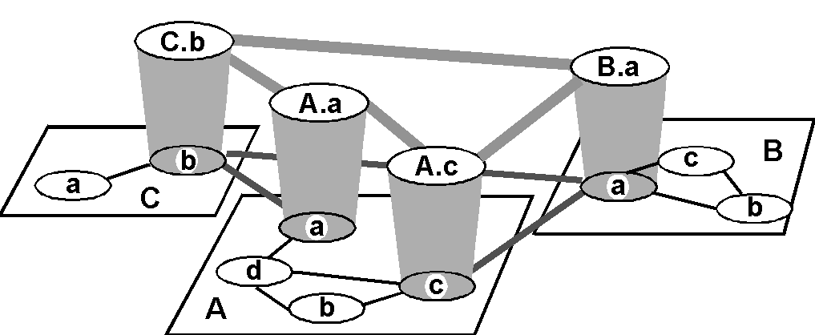
Internet AS Hierarchy
Intra-AS border (exterior gateway) routers
Inter-AS interior (gateway) routers

Slide 66
Intra-AS Routing
Also known as Interior Gateway Protocols (IGP)
Most common Intra-AS routing protocols:
  RIP: Routing Information Protocol
  OSPF: Open Shortest Path First
  IGRP: Interior Gateway Routing Protocol (Cisco proprietary)

Slide 67
RIP ( Routing Information Protocol)
Distance vector algorithm
Included in BSD-UNIX Distribution in 1982
Distance metric: # of hops (max = 15 hops)
  Can you guess why?
Distance vectors: exchanged among neighbors every 30 sec via Response Message (also called advertisement)
Each advertisement: list of up to 25 destination nets within AS

Slide 68
RIP: Example
z
w
x
y
A
D
B
C
Destination Network Next Router Num. of hops to dest.
w A 2
y B 2
z B 7
x -- 1
…. …. ....
Routing table in D

Slide 69
RIP: Example
Dest Next hops
w - -
x - -
z C 4
…. … ...
Advertisement
from A to D
z
w
x
y
A
D
B
C
Destination Network Next Router Num. of hops to dest.
w A 2
y B 2
z B A 7 5
x -- 1
…. …. ....
Routing table in D

Slide 70
RIP: Link Failure and Recovery
If no advertisement heard after 180 sec --> neighbor/link declared dead
  routes via neighbor invalidated
  new advertisements sent to neighbors
  neighbors in turn send out new advertisements (if tables changed)
  link failure info quickly propagates to entire net
  poison reverse used to prevent ping-pong loops (infinite distance = 16 hops)

Slide 71
RIP Table processing
RIP routing tables managed by application-level process called route-d (daemon)
advertisements sent in UDP packets, periodically repeated
routed
routed
Transprt
(UDP)
Transprt
(UDP)
network forwarding
(IP) table
network
(IP)
forwarding
table
link
link
physical
physical

Slide 72
RIP Table example (continued)
Router: giroflee.eurocom.fr
Destination Gateway Flags Ref Use Interface
-------------------- -------------------- ----- ----- ------ ---------
127.0.0.1 127.0.0.1 UH 0 26492 lo0
192.168.2. 192.168.2.5 U 2 13 fa0
193.55.114. 193.55.114.6 U 3 58503 le0
192.168.3. 192.168.3.5 U 2 25 qaa0
224.0.0.0 193.55.114.6 U 3 0 le0
default 193.55.114.129 UG 0 143454
Three attached class C networks (LANs)
Router only knows routes to attached LANs
Default router used to “go up”
Route multicast address: 224.0.0.0
Loopback interface (for debugging)

Slide 73
OSPF (Open Shortest Path First)
“open”: publicly available
Uses Link State algorithm
  LS packet dissemination
  Topology map at each node
  Route computation using Dijkstra’s algorithm
OSPF advertisement carries one entry per neighbor router
Advertisements disseminated to entire AS (via flooding)
  Carried in OSPF messages directly over IP (rather than TCP or UDP

Slide 74
OSPF “advanced” features (not in RIP)
Security: all OSPF messages authenticated (to prevent malicious intrusion)
Multiple same-cost paths allowed (only one path in RIP)
For each link, multiple cost metrics for different TOS (e.g., satellite link cost set “low” for best effort; high for real time)
Integrated uni- and multicast support:
  Multicast OSPF (MOSPF) uses same topology data base as OSPF
Hierarchical OSPF in large domains.

Slide 75

Hierarchical OSPF

Slide 76
Hierarchical OSPF
Two-level hierarchy: local area, backbone.
  Link-state advertisements only in area
  each nodes has detailed area topology; only know direction (shortest path) to nets in other areas.
Area border routers: “summarize” distances to nets in own area, advertise to other Area Border routers.
Backbone routers: run OSPF routing limited to backbone.
Boundary routers: connect to other AS’s.

Slide 77
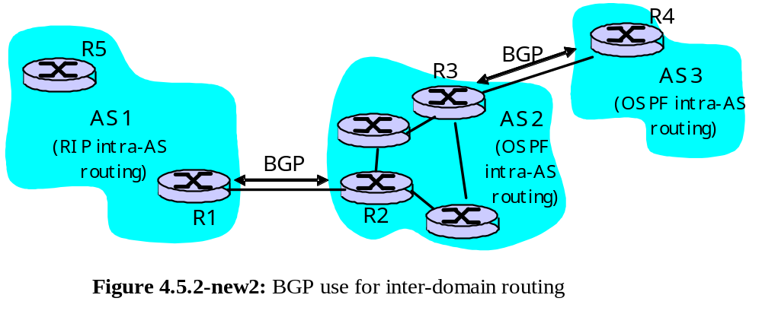
Inter-AS routing in the Internet: BGP

Slide 78
Internet inter-AS routing: BGP
BGP (Border Gateway Protocol): the de facto standard
Path Vector protocol:
  similar to Distance Vector protocol
  each Border Gateway broadcast to neighbors (peers) entire path (i.e., sequence of AS’s) to destination
  BGP routes to networks (ASs), not individual hosts
  E.g., Gateway X may send its path to dest. Z:
Path (X,Z) = X,Y1,Y2,Y3,…,Z

Slide 79
Internet inter-AS routing: BGP
Suppose: gateway X send its path to peer gateway W
W may or may not select path offered by X
  cost, policy (don’t route via competitors AS), loop prevention reasons.
If W selects path advertised by X, then:
Path (W,Z) = w, Path (X,Z)
Note: X can control incoming traffic by controlling it route advertisements to peers:
  e.g., don’t want to route traffic to Z -> don’t advertise any routes to Z

Slide 80
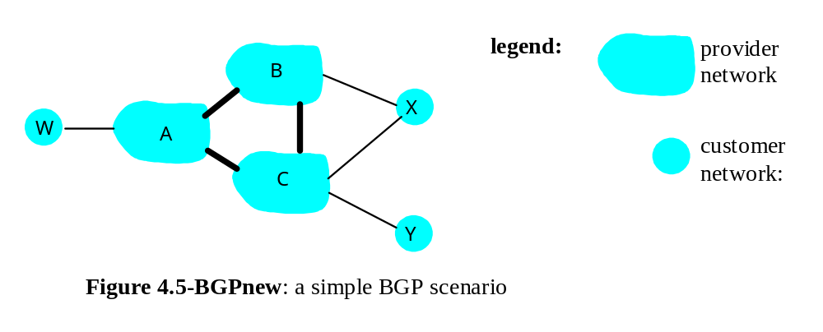
BGP: controlling who routes to you
A,B,C are provider networks
X,W,Y are customer (of provider networks)
X is dual-homed: attached to two networks
  X does not want to route from B via X to C
  .. so X will not advertise to B a route to C

Slide 81
BGP: controlling who routes to you
A advertises to B the path AW
B advertises to X the path BAW
Should B advertise to C the path BAW?
  No way! B gets no “revenue” for routing CBAW since neither W nor C are B’s customers
  B wants to force C to route to w via A
  B wants to route only to/from its customers!

Slide 82
BGP operation
Q: What does a BGP router do?
Receiving and filtering route advertisements from directly attached neighbor(s).
Route selection.
  To route to destination X, which path )of several advertised) will be taken?
Sending route advertisements to neighbors.

Slide 83
BGP messages
BGP messages exchanged using TCP.
BGP messages:
  OPEN: opens TCP connection to peer and authenticates sender
  UPDATE: advertises new path (or withdraws old)
  KEEPALIVE keeps connection alive in absence of UPDATES; also ACKs OPEN request
  NOTIFICATION: reports errors in previous msg; also used to close connection

Slide 84
Why different Intra- and Inter-AS routing ?
Policy:
Inter-AS: admin wants control over how its traffic routed, who routes through its net.
Intra-AS: single admin, so no policy decisions needed
Scale:
hierarchical routing saves table size, reduced update traffic
Performance:
Intra-AS: can focus on performance
Inter-AS: policy may dominate over performance

Slide 85
Chapter 4 roadmap
4.1 Introduction and Network Service Models
4.2 Routing Principles
4.3 Hierarchical Routing
4.4 The Internet (IP) Protocol
4.5 Routing in the Internet
4.6 What’s Inside a Router?
4.7 IPv6
4.8 Multicast Routing
4.9 Mobility

Slide 86

Router Architecture Overview
Two key router functions:
run routing algorithms/protocol (RIP, OSPF, BGP)
switching datagrams from incoming to outgoing link

Slide 87

Input Port Functions
Physical layer:
bit-level reception
Data link layer:
e.g., Ethernet
see chapter 5
Decentralized switching:
given datagram dest., lookup output port using routing table in input port memory
goal: complete input port processing at ‘line speed’
queuing: if datagrams arrive faster than forwarding rate into switch fabric

Slide 88

Input Port Queuing
Fabric slower that input ports combined -> queueing may occur at input queues
Head-of-the-Line (HOL) blocking: queued datagram at front of queue prevents others in queue from moving forward
queueing delay and loss due to input buffer overflow!

Slide 89

Three types of switching fabrics

Slide 90
Switching Via Memory
First generation routers:
packet copied by system’s (single) CPU
speed limited by memory bandwidth (2 bus crossings per datagram)
Input
Port
Memory
Output
Port
System Bus
Modern routers:
input port processor performs lookup, copy into memory
Cisco Catalyst 8500

Slide 91
Switching Via a Bus
datagram from input port memory
to output port memory via a shared bus
bus contention: switching speed limited by bus bandwidth
1 Gbps bus, Cisco 1900: sufficient speed for access and enterprise routers (not regional or backbone)

Slide 92
Switching Via An Interconnection Network
overcome bus bandwidth limitations
Banyan networks, other interconnection nets initially developed to connect processors in multiprocessor
Advanced design: fragmenting datagram into fixed length cells, switch cells through the fabric.
Cisco 12000: switches Gbps through the interconnection network

Slide 93

Output Ports
Buffering required when datagrams arrive from fabric faster than the transmission rate
Scheduling discipline chooses among queued datagrams for transmission

Slide 94

Output port queueing
buffering when arrival rate via switch exceeds output line speed
queueing (delay) and loss due to output port buffer overflow!

Slide 95
Chapter 4 roadmap
4.1 Introduction and Network Service Models
4.2 Routing Principles
4.3 Hierarchical Routing
4.4 The Internet (IP) Protocol
4.5 Routing in the Internet
4.6 What’s Inside a Router?
4.7 IPv6
4.8 Multicast Routing
4.9 Mobility

Slide 96
IPv6
Initial motivation: 32-bit address space completely allocated by 2008.
Additional motivation:
  header format helps speed processing/forwarding
  header changes to facilitate QoS
  new “anycast” address: route to “best” of several replicated servers
IPv6 datagram format:
  fixed-length 40 byte header
  no fragmentation allowed

Slide 97

IPv6 Header (Cont)
Priority: identify priority among datagrams in flow
Flow Label: identify datagrams in same “flow.”
(concept of“flow” not well defined).
Next header: identify upper layer protocol for data

Slide 98
Other Changes from IPv4
Checksum: removed entirely to reduce processing time at each hop
Options: allowed, but outside of header, indicated by “Next Header” field
ICMPv6: new version of ICMP
  additional message types, e.g. “Packet Too Big”
  multicast group management functions

Slide 99
Transition From IPv4 To IPv6
Not all routers can be upgraded simultaneous
  no “flag days”
  How will the network operate with mixed IPv4 and IPv6 routers?
Two proposed approaches:
  Dual Stack: some routers with dual stack (v6, v4) can “translate” between formats
  Tunneling: IPv6 carried as payload in IPv4 datagram among IPv4 routers

Slide 100
Dual Stack Approach
A
B
C
D
E
F
IPv6
IPv6
IPv4
IPv4
IPv6
IPv6
Flow: X
Src: A
Dest: F
data
Src:A
Dest: F
data
Src:A
Dest: F
data
Flow: ??
Src: A
Dest: F
data
A-to-B:
IPv6
B-to-C:
IPv4
B-to-C:
IPv4
B-to-C:
IPv6

Slide 101
Tunneling
A
B
E
F
Logical view:
tunnel
IPv6
IPv6
IPv6
IPv6
A
B
C
D
E
F
Physical view:
IPv6
IPv6
IPv4
IPv4
IPv6
IPv6
Flow: X
Src: A
Dest: F
data
Src:B
Dest: E
Src:B
Dest: E
Flow: X
Src: A
Dest: F
data
Flow: X
Src: A
Dest: F
data
Flow: X
Src: A
Dest: F
data
A-to-B:
IPv6
B-to-C:
IPv6 inside
IPv4
B-to-C:
IPv6 inside
IPv4
E-to-F:
IPv6

Slide 102
Chapter 4 roadmap
4.1 Introduction and Network Service Models
4.2 Routing Principles
4.3 Hierarchical Routing
4.4 The Internet (IP) Protocol
4.5 Routing in the Internet
4.6 What’s Inside a Router?
4.7 IPv6
4.8 Multicast Routing
4.9 Mobility

Slide 103
Multicast: one sender to many receivers
Multicast: act of sending datagram to multiple receivers with single “transmit” operation
  analogy: one teacher to many students
Question: how to achieve multicast
Multicast via unicast
source sends N unicast datagrams, one addressed to each of N receivers
routers
forward unicast
datagrams
multicast receiver (red)
not a multicast receiver (red)

Slide 104
Multicast: one sender to many receivers
Multicast: act of sending datagram to multiple receivers with single “transmit” operation
  analogy: one teacher to many students
Question: how to achieve multicast
Network multicast
Router actively participate in multicast, making copies of packets as needed and forwarding towards multicast receivers
Multicast
routers (red) duplicate and
forward multicast datagrams

Slide 105
Multicast: one sender to many receivers
Multicast: act of sending datagram to multiple receivers with single “transmit” operation
  analogy: one teacher to many students
Question: how to achieve multicast
Application-layer multicast
end systems involved in multicast copy and forward unicast datagrams among themselves

Slide 106
Internet Multicast Service Model
128.59.16.12
128.119.40.186
multicast
group
226.17.30.197
128.34.108.63
128.34.108.60
multicast group concept: use of indirection
  hosts addresses IP datagram to multicast group
  routers forward multicast datagrams to hosts that have “joined” that multicast group
Notes:
Notes:
The Internet multicast service model and addressing/group management ideas have their foundation in the PhD thesis of S. Deering: “Multicast Routing in a Datagram Network,” Dept. of Computer Science, Stanford University, 1991.
3.1 Network Layer: Introduction 3-2

Slide 107
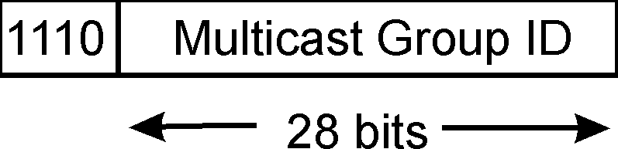
Multicast groups
class D Internet addresses reserved for multicast:
host group semantics:
  anyone can “join” (receive) multicast group
  anyone can send to multicast group
  no network-layer identification to hosts of members
needed: infrastructure to deliver mcast-addressed datagrams to all hosts that have joined that multicast group
Notes:
Notes:
3.1 Network Layer: Introduction 3-3

Slide 108
Joining a mcast group: two-step process
local: host informs local mcast router of desire to join group: IGMP (Internet Group Management Protocol)
wide area: local router interacts with other routers to receive mcast datagram flow
  many protocols (e.g., DVMRP, MOSPF, PIM)
IGMP
IGMP
wide-area
multicast
routing
IGMP
Notes:
Notes:
3.2 Network Layer: Multicast Addressing and Group Management 3-5

Slide 109
IGMP: Internet Group Management Protocol
host: sends IGMP report when application joins mcast group
  IP_ADD_MEMBERSHIP socket option
  host need not explicitly “unjoin” group when leaving
router: sends IGMP query at regular intervals
  host belonging to a mcast group must reply to query
query
report
Notes:
Notes:
3.2 Network Layer: Multicast Addressing and Group Management 3-6

Slide 110
IGMP
IGMP version 1
router: Host Membership Query msg broadcast on LAN to all hosts
host: Host Membership Report msg to indicate group membership
  randomized delay before responding
  implicit leave via no reply to Query
RFC 1112
IGMP v2: additions include
group-specific Query
Leave Group msg
  last host replying to Query can send explicit Leave Group msg
  router performs group-specific query to see if any hosts left in group
  RFC 2236
IGMP v3: under development as Internet draft
Notes:
Notes:
RFC-1112: S. Deering, “Host Extension for IP Multicasting,” August 1989
RFC 2236: R. Fenner, “Internet Group Management Protocol, Version 2”, November 1997.
B. Cain, S. Deering, A. Thyagarajan, “Internet Group Management Protocol, Version 3,” work in progress, draft-ietf-idmr-igmp-v3-00.txt
3.2 Network Layer: Multicast Addressing and Group Management 3-7

Slide 111
Multicast Routing: Problem Statement
Goal: find a tree (or trees) connecting routers having local mcast group members
  tree: not all paths between routers used
  source-based: different tree from each sender to rcvrs
  shared-tree: same tree used by all group members
Shared tree
Source-based trees
Notes:
Notes:
3.3 Network Layer: Multicast Routing Algorithms 3-9

Slide 112
Approaches for building mcast trees
Approaches:
source-based tree: one tree per source
  shortest path trees
  reverse path forwarding
group-shared tree: group uses one tree
  minimal spanning (Steiner)
  center-based trees
…we first look at basic approaches, then specific protocols adopting these approaches
Notes:
Notes:
3.3 Network Layer: Multicast Routing Algorithms 3-11

Slide 113
Shortest Path Tree
mcast forwarding tree: tree of shortest path routes from source to all receivers
  Dijkstra’s algorithm
S: source
LEGEND
R1
2
1
R4
router with attached
group member
R2
5
3
router with no attached
group member
4
R5
R3
6
i
link used for forwarding,
i indicates order link
added by algorithm
R6
R7
Notes:
Notes:
3.3 Network Layer: Multicast Routing Algorithms 3-12

Slide 114
Reverse Path Forwarding
rely on router’s knowledge of unicast shortest path from it to sender
each router has simple forwarding behavior:
if (mcast datagram received on incoming link on shortest path back to center)
then flood datagram onto all outgoing links
else ignore datagram
Notes:
Notes:
3.3 Network Layer: Multicast Routing Algorithms 3-13

Slide 115
Reverse Path Forwarding: example
S: source
LEGEND
R1
R4
router with attached
group member
R2
router with no attached
group member
R5
R3
datagram will be forwarded
R6
R7
datagram will not be
forwarded
result is a source-specific reverse SPT
  may be a bad choice with asymmetric links
Notes:
Notes:
3.3 Network Layer: Multicast Routing Algorithms 3-14

Slide 116
Reverse Path Forwarding: pruning
forwarding tree contains subtrees with no mcast group members
  no need to forward datagrams down subtree
  “prune” msgs sent upstream by router with no downstream group members
S: source
LEGEND
R1
router with attached
group member
R4
R2
router with no attached
group member
P
R5
P
prune message
R3
P
links with multicast
forwarding
R6
R7
Notes:
Notes:
3.3 Network Layer: Multicast Routing Algorithms 3-15

Slide 117
Shared-Tree: Steiner Tree
Steiner Tree: minimum cost tree connecting all routers with attached group members
problem is NP-complete
excellent heuristics exists
not used in practice:
  computational complexity
  information about entire network needed
  monolithic: rerun whenever a router needs to join/leave
Notes:
Notes:
1. See L. Wei and D. Estrin, “A Comparison of multicast trees and algorithms,” TR USC-CD-93-560, Dept. Computer Science, University of California, Sept 1993 for a comparison of heuristic approaches.
3.3 Network Layer: Multicast Routing Algorithms 3-16

Slide 118
Center-based trees
single delivery tree shared by all
one router identified as “center” of tree
to join:
  edge router sends unicast join-msg addressed to center router
  join-msg “processed” by intermediate routers and forwarded towards center
  join-msg either hits existing tree branch for this center, or arrives at center
  path taken by join-msg becomes new branch of tree for this router
Notes:
Notes:
1. It’s always nice to see a PhD dissertation with impact. The earliest discussion of center-based trees for multicast appears to be D. Wall, “Mechanisms for Broadcast and Selective Broadcast,” PhD dissertation, Stanford U., June 1980.
3.3 Network Layer: Multicast Routing Algorithms 3-17

Slide 119
Center-based trees: an example
Suppose R6 chosen as center:
LEGEND
R1
router with attached
group member
R4
3
R2
router with no attached
group member
2
R5
1
path order in which join messages generated
R3
1
R6
R7
Notes:
Notes:
3.3 Network Layer: Multicast Routing Algorithms 3-18

Slide 120
Internet Multicasting Routing: DVMRP
DVMRP: distance vector multicast routing protocol, RFC1075
flood and prune: reverse path forwarding, source-based tree
  RPF tree based on DVMRP’s own routing tables constructed by communicating DVMRP routers
  no assumptions about underlying unicast
  initial datagram to mcast group flooded everywhere via RPF
  routers not wanting group: send upstream prune msgs
Notes:
Notes:
D. Waitzman, S. Deering, C. Partridge, “Distance Vector Multicast Routing Protocol,” RFC 1075, Nov. 1988. The version of DVMRP in use today is considerably enhanced over the RFC1075 spec.
A more up-to-date “work-in-progress” defines a version 3 of DVMRP: T. Pusateri, “Distance Vector Multicast Routing Protocol,” work-in-progress, draft-ietf-idmr-v3-05.ps
3.4 Network Layer: Internet Multicast Routing Algorithms 3-20

Slide 121
DVMRP: continued…
soft state: DVMRP router periodically (1 min.) “forgets” branches are pruned:
  mcast data again flows down unpruned branch
  downstream router: reprune or else continue to receive data
routers can quickly regraft to tree
  following IGMP join at leaf
odds and ends
  commonly implemented in commercial routers
  Mbone routing done using DVMRP
Notes:
Notes:
1. See www.mbone.com/mbone/routers.html for a (slightly outdatet) list of multicast capable routers (supporting DVMPR as well as other protocols) from various vendors.
2. ftp://parcftp.xerox.com/pub/net-research/ipmulti for circa 1996 public copy “mrouted” v3.8 of DVMRP routing software for various workstation routing platforms.
3.4 Network Layer: Internet Multicast Routing Algorithms 3-21

Slide 122
Tunneling
Q: How to connect “islands” of multicast routers in a “sea” of unicast routers?
physical topology
logical topology
mcast datagram encapsulated inside “normal” (non-multicast-addressed) datagram
normal IP datagram sent thru “tunnel” via regular IP unicast to receiving mcast router
receiving mcast router unencapsulates to get mcast datagram
Notes:
Notes:
For a general discussion of IP encapsulation, see C. Perkins, “IP Encapsulation within IP,” RFC 2003, Oct. 1996.
The book S. Bradner, A Mankin, “Ipng: Internet protocol next generation,” Addison Wesley, 1995 has a very nice discussion of tunneling
Tunneling can also be used to connect islands of IPv6 capable routers in a sea IPv4 capable routers. The long term hope is that the sea evaporates leaving only lands of IPv6!
3.4 Network Layer: Internet Multicast Routing Algorithms 3-22

Slide 123
PIM: Protocol Independent Multicast
not dependent on any specific underlying unicast routing algorithm (works with all)
two different multicast distribution scenarios :
Dense:
group members densely packed, in “close” proximity.
bandwidth more plentiful
Sparse:
# networks with group members small wrt # interconnected networks
group members “widely dispersed”
bandwidth not plentiful
Notes:
Notes:
a very readable discussion of the PIM architecture is S. Deering, D. Estrin, D. Faranacci, V. Jacobson, C. Liu, L. Wei, “The PIM Architecture for Wide Area Multicasting,” IEEE/ACM Transactions on Networking, Vol. 4, No. 2, April 1996.
D. Estrin et al, PIM-SM: Protocol Specification, RFC 2117, June 1997
S. Deering et al, PIM Version 2, Dense Mode Specification, work in progress, draft-ietf-idmr-pim-dm-05.txt
PIM is implemented in Cisco routers and has been deployed in UUnet as part of their streaming multimedia delivery effort. See S. LaPolla, “IP Multicast makes headway among ISPs,” PC Week On-Line, http://www.zdnet.com/pcweek/news/1006/06isp.html
3.4 Network Layer: Internet Multicast Routing Algorithms 3-25

Slide 124
Consequences of Sparse-Dense Dichotomy:
Dense
group membership by routers assumed until routers explicitly prune
data-driven construction on mcast tree (e.g., RPF)
bandwidth and non-group-router processing profligate
Sparse:
no membership until routers explicitly join
receiver- driven construction of mcast tree (e.g., center-based)
bandwidth and non-group-router processing conservative
Notes:
Notes:
3.4 Network Layer: Internet Multicast Routing Algorithms 3-26

Slide 125
PIM- Dense Mode
flood-and-prune RPF, similar to DVMRP but
underlying unicast protocol provides RPF info for incoming datagram
less complicated (less efficient) downstream flood than DVMRP reduces reliance on underlying routing algorithm
has protocol mechanism for router to detect it is a leaf-node router
Notes:
Notes:
3.4 Network Layer: Internet Multicast Routing Algorithms 3-27

Slide 126
PIM - Sparse Mode
center-based approach
router sends join msg to rendezvous point (RP)
  intermediate routers update state and forward join
after joining via RP, router can switch to source-specific tree
  increased performance: less concentration, shorter paths
R1
R4
join
R2
join
R5
join
R3
R7
R6
all data multicast
from rendezvous
point
rendezvous
point
Notes:
Notes:
3.4 Network Layer: Internet Multicast Routing Algorithms 3-28

Slide 127
PIM - Sparse Mode
sender(s):
unicast data to RP, which distributes down RP-rooted tree
RP can extend mcast tree upstream to source
RP can send stop msg if no attached receivers
  “no one is listening!”
R1
R4
join
R2
join
R5
join
R3
R7
R6
all data multicast
from rendezvous
point
rendezvous
point
Notes:
Notes:
3.4 Network Layer: Internet Multicast Routing Algorithms 3-29

Slide 128
Chapter 4 roadmap
4.1 Introduction and Network Service Models
4.2 Routing Principles
4.3 Hierarchical Routing
4.4 The Internet (IP) Protocol
4.5 Routing in the Internet
4.6 What’s Inside a Router?
4.7 IPv6
4.8 Multicast Routing
4.9 Mobility

Slide 129
What is mobility?
spectrum of mobility, from the network perspective:
no mobility
high mobility
mobile user, using
same access point
mobile user, connecting/ disconnecting from network using DHCP.
mobile user, passing through multiple access point while maintaining ongoing connections (like cell phone)

Slide 130
Mobility: Vocabulary
home network: permanent “home” of mobile
(e.g., 128.119.40/24)
home agent: entity that will perform mobility functions on behalf of mobile, when mobile is remote
wide area network
Permanent address: address in home network, can always be used to reach mobile
e.g., 128.119.40.186
correspondent

Slide 131
Mobility: more vocabulary
visited network: network in which mobile currently resides (e.g., 79.129.13/24)
Permanent address: remains constant (e.g., 128.119.40.186)
Care-of-address: address in visited network.
(e.g., 79,129.13.2)
wide area network
home agent: entity in visited network that performs mobility functions on behalf of mobile.
correspondent: wants to communicate with mobile

Slide 132



How do you contact a mobile friend:
Consider friend frequently changing addresses, how do you find her?
I wonder where Alice moved to?
search all phone books?
call her parents?
expect her to let you know where he/she is?

Slide 133
Mobility: approaches
Let routing handle it: routers advertise permanent address of mobile-nodes-in-residence via usual routing table exchange.
  routing tables indicate where each mobile located
  no changes to end-systems
Let end-systems handle it:
  indirect routing: communication from correspondent to mobile goes through home agent, then forwarded to remote
  direct routing: correspondent gets foreign address of mobile, sends directly to mobile

Slide 134
Mobility: approaches
Let routing handle it: routers advertise permanent address of mobile-nodes-in-residence via usual routing table exchange.
  routing tables indicate where each mobile located
  no changes to end-systems
let end-systems handle it:
  indirect routing: communication from correspondent to mobile goes through home agent, then forwarded to remote
  direct routing: correspondent gets foreign address of mobile, sends directly to mobile
not
scalable
to millions of
mobiles

Slide 135
Mobility: registration
visited network
home network
1
2
wide area network
mobile contacts foreign agent on entering visited network
foreign agent contacts home agent home: “this mobile is resident in my network”
End result:
Foreign agent knows about mobile
Home agent knows location of mobile

Slide 136
Mobility via Indirect Routing
foreign agent receives packets, forwards to mobile
home agent intercepts packets, forwards to foreign agent
visited
network
home
network
3
wide area network
2
1
correspondent addresses packets using home address of mobile
4
mobile replies directly to correspondent

Slide 137
Indirect Routing: comments
Mobile uses two addresses:
  permanent address: used by correspondent (hence mobile location is transparent to correspondent)
  care-of-address: used by home agent to forward datagrams to mobile
foreign agent functions may be done by mobile itself
triangle routing: correspondent-home-network-mobile
  inefficient when
  correspondent, mobile
  are in same network

Slide 138
Forwarding datagrams to remote mobile
foreign-agent-to-mobile packet
packet sent by home agent to foreign agent: a packet within a packet
dest: 128.119.40.186
dest: 79.129.13.2
dest: 128.119.40.186
Permanent address: 128.119.40.186
Care-of address: 79.129.13.2
dest: 128.119.40.186
packet sent by correspondent

Slide 139
Indirect Routing: moving between networks
suppose mobile user moves to another network
  registers with new foreign agent
  new foreign agent registers with home agent
  home agent update care-of-address for mobile
  packets continue to be forwarded to mobile (but with new care-of-address)
Mobility, changing foreign networks transparent: on going connections can be maintained!

Slide 140
Mobility via Direct Routing
foreign agent receives packets, forwards to mobile
correspondent forwards to foreign agent
visited
network
home
network
4
wide area network
2
3
correspondent requests, receives foreign address of mobile
1
4
mobile replies directly to correspondent

Slide 141
Mobility via Direct Routing: comments
overcome triangle routing problem
non-transparent to correspondent: correspondent must get care-of-address from home agent
  What happens if mobile changes networks?

Slide 142
Mobile IP
RFC 3220
has many features we’ve seen:
  home agents, foreign agents, foreign-agent registration, care-of-addresses, encapsulation (packet-within-a-packet)
three components to standard:
  agent discovery
  registration with home agent
  indirect routing of datagrams

Slide 143

Mobile IP: agent discovery
agent advertisement: foreign/home agents advertise service by broadcasting ICMP messages (typefield = 9)
H,F bits: home and/or foreign agent
R bit: registration required

Slide 144

Mobile IP: registration example

Slide 145
Network Layer: summary
What we’ve covered:
network layer services
routing principles: link state and distance vector
hierarchical routing
IP
Internet routing protocols RIP, OSPF, BGP
what’s inside a router?
IPv6
mobility
Next stop:
the Data
link layer!

