Slide 1
Evaluating and optimizing SQL query with Postgres Explain Analyze

Slide 2
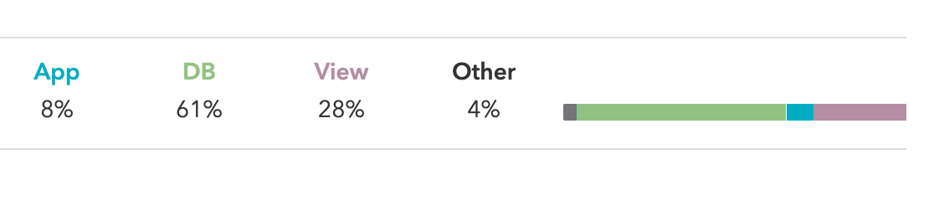
An HTTP request journey
Browser
Server
Framework
Database
Framework
Server
Browser

Slide 3
Get the query and Read the Analyze
What you need:
A way to get the raw SQL query
A way to execute the Analyze and retrieve the result

Slide 4
Getting the raw sql
Django => .query()
Sql Alchemy => .str()
SqlModel => print(query.compile(compile_kwargs={‘literal_bindings’: True))
Query log
Import pdb; pdb.set_trace()

Slide 5
Live example

Slide 6
An HTTP request journey
Browser
Server
Framework
Database
Framework
Server
Browser
Parsing
Planning
Execution

Slide 7
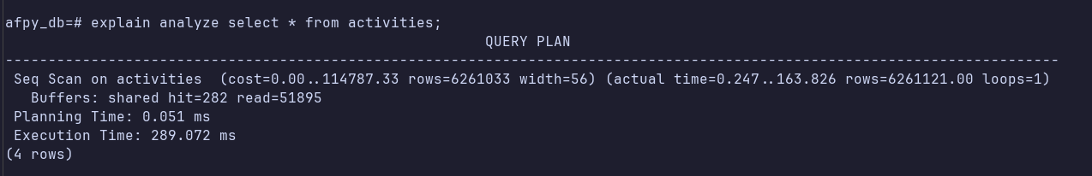
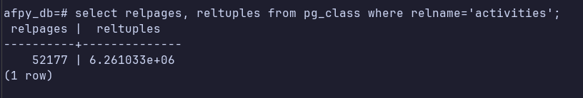
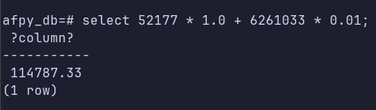
Table stats

Slide 8
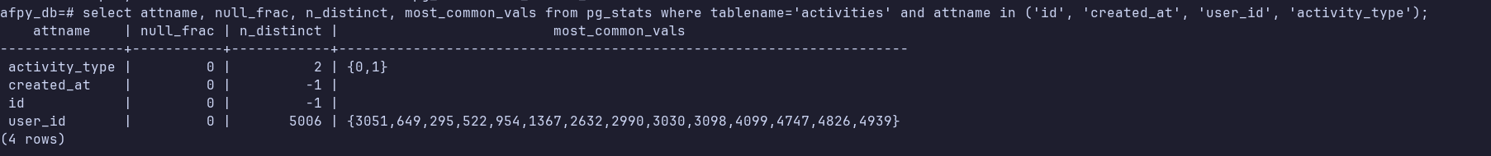
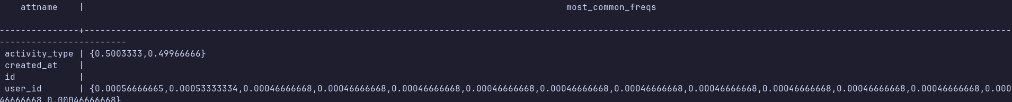
pg_stats

Slide 9
Ways to optimize for a Query
Optimize the raw query
Add an index or remove one
Upgrade your database spec: work_mem and shared buffers

Slide 10
Conclusion How to Automate the Process?
HypoPG
PG analyze

Slide 11
Questions

