Slide 1
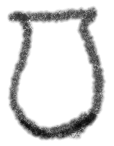
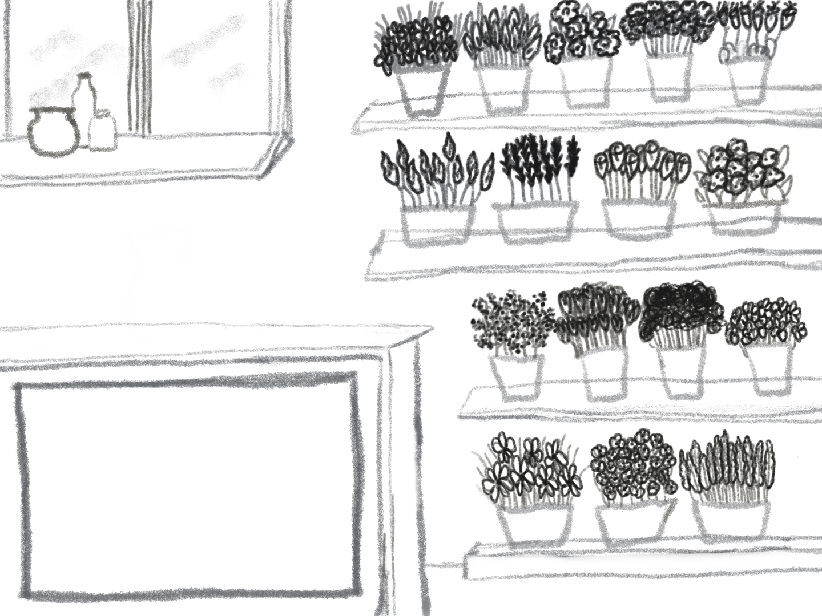
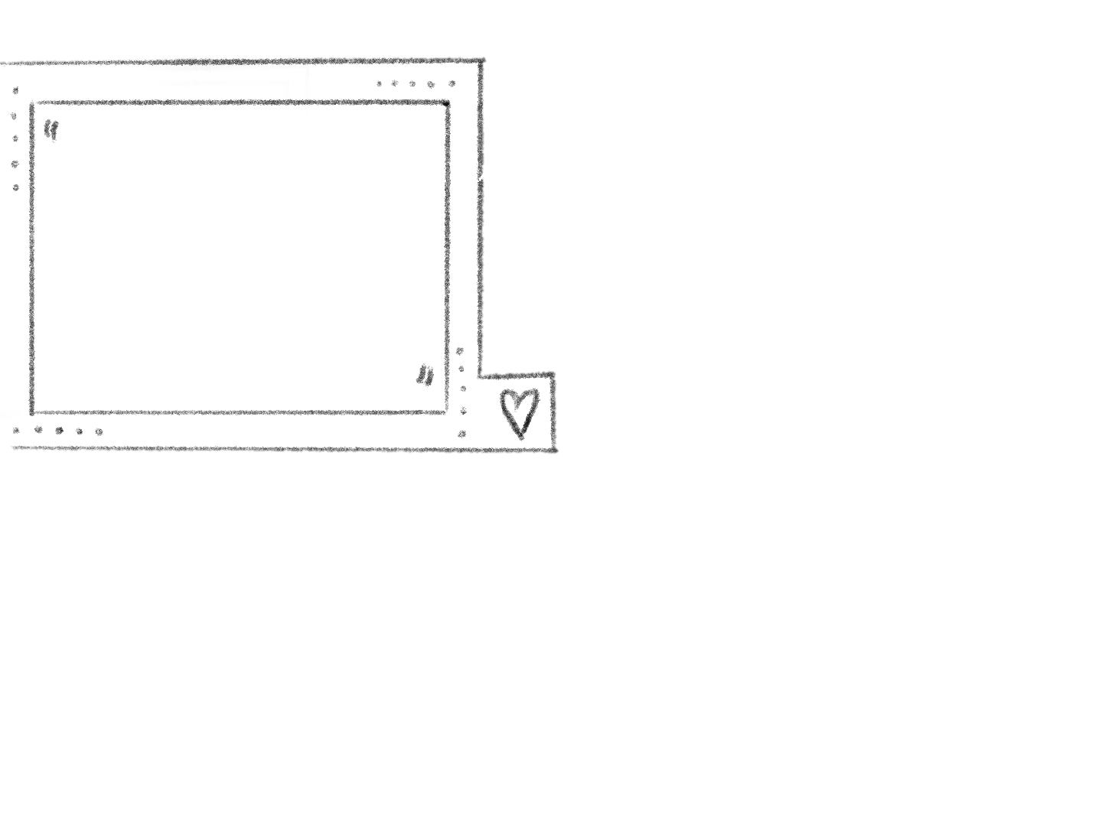

I’m hopelessly in love with my childhood friend of 17 years. I’m afraid I’ve ruined any chances of him looking at me in a romantic light because I used to call him “like my brother”. And from what I know about him, I’m not his physical type. I don't want to ruin our friendship; it means so much to me. But these feelings are overwhelming.
New Order!
Notes:
Opening scene
https://www.reddit.com/r/relationship_advice/comments/1dp4ae5/i_24m_am_hopelessly_in_love_with_my_24m_childhood/
I (24M) am hopelessly in love with my (24M) childhood bff who's also queer, what should I do? We've known each other for about 17 years now, we were really good friends and became extremely close when we came out to each other (him as gay, me as bi) at 22. Since then, I've recently started developing feelings for him now that I truly know the real him, without any filters in fear of being judged.
There's just one problem, I used to call him as "my brother" constantly (because at the time he always felt like the brother I never had), so I fear that I've completely ruined any chances of him looking at me in a romantic light. And from what I know about him, he's into thin men with mustaches and light facial hair, which I'm definitely not. I don't think I can ever tell him because I don't want to ruin our friendship, it means so much to me.
So what should I do? Do I bide my time and try to make romantic gestures to make him consider me as an option? Do I try to be more forward? Or do I just do nothing so I don't ruin our beautiful friendship?

Slide 2
Each option is part of the taxonomy
Filling an Order
Positive, uplifting statements about the customer’s character and capability to handle their given situation
Empowerment
Expands and shows the “order”
Response appears here as player “builds”
Hover over cards for more info
Notes:
Questions:
What would we call the empathy seeker in this game?

Slide 3
Filling an Order
Sample snippet written on pot (needs redrawing)
Matching flowers spawn inside vase as snippets are added
Thank you for sharing
I appreciate that you shared this.
It sounds like your feelings are weighing heavily on you.
Response appears here as player “builds”
No matter what you decide to do, everything will be okay.
You’re really brave!
Notes:
Questions:
What would we call the empathy seeker in this game?
How would we include self-disclosure ? Fill in the blank?
How would we include acknowledgment?

Slide 4
Order 2
Today I was home all day with my toddler. We played in the water, painted, played dolls, and did educational games. Then I did some cleaning. My husband wasn’t home all day and didn’t tell me he’d be gone. Why is this so exhausting? I am so exhausted. I feel like my brain is fried and totally depleted.
Notes:
Today I was home all day with my toddler. Wasn’t planned, usually I’ve got a plan if we’re not doing much. Husband wasn’t home and didn’t tell me he’d be gone.
Soooooo I didn’t plan on going out. We played in the water, we painted, we watched tv, did educational games on an app together, we did stamps, we colored, read, played dolls…and then I cleaned the kitchen and organized some things. I hate not having a plan. My husband eventually came home around 530.
WHY AM I SO EXHAUSTED? Can someone explain this to me? I work part time the later half of the day. Why? Why is this so exhausting? I feel like my brain is fried and I’m totally depleted.

Slide 5
Order 2
I’m currently working a management role and me and my whole team are being made redundant next month. There’s an internal role available, which would be a demotion for me, but I still want to apply because I’m qualified. There’s someone else on my team who’s qualified too, though, and I’m afraid my team will think I’m a traitor if I apply and get it. I don’t know what to do.
Notes:
Me and my team are being made redundant by the end of August and there is 1 available internal role available. The role is currently part time and there is a person on my team who has been doing it part time for nearly a year. They are making it full time and now it's up for advertisement. Everyone presumes that the part time worker will just get it but I have put in an application because I want it. I am more than qualified and currently in a management position.
I have a good chance of getting the job but I am so conflicted about potentially 'stealing' this away from one of my team. She is really lovely and good at what she does. I might not get it as she is already doing the role but I j know that upper management are keen for me to apply
If I get the role I will be disliked by my team and looked on as a traitor. But I want the job and I need to think about looking for another job soon!

