Slide 1
Assignment 2
UN Data Analysis
Eben Gunadi
Notes:
Slides can vary as per your presentation, but header and footer should be consistent

Slide 2
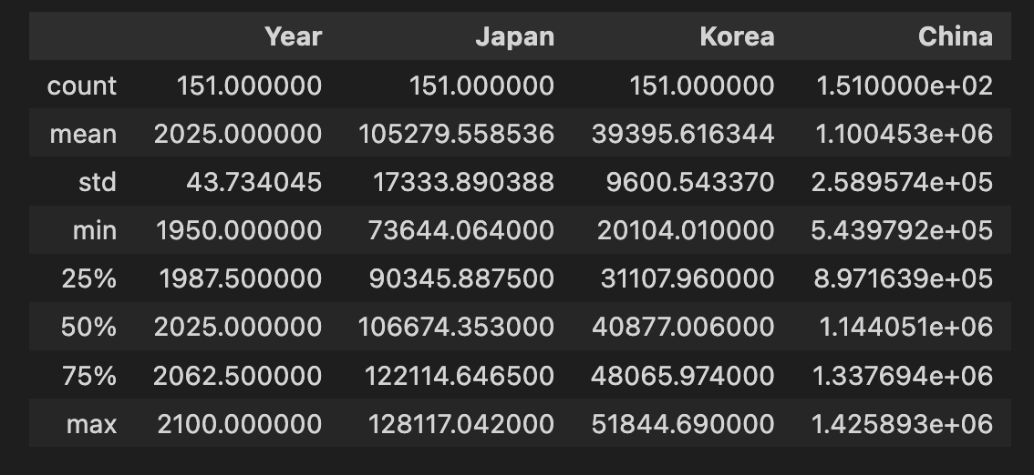
Descriptive Statistics
Summary statistics
Population data

Slide 3
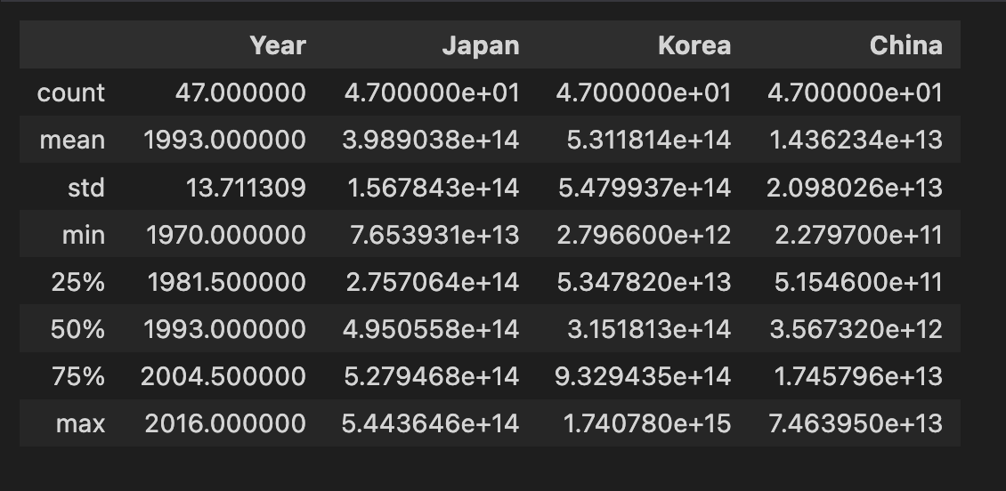
Descriptive Statistics
Summary statistics
GDP data

Slide 4
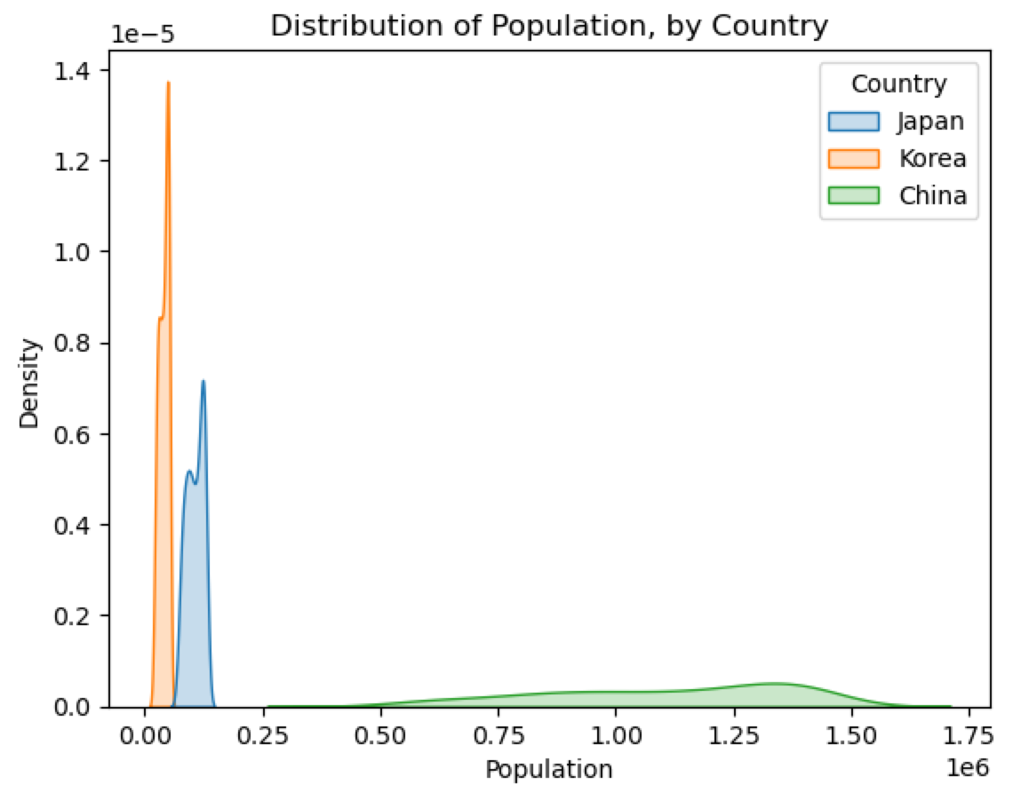
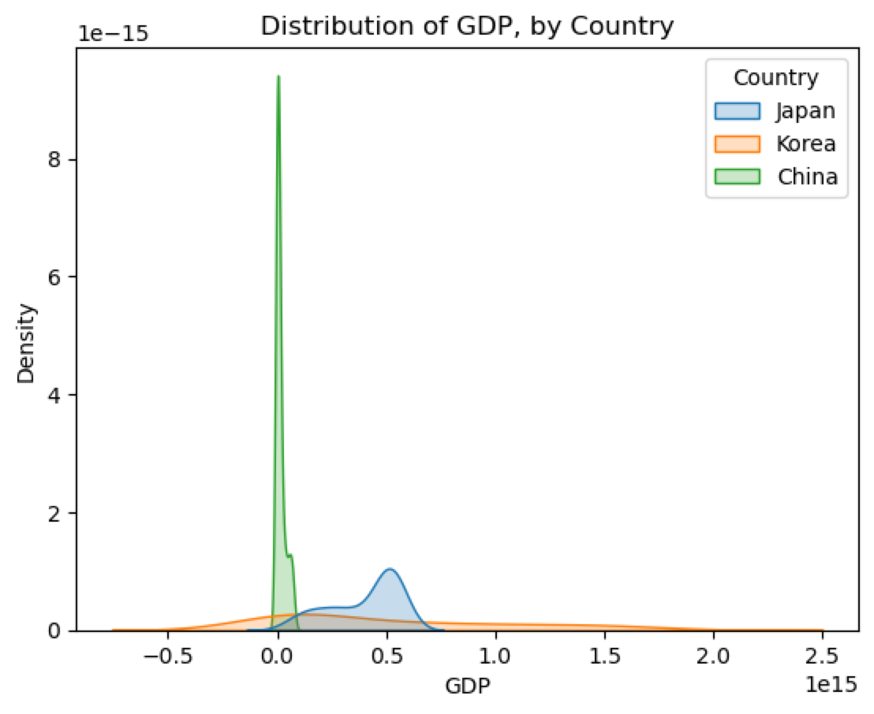
Descriptive Statistics
Distribution visualizations

Slide 5
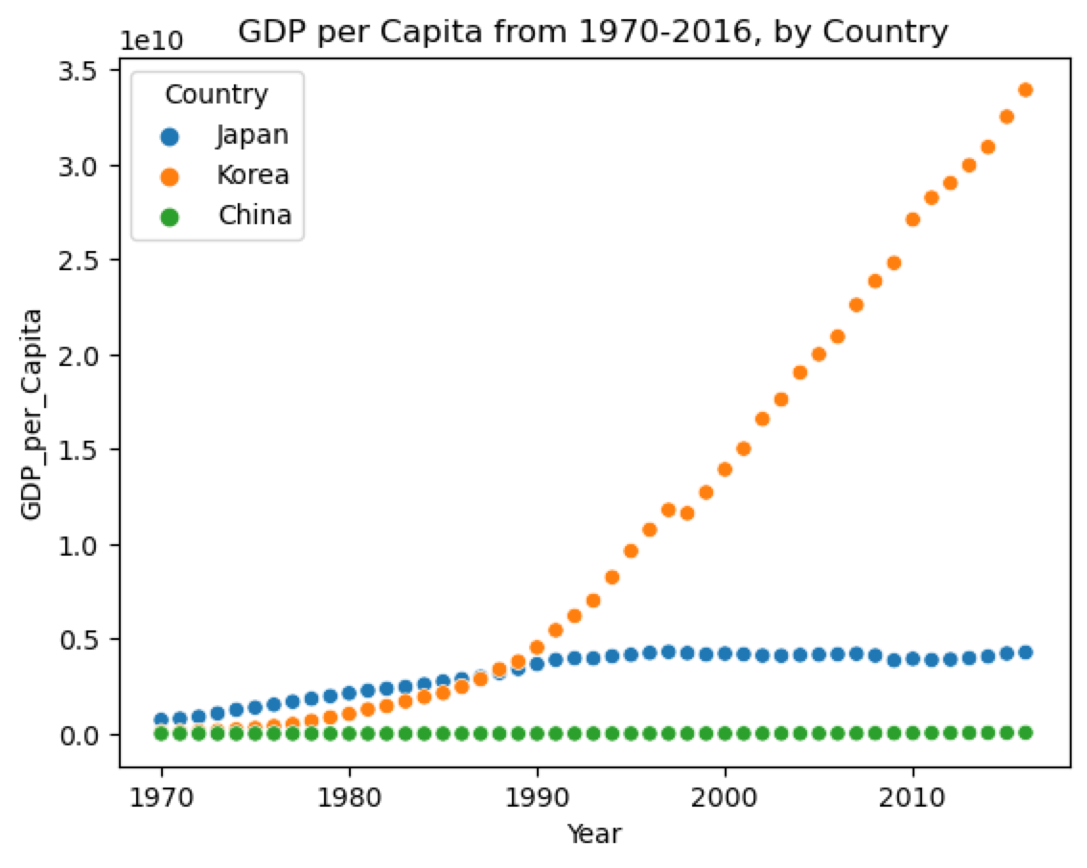
Data Visualization
Scatter plot

Slide 6
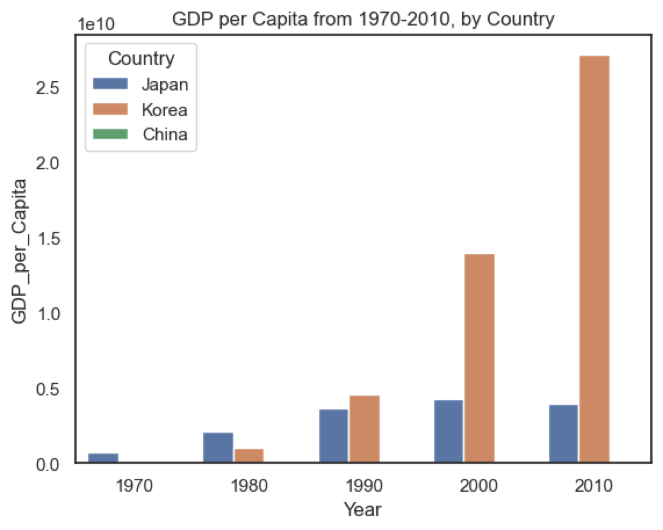
Data Visualization
Bar chart

Slide 7
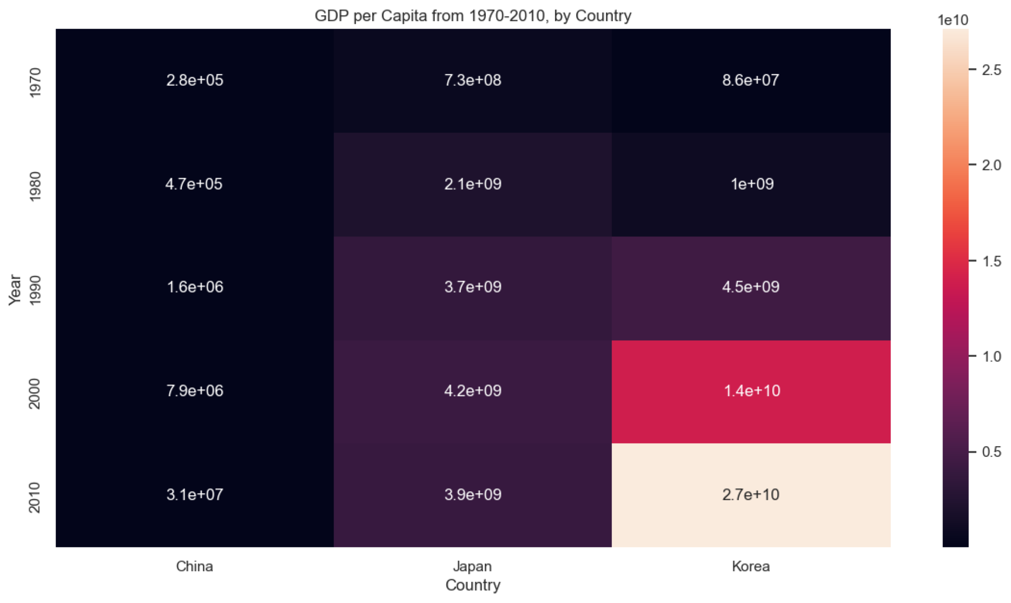
Data Visualization
Heatmap

Slide 8
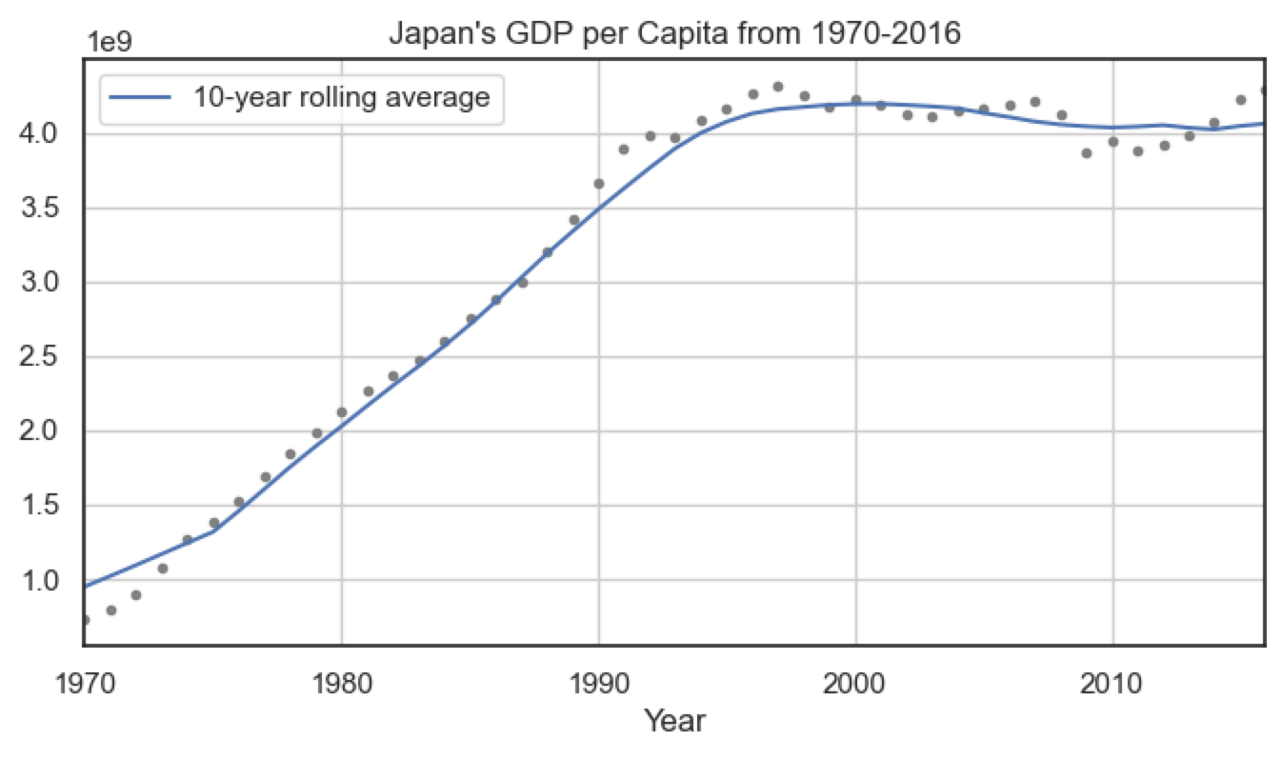
Time Series Analysis
Rolling averages

Slide 9
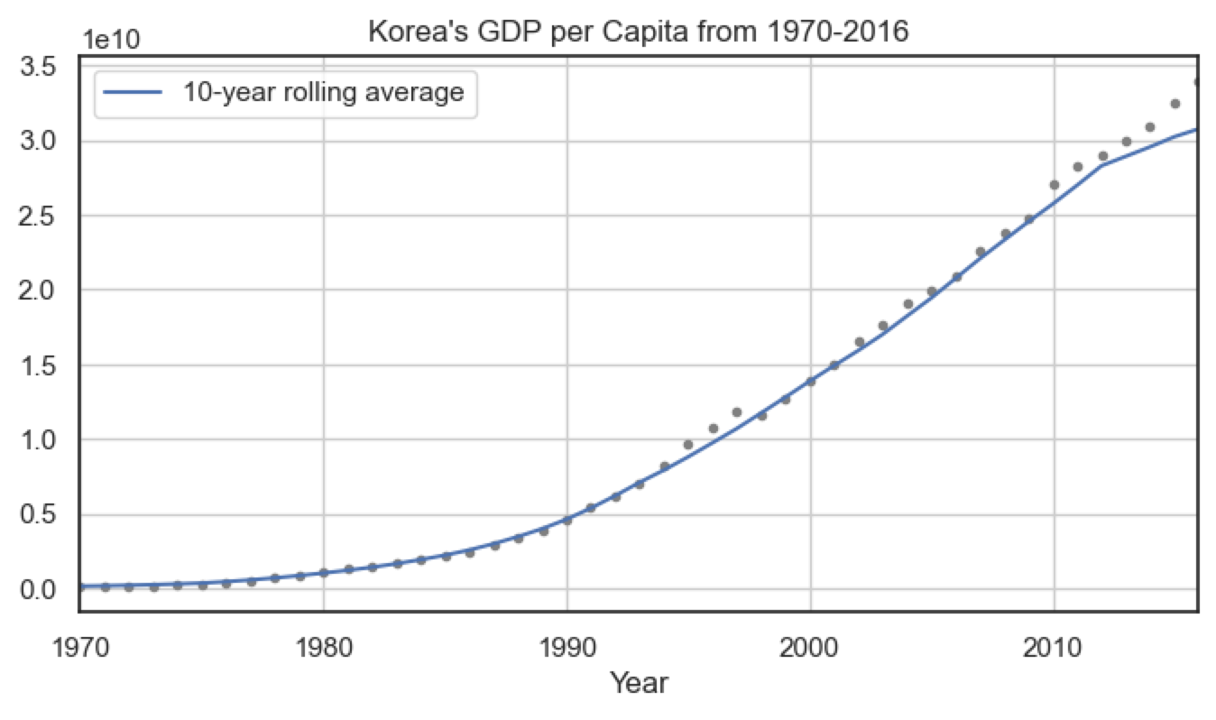
Time Series Analysis
Rolling averages

Slide 10
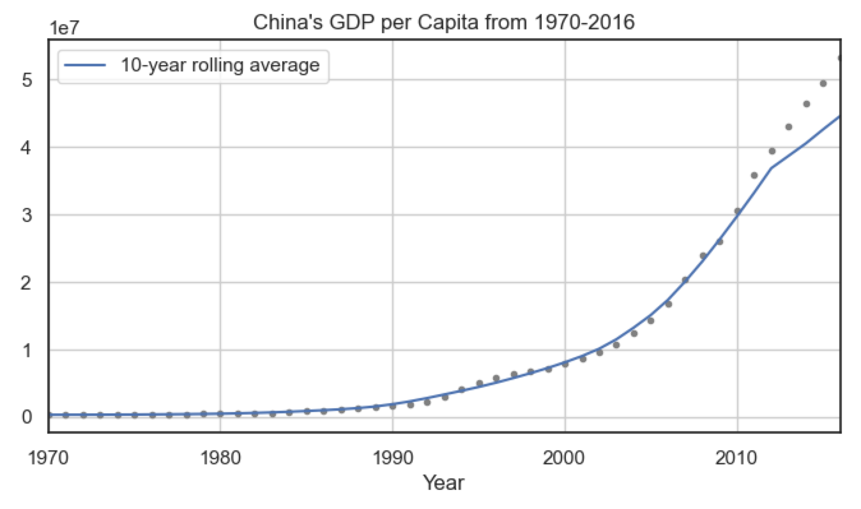
Time Series Analysis
Rolling averages

Slide 11
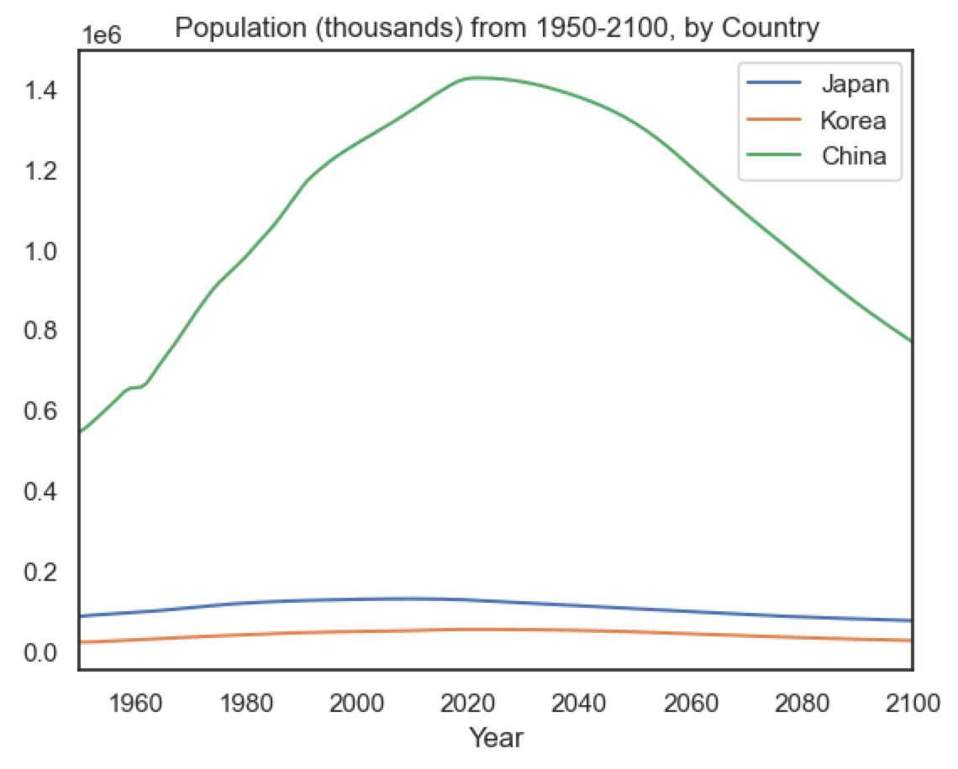
Time Series Analysis
Time series graphs

Slide 12
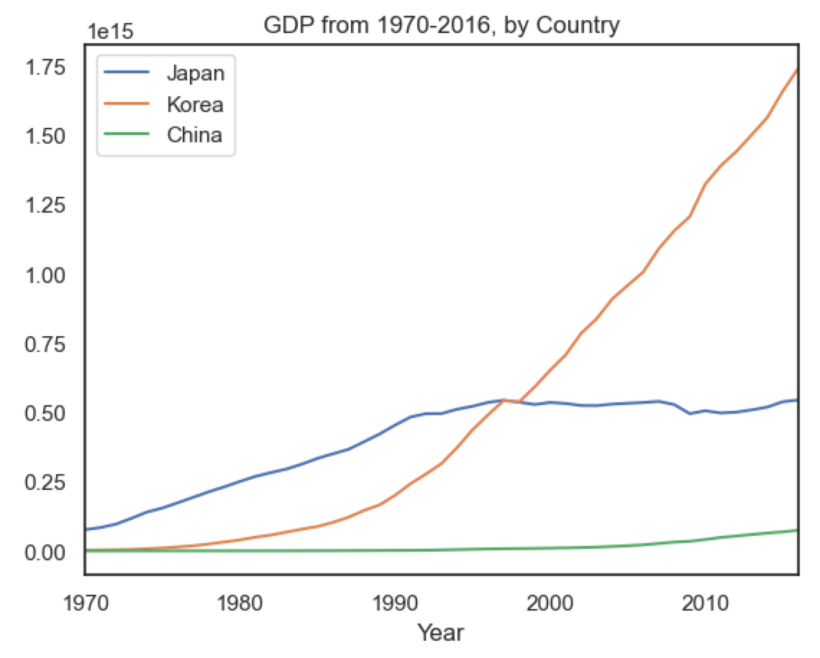
Time Series Analysis
Time series graphs

Slide 13
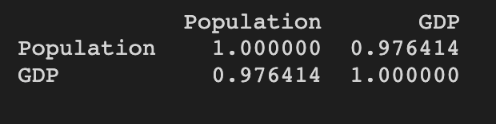
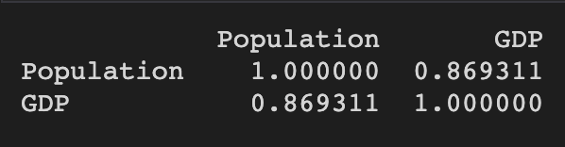
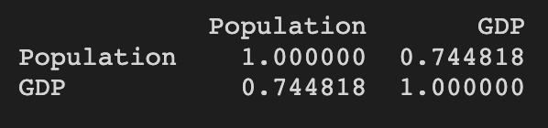
Correlation and Regression
Correlation coefficient between Population and GDP
Japan
Korea
China

Slide 14
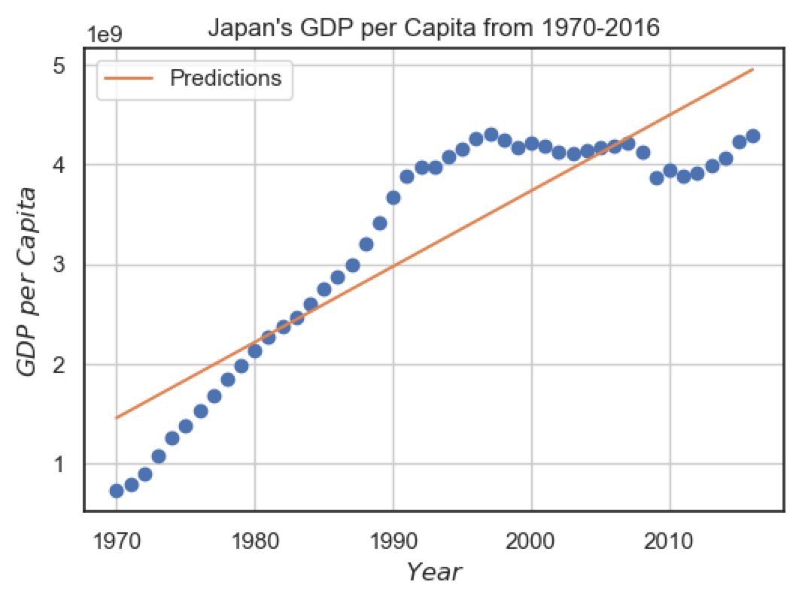
Correlation and Regression
Regression plots

Slide 15
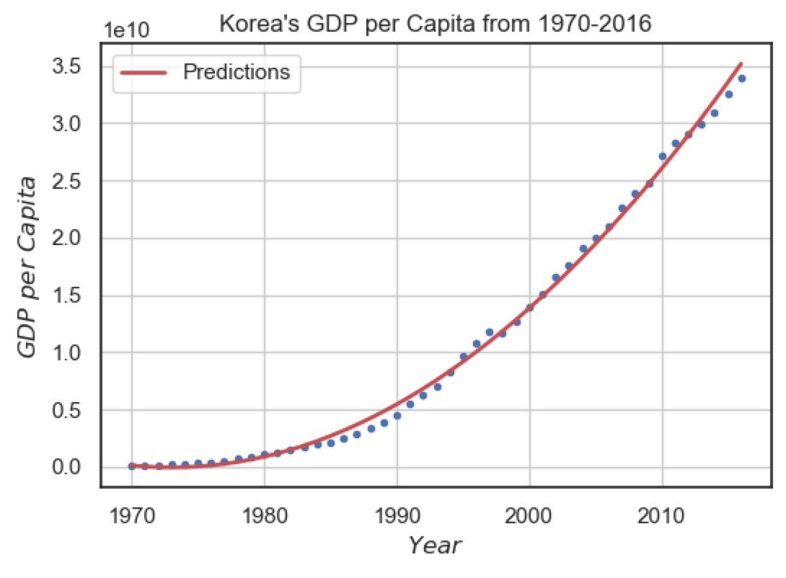
Correlation and Regression
Regression plots

Slide 16
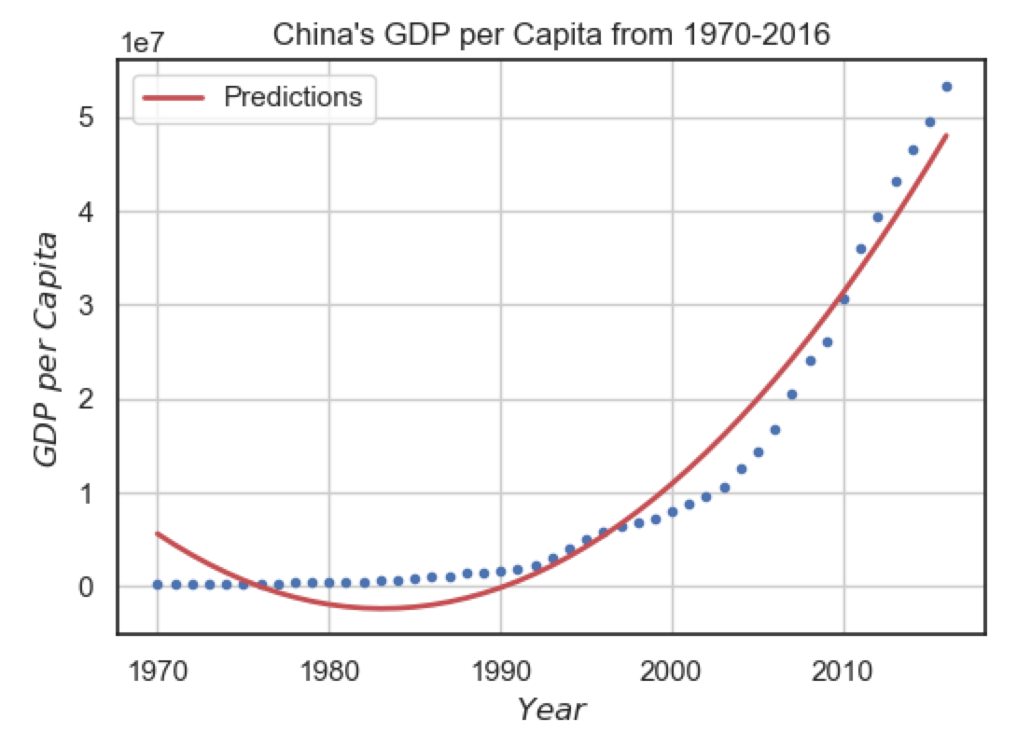
Correlation and Regression
Regression plots

Slide 17
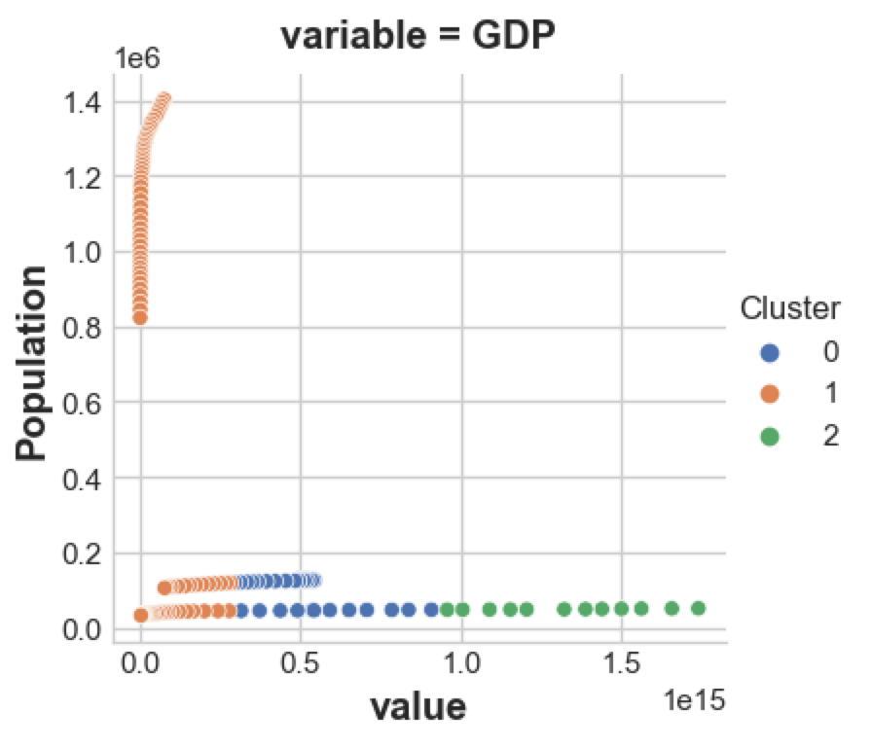
Cluster Analysis

Slide 18
Interpretation and Insights
This exploratory analysis suggests that the economic welfare of all three countries (measured by GDP per capita and GDP) have increased significantly in the past four decades. For Japan, this growth seems to have plateaued around 1990. Korea seems to have enjoyed the greatest percent increase overall.
Population-wise, Korea and Japan have remained stable while China's much larger population skyrocketed and peaked around 2020. The sudden decrease in China's population may explain why it has a lower correlation coefficient between population and GDP (0.744818), as opposed to the other two countries (0.976414 for Japan and 0.869311 for Korea).

Slide 19
THANK YOU

