Slide 1
Assignment 4
Task 2: Country Comparison Infographic
Eben Gunadi
Notes:
Slides can vary as per your presentation, but header and footer should be consistent

Slide 2
Data
The original, full data on "Labour force and unemployment" can be downloaded here:
https://data.un.org/_Docs/SYB/CSV/SYB65_329_202209_Labour%20Force%20and%20Unemployment.csv
Note that the first row is the spreadsheet title and must be manually removed prior to processing.
"code/filter_data.py” in the GitHub repository was used to process the data
The data is filtered to only look at “Labour force participation” data and countries “United States of America” and “Indonesia”
"data/labour.csv" is the processed data used for the visualizations

Slide 3
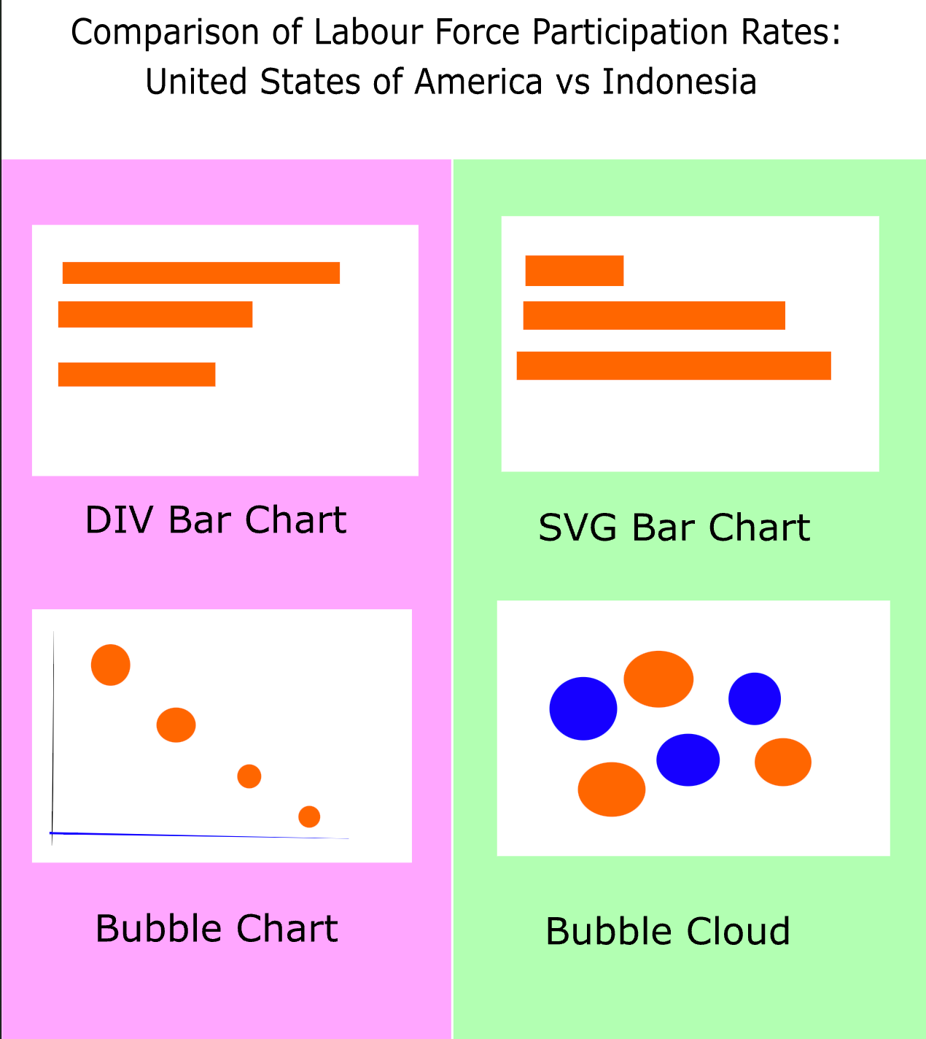
Inkscape Wireframe
“svg/wireframe.svg” in the GitHub repository
Visualizations for the two countries are laid out in separate columns with contrasting colors
To accommodate readers with red-green color-vision deficiency, pink and yellow-green are used
Pink: rgba(255, 0, 141, 1)
Yellow-green: rgba(89, 198, 27, 1)

Slide 4
Visualization Code References
Code for “html/div_bars.html”, “html/svg_bars.html”, and “html/bubble_chart.html” in the the GitHub repository are based off “D3 with data join” examples in the following respective lab files:
“2_div_bars.html”
“3_svg_bars.html”
“4_scatterplot.html”
(Axis, legends, and labels were added using ChatGPT)
Code for “bubble_cloud.html” is based off sample code from Observable
https://observablehq.com/@d3/bubble-chart/2

Slide 5
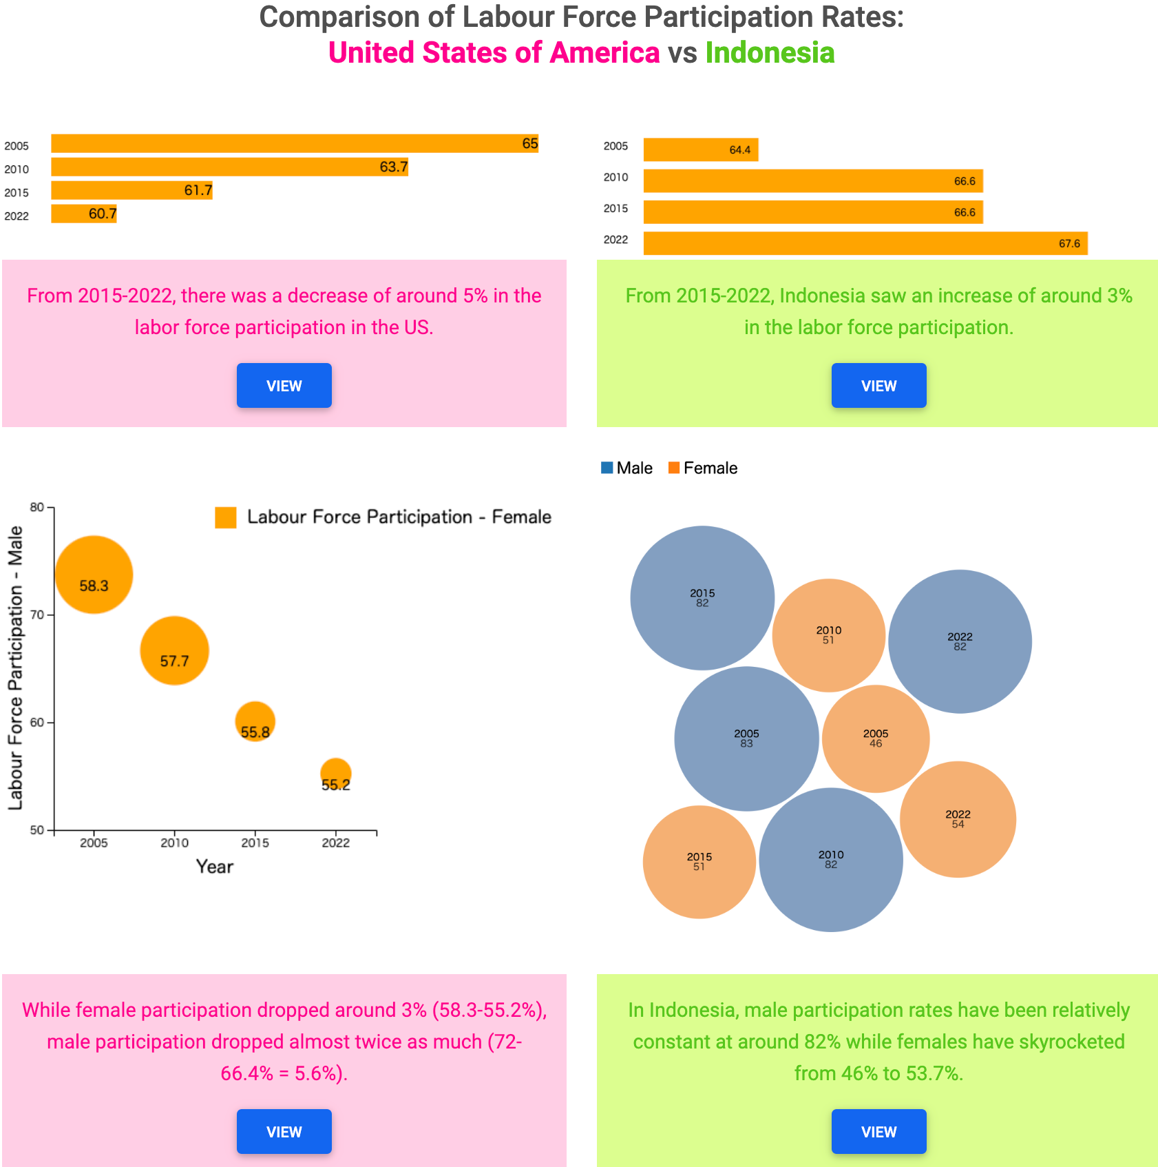
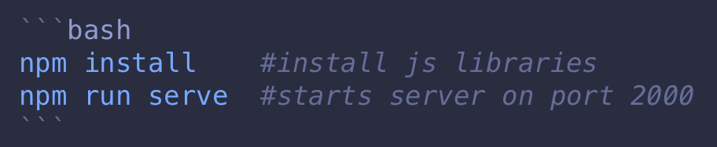
Landing Page
"index.html" is the landing page. It can be served on a browser via hot-reload:
Alternately, this page can be viewed in GitHub at https://egunadi.github.io/dsci554-a4/

Slide 6
THANK YOU

