Slide 1
Assignment 4
Task 1: Infographic Comparison
Eben Gunadi
Notes:
Slides can vary as per your presentation, but header and footer should be consistent

Slide 2
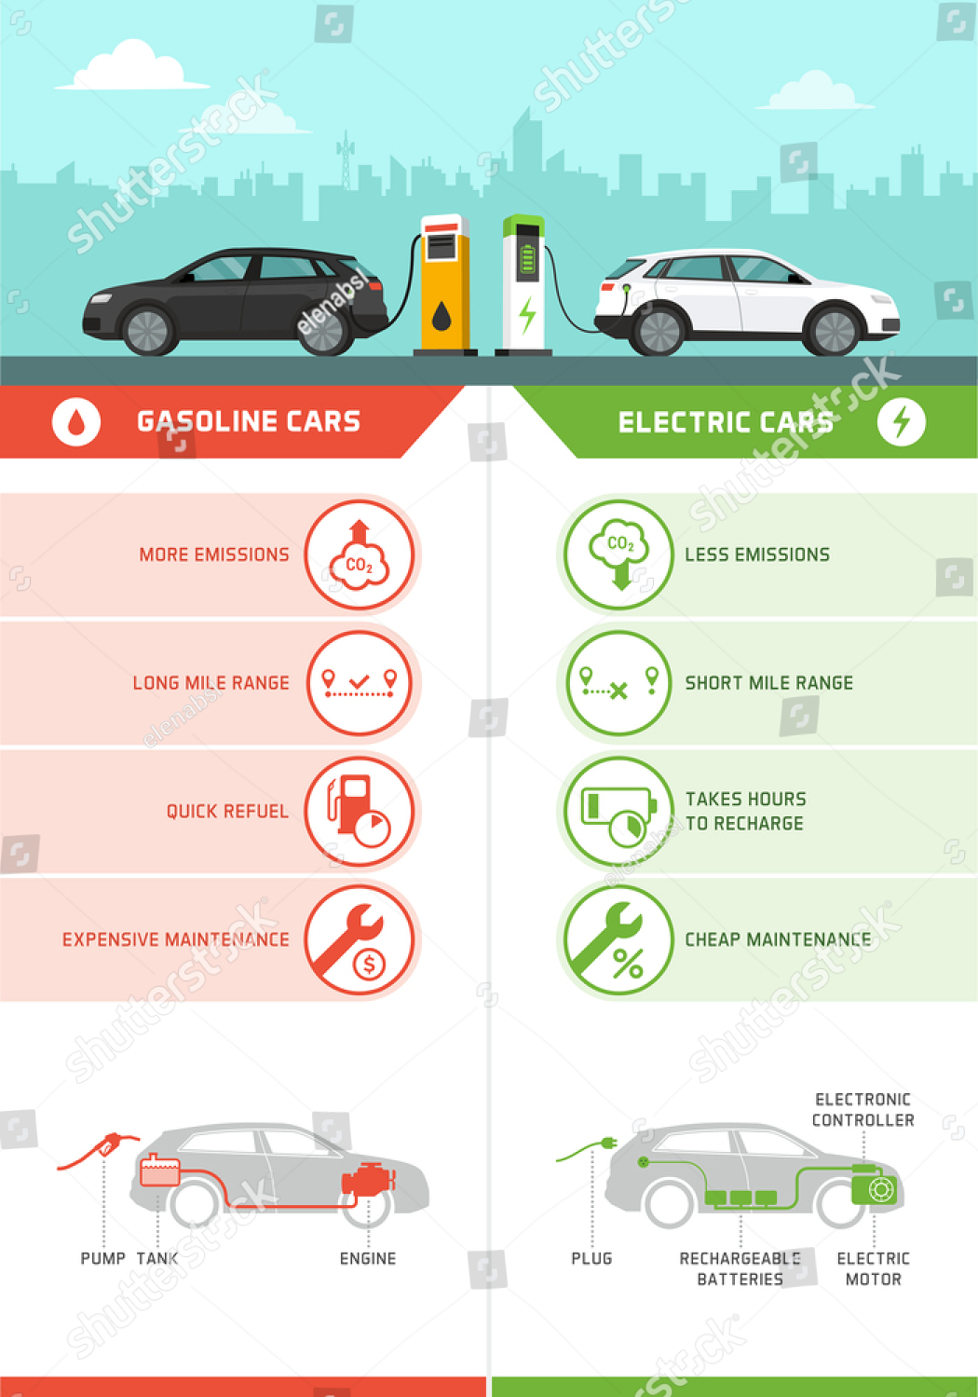
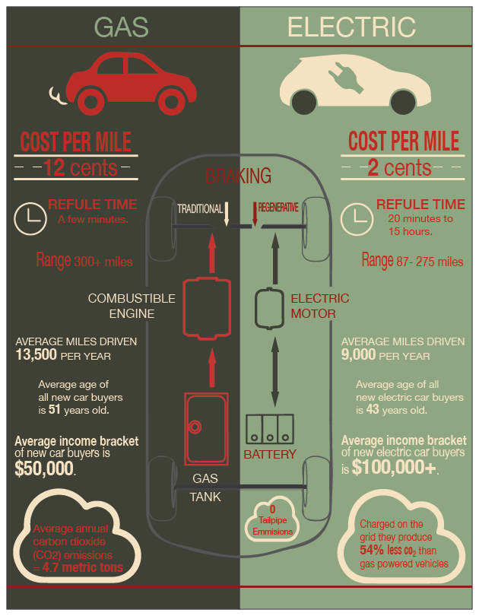
VS
Notes:
- <https://www.shutterstock.com/shutterstock/photos/1651650298/display_1500/stock-vector-gasoline-cars-and-electric-cars-comparison-infographic-with-icons-cars-refueling-and-charging-at-1651650298.jpg>
- <https://www.behance.net/gallery/44059983/Gas-Cars-verses-Electric-Cars>

Slide 3
Exhibit 1
Visualization wheel assessment
Logos contain abstractions (ex. “$”)
Top third of the page is mostly decoration
Lots of empty space or lightness
Contains both tabular data and diagrams (multidimensionality)
Users will have familiarity with the standard two-column layout used
Lots of redundancy since the two columns are simply opposites of each other

Slide 4
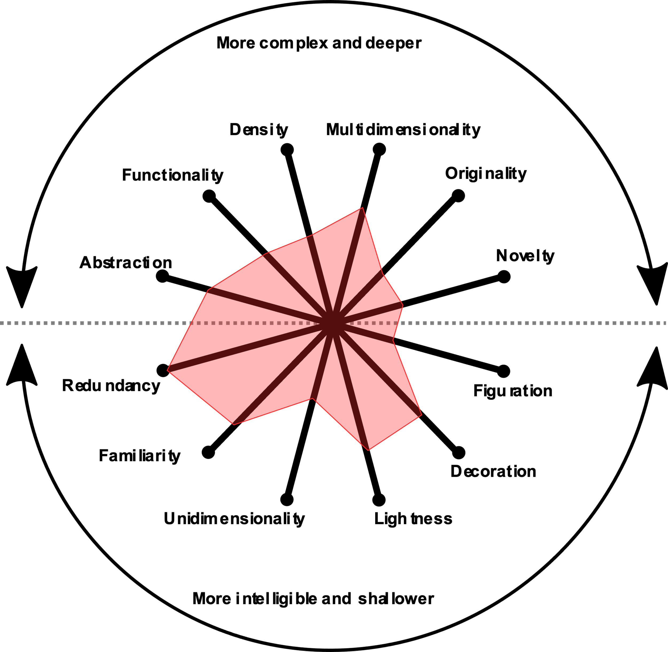
Exhibit 1
Visualization wheel assessment

Slide 5
Exhibit 2
Visualization wheel assessment
Logos are mostly figurations
More functionality with little decoration
Lots of density with text dominating space
Contains both tabular data and diagrams (multidimensionality)
Layout has some originality with staggered data, varying fonts, and diagram overlay
Each field has unique data or novelty

Slide 6
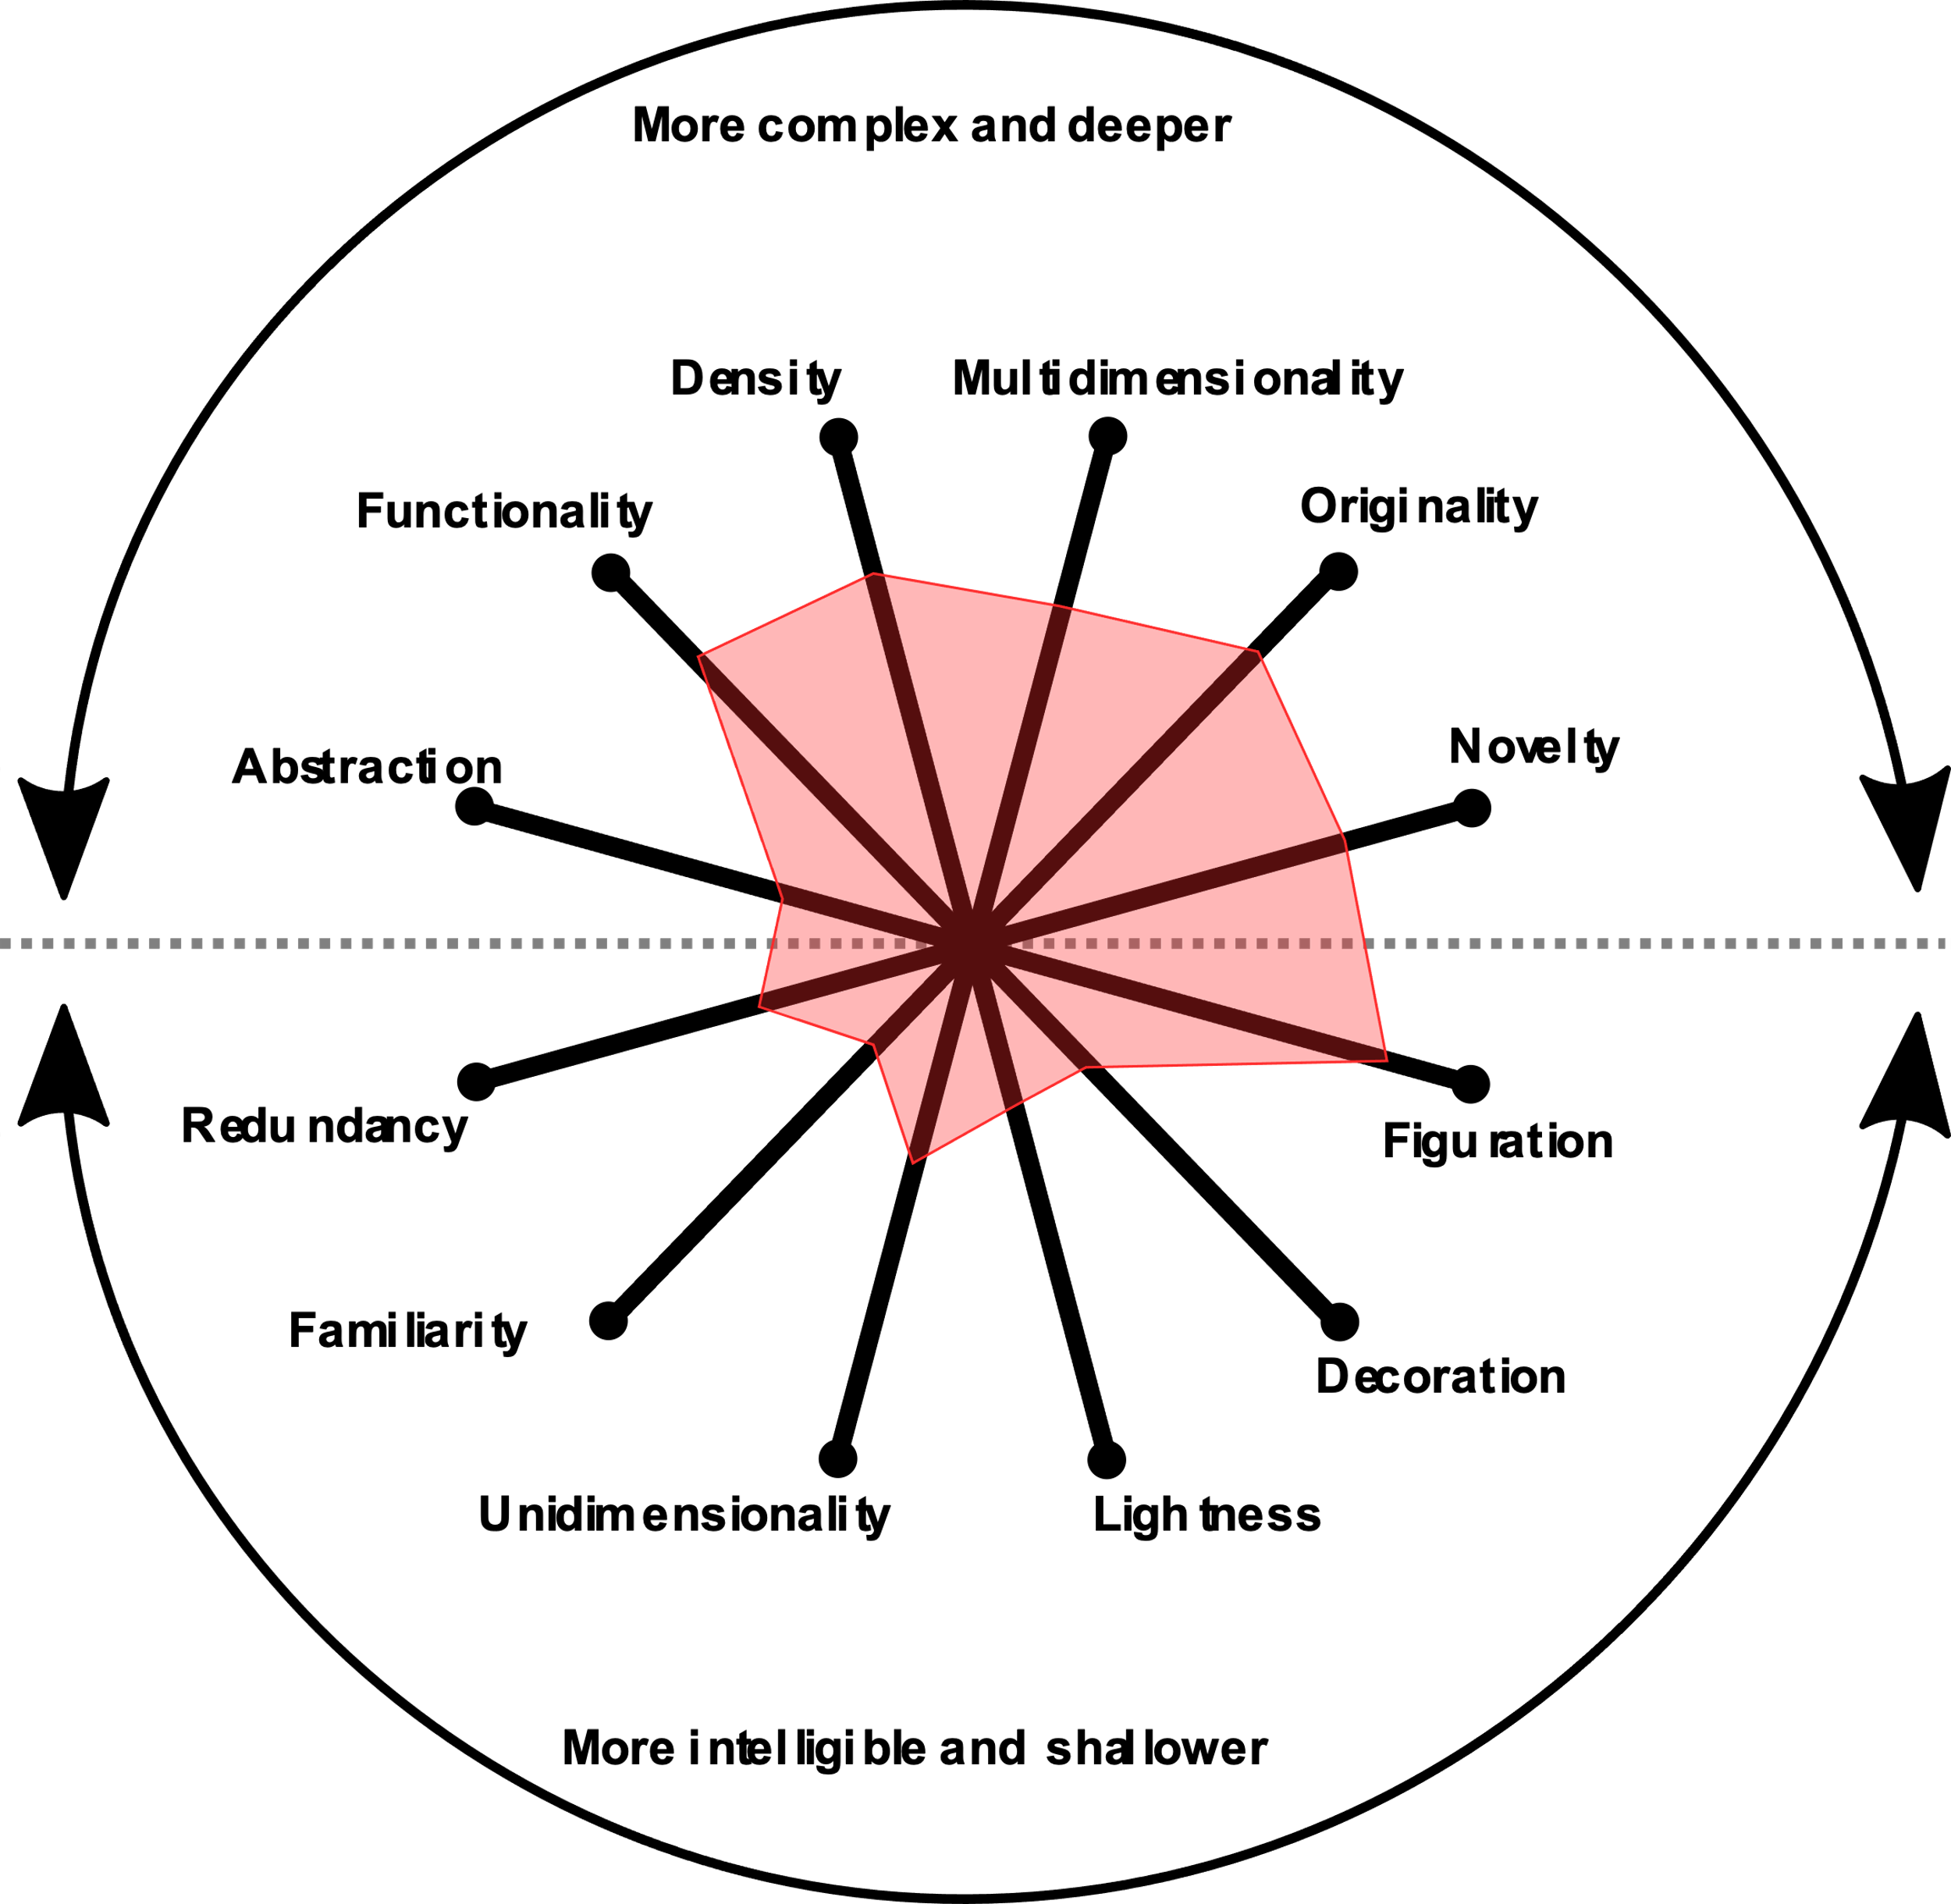
Exhibit 2
Visualization wheel assessment

Slide 7
Exhibit 1
Pros
There is a clear distinction between the two columns from top to bottom
Font size and style is uniform and neutral
Each column has a distinct color
Cons and suggestions for improvement
Data is limited and may not be enough to make an informed decision
Top picture can be cropped to fit more data
Numbers can be included, like the average time it takes to refuel/recharge
There are readers with red-green color-vision deficiency
Can modify red to pink and green to yellow-green

Slide 8
Exhibit 2
Pros
There is enough data to make an informed decision
Cons and suggestions for improvement
The middle overlay makes it seem there is overlap between the two columns
Two separate diagrams would be cleaner
Varying font sizes puts arbitrary emphasis on larger text
Uniform font size and style would be more neutral
Similar colors are used for both columns
Having a separate color palette will help differentiate the two

Slide 9
THANK YOU

