Slide 1
Assignment 6
Evaluate and Create Dashboards: Part 2
Eben Gunadi
DSCI554, Fall ‘23
Notes:
Slides can vary as per your presentation, but header and footer should be consistent

Slide 2
User Stories
As an economist, I’m able to compare Japan, Indonesia, China, Singapore, and Korea’s GDP per capita over the past fifty years
DSCI554, Fall ‘23

Slide 3
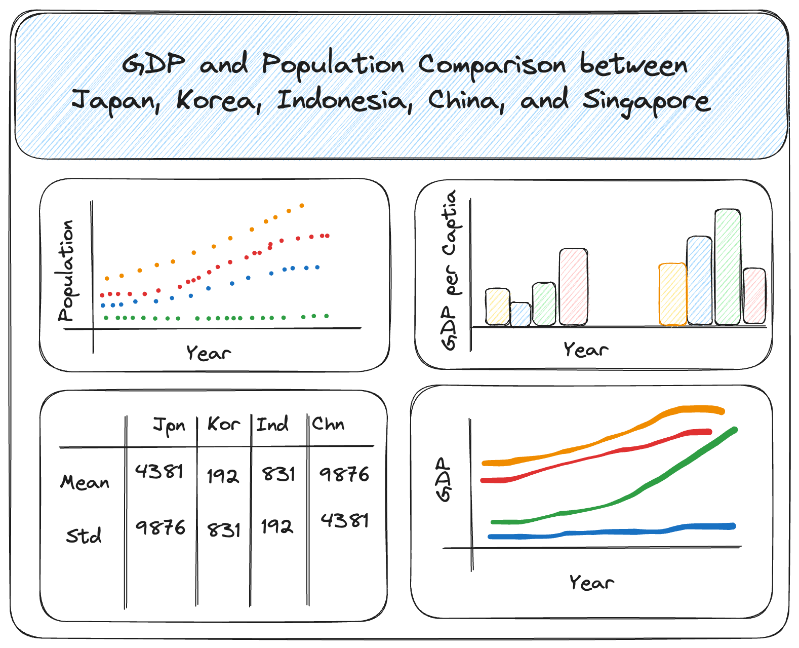
Excalidraw Wireframe
“svg/wireframe.svg” in the GitHub repository
KPIs are population, GDP, and GDP per capita over time
When applicable, data for the five countries are contrasted with different colors
Okabe Ito qualitative color scale used:
https://mikemol.github.io/technique/colorblind/2018/02/11/color-safe-palette.html
DSCI554, Fall ‘23

Slide 4
Data Collection
United Nations (UN) data on total population, both sexes combined (thousands), for Japan, Indonesia, China, Singapore, and Korea can be downloaded here:
https://data.un.org/Data.aspx?q=japan&d=PopDiv&f=variableID%3a12%3bcrID%3a156%2c360%2c392%2c410%2c702&c=2,4,6,7&s=_crEngNameOrderBy:asc,_timeEngNameOrderBy:desc,_varEngNameOrderBy:asc&v=1
UN data on GDP by type of expenditure for Japan, Indonesia, China, Singapore, and Korea can be downloaded here:
https://data.un.org/Data.aspx?q=japan&d=SNAAMA&f=grID%3a101%3bcurrID%3aNCU%3bpcFlag%3afalse%3bcrID%3a156%2c360%2c392%2c410%2c702&c=2,3,5,6&s=_crEngNameOrderBy:asc,yr:desc&v=1
Both datasets are housed in the “data” folder in the GitHub repository
DSCI554, Fall ‘23

Slide 5
Data Preprocessing
Bar Chart
“py/bar-chart.py” in the GitHub repository was used to process the data
“data/gdp_per_capita.json” is the processed data used for visualization in “js/bar-chart.js”
Line Chart
“py/line-chart.py” in the GitHub repository was used to process the data
“data/gdp.json” is the processed data used for visualization in “js/line-chart.js”
Table
“py/table.py” in the GitHub repository was used to process the data
“data/statistics.json” is the processed data used for visualization in “js/table.js”
Scatterplot
“py/scatterplot.py” in the GitHub repository was used to process the data
“data/population.json” is the processed data used for visualization in “js/scatterplot.js”
DSCI554, Fall ‘23

Slide 6
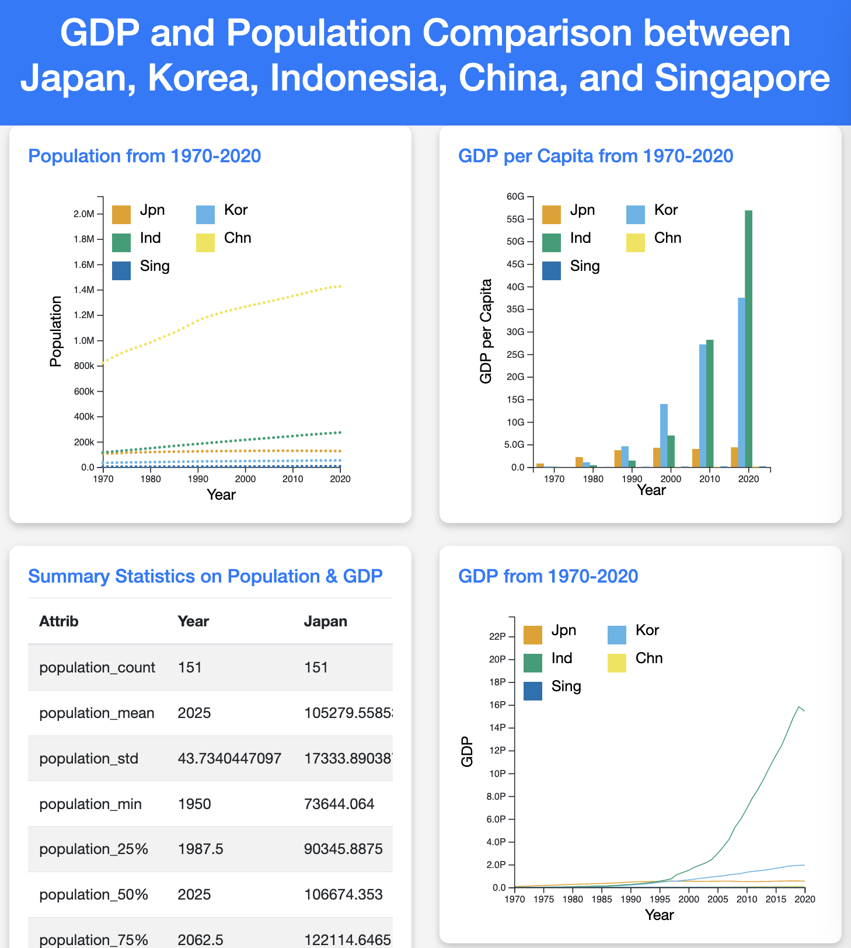
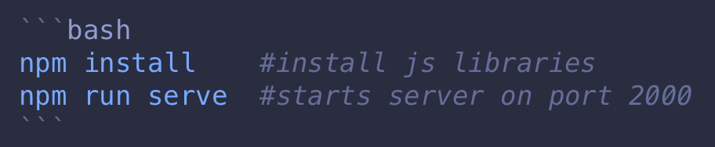
Landing Page
"index.html" is the landing page. It can be served on a browser via hot-reload:
Chart titles can be clicked to view the chart on a separate HTML page
Alternatively, this page can be viewed on GitHub at https://egunadi.github.io/dsci554-a6/
DSCI554, Fall ‘23

Slide 7
Visualization Wheel Assessment
Lines, dots, and bars are abstractions
All functionality with no decoration
Lots of density with text and charts dominating space
Contains both tabular data and diagrams (multidimensionality)
Users will have familiarity with the standard four-by-four layout used
While each visualization is unique in form or has novelty, there is also redundancy since they present variance of the same underlying data
DSCI554, Fall ‘23

Slide 8
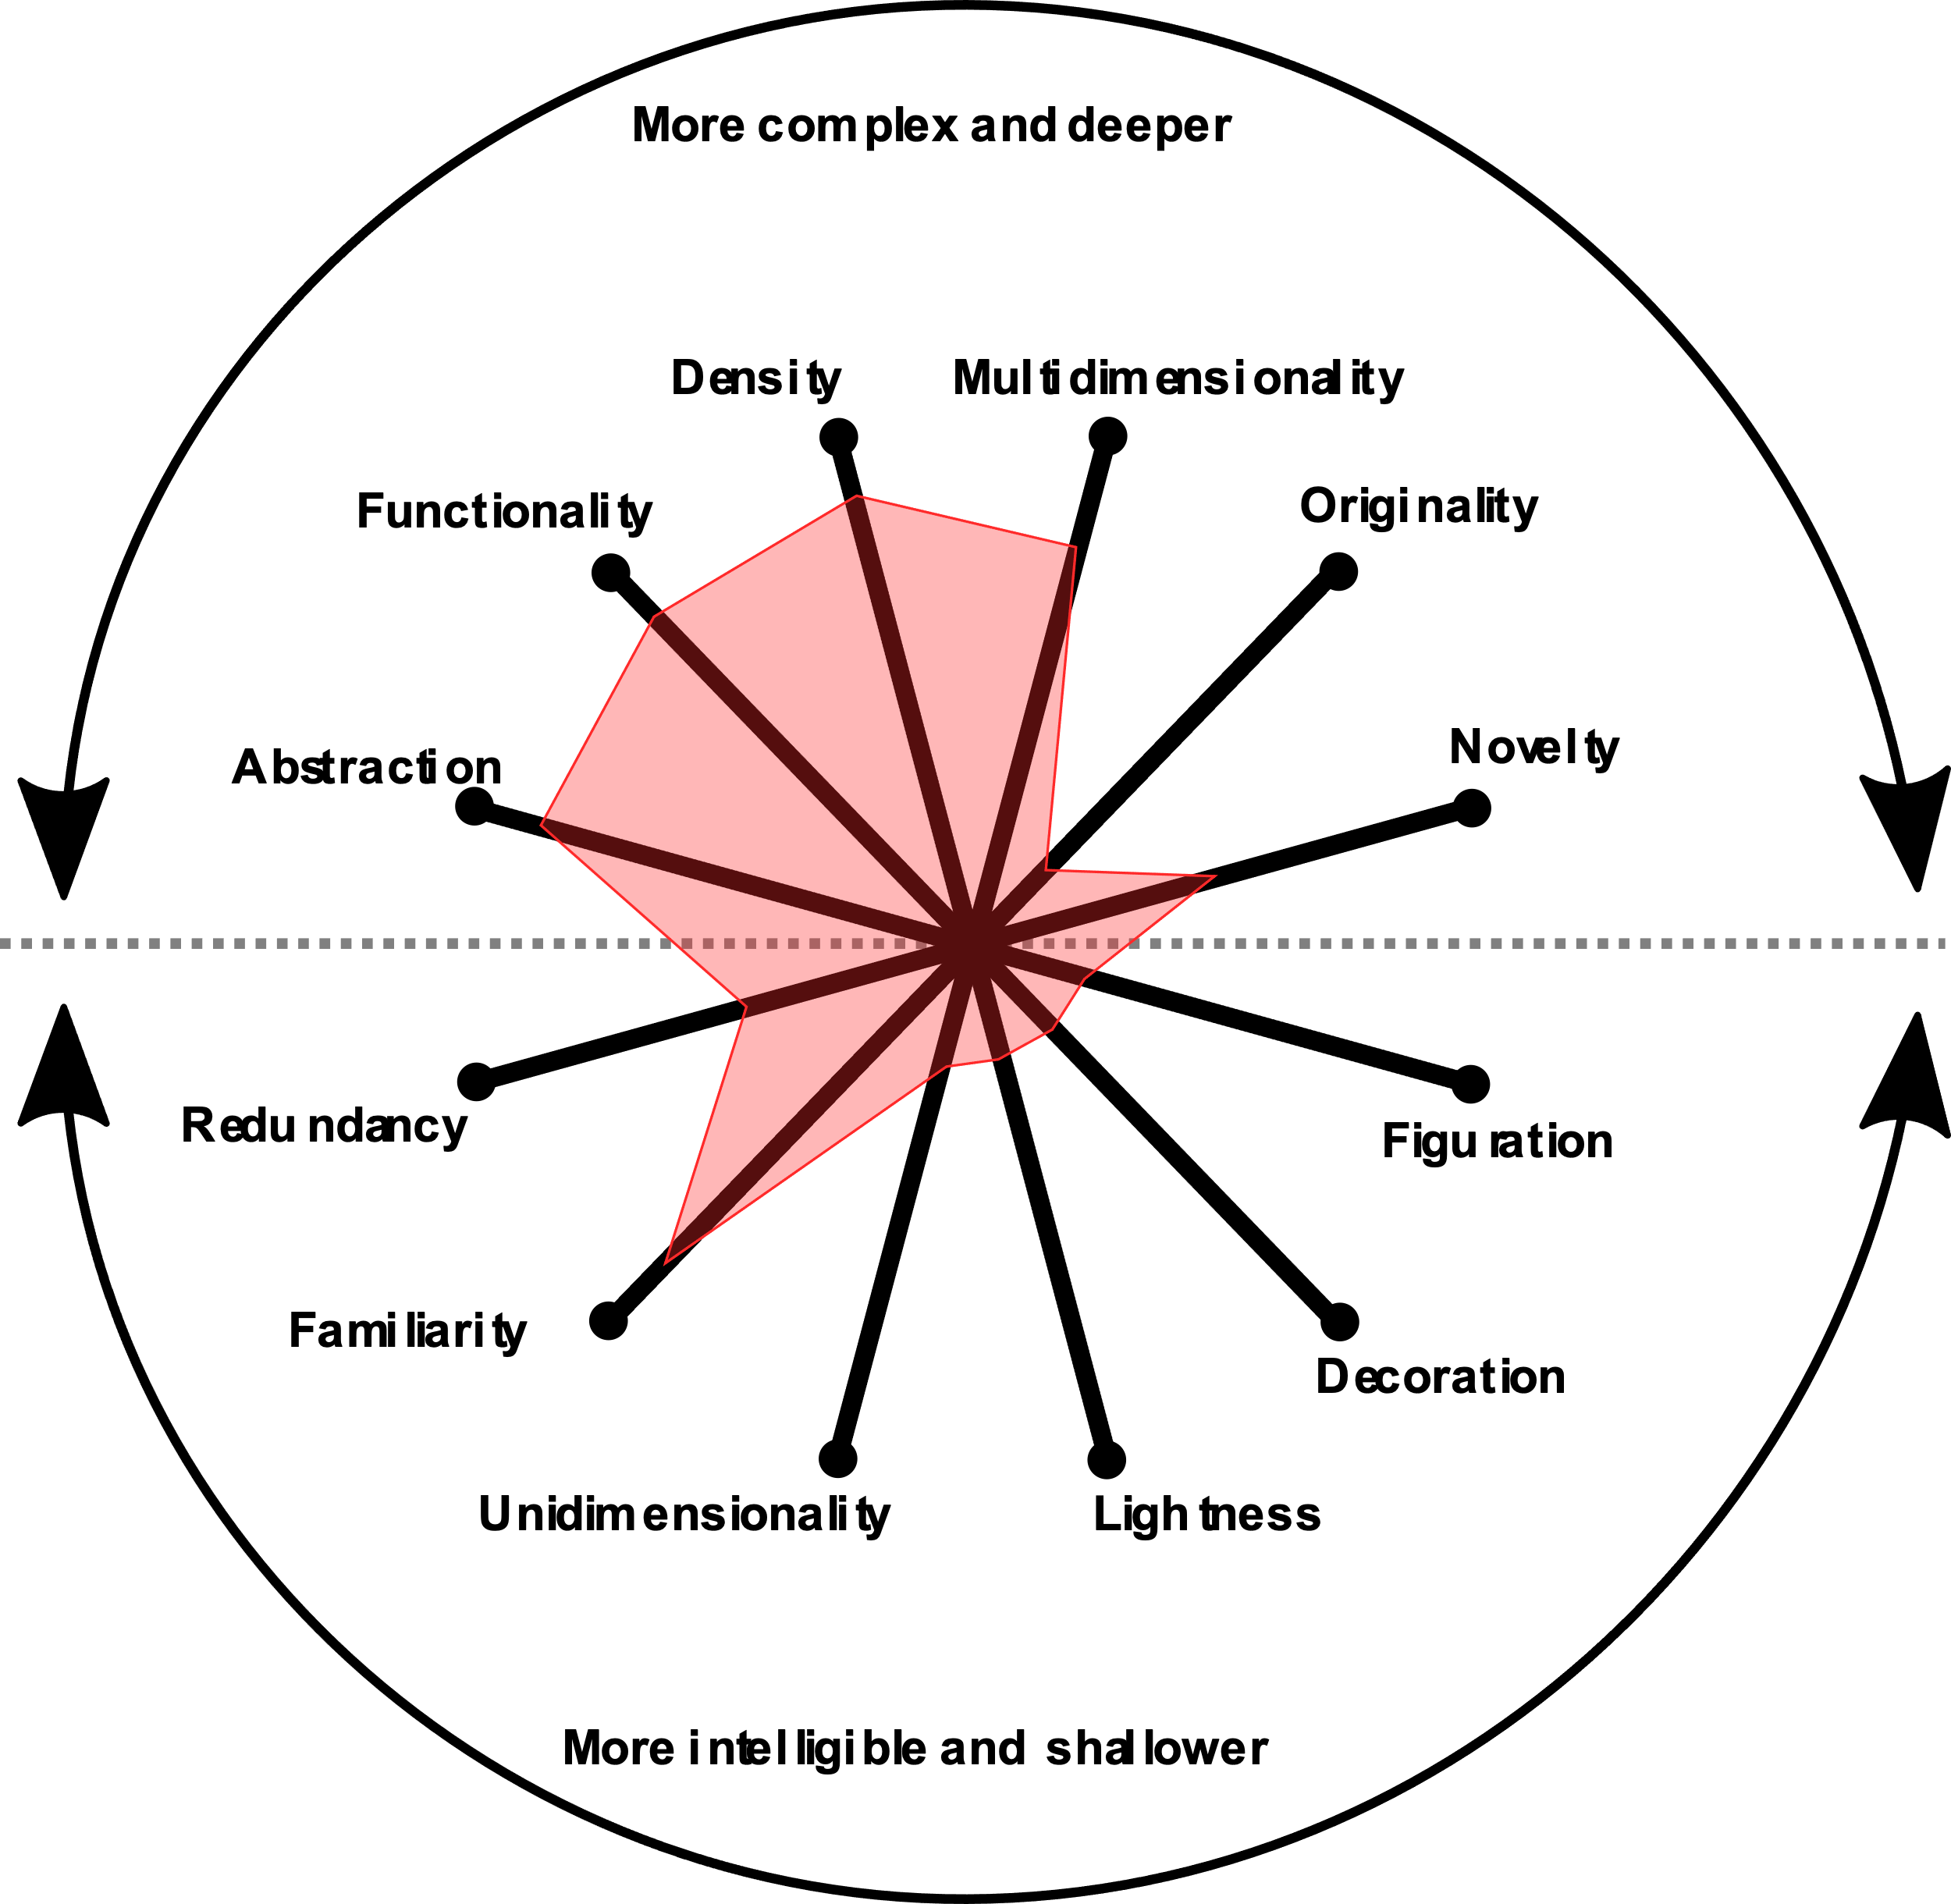
Visualization Wheel Assessment
DSCI554, Fall ‘23

Slide 9
THANK YOU

