Slide 1
Assignment 7
Countries Infographic or Dashboard with Interactive Chart
Eben Gunadi
DSCI554, Fall ‘23
Notes:
Slides can vary as per your presentation, but header and footer should be consistent

Slide 2
User Stories
As an economist, I’m able to compare the gender wage gap and life expectancy at birth for Belarus, Indonesia, Mexico, Paraguay, the Philippines, Singapore, Sri Lanka, Sweden, and the United Kingdom in 2008
DSCI554, Fall ‘23

Slide 3
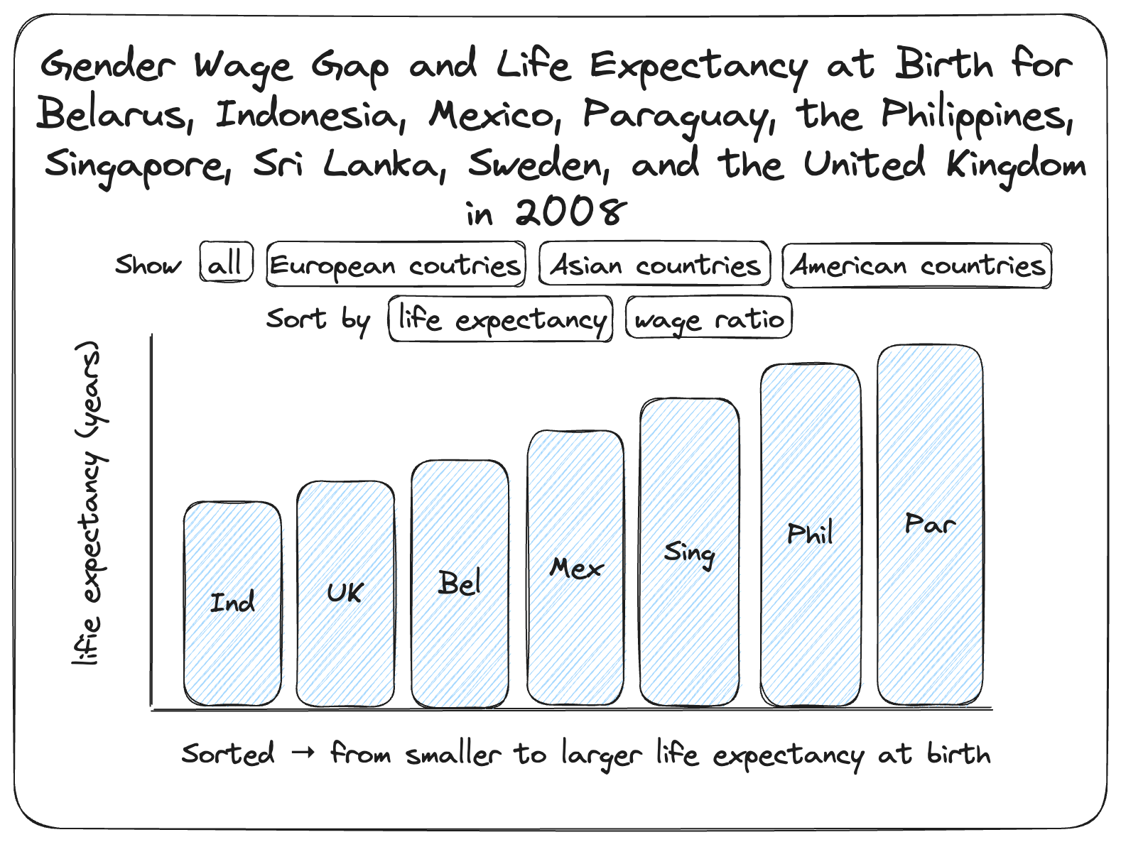
Excalidraw Wireframe
“svg/wireframe.svg” in the GitHub repository
KPIs are
Ratio of male to female wages in 2008
Life expectancy at birth in 2008
The data is initially sorted by life expectancy
The Sort by “wage ratio” button resorts the bars by gender wage gap
To reset, users can click on the Sort by “life expectancy” button
All ten countries are initially shown
There are filters to only show European, Asian, or American countries
To reset, users can click on the Show “all” button
DSCI554, Fall ‘23

Slide 4
Data Collection
United Nations (UN) data on 2008 wages in Belarus, Indonesia, Mexico, Paraguay, the Philippines, Singapore, Sri Lanka, Sweden, and the United Kingdom can be downloaded here:
http://data.un.org/Data.aspx?q=indonesia&d=LABORSTA&f=tableCode%3a5A%3bcountryCode%3aBY%2cGB%2cID%2cLK%2cMX%2cPH%2cPY%2cSE%2cSG%2cUA%3byr%3a2008&c=2,3,5,7,9,11,13,15,17,18&s=country_nameEnglish:asc,yr:desc,sexCode:asc&v=1
Note that a fresh download includes a footnote section that must be removed before the file can be processed
UN data on 2008 life expectancy in Belarus, Indonesia, Mexico, Paraguay, the Philippines, Singapore, Sri Lanka, Sweden, and the United Kingdom can be downloaded here :
http://data.un.org/Data.aspx?q=indonesia&d=PopDiv&f=variableID%3a68%3bcrID%3a112%2c144%2c360%2c484%2c600%2c608%2c702%2c752%2c804%2c826%3btimeID%3a59&c=2,4,6,7&s=_crEngNameOrderBy:asc,_timeEngNameOrderBy:desc,_varEngNameOrderBy:asc&v=1
Both datasets are housed in the “data” folder in the GitHub repository
DSCI554, Fall ‘23

Slide 5
Data Preprocessing
process_data.py in the GitHub repository was used to process the data
Wage ratio data is calculated by dividing the wage for men by the wage for women
“data/life_expectancy_and_wages.tsv” is the processed data used for visualization in “js/bar-chart.js”
DSCI554, Fall ‘23

Slide 6
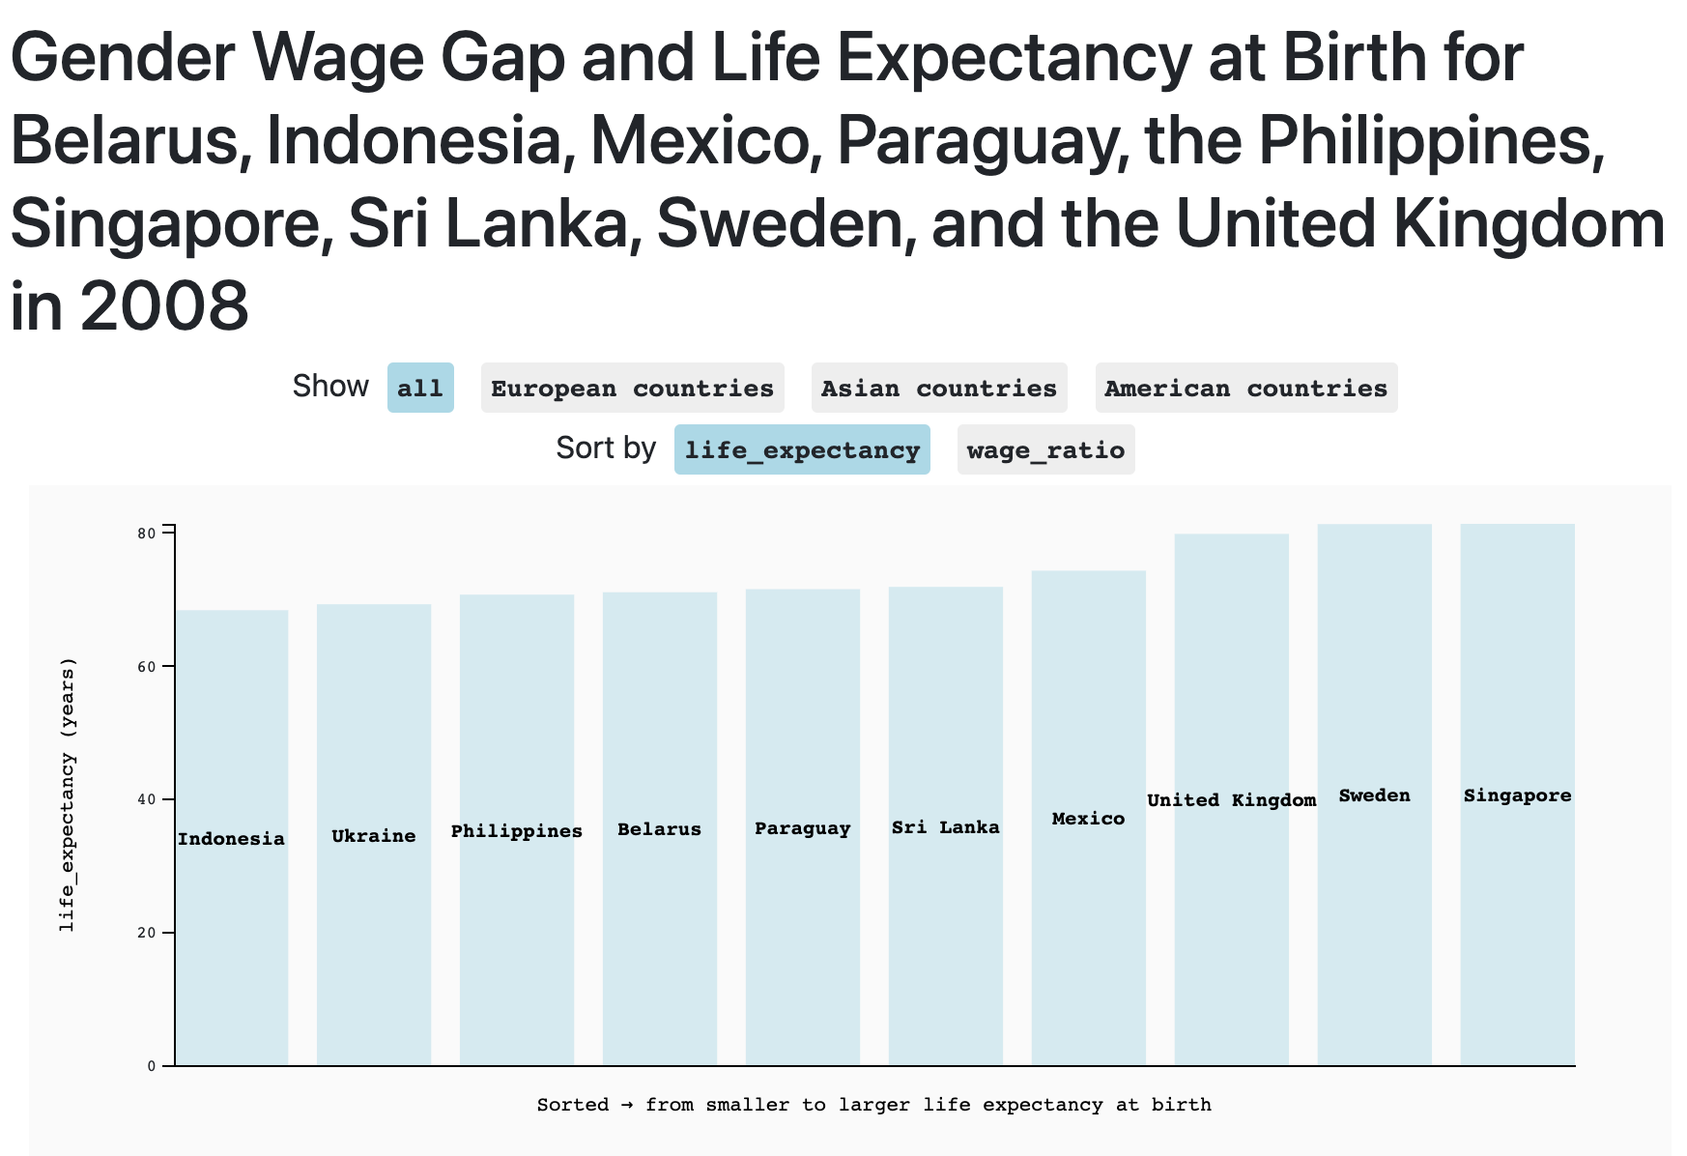

Landing Page
"index.html" is the landing page. It can be served on a browser via hot-reload:
Alternatively, this page can be viewed on GitHub at https://egunadi.github.io/dsci554-a7/
DSCI554, Fall ‘23

Slide 7
Visualization Wheel Assessment
Bars are abstractions
All functionality with no decoration
Lots of density with the chart and text dominating space
Contains only one diagram (unidimensionality)
Users will have familiarity with the standard bar chart used
While each sort and filter option shows a different dataset or has novelty, there is also redundancy since all use a bar chart and are within the scope of the ten countries of interest
DSCI554, Fall ‘23

Slide 8
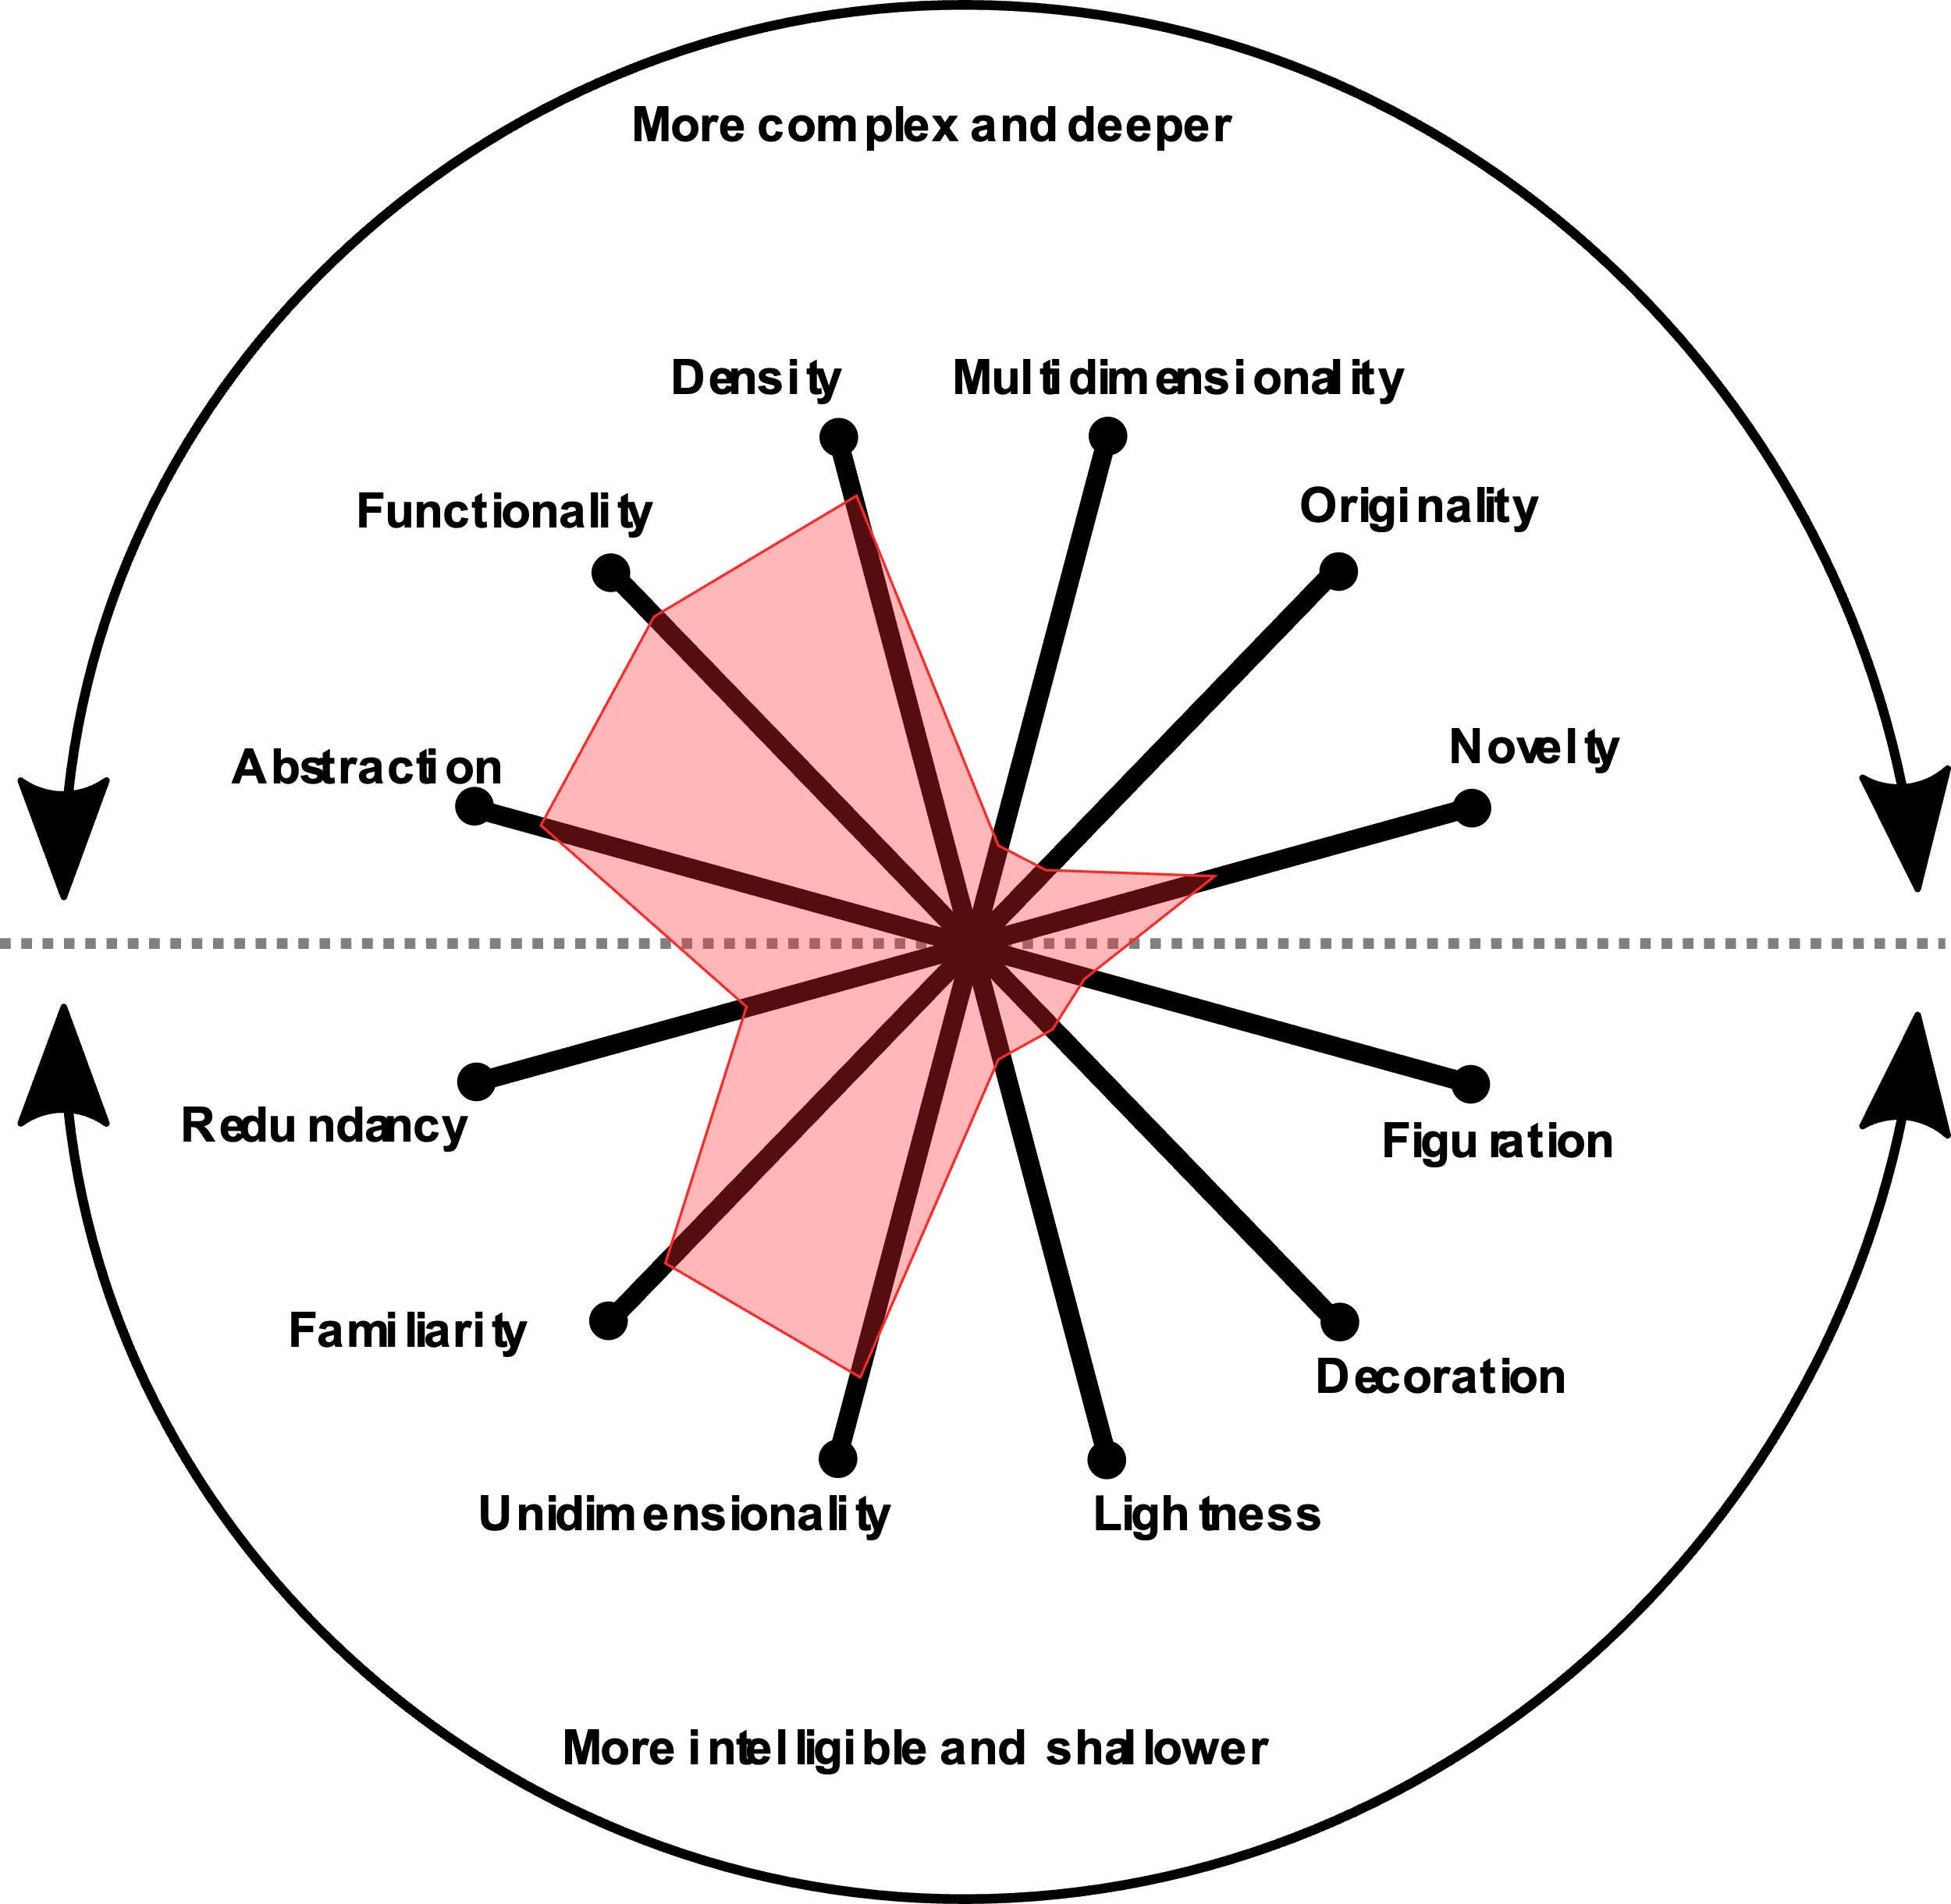
Visualization Wheel Assessment
DSCI554, Fall ‘23

Slide 9
THANK YOU

