Slide 1
Assignment 9
Evaluate and Create Dashboards
With Color Scales and Maps
Eben Gunadi
DSCI554, Fall ‘23
Notes:
Slides can vary as per your presentation, but header and footer should be consistent

Slide 2
User Stories
As an economist, I’m able to compare Japan, Indonesia, China, Singapore, and Korea’s GDP per capita over the past fifty years
DSCI554, Fall ‘23

Slide 3
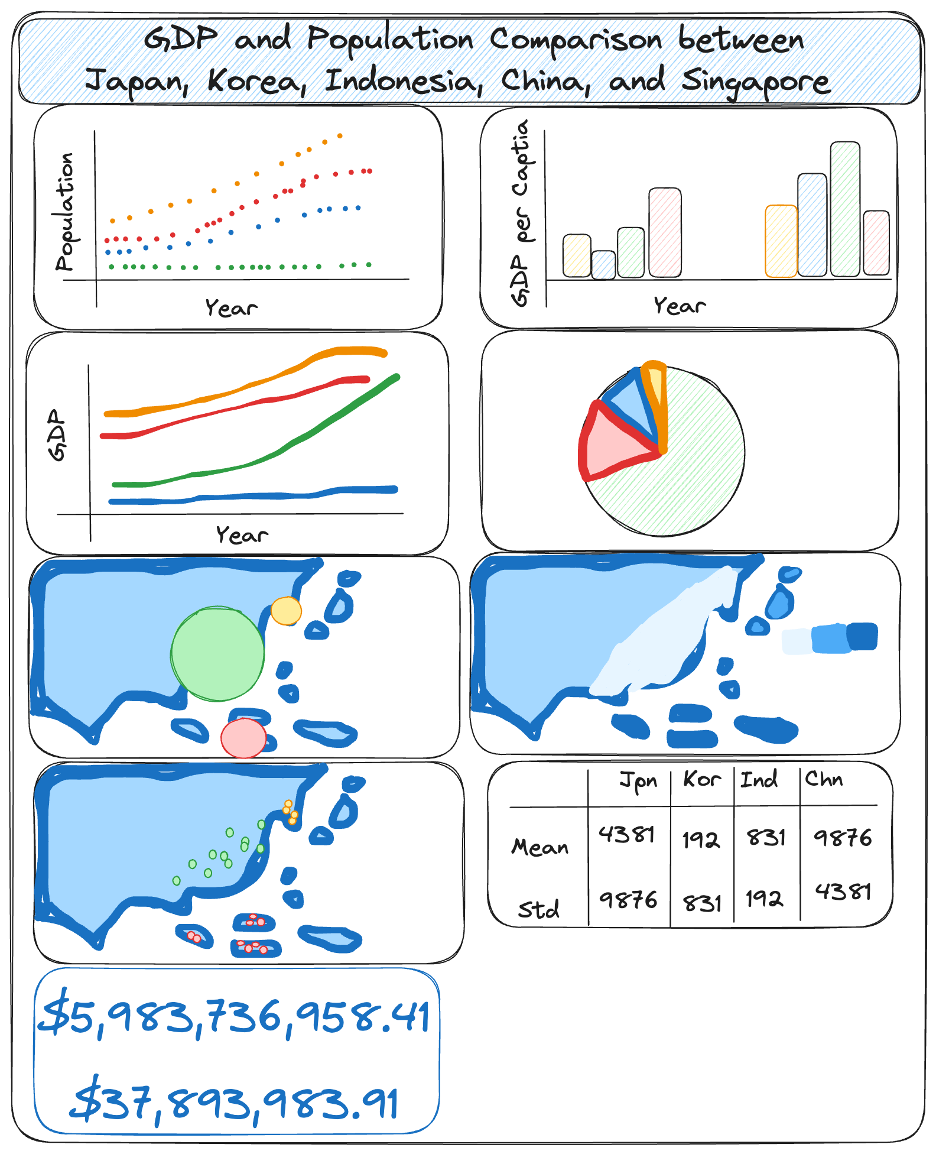
Excalidraw Wireframe
“svg/wireframe.svg” in the GitHub repository
KPIs are population, GDP, and GDP per capita over time
When applicable, data for the five countries are contrasted with the schemeTableau10 D3 color scale
This categorical scheme is friendly for users with color-vision deficiencies:
https://www.tableau.com/blog/colors-upgrade-tableau-10-56782
DSCI554, Fall ‘23

Slide 4
Data Collection
United Nations (UN) data on total population, both sexes combined (thousands), for Japan, Indonesia, China, Singapore, and Korea can be downloaded here:
https://data.un.org/Data.aspx?q=japan&d=PopDiv&f=variableID%3a12%3bcrID%3a156%2c360%2c392%2c410%2c702&c=2,4,6,7&s=_crEngNameOrderBy:asc,_timeEngNameOrderBy:desc,_varEngNameOrderBy:asc&v=1
UN data on GDP by type of expenditure for Japan, Indonesia, China, Singapore, and Korea can be downloaded here:
https://data.un.org/Data.aspx?q=japan&d=SNAAMA&f=grID%3a101%3bcurrID%3aNCU%3bpcFlag%3afalse%3bcrID%3a156%2c360%2c392%2c410%2c702&c=2,3,5,6&s=_crEngNameOrderBy:asc,yr:desc&v=1
Data on city coordinates can be downloaded here:
https://simplemaps.com/data/world-cities
All datasets are housed in the “data” folder in the GitHub repository.
DSCI554, Fall ‘23

Slide 5
Data Preprocessing
Bar Chart
“py/bar-chart.py” in the GitHub repository was used to process the data
“data/gdp_per_capita.json” is the processed data used for visualization in “js/bar-chart.js”
Line Chart
“py/line-chart.py” in the GitHub repository was used to process the data
“data/gdp.json” is the processed data used for visualization in “js/line-chart.js”
Table
“py/table.py” in the GitHub repository was used to process the data
“data/statistics.json” is the processed data used for visualization in “js/table.js”
Scatterplot
“py/scatterplot.py” in the GitHub repository was used to process the data
“data/population.json” is the processed data used for visualization in “js/scatterplot.js”
Pie Chart
Also uses “data/population.json” for visualization in “js/pie-chart.js”
Big Numbers
Also uses “data/gdp_per_capita.json” for visualization in “js/big-number.js”
DSCI554, Fall ‘23

Slide 6
Data Preprocessing - Continued
Proportional Symbol Map
“py/proportional-symbol-map.py” in the GitHub repository was used to process the data
“data/population_2020_circles.json” is the processed data used for visualization in “js/proportional-symbol-map.js”
Choropleth Map
“py/choropleth-map.py” in the GitHub repository was used to process the data
“data/gdp_per_capita_2020.csv” is the processed data used for visualization in “js/choropleth-map.js”
Dot Map
“py/dot-map.py” in the GitHub repository was used to process the data
“data/cities.json” is the processed data used for visualization in “js/dot-map.js”
DSCI554, Fall ‘23

Slide 7
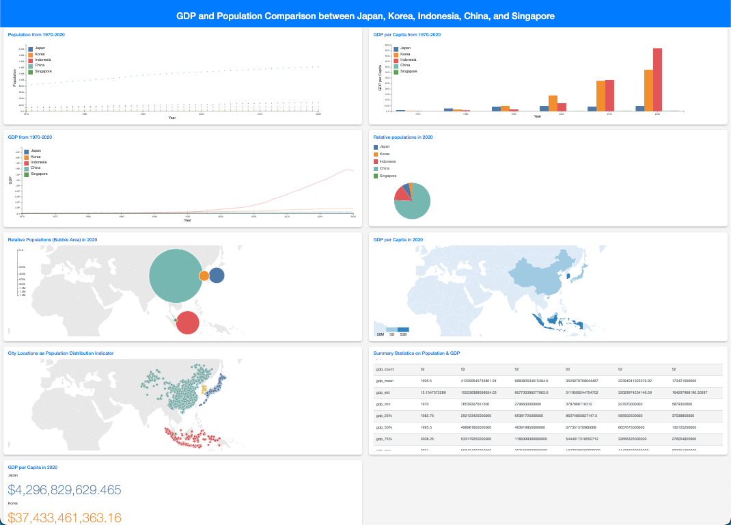
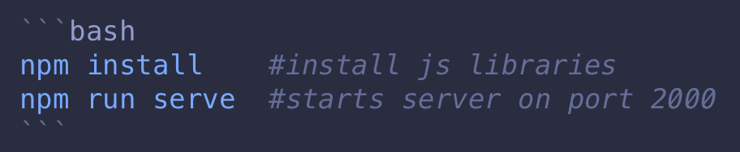
Landing Page
"index.html" is the landing page. It can be served on a browser via hot-reload:
Chart titles can be clicked to view the chart on a separate HTML page
Alternatively, this page can be viewed on GitHub at https://egunadi.github.io/dsci554-a9/
DSCI554, Fall ‘23

Slide 8
Visualization Wheel Assessment
Lines, dots, pies, and bars are abstractions, but maps are figurations
All functionality with no decoration
Lots of density with text and charts dominating space
Contains both tabular data and diagrams (multidimensionality)
Users will have familiarity with the standard two-column layout used
While each visualization is unique in form or has novelty, there is redundancy since they present variations of the same underlying data and have a consistent color scheme. Four of them also have the same legend.
DSCI554, Fall ‘23

Slide 9
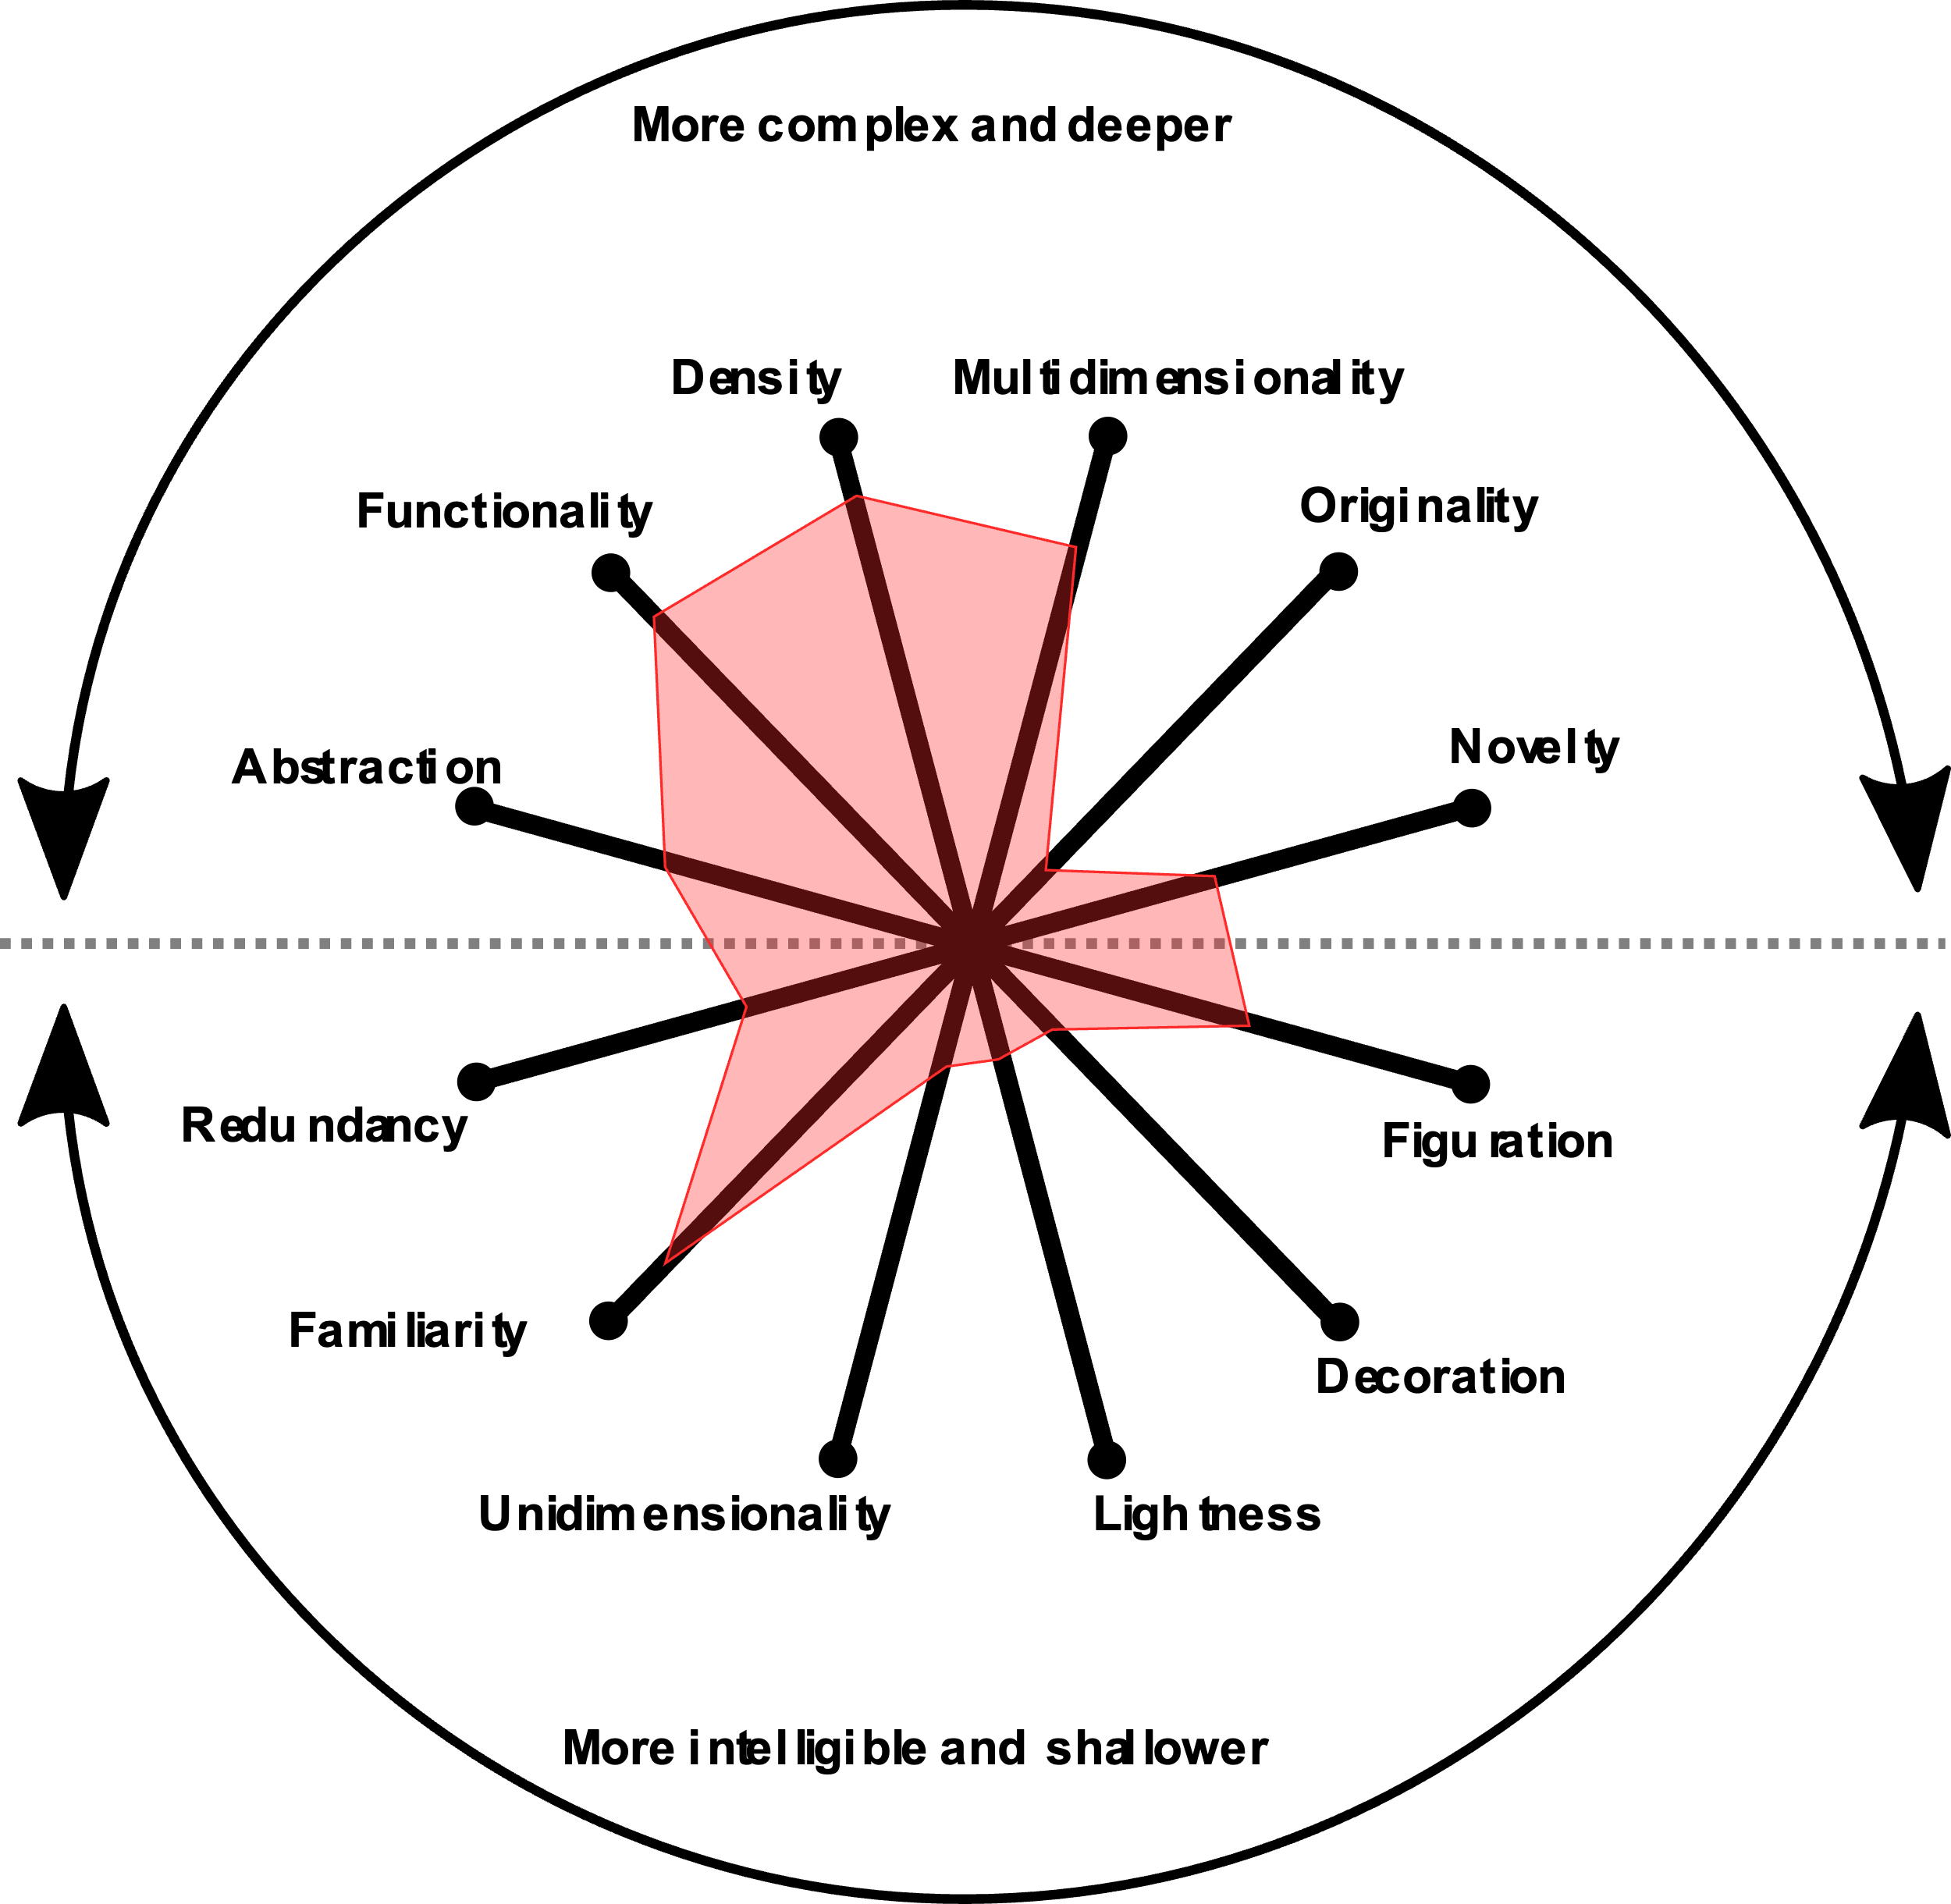
Visualization Wheel Assessment
DSCI554, Fall ‘23

Slide 10
THANK YOU

