Slide 1
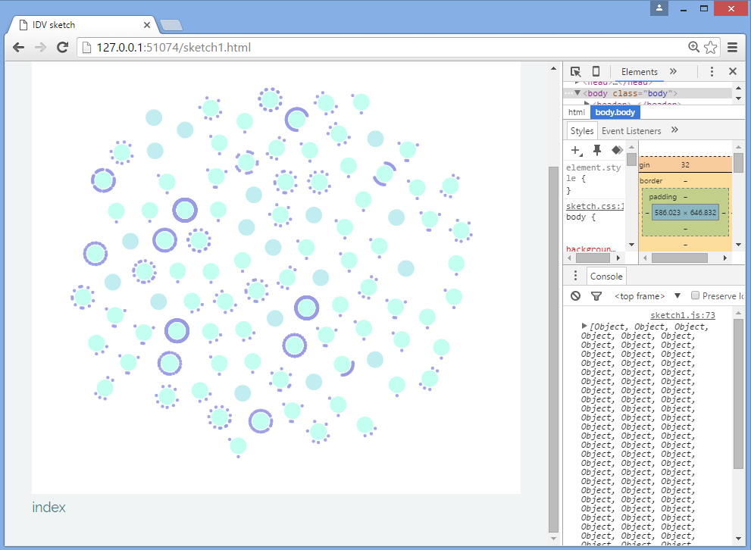
Jonathan Fields – the tweets with the most retweets are almost all @RT!!

Slide 2
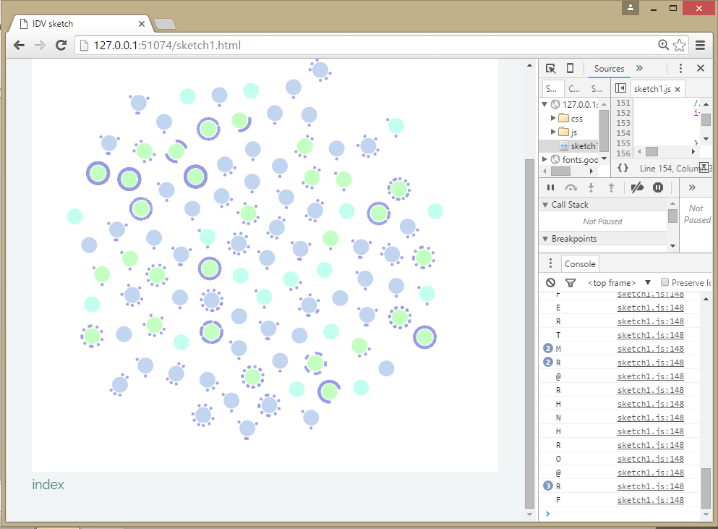
Green RT
Purple @mention at beginning of tweet (doesn’t catch in-body mentions)
Aqua simple tweet

Slide 3
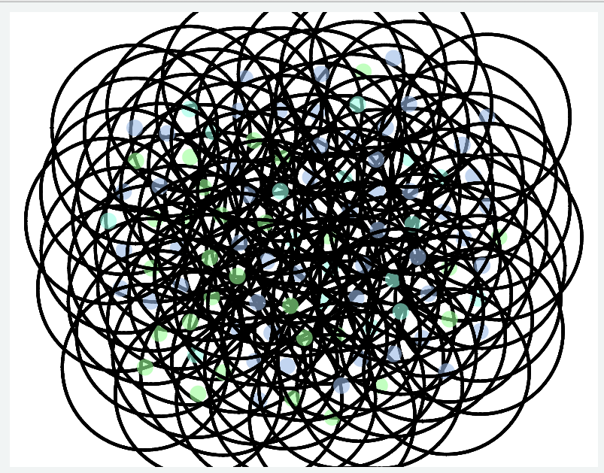
This is what happens when you make the y value 100.

Slide 4
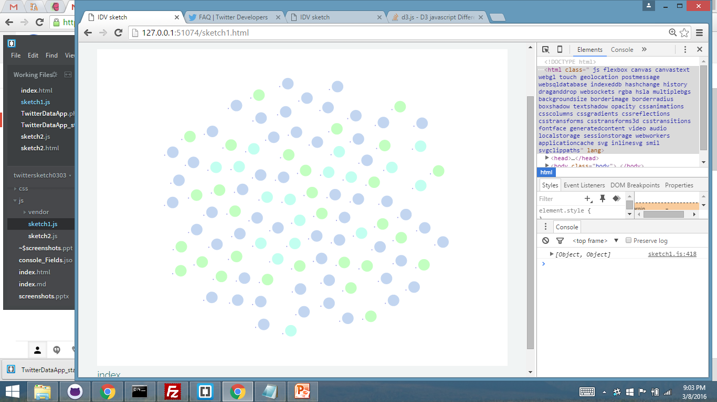

Slide 5
