Slide 1
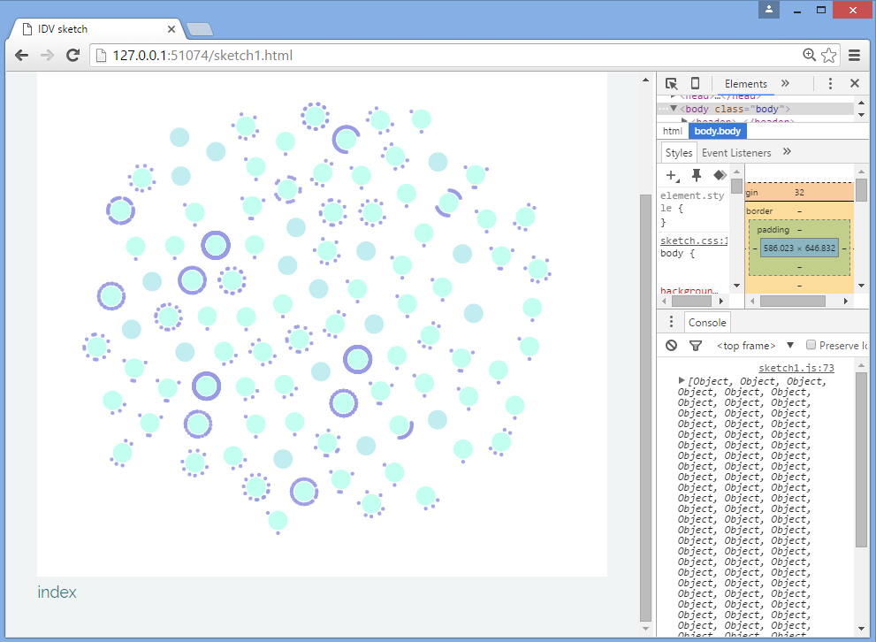
Jonathan Fields – the tweets with the most retweets are almost all @RT!!

Slide 2
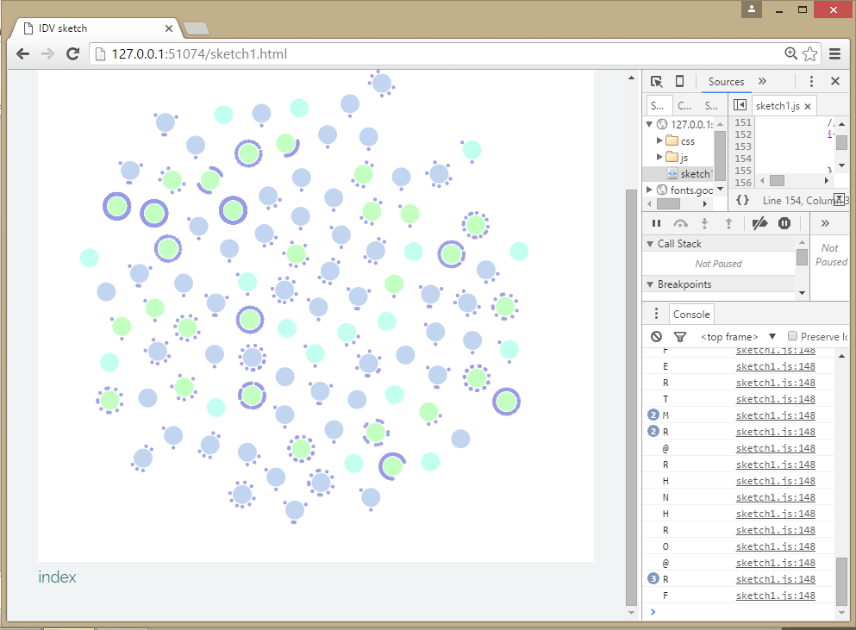
Green RT
Purple @mention at beginning of tweet (doesn’t catch in-body mentions)
Aqua simple tweet

