Slide 1
Visualizing the CrunchBase database
By Erica Gunn

Slide 2
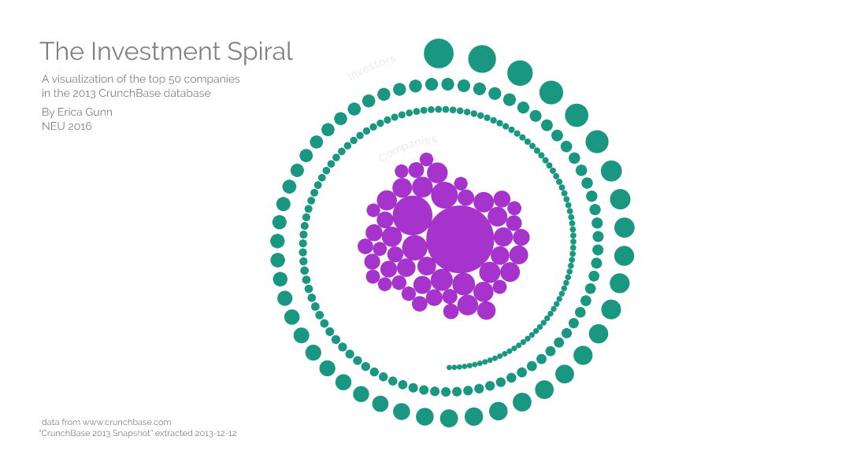
http://egunn.github.io/ProcessingFinalProject/

Slide 3
Data structure:
Companies
array
Connections
array
Investors
array
50
~1750
200

Slide 4
Data structure:
Companies
array
Connections
array
Investors
array
update
50
~1750
200
Mouse select

Slide 5
Data structure:
Companies
array
Connections
array
Investors
array
update
update
50
~1750
200
Mouse select

Slide 6
Data structure:
Companies
array
Connections
array
Investors
array
update
update
50
~1750
200
update
update
Mouse select
Mouse select

Slide 7
Prototypes:
What we did in class:
Companies
Investors
draw()
draw()
update()
update()
incRadius()
incRadius()

Slide 8
Prototypes:
What we did in class:
What I did instead:
Particle
Companies
Investors
draw()
draw()
draw()
update()
update()
update()
incRadius()
incRadius()
incRadius()
Companies
Investors
drawCompany()
drawInvestor()
updateCompany()
updateInvestor()

