Slide 1
Edurobotics 2016 International Conference
The effectiveness of integrating robotic activities into higher education computer science curricula: a case study in a developing country
Ernest B.B. Gyebi, Marc Hanheide and Grzegorz Cielniak
School of Computer Science, University of Lincoln, UK

Slide 2
Overview
Background to the Study
Methodology
Results
Discussions
Conclusions

Slide 3
Background to the Study
Challenges of Higher Education in Developing countries
teaching Method
educational backgrounds of students
Educational robotics in our context
teaching transferable skills (i.e. programming) rather than robotics discipline itself
a means for addressing pedagogical issues: improving students’ engagement, motivation etc.
Objective: integration of robotics activities into formal classroom curriculum to assess
students’ motivation, engagement and level of understanding in learning general computer programming
the use of robotic set-up as a tool for conducting educational activities.

Slide 4
Methodology
Course Overview
Introduction to Computer Science I
Learning Activities: (paper-based and robot-based)
introduction to programming languages
data representation: number system conversions
logic operations: basic Boolean operations
programming fundamentals: variables, data types
control structures: IF-ELSE statements, loops
Study Design
five workshops, each consisting of paper-based and robotic-based activities
10 groups (odd groups participated in paper-based, Even groups in robot-based for a particular workshop)
groups are swapped in the next session to complete that workshop
sessions repeated for all workshops
Student Surveys
initial survey, final survey and workshop evaluation
Participants
first year students, winter 2015
total of 202 students, 194 participated, 178 and 166 participated in the initial and final surveys respectively

Slide 5
Results
Students’ self-Assessments
workshop activities
learning
Students’ Exam Performances

Slide 6
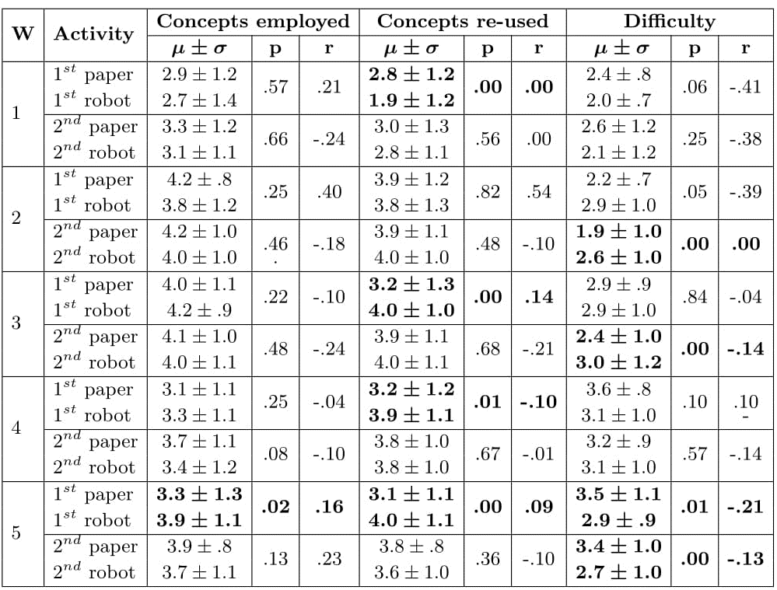
Workshop Activities

Slide 7
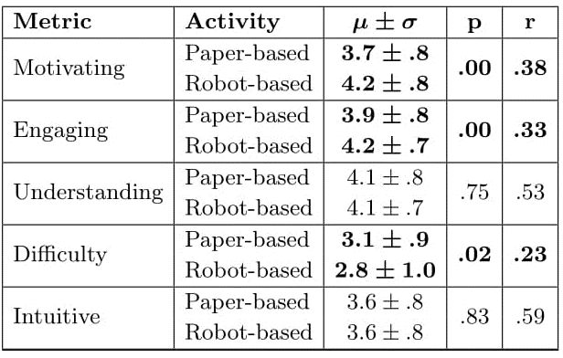
Students’ Learning

Slide 8
Exam Results

Slide 9
Discussions
Students motivation and Engagement
Effectiveness of using robotic set-up as a tool
robot platform
students interactions with the set-up
Issues with delivery of the learning activities
limited number of robots
power outages

Slide 10
Conclusions
Our experience in integrating educational robotics activities into Computer Science curricula
benefits of educational robotic activities on students’ engagement and learning
issues with teaching with educational robots in developing countries
Future Work
to investigate the effectiveness of the activities in a longer term
look at the potential learning gains for using educational robots for teaching specific topics in Computer Science

