Slide 1

ATM finder
Dóra Schuszter
János Marx
Péter Marogna
Tamás Barnabás Egyed

Slide 2
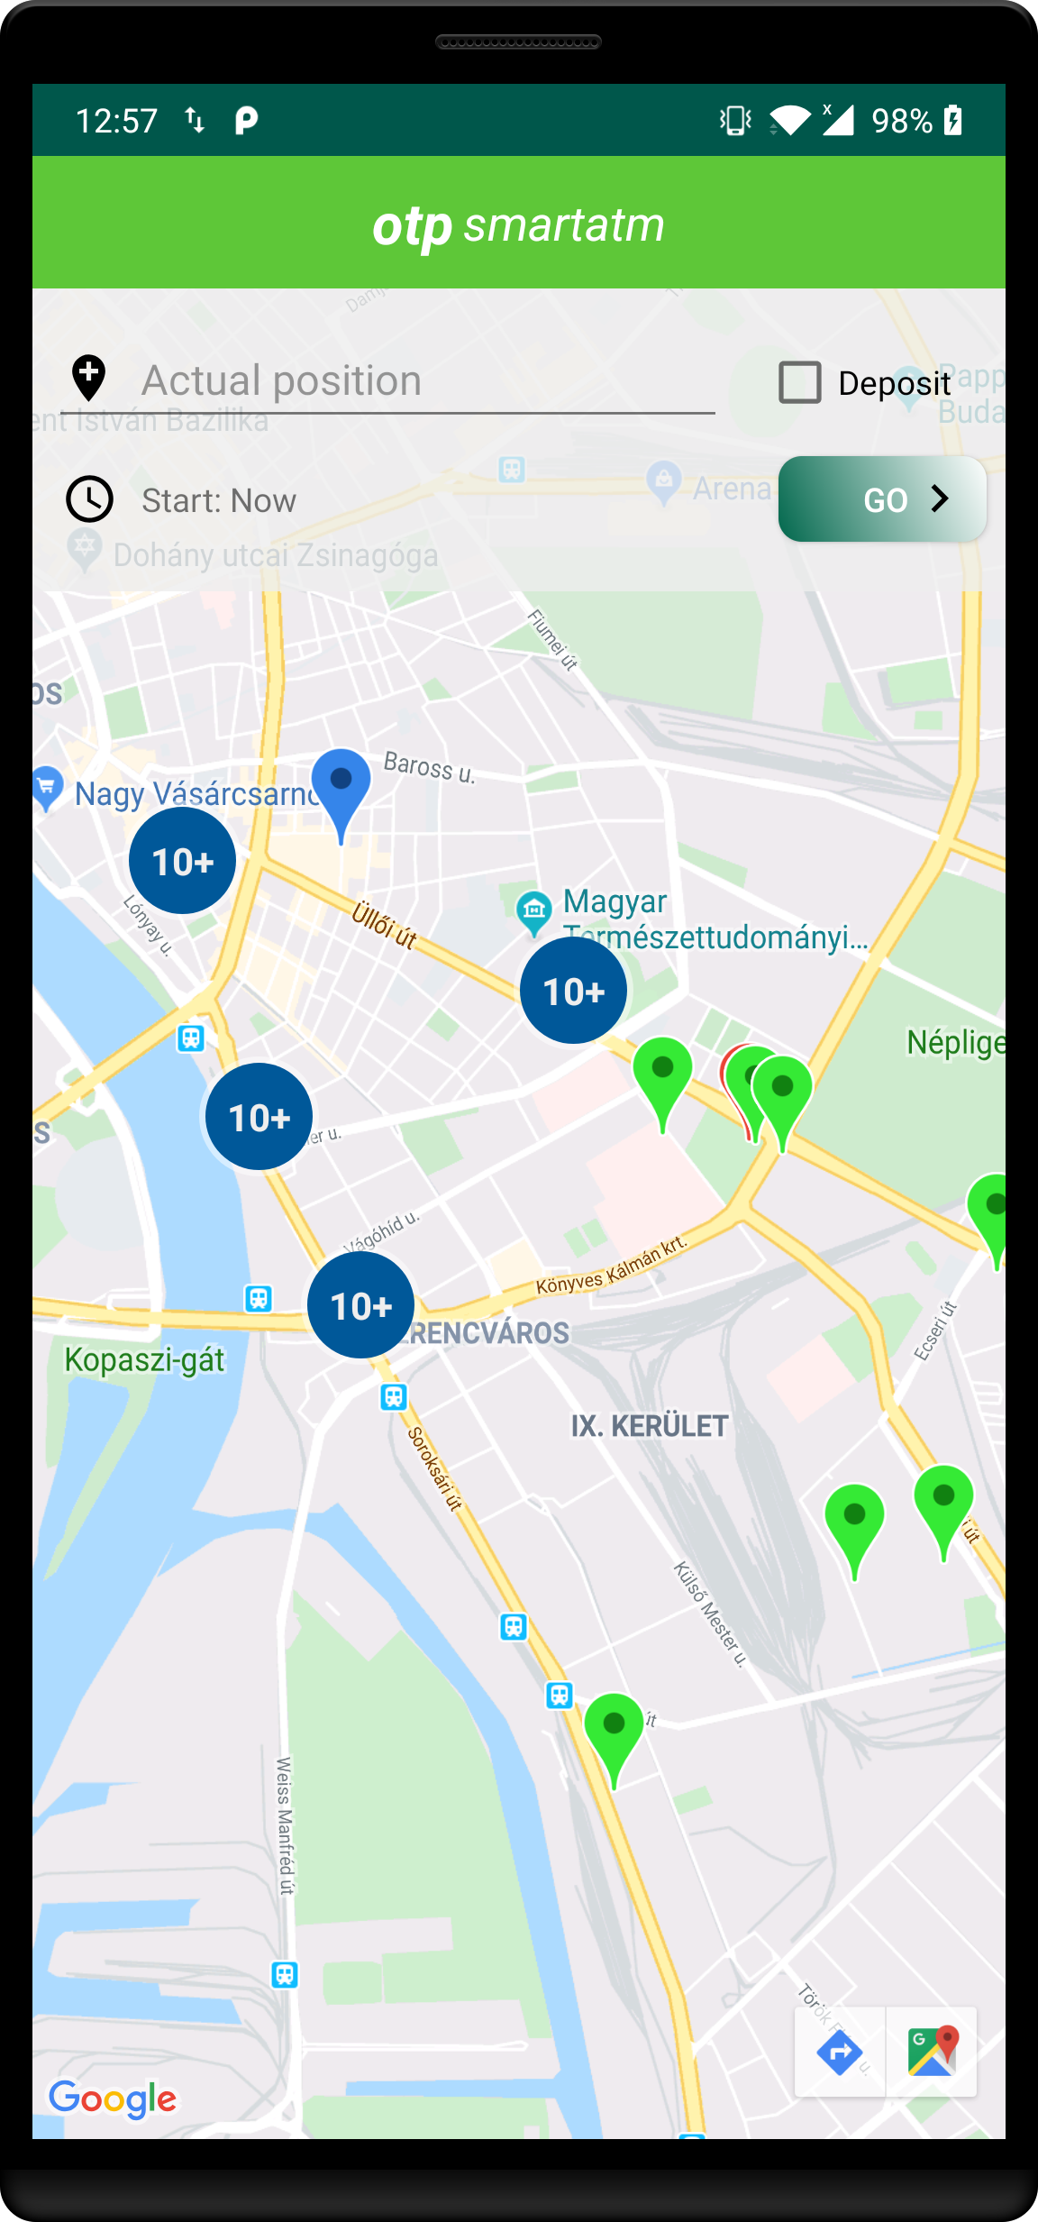
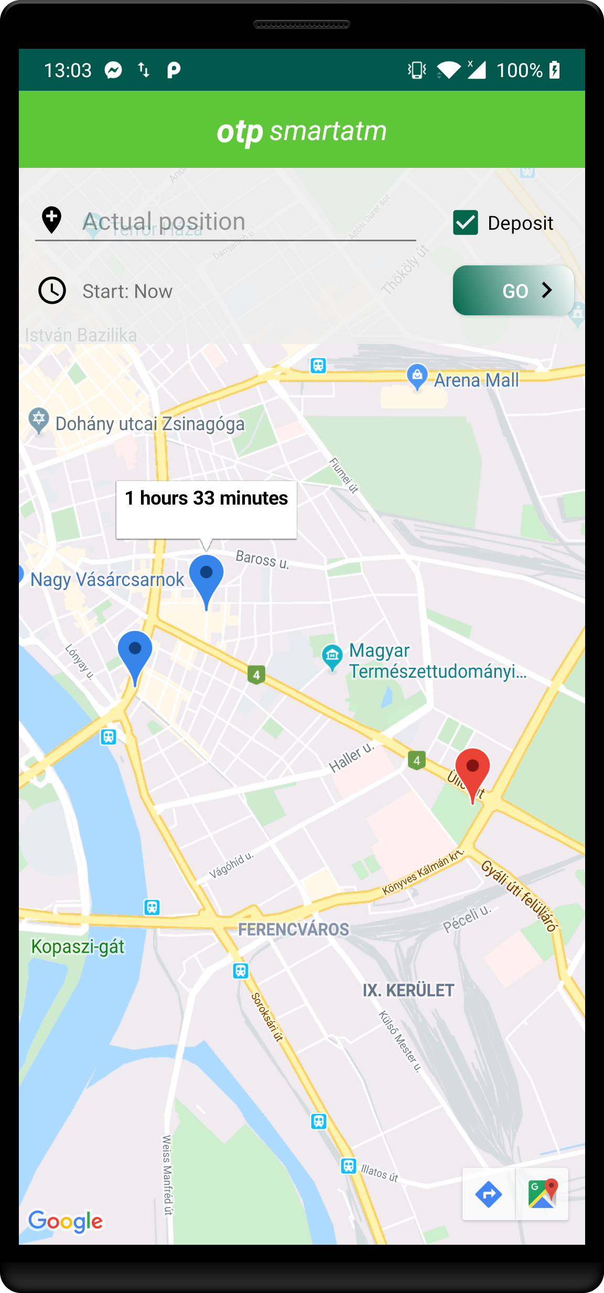
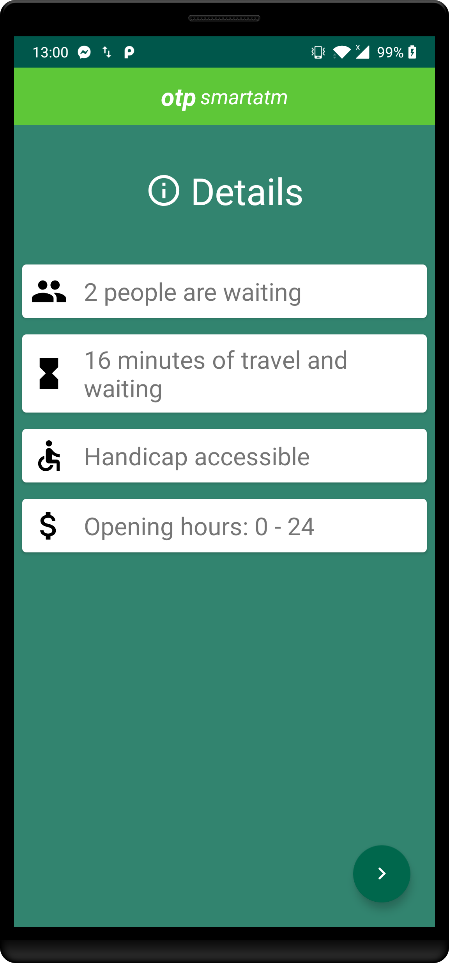

Slide 3
DEMO

Slide 4
Microservice architecture
Easier to Build and Maintain Apps
Organized Around Business Capabilities
Improved Productivity and Speed
Flexibility in Using Technologies and Scalability
Autonomous, Cross-functional Teams

Slide 5


ATM Finder server behind the scenes
DOCKER
KUBERNETES
”Securely build, share and run modern applications anywhere”
”Kubernetes is a portable, extensible, open-source platform for managing containerized workloads and services”

Slide 6
Kiejtés megtanulása
favourites
Further development ideas
ATM reservation
More info about the world
Geofence API
Handicap accessible
Save favourites

Slide 7




TOOLS
Kube Forwarder
Telepresence
https://kube-forwarder.pixelpoint.io/
Forward ports from the cluster
https://www.telepresence.io/
Microservice local debugger
Elasticsearch
Kibana
https://www.elastic.co/
Distributed, RESTful search and analytics engine
https://www.elastic.co/products/kibana
visualizing, analyzing, and exploring your data

Slide 8

THANKS!

