Slide 1
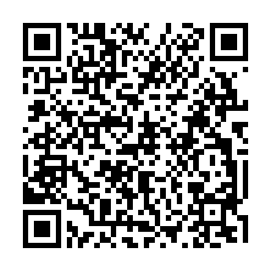
Egzon Zeneli
Email: egzon.zeneli@gmail.com
Twitter: egzonzeneli
Blog: egzonzeneli.com
Anëtarë:
ALNUG
ALSSUG

Slide 2

ALNUG Qershor 2012

Slide 3
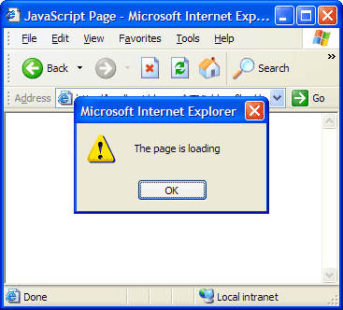
JavaScript
Netscape
Google V8 Engine,WinRT WinJS

Slide 4



JavaScript MV

Slide 5
BackboneJS
Pse vlersohet ?
E maturuar
> ~ 1000 rreshta
E testueshme Jasmine, Qunit
Event-Driven
RESTful
M`varët
Underscore (> 60 f-one, sortimin i array-ve, binding)
jQuery || Zepto

Slide 6
BackboneJS MV*
Events
HTML Templates
Collections
Views
Page / DOM
Models
Routers
URL / Hash
Change (Route)
Models
Models

Slide 7
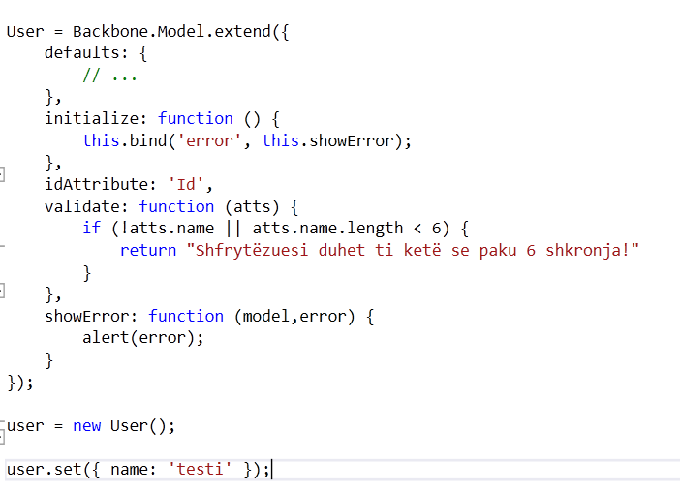
BackboneJS Model

Slide 8
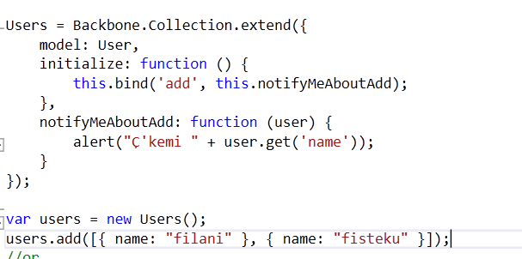
BackboneJS Collection

Slide 9
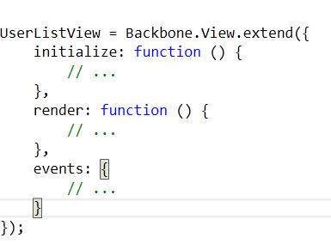
BackboneJS View
Klasa qe e kontrollojnë prezantimin e modelit

Slide 10
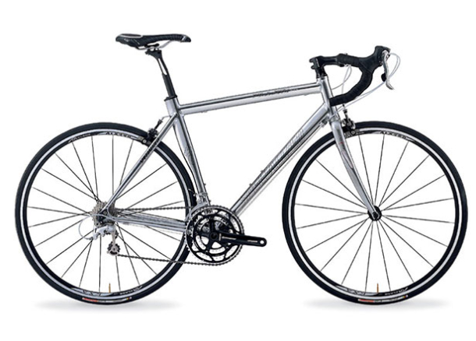
BackboneJS Demo

Slide 11

Backbone Aggregate Root
www.backbonejs.org
Nuget

Slide 12
BacknoneJS
Faleminderit

