Slide 1

Fractals
Infinite Details from Simple Rules
Aditya Tirtho Roy (2305178)
Farhan Ehsas Sami (2305177)
Pritom Biswas (2305160)
Department of Computer Science and Engineering
Bangladesh University of Engineering and Technology (BUET)
CSE 200 Presentation

Slide 2

History

Slide 3
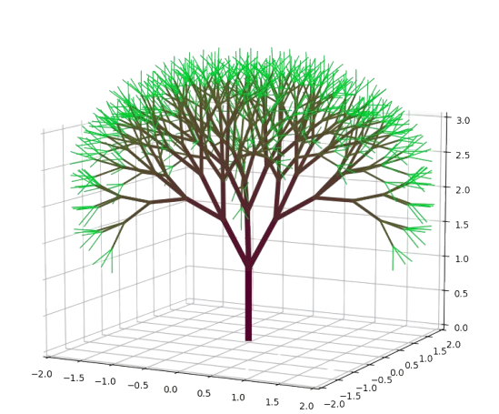

So, You’re Designing All the Trees...
Imagine you’re a game developer. You’ve just been handed one job: design
every tree in the game — all of them.
Aditya, Sami, Pritom
Fractals
2 / 31

Slide 4
So, You’re Designing All the Trees...
Imagine you’re a game developer. You’ve just been handed one job: design
every tree in the game — all of them.
You could hand-draw every branch, every
twig, every leaf, one at a time...
Aditya, Sami, Pritom
Fractals
2 / 31

Slide 5
So, You’re Designing All the Trees...
Imagine you’re a game developer. You’ve just been handed one job: design
every tree in the game — all of them.
You could hand-draw every branch, every
twig, every leaf, one at a time...
(kind of like how Rockstar’s been
“finishing” GTA 6 for the last decade.)
Aditya, Sami, Pritom
Fractals
2 / 31

Slide 6

So, You’re Designing All the Trees...
Imagine you’re a game developer. You’ve just been handed one job: design
every tree in the game — all of them.
You could hand-draw every branch, every
twig, every leaf, one at a time...
(kind of like how Rockstar’s been
“finishing” GTA 6 for the last decade.)
Or, you write one rule — “a branch splits into two smaller
branches” — and let that rule call itself, again and again, at a
smaller scale every time.
Aditya, Sami, Pritom
Fractals
2 / 31

Slide 7

So, You’re Designing All the Trees...
Imagine you’re a game developer. You’ve just been handed one job: design
every tree in the game — all of them.
You could hand-draw every branch, every
twig, every leaf, one at a time...
(kind of like how Rockstar’s been
“finishing” GTA 6 for the last decade.)
Or, you write one rule — “a branch splits into two smaller
branches” — and let that rule call itself, again and again, at a
smaller scale every time.
Trunk becomes branch, branch becomes twig, twig becomes leaf — same
rule, every time. The engine genuinely can’t tell the whole tree apart from
one tiny piece of it.
Aditya, Sami, Pritom
Fractals
2 / 31

Slide 8

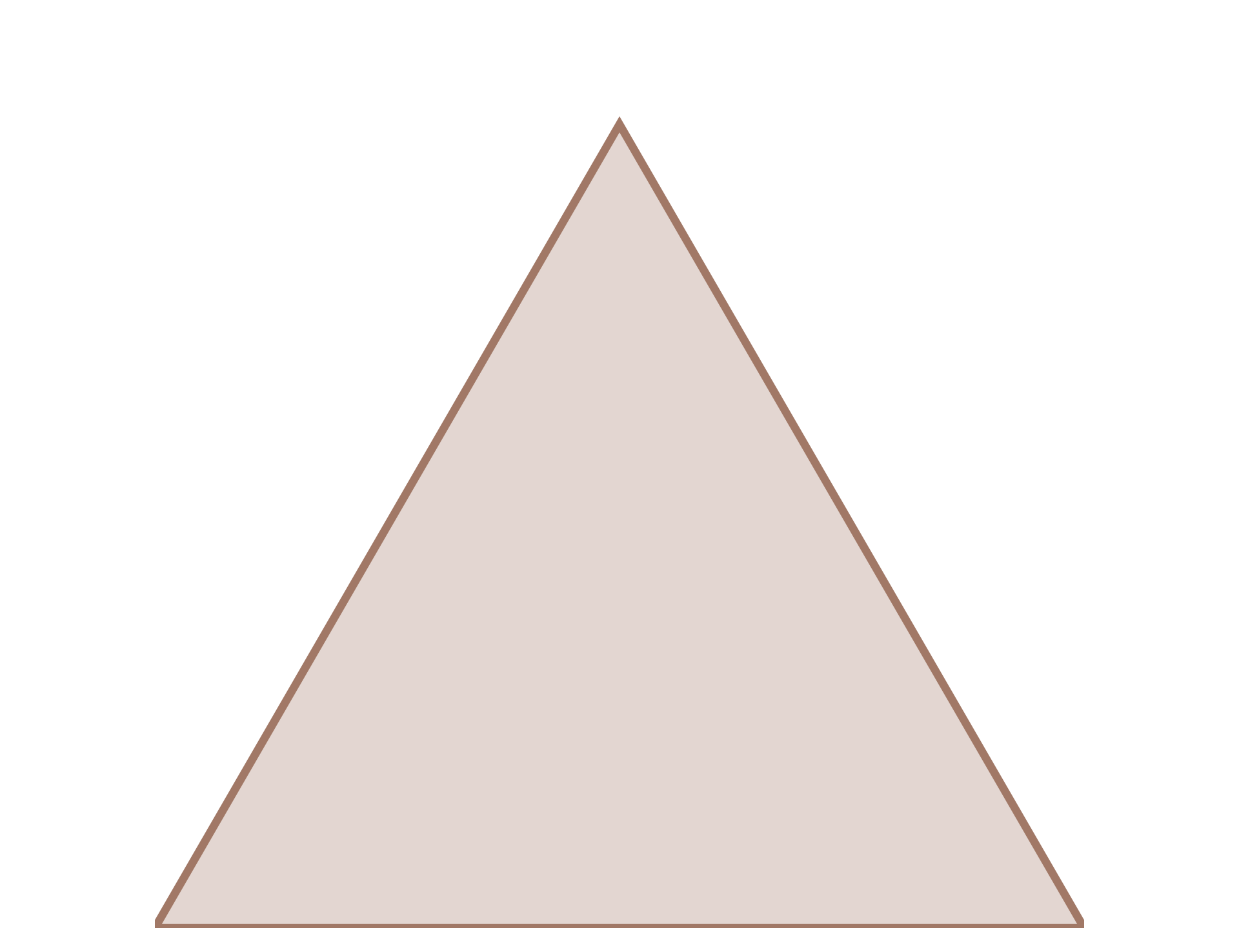
D´ej`a Vu?
Here’s the simplest possible version of
that same trick: draw a triangle.
Aditya, Sami, Pritom
Fractals
3 / 31

Slide 9
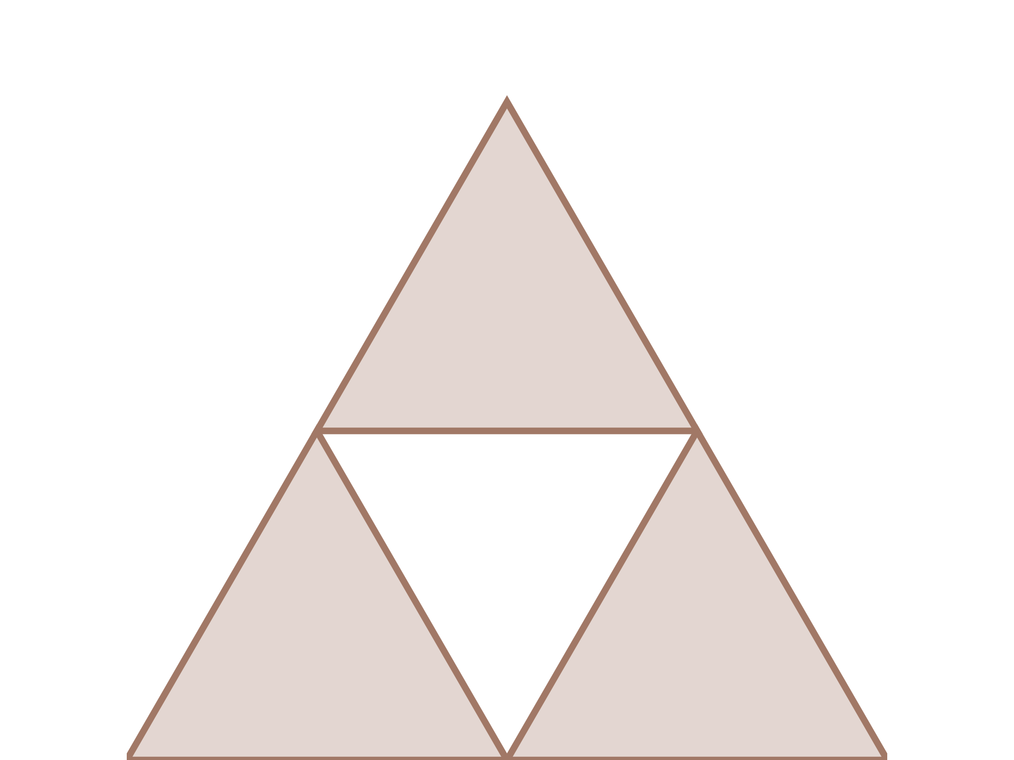
D´ej`a Vu?
Here’s the simplest possible version of
that same trick: draw a triangle.
Cut a smaller triangle out of the middle.
Aditya, Sami, Pritom
Fractals
3 / 31

Slide 10
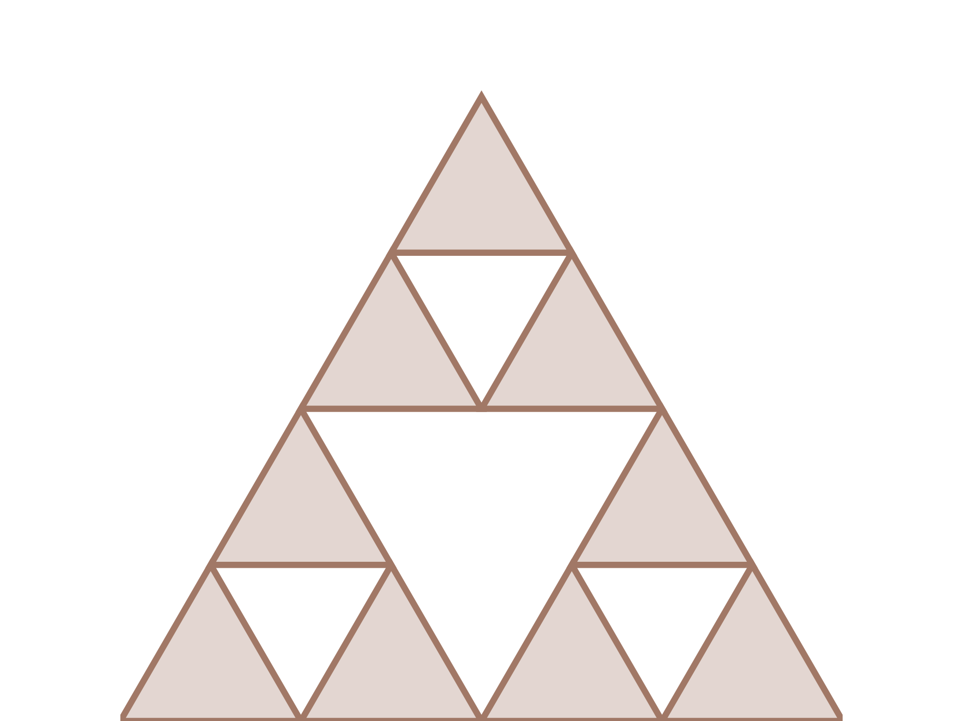
D´ej`a Vu?
Here’s the simplest possible version of
that same trick: draw a triangle.
Cut a smaller triangle out of the middle.
Now do that again, inside each of the
three triangles you’ve got left.
Aditya, Sami, Pritom
Fractals
3 / 31

Slide 11
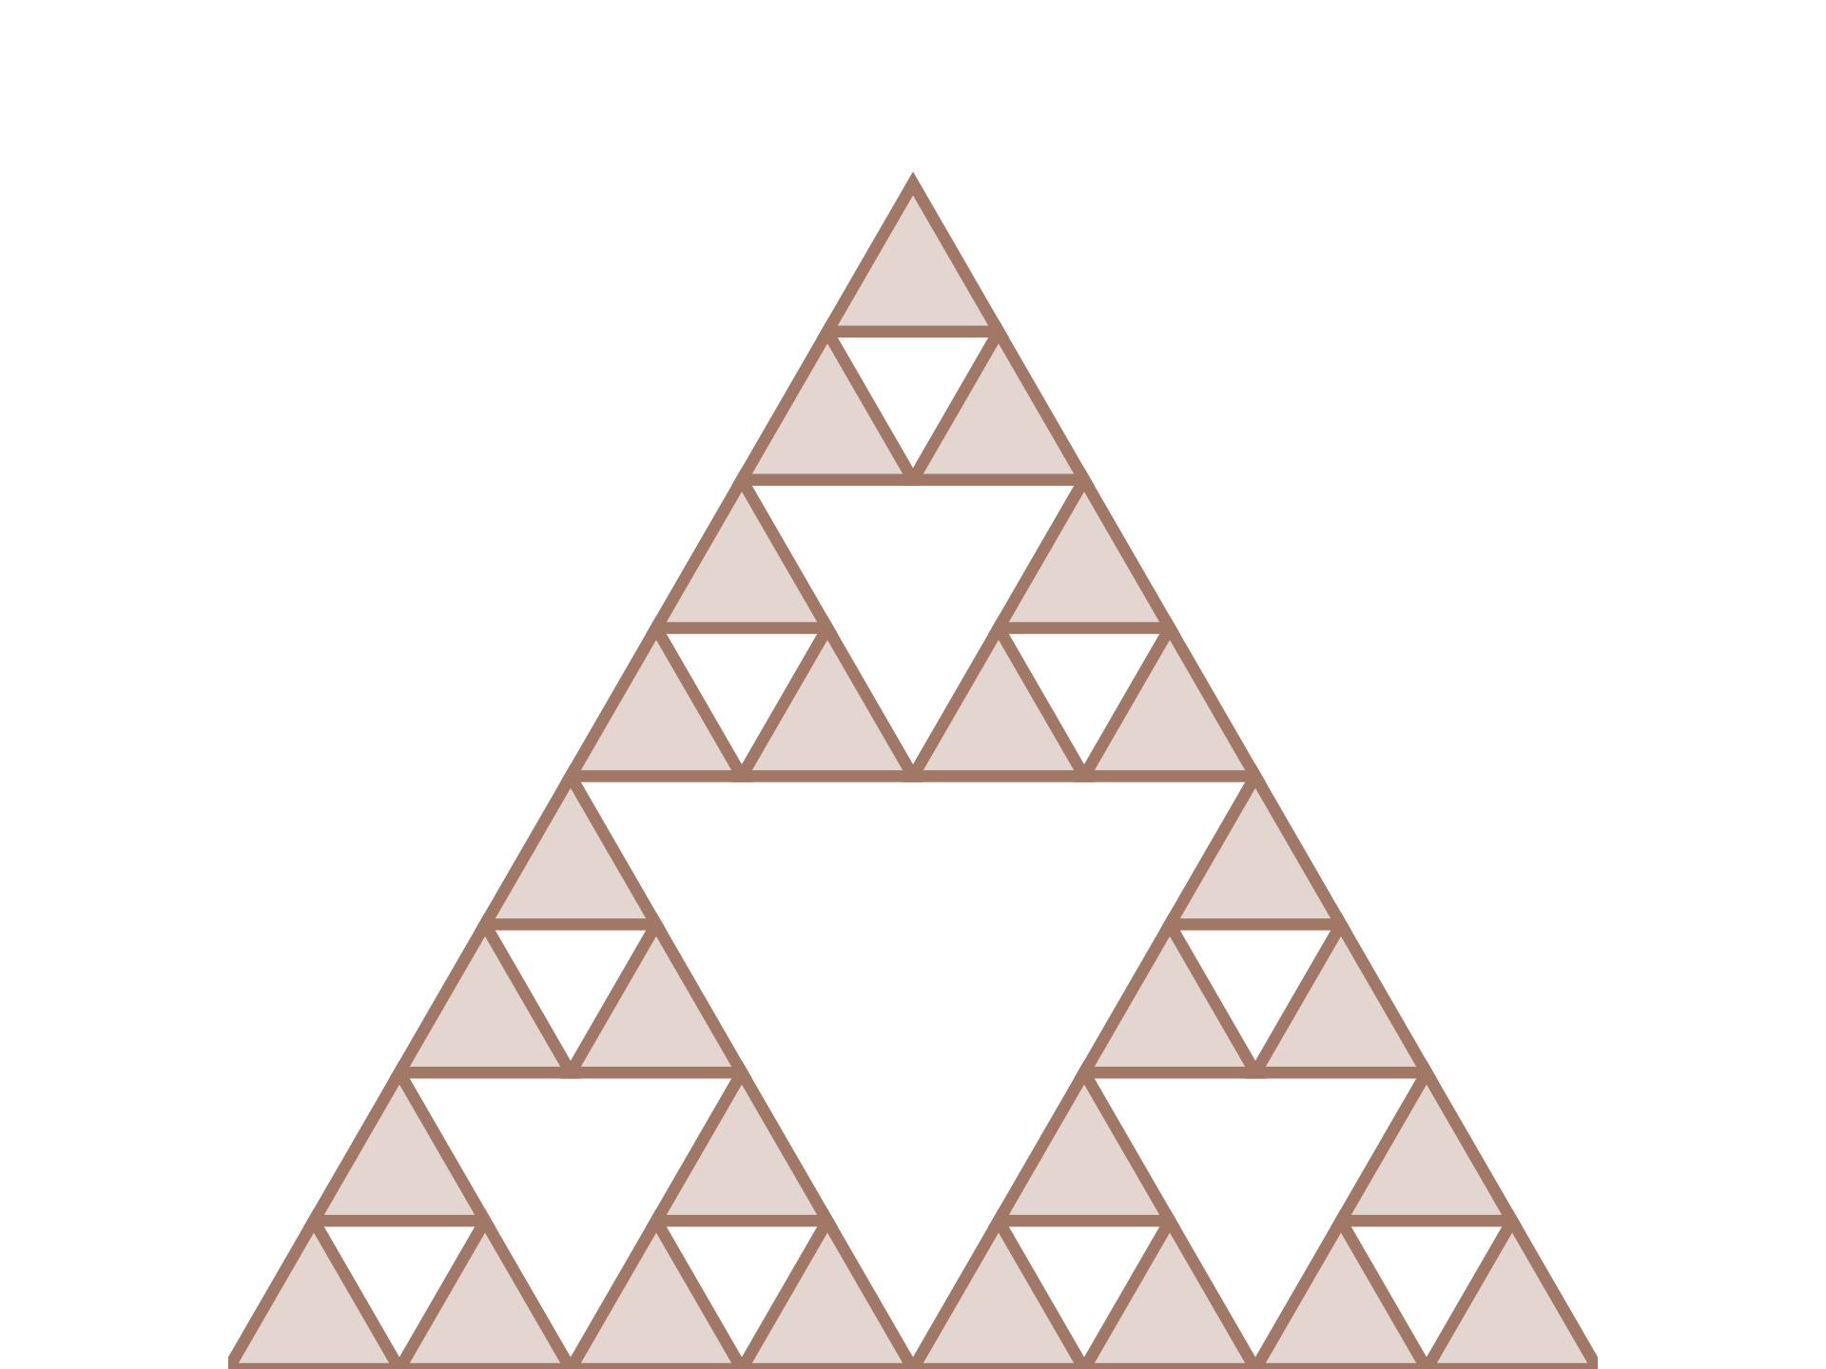
D´ej`a Vu?
Here’s the simplest possible version of
that same trick: draw a triangle.
Cut a smaller triangle out of the middle.
Now do that again, inside each of the
three triangles you’ve got left.
And again — forever.
Aditya, Sami, Pritom
Fractals
3 / 31

Slide 12

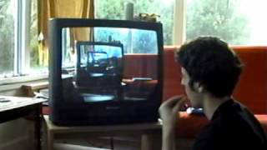
D´ej`a Vu?
Here’s the simplest possible version of
that same trick: draw a triangle.
Cut a smaller triangle out of the middle.
Now do that again, inside each of the
three triangles you’ve got left.
And again — forever.
It’s basically filming yourself watching
TV, while the TV plays that exact clip
of you watching TV.
Aditya, Sami, Pritom
Fractals
3 / 31

Slide 13

D´ej`a Vu?
Here’s the simplest possible version of
that same trick: draw a triangle.
Cut a smaller triangle out of the middle.
Now do that again, inside each of the
three triangles you’ve got left.
And again — forever.
It’s basically filming yourself watching
TV, while the TV plays that exact clip
of you watching TV.
Weird, right? That’s a fractal — a shape built out of smaller copies of
itself.
Aditya, Sami, Pritom
Fractals
3 / 31

Slide 14

What are Fractals?
Definition
A fractal is a geometric shape containing detailed structure
at arbitrarily small scales, usually having a fractal dimension
strictly exceeding the topological dimension.
Key Characteristics:
• Scale invariance: Details at every level of magnification
• Fractal dimension: More than the conventional dimension
• Infinite complexity: Generated by simple, recursive rules
• Like the infinite complexities of nature
Aditya, Sami, Pritom
Fractals
4 / 31

Slide 15

What are Fractals?
Definition
A fractal is a geometric shape containing detailed structure
at arbitrarily small scales, usually having a fractal dimension
strictly exceeding the topological dimension.
Key Characteristics:
• Scale invariance: Details at every level of magnification
• Fractal dimension: More than the conventional dimension
• Infinite complexity: Generated by simple, recursive rules
• Like the infinite complexities of nature
”Clouds are not spheres, mountains are not
cones, coastlines are not circles...”
— Benoit Mandelbrot
Aditya, Sami, Pritom
Fractals
4 / 31

Slide 16

Mandelbrot’s Question
In the 1960s, working at IBM, Benoit Mandelbrot asked a deceptively simple
question:
“How long is the coast of Britain?”
Aditya, Sami, Pritom
Fractals
5 / 31

Slide 17
Mandelbrot’s Question
In the 1960s, working at IBM, Benoit Mandelbrot asked a deceptively simple
question:
“How long is the coast of Britain?”
The honest answer: it depends on your ruler. Measure with a 100 km ruler,
get one length. Use a 1 km ruler, and the measured length grows — every
bay and inlet you’d smoothed over now counts. The length never converges
to a single number.
Aditya, Sami, Pritom
Fractals
5 / 31

Slide 18
Mandelbrot’s Question
In the 1960s, working at IBM, Benoit Mandelbrot asked a deceptively simple
question:
“How long is the coast of Britain?”
The honest answer: it depends on your ruler. Measure with a 100 km ruler,
get one length. Use a 1 km ruler, and the measured length grows — every
bay and inlet you’d smoothed over now counts. The length never converges
to a single number.
Mandelbrot’s insight: this isn’t a flaw in the coastline — it’s a sign that
classical length and area are the wrong tools for something like this. What a
coastline actually needed was exactly the kind of “useless” geometry
mathematicians had quietly been building for a century already — without
knowing why.
Aditya, Sami, Pritom
Fractals
5 / 31

Slide 19

Borrowed Tools
Mandelbrot wasn’t building from nothing.
Aditya, Sami, Pritom
Fractals
6 / 31

Slide 20

Borrowed Tools
Mandelbrot wasn’t building from nothing.
Back in 1872, Karl Weierstrass broke an assumption every
mathematician had taken for granted — on purpose.
Aditya, Sami, Pritom
Fractals
6 / 31

Slide 21
Borrowed Tools
Mandelbrot wasn’t building from nothing.
Back in 1872, Karl Weierstrass broke an assumption every
mathematician had taken for granted — on purpose.
That set off a decades-long spree: mathematicians started building weirder
and weirder shapes on purpose, just to see where ordinary geometry broke
down — Cantor’s dust and Koch’s endless jagged curve.
Aditya, Sami, Pritom
Fractals
6 / 31

Slide 22
Borrowed Tools
Mandelbrot wasn’t building from nothing.
Back in 1872, Karl Weierstrass broke an assumption every
mathematician had taken for granted — on purpose.
That set off a decades-long spree: mathematicians started building weirder
and weirder shapes on purpose, just to see where ordinary geometry broke
down — Cantor’s dust and Koch’s endless jagged curve.
For nearly a century, these were dismissed as beautiful but useless.
Mandelbrot was the one who realized they weren’t useless at all — he gave
the whole family a name: fractal.
Aditya, Sami, Pritom
Fractals
6 / 31

Slide 23

Borrowed Tools
Mandelbrot wasn’t building from nothing.
Back in 1872, Karl Weierstrass broke an assumption every
mathematician had taken for granted — on purpose.
That set off a decades-long spree: mathematicians started building weirder
and weirder shapes on purpose, just to see where ordinary geometry broke
down — Cantor’s dust and Koch’s endless jagged curve.
For nearly a century, these were dismissed as beautiful but useless.
Mandelbrot was the one who realized they weren’t useless at all — he gave
the whole family a name: fractal.
And that triangle? The exact one you watched me draw a few
minutes ago.
Aditya, Sami, Pritom
Fractals
6 / 31

Slide 24

Some Fractals

Slide 25

The Sierpinski Triangle
Let’s construct the Sierpinski Triangle:
Construction Process
1. Start with an equilateral triangle
Iteration 0
Aditya, Sami, Pritom
Fractals
7 / 31

Slide 26
The Sierpinski Triangle
Let’s construct the Sierpinski Triangle:
Construction Process
1. Start with an equilateral triangle
2. Remove the central triangle (triangle
connecting midpoints of the sides)
Iteration 1
Aditya, Sami, Pritom
Fractals
7 / 31

Slide 27
The Sierpinski Triangle
Let’s construct the Sierpinski Triangle:
Construction Process
1. Start with an equilateral triangle
2. Remove the central triangle (triangle
connecting midpoints of the sides)
3. Repeat for each triangle
Iteration 2
Aditya, Sami, Pritom
Fractals
7 / 31

Slide 28
The Sierpinski Triangle
Let’s construct the Sierpinski Triangle:
Construction Process
1. Start with an equilateral triangle
2. Remove the central triangle (triangle
connecting midpoints of the sides)
3. Repeat for each triangle
4. After infinite iterations, we get the
Sierpinski Triangle
Iteration 3
Aditya, Sami, Pritom
Fractals
7 / 31

Slide 29

Area & Perimeter

Slide 30
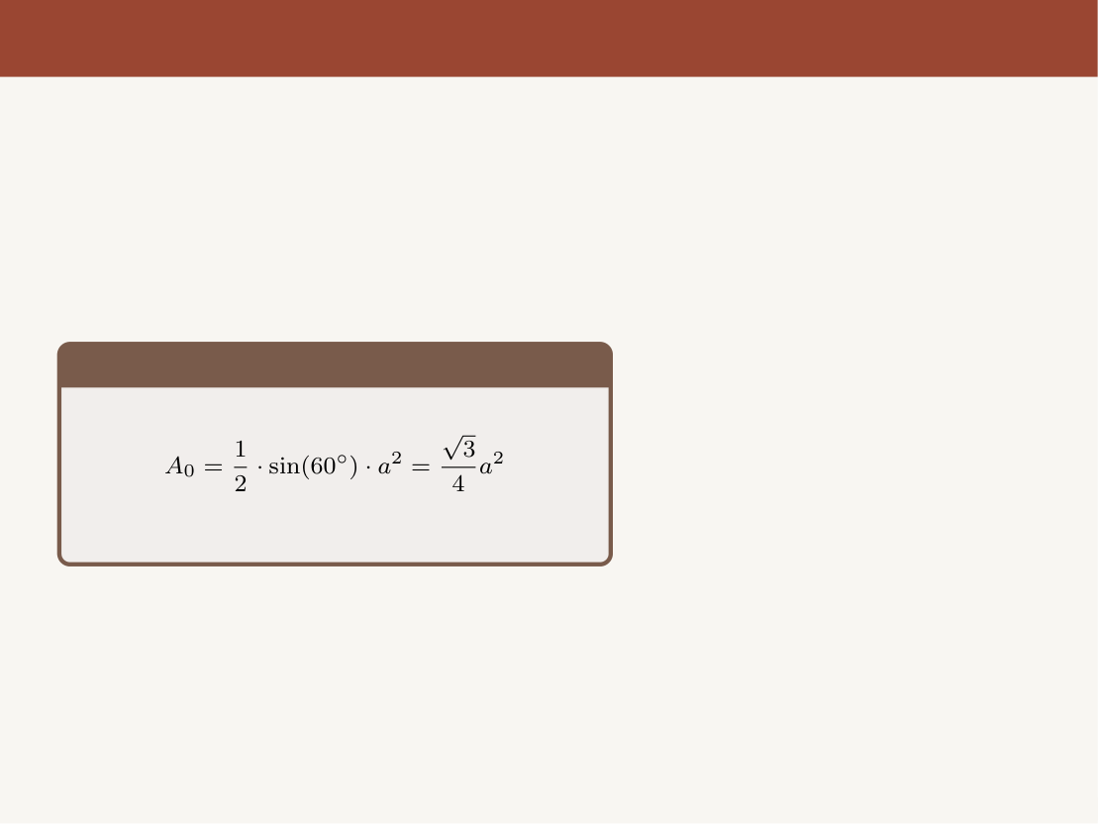
The Sierpinski Triangle: Area
Now let’s find the area of triangle(s):
Area Calculation
Iteration 0
Aditya, Sami, Pritom
Fractals
8 / 31

Slide 31
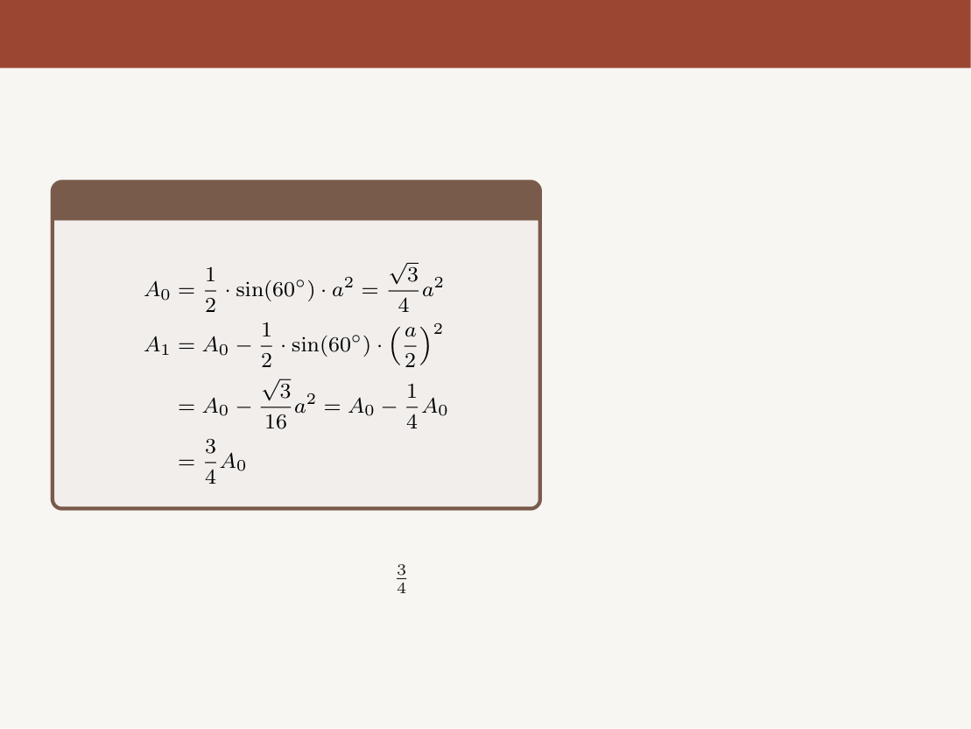
The Sierpinski Triangle: Area
Now let’s find the area of triangle(s):
Area Calculation
Iteration 1
We cut out one fourth of the area at each step.
So, naturally area is reduced by
at each
step.
Aditya, Sami, Pritom
Fractals
8 / 31

Slide 32
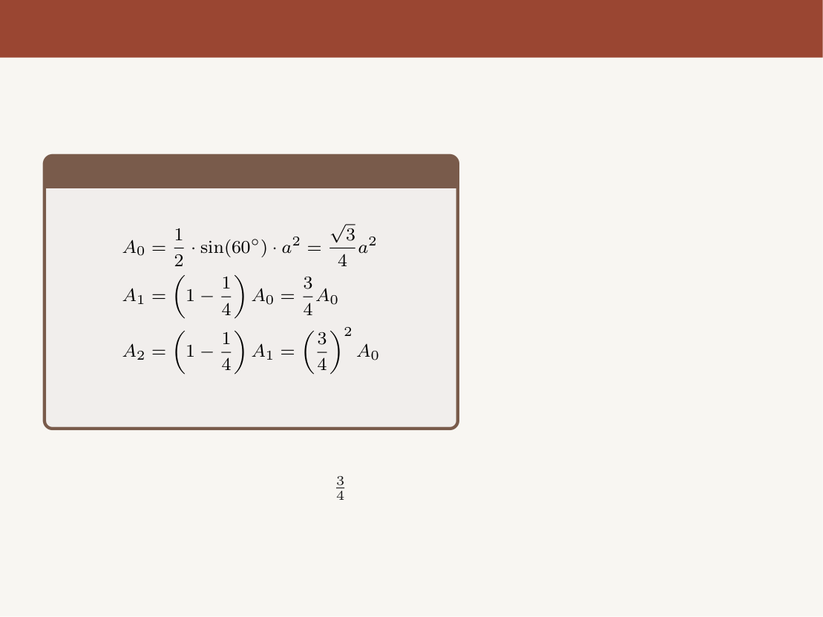
The Sierpinski Triangle: Area
Now let’s find the area of triangle(s):
Area Calculation
Iteration 2
We cut out one fourth of the area at each step.
So, naturally area is reduced by
at each
step.
Aditya, Sami, Pritom
Fractals
8 / 31

Slide 33
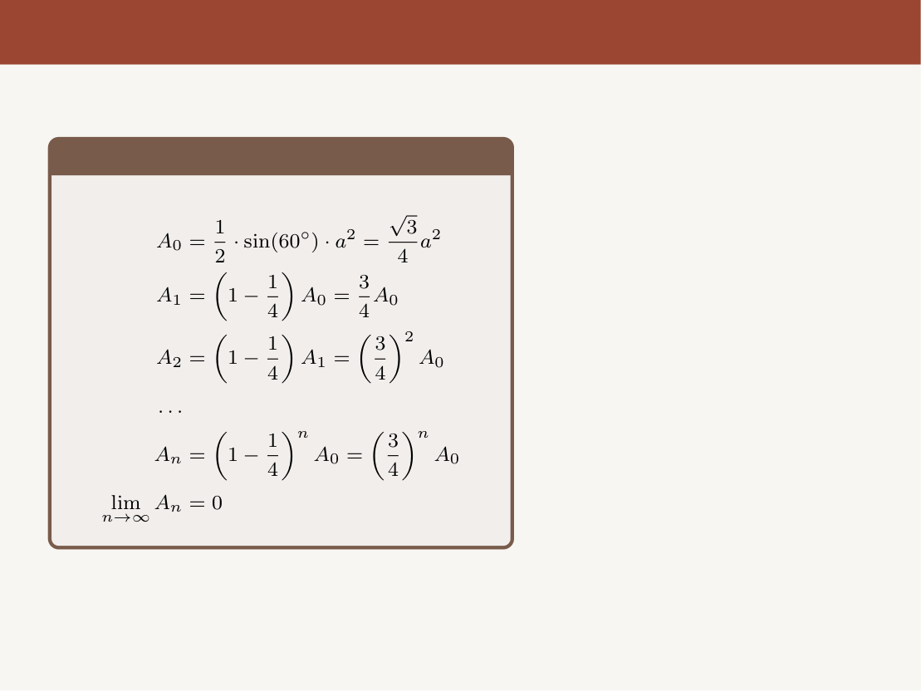
The Sierpinski Triangle: Area
Now let’s find the area of triangle(s):
Area Calculation
Iteration 3
The area of the Sierpinski Triangle is zero
even though it is a 2D shape.
Aditya, Sami, Pritom
Fractals
8 / 31

Slide 34

The Sierpinski Triangle: Perimeter
Now let’s find the perimeter:
Perimeter Calculation
Iteration 0
Aditya, Sami, Pritom
Fractals
9 / 31

Slide 35
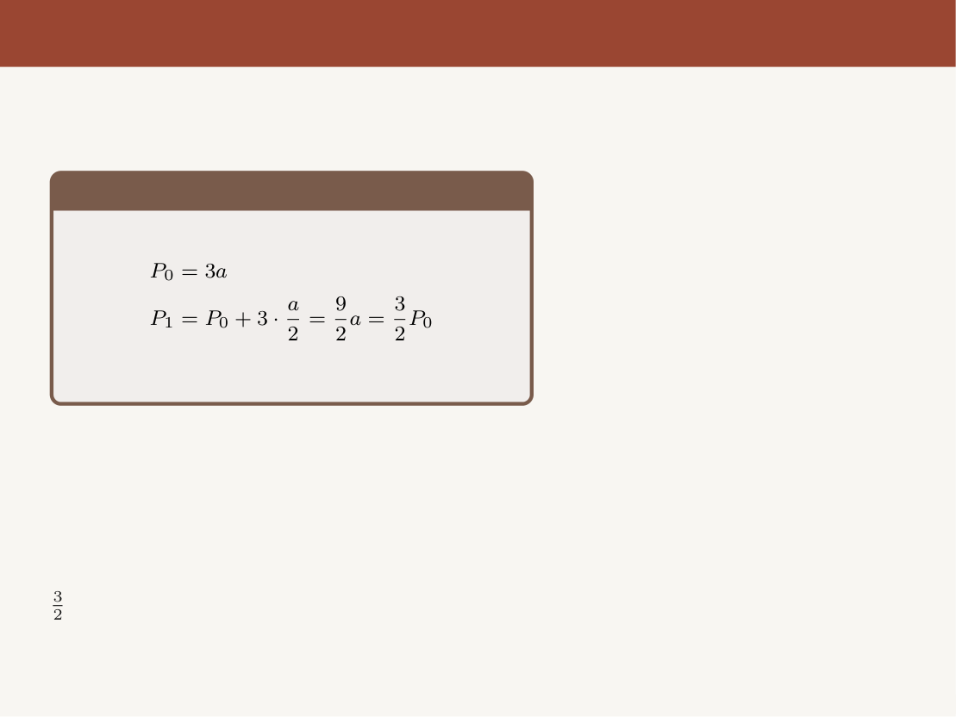
The Sierpinski Triangle: Perimeter
Now let’s find the perimeter:
Perimeter Calculation
We add half of the previous perimeter at each
step. This is because we add the same
number of triangles as the last step, but each
Iteration 1
triangle is half the size of the previous one.
As a result, the perimeter grows by a factor of
at each step.
Aditya, Sami, Pritom
Fractals
9 / 31

Slide 36
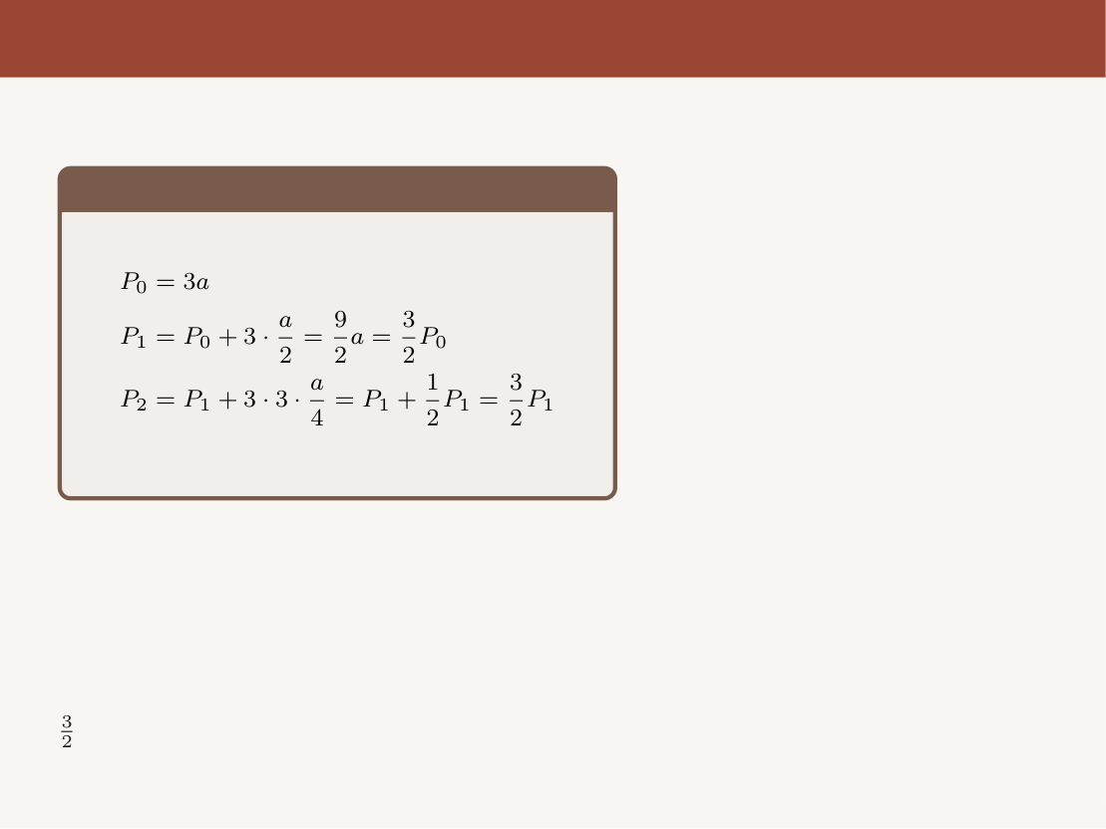
The Sierpinski Triangle: Perimeter
Now let’s find the perimeter:
Perimeter Calculation
We add half of the previous perimeter at each
step. This is because we add the same
Iteration 2
number of triangles as the last step, but each
triangle is half the size of the previous one.
As a result, the perimeter grows by a factor of
at each step.
Aditya, Sami, Pritom
Fractals
9 / 31

Slide 37
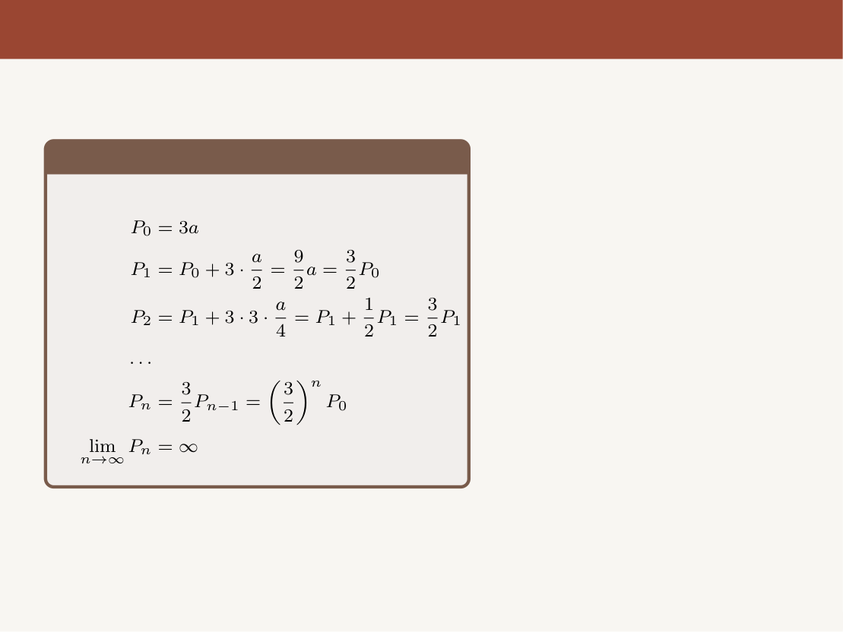
The Sierpinski Triangle: Perimeter
Now let’s find the perimeter:
Perimeter Calculation
Iteration 3
The Sierpinski Triangle has infinite
perimeter but zero area.
Aditya, Sami, Pritom
Fractals
9 / 31

Slide 38

Handoff to Speaker 2
We’ve now seen something strange, and precise:
• A 2D shape (Sierpinski Triangle) with zero area.
• A shape built from a rule so simple a child could apply it by hand.
• No matter how far we zoom in, there’s always more detail.
Aditya, Sami, Pritom
Fractals
10 / 31

Slide 39

Handoff to Speaker 2
We’ve now seen something strange, and precise:
• A 2D shape (Sierpinski Triangle) with zero area.
• A shape built from a rule so simple a child could apply it by hand.
• No matter how far we zoom in, there’s always more detail.
If it isn’t a line, and it isn’t a surface — what is its true di-
mension?
Aditya, Sami, Pritom
Fractals
10 / 31

Slide 40
Handoff to Speaker 2
We’ve now seen something strange, and precise:
• A 2D shape (Sierpinski Triangle) with zero area.
• A shape built from a rule so simple a child could apply it by hand.
• No matter how far we zoom in, there’s always more detail.
If it isn’t a line, and it isn’t a surface — what is its true di-
mension?
That number is exactly what Hausdorff was reaching for in 1918 — and it’s
where Speaker 2 picks up the story.
Aditya, Sami, Pritom
Fractals
10 / 31

Slide 41

Fractal Dimension

Slide 42
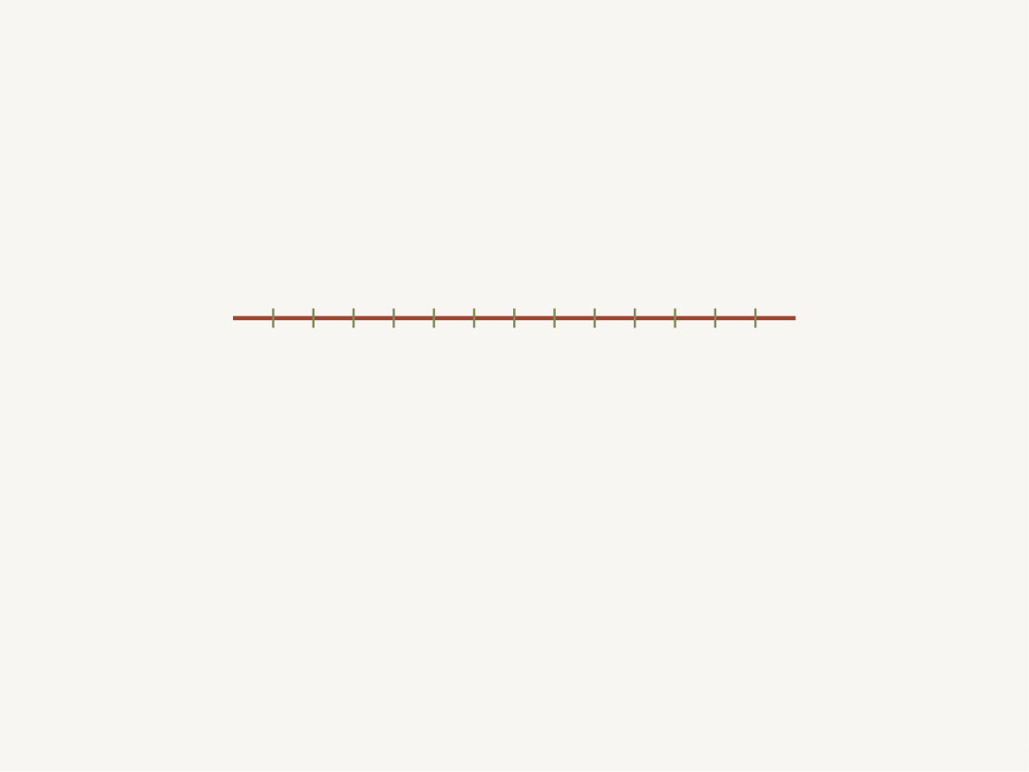
Let’s talk about a property of fractals...
Fractal Dimension
What does it mean for a shape to have a non-integer dimension?
Aditya, Sami, Pritom
Fractals
11 / 31

Slide 43
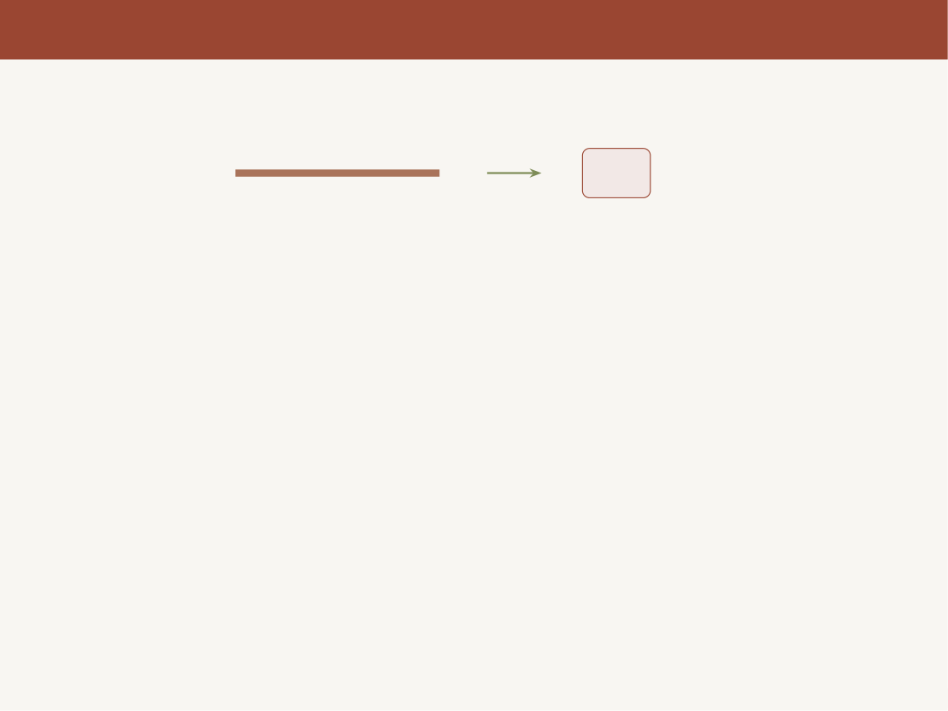
Dimensions We Know
We are all familiar with integer dimensions:
1D
Line
Aditya, Sami, Pritom
Fractals
12 / 31

Slide 44
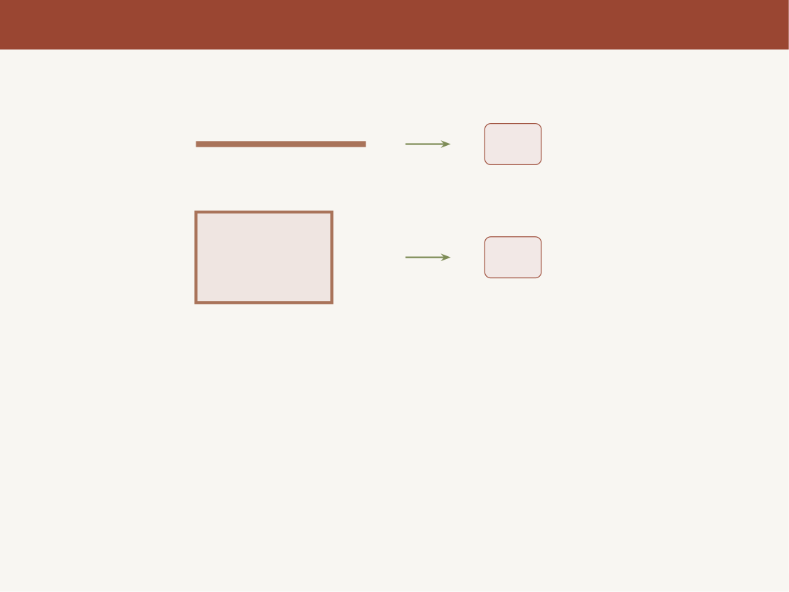
Dimensions We Know
We are all familiar with integer dimensions:
1D
Line
2D
Square
Aditya, Sami, Pritom
Fractals
12 / 31

Slide 45
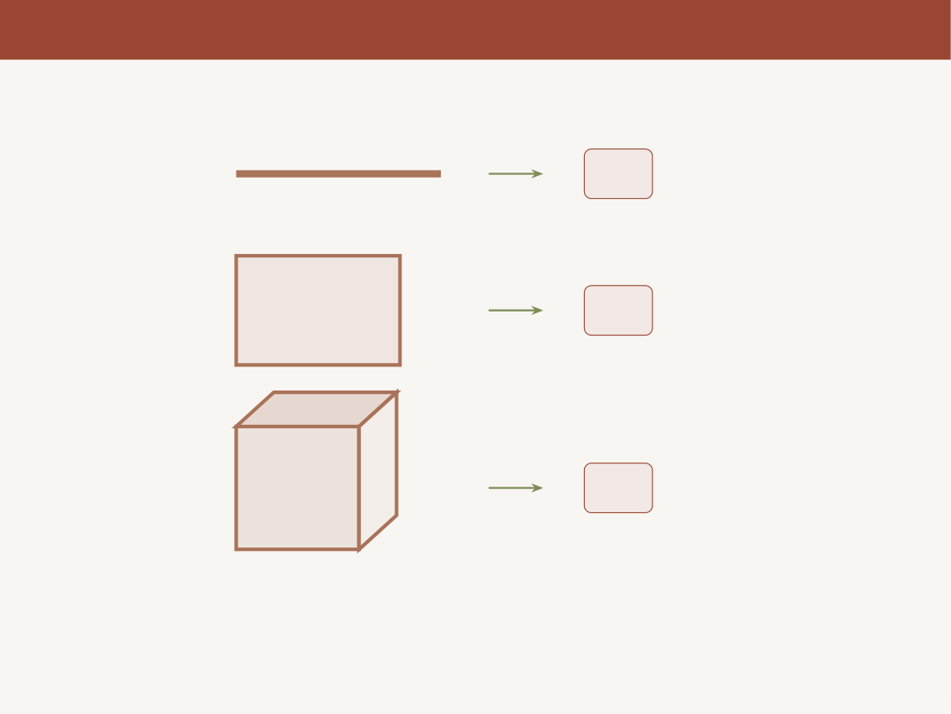
Dimensions We Know
We are all familiar with integer dimensions:
1D
Line
2D
Square
3D
Cube
Dimensions are always whole numbers... right?
Aditya, Sami, Pritom
Fractals
12 / 31

Slide 46

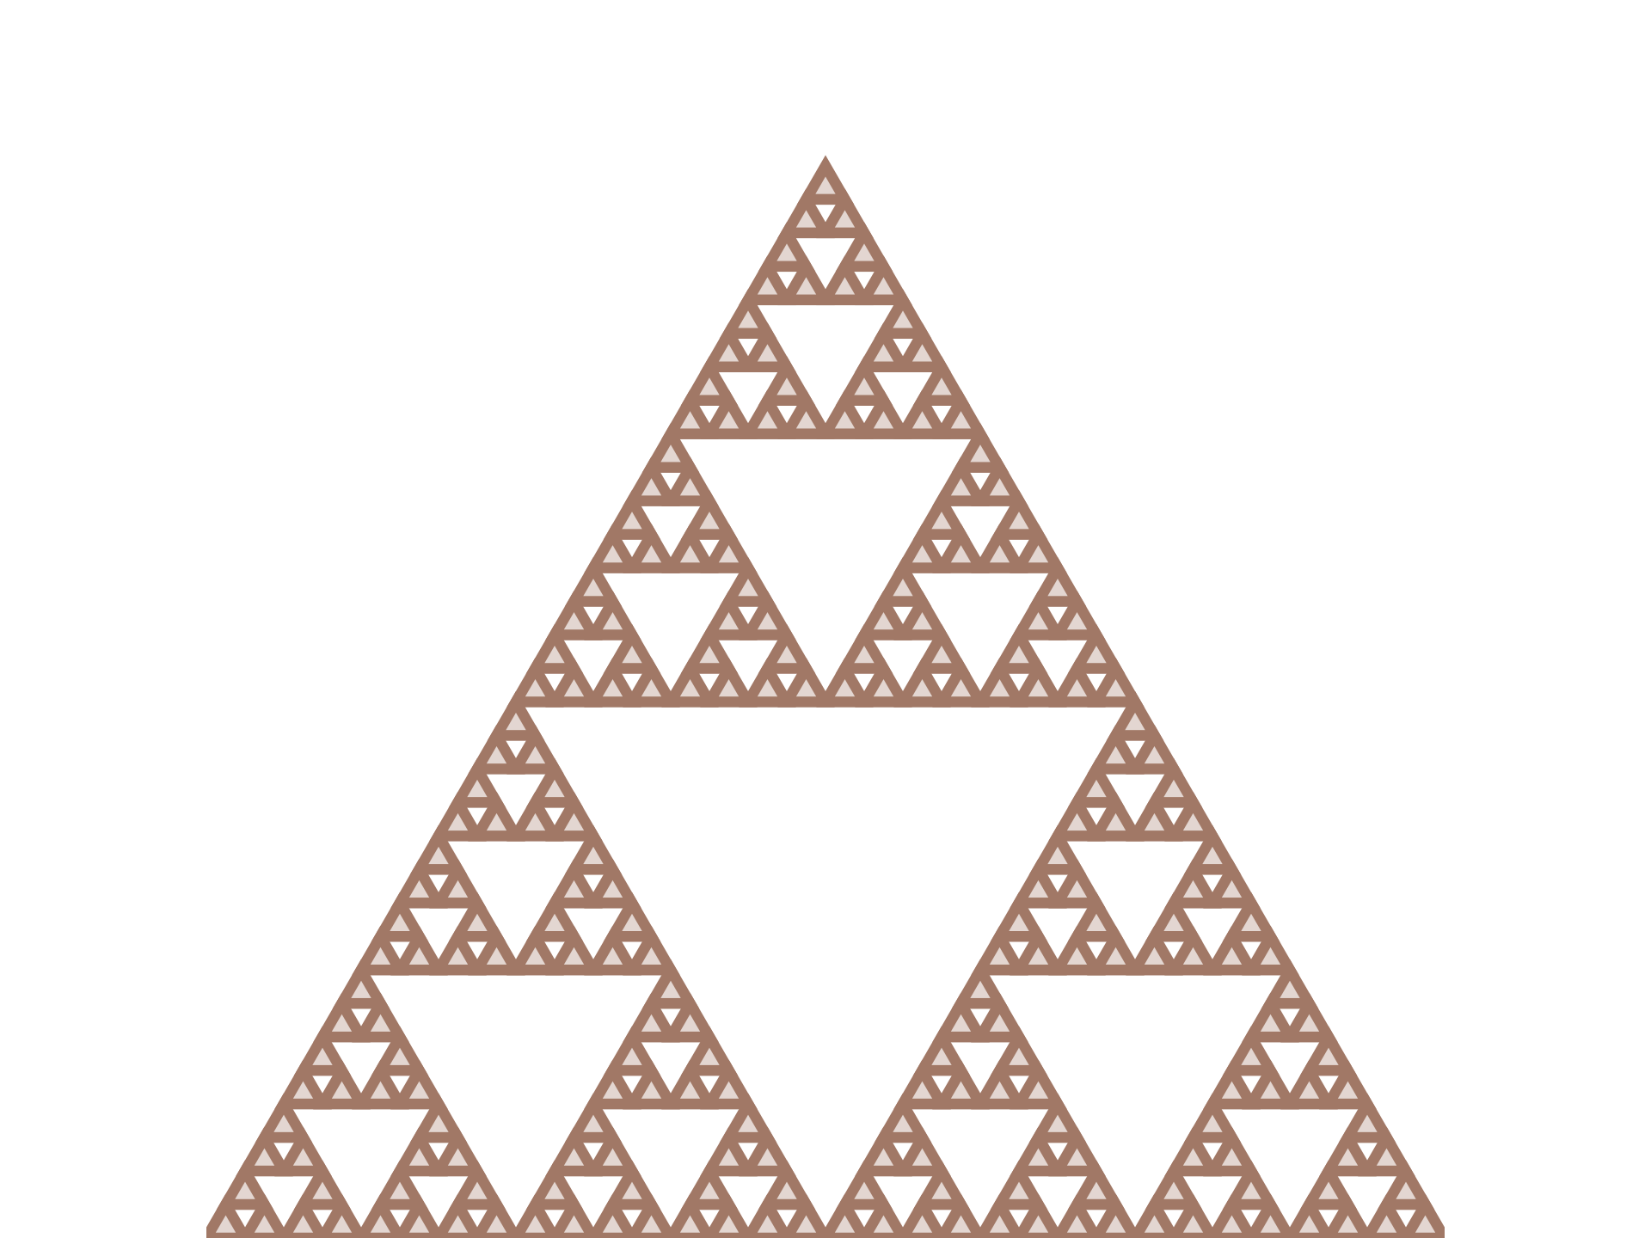
What About This One?
What dimension does this
shape have?
Any guesses?
• It lives in 2D space...
• But it has zero area
• And infinite perimeter
Sierpinski Triangle
It’s not quite 2D, but it’s clearly more than
1D...
Aditya, Sami, Pritom
Fractals
13 / 31

Slide 47
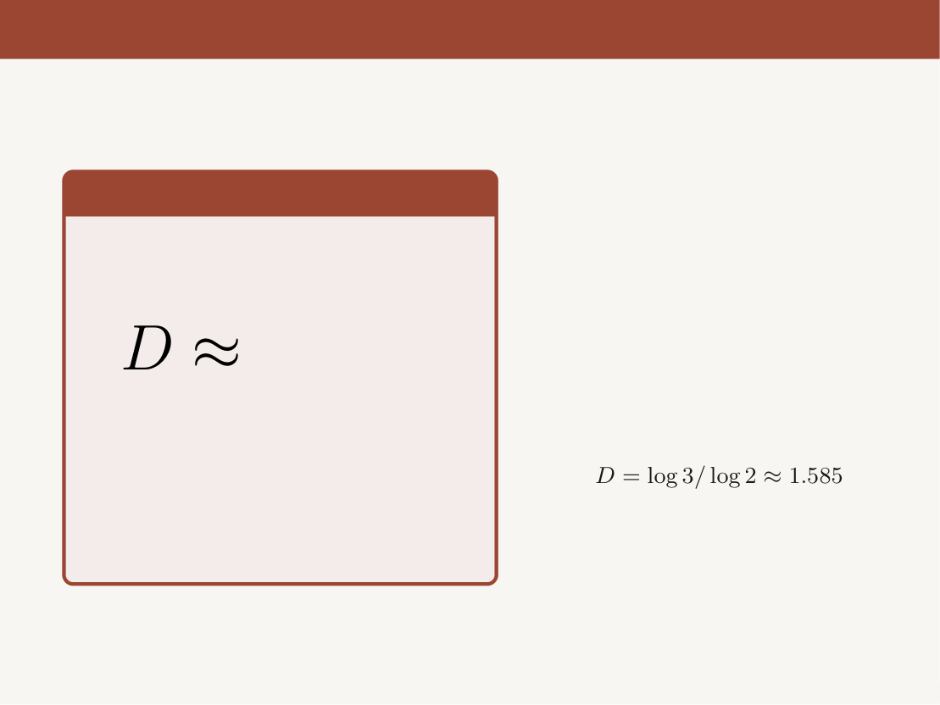
What About This One?
Sierpinski Dimension
The Sierpinski Triangle has a
fractal dimension of:
1.585
!!
A non-integer dimension —
between a line (1D) and a filled
surface (2D).
Aditya, Sami, Pritom
Fractals
13 / 31

Slide 48
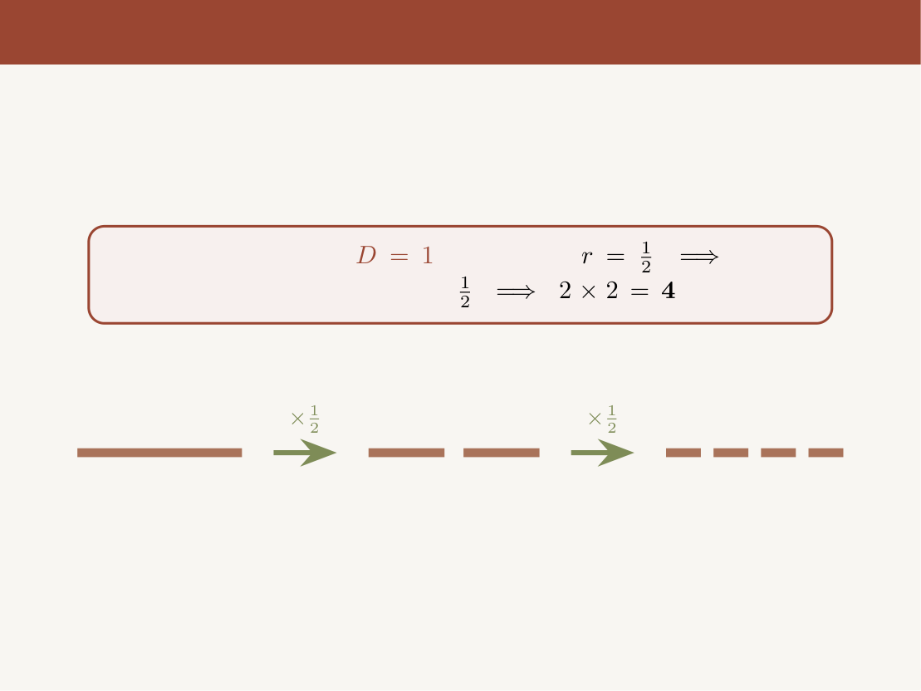
Self-Similarity & Scaling
Scaling a Line (
):
Scale by
2
pieces.
Scale again by
pieces.
Original Line
2 pieces
4 pieces
Aditya, Sami, Pritom
Fractals
14 / 31

Slide 49
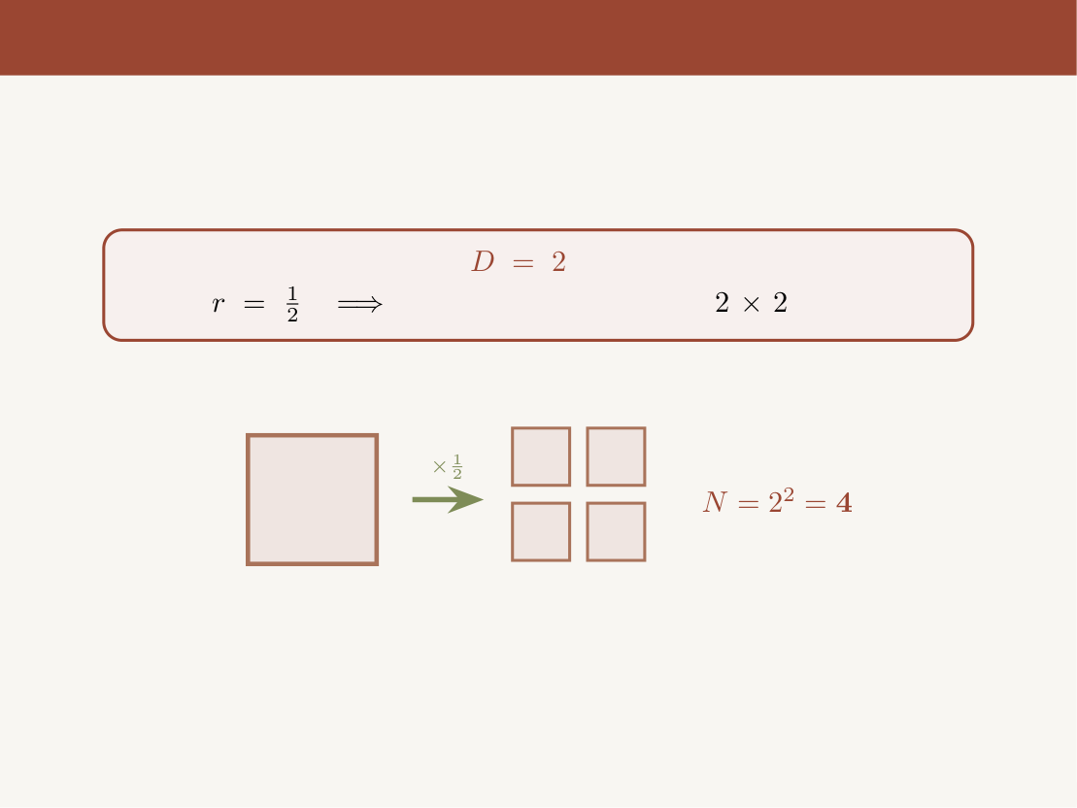
Self-Similarity & Scaling
Scaling a Square (
) — Step 1:
Scale by
4 self-similar pieces (
grid).
Original Square
4 pieces
Aditya, Sami, Pritom
Fractals
14 / 31

Slide 50
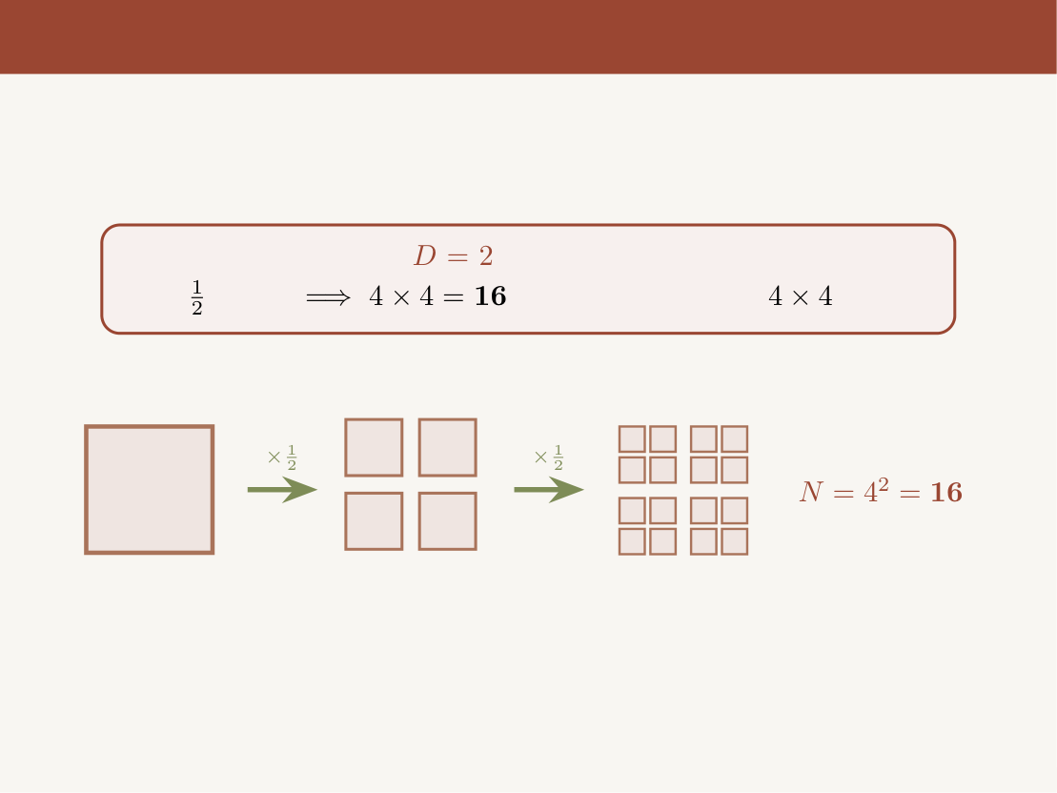
Self-Similarity & Scaling
Scaling a Square (
) — Step 2:
Scale each piece
by
again
self-similar pieces (
grid)!
Original
4 pieces
16 pieces
Aditya, Sami, Pritom
Fractals
14 / 31

Slide 51
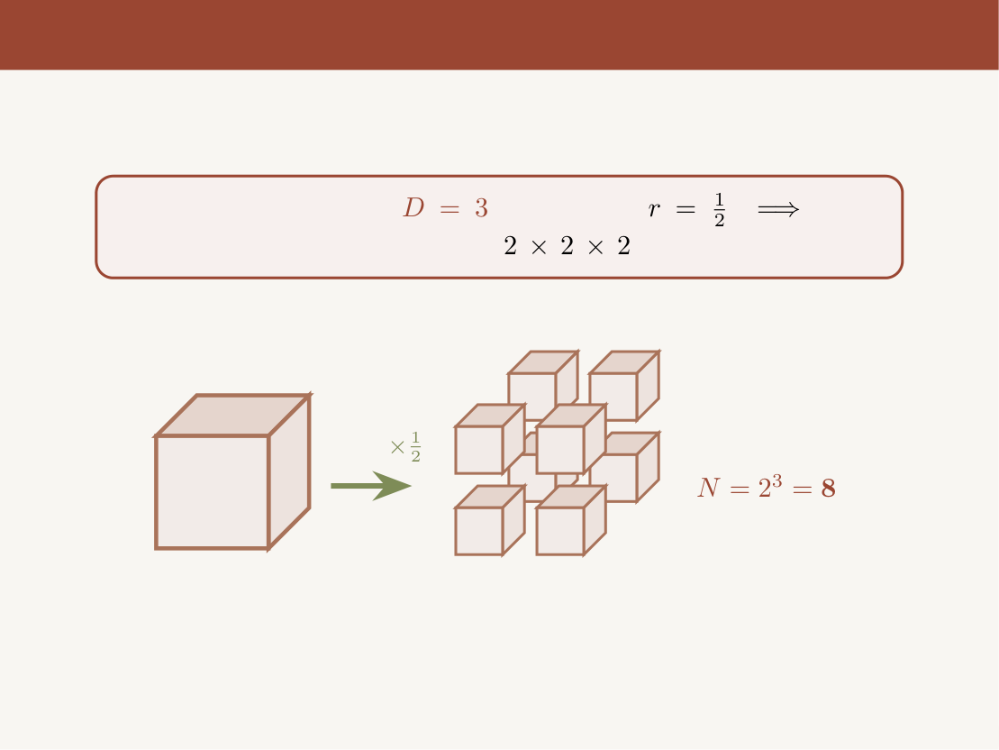
Self-Similarity & Scaling
Scaling a Cube (
):
Scale by
8 self-similar pieces (
grid in 3D).
scale
Original Cube
8 separated cubes
Aditya, Sami, Pritom
Fractals
14 / 31

Slide 52
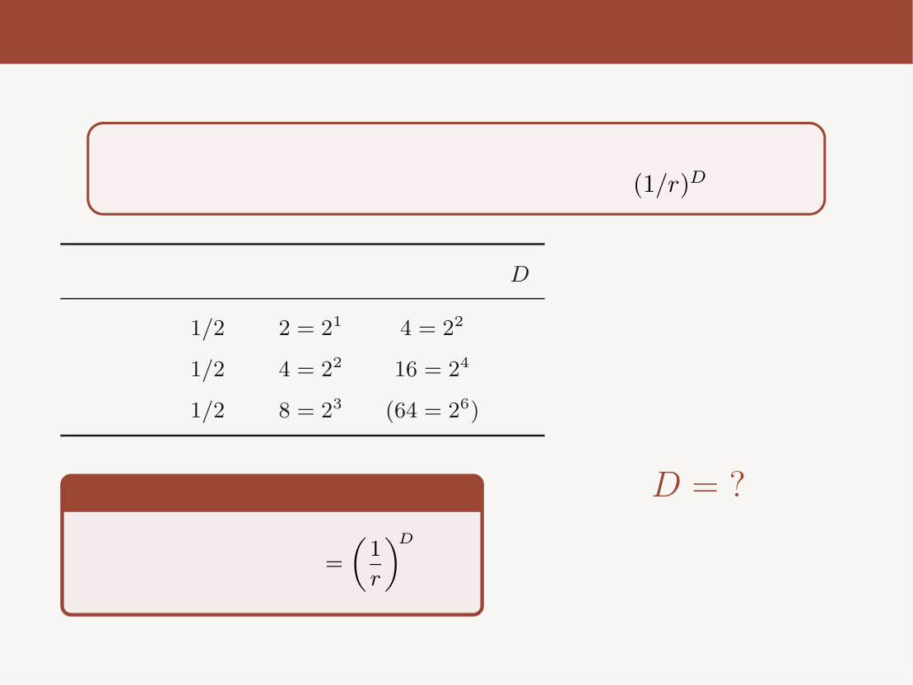
Self-Similarity & Scaling
Do You See a Pattern?
Each scaling step multiplies pieces by
!
Shape
Scale
1st Step
2nd Step
Line
1
Square
2
Cube
3
The Pattern
What if the shape is a fractal?
Number of pieces
Aditya, Sami, Pritom
Fractals
14 / 31

Slide 53
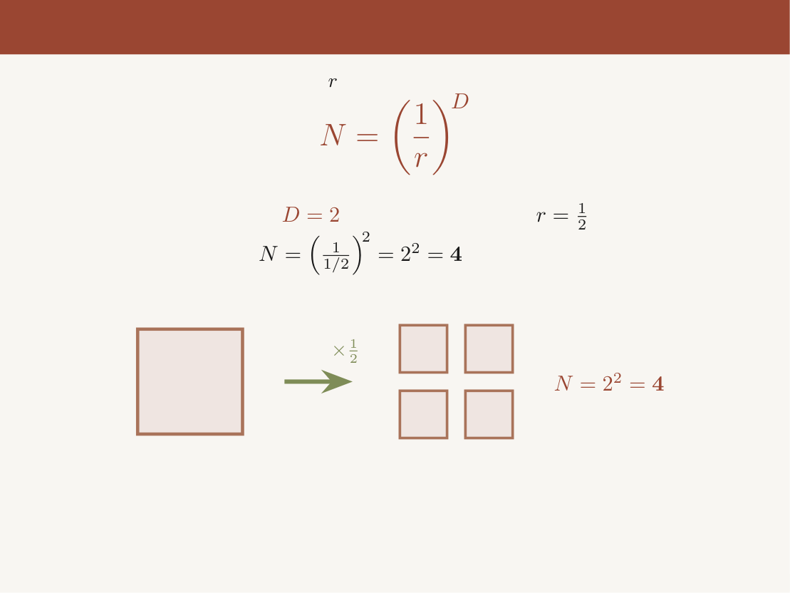
The Self-Similarity Rule
After scaling by factor
, the number of self-similar pieces is:
Square (
)
with scale factor
:
pieces
scale
Original Square
4 separated pieces
Aditya, Sami, Pritom
Fractals
15 / 31

Slide 54
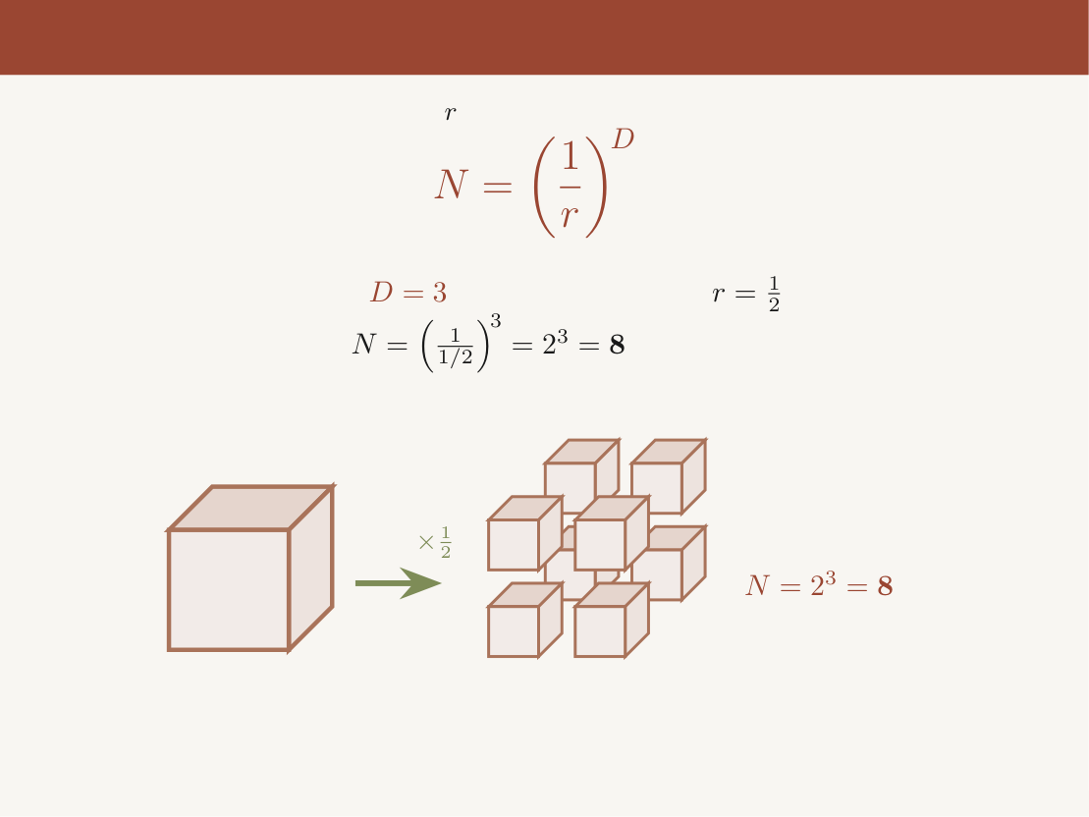
The Self-Similarity Rule
After scaling by factor
, the number of self-similar pieces is:
Cube (
)
with scale factor
:
pieces
scale
Original Cube
8 separated small cubes
Can we use this same rule to find the dimension of a fractal?
Aditya, Sami, Pritom
Fractals
15 / 31

Slide 55
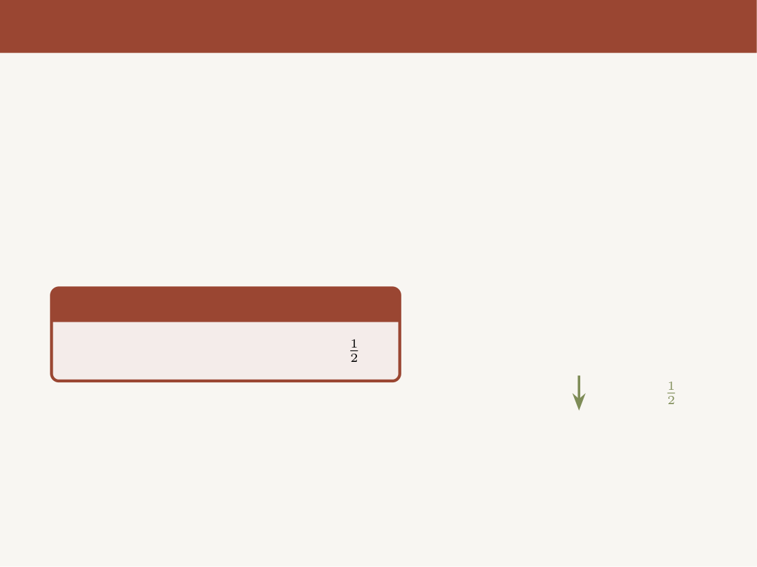
Dimension of the Sierpinski Triangle
Let’s apply the self-similarity rule to the
Sierpinski Triangle.
Step 1
Scale the Sierpinski Triangle by
.
scale by
Aditya, Sami, Pritom
Fractals
16 / 31

Slide 56
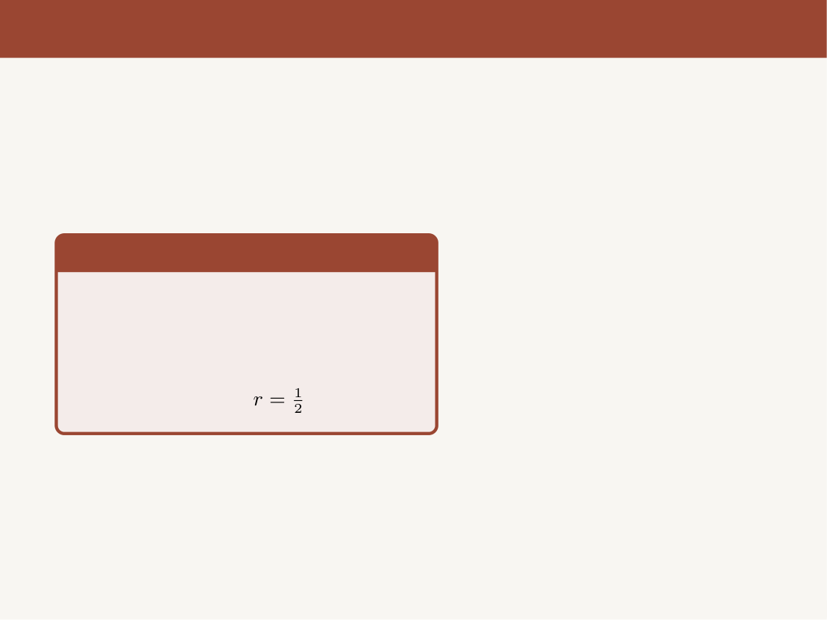
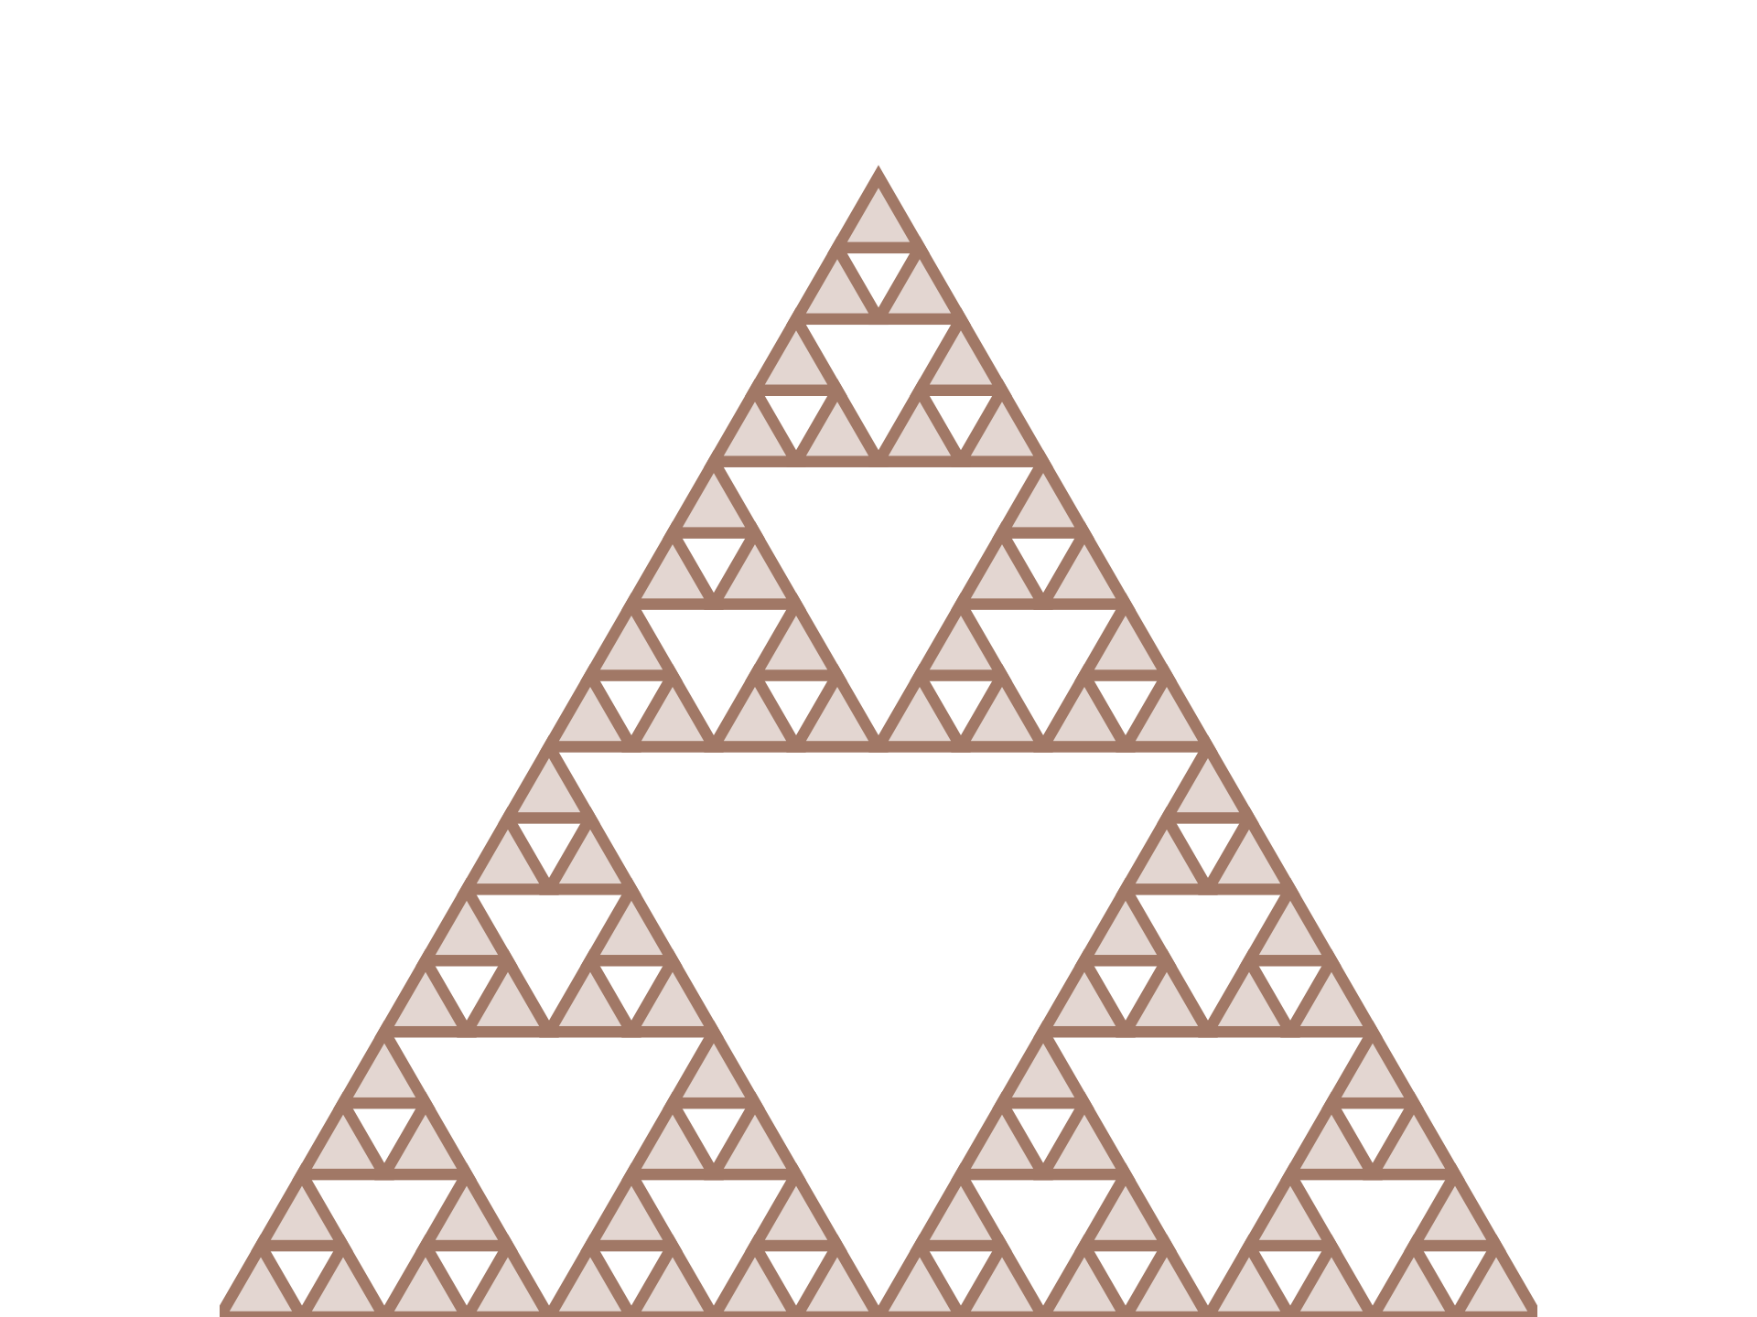
Dimension of the Sierpinski Triangle
Step 2 — Self-Similar Pieces
We get exactly 3 self-similar copies
of the original triangle.
Each smaller triangle is a perfect
replica, scaled by
.
3 copies
Aditya, Sami, Pritom
Fractals
16 / 31

Slide 57
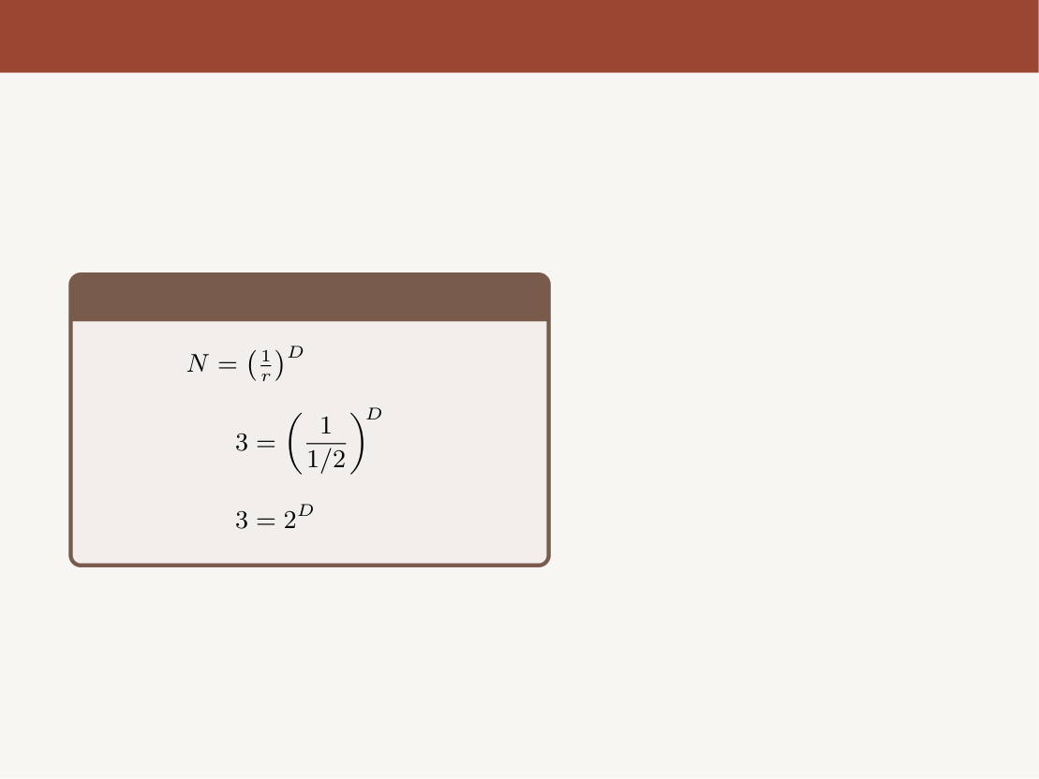
Dimension of the Sierpinski Triangle
Step 3 — The Equation
Using
:
3 copies
Aditya, Sami, Pritom
Fractals
16 / 31

Slide 58
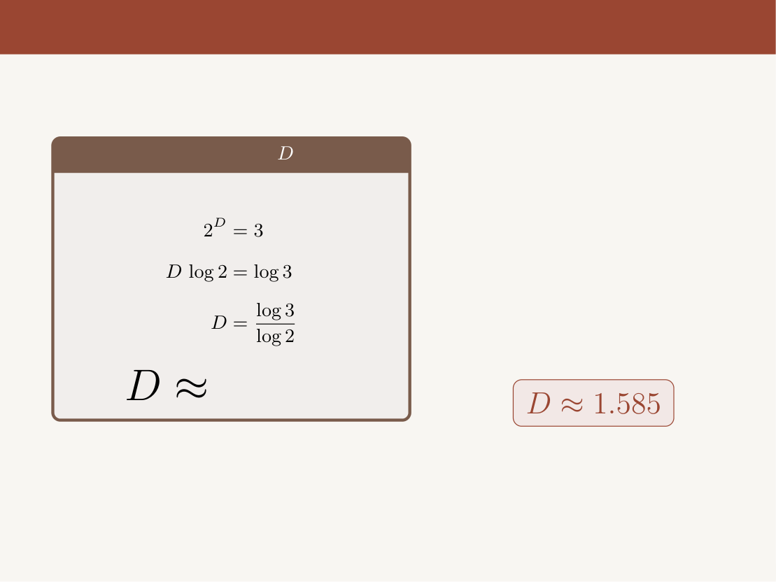
Dimension of the Sierpinski Triangle
Step 4 — Solving for
1.585
Not an integer! — strictly between 1D
(line) and 2D (surface).
Aditya, Sami, Pritom
Fractals
16 / 31

Slide 59
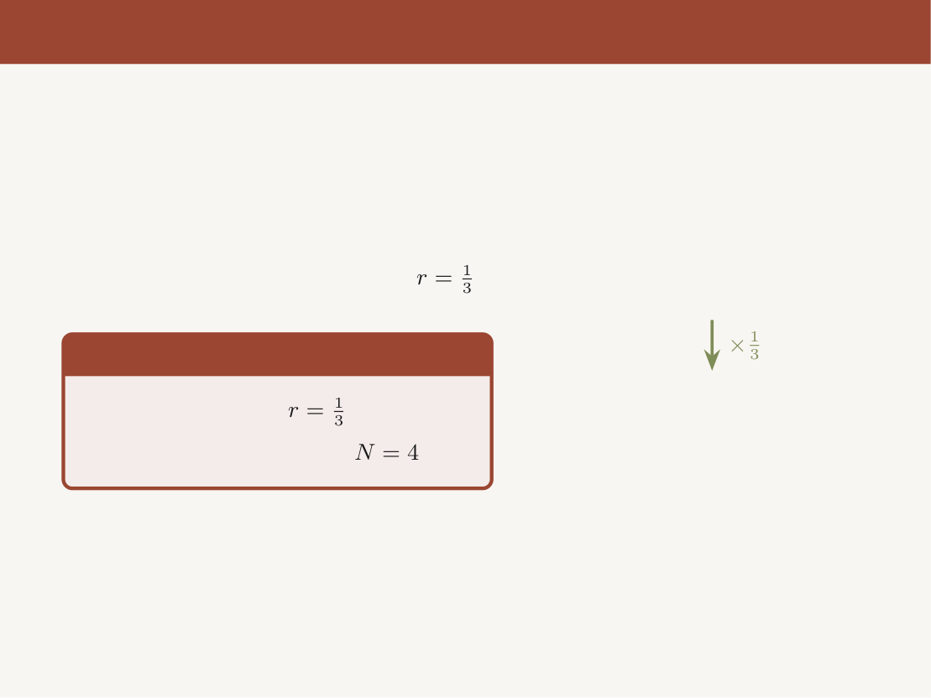
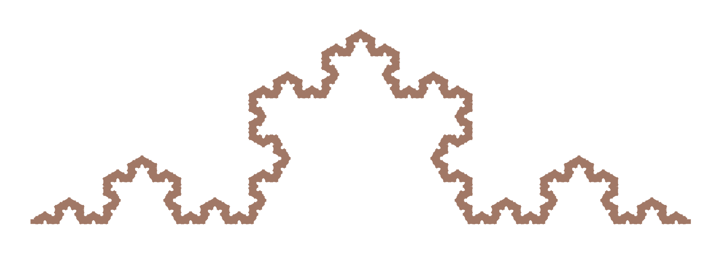
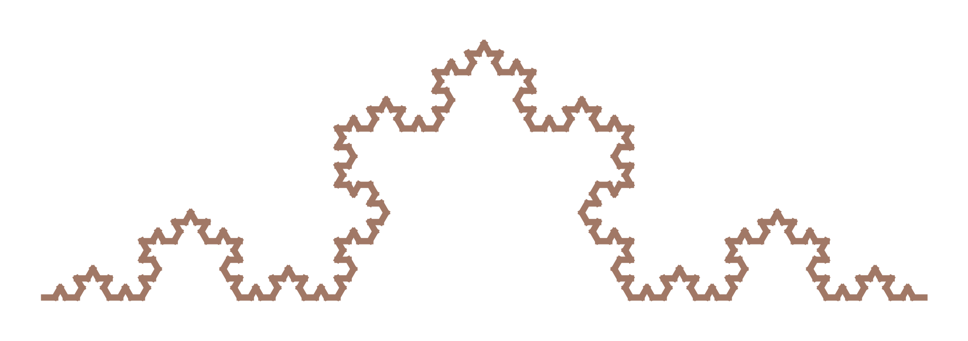
Similarly: The Koch Curve
The Koch Curve can be divided into 4
self-similar pieces, each scaled by
.
Setup
• Scale factor:
• Self-similar pieces:
4 copies
Aditya, Sami, Pritom
Fractals
17 / 31

Slide 60
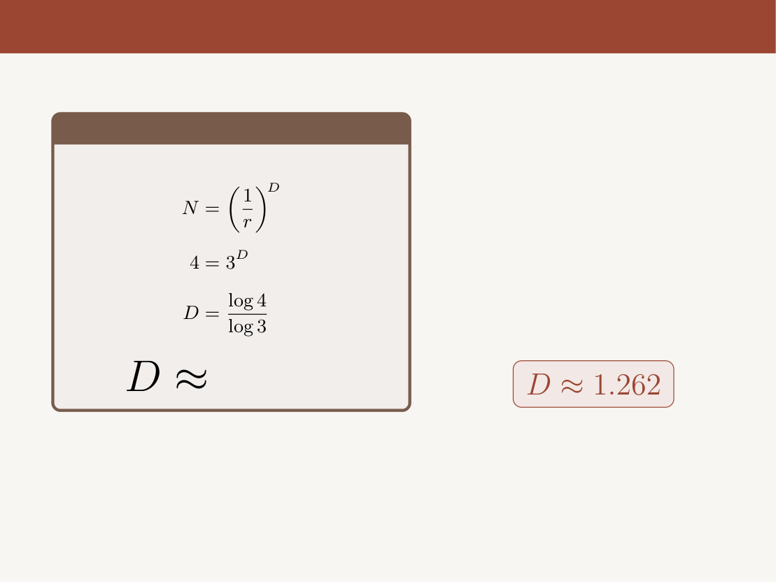
Similarly: The Koch Curve
Koch Dimension
1.262
Also non-integer — between a line (1D)
and a surface (2D), but closer to a line
than the Sierpinski Triangle.
Aditya, Sami, Pritom
Fractals
17 / 31

Slide 61
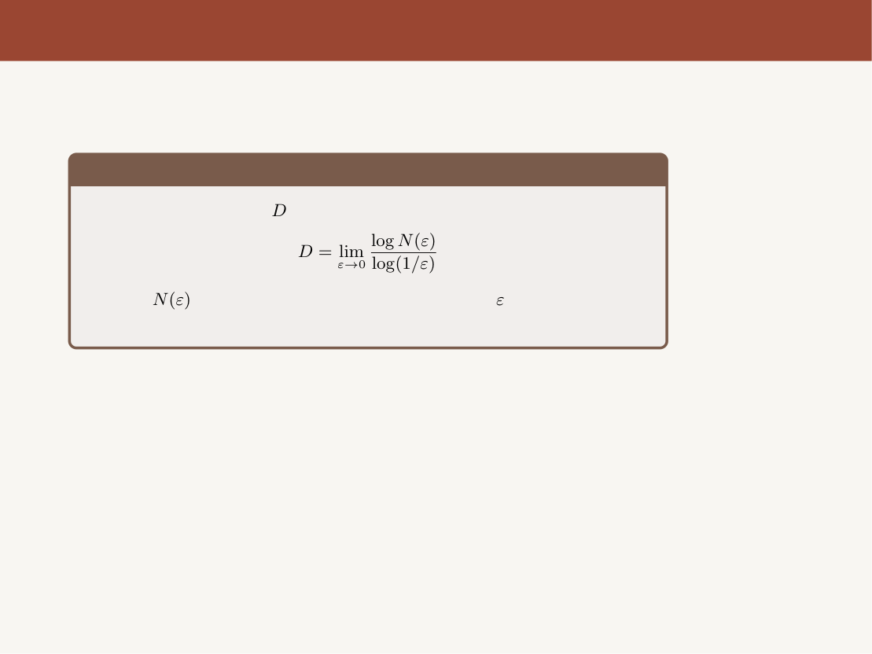
The General Theory: Box-Counting Dimension
The Self-Similarity Dimension works beautifully for self-similar fractals. But
what about more complex shapes?
Box-Counting Dimension
The fractal dimension
is defined as:
where
is the number of boxes of side length
needed to cover
the fractal.
Aditya, Sami, Pritom
Fractals
18 / 31

Slide 62
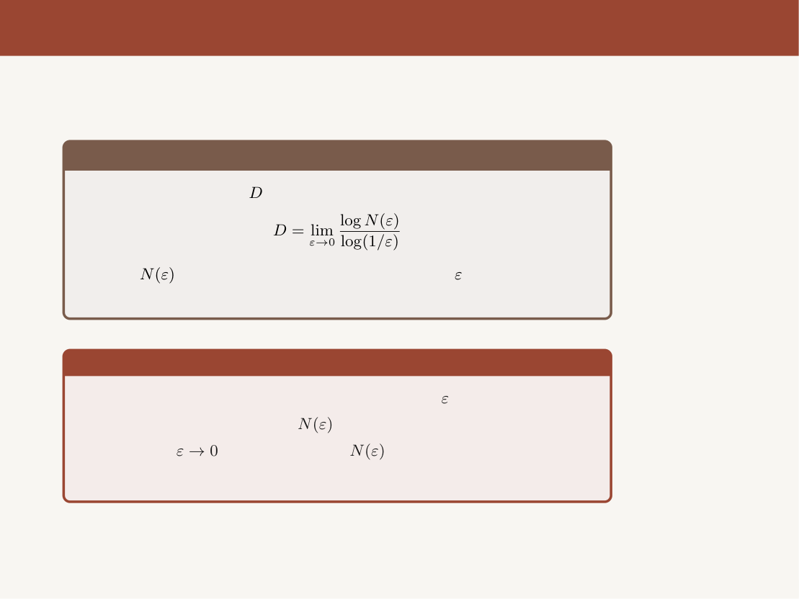
The General Theory: Box-Counting Dimension
The Self-Similarity Dimension works beautifully for self-similar fractals. But
what about more complex shapes?
Box-Counting Dimension
The fractal dimension
is defined as:
where
is the number of boxes of side length
needed to cover
the fractal.
Intuition
• Cover the fractal with a grid of boxes of size
• Count how many boxes
the fractal touches
• Shrink
and observe how
grows
• The rate of growth tells us the dimension
For a deeper dive, see 3Blue1Brown: Fractals are typically not self-similar
Aditya, Sami, Pritom
Fractals
18 / 31

Slide 63
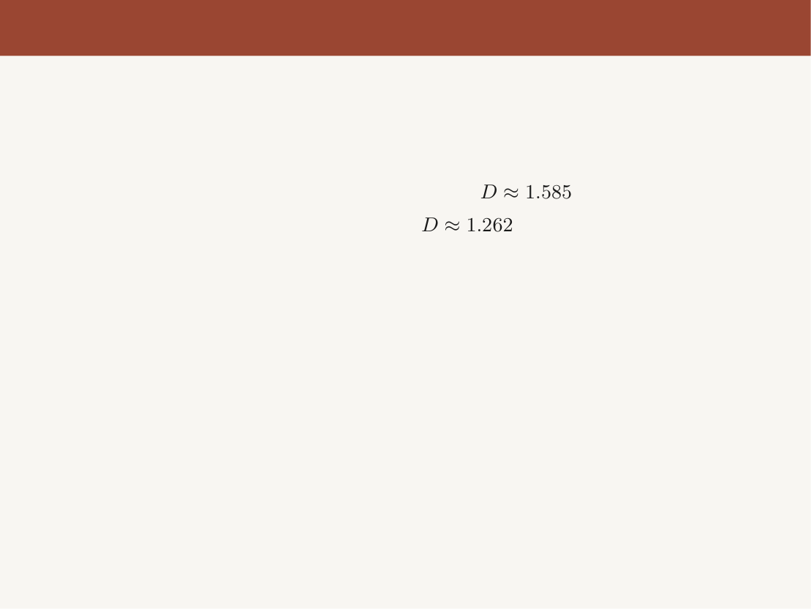
Handoff to Speaker 3
We’ve now uncovered a remarkable property of fractals:
• They have non-integer dimensions — genuinely “between” the familiar
1D, 2D, 3D.
• The Sierpinski Triangle lives in dimension
.
• The Koch Curve lives in dimension
.
• The box-counting dimension generalises this to any shape.
Aditya, Sami, Pritom
Fractals
19 / 31

Slide 64
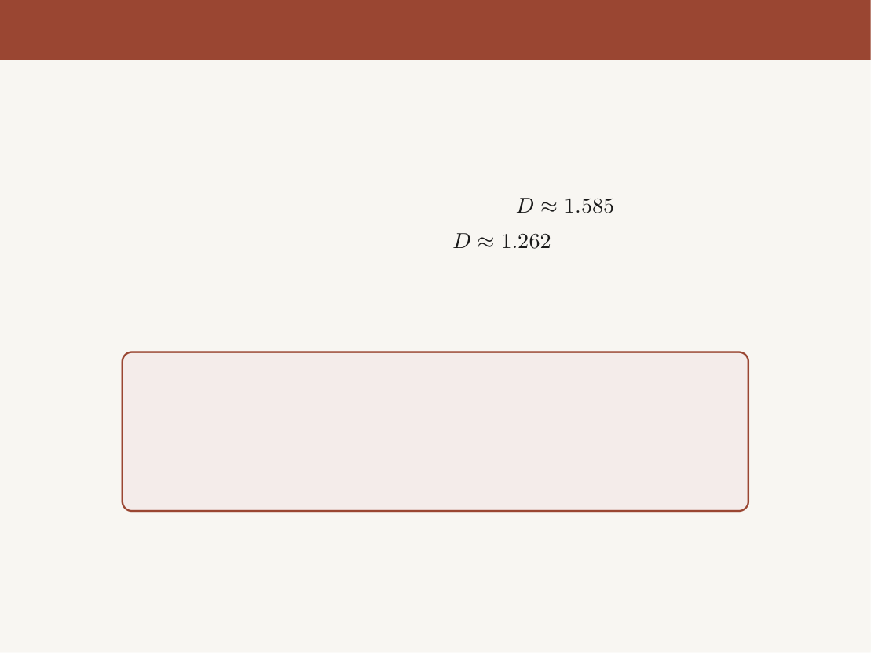
Handoff to Speaker 3
We’ve now uncovered a remarkable property of fractals:
• They have non-integer dimensions — genuinely “between” the familiar
1D, 2D, 3D.
• The Sierpinski Triangle lives in dimension
.
• The Koch Curve lives in dimension
.
• The box-counting dimension generalises this to any shape.
We now know what fractals are and how to measure their
complexity.
But where do we see them? And how are they used in
computer science?
Aditya, Sami, Pritom
Fractals
19 / 31

Slide 65
Handoff to Speaker 3
We’ve now uncovered a remarkable property of fractals:
• They have non-integer dimensions — genuinely “between” the familiar
1D, 2D, 3D.
• The Sierpinski Triangle lives in dimension
.
• The Koch Curve lives in dimension
.
• The box-counting dimension generalises this to any shape.
We now know what fractals are and how to measure their
complexity.
But where do we see them? And how are they used in
computer science?
That’s exactly where Speaker 3 takes us — fractals in nature, art, and
computation.
Aditya, Sami, Pritom
Fractals
19 / 31

Slide 66

Fractals in the Real World

Slide 67
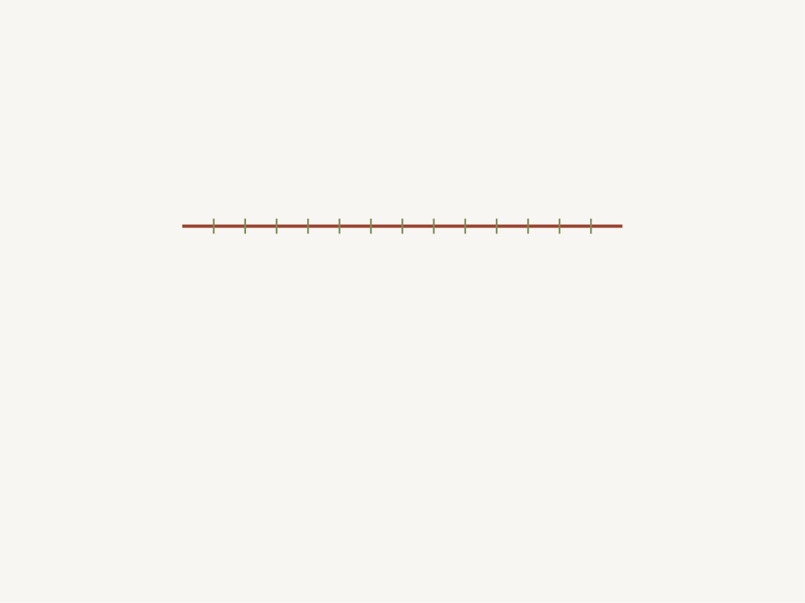
We know what a fractal is, and how to measure it...
Fractals in the Real
World
Where does all of this actually show up?
Aditya, Sami, Pritom
Fractals
20 / 31

Slide 68
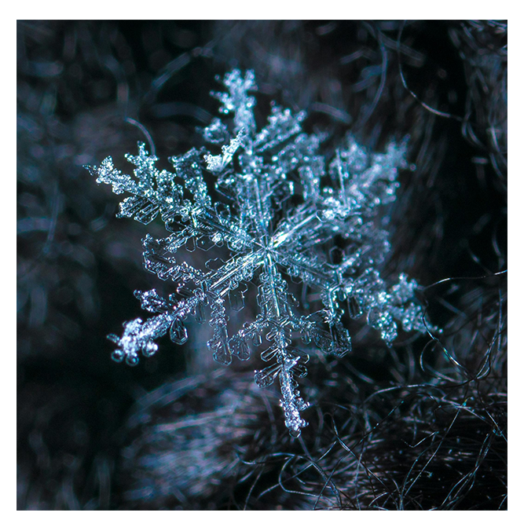
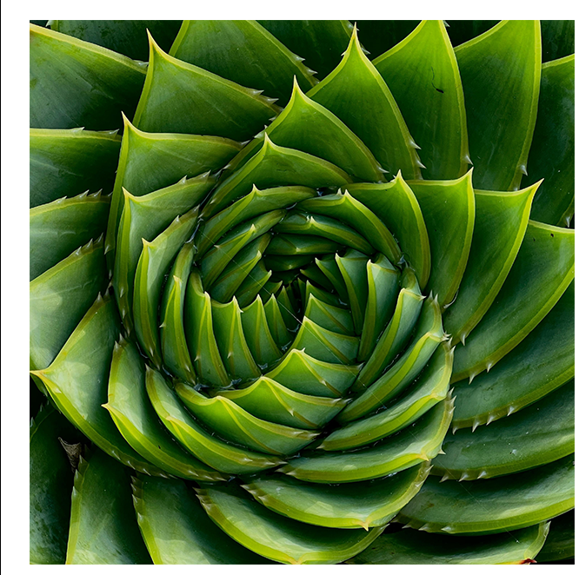
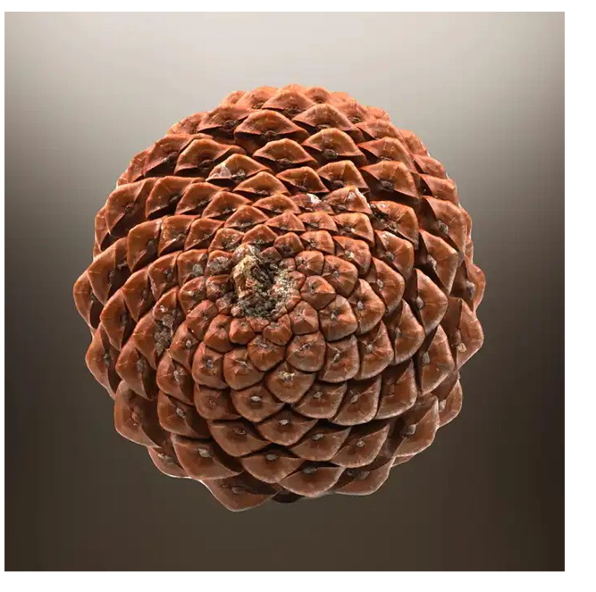

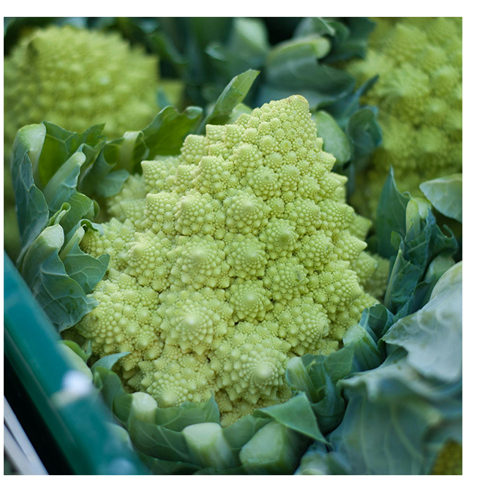
Nature draws with one rule, repeated
Aditya, Sami, Pritom
Fractals
21 / 31

Slide 69
Nature draws with one rule, repeated
Aditya, Sami, Pritom
Fractals
21 / 31

Slide 70
Nature draws with one rule, repeated
Aditya, Sami, Pritom
Fractals
21 / 31

Slide 71
Nature draws with one rule, repeated
Aditya, Sami, Pritom
Fractals
21 / 31

Slide 72

Nature draws with one rule, repeated
Broccoli, ice, leaves, cones — the same shape at every zoom.
Aditya, Sami, Pritom
Fractals
21 / 31

Slide 73
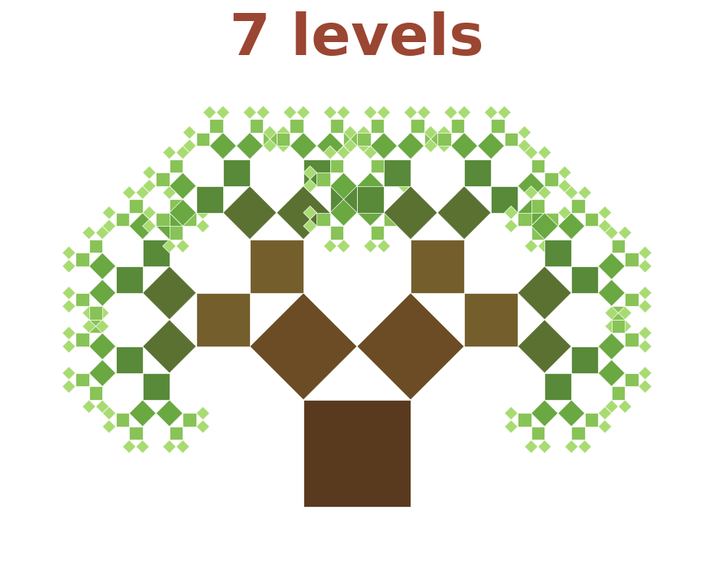
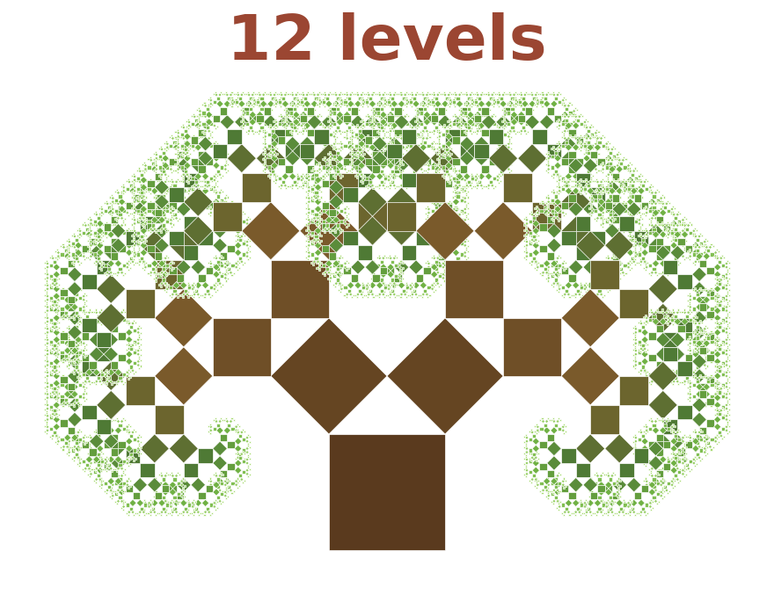

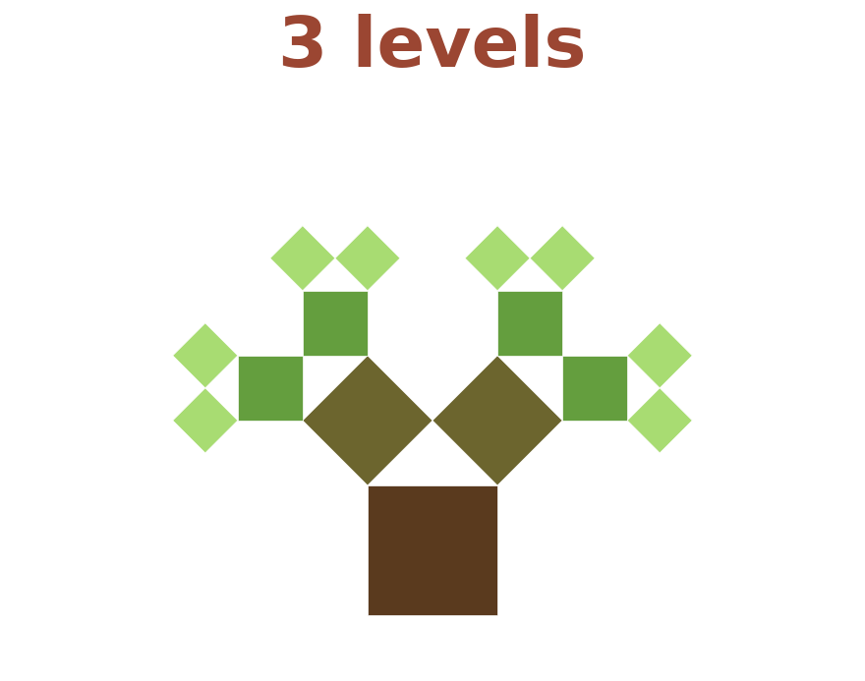
A tree built from nothing but squares
Pythagorean tree, after A. E. Bosman (1942), drawn at
.
Aditya, Sami, Pritom
Fractals
22 / 31

Slide 74
A tree built from nothing but squares
Pythagorean tree, after A. E. Bosman (1942), drawn at
.
Aditya, Sami, Pritom
Fractals
22 / 31

Slide 75

A tree built from nothing but squares
Pythagorean tree, after A. E. Bosman (1942), drawn at
.
Aditya, Sami, Pritom
Fractals
22 / 31

Slide 76
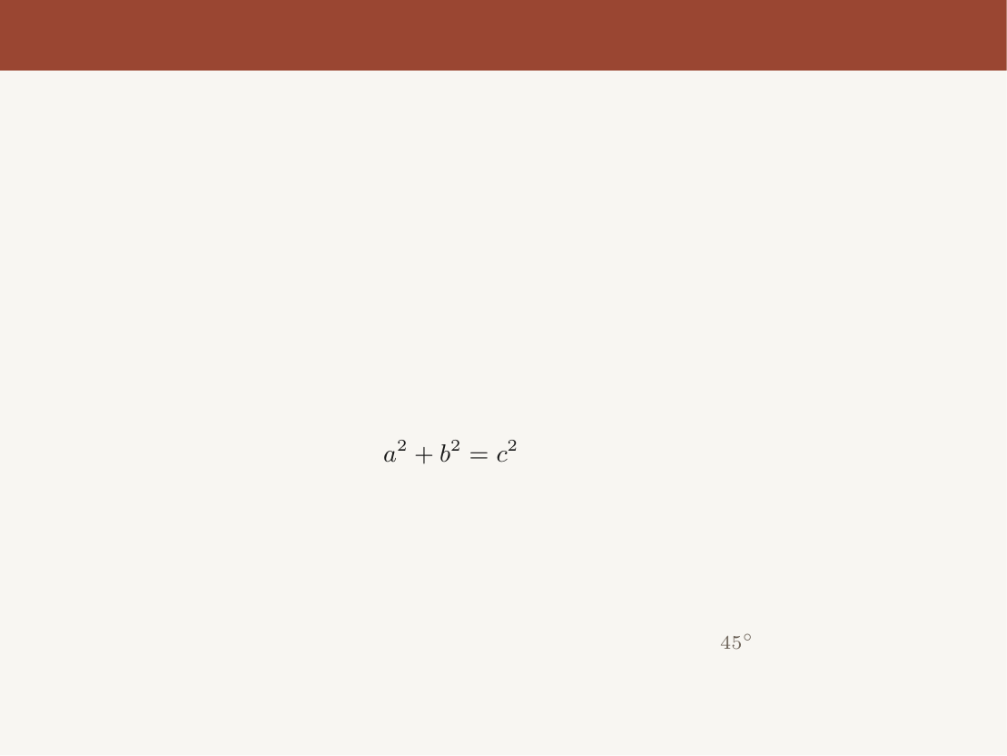
A tree built from nothing but squares
Stand a right triangle on each square’s top edge and grow a new square on
each leg — so
sits at every single joint.
Pythagorean tree, after A. E. Bosman (1942), drawn at
.
Aditya, Sami, Pritom
Fractals
22 / 31

Slide 77
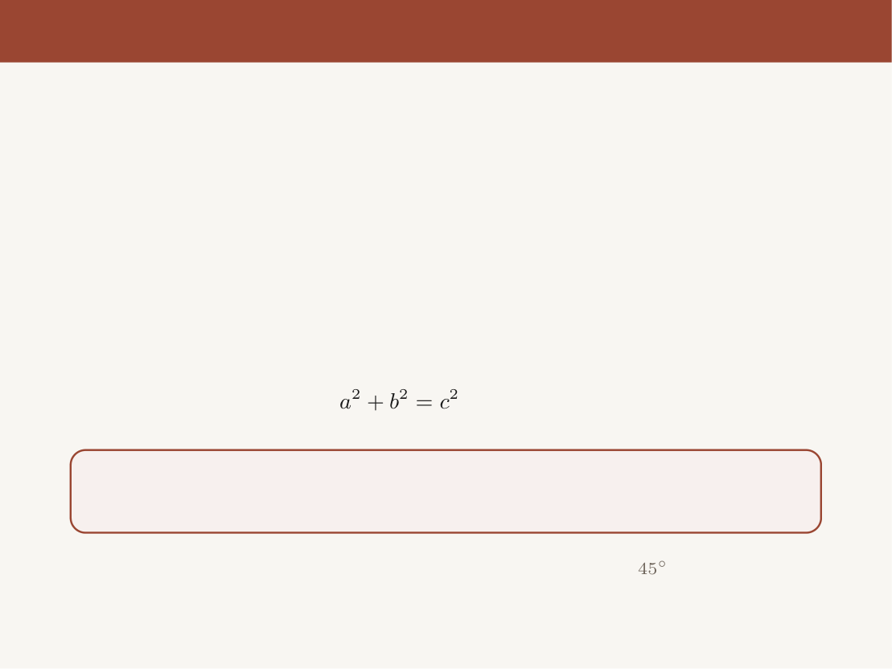
A tree built from nothing but squares
Stand a right triangle on each square’s top edge and grow a new square on
each leg — so
sits at every single joint.
Nobody designed a single branch. One rule, repeated twelve times, and
a tree appears.
Pythagorean tree, after A. E. Bosman (1942), drawn at
.
Aditya, Sami, Pritom
Fractals
22 / 31

Slide 78
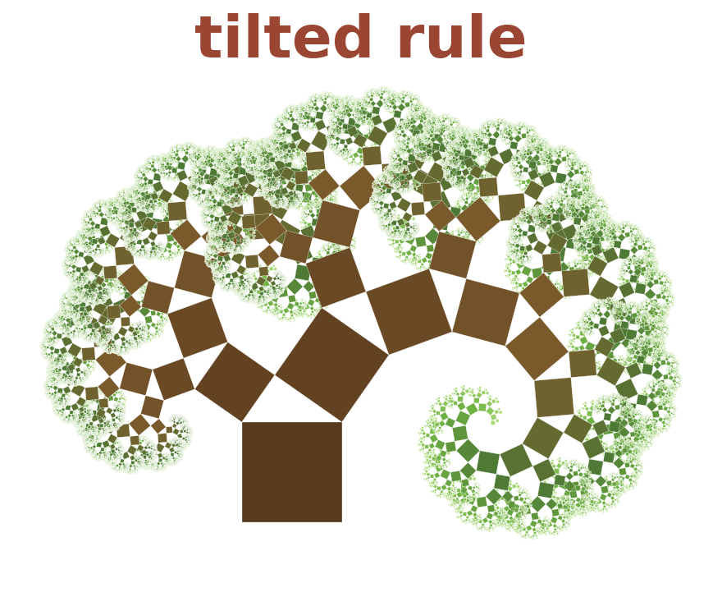
Tilt the rule and it starts to look alive
Aditya, Sami, Pritom
Fractals
23 / 31

Slide 79

Tilt the rule and it starts to look alive
• At
the two branches
match exactly — too
perfect to be real
Aditya, Sami, Pritom
Fractals
23 / 31

Slide 80

Tilt the rule and it starts to look alive
• At
the two branches
match exactly — too
perfect to be real
• Tilt that triangle to
and
they stop matching
Aditya, Sami, Pritom
Fractals
23 / 31

Slide 81
Tilt the rule and it starts to look alive
• At
the two branches
match exactly — too
perfect to be real
• Tilt that triangle to
and
they stop matching
• The tree leans, the way a
real one grows toward the
light
Aditya, Sami, Pritom
Fractals
23 / 31

Slide 82

Tilt the rule and it starts to look alive
• At
the two branches
match exactly — too
perfect to be real
• Tilt that triangle to
and
they stop matching
• The tree leans, the way a
real one grows toward the
light
One number changed —
and a diagram turns into a
plant.
Aditya, Sami, Pritom
Fractals
23 / 31

Slide 83




Branching packs a huge surface into a small space
airways and blood vessels of the lung
vessels in the retina
the same vessels, zoomed in
Lung branching figures: Weibel (1963).
Aditya, Sami, Pritom
Fractals
24 / 31

Slide 84
Branching packs a huge surface into a small space
airways and blood vessels of the lung
vessels in the retina
the same vessels, zoomed in
Lung branching figures: Weibel (1963).
Aditya, Sami, Pritom
Fractals
24 / 31

Slide 85
Branching packs a huge surface into a small space
airways and blood vessels of the lung
vessels in the retina
the same vessels, zoomed in
Lung branching figures: Weibel (1963).
Aditya, Sami, Pritom
Fractals
24 / 31

Slide 86

Branching packs a huge surface into a small space
airways and blood vessels of the lung
vessels in the retina
the same vessels, zoomed in
• Lungs: about 23 splits
70 m
of surface packed inside
5 litres
Lung branching figures: Weibel (1963).
Aditya, Sami, Pritom
Fractals
24 / 31

Slide 87
Branching packs a huge surface into a small space
airways and blood vessels of the lung
vessels in the retina
the same vessels, zoomed in
• Lungs: about 23 splits
70 m
of surface packed inside
5 litres
• Doctors track the dimension of retinal vessels to spot disease early
Lung branching figures: Weibel (1963).
Aditya, Sami, Pritom
Fractals
24 / 31

Slide 88

Branching packs a huge surface into a small space
airways and blood vessels of the lung
vessels in the retina
the same vessels, zoomed in
• Lungs: about 23 splits
70 m
of surface packed inside
5 litres
• Doctors track the dimension of retinal vessels to spot disease early
Branching again and again is nature’s cheapest way to get area out of
volume.
Lung branching figures: Weibel (1963).
Aditya, Sami, Pritom
Fractals
24 / 31

Slide 89

Fractal compression: a whole plant in 28 numbers
Barnsley fern: an iterated function system (Barnsley, Fractals Everywhere, 1988), plotted by the
chaos game.
Aditya, Sami, Pritom
Fractals
26 / 31

Slide 90

Fractal compression: a whole plant in 28 numbers
• Four rules, each a shrink-and-tilt of
the whole picture, applied at random
Barnsley fern: an iterated function system (Barnsley, Fractals Everywhere, 1988), plotted by the
chaos game.
Aditya, Sami, Pritom
Fractals
26 / 31

Slide 91


Fractal compression: a whole plant in 28 numbers
• Four rules, each a shrink-and-tilt of
the whole picture, applied at random
•
coefficients
4 probabilities
28
numbers
Barnsley fern: an iterated function system (Barnsley, Fractals Everywhere, 1988), plotted by the
chaos game.
Aditya, Sami, Pritom
Fractals
26 / 31

Slide 92
Fractal compression: a whole plant in 28 numbers
• Four rules, each a shrink-and-tilt of
the whole picture, applied at random
•
coefficients
4 probabilities
28
numbers
• Those 28 numbers redraw the fern at
any resolution — zoom in, there is
always more leaf
Barnsley fern: an iterated function system (Barnsley, Fractals Everywhere, 1988), plotted by the
chaos game.
Aditya, Sami, Pritom
Fractals
26 / 31

Slide 93

Fractal compression: a whole plant in 28 numbers
• Four rules, each a shrink-and-tilt of
the whole picture, applied at random
•
coefficients
4 probabilities
28
numbers
• Those 28 numbers redraw the fern at
any resolution — zoom in, there is
always more leaf
Store the rule, not the pixels — the idea
behind fractal image compression.
Barnsley fern: an iterated function system (Barnsley, Fractals Everywhere, 1988), plotted by the
chaos game.
Aditya, Sami, Pritom
Fractals
26 / 31

Slide 94



Game worlds are grown from a rule, not stored
Terrain generated here by summing 7 layers of noise, each half the size of the last (fractal Brownian
motion).
Aditya, Sami, Pritom
Fractals
27 / 31

Slide 95
Game worlds are grown from a rule, not stored
Terrain generated here by summing 7 layers of noise, each half the size of the last (fractal Brownian
motion).
Aditya, Sami, Pritom
Fractals
27 / 31

Slide 96
Game worlds are grown from a rule, not stored
Terrain generated here by summing 7 layers of noise, each half the size of the last (fractal Brownian
motion).
Aditya, Sami, Pritom
Fractals
27 / 31

Slide 97

Game worlds are grown from a rule, not stored
Add smaller bumps at every scale — the Koch idea — and a handful
of numbers becomes an endless mountain range. Store the rule, not the
map.
Terrain generated here by summing 7 layers of noise, each half the size of the last (fractal Brownian
motion).
Aditya, Sami, Pritom
Fractals
27 / 31

Slide 98


Keep stacking layers and you get a world
15 layers of value noise, each half the width and
the height of the one before.
Aditya, Sami, Pritom
Fractals
28 / 31

Slide 99

Keep stacking layers and you get a world
Same rule, 15 layers instead of 7 — ridges, valleys, snow lines and lakes.
Not one of them was drawn by hand.
15 layers of value noise, each half the width and
the height of the one before.
Aditya, Sami, Pritom
Fractals
28 / 31

Slide 100
One honest catch: real fractals stop
• A fern looks like a fern ... until you reach a single cell
Aditya, Sami, Pritom
Fractals
29 / 31

Slide 101
One honest catch: real fractals stop
• A fern looks like a fern ... until you reach a single cell
• Lungs stop branching after about 23 splits
Aditya, Sami, Pritom
Fractals
29 / 31

Slide 102
One honest catch: real fractals stop
• A fern looks like a fern ... until you reach a single cell
• Lungs stop branching after about 23 splits
• A tree runs out at the last twig
Aditya, Sami, Pritom
Fractals
29 / 31

Slide 103
One honest catch: real fractals stop
• A fern looks like a fern ... until you reach a single cell
• Lungs stop branching after about 23 splits
• A tree runs out at the last twig
• Only the mathematical ones — Sierpinski, Koch — go
on forever
Aditya, Sami, Pritom
Fractals
29 / 31

Slide 104

One honest catch: real fractals stop
• A fern looks like a fern ... until you reach a single cell
• Lungs stop branching after about 23 splits
• A tree runs out at the last twig
• Only the mathematical ones — Sierpinski, Koch — go
on forever
A fractal is a model of nature — and every good model knows the range
where it works.
Aditya, Sami, Pritom
Fractals
29 / 31

Slide 105

One rule, repeated, explains what smooth geometry
couldn’t
Part 1 — the surprise
zero area,
infinite edge
Aditya, Sami, Pritom
Fractals
30 / 31

Slide 106

One rule, repeated, explains what smooth geometry
couldn’t
Part 1 — the surprise
Part 2 — the number
zero area,
infinite edge
Sierpinski
Koch
Aditya, Sami, Pritom
Fractals
30 / 31

Slide 107
One rule, repeated, explains what smooth geometry
couldn’t
Part 1 — the surprise
Part 2 — the number
Part 3 — the world
zero area,
trees, lungs, ferns,
infinite edge
Sierpinski
game worlds
Koch
Aditya, Sami, Pritom
Fractals
30 / 31

Slide 108

One rule, repeated, explains what smooth geometry
couldn’t
Part 1 — the surprise
Part 2 — the number
Part 3 — the world
zero area,
trees, lungs, ferns,
infinite edge
Sierpinski
game worlds
Koch
“Clouds are not spheres, mountains are not cones,
coastlines are not circles...” — Mandelbrot
Roughness has a number, and simple rules make it.
Aditya, Sami, Pritom
Fractals
30 / 31

Slide 109
One rule, repeated, explains what smooth geometry
couldn’t
Part 1 — the surprise
Part 2 — the number
Part 3 — the world
zero area,
trees, lungs, ferns,
infinite edge
Sierpinski
game worlds
Koch
“Clouds are not spheres, mountains are not cones,
coastlines are not circles...” — Mandelbrot
Roughness has a number, and simple rules make it.
Thank you — questions welcome.
Aditya, Sami, Pritom
Fractals
30 / 31

Slide 110
References
• B. Mandelbrot, “How long is the coast of Britain? Statistical self-similarity and
fractional dimension,” Science, 1967.
• B. Mandelbrot, The Fractal Geometry of Nature, 1982.
• E. R. Weibel, Morphometry of the Human Lung, Springer, 1963.
• M. F. Barnsley, Fractals Everywhere, Academic Press, 1988 (iterated function
systems, the fern).
• A. E. Bosman, Het wondere onderzoekingsveld van de vlakke meetkunde, 1957
(Pythagorean tree, drawn 1942).
• A. Fournier, D. Fussell, L. Carpenter, “Computer rendering of stochastic models,”
Comm. ACM, 1982 (fractal terrain).
• 3Blue1Brown, “Fractals are typically not self-similar” (video).
Aditya, Sami, Pritom
Fractals
31 / 31

