Slide 1
Executable Universal Composability with Effect Handlers
Markulf Kohlweiss¹, Sam Lindley¹, Sabine Oechsner², Jesse Sigal¹
¹University of Edinburgh, ²Vrije Universiteit Amsterdam

Slide 2
Outline
Universal Composability (UC)
Expressing UC protocols
UC in more detail
Secure from authenticated channel example
Conclusion and further work

Slide 3
Universal Composability
What? Why? How?

Slide 4
Universal Composability
What?
Why?
How?
Provable security
Composable security proofs
Low-level, e.g. Turing machines or transition functions
Specifications are integral to implementations and proofs
A formal system
(De)composition
Model of computation
Four kinds of entities
Prescribed interaction
Security as indistinguishability
Our aim: expressive and executable UC
Notes:
Emphasize that UC is about proving security.
Say at the outset that we're focussing on implementation and not proving (for now).

Slide 5
Expressing UC protocols
Mind the gap!
Notes:
Who has heard of UC? Who has seen a UC proof? Who has written a UC proof? Who has written a UC with ITMs?

Slide 6
Level of abstraction
On the downside, we note that the ITM model, or “programming language” provides only a relatively low level abstraction of computer programs and protocols. In contrast, current literature describes protocols in a much higher-level (and often informal) language
- Canetti
“Universally Composable Security: A New Paradigm for Cryptographic Protocol”, Canetti (2020)

Slide 7
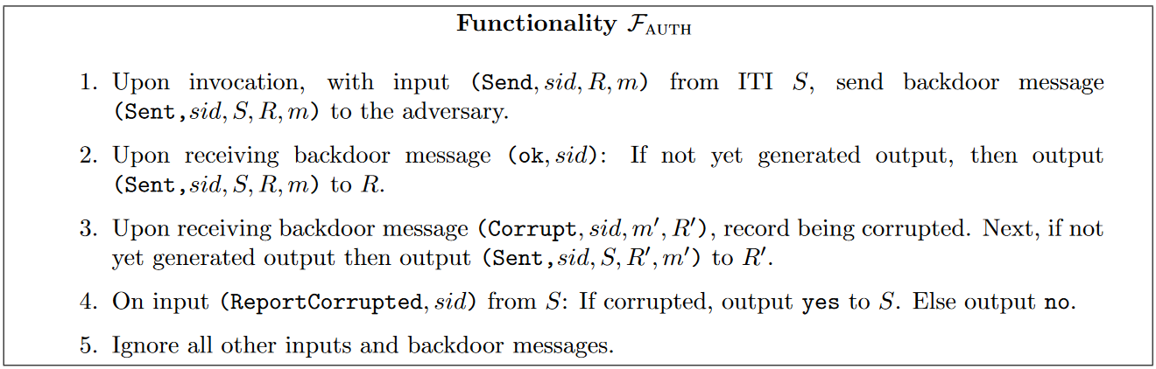
Example informal description
“Universally Composable Security: A New Paradigm for Cryptographic Protocol”, Canetti (2020)

Slide 8
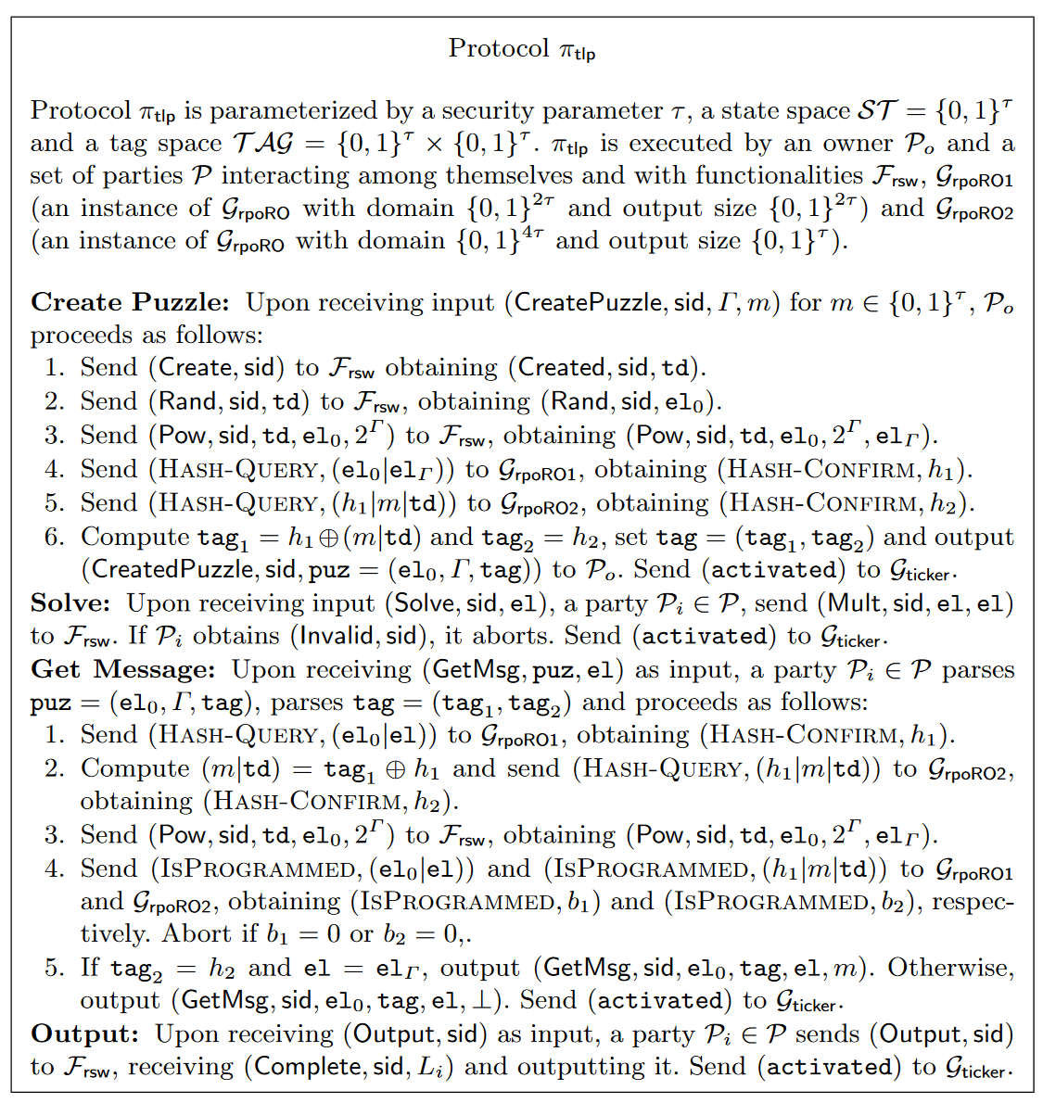
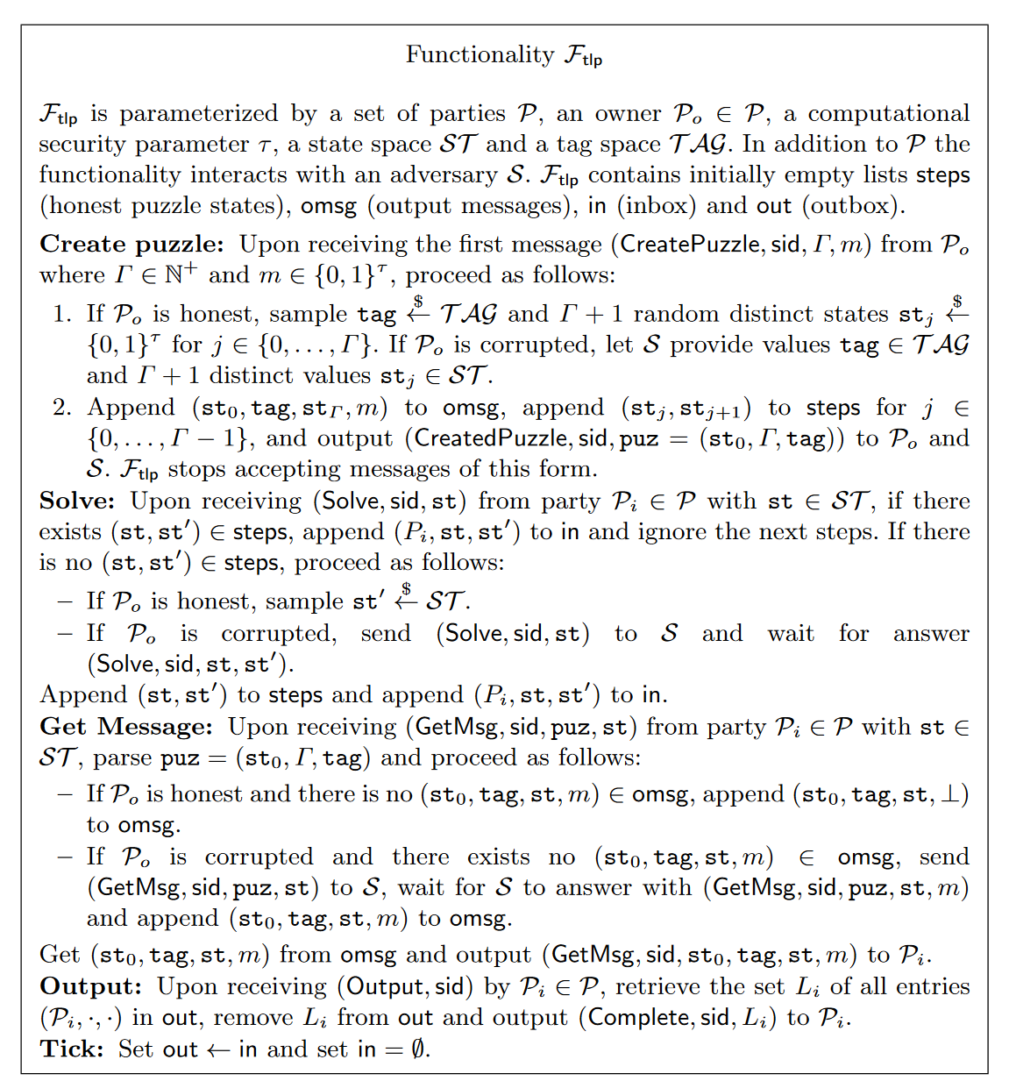
Extract from larger example
“TARDIS: A Foundation of Time-Lock Puzzles in UC”, Baum, David, Dowsley, Nielsen, Oechsner (2021)

Slide 9
Goal: a useful middle ground
Plan in progress
On paper
Code
Testing
Verification
Solution
Benefits
Use a high-level formal language expressive enough for UC
Even better, a programming language
Don’t aim for proofs, just execution
Precision Experimentation
Testing Reuse existing entities
Debugging Program verification?

Slide 10
Relevance to proofs
Precision is necessary for proofs
Experimentation, debugging, and testing are fundamental in the creation of entities as well as the process of proving
Reusing the work of others lowers the burden
Variants of UC are easy to explore; different meta-theories
By phrasing UC as programs, potential for UC as program verification

Slide 11
Why effect handlers?
UC needs randomness, state, and messaging
UC prescribes a form of cooperative concurrency
Effect handlers are powerful enough to express all of these in a unified way
But the end user need not use them directly!
Notes:
The user also doesn't need to worry about how state and sampling are implemented.

Slide 12
Benefits of effect handlers
Dynamic
Compositional
Different random sampling distributions or even complete enumeration
Replace randomness with deterministic pseudo-random for testing
Replace randomness with list of samples for low probability events
Configurable levels of behaviour observation
All with one implementation
UC variations are simple
One entity in many UC variations
Composition of UC entities from composition of effect handlers
Notes:
Future tools to help look at behaviour and traces, for example opting into certain information at the top level after only writing one implementation

Slide 13
Universal Composability
In more detail

Slide 14
Model of computation
Interactive Turing machines (Canetti): Turing machines with multiple tapes, some readable and writeable from other machines, some read only. Original definition.
Interactive agents (CDN): Based on probabilistic transition functions. Take an input state and activation point, return an output state and command. Variation.
“Universally Composable Security: A New Paradigm for Cryptographic Protocol”, Canetti (2001, 2020)
“Secure Multiparty Computation and Secret Sharing”, Cramer, Damgård, Nielsen (2015)

Slide 15
Four kinds of entities
Resources (ideal functionalities): ideal description of a (communication) protocol
Parties (form a protocol): agents using a resources to make a new resource
Simulators: technical feature to phrase security
Environments: adversary which can interact with and observe the system
“Secure Multiparty Computation and Secret Sharing”, Cramer, Damgård, Nielsen (2015)

Slide 16
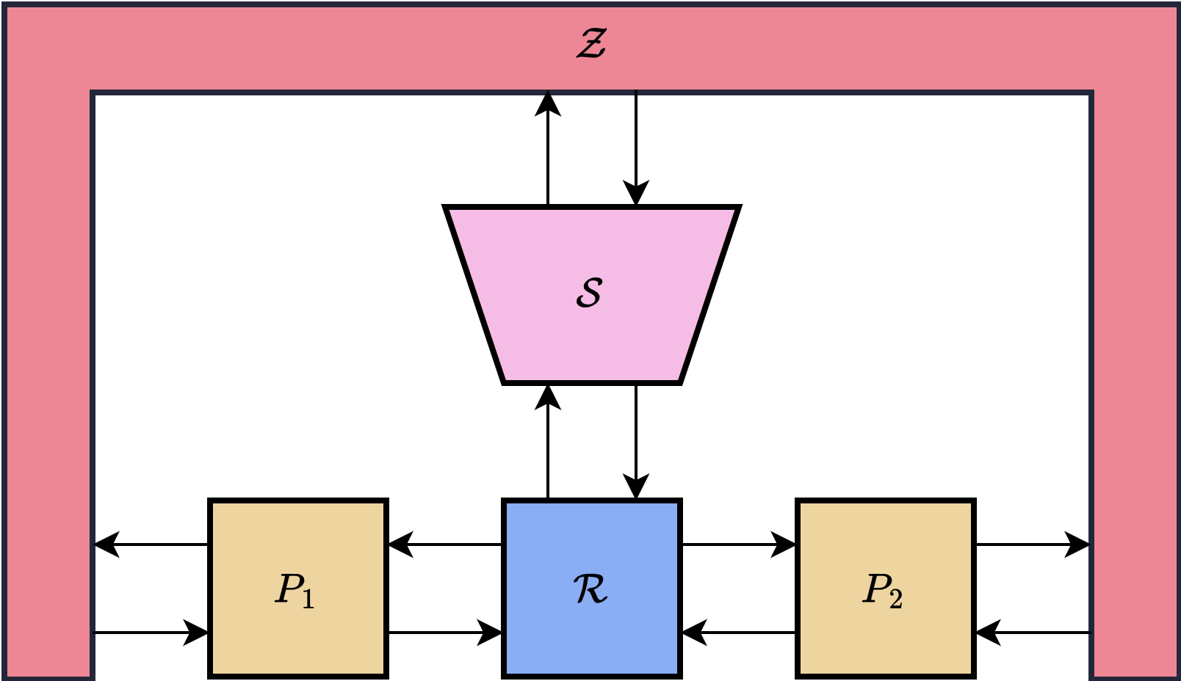
Prescribed interaction
Fixed
Composition
Concurrency
Message passing
“Secure Multiparty Computation and Secret Sharing”, Cramer, Damgård, Nielsen (2015)

Slide 17
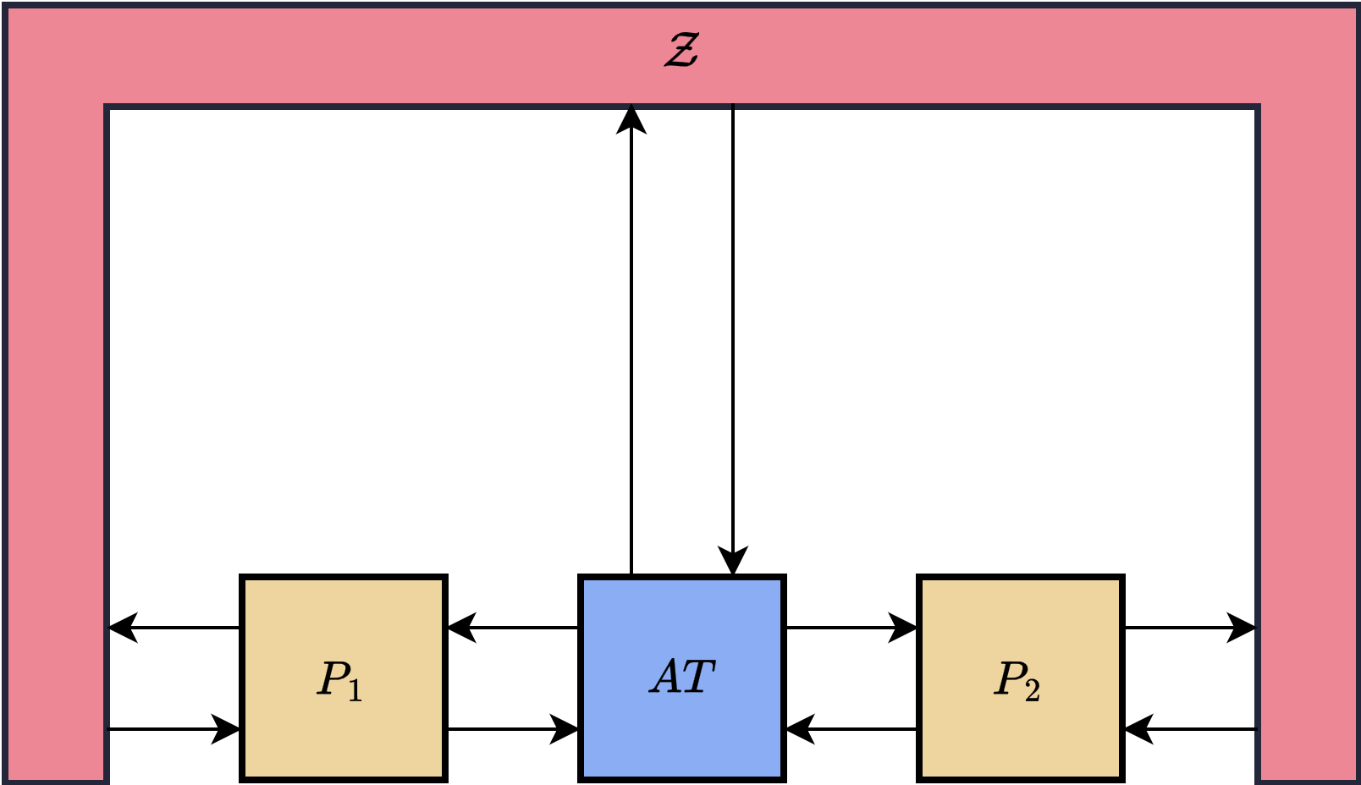
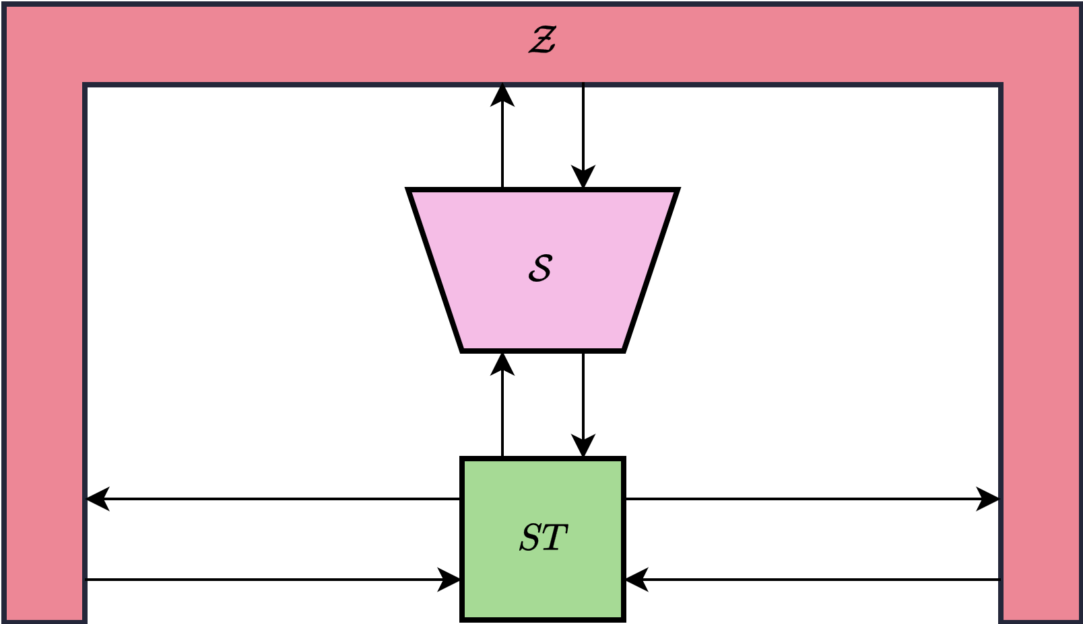
Security as indistinguishability
“Secure Multiparty Computation and Secret Sharing”, Cramer, Damgård, Nielsen (2015)

Slide 18
Secure from authenticated channel
A simple example

Slide 19
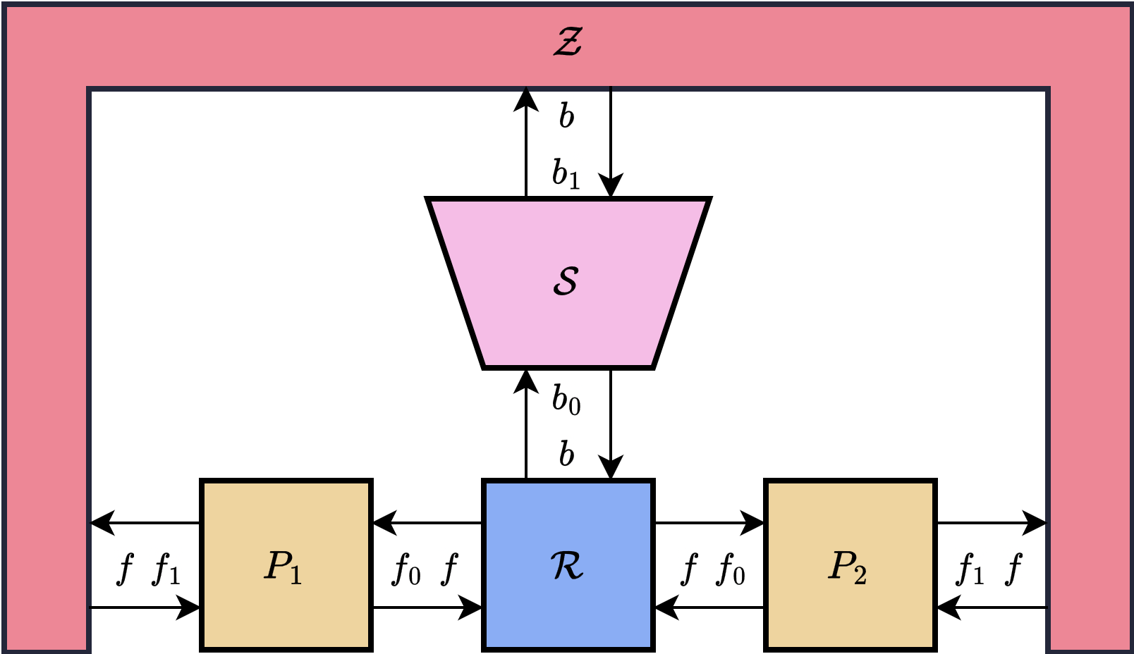
Framework: the entities
resource<f,b,e>
party<f0,f1,e>
protocol<f0,f1,e>
simulator<b0,b1,e>
environment<f,b,e>

Slide 20
Framework: combining entities
fun create-protocol(
pars : list<party<f0,f1,e>>
) : protocol<f0,f1,e>
fun using-resource(
pro : protocol<f0,f1,e>, res : resource<f0,b,e>
) : <error> resource<f1,b,e>
fun applying-simulator(
res : resource<f,b0,e>, sim : simulator<b0,b1,e>
) : <error> resource<f,b1,e>
fun in-environment(
res : resource<f,b,e>, env : environment<f,b,e>
) : <distinguish,error,div|e> void

Slide 21
User: Secure from authenticated
val resource-st : resource<st-func,st-back,<console>>
val resource-at : resource<at-func,at-back,<console>>
val party-one : party<at-func,st-func,<console>>
val party-two : party<at-func,st-func,<console>>
val protocol : protocol<at-func,st-func,<console>> =
create-protocol([party-one, party-two])
val simulator : simulator<st-back,at-back,<console>>
val environment : environment<st-func,at-back,<console>>
protocol
.using-resource(resource-at)
.in-environment(environment)
resource-st
.applying-simulator(simulator)
.in-environment(environment)
Note we wrote a concrete environment!

Slide 22
Executions
AT and protocol
En: started
P1: activated on func port: STInOne
AT: activated on func port: ATInOne
En: activated on leak port: ATLeak
AT: activated on leak port: ATInfl
P2: activated on res port: ATOutTwo
AT: activated on func port: ATInTwo
En: activated on leak port: ATLeak
AT: activated on leak port: ATInfl
P1: activated on res port: ATOutOne
AT: activated on func port: ATInOne
En: activated on leak port: ATLeak
AT: activated on leak port: ATInfl
P2: activated on res port: ATOutTwo
En: activated on func port: STOutTwo

Slide 23
Executions
ST and simulator
En: started
ST: activated on func port: STInOne
Sm: activated on infl port: STLeak
En: activated on leak port: ATLeak
Sm: activated on leak port: ATInfl
En: activated on leak port: ATLeak
Sm: activated on leak port: ATInfl
En: activated on leak port: ATLeak
Sm: activated on leak port: ATInfl
ST: activated on leak port: STInfl
En: activated on func port: STOutTwo

Slide 24
Environment view
AT and protocol
ST and simulator
En: started En: sending message: STIn(MID(1), PID(2), Msg(test)) En: activated on leak port: ATLeak En: got leak: ATLeak(MID(1), PID(1), PID(2), Msg(HELLO)) En: instructing delivery with: ATInfl(MID(1), PID(1), PID(2)) En: activated on leak port: ATLeak En: got leak: ATLeak(MID(1), PID(2), PID(1), Msg(REAL-KEY)) En: instructing delivery with: ATInfl(MID(1), PID(2), PID(1)) En: activated on leak port: ATLeak En: got leak: ATLeak(MID(1), PID(1), PID(2), Msg(REAL-KEYtest)) En: instructing delivery with: ATInfl(MID(1), PID(1), PID(2)) En: activated on func port: STOutTwo En: got message id: STOut(MID(1), PID(1), Msg(test))
En: started En: sending message: STIn(MID(1), PID(2), Msg(test)) En: activated on leak port: ATLeak En: got leak: ATLeak(MID(1), PID(1), PID(2), Msg(HELLO)) En: instructing delivery with: ATInfl(MID(1), PID(1), PID(2)) En: activated on leak port: ATLeak En: got leak: ATLeak(MID(1), PID(2), PID(1), Msg(SIM-KEY)) En: instructing delivery with: ATInfl(MID(1), PID(2), PID(1)) En: activated on leak port: ATLeak En: got leak: ATLeak(MID(1), PID(1), PID(2), Msg(SIM-KEY0000)) En: instructing delivery with: ATInfl(MID(1), PID(1), PID(2)) En: activated on func port: STOutTwo En: got message id: STOut(MID(1), PID(1), Msg(test))
Notes:
Emphasize that you can see as much or as little of the tracing as you want. I.e., just the trace that the environment sees

Slide 25
Conclusion and further work
Into the future!

Slide 26
Finishing up
Conclusion
Further work
UC is a formal framework for composable security proofs
UC is too low-level, so protocols are still too informal
PL and effect handlers provide an executable & expressive formal system
Better user support
Full library
Bigger case studies
Testing tools
Reasoning
Thank you!

Slide 27
Related work
On paper
Code
Testing
Verification
Verification, low-level
Encode UC in existing system
EasyUC (EasyCrypt) [Canetti, Stoughton, Varia, 2019]
Constructive Cryptography (Isabelle/CryptHOL) [Lochbihler et al., 2019]
EasyUC (EasyCrypt) [Canetti, Stoughton, Varia, 2019]
Cost logic (EasyCrypt) [Barbosa et al., 2021]
On paper, low-level
High-level PL
ILC [Liao, Hammer, Miller, 2019]
IPDL [Gancher et al., 2023]
This work
Notes:
EasyUC: on paper -> real code* -> verification (*technically EasyCrypt code is not executable, but then it could be made to)
- very close to UC computation model: I/O automata instead of ITMs
- interesting proof of concept, but proofs don't seem to scale well
https://ieeexplore.ieee.org/document/8823672
IPDL: on paper -> real code* -> verification (*this is in Coq but I guess you could extract code?)
- orthogonal approach: focus on simplifying security proofs for a subset of protocols (with hope for some proof automation) vs. a framework to express anything you can with UC
https://dl.acm.org/doi/10.1145/3571223
ILC: on paper -> real code -> testing* (*no testing done yet but it would be possible of course)
- calculus on paper
- explicit token passing of UC, that feels like an unnecessary artefact
- Haskell implementation (no formal connection with calculus)
- limited to two parties
- summary: nice first step and proof of concept, why no formal connection?
https://dl.acm.org/doi/10.1145/3314221.3314607
cost logic paper: on paper -> real code* -> verification (*technically EasyCrypt code is not executable, but then it could be made to)
- approach was not to stay as close as possible to UC paper, but to find an encoding that is a compromise, i.e. close to UC ideas and usable in EasyCrypt (still limited language though, pWhile with modules)
https://dl.acm.org/doi/10.1145/3460120.3484548
CC in Isabelle/HOL: on paper -> real code* -> verification (*don't know if Isabelle allows code extraction?)
- not technically UC, but constructive cryptography is close enough in spirit
- I would put this in a similar category to EasyUC: they stuck to a low-level computation model (reactive systems) that is close to how CC is defined on paper
https://ieeexplore.ieee.org/document/8823694/

