Slide 1
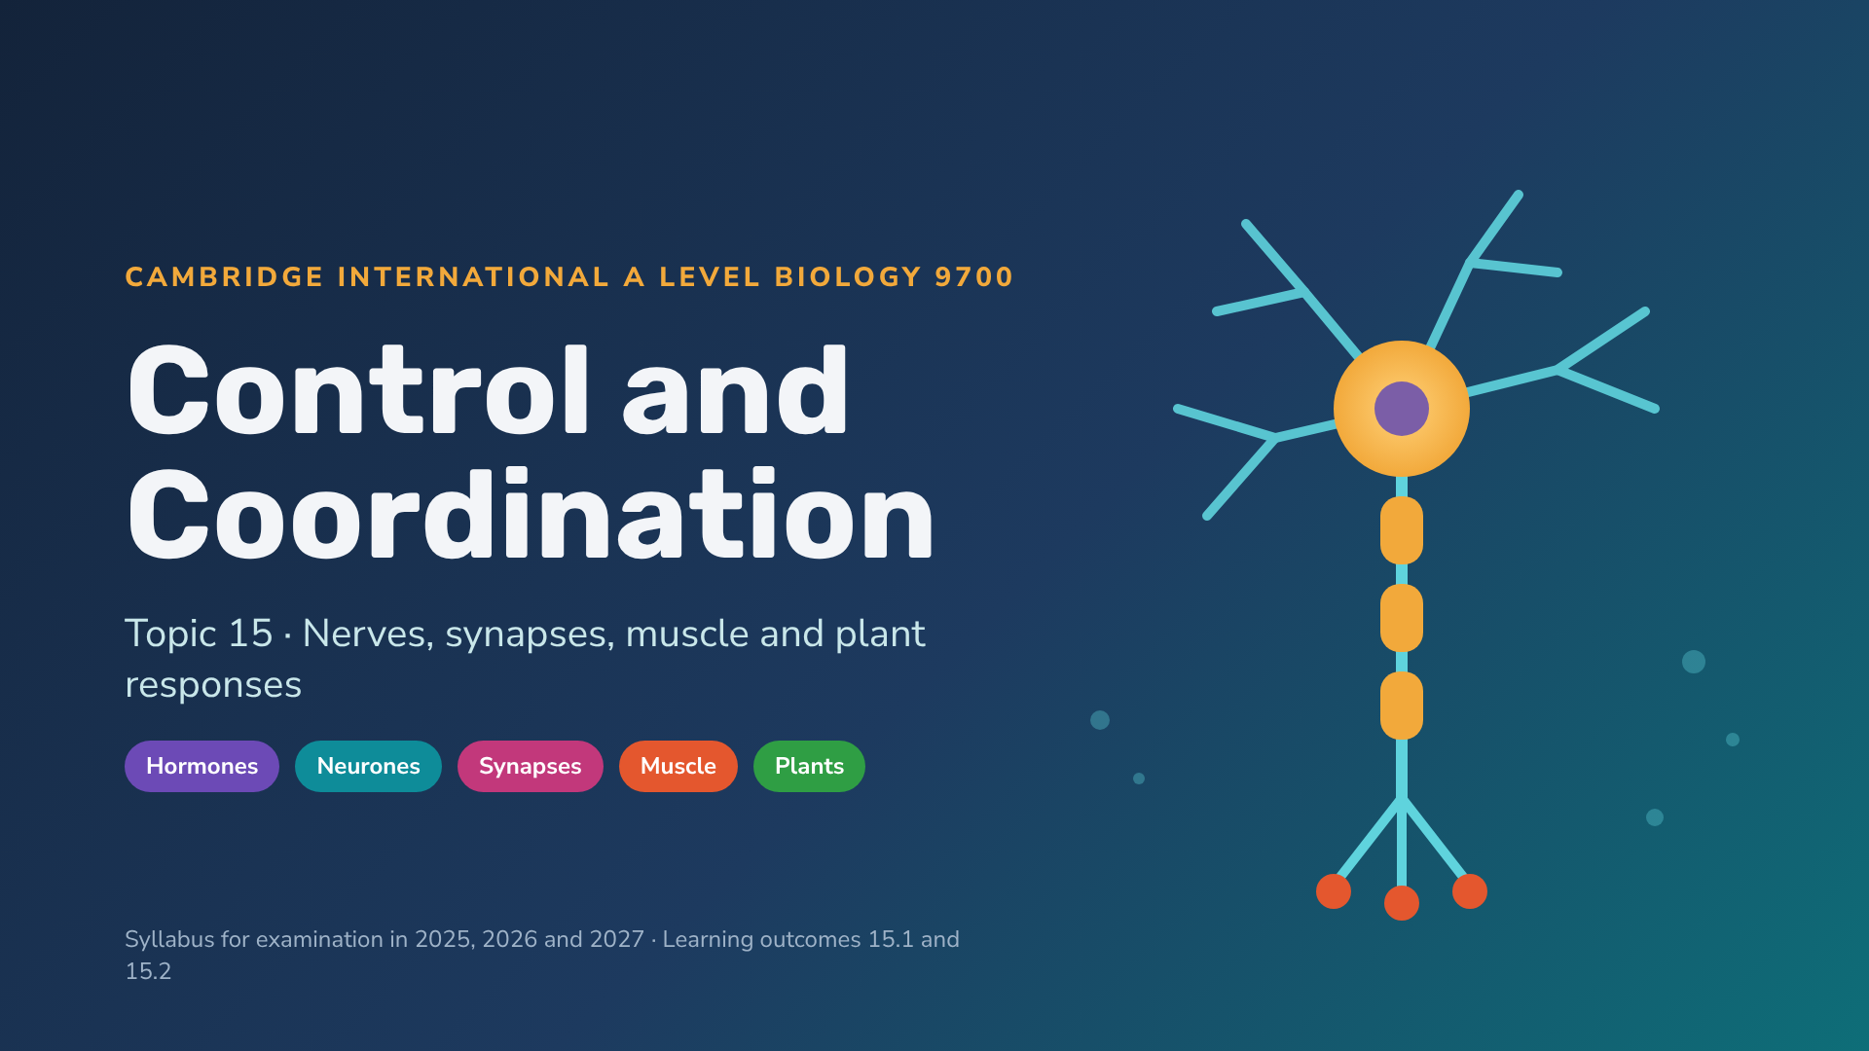
Notes:
Welcome slide. The deck is colour-coded by syllabus section: purple = endocrine, teal = neurones and receptors, blue = action potentials, pink = synapses, coral = muscle, green = plants. Amber slides are activities; navy slides are exam practice. Answers to activities are in the speaker notes.

Slide 2
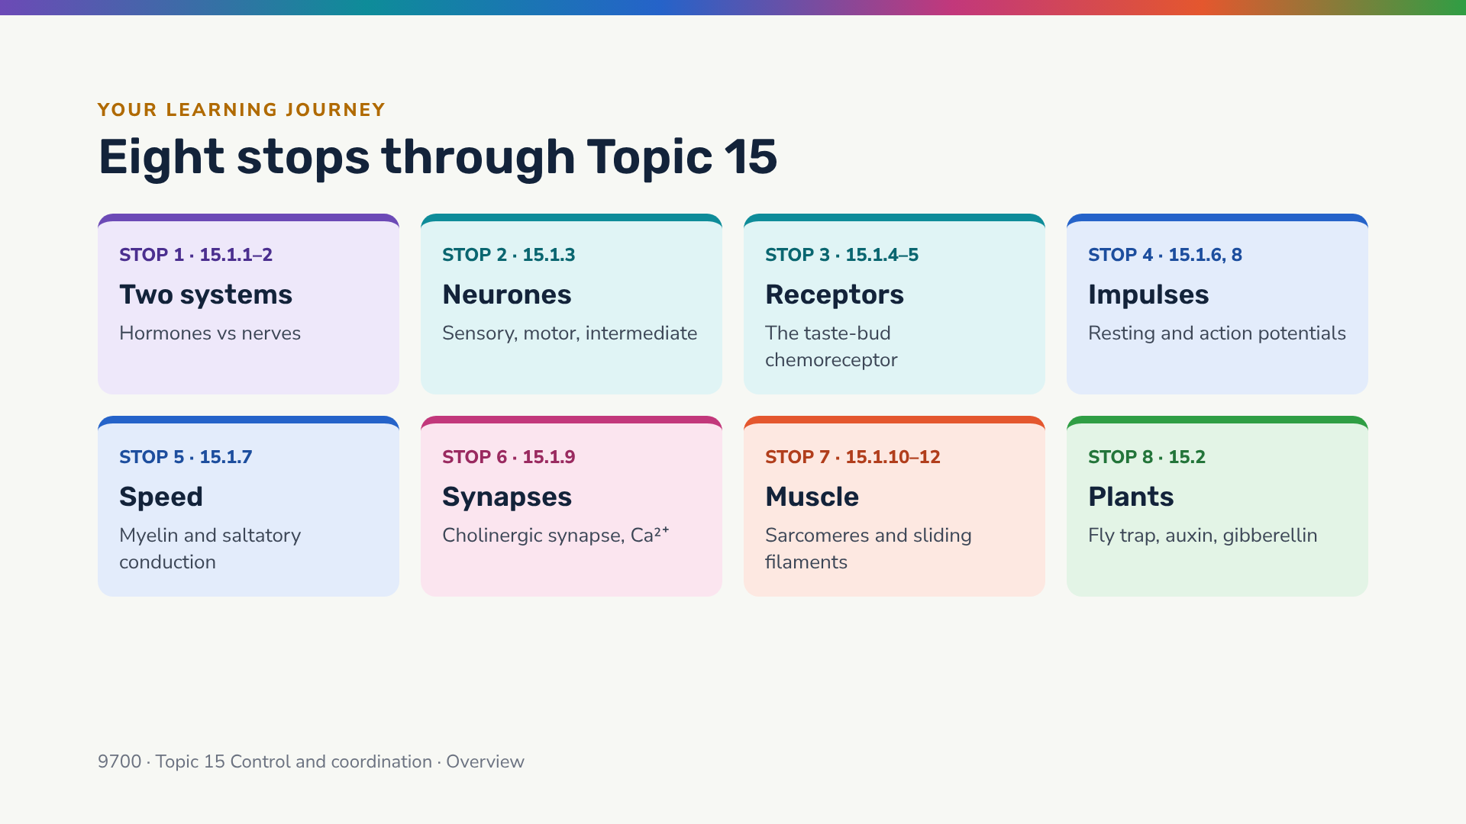
Notes:
Use this map at the start of each lesson to show where you are. Colour coding on every slide matches these cards.

Slide 3
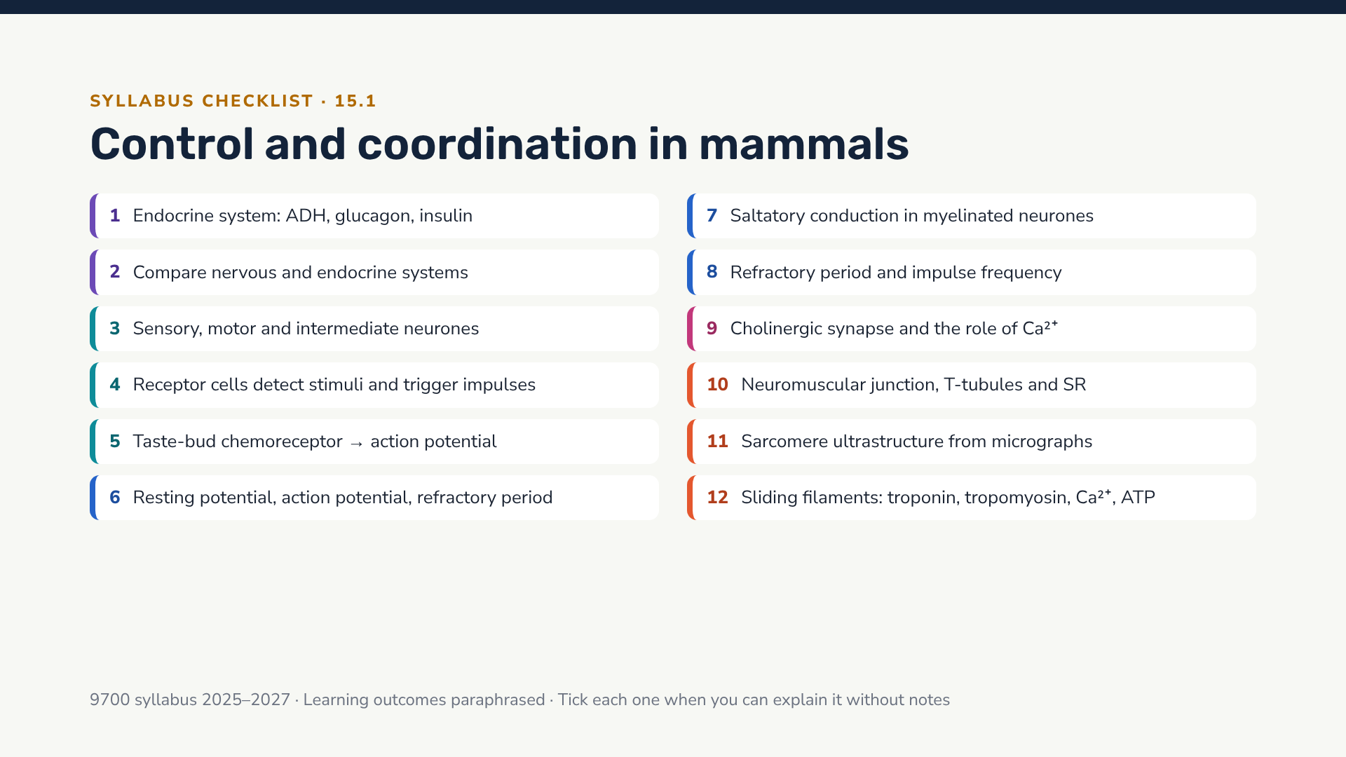
Notes:
Give students a printed copy of this checklist. Ask them to RAG-rate (red/amber/green) each learning outcome now, and again at the end of the topic.

Slide 4
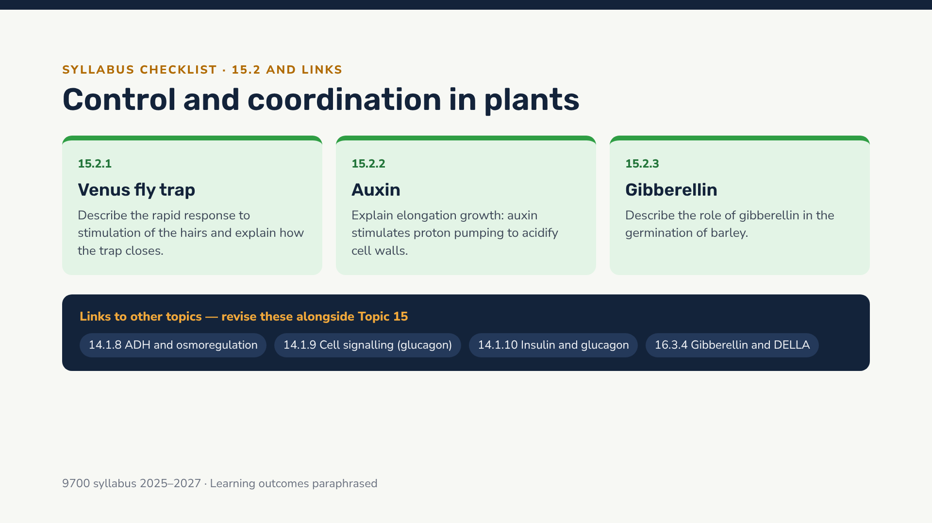
Notes:
Point out that 15.1.1 explicitly cross-references 14.1.8–10, and 15.2.3 cross-references 16.3.4 — examiners can set synoptic questions across these.

Slide 5
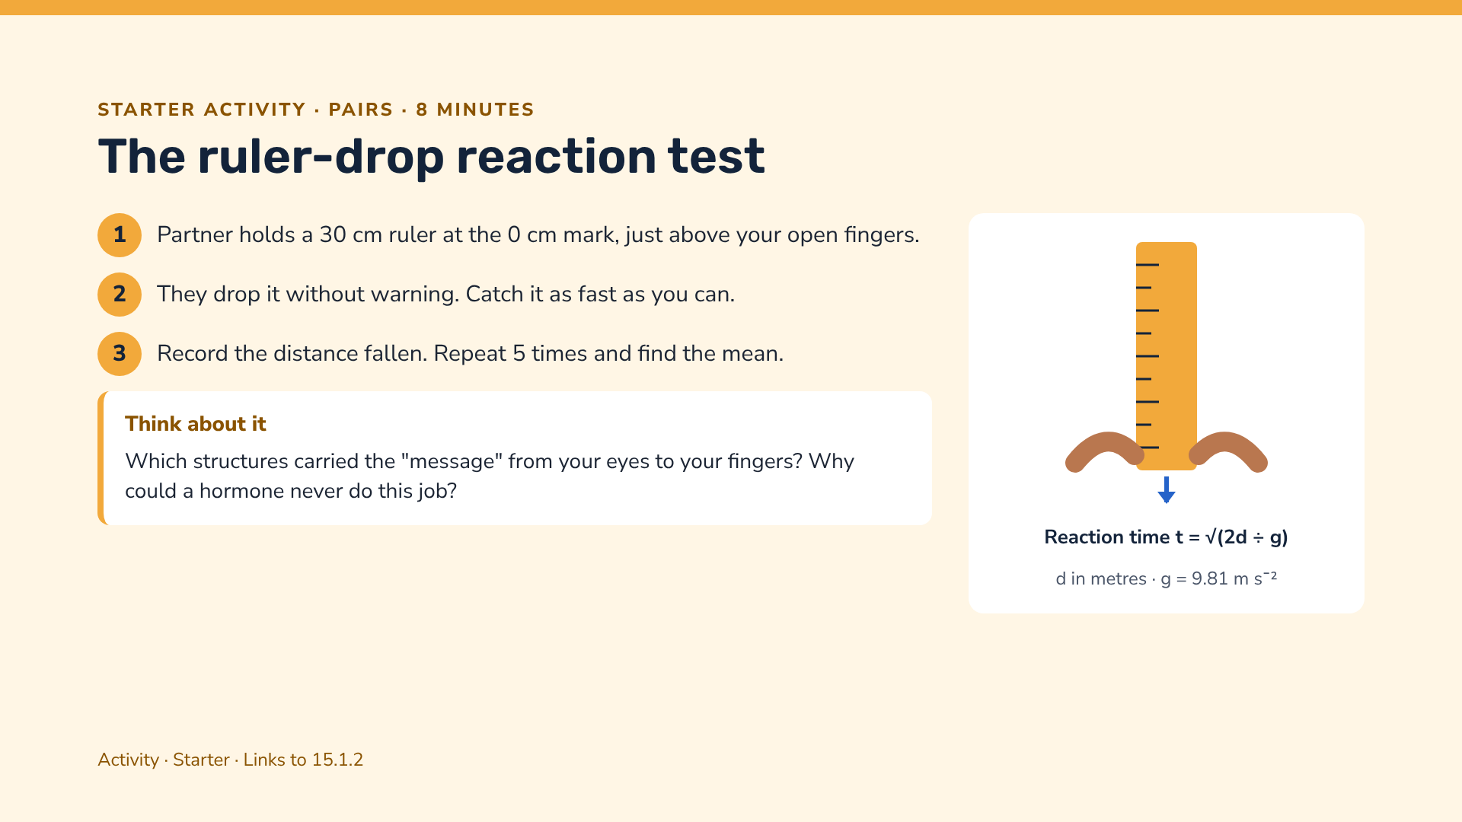
Notes:
Example: a drop of 0.15 m gives t = √(0.30 ÷ 9.81) ≈ 0.17 s. Use the discussion to elicit: receptor (retina) → sensory neurone → CNS → motor neurone → effector (finger muscles). Hormones travel in the blood and act too slowly and too widely for this.

Slide 6
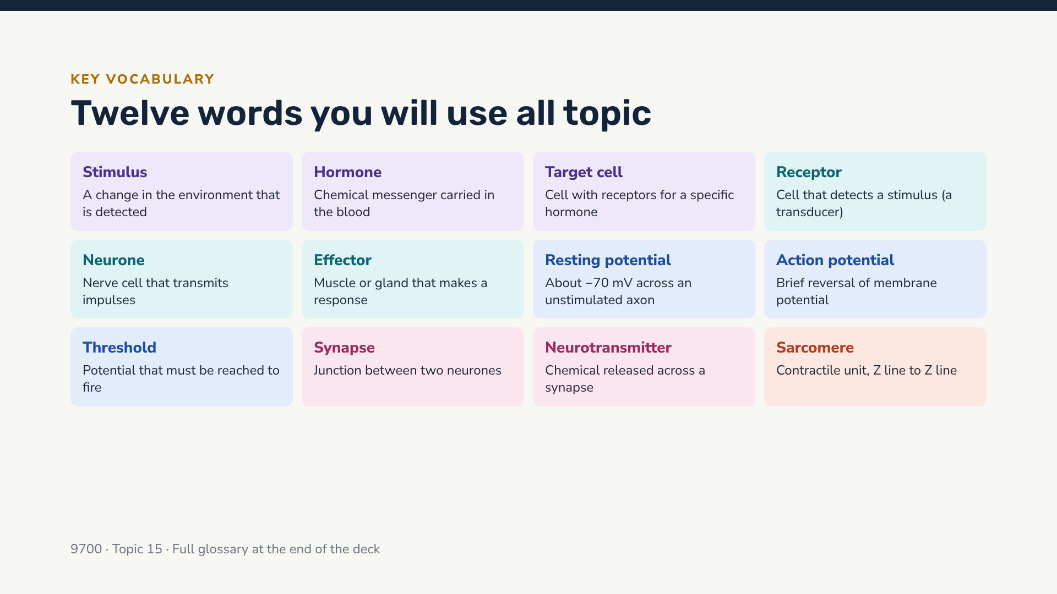
Notes:
Quick game: read a definition aloud, students write the term on mini whiteboards. Revisit at the end of each lesson.

Slide 7
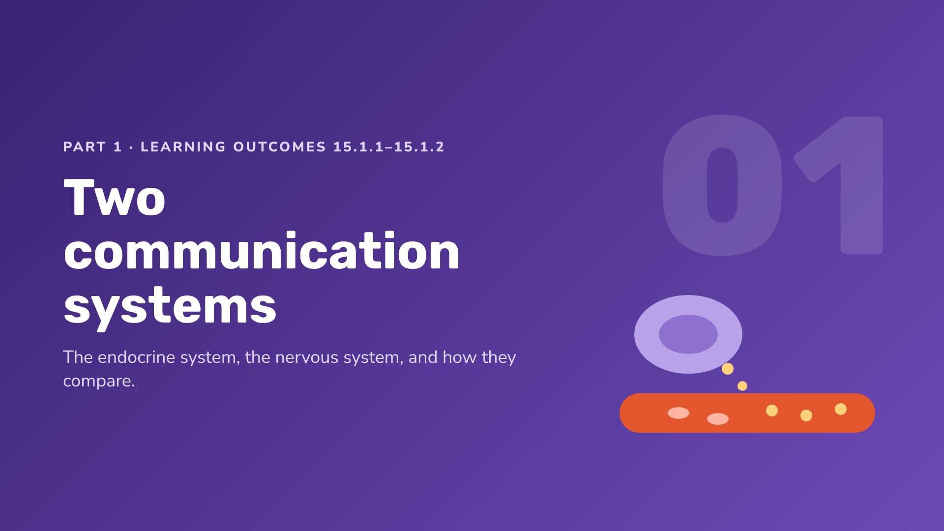
Notes:
Section 1 covers the endocrine system using ADH, glucagon and insulin, and the comparison with the nervous system.

Slide 8
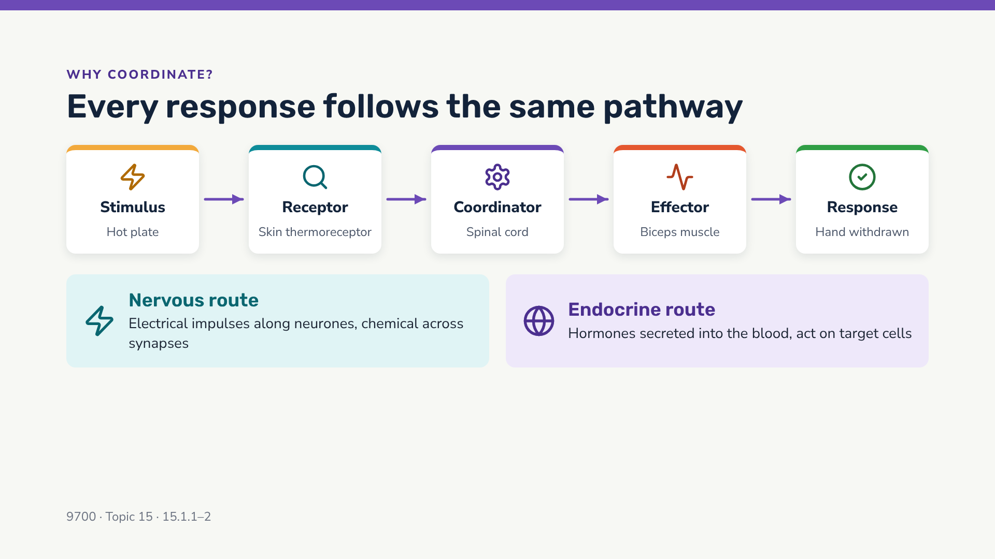
Notes:
Ask students for a hormonal example of the same pathway: high blood glucose (stimulus) → beta cells (receptor and coordinator) → insulin → liver and muscle cells (effectors) → glucose uptake (response).

Slide 9
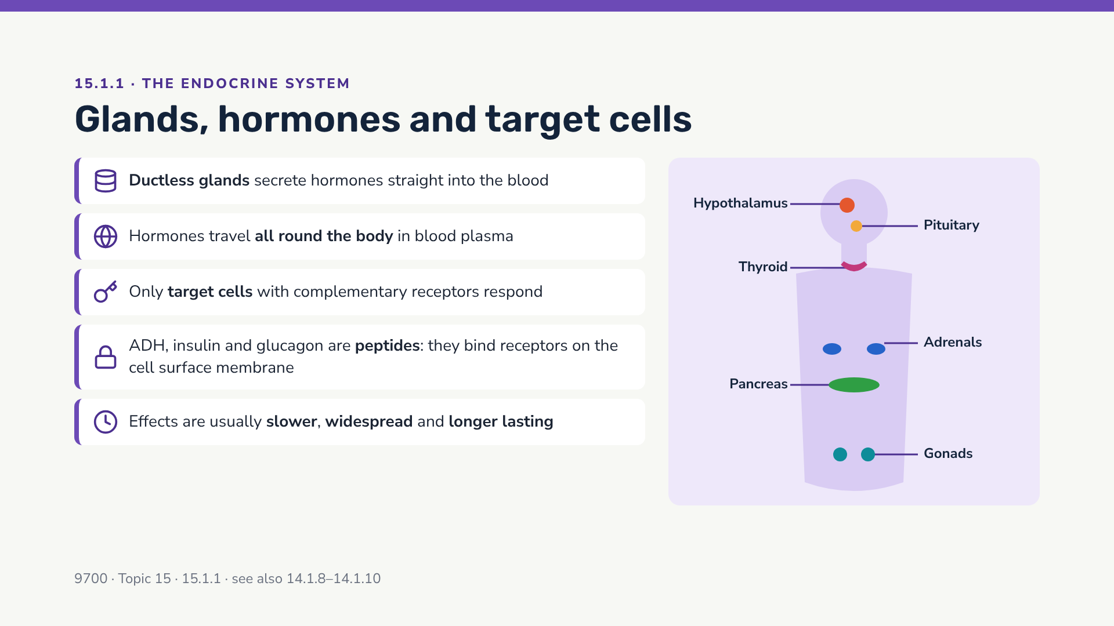
Notes:
Exam focus: the syllabus asks for features of the endocrine system with reference to ADH, glucagon and insulin only. Steroid hormones are not required. Emphasise: endocrine glands are ductless; hormones are carried in the blood; specificity comes from receptor shape on target cells.

Slide 10
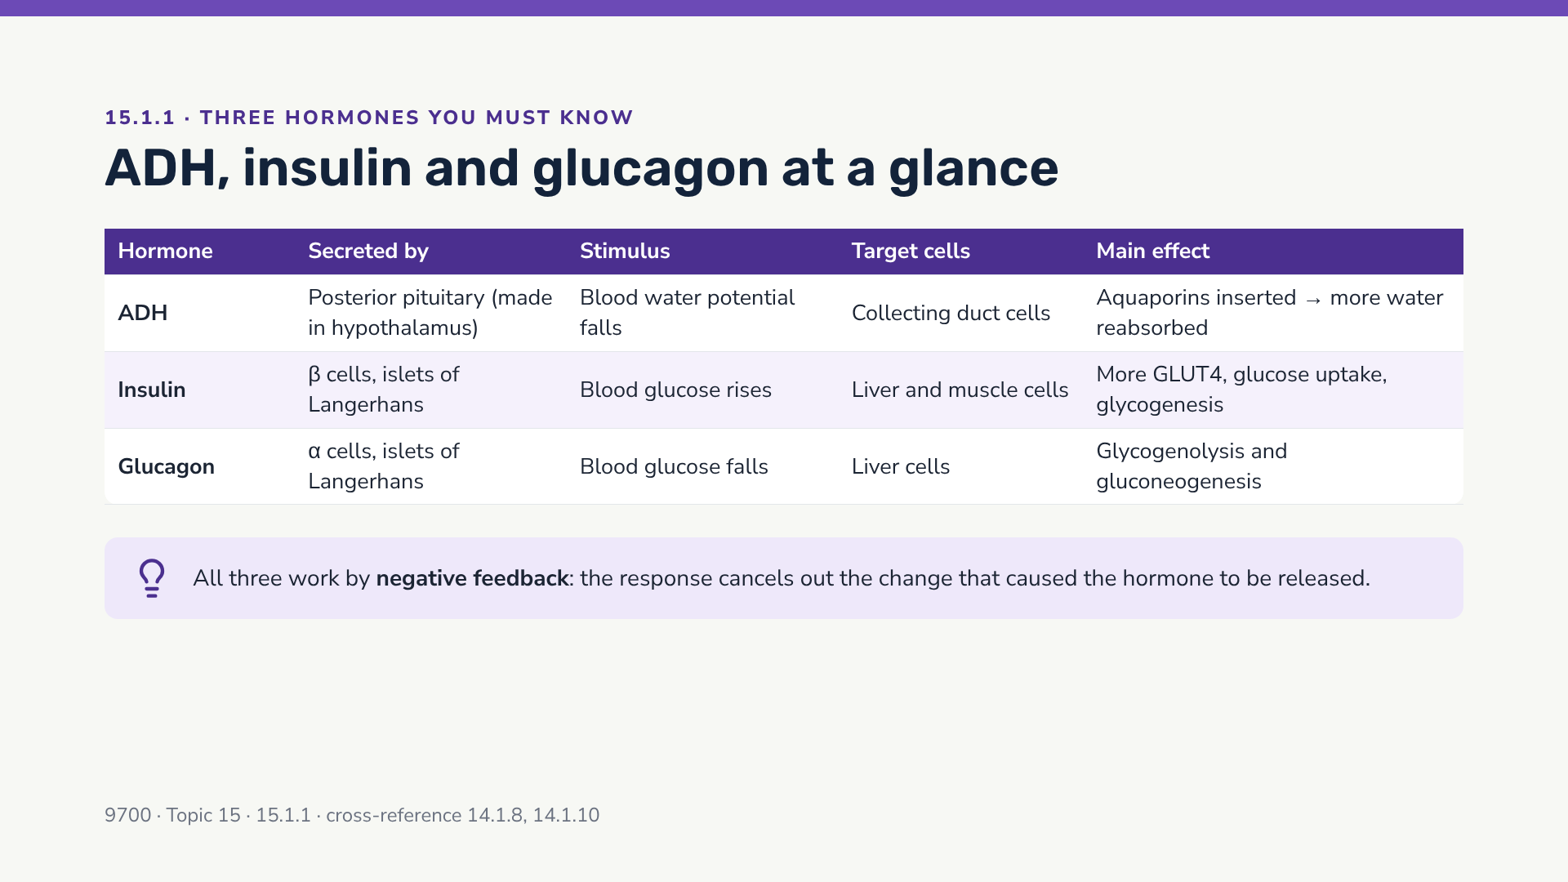
Notes:
Glucagon does NOT act on muscle cells (muscle lacks glucagon receptors). Insulin acts on muscle cells by increasing GLUT4 transporters in the membrane; on liver cells it activates glucokinase and glycogen synthase (glycogenesis).

Slide 11
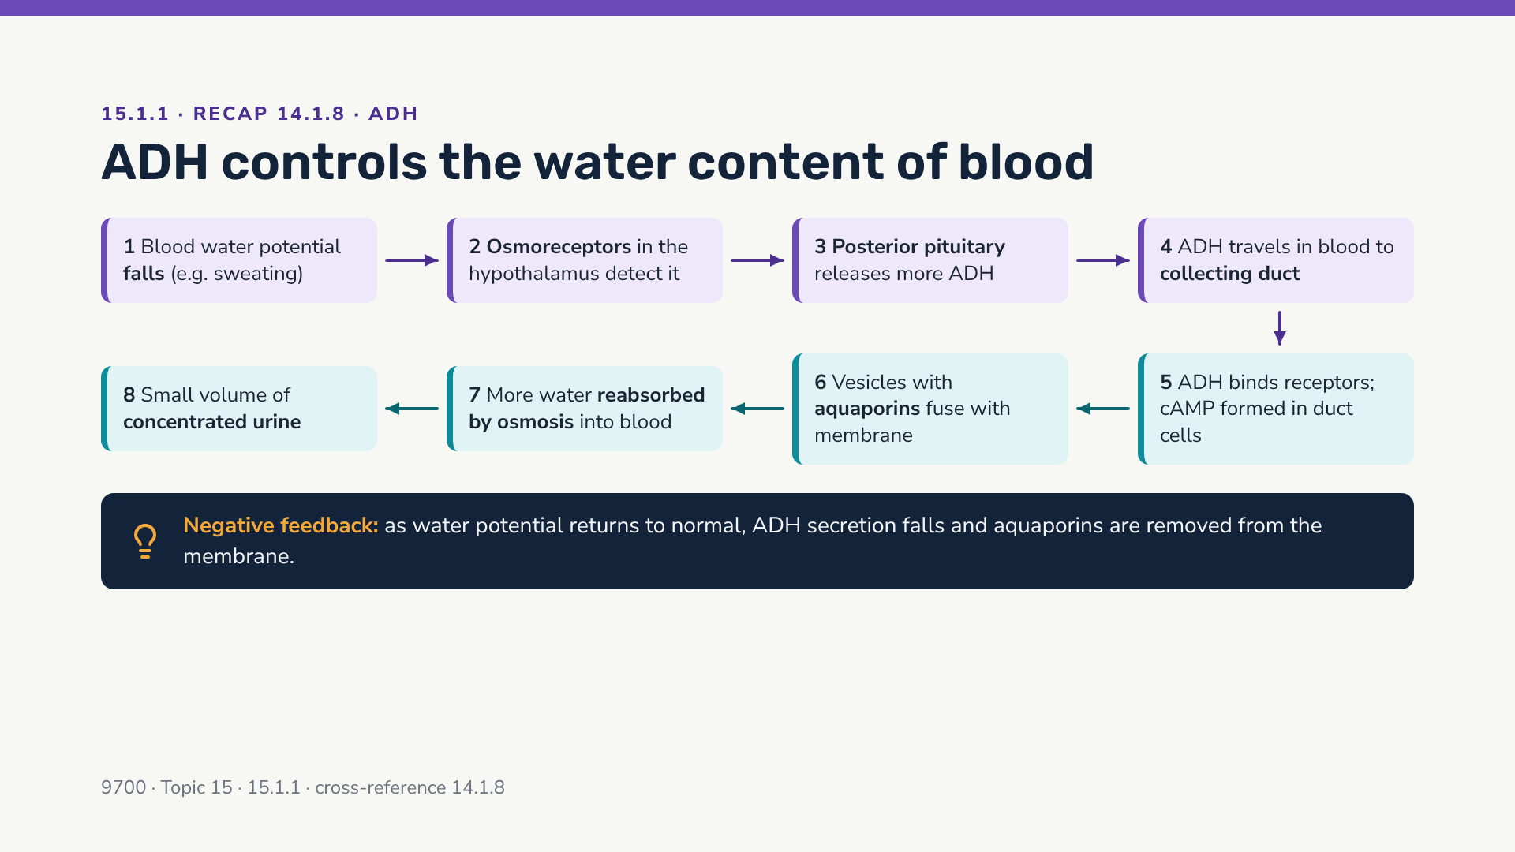
Notes:
Read the chain left to right along the top, then right to left along the bottom. ADH is made by neurosecretory cells in the hypothalamus and stored in / released from the posterior pituitary — a nice link between the nervous and endocrine systems.

Slide 12
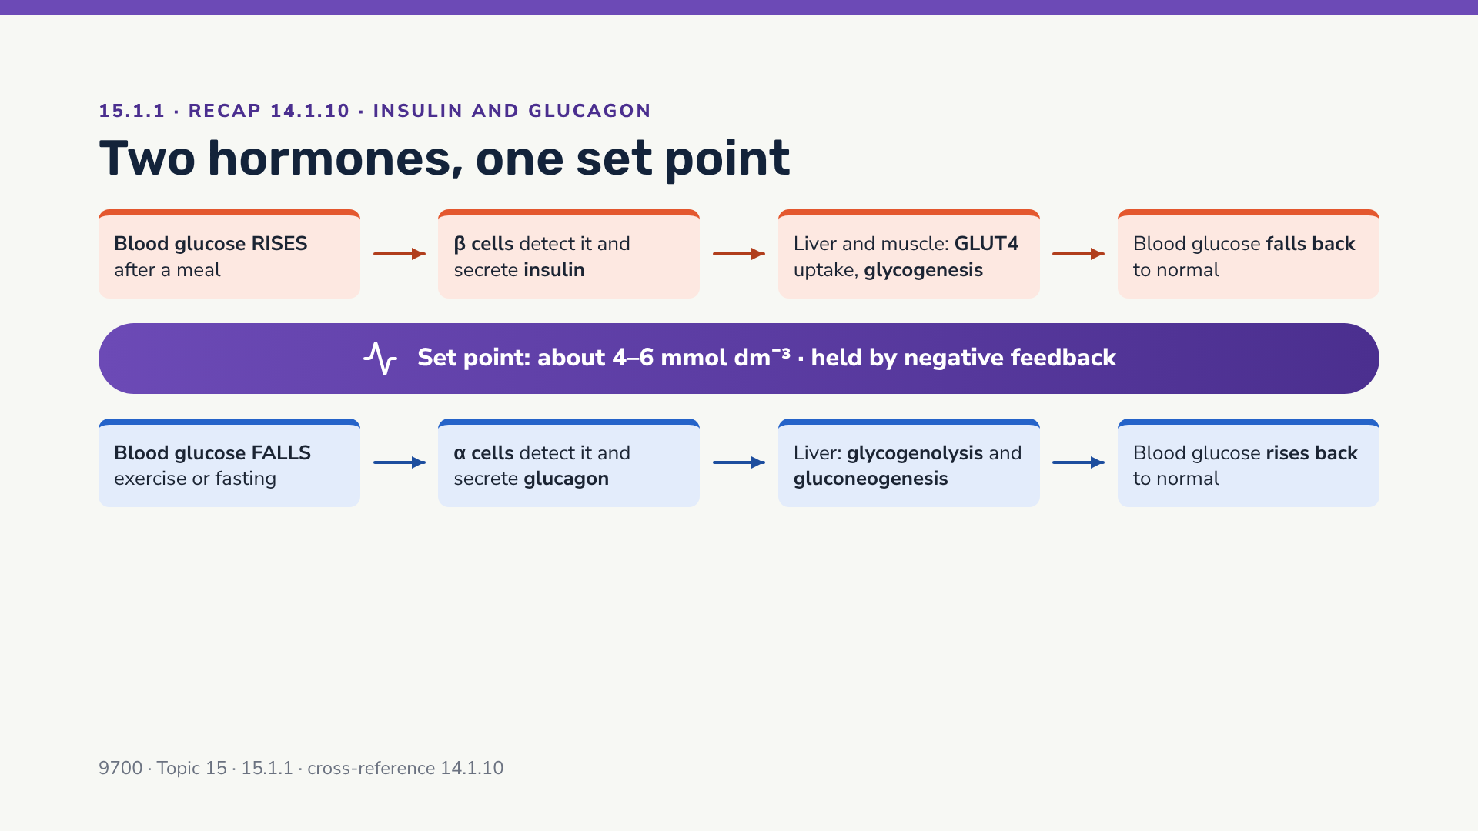
Notes:
Insulin and glucagon are antagonistic hormones. The islet cells act as both receptor and coordinator — no nerves are needed. Remind students that glucagon acts on liver cells only (not muscle).

Slide 13
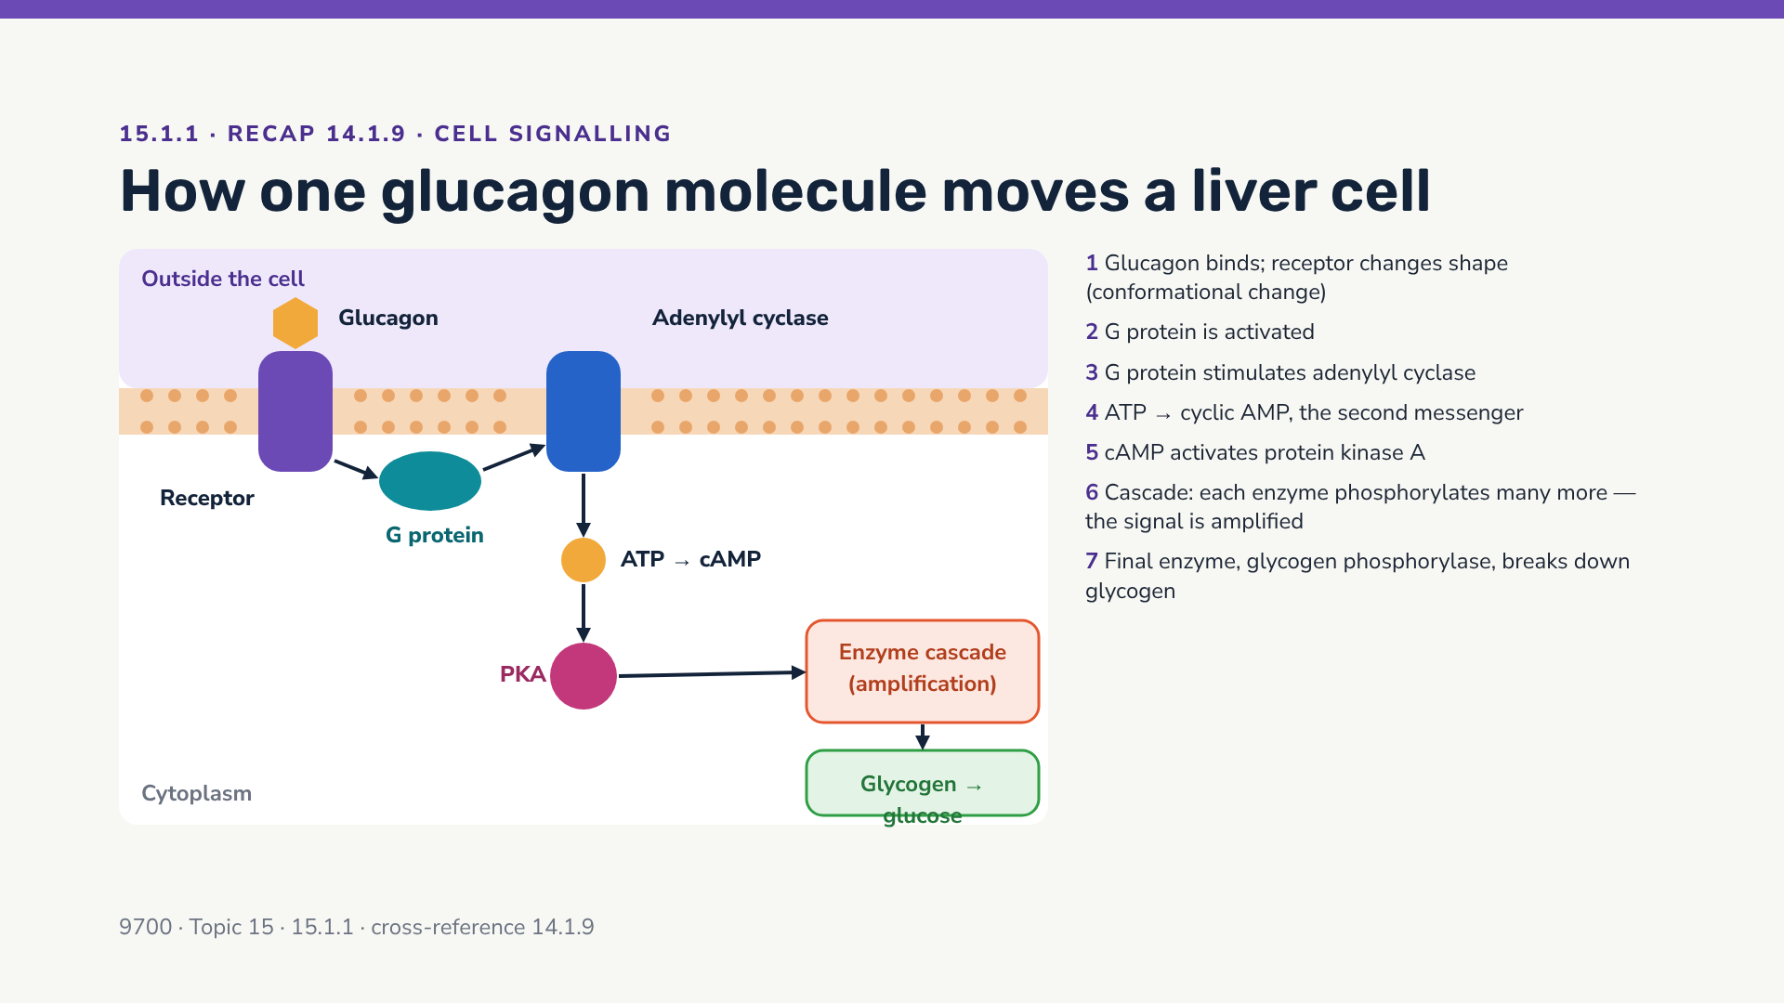
Notes:
The syllabus wording for 14.1.9 is reflected in the seven steps. Key exam words: conformational change, G protein, adenylyl cyclase, second messenger cAMP, protein kinase A, phosphorylation, amplification. A few hormone molecules → millions of glucose molecules released.

Slide 14
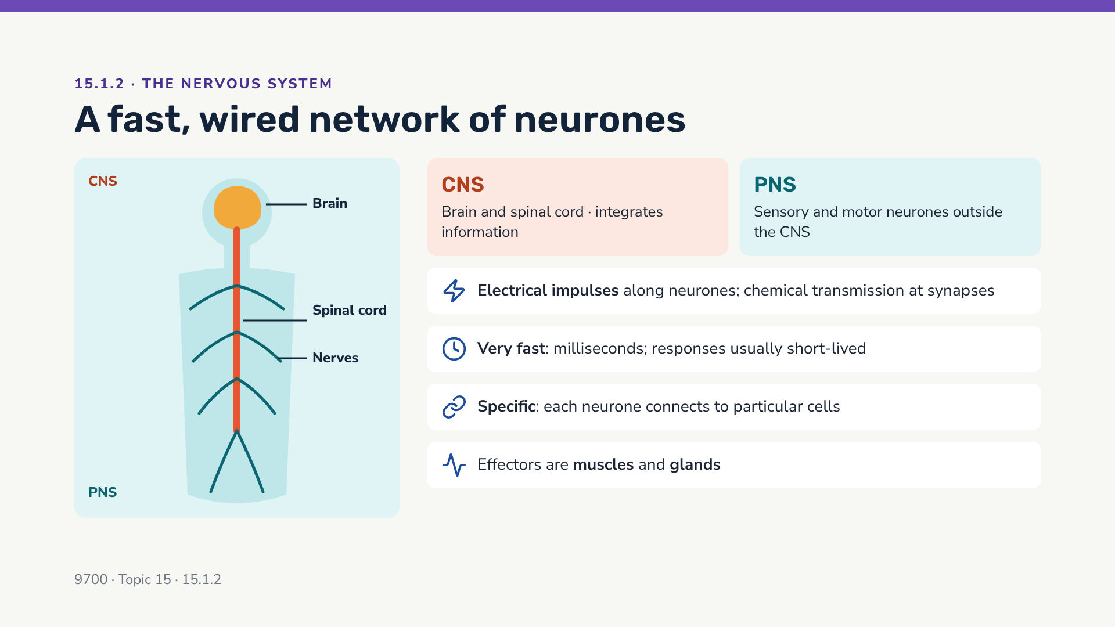
Notes:
CNS = central nervous system (brain and spinal cord). PNS = peripheral nervous system (all neurones outside the CNS, carried in nerves). A nerve is a bundle of many neurones wrapped in connective tissue — not the same thing as a neurone.

Slide 15
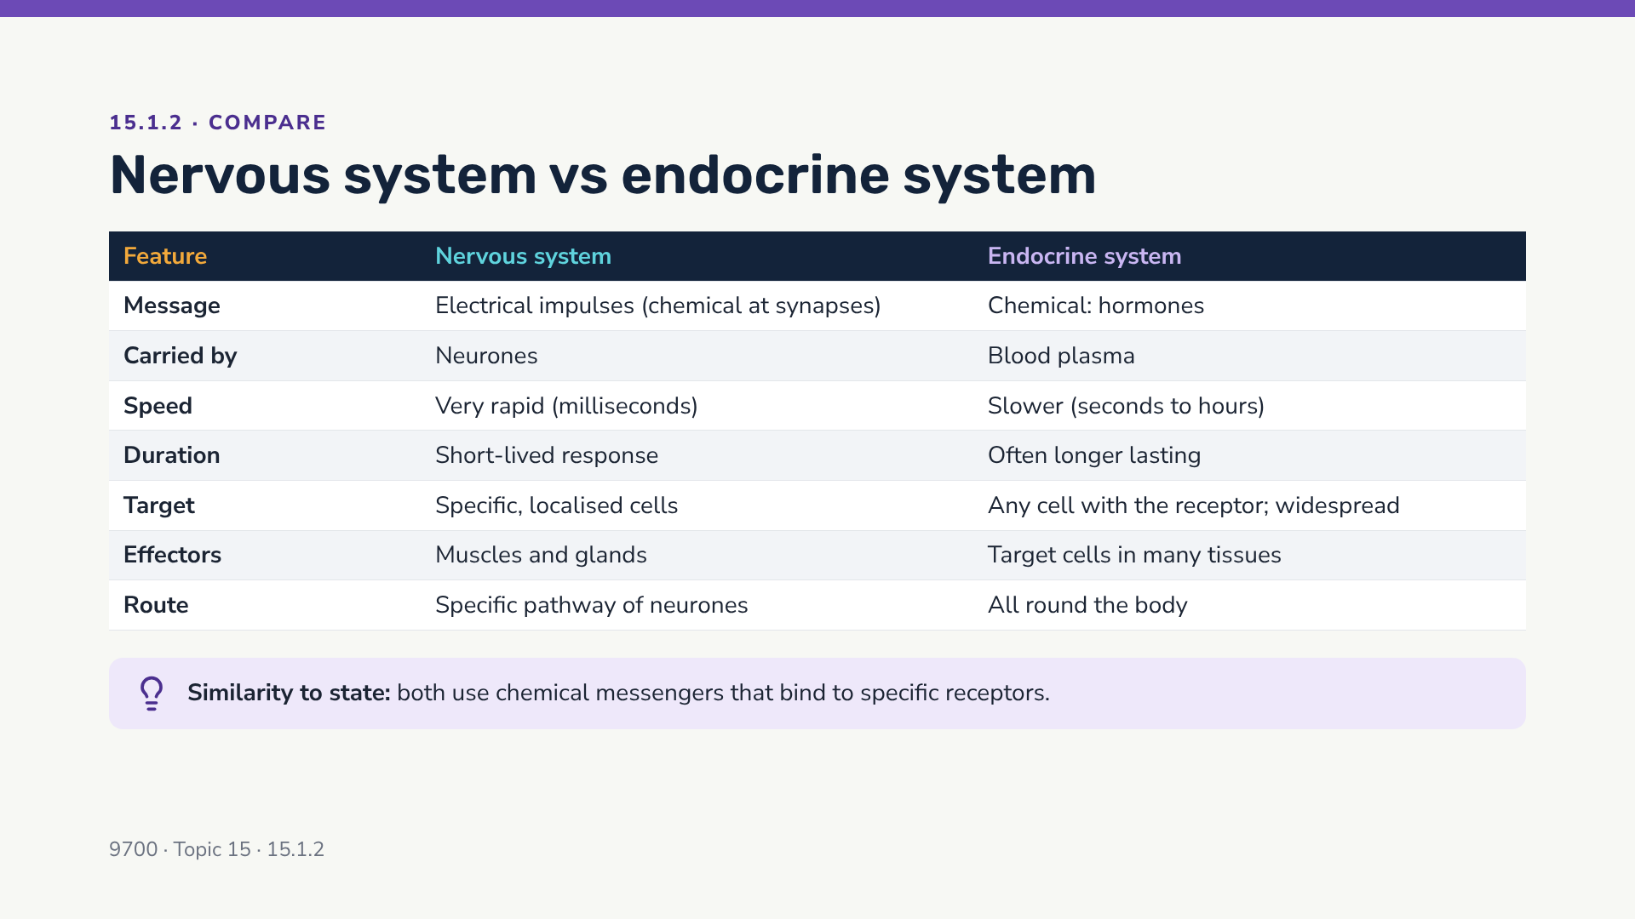
Notes:
Exam tip: "compare" questions need matched pairs — state the nervous feature AND the endocrine feature for the same point, ideally with a comparative word (faster / slower). Always include at least one similarity if the question says "compare".

Slide 16
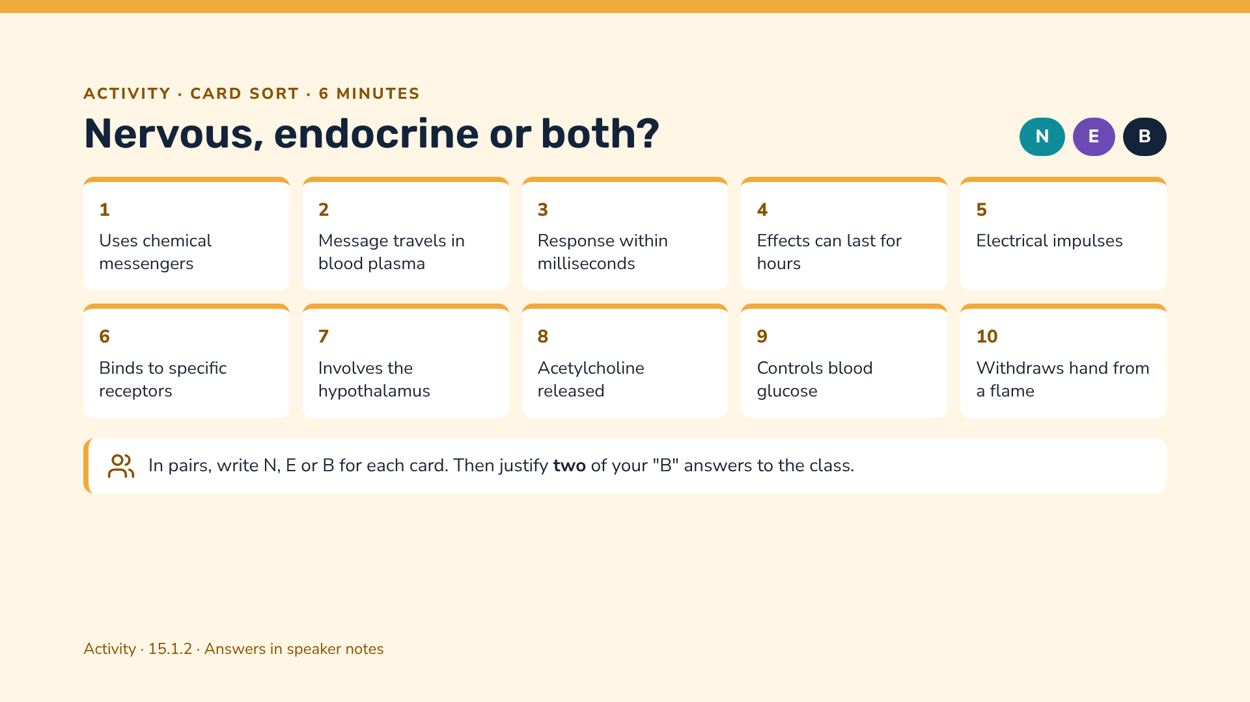
Notes:
Answers: 1 B (neurotransmitters and hormones); 2 E; 3 N; 4 E; 5 N; 6 B (hormone receptors on target cells; neurotransmitter receptors on postsynaptic membranes); 7 B (hypothalamus contains neurones and its neurosecretory cells make ADH); 8 N; 9 E (insulin/glucagon); 10 N (reflex).

Slide 17
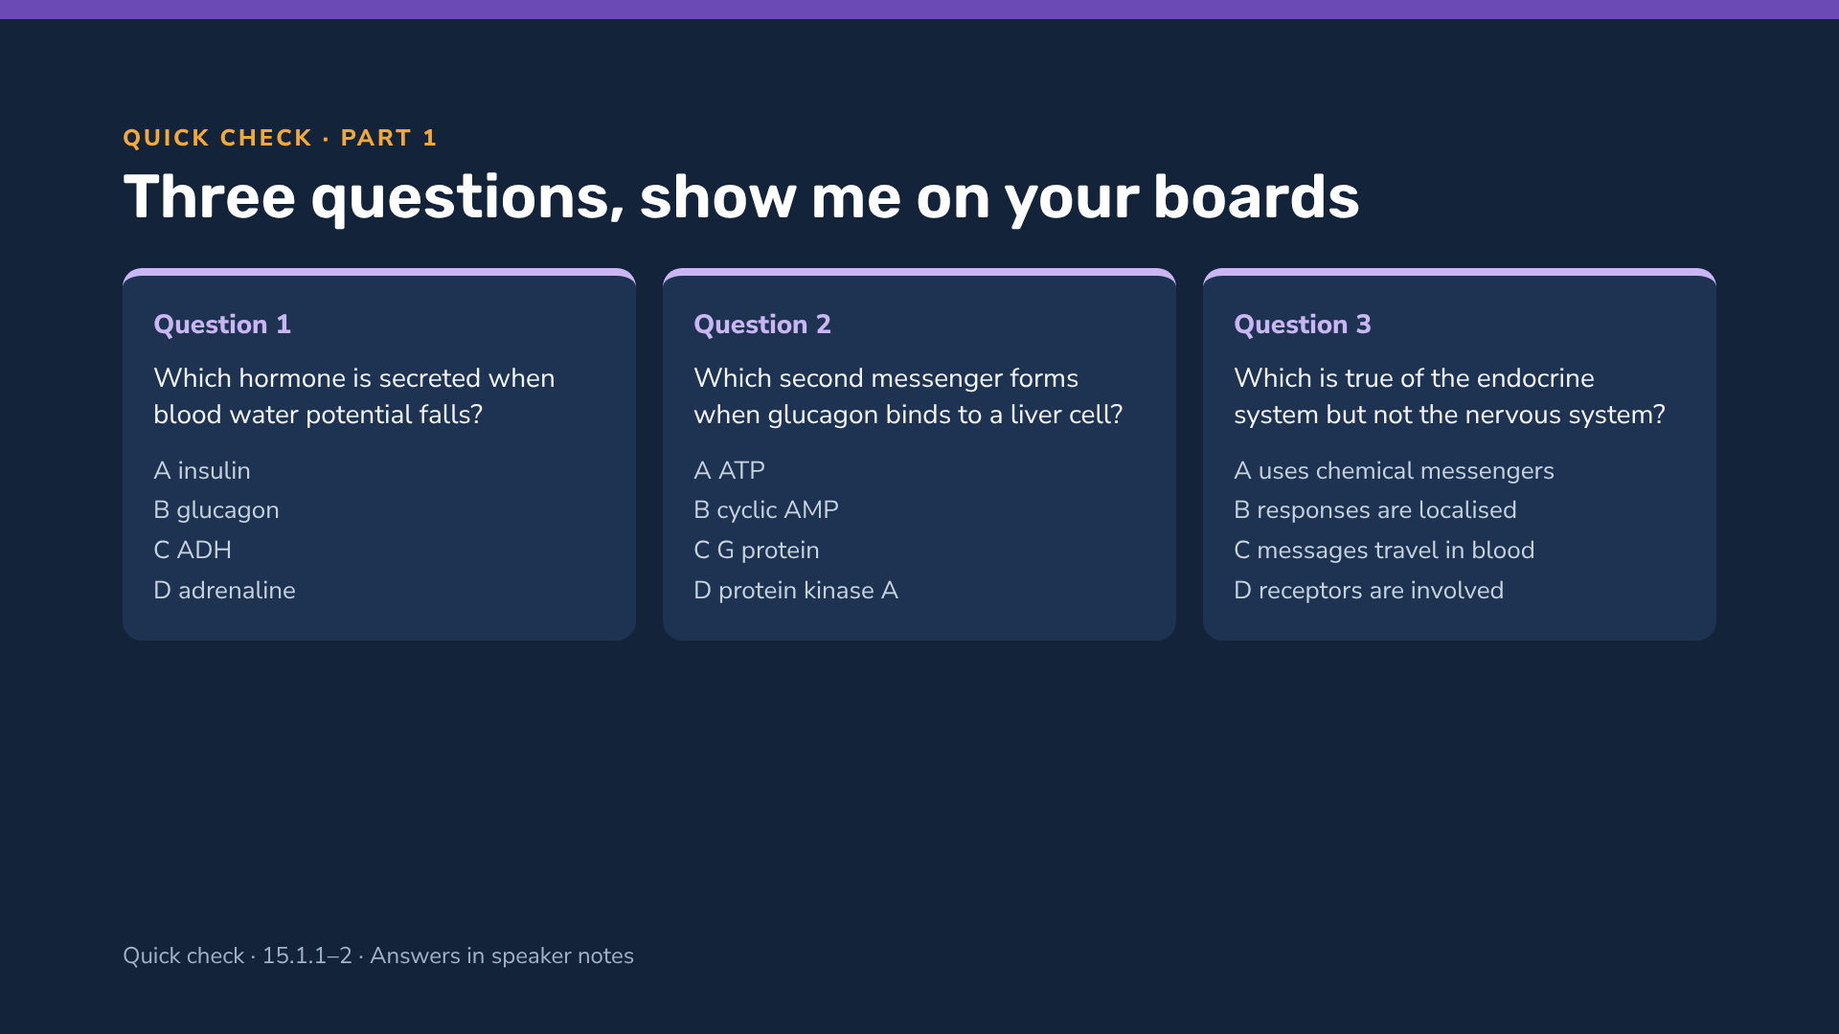
Notes:
Answers: Q1 C (ADH); Q2 B (cyclic AMP — ATP is the substrate, PKA is activated by cAMP); Q3 C (both systems use chemical messengers and receptors; nervous responses are the localised ones).

Slide 18
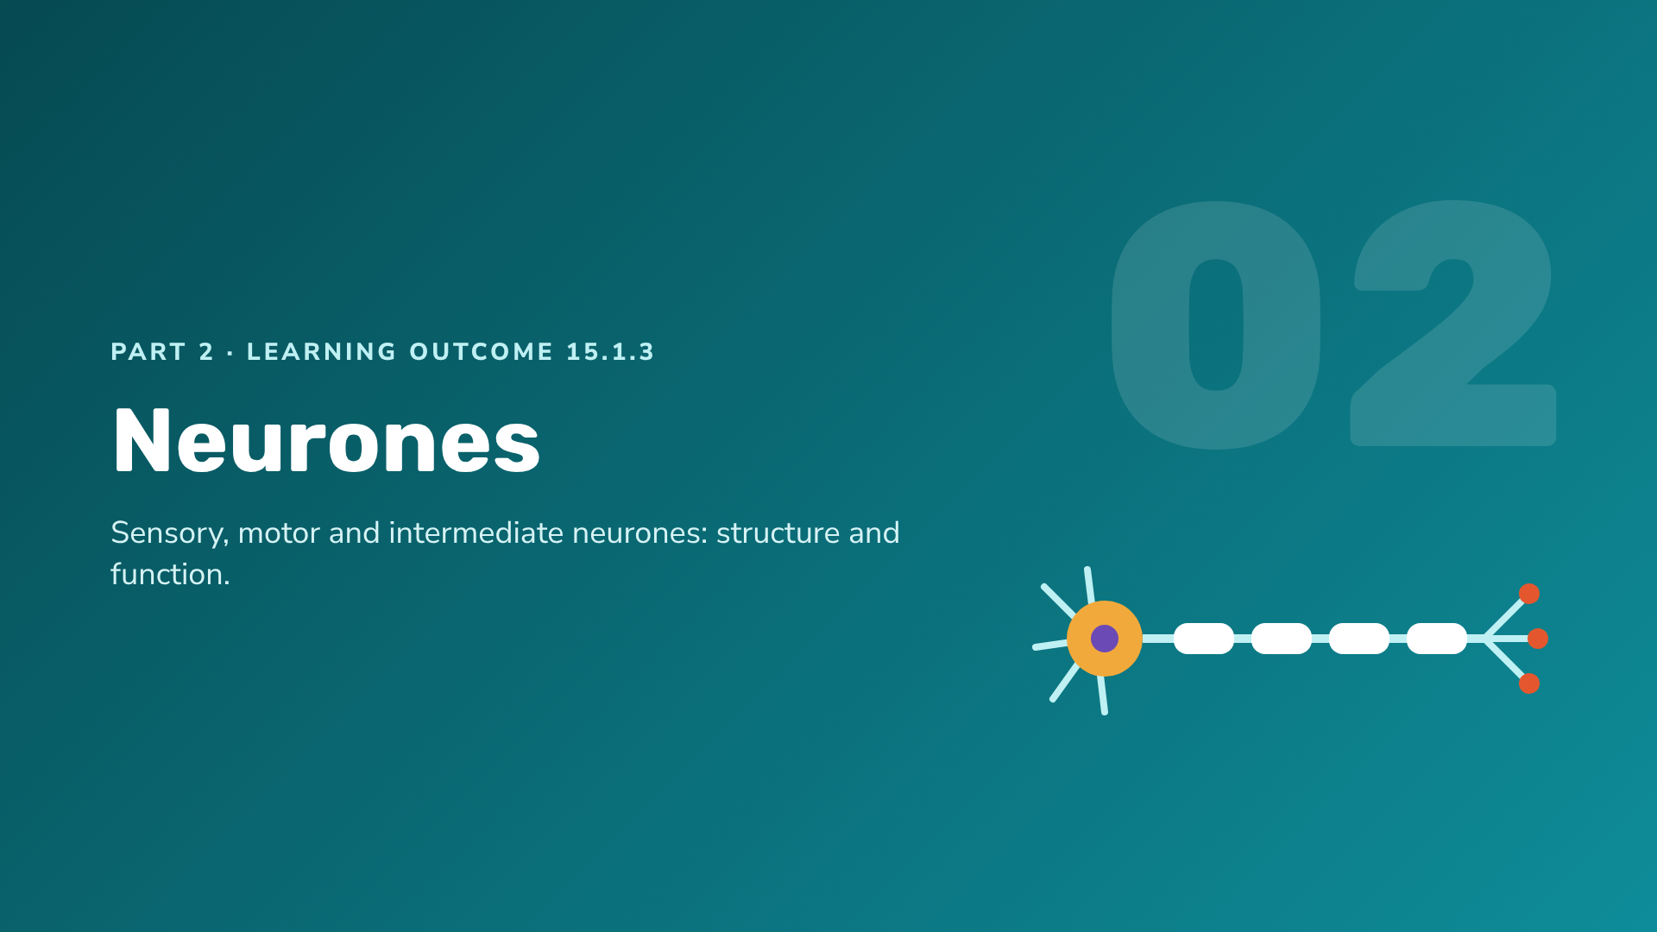
Notes:
Section 2: neurone structure. Students must be able to draw and label a motor neurone and a sensory neurone, and state that intermediate (relay) neurones connect them.

Slide 19
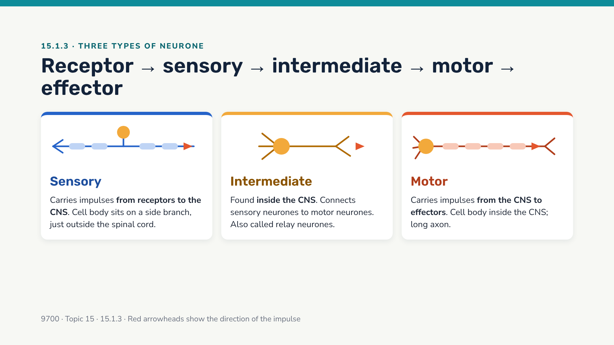
Notes:
The syllabus only requires students to STATE that intermediate neurones connect sensory and motor neurones; detailed structure is needed for sensory and motor neurones (next slides).

Slide 20
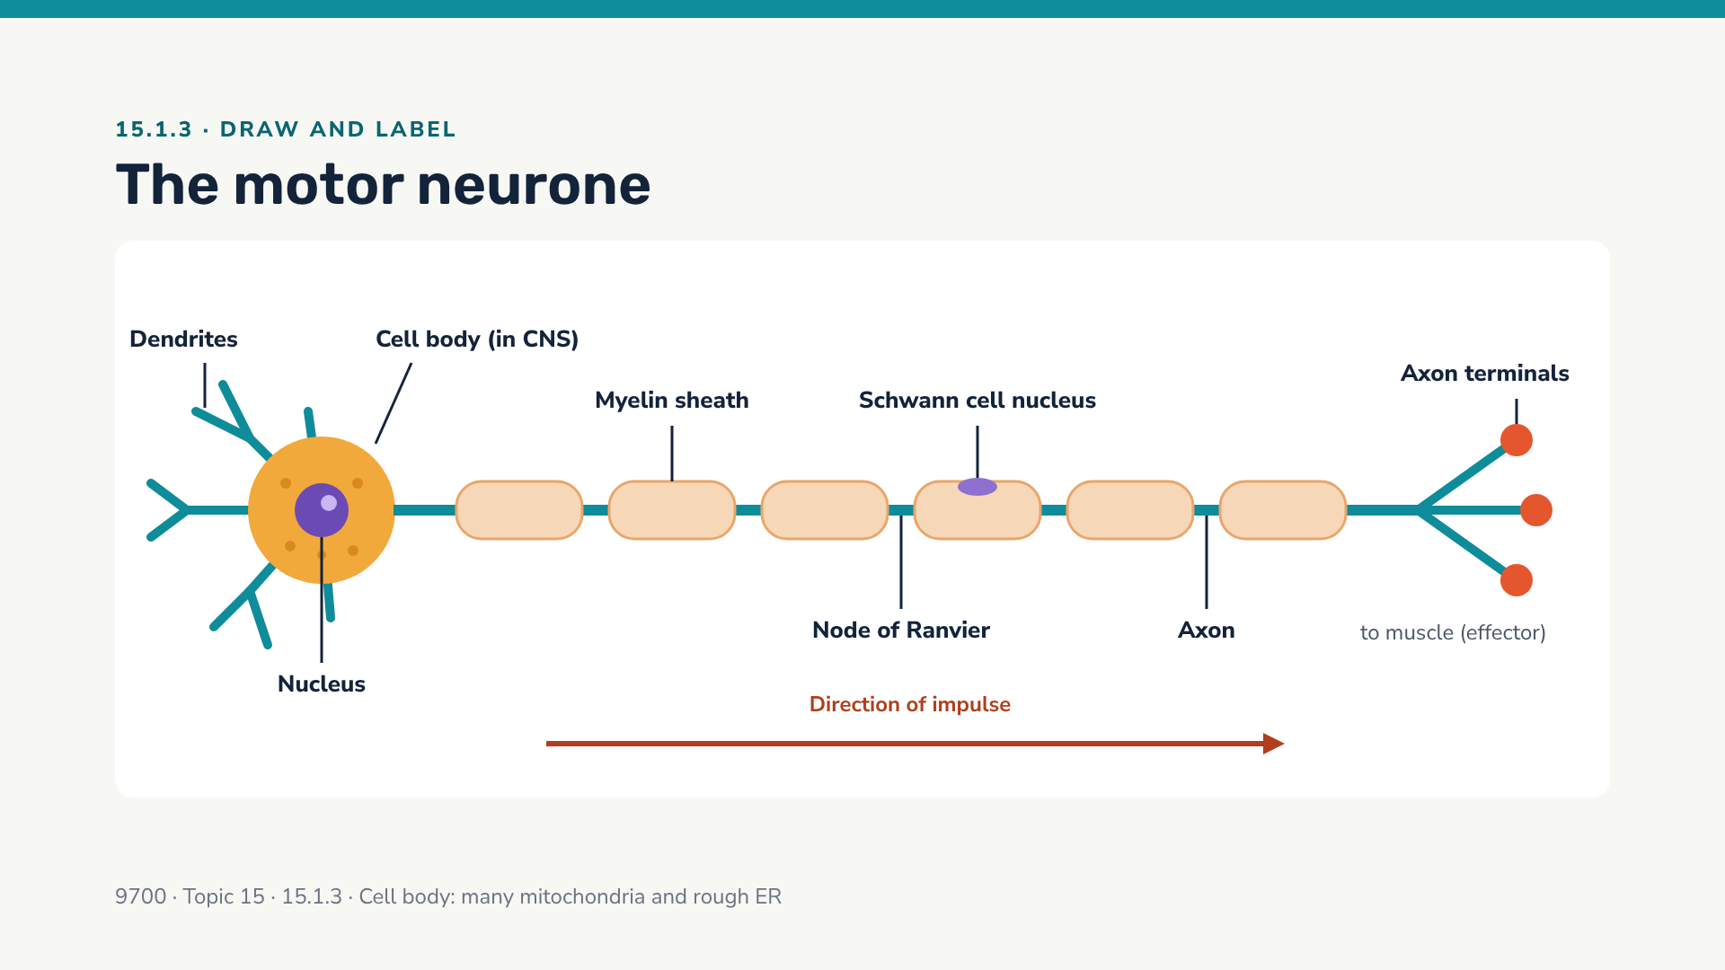
Notes:
Key features to draw: cell body at the END of the fibre with nucleus, many dendrites, one long axon, Schwann cells forming the myelin sheath, gaps = nodes of Ranvier, branched axon terminals ending in synaptic knobs at the effector. Dots in the cell body represent rough ER (Nissl granules).

Slide 21
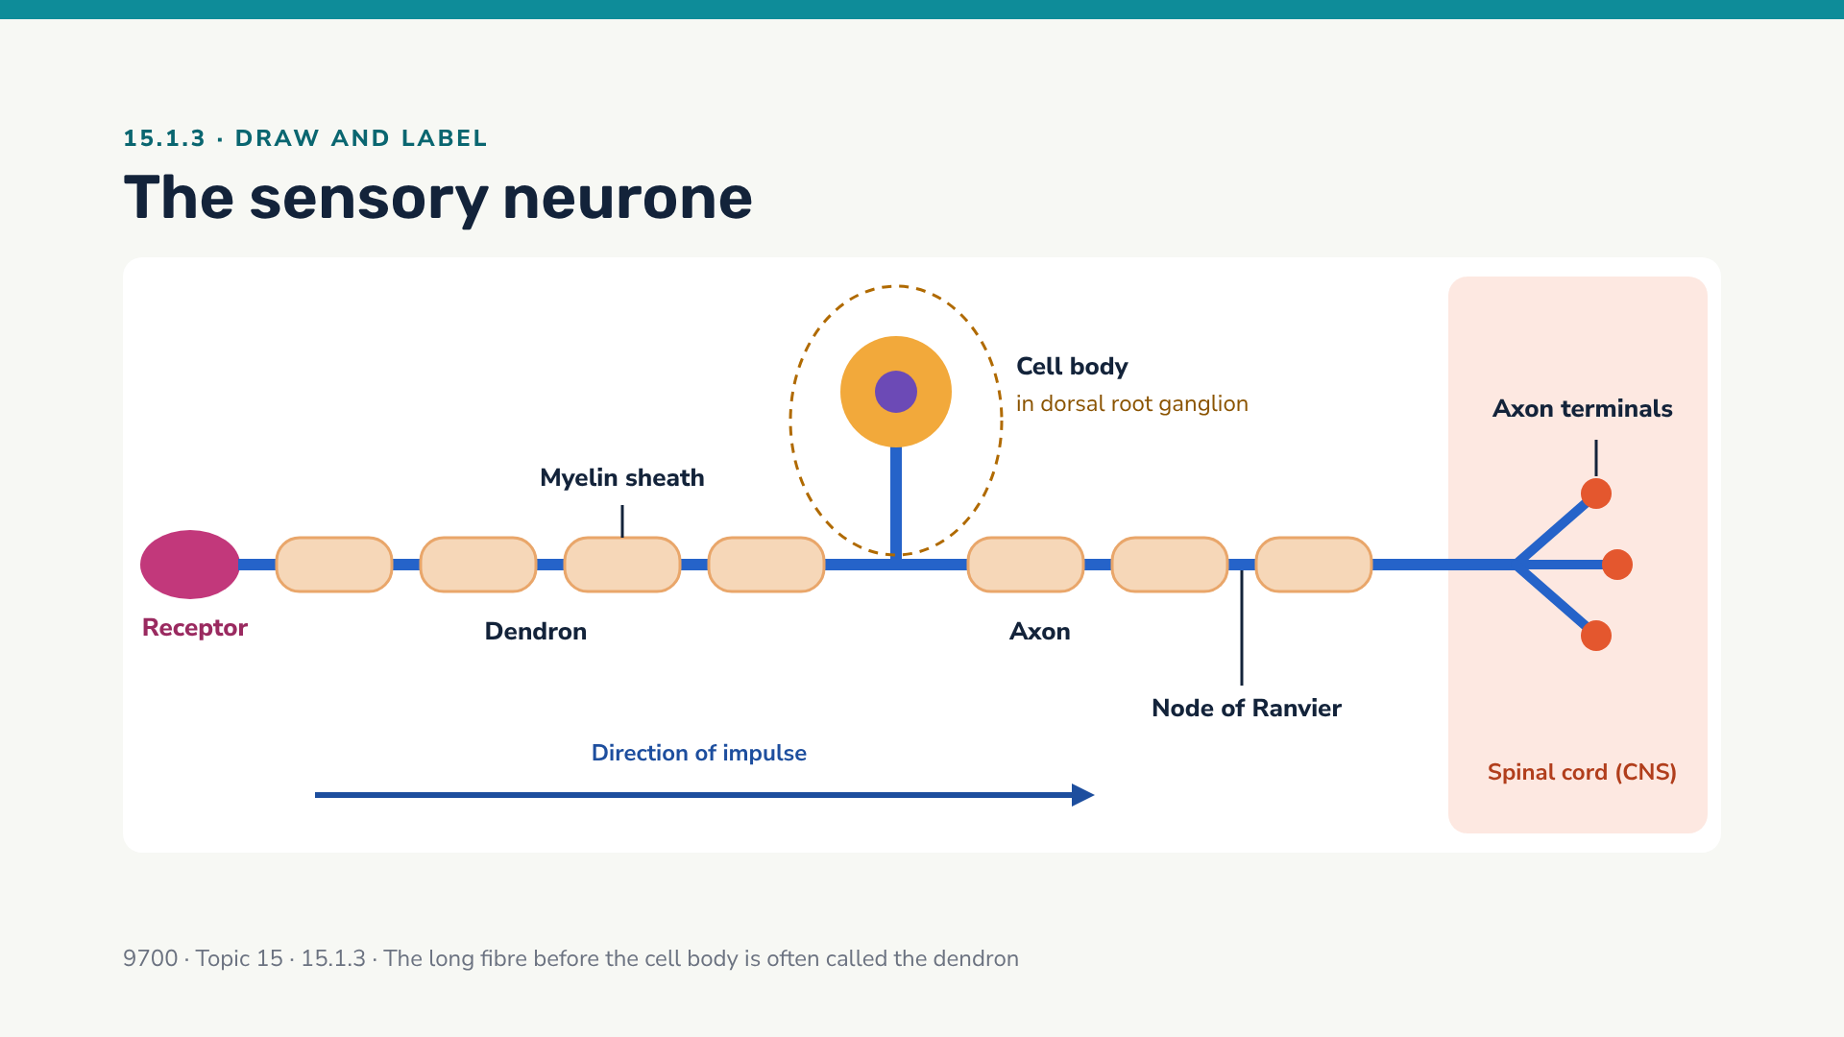
Notes:
Contrast with the motor neurone: the sensory neurone's cell body is NOT at the end of the fibre — it sits on a short side branch in the dorsal root ganglion, just outside the spinal cord. The impulse never has to pass through the cell body.

Slide 22
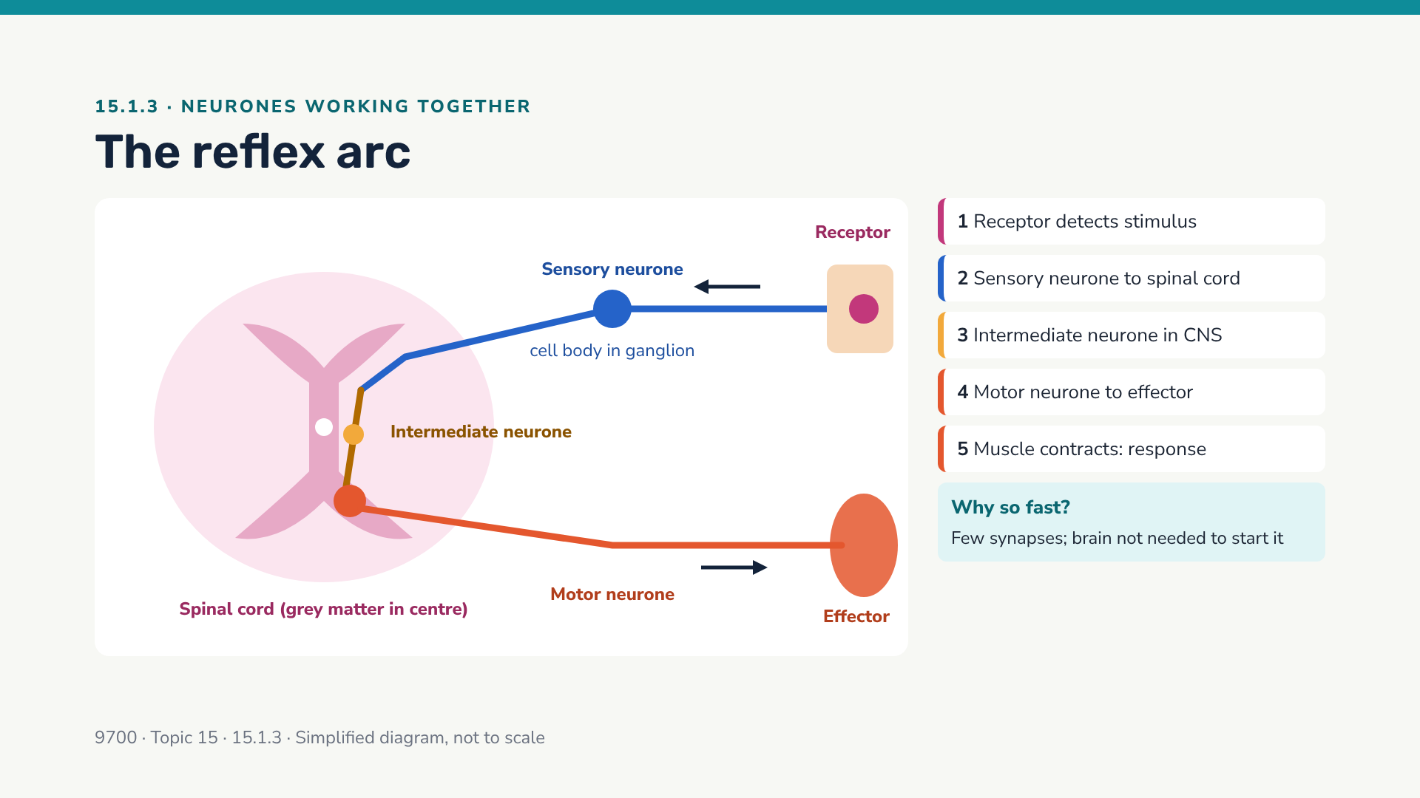
Notes:
Reflex arcs are not named explicitly in the 9700 outcomes, but they are the clearest way to show how the three neurone types connect (15.1.3). Point out the two synapses in the grey matter.

Slide 23
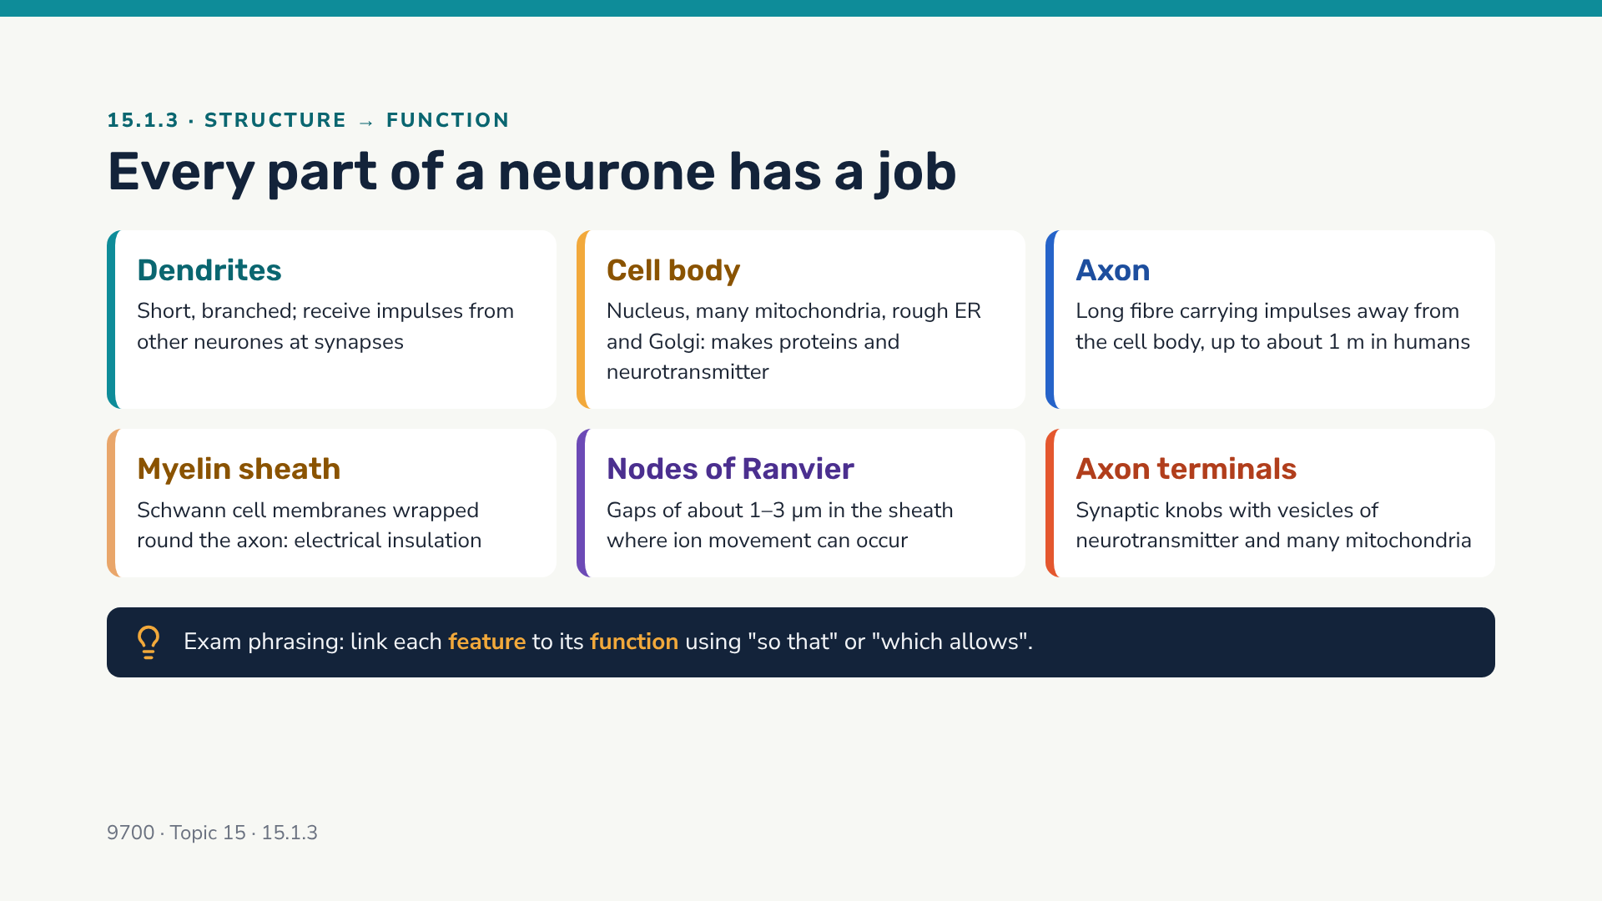
Notes:
Example of a good answer: "The axon terminals contain many mitochondria, which provide ATP for the synthesis of acetylcholine and for exocytosis of vesicles."

Slide 24
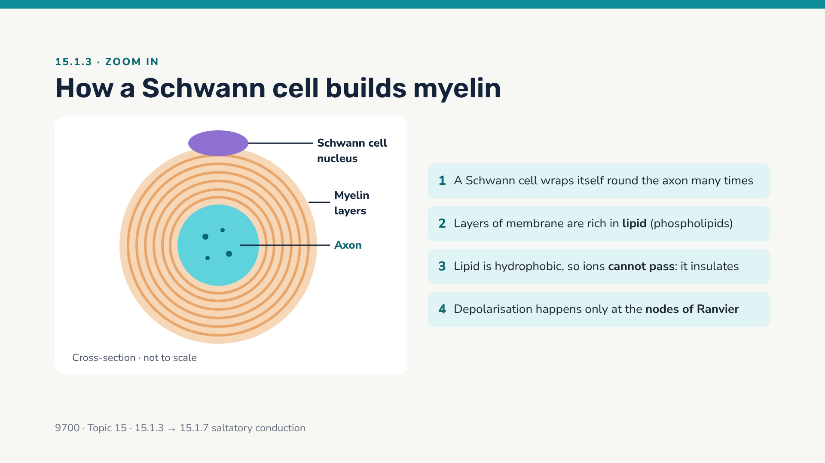
Notes:
Bridge to 15.1.7: because ions can only cross the membrane at the nodes, the action potential "jumps" from node to node — saltatory conduction. Not all neurones are myelinated; many in the autonomic system are not.

Slide 25
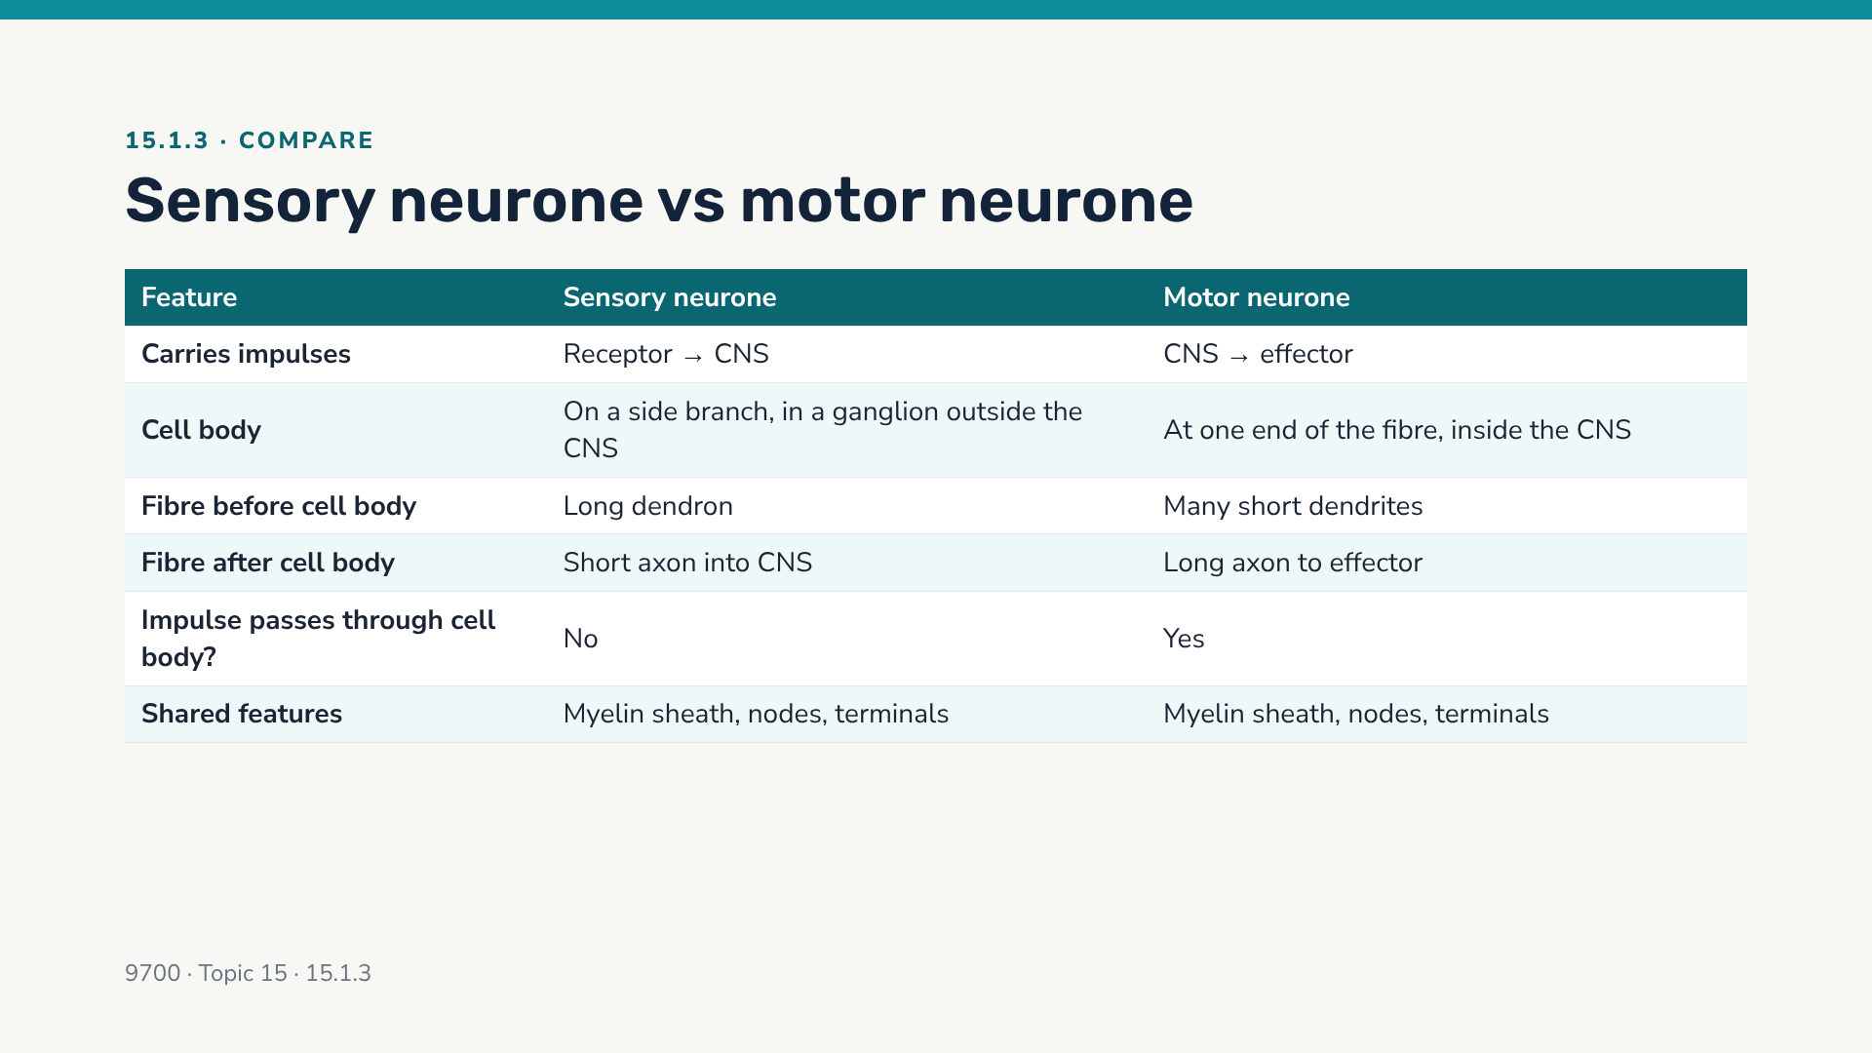
Notes:
Quick oral check: cover one column and ask students to recall it from the other. Intermediate neurones: within the CNS, short, many connections.

Slide 26
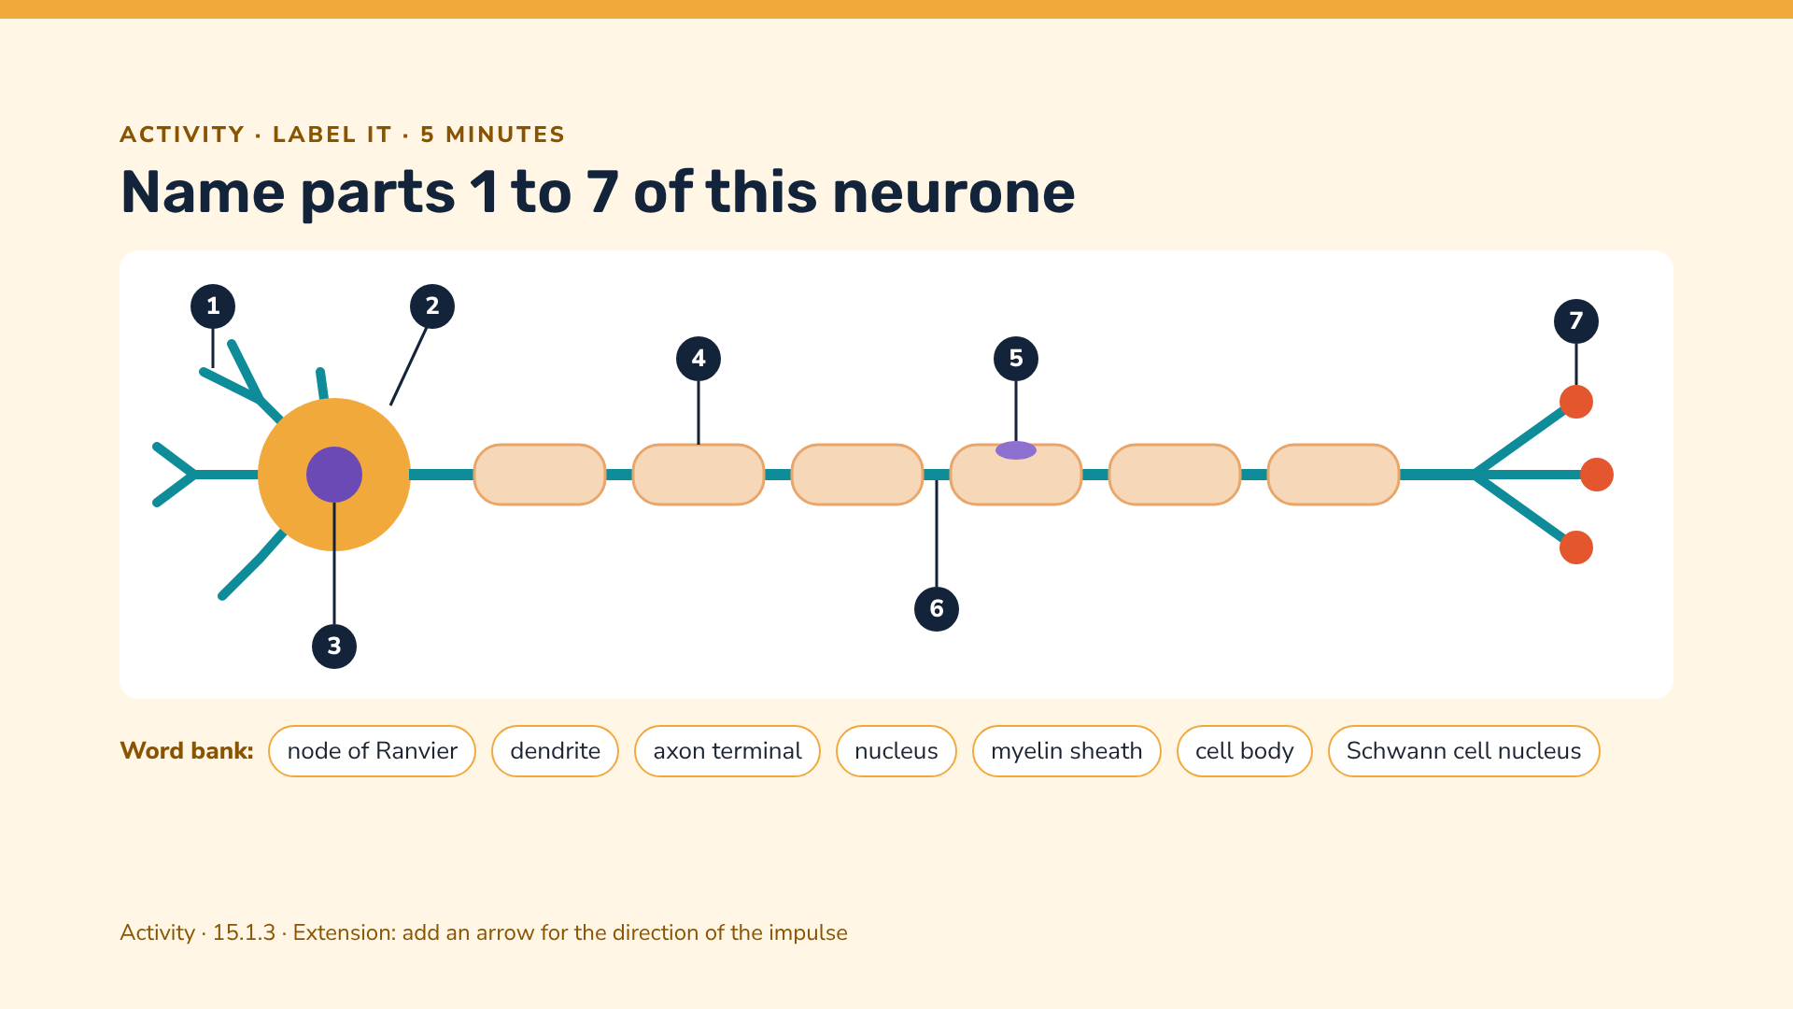
Notes:
Answers: 1 dendrite; 2 cell body; 3 nucleus; 4 myelin sheath; 5 Schwann cell nucleus; 6 node of Ranvier; 7 axon terminal (synaptic knob). Extension: arrow points left to right (cell body → terminals). Which type is this? Motor neurone (cell body at the end, long axon).

Slide 27
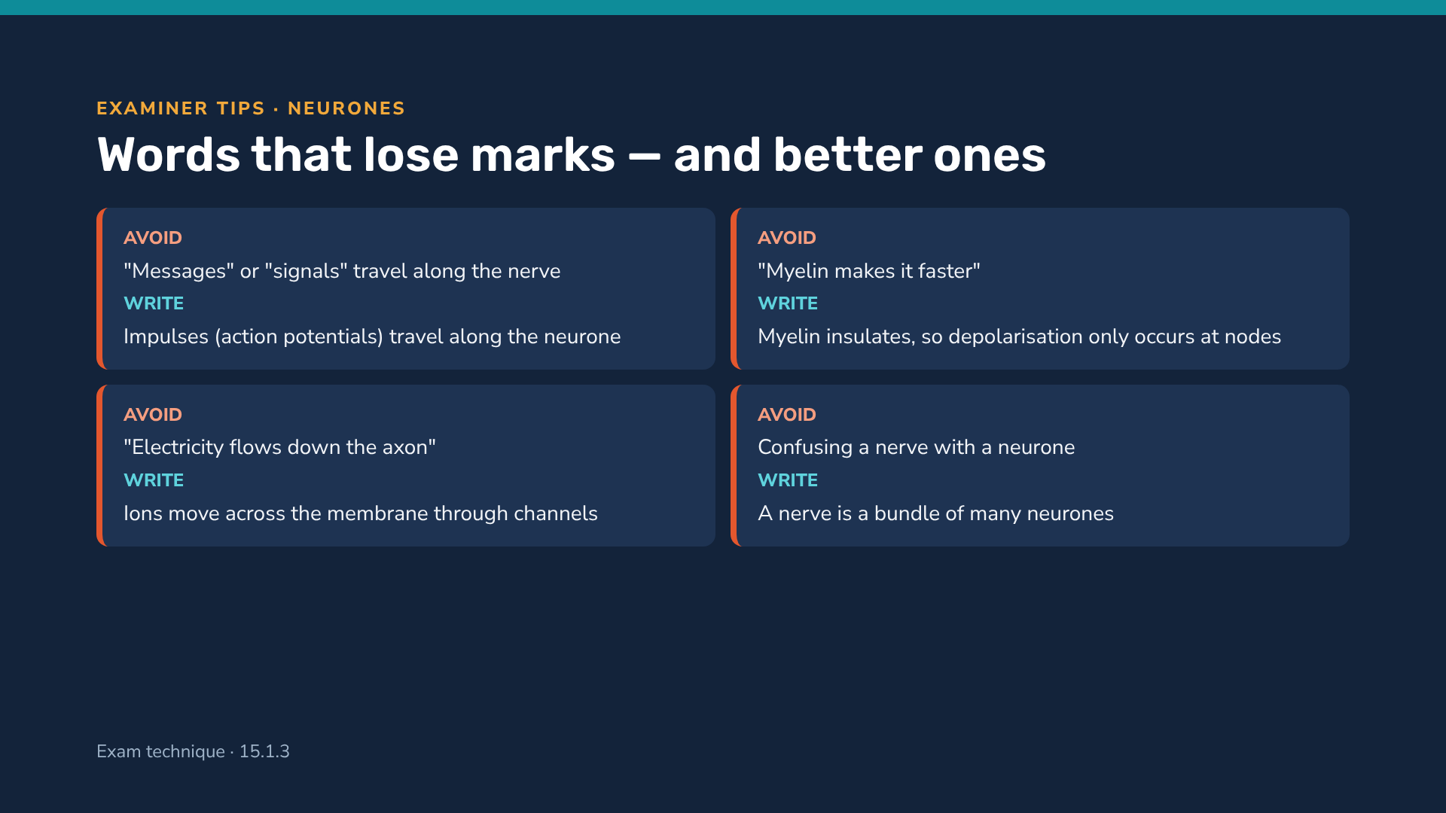
Notes:
These are common phrasing slips; precise vocabulary is rewarded in mark schemes. Ask students to rewrite a weak answer using the "write" column.

Slide 28
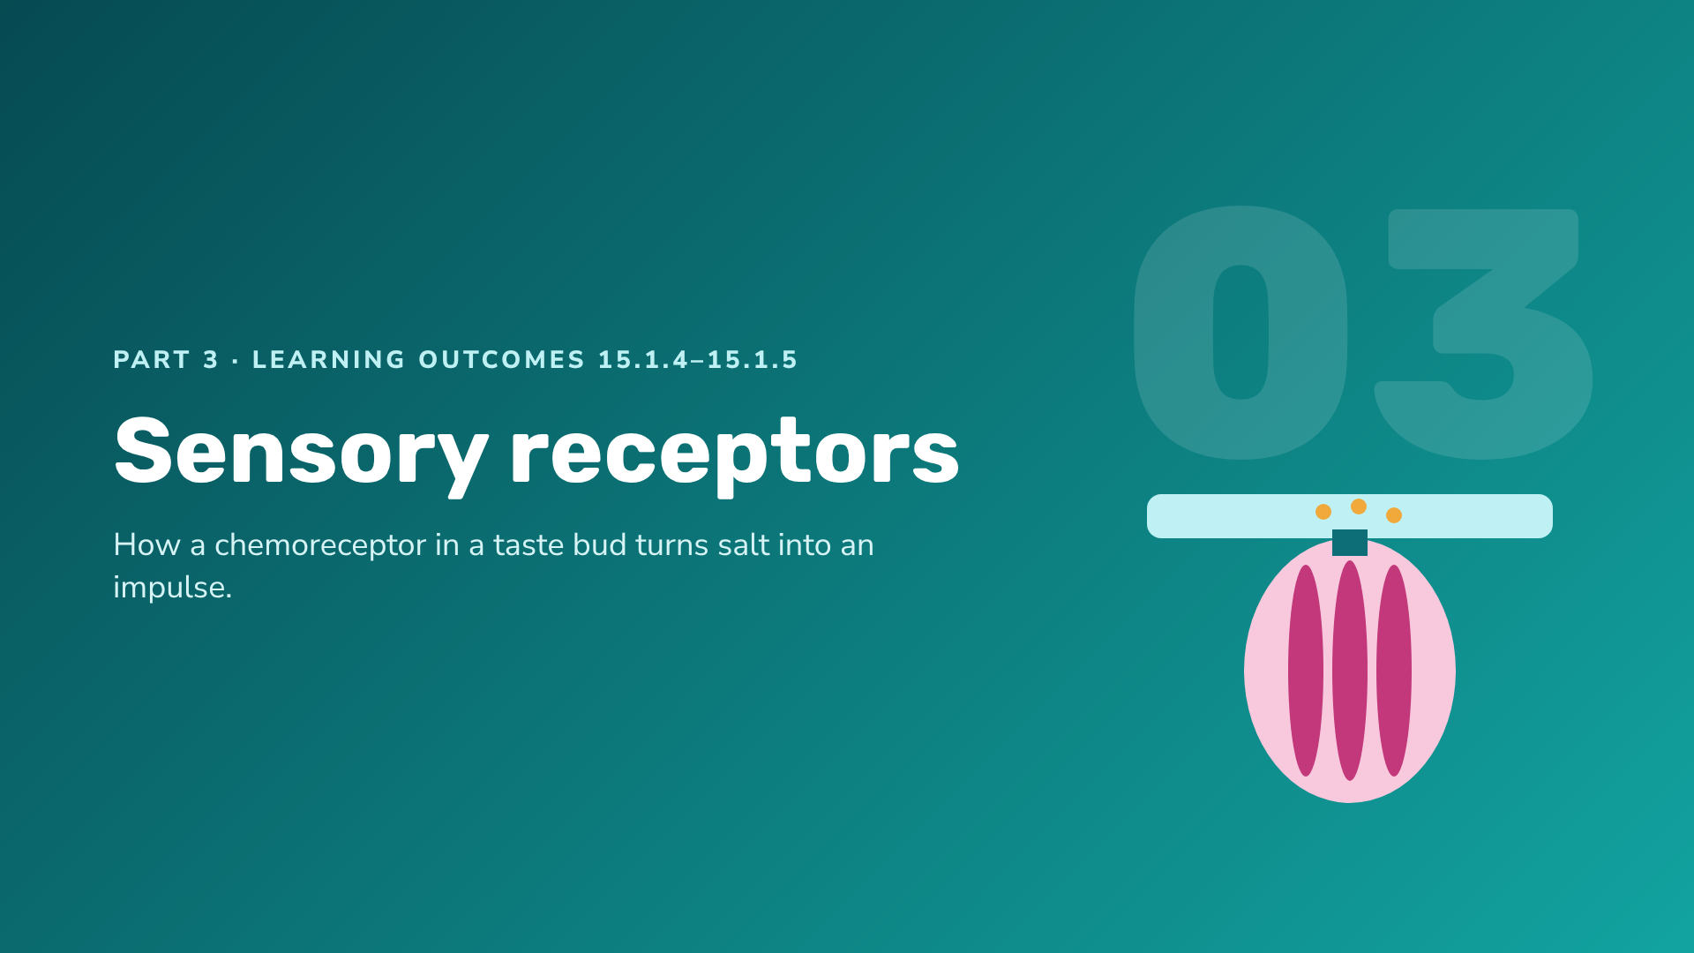
Notes:
Section 3: receptors as transducers, and the sequence of events in a taste-bud chemoreceptor (the syllabus's required example).

Slide 29
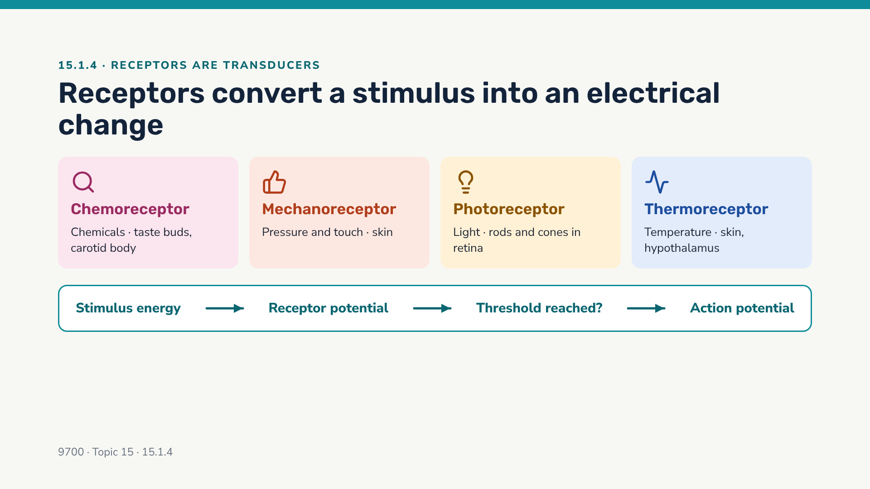
Notes:
A receptor is specific to one type of stimulus. A small stimulus gives a small receptor potential (graded); only if it reaches threshold is an action potential triggered in the sensory neurone. Some receptors are specialised ends of sensory neurones; others (like taste cells) are separate cells that synapse with a sensory neurone.

Slide 30
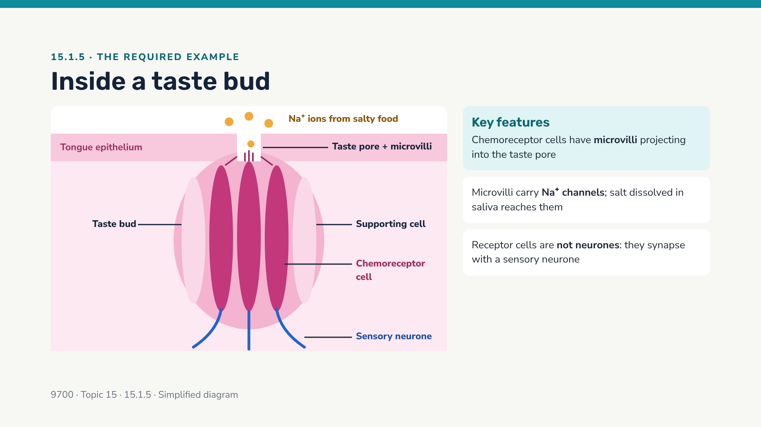
Notes:
Point out that the receptor cell releases neurotransmitter onto the sensory neurone — so the taste cell behaves like a presynaptic cell. Next slide gives the full sequence.

Slide 31
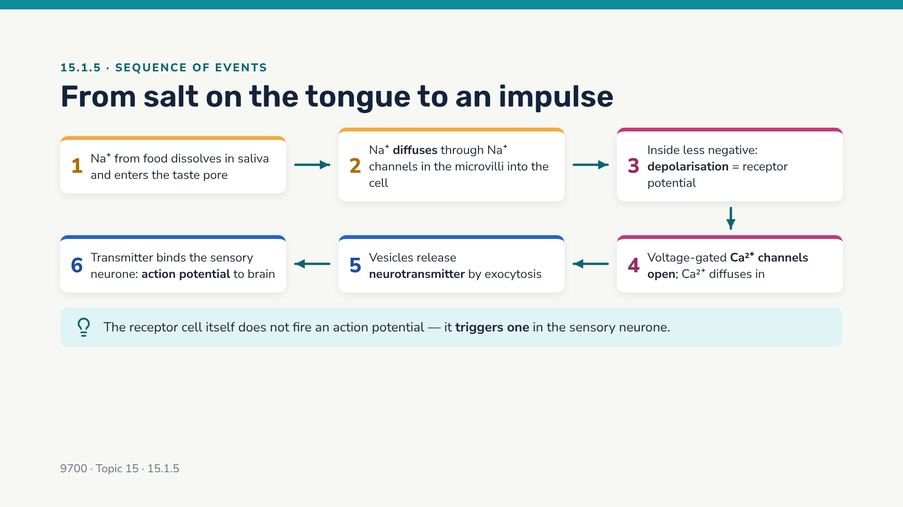
Notes:
This is the syllabus sequence for 15.1.5. Note the parallel with a synapse: depolarisation → Ca2+ channels → exocytosis of transmitter. Read the bottom row from right to left (4 → 5 → 6).

Slide 32
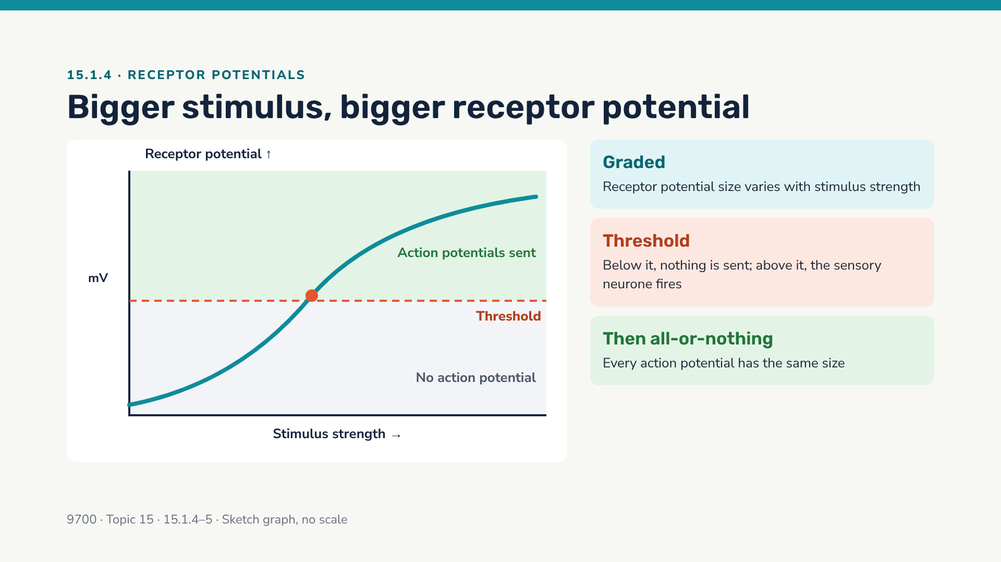
Notes:
Contrast: receptor potentials are graded; action potentials are all-or-nothing. This is the key idea for the next two slides.

Slide 33
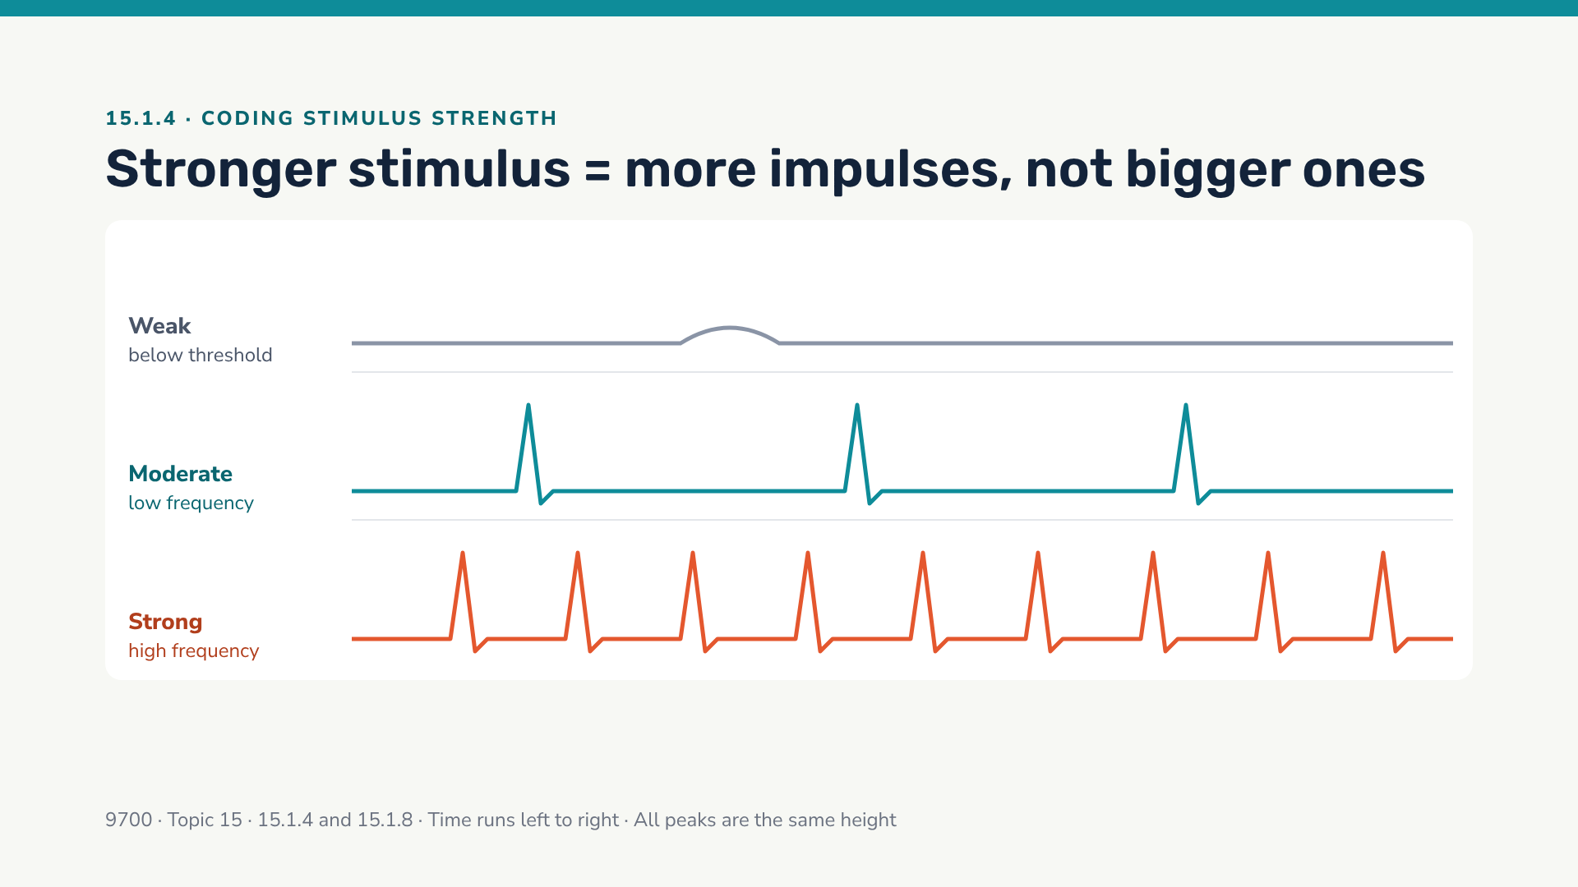
Notes:
Ask: "Why are all the peaks the same height?" (All-or-nothing.) "What limits how close together they can be?" (The refractory period — sets up 15.1.8.) The brain also judges strength by how many receptors/neurones are firing.

Slide 34
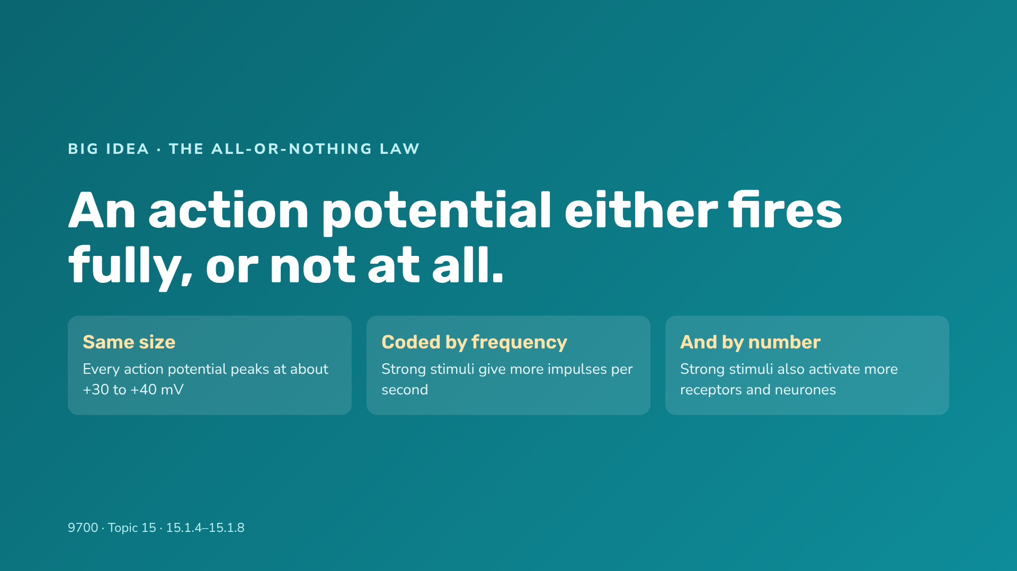
Notes:
Analogy: flushing a toilet — pushing the handle harder does not give a bigger flush; you need to push it past a threshold, then it always flushes the same. To signal "more", you flush more often.

Slide 35
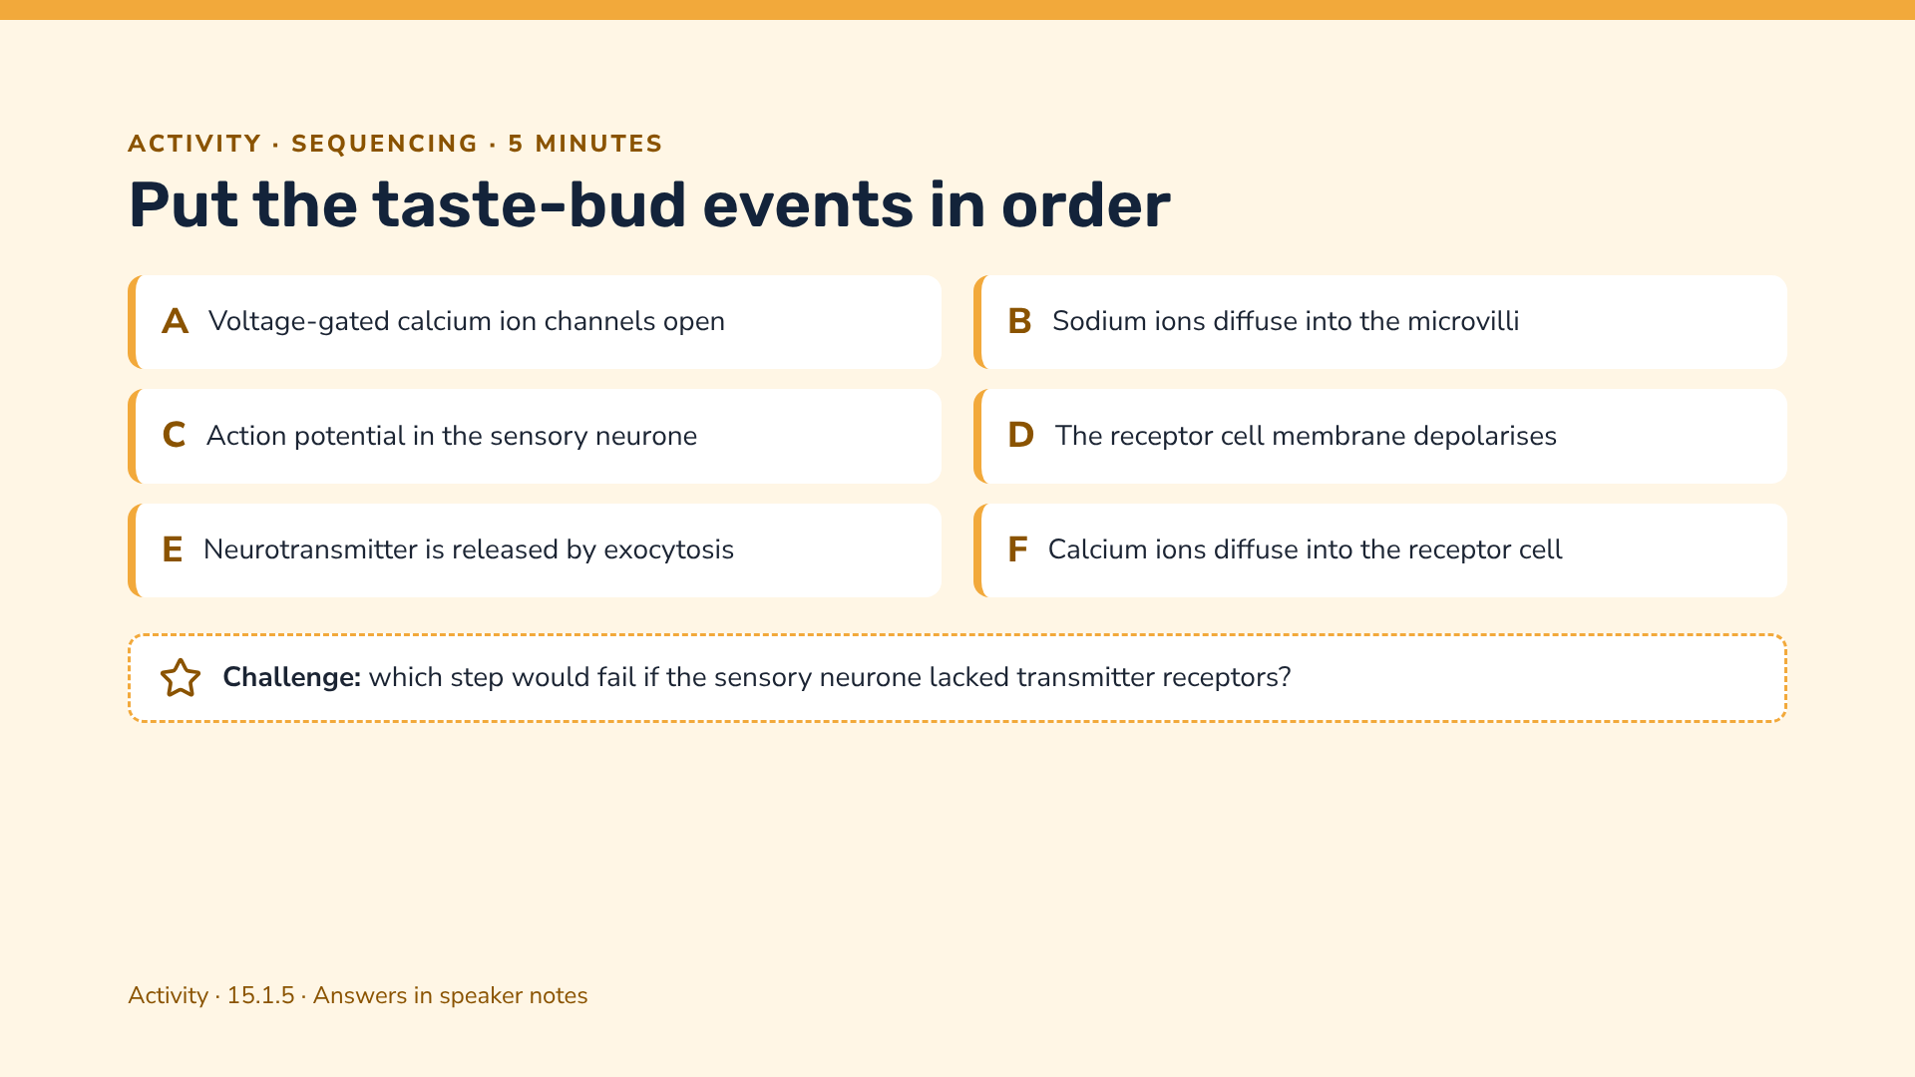
Notes:
Correct order: B → D → A → F → E → C. Challenge: C would fail — transmitter could not bind, so no depolarisation / action potential in the sensory neurone.

Slide 36
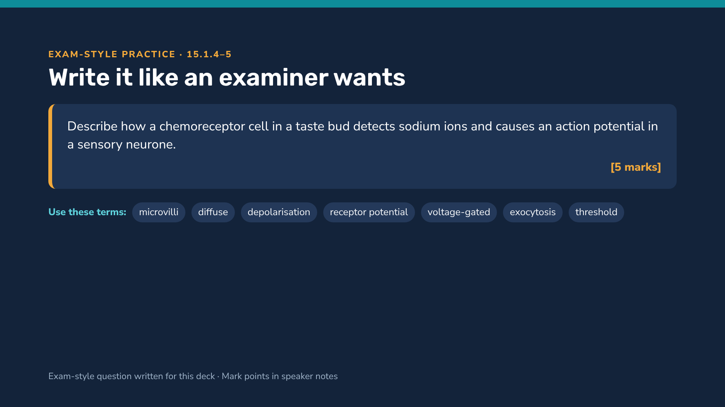
Notes:
Mark points (any 5): Na+ diffuse through (Na+) channels in microvilli / cell surface membrane; inside of cell becomes less negative / depolarisation; this is a receptor potential / generator potential; if threshold reached, voltage-gated Ca2+ channels open; Ca2+ diffuse into the cell; vesicles fuse with membrane / exocytosis of neurotransmitter; neurotransmitter binds to receptors on the sensory neurone; depolarises the sensory neurone / action potential if threshold reached.

Slide 37
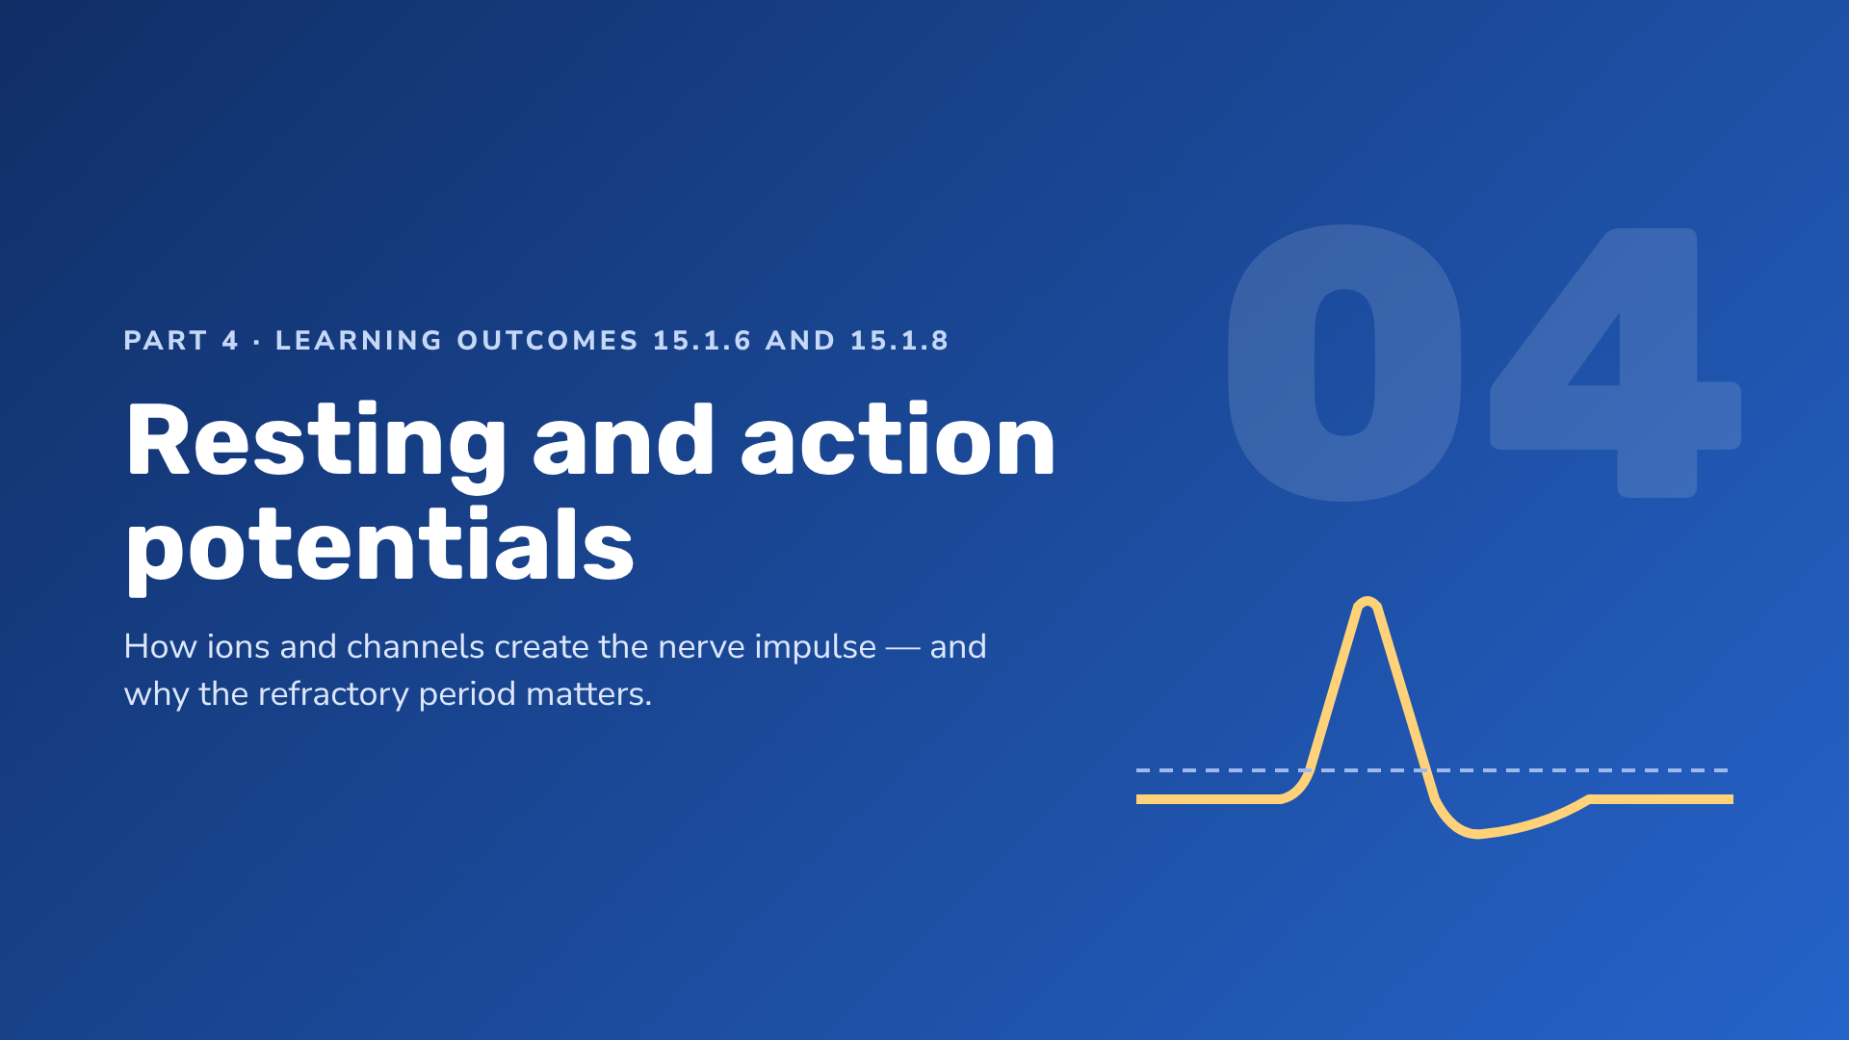
Notes:
This is the most heavily examined part of Topic 15. Expect graph interpretation and extended explanations.

Slide 38
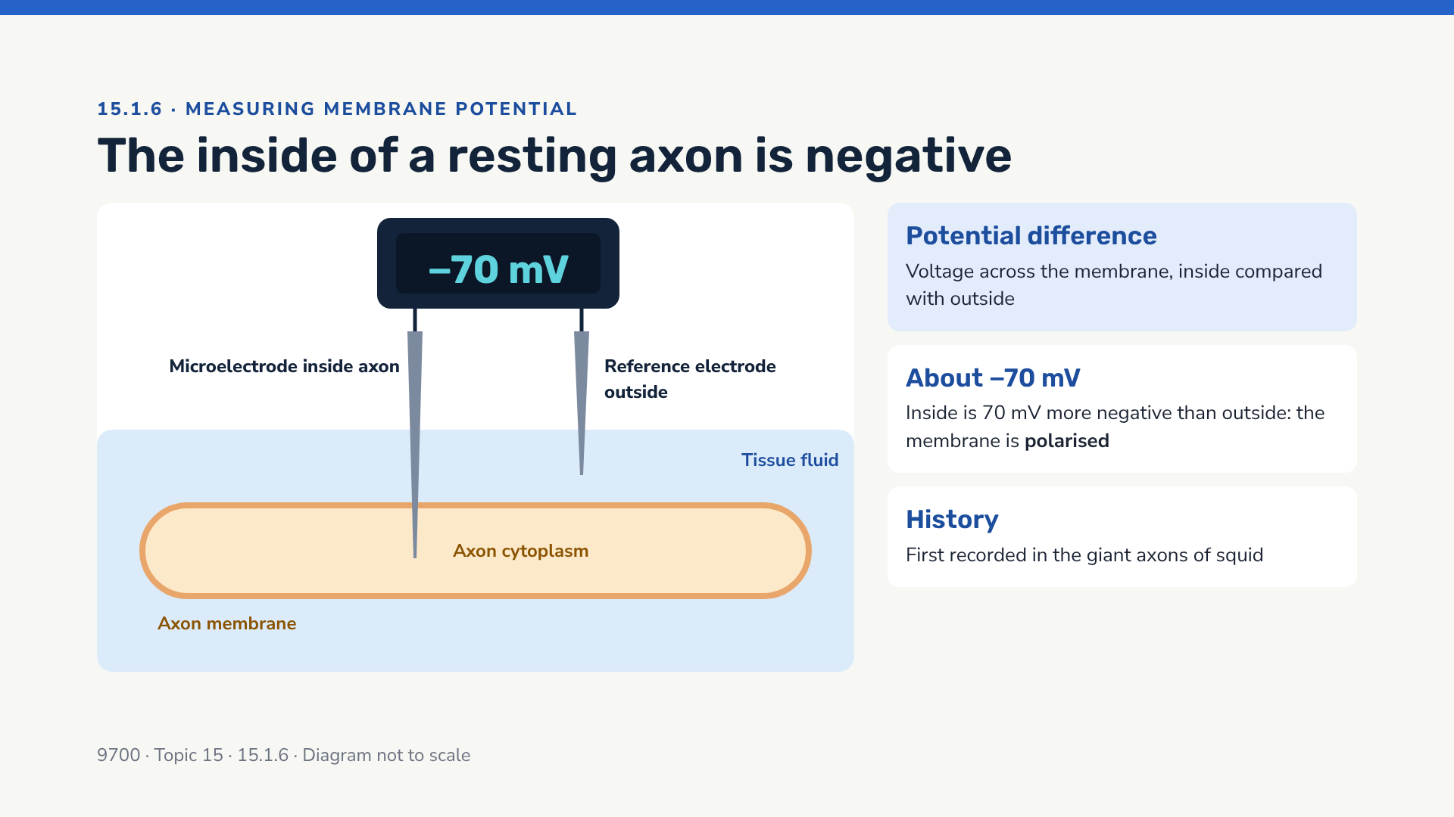
Notes:
Values quoted in textbooks vary slightly (−60 to −70 mV); accept −70 mV as the standard figure. The trace is displayed on an oscilloscope in real experiments.

Slide 39
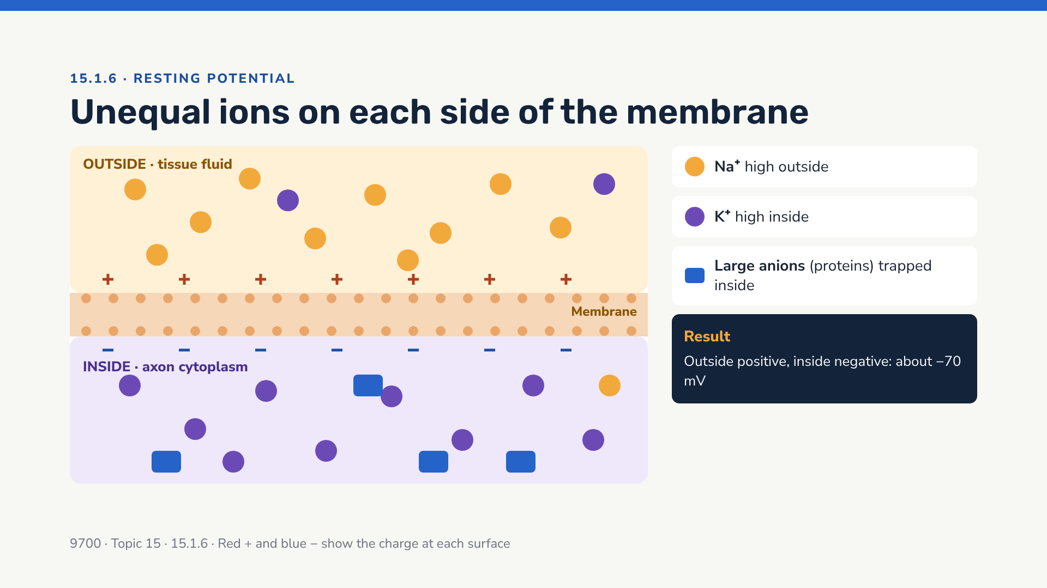
Notes:
Use this picture before explaining HOW the gradient is maintained (next slide). Ask: "If ions could move freely, which way would Na+ go? K+?" (Na+ in, K+ out — both down their concentration gradients.)

Slide 40
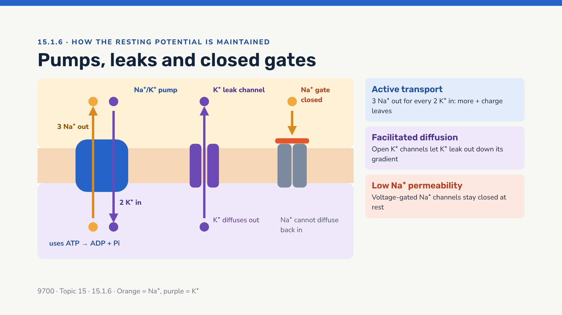
Notes:
Key exam point: the membrane is much MORE permeable to K+ than to Na+ at rest, so K+ diffuses out faster than Na+ can leak in. Combined with the 3:2 pump ratio and trapped organic anions, the inside stays at about −70 mV.

Slide 41
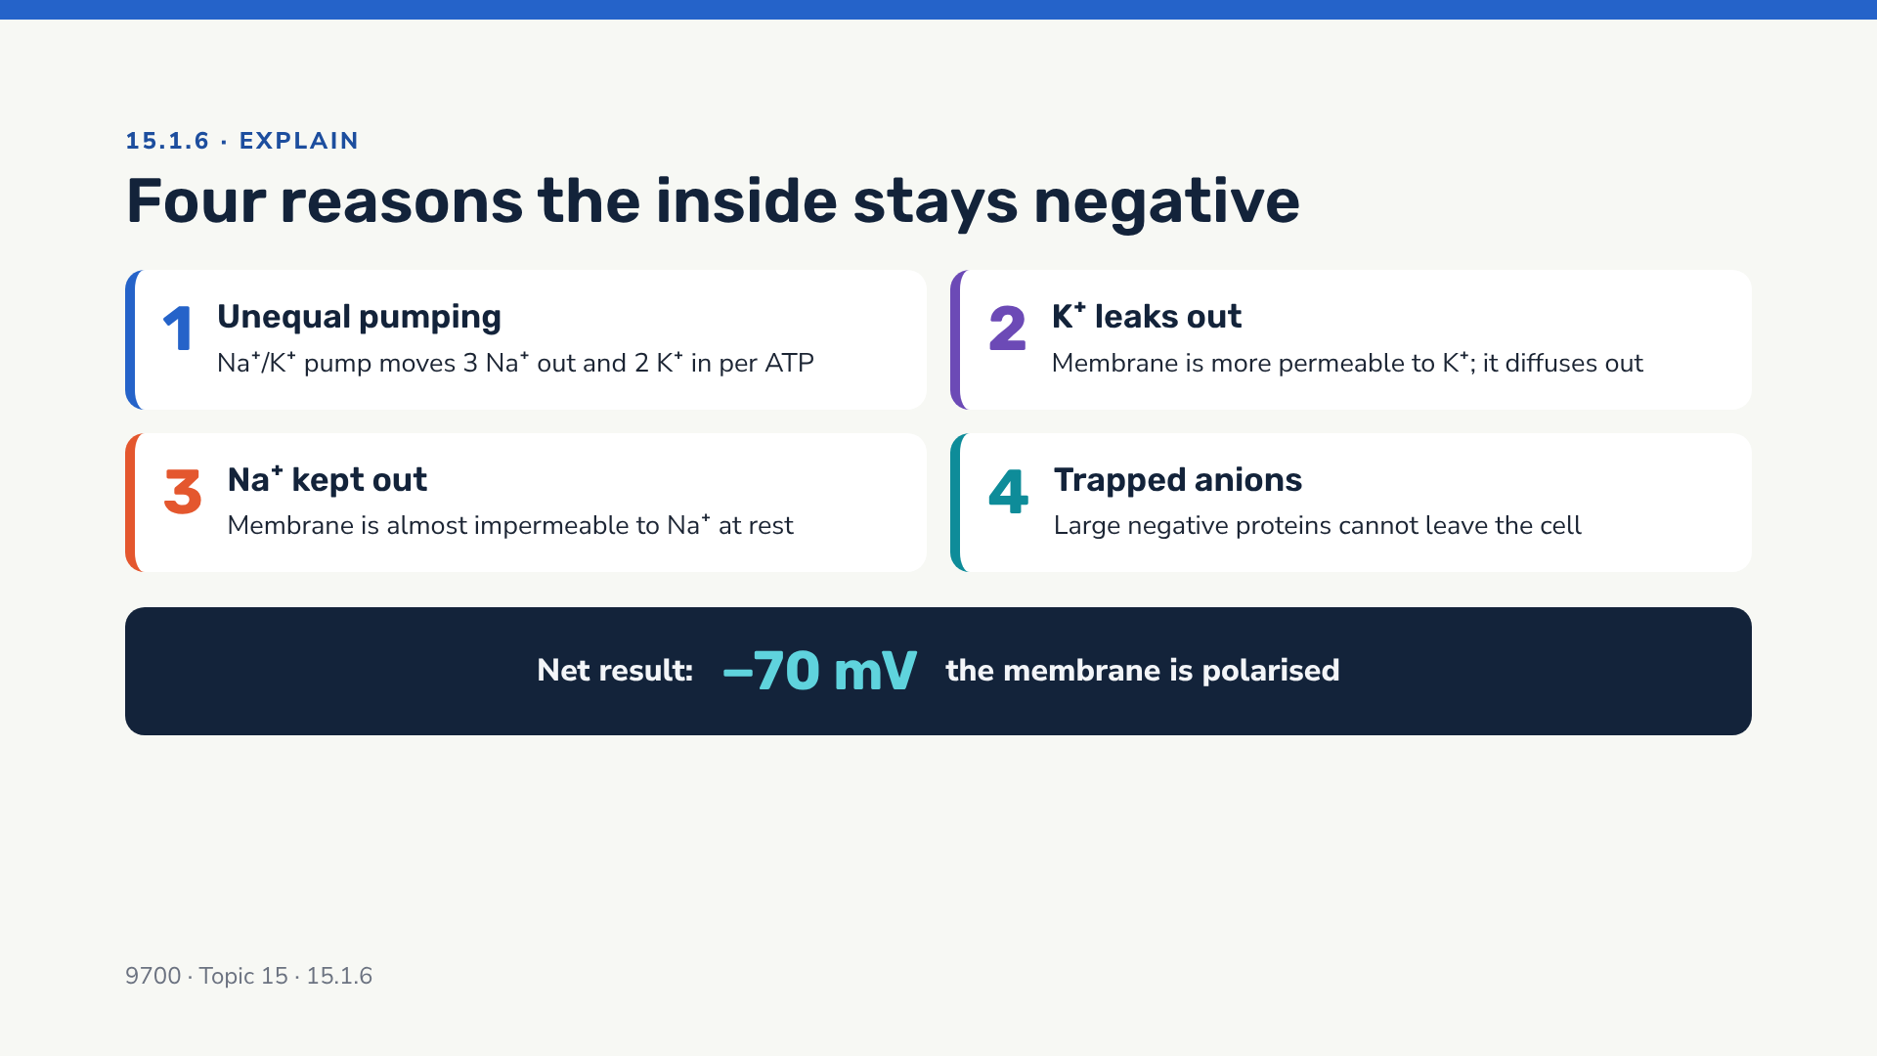
Notes:
Mnemonic: "Pump, Leak, Lock, Lock-in" — Pump (3:2), K+ Leak, Na+ gates Locked, anions Locked in. Mark schemes usually credit points 1–3 most strongly.

Slide 42
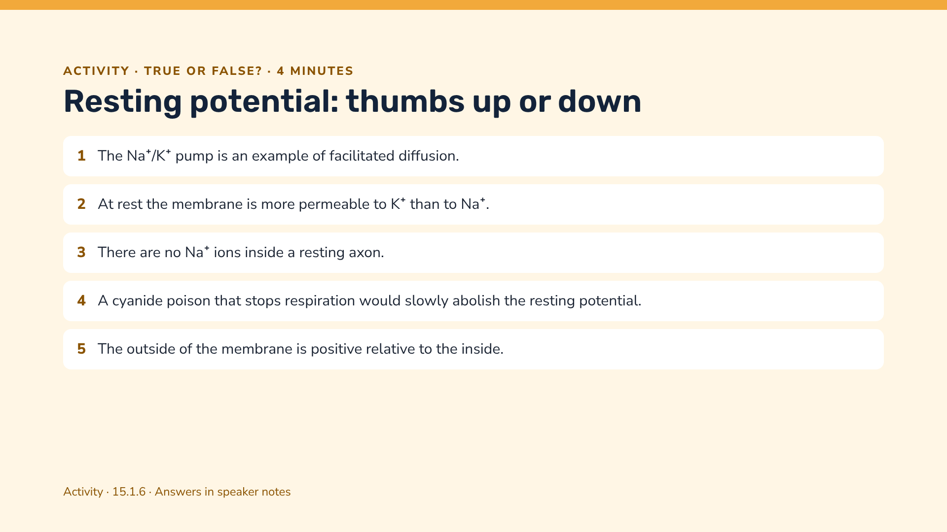
Notes:
1 False — it is active transport (uses ATP). 2 True. 3 False — the concentration is low, not zero. 4 True — no ATP, so the pump stops and the gradients run down. 5 True.

Slide 43
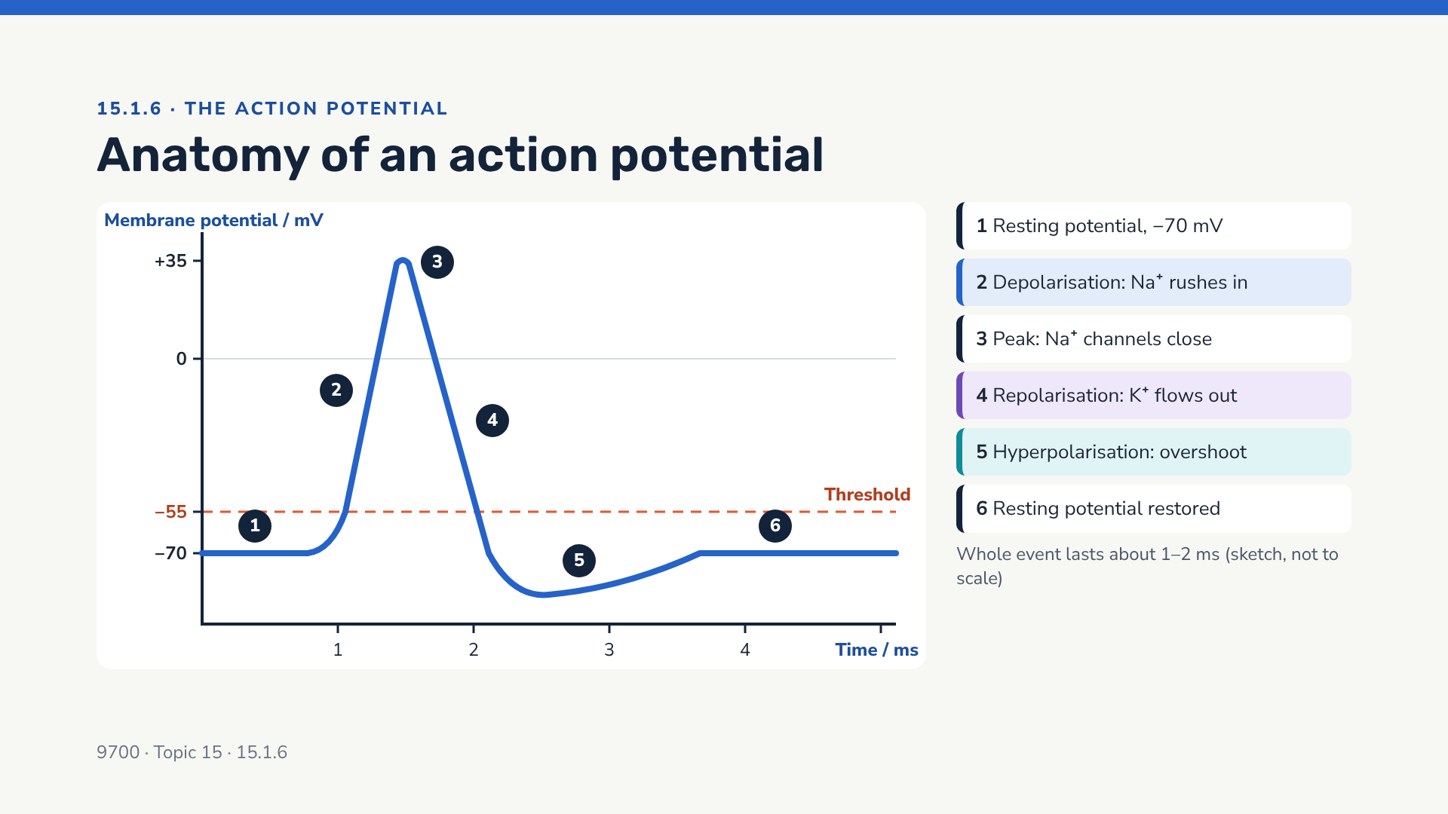
Notes:
Have students copy this graph and annotate it as you go through the next three slides. Typical values: threshold about −55 mV (textbooks quote −50 to −55), peak +30 to +40 mV, hyperpolarisation to about −80 to −90 mV.

Slide 44
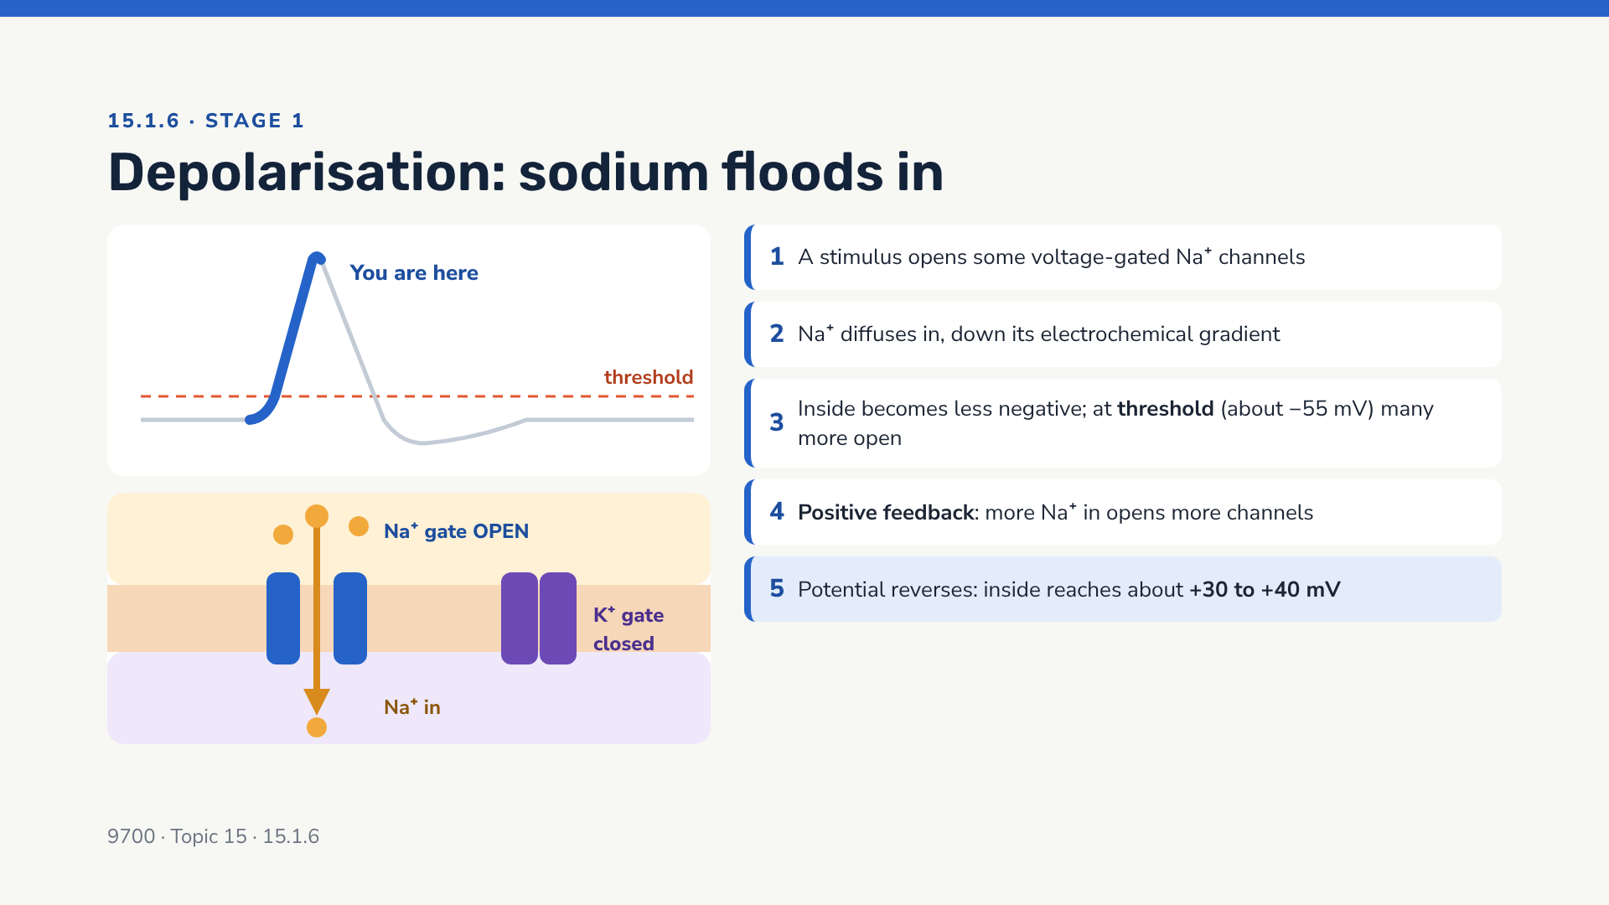
Notes:
Emphasise "voltage-gated": these channels open in response to a change in membrane potential. Electrochemical gradient = Na+ is more concentrated outside AND attracted to the negative inside.

Slide 45
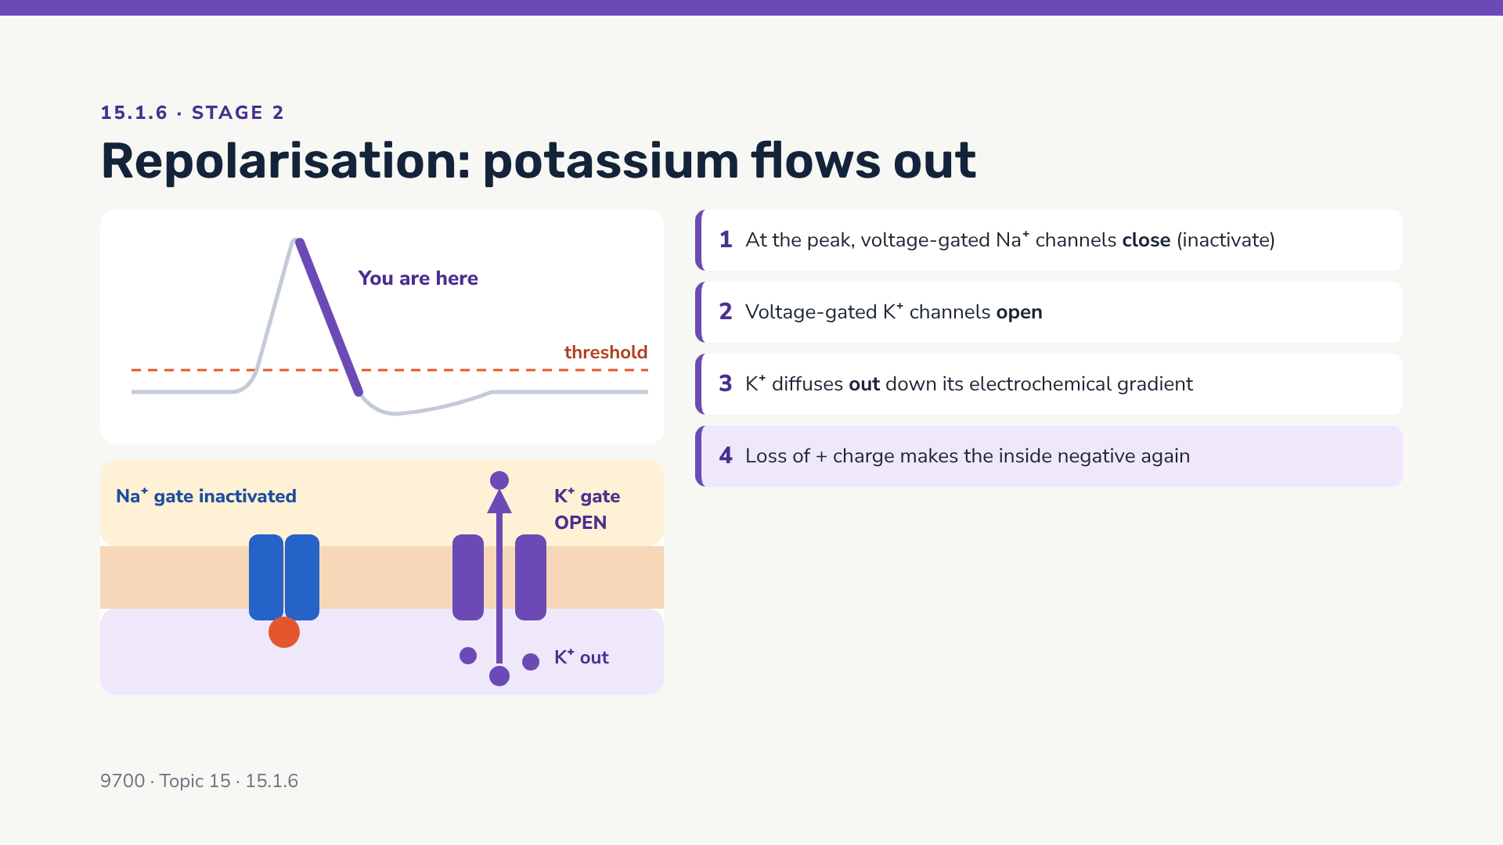
Notes:
Note that the red ball in the diagram represents the inactivation gate plugging the Na+ channel. It cannot reopen until the membrane has repolarised — this is the basis of the absolute refractory period.

Slide 46
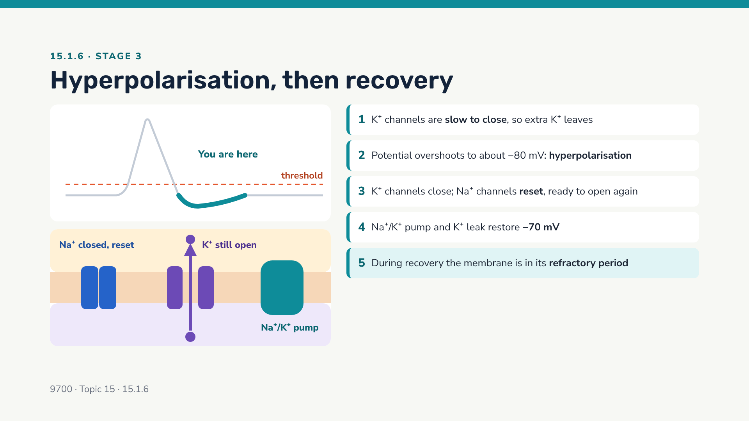
Notes:
Syllabus wording: "how the resting potential is restored during the refractory period". Note that very few ions actually move during one action potential, so the concentration gradients barely change — the pump keeps them steady over many impulses.

Slide 47
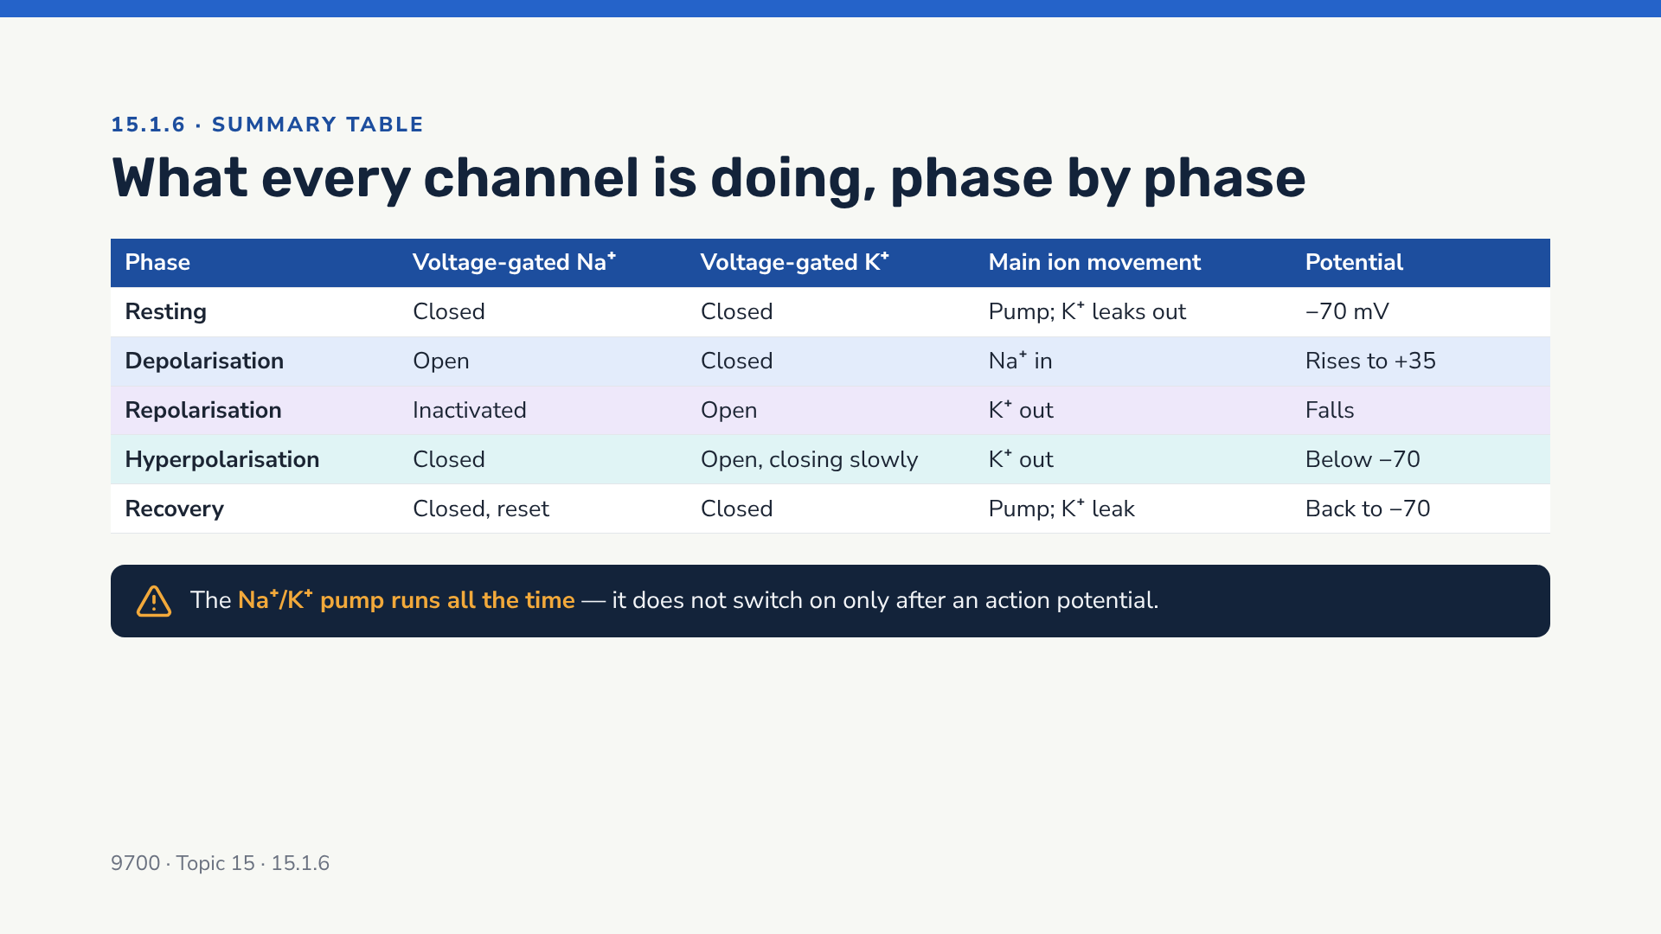
Notes:
Print as a revision card. Common misconception: "the pump causes repolarisation". It does not — repolarisation is caused by K+ diffusing out through voltage-gated K+ channels.

Slide 48
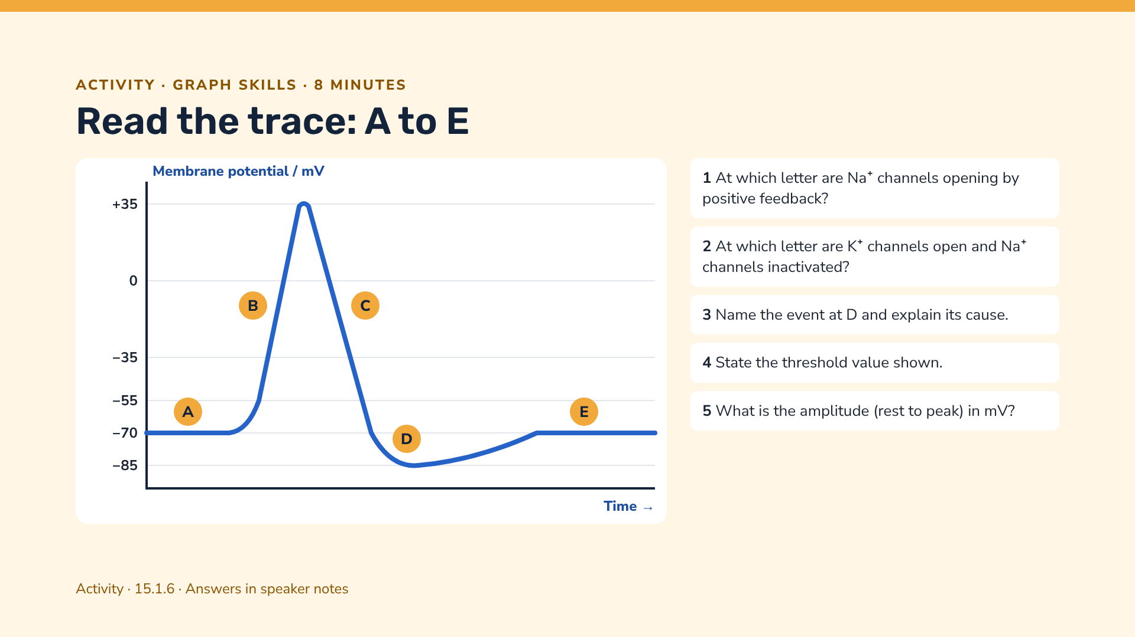
Notes:
Answers: 1 B. 2 C. 3 Hyperpolarisation — voltage-gated K+ channels are slow to close so too many K+ ions diffuse out. 4 −55 mV. 5 From −70 to +35 = 105 mV.

Slide 49
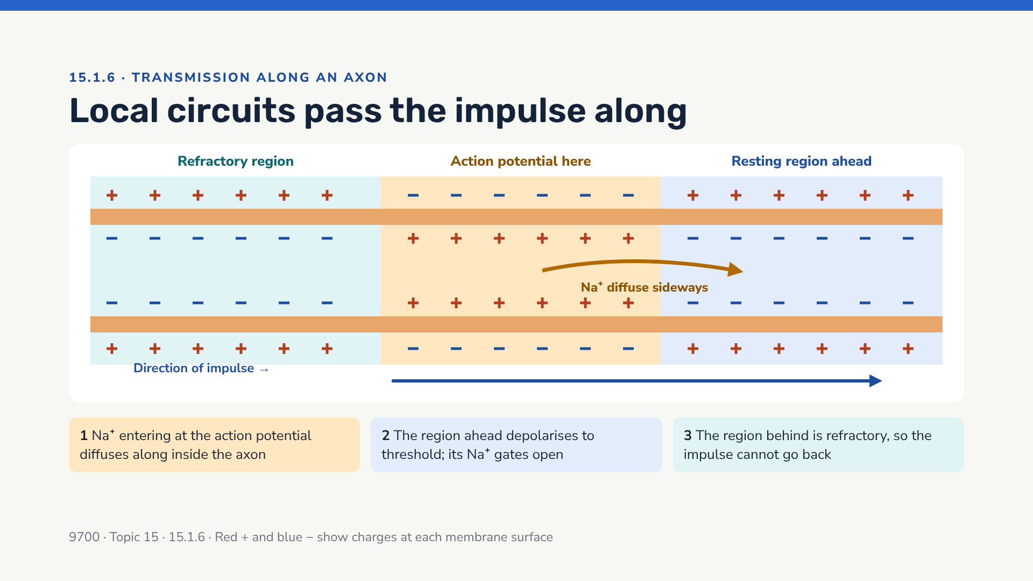
Notes:
Describe this as a "Mexican wave" — each region triggers the next. In unmyelinated axons this happens along the whole membrane, so it is relatively slow. Myelinated axons are next.

Slide 50
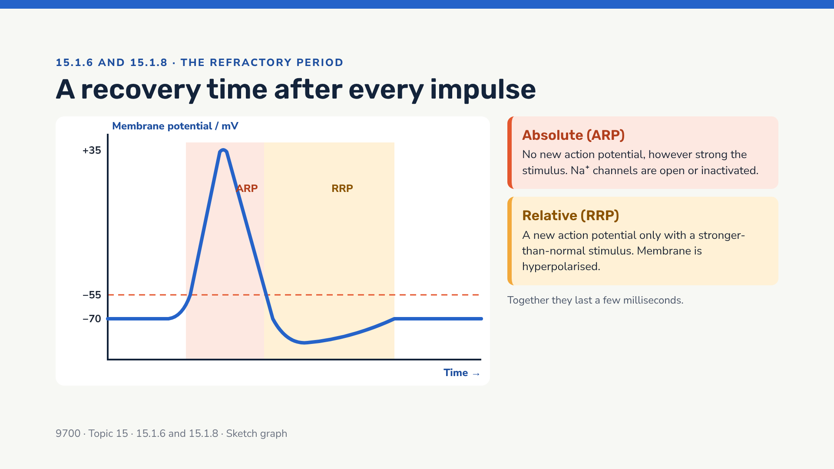
Notes:
The syllabus does not require the absolute/relative distinction by name, but it helps explain 15.1.8. During the ARP the Na+ channel inactivation gates have not reset; during the RRP, K+ channels are still open so it is harder to reach threshold.

Slide 51

Notes:
15.1.8 asks students to "explain the importance of the refractory period in determining the frequency of impulses". Point 3 is the direct answer; points 1 and 2 are frequently credited too.

Slide 52

Notes:
Point out units: frequency in impulses per second (Hz). The longer the refractory period, the lower the maximum frequency. Real maximum firing rates are usually lower than this simple calculation suggests.

Slide 53

Notes:
Q1: 1 ÷ 0.004 = 250 impulses per second. Q2: 1 ÷ 800 = 0.00125 s = 1.25 ms. Q3: 0.60 ÷ 0.0060 = 100 m s−1. Q4: during the relative refractory period a stronger-than-normal stimulus is needed; stimuli are rarely that strong; also time is needed for the pump / ion movements; the absolute period is only part of the full recovery.

Slide 54

Notes:
Q1 (any 6): stimulus / threshold reached (about −55 mV); voltage-gated Na+ channels open; Na+ diffuses in; positive feedback, more channels open; inside becomes positive / about +30 to +40 mV; Na+ channels close / inactivate; voltage-gated K+ channels open; K+ diffuses out; repolarisation; K+ channels slow to close so hyperpolarisation; Na+/K+ pump (and K+ leak) restore −70 mV. Q2 (3): during refractory period another action potential cannot be generated (absolute) / needs a stronger stimulus (relative); so action potentials are discrete / separated; this sets a minimum time between impulses / maximum frequency; stronger stimuli give higher frequency up to this limit.

Slide 55

Notes:
"Saltare" is Latin for "to leap or jump" — a useful hook for remembering the term.

Slide 56

Notes:
Speeds vary with diameter and temperature; quote "about 100 m s−1" for myelinated mammalian motor neurones and "a few m s−1" or less for thin unmyelinated fibres.

Slide 57

Notes:
Full answer: fewer places where depolarisation must occur → fewer action potentials per length of axon → faster. Bonus: less ATP used because fewer ions need pumping back (only at nodes) — so myelination is also more energy-efficient.

Slide 58

Notes:
Only myelination/saltatory conduction is named in 15.1.7, but data questions often show diameter or temperature effects. Endotherms (mammals, birds) have faster conduction partly because of their higher, constant body temperature.

Slide 59

Notes:
Answer: myelination increases speed far more efficiently than increasing diameter. Vertebrates can pack many fast, narrow myelinated neurones into a small space; squid evolved one very wide axon for its escape response.

Slide 60

Notes:
1 Without myelin, saltatory conduction cannot occur in that region; depolarisation must happen along the whole membrane / more action potentials per length; slower. 2 Na+ channels are concentrated at the nodes, so the demyelinated membrane may have too few channels; local circuits leak (ions lost across membrane), so the next node may not reach threshold — conduction block. 3 Delayed / missing impulses to muscles → weakness, poor coordination; to/from eyes (optic nerve) → blurred vision.

Slide 61

Notes:
Answers: Q1 D (K+ out). Q2 B (only at nodes). Q3 B (refractory period — the region behind cannot be re-excited).

Slide 62

Notes:
A cholinergic synapse is one that uses acetylcholine (ACh) as its neurotransmitter.

Slide 63

Notes:
Ask why impulses can't simply jump the gap electrically: the cleft is too wide for local circuits to depolarise the postsynaptic membrane. Synapses also let the nervous system integrate and filter information.

Slide 64

Notes:
Point out: many mitochondria (ATP for vesicle movement, ACh resynthesis and Ca2+ pumping); vesicles cluster at the presynaptic membrane; receptors only on the postsynaptic side — which is why transmission is one-way.

Slide 65

Notes:
Model answer phrase for step 8: "Acetylcholinesterase hydrolyses acetylcholine into choline and ethanoic acid (acetate), which diffuse back to the presynaptic knob, where ACh is resynthesised using ATP." This stops continuous stimulation of the postsynaptic membrane.

Slide 66

Notes:
The syllabus explicitly mentions calcium ions for 15.1.9 — candidates commonly lose marks by forgetting the Ca2+ step. Link: the same Ca2+ trigger occurs in the taste-bud receptor cell (15.1.5) and in muscle (15.1.10–12, from the sarcoplasmic reticulum).

Slide 67

Notes:
ACh is resynthesised from choline and acetyl coenzyme A (acetyl CoA from the link reaction — a nice synoptic link to respiration, Topic 12). The enzyme AChE is located in the synaptic cleft / on the postsynaptic membrane.

Slide 68

Notes:
Only one-way transmission follows directly from 15.1.9. The others help with application ("suggest") questions.

Slide 69

Notes:
Organophosphates are found in some insecticides and nerve agents. Curare was used historically as an arrow poison and as a muscle relaxant in surgery. These are not required facts — students should be able to reason about any unfamiliar substance from a description.

Slide 70

Notes:
Toxin variations: (a) "Curare" student blocks the receptors; (b) "Organophosphate" student holds AChE so it can't act — ACh keeps binding; (c) "No calcium" — Ca2+ actors sit down, so vesicles never fuse. Debrief: which step was affected each time?

Slide 71

Notes:
W: no Ca2+ entry → vesicles don't fuse → no ACh released → no postsynaptic action potential (less). X: ACh can't be resynthesised → vesicles run out with repeated stimulation → transmission fails over time (fatigue). Y: receptors stay open → continuous depolarisation → continuous stimulation (e.g. muscle spasm), then possibly blocked as Na+ channels stay inactivated. Z: K+ leaves → inside more negative / hyperpolarised → harder to reach threshold → less firing (inhibitory).

Slide 72

Notes:
(a) depolarisation / action potential opens voltage-gated Ca2+ channels; Ca2+ diffuse into presynaptic knob; cause vesicles to move to / fuse with presynaptic membrane; exocytosis of ACh; Ca2+ then pumped out. (b) vesicles of ACh only in presynaptic knob; receptors only on postsynaptic membrane. (c) ACh not broken down / remains in cleft; continues to bind receptors / Na+ channels stay open; continuous depolarisation of the muscle membrane; muscle stays contracted / spasms / cannot relax (may lead to paralysis).

Slide 73

Notes:
Striated (skeletal) muscle only. Start with structure (15.1.11), then excitation (15.1.10), then the sliding filament model (15.1.12).

Slide 74

Notes:
Muscle fibre = muscle cell. It forms by fusion of many cells, so it is multinucleate. Specialised names: sarcolemma (cell surface membrane), sarcoplasm (cytoplasm), sarcoplasmic reticulum (specialised ER).

Slide 75

Notes:
Structure–function: T-tubules are infoldings of the sarcolemma, so depolarisation reaches every myofibril at almost the same time; SR wraps each myofibril, so Ca2+ is released right where it is needed.

Slide 76

Notes:
Definitions: A band = length of the thick filaments (includes overlap) — dark. I band = thin filaments only — light; it is split by the Z line, so half of each I band belongs to the next sarcomere. H zone = thick filaments only, no overlap. M line = middle, holds thick filaments together. Z line = anchors thin filaments; marks the ends of each sarcomere.

Slide 77

Notes:
Answer: Z line to Z line = 600 px on screen; scale bar 240 px = 1 µm; so sarcomere = 600 ÷ 240 = 2.5 µm. Encourage students to measure with a ruler on printed copies. In real micrographs, also show them the M line as a thin dark line in the middle of the H zone.

Slide 78

Notes:
The myosin heads on each half of the thick filament point in opposite directions, so both sets of thin filaments are pulled towards the M line.

Slide 79

Notes:
Mnemonic: the A band stays the sAme; HI changes (H zone and I band shorten). This banding evidence is what led to the sliding filament model.

Slide 80

Notes:
Q1 A band = thick filament length = 1.6 µm (it never changes). Q2 2.4 − 1.6 = 0.8 µm (0.4 µm at each end). Q3 H zone = sarcomere − 2 × thin = 2.4 − 2.0 = 0.4 µm when relaxed; at 2.0 µm, H = 2.0 − 2.0 = 0 (H zone disappears). Q4 thin filaments overlap each other / interfere, and thick filaments hit the Z lines, so fewer effective cross-bridges can form.

Slide 81

Notes:
The folds of the motor end plate increase surface area for ACh receptors. AChE is present in the cleft here too. Each muscle fibre normally has one neuromuscular junction; one motor neurone may supply many fibres (a motor unit).

Slide 82

Notes:
15.1.10 wording: "describe the roles of neuromuscular junctions, the T-tubule system and sarcoplasmic reticulum in stimulating contraction in striated muscle." This slide covers all three.

Slide 83

Notes:
Key sequence for exams: Ca2+ binds to TROPONIN (not tropomyosin) → troponin changes shape → TROPOMYOSIN moves → binding sites on ACTIN exposed → MYOSIN heads attach forming cross-bridges.

Slide 84

Notes:
The cycle repeats as long as Ca2+ and ATP are present — each head "rows" along actin many times per second. Heads cycle asynchronously, so tension is maintained. Common error: saying ATP provides energy for the head to ATTACH — it is needed to DETACH and to re-cock.

Slide 85

Notes:
This explains why muscle fibres contain so many mitochondria. Contracting muscle can also regenerate ATP quickly using creatine phosphate, and anaerobically via glycolysis (link to Topic 12), but these are not required here.

Slide 86

Notes:
Note: AChE at the neuromuscular junction removes ACh, so the sarcolemma repolarises and stops releasing Ca2+. Relaxation is an active (ATP-requiring) process because of the Ca2+ pumps.

Slide 87

Notes:
Rigor: after death respiration stops, so no ATP; myosin heads stay bound to actin (ATP needed to detach); also Ca2+ leaks from SR and can't be pumped back. Leaky SR: Ca2+ stays in sarcoplasm, binding sites stay exposed, muscle stays contracted / cannot relax (sustained contraction, cramp). Glycerinated fibres: without Ca2+, tropomyosin blocks the binding sites so cross-bridges can't form, even though ATP is present; Ca2+ binds troponin to expose sites.

Slide 88

Notes:
Challenge students to close their eyes and recite the 10 steps, then add one extra detail to each step. Great as a plenary or a starter for the next lesson.

Slide 89

Notes:
(a) action potential spreads along sarcolemma and down T-tubules; into the centre of the fibre / reaches all myofibrils; T-tubules depolarise the SR membrane; Ca2+ channels in SR open / Ca2+ released into sarcoplasm. (b) Ca2+ binds to troponin; troponin changes shape; tropomyosin moves / exposes binding sites on actin; myosin heads bind, forming cross-bridges; head tilts / power stroke, ADP + Pi released; actin pulled towards M line / centre of sarcomere; ATP binds, myosin head detaches; ATP hydrolysed (myosin ATPase), head returns / re-cocks; cycle repeats; filaments do not change length. (c) I band; H zone (also accept: sarcomere / Z lines closer together). A band does not change.

Slide 90

Notes:
Plants have no nervous system, but they DO use electrical signals (action potentials) as well as plant hormones (plant growth regulators).

Slide 91

Notes:
Plant hormones are sometimes called plant growth regulators because they act at low concentrations and are not always made in specific glands. Link to 14.2: abscisic acid closes stomata using Ca2+ as a second messenger.

Slide 92

Notes:
The trap is a modified leaf. The "teeth" are stiff marginal bristles that interlock to cage the prey. Trigger hairs act as mechanoreceptors.

Slide 93

Notes:
Why two touches? It stops the trap wasting energy on raindrops or debris — a form of short-term "memory" (Ca2+ is thought to build up after the first stimulus). After closing, the struggling prey triggers more action potentials, the trap seals tightly, and glands secrete digestive enzymes (proteases). Closure is a growth-like turgor change, so the trap can only reopen slowly, over hours to days.

Slide 94

Notes:
1 Avoids wasting energy/ATP closing on raindrops or debris; makes it more likely the stimulus is a live, moving insect. 2 Both convert a stimulus into a receptor potential via ion channels; both lead to action potentials if threshold is reached; different stimuli (mechanical vs chemical); taste cell releases transmitter onto a separate neurone, whereas in the trap the action potential spreads through the leaf cells. 3 Closure depends on rapid turgor change / cell expansion (irreversible wall loosening); reopening requires growth / slow water movement and re-establishing gradients. 4 No further stimulation from struggling, so the trap does not seal and no digestion; it reopens (within about a day).

Slide 95

Notes:
Phototropism is a context example only — the syllabus focus is the MECHANISM of elongation (next slide). Auxin moves from cell to cell by diffusion and by carrier proteins (polar transport).

Slide 96

Notes:
Syllabus wording: "explain the role of auxin in elongation growth by stimulating proton pumping to acidify cell walls". Expansins are proteins in the cell wall that are active at low pH; they break hydrogen bonds between cellulose microfibrils and other wall polysaccharides, so the wall can stretch under turgor.

Slide 97

Notes:
Link to 16.3.4: DELLA proteins normally inhibit transcription by binding to a transcription factor (PIF). Gibberellin causes DELLA to be broken down, so PIF can bind to the promoter of the amylase gene and transcription begins. The aleurone layer is a protein-rich layer just inside the seed coat.

Slide 98

Notes:
Use as a revision grid: blank out cells and ask students to fill them from memory.

Slide 99

Notes:
(a) two stimulations (of one hair or two hairs) within about 20 s; receptor potential / action potential generated; action potential spreads across lobes / to midrib; H+ pumped into cell walls / walls loosen; (Ca2+ involved;) water enters cells by osmosis; rapid expansion of outer cells / change in turgor; lobes change from convex to concave and snap shut. (b) auxin binds receptor; stimulates / activates ATPase proton pumps in cell surface membrane; H+ pumped into cell wall; pH of wall decreases; expansins activated; bonds between cellulose microfibrils loosened; water enters by osmosis; cell wall stretches / cell elongates. (c) seed absorbs water; embryo produces gibberellin; GA diffuses to aleurone layer; GA causes breakdown of DELLA proteins; PIF / transcription factor binds promoter; amylase gene transcribed / amylase synthesised; amylase hydrolyses starch in endosperm to maltose / glucose; glucose used by embryo for respiration / growth.

Slide 100

Notes:
Collect sticky notes at the door. Use the questions to plan the next lesson's starter. Ask students to compare their RAG ratings with the start of the topic.

Slide 101

Notes:
Activity idea: print this map with the keyword lines blank. Students fill each branch from memory, then check against the deck.

Slide 102

Notes:
Quick quiz: read a definition and have students race to name the term. Add any extra terms your class found tricky.

Slide 103

Notes:
End of deck. Suggested next step: past-paper questions on Topic 15 from Paper 4 (A Level structured questions).

