Slide 1

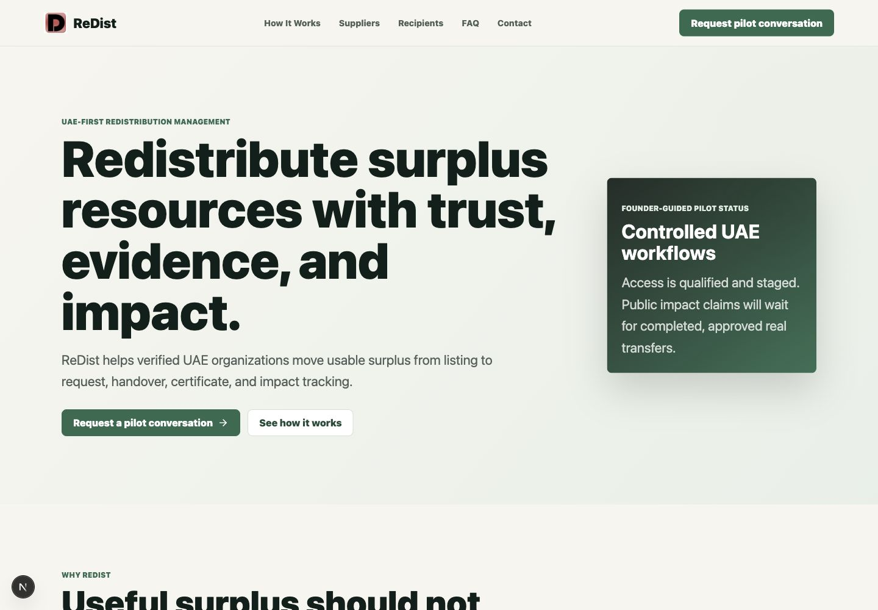
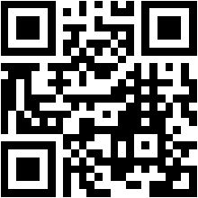
ReDist
UAE PILOT EDITION
ReDist
Surplus redistribution with trust, evidence, and impact.
https://www.redistribut.com | [Founder Name] | [Contact]
redistribut.com

Slide 2
EXECUTIVE SUMMARY
A controlled redistribution platform for verified organizations
ReDist helps suppliers list usable surplus, recipients request resources, and both parties complete evidence-backed handovers.
Core position
Pilot status
Proof model
UAE-first organization-to-organization redistribution with controlled workflows, founder-guided onboarding, and verification boundaries.
Built for the first guided UAE workflow: one supplier, one recipient, one handover, one certificate, one feedback cycle.
Impact claims are supported only by completed transfers, certificate evidence, and approved participant feedback.
01
01
01
Supplier workflow
Recipient workflow
Evidence cycle
ReDist Executive Presentation | 02

Slide 3
THE PROBLEM
Useful surplus is hard to move with confidence
Redistribution often depends on scattered calls, informal contacts, spreadsheets, and screenshots.
Operational friction
The result
- Unknown recipient suitability
- Incomplete resource and request details
- Unclear handover responsibility
- Missing completion evidence
- ESG teams need proof, not screenshots
Usable surplus can stay idle, be discarded, or move without enough trust and evidence for enterprise teams.
ReDist Executive Presentation | 03

Slide 4
WHY NOW IN THE UAE
The UAE has the right operating sectors for a guided pilot
ReDist starts with controlled workflows before wider scale.
Hotels and hospitality
Warehouses and logistics
Restaurants and food service
Commonly has either surplus resources, operational needs, or strong distribution networks.
Commonly has either surplus resources, operational needs, or strong distribution networks.
Commonly has either surplus resources, operational needs, or strong distribution networks.
NGOs and schools
Corporate ESG teams
Commonly has either surplus resources, operational needs, or strong distribution networks.
Need practical, defensible evidence for reporting.
ReDist Executive Presentation | 04

Slide 5
THE REDIST SOLUTION
A redistribution workflow, not a consumer marketplace
ReDist organizes how verified organizations list, request, approve, hand over, verify, and evidence surplus movement.
01
02
03
04
05
06
07
List
->
Discover
->
Request
->
Approve
->
Handover
->
Verify
->
Impact
Operating principle
Every step should answer: who owns the action, what information is needed, and what evidence remains after completion.
ReDist Executive Presentation | 05

Slide 6
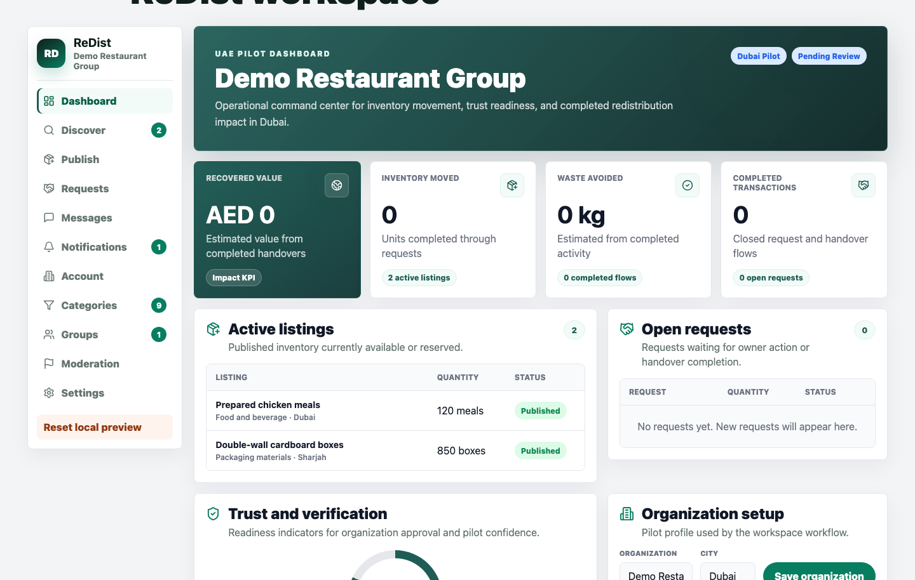
HOW IT WORKS
From surplus listing to verified handover
The workspace is designed around daily operational actions for suppliers, recipients, and administrators.
Workflow steps
- Supplier lists approved surplus
- Recipient discovers resources
- Recipient submits request
- Supplier approves or clarifies
- Handover is coordinated
- Completion is verified
- Certificate and impact evidence are reviewed
ReDist Executive Presentation | 06

Slide 7
TRUST AND VERIFICATION
Trust is built through workflow boundaries
ReDist separates operational evidence from legal or audited ESG guarantees.
Founder-guided pilot access
Organization-level participation
Supplier approval before release
Designed to reduce ambiguity before resources move.
Designed to reduce ambiguity before resources move.
Designed to reduce ambiguity before resources move.
Verification where required
Handover confirmation
Certificate-backed evidence
Designed to reduce ambiguity before resources move.
Designed to reduce ambiguity before resources move.
Designed to reduce ambiguity before resources move.
Boundary note
Certificates are operational evidence, not legal guarantees or audited ESG certificates.
ReDist Executive Presentation | 07

Slide 8
IMPACT AND ESG
Impact should be credible, traceable, and conservative
ReDist groups results by what the organization can reasonably evidence.
AED
Items
Waste
Cert.
Value recovered
Redistributed
Diverted
Evidence
Evidence rule
No public impact claims until real transfers are completed, verified, and approved for publication.
ReDist Executive Presentation | 08

Slide 9
PILOT PROGRAM
Wave 1 is intentionally small
The goal is market evidence, not scale theater.
01
02
03
04
05
06
07
1 supplier
->
1 recipient
->
1 category
->
1 handover
->
1 certificate
->
1 feedback
->
1 case study
Pilot goal
Generate first real market evidence through a guided workflow that can be repeated with confidence.
ReDist Executive Presentation | 09

Slide 10
BENEFITS BY STAKEHOLDER
Each participant gets a practical operating reason to join
The pilot is framed around usefulness, control, and evidence.
Suppliers
Recipients
Partners
- Make surplus useful
- Keep approval control
- Preserve evidence
- Discover resources
- Track requests
- Receive evidence
- Support circular economy activity
- Connect networks
- Strengthen evidence standards
ReDist Executive Presentation | 10

Slide 11
STRATEGIC PARTNERSHIPS
Partnerships can accelerate trust and access
ReDist can work with organizations that supply, receive, introduce, sponsor, or validate circular economy workflows.
Supplier network partner
Recipient network partner
ESG reporting collaborator
Potential role in building a trusted UAE redistribution ecosystem.
Potential role in building a trusted UAE redistribution ecosystem.
Potential role in building a trusted UAE redistribution ecosystem.
Ecosystem introducer
Pilot sponsor
Category partner
Potential role in building a trusted UAE redistribution ecosystem.
Potential role in building a trusted UAE redistribution ecosystem.
Potential role in building a trusted UAE redistribution ecosystem.
ReDist Executive Presentation | 11

Slide 12
PILOT PARTICIPATION PROCESS
From first conversation to first workflow
The meeting path keeps qualification and next actions clear.
01
02
03
04
05
06
07
Intro
->
Discovery
->
Qualify
->
Score
->
Decision
->
Onboard
->
Workflow
Call to action
Confirm role, contact, first category, and onboarding readiness.
ReDist Executive Presentation | 12

Slide 13
DECISION AND NEXT STEPS
A simple qualification decision
The next step is clear only when the first safe category, owner, and workflow are known.
Next-step checklist
- Confirm supplier, recipient, partner, or ESG collaborator role
- Identify first safe category or need
- Assign decision maker and coordinator
- Complete qualification checklist
- Schedule onboarding if qualified
redistribut.com
Book the founder conversation
Use the website QR or contact form to route the organization into the founder pipeline.
ReDist Executive Presentation | 13

Slide 14
APPENDIX FAQ
Questions executives usually ask
Short answers for first meetings.
Is ReDist a marketplace?
Is it public self-serve?
No. It is a controlled redistribution workflow for organizations.
Not for the first pilot. Wave 1 is founder-guided.
Who owns quality and safety?
Is the certificate audited ESG proof?
The participating organizations remain responsible for suitability and safe handover.
No. It is operational evidence unless separately reviewed.
What is the first pilot goal?
Complete Transfer #0001 and create defensible evidence.
ReDist Executive Presentation | 14

Slide 15
ReDist
Ready to test a guided redistribution workflow?
[Founder Name]
[Email]
[Phone / WhatsApp]
https://www.redistribut.com
redistribut.com
ReDist UAE Pilot Edition

