Slide 1
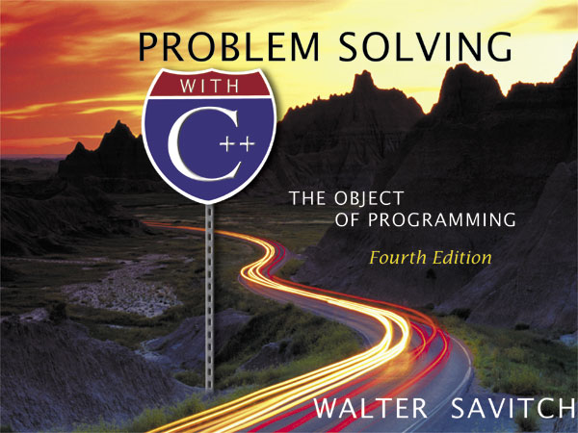

Slide 2
Chapter 1
Introduction to Computers and C++ Programming

Slide 3
Overview
Computer Systems (1.1)
Programming and Problem Solving (1.2)
Introduction to C++ (1.3)
Testing and Debugging (1.4)

Slide 4
Computer Systems
1.1
A computer program is…
A set of instructions for a computer to follow
Computer software is …
The collection of programs used by a computer
Includes:
orange
Translators
System Managers

