Slide 1
Software Vulnerability
Management Techniques
Ehab Qadah
Seminar: Selected Topics in IT-Security
University of Bonn

Slide 2
Motivation
In 2015, according to Symantec, 5,585 new vulnerabilities were found.
According the US Department of Homeland Security
(DHS), 90% of security incidents result from exploits against defects in software.
Thus, finding the vulnerable software inside an organization is important to prevent cyber-attacks.
Notes:
Leaving your systems with unpatched vulnerabilities can have a number of consequences, ranging from embarrassment to heavy damage when an such a vulnerability is exploited by an attacker
unpatched vulnerable software is good tool for hackers

Slide 3
Outline
Introduction
Software Vulnerability Management (SVM) Standards
        Security Content Automation Protocol (SCAP)
        Common Platform Enumeration (CPE)
        Common Vulnerabilities and Exposures (CVE)
        Common Vulnerability Scoring System (CVSS)
Software Vulnerability Management Approaches
        SVM Using open Standards
        SVM Using Social Networks Information
Discussion
Conclusion

Slide 4
Introduction
Vulnerability: is a defect or weakness in a system that leads to a security incident or unauthorized access to information or services by attackers.
Software Vulnerability Management (SVM): the continuous process that identifies vulnerabilities in a software product that is installed inside an organization.

Slide 5
Introduction
Process flow of the Software Vulnerability Management System.

Slide 6
SVM Standards
Security Content Automation Protocol (SCAP)
        Collection of open standards to identify security flaws
        and config issues.
        Supports automated vulnerability management, patch checking, and security measurement.
        Maintained by the National Institute of Standards and Technology (NIST).
        Content is accessible via the National Vulnerability Database (NVD).
        Used by SVM systems to automate the process of identification of vulnerable software.
Notes:
SCAP is a multi-purpose framework of specifications that support automated
configuration, vulnerability and patch checking, technical control compliance activities, and security
measurement.

Slide 7
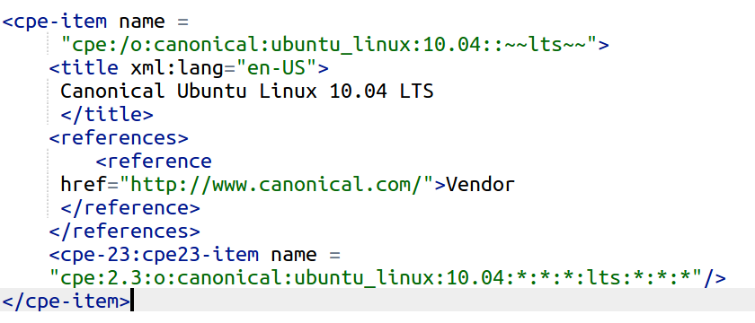
Common Platform Enumeration (CPE)
A dictionary that identifies software products and
applications, operating systems, and HW devices.
An example of the Official CPE Dictionary entry provided By NVD.

Slide 8
Common Vulnerabilities and Exposures (CVE)
List of publicly known vulnerabilities.
Unique ID for each vulnerability is assigned.
e.g.: CVE-2017-0001, where the CVE ID is CVE
prefix + year + sequence number.
Allow to share data between separate security tools.
Notes:
CVE’s common identifiers make it easier to share data across separate network security databases and tools

Slide 9
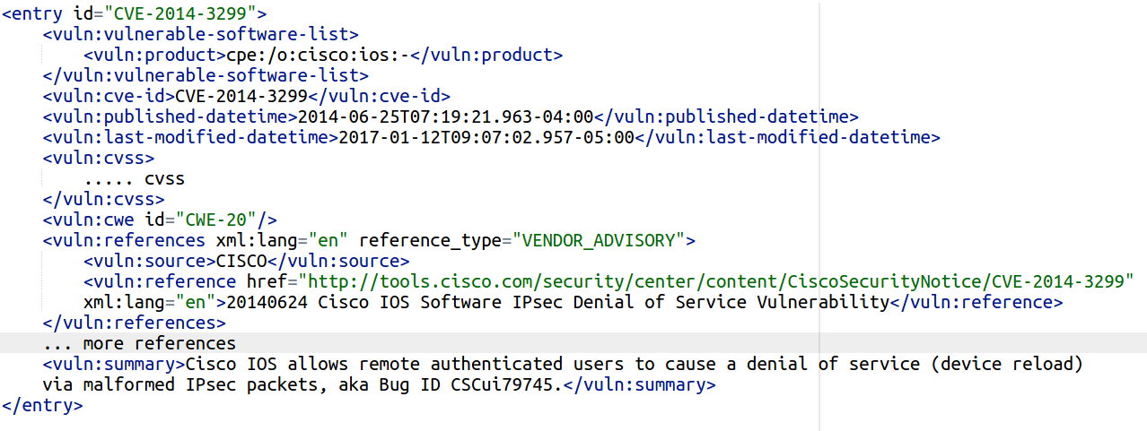
Common Vulnerabilities and Exposures (CVE)
NVD provides an XML feed for the vulnerabilities listed in CVE.
“CVE-2014-3299” vulnerability entry by NVD.

Slide 10
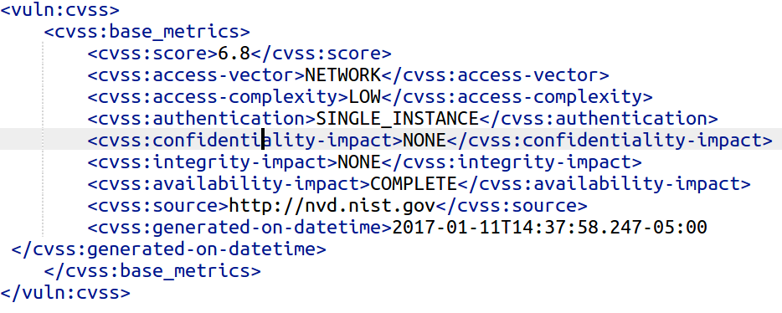
Common Vulnerability Scoring System
(CVSS)
Scoring system which provides the characteristics and relative severity of a vulnerability.
CVSS score and metrics of the "CVE-2014-3299" vulnerability.
Notes:
. In SCAP this refers to evaluating specific characteristics of a security weakness (for example, software vulnerabilities and security configuration issues) and, based on those characteristics, generating a score that reflects their relative severity
Capture characteristics of a vulnerability, and produce a numerical score reflecting its severity, as well as a textual representation of that score.
This metric measures the impact to the confidentiality of the information resources managed by a software componen

Slide 11
Software Vulnerability
Management Approaches

Slide 12
SVM Using Open Standards
Proposed by Takahashi et al. to automatically monitor vulnerabilities in IT assets inside an organization.
Open standards and information sources are used to develop a system that can be used by a wide range of organizations.
 Takahashi et al. ”Toward automated vulnerability monitoring using open information and standardized tools.”

Slide 13
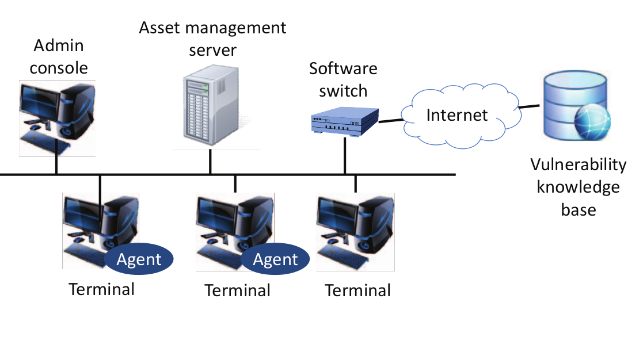
SVM Using Open Standards
 Takahashi et al. ”Toward automated vulnerability monitoring using open information and standardized tools.”
Source: Takahashi et al. ”Toward automated vulnerability monitoring using open information and standardized tools.”

Slide 14
SVM Using Open Standards

Slide 15
SVM using Social Networks Information
Getting informed about zero-day vulnerabilities is
difficult, due to the delay of vulnerability information publication.
Trabelsi et al.¹ proposed an approach to detect
software vulnerabilities based on security information collected from Twitter.
Identify a vulnerable software earlier than the normal vulnerabilities repositories.
¹ Trabelsi, Slim, et al. ”Mining social networks for software vulnerabilities monitoring.”

Slide 16
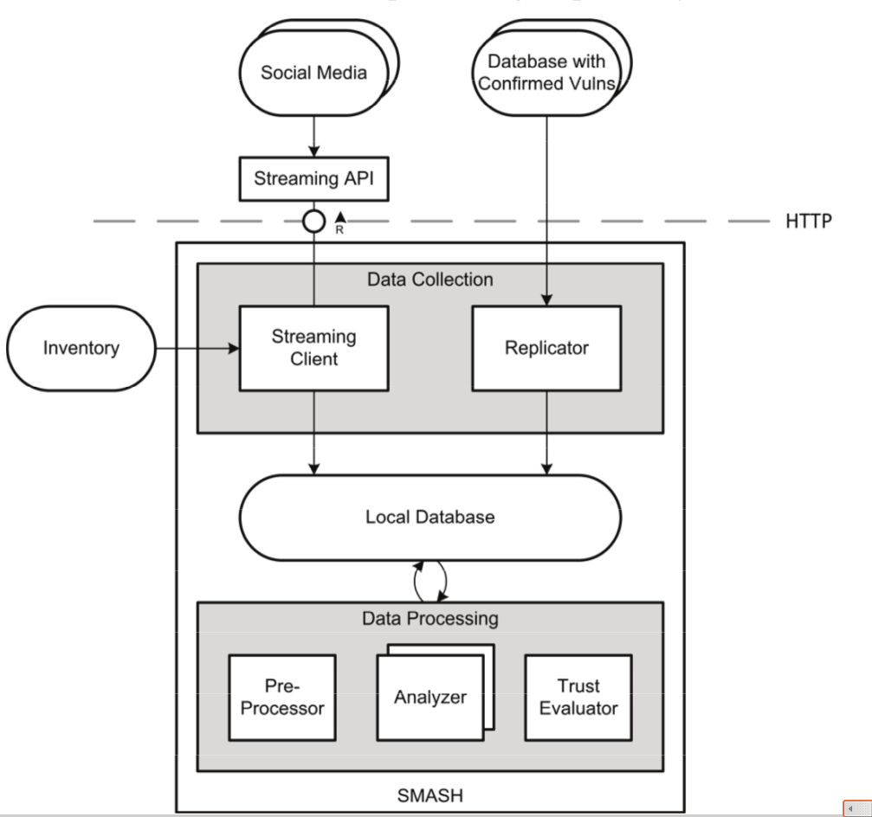
SVM using Social Networks Information
Source: Trabelsi, Slim, et al. ”Mining social networks for software vulnerabilities monitoring.”

Slide 17
Discussion
The first system is not fully automated, it just sends
an alert when a new vulnerability is found.
The first system does not validate the computed CPE-ID.
The accuracy of the second system’s output is fundamentally affected by the strength of the user
trust model.

Slide 18
Conclusion
Organizations must continually monitor software vulnerabilities to prevent possible attacks.
SVM systems help organizations to automatically monitor the software vulnerabilities.
SCAP Standards (e.g., CVE) help to automate the process of SVM and the exchange of security information.
Issue: the availability and reliability of vulnerabilities information.

Slide 19
THANK YOU FOR YOUR ATTENTION

