Slide 1




ETF SARAJEVO · DATA SCIENCE & ARTIFICIAL INTELLIGENCE · NUMERICAL OPTIMIZATION
RobotTrajectoryOpt
2D Robot Path Planning via Nonlinear Model Predictive Control
Active-Set QP + SQP Trajectory Optimization, with Real-Time Visualization
STUDENT
COURSE
PROFESSOR
ACADEMIC YEAR
Emin Hadžiabdić
Numerical Optimization
Prof. Dr. Izudin Džafić
2025 / 26
github.com/ehadziabdic/RobotTrajectoryOpt
ROBOTTRAJECTORYOPT
01

Slide 2

THE CORE IDEA
Planning as Optimization, Not Search
▸ A term project for the Numerical Optimization course: 2D robot path planning is reframed as a continuous constrained optimization problem, not a discrete grid search.
▸ At every control step, solve for the steering angle and acceleration that keep the robot closest to a reference path — without ever breaking its physical limits.
▸ Vehicle dynamics are the constraints, so the controller can never propose a command the robot could not physically execute — planning and control become one formulation.
▸ This is the same class of controller (MPC) used in production automotive and robotics systems, scaled to a transparent, from-scratch educational implementation.
WHY NOT A*?
A* / grid search
Cells on a discretized map; no native concept of speed or turning radius
Needs a separate tracking controller layered on top of the planned path
MPC / this project
A continuous constrained QP — dynamics are baked in as equality constraints
The output is guaranteed physically realizable by construction, every step
ROBOTTRAJECTORYOPT
INTRODUCTION
02

Slide 3
01
Problem Formulation
Vehicle model, decision vector, cost function & constraints
Kinematic bicycle vehicle model
Decision vector & quadratic cost
Quintic reference path generation
Dynamics & actuator constraints
Obstacle avoidance with slack
ROBOTTRAJECTORYOPT
03

Slide 4

01 · PROBLEM FORMULATION
Vehicle Model — Kinematic Bicycle
x[t+1] = x[t] + v[t]·cos(ψ[t])·Δt
y[t+1] = y[t] + v[t]·sin(ψ[t])·Δt
ψ[t+1] = ψ[t] + (v[t]/Lf)·δ[t]·Δt
v[t+1] = v[t] + a[t]·Δt
y
ψ (heading)
v
Lf
δ (steering)
Fixed-step discretization of the continuous bicycle model. Lf is the effective wheelbase (center-of-mass to front axle).
Δt = 0.1 s
x
state s = (x, y, ψ, v) controls u = (δ, a)
Lf = 0.5 m
N = 20 steps (2.0 s look-ahead)
ROBOTTRAJECTORYOPT
PROBLEM FORMULATION
04

Slide 5

01 · PROBLEM FORMULATION
Decision Vector & Cost Function
80
STATES (x, y, ψ, v)
38
CONTROLS (δ, a)
40
SLACK (obstacle σ)
z = [ x₀…x₁₉ | y₀…y₁₉ | ψ₀…ψ₁₉ | v₀…v₁₉ | δ₀…δ₁₈ | a₀…a₁₈ | σ₀…σ₃₉ ] → 158 decision variables total (N = 20)
QUADRATIC COST — diagonal Hessian, minimized every SQP iteration
Symbol | Value | Role
qx | 0.5 | Weak — x is largely a consequence of speed, not directly steered
qy | 50.0 | Strong — dominant term for lateral path tracking
qψ | 25.0 | Strong — keeps heading aligned with the path tangent
qv | 1.0 | Weak — lets the solver trade velocity freely to aid tracking
rδ , ra | 0.5 | Penalize aggressive steering / acceleration
w_slack | 8000.0 | Very strong — makes obstacle-avoidance slack expensive
The large gap between qy, qψ and qv is a documented tuning decision: a high velocity weight made the solver hold speed constant instead of tracking the path, so weight was shifted toward lateral / heading accuracy.
ROBOTTRAJECTORYOPT
PROBLEM FORMULATION
05

Slide 6

01 · PROBLEM FORMULATION
Reference Path — Quintic Polynomials
y(x) = c0 + c1x + c2x² + c3x³ + c4x⁴ + c5x⁵
y'(x) = c1 + 2c2x + 3c3x² + 4c4x³ + 5c5x⁴
quintic S-weave — value & slope pinned at both ends
▸ A quintic (not a cubic) is used so that both value and slope can be pinned at the start and end of a maneuver.
▸ Choosing y(0)=0, y′(0)=0 matches the reference heading to the vehicle′s initial heading (ψ₀ = 0) exactly — no instantaneous heading mismatch.
▸ The reference is regenerated fresh from the vehicle′s current position at every step, so the N-step grid always reflects where the vehicle actually is.
▸ Past trackLength, the reference degrades gracefully into a straight-line continuation tangent to the polynomial.
x = 40 m
x = 0 (ψ matched)
δ_ff = arctan( Lf·Δψ / (v·Δt) )
Feedforward steering estimate from reference curvature — a good initial guess for the steering variable.
ROBOTTRAJECTORYOPT
PROBLEM FORMULATION
06

Slide 7

01 · PROBLEM FORMULATION
Constraints — Equality & Inequality Rows
EQUALITY — VEHICLE DYNAMICS
INEQUALITY — ACTUATOR & VELOCITY BOUNDS
▸ Re-linearized at every SQP iteration around the current nominal trajectory z̄ — first-order (Jacobian) linearization of the bicycle model.
▸ Produces 4 constraint rows per step t = 0 … N−2, one for each state (x, y, ψ, v).
▸ Plus 4 rows that lock the very first state (x₀, y₀, ψ₀, v₀) to the robot′s true, measured telemetry.
▸ Re-linearizing every iteration is exactly what makes the outer loop an SQP scheme.
Bound | Constraint form
δ (steering) | −0.6 ≤ δₜ ≤ 0.6 rad
a (accel.) | −3.0 ≤ aₜ ≤ 3.0 m/s²
v (velocity) | 0 ≤ vₜ ≤ 3.0 m/s
Built once per SQP call by MpcInequality::buildBoundRows() and held constant across iterations — a genuine QP row, not a post-hoc clamp.
tag = (kind << 24) | (t << 8) | idx
Unique tag per row — used to match constraints for active-set warm-starting across SQP iterations.
ROBOTTRAJECTORYOPT
PROBLEM FORMULATION
07

Slide 8

01 · PROBLEM FORMULATION
Obstacle Avoidance — Slack-Relaxed Inequality
▸ Obstacles are circular keep-out zones (x_obs, y_obs, r) with an extra 0.3 m safety margin — effective radius R = r + 0.3.
▸ The nonlinear distance constraint ‖(x,y) − obs‖² ≥ R² is linearized about the nominal predicted position using its gradient.
▸ A per-step slack variable σ ≥ 0 relaxes the row so the QP always stays feasible, even mid-maneuver.
▸ The heavy slack weight w_slack = 8000 in the cost strongly discourages the trajectory from lingering near an obstacle.
▸ Far from any obstacle (beyond 2R) the slack collapses to zero and the row becomes inactive.
robot (x, y)
R = r + 0.3
∇ (gradient)
obstacle
linearized keep-out boundary — a tangent-plane cut through the true circle at the current nominal position
ROBOTTRAJECTORYOPT
PROBLEM FORMULATION
08

Slide 9
02
Solving the QP
An Active-Set solver wrapped in an outer SQP loop
The QP subproblem & Active-Set solver
SQP outer loop & damped convergence
Robustness mechanisms
ROBOTTRAJECTORYOPT
09

Slide 10

02 · SOLVING THE QP
Active-Set QP Solver
min_z ½(z − z_ref)ᵀ H (z − z_ref)
s.t. A(z̄) z = b(z̄) [dynamics + init state]
C_ineq z ≥ d_ineq [bounds + obstacle rows]
1
2
3
4
Init working set
Assemble sparse KKT
Factorize & solve
Feasibility check
warm-start from previous solve, matched by tag
[[H, Aᵀeq],[Aeq, 0]] with active inequalities folded in
sparse indefinite LDLᵀ + Tikhonov reg. ε=1e-8
blocking constraint found → add to working set
5
6
7
Optimality check
Post-hoc clamp
Converge
λ < −1e-8 → drop the redundant constraint
safety net — rarely fires once QP rows are correct
no blocking row, all λ ≥ 0, or maxActiveSetIter = 20
Duplicate-row detection prevents two near-identical coefficient vectors (within 1e-12) from entering the working set together.
ROBOTTRAJECTORYOPT
SOLVING THE QP
10

Slide 11

02 · SOLVING THE QP
SQP — Sequential Quadratic Programming
1
Update reference trajectory — fresh quintic from vehicle′s current position
tol = 2 × 10⁻³
2
Linearize dynamics at z̄ — produces A, b for this iteration
max iterations = 60
3
Build obstacle inequality rows — re-linearized around the current nominal path
α (damping) = 0.12
4
Combine with bound rows — constant across iterations
5
Solve the Active-Set QP — see previous slide
ROLLBACK-SAFE
Damp the step — z ← z + α·(z_new − z), α = 0.12
If the iteration limit is reached before max|Δz| < tol, the solver rolls back to the iterate with the smallest observed max|Δz| and returns that as a stable, if sub-converged, result — never a diverging one.
6
7
Check convergence — maxᵢ |z_new,ᵢ − zᵢ| < tol
8
Track best solution — for rollback if the iteration budget is hit
ROBOTTRAJECTORYOPT
SOLVING THE QP
11

Slide 12





02 · SOLVING THE QP
Robustness Mechanisms
Warm-Start t=0 Snap
Fresh Reference Every Step
Stagnation Detection
Initial state snapped to true vehicle telemetry before every solve — prevents drift.
Reference trajectory regenerated from the vehicle′s current position at each call.
Resets the nominal trajectory if SQP converges too fast with a near-zero update.
QP Failure Recovery
Stale Warm-Start Detection
Angle Wrapping
Falls back to the polynomial reference with feedforward controls instead of freezing.
Discards the warm-start and uses a fresh reference if lastMaxAbs ≥ 5.0.
Heading ψ is wrapped to [−π, π] throughout to avoid wraparound artifacts.
ROBOTTRAJECTORYOPT
SOLVING THE QP
12

Slide 13
03
Real-Time GUI Application
A natID desktop app for experimentation & visual verification
Interface overview
Three built-in scenarios
Solver controls & settings
Live telemetry & multi-language UI
ROBOTTRAJECTORYOPT
13

Slide 14

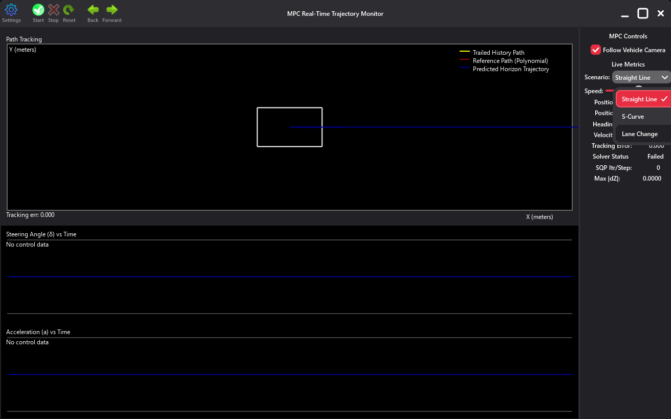
03 · GUI APPLICATION
Interface Overview
▸ Three coordinated panes: a top toolbar, a large path-tracking canvas with two time-series canvases beneath it, and a right-hand sidebar of live controls & telemetry.
▸ The main canvas plots the trailed history (yellow), the reference path (red), and the predicted horizon (blue) — all drawn live, every step.
▸ The vehicle icon is a rectangle with a heading indicator, oriented along ψ; a running Tracking Err readout sits in the canvas corner.
▸ "Follow Vehicle Camera" toggles whether the viewport auto-recenters on the moving vehicle.
Straight Line scenario before the first solve — scenario dropdown open, predicted horizon flat, control plots empty
ROBOTTRAJECTORYOPT
GUI APPLICATION
14

Slide 15

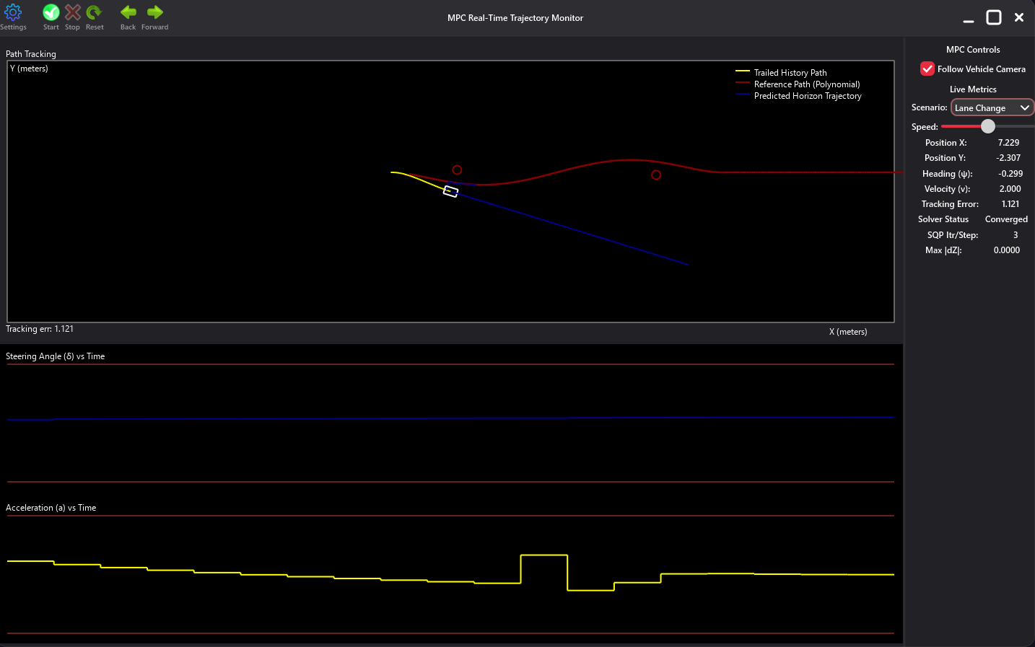
03 · GUI APPLICATION
Three Built-in Scenarios
Scenario | Setup
Straight Line | v₀=1.0 m/s · no obstacles · 85 m — sanity-check baseline, reference is the x-axis
Lane Change | v₀=1.5 m/s · 2 obstacles (r=0.5) · ±1.5 m S-weave · 40 m
S-Curve | v₀=1.5 m/s · no obstacles · negated Lane-Change quintic · isolates pure tracking
c5 = ampl/915849, c4 = ∓100·c5
c3 = ±3200·c5, c2 = ∓32000·c5
roots (and zero slope) at x = 0, x = 40
Lane-Change / S-Curve coefficients are generated in closed form from one amplitude parameter (ampl = 1.5 m).
Lane Change, mid-weave: two obstacles (red circles), yellow history, red reference, blue predicted horizon — solver converged in 3 iterations
ROBOTTRAJECTORYOPT
GUI APPLICATION
15

Slide 16

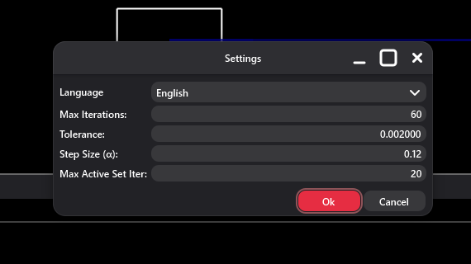
03 · GUI APPLICATION
Solver Controls & Settings Dialog
SETTINGS DIALOG — 5 configurable parameters
Parameter | Range (default)
Language | 6 UI languages
Max Iterations | 1 – 1,000,000 (60)
Tolerance | 1e-8 – 1.0 (2×10⁻³)
Step Size α | 0.01 – 1.0 (0.12)
Max Active Set Iter | 1 – 100 (20)
TOOLBAR
▸ Start / Stop — begins or halts continuous, timer-driven stepping
▸ Reset — restores the scenario′s initial state, clears warm-start
▸ Back / Forward — step through previously captured snapshots
Language, Max Iterations, Tolerance, Step Size α, and Max Active Set Iter — all five apply to the SQP solver for every subsequent step
ROBOTTRAJECTORYOPT
GUI APPLICATION
16

Slide 17

03 · GUI APPLICATION
Live Telemetry & Multilingual UI
LIVE METRICS HUD (SIDEBAR)
Field | Meaning
Position X / Y | True vehicle position (m), from bicycle-model integration
Heading (ψ) / Velocity (v) | Current heading (rad) and speed (m/s)
Tracking Error | Distance to the nearest point on the discretized reference
Solver Status | Converged / Running (maxIter hit) / Failed
SQP Itr/Step, Max|dZ| | Iteration count and final per-variable change
6 UI LANGUAGES
English
Bosnian
German
Spanish
French
Japanese
Translation files live under res/tr/ as XML resources. The language is changed from the Settings dialog; a restart applies it.
ROBOTTRAJECTORYOPT
GUI APPLICATION
17

Slide 18
04
Verification & Correctness
Auditing the final implementation against the original proposal
Mathematical verification
Control-flow audit — "no cheating"
ROBOTTRAJECTORYOPT
18

Slide 19

04 · VERIFICATION
Mathematical Verification
The full src/ tree was cross-checked line-by-line against the mathematical formulation. Every claim below is confirmed by direct inspection of MpcEngine.h, MpcSqp.h, MpcActiveSetQp.h, MpcCost.h, MpcConstraints.h and MpcInequality.h.
Dynamics linearization All four state equations linearized with the correct partial derivatives, including ψ-dynamics linearized around (v_nom, δ_nom).
Cost function The diagonal Hessian and linear term correctly implement the quadratic tracking-and-effort cost.
Obstacle linearization Correct gradient-based linearization of the nonlinear distance-inequality constraint.
Velocity bounds Correctly encoded as inequality rows in the QP (0 ≤ v ≤ v_max), not a post-hoc clamp.
Tag-based warm-starting Constraints are correctly matched across SQP iterations via the (kind, t, idx) tag encoding.
ROBOTTRAJECTORYOPT
VERIFICATION
19

Slide 20

04 · VERIFICATION
Does the Implementation Match the Proposal?
MainView::advanceOneStep
-> MpcEngine::Solve
-> ensureNominalInitialized
-> MpcSqp::Solve
-> buildBoundRows (constant)
-> for iter in 0..maxIter:
UpdateReferenceTrajectory
buildObstacleRows
SolveActiveSetQP
-> sparse LDLᵀ factorize/solve
-> extract delta[0], accel[0]
-> bicycle model update
WHAT "NO CHEATING" MEANS
No direct reference interpolation — the reference enters only through the cost function′s z_ref vector
No pre-computed trajectories — no lookup table, no offline generation
No PID or heuristic tracking — no pure-pursuit, no cross-track-error controller
No state projection or snapping — the state evolves through bicycle-model integration
No solver stubs — the Active-Set QP is a genuine numerical solver
ROBOTTRAJECTORYOPT
VERIFICATION
20

Slide 21
05
Features & Tech Stack
What shipped, what it′s built on, and how it maps to the original plan
Tech stack & known limitations
Proposal vs. delivered implementation
ROBOTTRAJECTORYOPT
21

Slide 22

05 · FEATURES & TECH STACK
Tech Stack & Known Limitations
BUILT WITH
KNOWN LIMITATIONS
C++17
CMake 3.18+
▸ Quadratic cost only — nonlinear dynamics are handled via first-order linearization inside SQP, not a second-order correction.
▸ Short horizon — N=20, dt=0.1s looks only 2 seconds ahead.
▸ Single robot — no multi-vehicle collision avoidance.
▸ Static obstacles only — moving obstacles would need per-iteration re-linearization.
▸ Display-axis plot bounds (±0.436 rad, ±1.0 m/s²) are a visualization choice — the real solver bounds are wider (±0.6 rad, ±3.0 m/s²).
natID Framework
Sparse LDLᵀ solver
MIT License
Windows · macOS · Linux
natID also supplies the dense/sparse matrix library (Dense/Sparse::IDblMatrix) and the natGUI toolkit — no Eigen, JUCE, or other third-party dependency is required.
ROBOTTRAJECTORYOPT
FEATURES & TECH STACK
22

Slide 23

05 · FEATURES & TECH STACK
Proposal vs. Delivered
PROPOSED · May 2026
DELIVERED · FINAL IMPLEMENTATION
▸ Sparse LU factorization for the chained dynamics constraint matrix
▸ KKT / Lagrange-Newton handling of inequality constraints
▸ Two open-source C++ MPC repos adapted as a mathematical starting point
▸ Dense matrices for state vectors; sparse for the block-diagonal physics constraints
▸ natID GUI rendering the path, obstacles, and a live re-solve on obstacle drag
▸ Full Active-Set QP with sparse indefinite LDLᵀ factorization and warm-starting
▸ Inequality constraints as explicit QP rows — bounds and obstacles alike, not Lagrange-Newton
▸ Reference repos kept unused under res/mpc/ as background material only — audited, not compiled (Section 7)
▸ Custom Dense/Sparse matrix types from natID, exactly as proposed
▸ Real-time natID GUI: live path, predicted horizon, telemetry, and a 6-language settings dialog
✓ Verified faithful to the proposal — §7 audit
ROBOTTRAJECTORYOPT
FEATURES & TECH STACK
23

Slide 24
Thank You
Every steering and acceleration command shown is the direct output of a live, verifiable optimization solve.
github.com/ehadziabdic/RobotTrajectoryOpt
Emin Hadžiabdić
Faculty of Electrical Engineering (ETF), University of Sarajevo
Data Science and Artificial Intelligence
ROBOTTRAJECTORYOPT
24

