Slide 1


Endava Tech Courses
OCTOBER @22
JAVA Course
CLEAN CODE
DAMANCIUC XENIA
SENIOR JAVA ENGINEER
00 — Thumbnail
DAMANCIUC XENIA

Slide 2

Endava Tech Courses
OCTOBER @22
Introduction
01
Meaningful names
02
Functions
03
Classes
04
Comments
05
Formatting
06
Useful resources
07
01 — Agenda
DAMANCIUC XENIA – IVAN KULISNKI

Slide 3
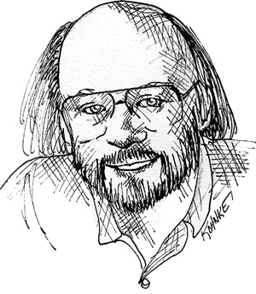

Endava Tech Courses
October @22
What is Clean Code?
“I like my code to be elegant and efficient. The logic should be straightforward to make it hard for bugs to hide, the dependencies minimal to ease maintenance, error handling complete according to an articulated strategy, and performance close to optimal so as not to tempt people to make the code messy with unprincipled optimizations. Clean code does one thing well.”
Bjarne Stroustrup, inventor of C++
01 — Introduction
XENIA DAMANCIUC

Slide 4
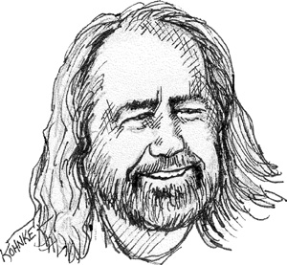
Endava Tech Courses
October @22
What is Clean Code?
“Clean code is simple and direct. Clean code reads like well-written prose. Clean code never obscures the designer’s intent but rather is full of crisp abstractions and straightforward lines of control.”
Grady Booch, inventor of UML
01 — Introduction
XENIA DAMANCIUC

Slide 5
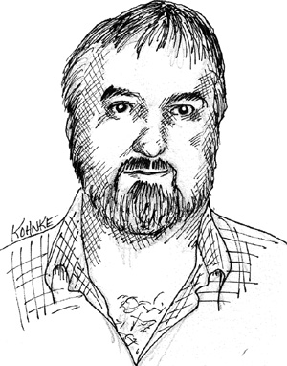
Endava Tech Courses
October @22
What is Clean Code?
“Clean code always looks like it was written by someone who cares. There is nothing obvious that you can do to make it better. All of those things were thought about the code’s author, and if you try to imagine improvements, you’re led back to where you are, sitting in appreciation of the code left for you – code left by someone who cares deeply about the craft.”
Micheal Feathers, author of Working Effectively with Legacy Code
01 — Introduction
XENIA DAMANCIUC

Slide 6
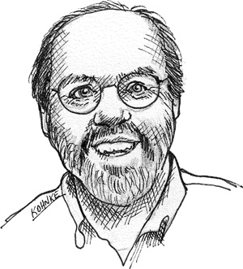
Endava Tech Courses
October @22
What is Clean Code?
“You know you are working on clean code when each routine you read turns out to be pretty much what you expected. You can call it beautiful code when the code also makes it look like the language was made for the problem.”
Ward Cunnigham, inventor of Wiki, inventor of Fit and coinventor of eXtreme programming
01 — Introduction
XENIA DAMANCIUC

Slide 7
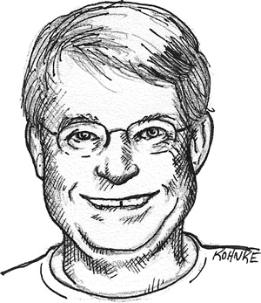
Endava Tech Courses
October @22
What is Clean Code?
“Any fool can write code that a computer can understand. Good programmers write code that humans can understand. “
Robert Martin, aka Uncle Bob,
founder of Agile Manifesto, SOLID principles
01 — Introduction
XENIA DAMANCIUC

Slide 8

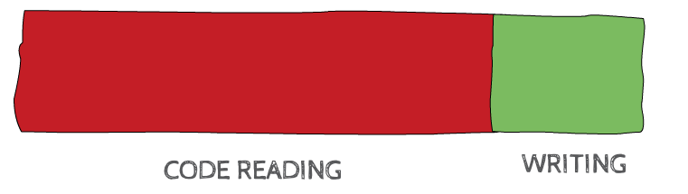
Endava Tech Courses
October @22
Why Clean Code?
“We READ 10x more time than we write”
01 — Introduction
XENIA DAMANCIUC

Slide 9

Endava Tech Courses
October @22
The boy scout rule
“Always leave the code you’re editing a little better than you found it.”
01 — Introduction
XENIA DAMANCIUC

Slide 10
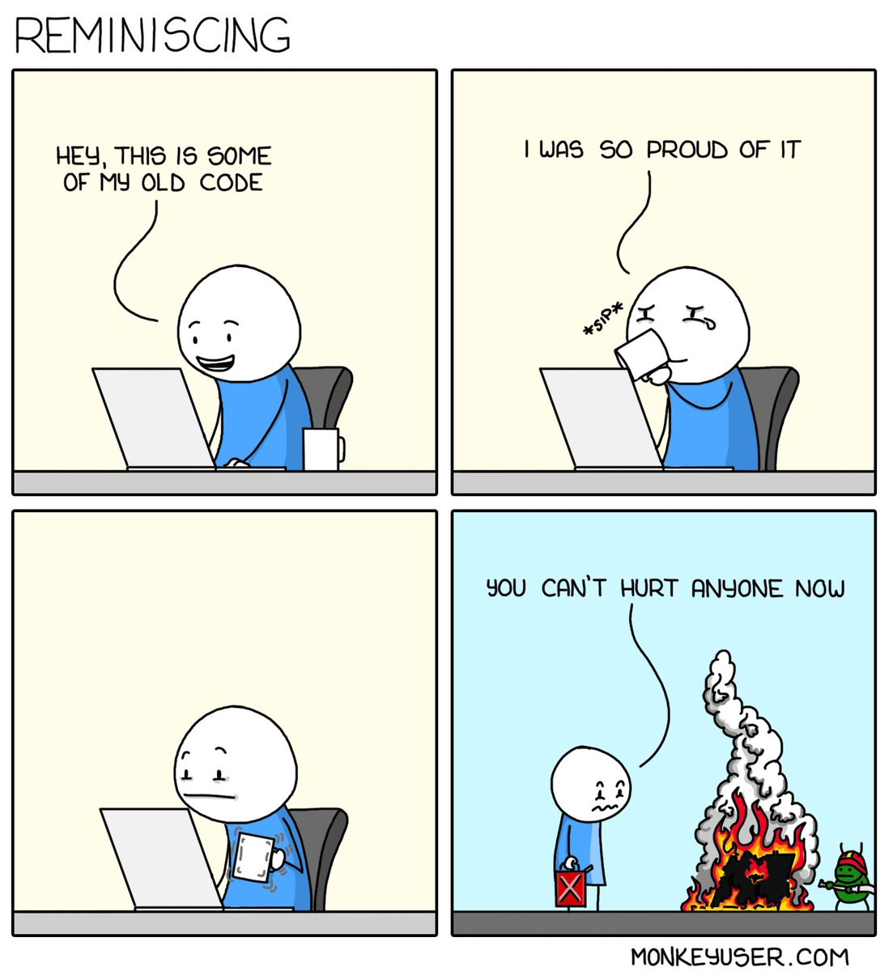
Endava Tech Courses
October @22
01 — Introduction
XENIA DAMANCIUC

Slide 11
Endava Tech Courses
October @22
Meaningful names
Use intention-Revealing Names
Avoid disinformation
Make meaningful distinctions
Use pronounceable names
Use searchable names
Interfaces and implementations
Avoid mental mapping
Pay attention to class and method names
02 — Meaningful names
XENIA DAMANCIUC

Slide 12
Endava Tech Courses
October @22
Functions
Smaller methods run faster
Functions should do one thing
Functions names should say what they do
Remove duplicate code -> DRY
No Boolean params
No nullable params
Avoid returning null -> Wrap it in Optional<>
Throw an exception
02 — Meaningful names
XENIA DAMANCIUC

Slide 13
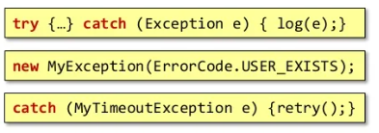
Endava Tech Courses
October @22
Functions
Global exception handler
Nice user messages: use enum
Nice exception only for selective catch
03 — Functions
XENIA DAMANCIUC

Slide 14

Endava Tech Courses
October @22
Functions
Keep it simple stupid
03 — Functions
XENIA DAMANCIUC

Slide 15
Endava Tech Courses
October @22
Classes
Follow the order:
public static constants
private static variables
private instance variables
public functions
private functions
04 — Classes
XENIA DAMANCIUC

Slide 16
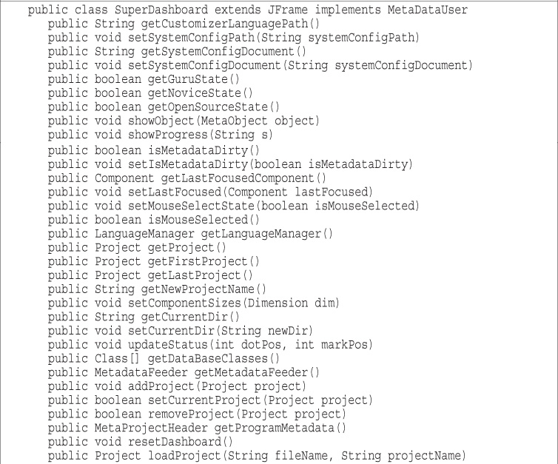
Endava Tech Courses
October @22
Classes
04 — Classes
XENIA DAMANCIUC

Slide 17
Endava Tech Courses
October @22
Classes
... and then should be smaller than that!.
With functions we count lines, with classes we count responsibilities.
Classes should have one responsibility -> one reason to change.
04 — Classes
XENIA DAMANCIUC

Slide 18
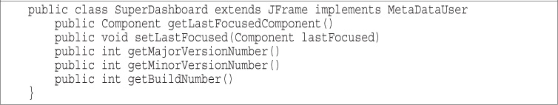
Endava Tech Courses
October @22
Classes
04 — Classes
XENIA DAMANCIUC

Slide 19

Endava Tech Courses
October @22
SRP
04 — Classes
XENIA DAMANCIUC

Slide 20
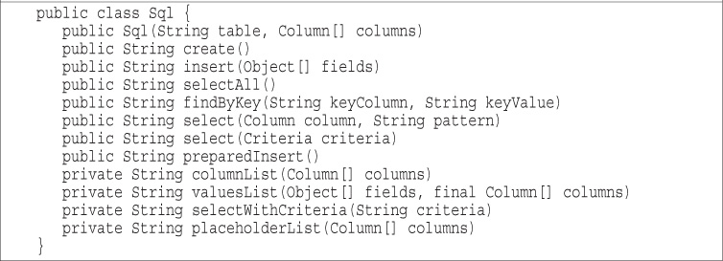
Endava Tech Courses
October @22
Classes
04 — Classes
XENIA DAMANCIUC

Slide 21
Endava Tech Courses
October @22
Open-Closed principle
Objects or entities should be open for extension but closed for modification.
This means that a class should be extendable without modifying the class itself.
04 — Classes
XENIA DAMANCIUC

Slide 22
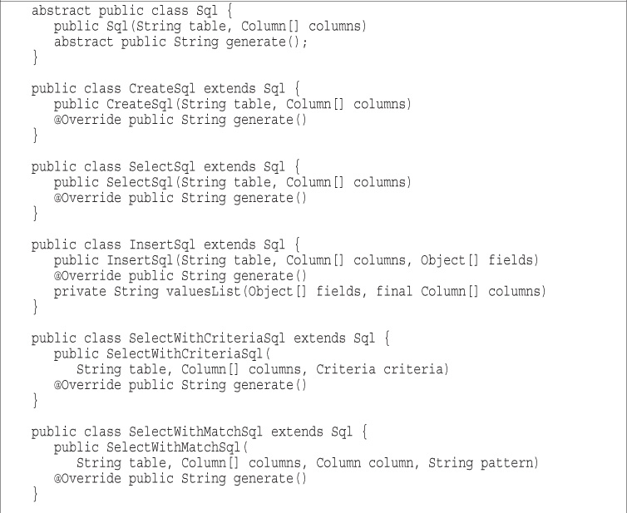
Endava Tech Courses
October @22
Classes
04 — Classes
XENIA DAMANCIUC

Slide 23
Endava Tech Courses
October @22
Open-Closed principle
Allow new functionality via subclassing.
We incorporate new features by extending the system, not by making modifications to existing code.
04 — Classes
XENIA DAMANCIUC

Slide 24
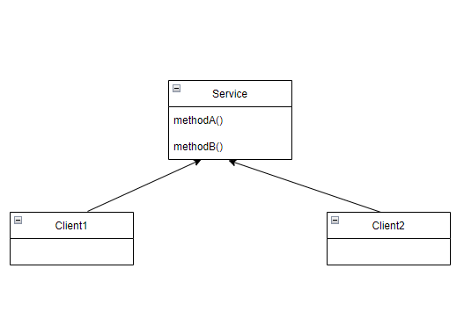
Endava Tech Courses
October @22
Interface segregation principle (ISP)
04 — Classes
XENIA DAMANCIUC

Slide 25
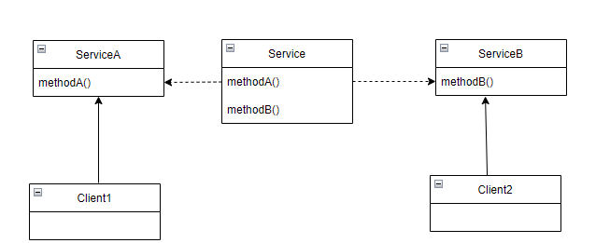
Endava Tech Courses
October @22
Interface segregation principle (ISP)
04 — Classes
XENIA DAMANCIUC

Slide 26
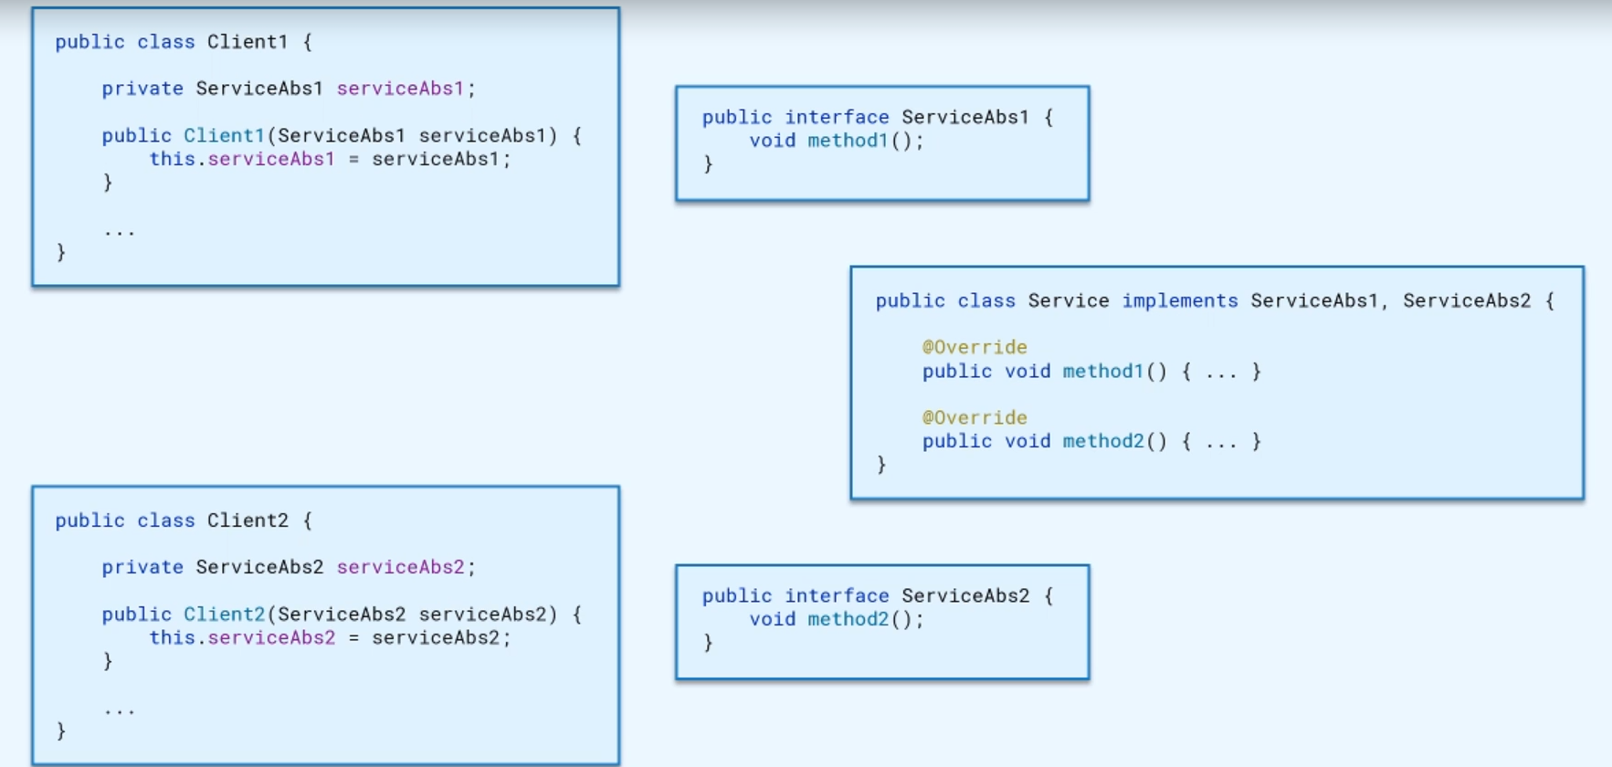
Endava Tech Courses
October @22
Interface segregation principle (ISP)
04 — Classes
XENIA DAMANCIUC

Slide 27
Endava Tech Courses
October @22
Dependency inversion principle
High-level modules should not depend on low-level modules. Both should depend on abstractions.
Abstraction should not depend on details. Details should happen on abstractions.
04 — Classes
XENIA DAMANCIUC

Slide 28
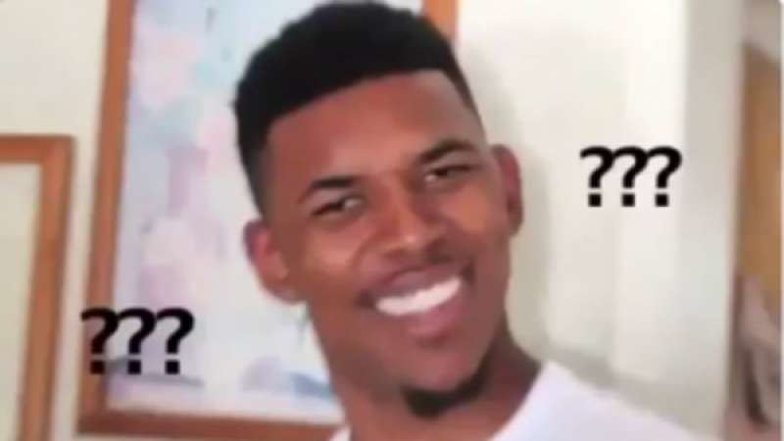
Endava Tech Courses
October @22
Dependency inversion principle
04 — Classes
XENIA DAMANCIUC

Slide 29
Endava Tech Courses
October @22
Dependency inversion principle
Client: Your main class/code that runs the high-level module.
High-Level Modules: Interface/Abstraction that your client uses.
Low-Level Modules: Details of your interfaces/abstraction.
04 — Classes
XENIA DAMANCIUC

Slide 30
Endava Tech Courses
October @22
Dependency inversion principle
Imagine you have a car, and your different components are:
Client: You as the person driving the car.
High-Level Modules: The steering wheel and the gas/brake peddles.
Low-Level Modules: Engine
04 — Classes
XENIA DAMANCIUC

Slide 31
Endava Tech Courses
October @22
Dependency inversion principle
Abstractions don't depend on details.
It doesn't matter whether my engine has changed or not, I still should be able to drive my car the same way.
04 — Classes
XENIA DAMANCIUC

Slide 32
Endava Tech Courses
October @22
Dependency inversion principle
Details should depend upon abstractions.
I would not want an engine that causes the brake to double the speed.
04 — Classes
XENIA DAMANCIUC

Slide 33
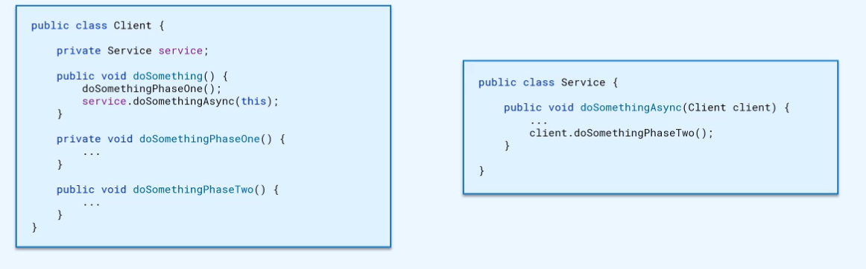
Endava Tech Courses
October @22
Dependency inversion principle
04 — Classes
XENIA DAMANCIUC

Slide 34
Endava Tech Courses
October @22
Dependency inversion principle
Circular dependency
04 — Classes
XENIA DAMANCIUC

Slide 35
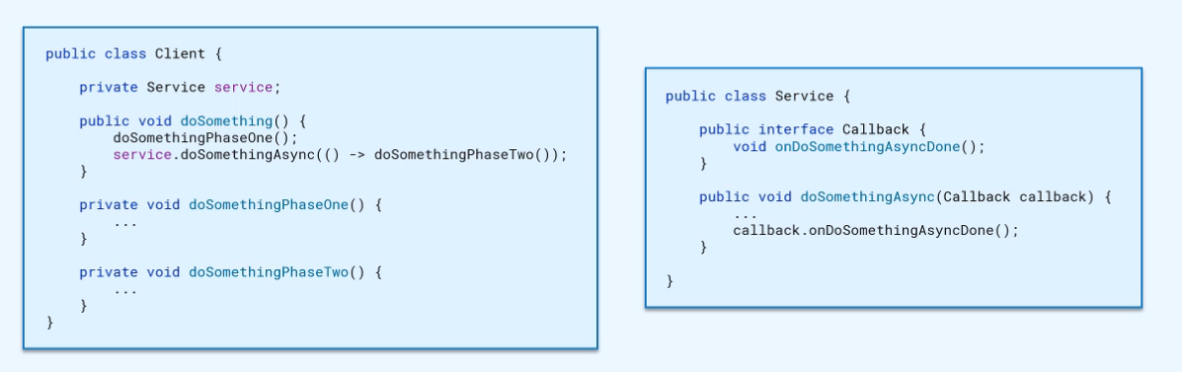
Endava Tech Courses
October @22
Dependency inversion principle
04 — Classes
XENIA DAMANCIUC

Slide 36
Endava Tech Courses
October @22
Comments
Comments do not make up for Bad Code
Explain yourself in code
Informative comments
Clarification
05 — Comments
XENIA DAMANCIUC

Slide 37

Endava Tech Courses
October @22
Comments
Comments do not make up for Bad Code
Explain yourself in code
05 — Comments
XENIA DAMANCIUC

Slide 38

Endava Tech Courses
October @22
Comments
Informative comments
05 — Comments
XENIA DAMANCIUC

Slide 39
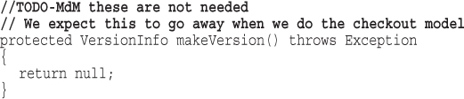
Endava Tech Courses
October @22
Comments
//TODO
05 — Comments
XENIA DAMANCIUC

Slide 40
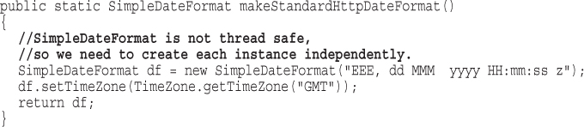
Endava Tech Courses
October @22
Comments
Warning of consequences
05 — Comments
XENIA DAMANCIUC

Slide 41
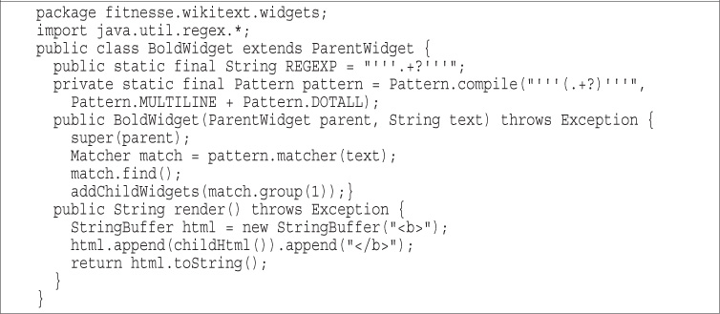
Endava Tech Courses
October @22
Formatting
VERTICAL FORMATTING
06 — Formatting
XENIA DAMANCIUC

Slide 42
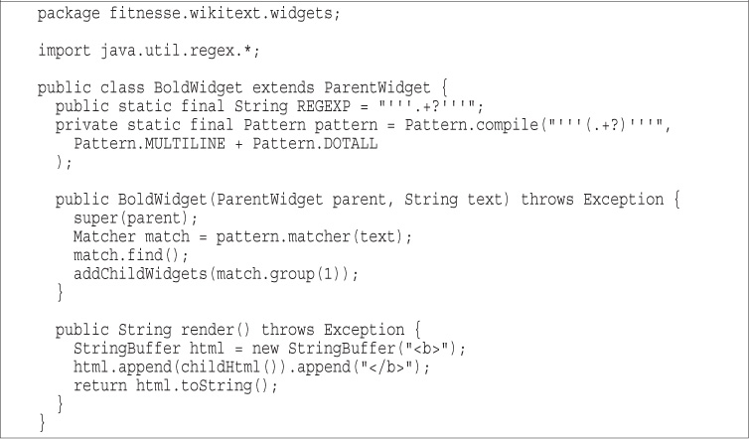
Endava Tech Courses
October @22
Formatting
VERTICAL FORMATTING
06 — Formatting
XENIA DAMANCIUC

Slide 43
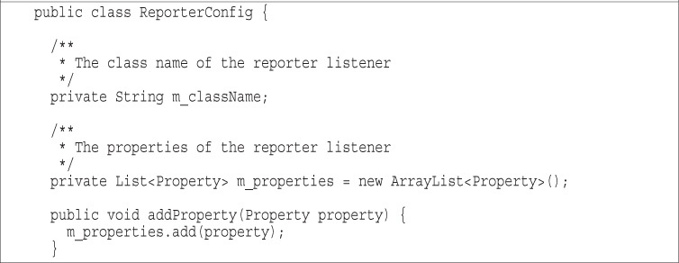
Endava Tech Courses
October @22
Formatting
VERTICAL DENSITY
06 — Formatting
XENIA DAMANCIUC

Slide 44
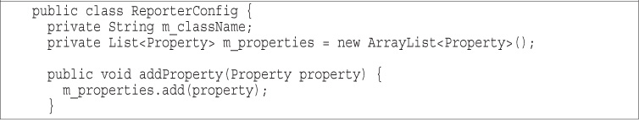
Endava Tech Courses
October @22
Formatting
VERTICAL DENSITY
06 — Formatting
XENIA DAMANCIUC

Slide 45
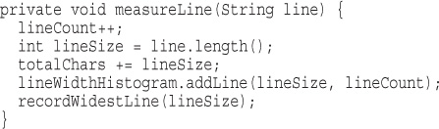
Endava Tech Courses
October @22
Formatting
HORIZONTAL OPENNESS AND DENSITY
06 — Formatting
XENIA DAMANCIUC

Slide 46
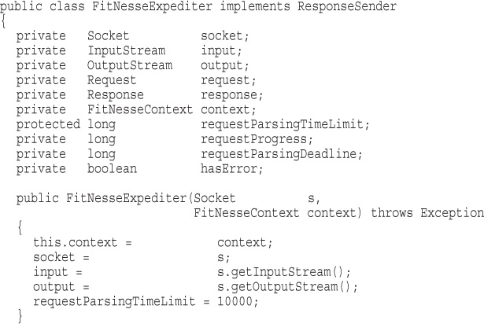
Endava Tech Courses
October @22
Formatting
HORIZONTAL ALIGNMENT
06 — Formatting
XENIA DAMANCIUC

Slide 47
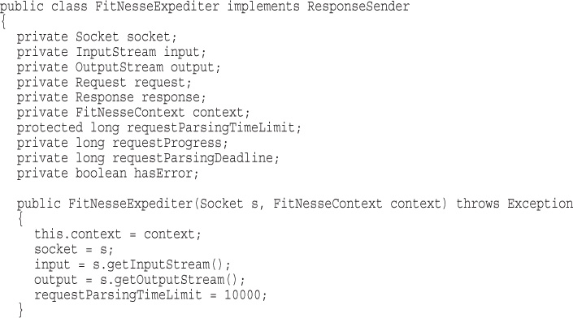
Endava Tech Courses
October @22
Formatting
HORIZONTAL ALIGNMENT
06 — Formatting
XENIA DAMANCIUC

Slide 48


Endava Tech Courses
October @22
Team rules
06 — Formatting
XENIA DAMANCIUC

Slide 49
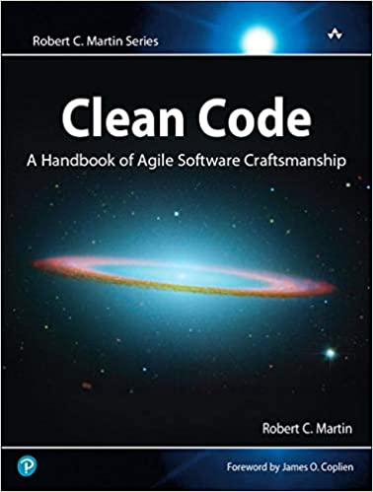

Endava Tech Courses
October @22
Useful resources
07 — Useful resources
XENIA DAMANCIUC

Slide 50


