Slide 1

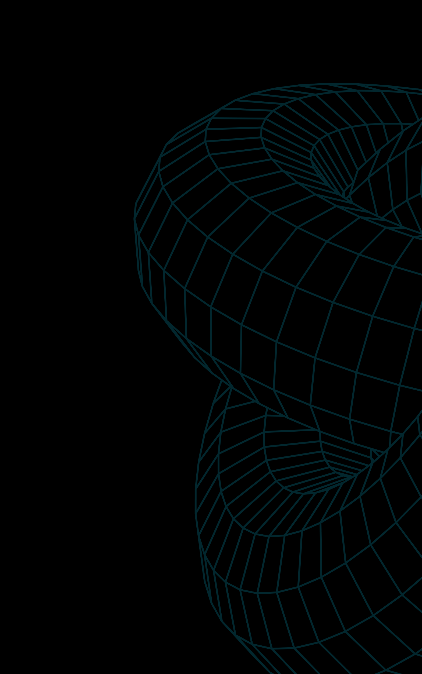
Endava Tech Courses
OCTOBER @22
Design Patterns
ELENA HAJDEU-CHICAROS – XENIA DAMANCIUC

Slide 2
Endava Tech Courses
OCTOBER @22
Agenda
01. What is a Design Pattern?
02. Singleton method
03. Factory method
04. Builder method
05. Observer method
00 — Agenda
ELENA HAJDEU-CHICAROS – XENIA DAMANCIUC

Slide 3
Endava Tech Courses
OCTOBER @22
WHAT IS A DESIGN PATTERN?
Design Pattern:
A description / Template for how to solve a problem that can be used in many different situations is a design pattern
Design patterns are usually used to prevent subtle issues that can cause major problems and improves code readability for coders and architects familiar with the patterns.
They provide general solutions, documented in a format that doesn’t require specific tied to a particular problem.
Also design patterns allows developers to communicate using well-known names for software interaction, moreover this patterns can be improved so they became a more confident solution than ad-hoc ones.
01 — What is a design pattern
ELENA HAJDEU-CHICAROS – XENIA DAMANCIUC

Slide 4



Endava Tech Courses
OCTOBER @22
WHAT IS A DESIGN PATTERN?
6
Creational
This type of patterns are only about class and object creation. While class ones uses inheritance effectively in the instantiation process, the other ones, object, uses delegation to get the job done. Also, they increase flexibility and reuse of existing code.
8
structural
This type of patterns refers to Class and Object composition. Talking about Class composition we’ll find usages of inheritance in order to compose interfaces. Otherwise referring to object composition patterns define ways of composing them in such a way so we can obtain new functionality. Composing objects and classes into larger structures.
12
behavioral
This type of patterns totally refers to Class-Object communication or Object-Object communication, containing the algorithms and assignment of responsibilities between objects.
01 — What is a design pattern
ELENA HAJDEU-CHICAROS – XENIA DAMANCIUC

Slide 5



Endava Tech Courses
OCTOBER @22
WHY DO WE NEED DESIGN PATTERNS?
Code Reusability
Problem reducer
Easier changes
Reminding what a design pattern is we can guess that a main goal of it is to help us to structure the code properly, so we’ll avoid code duplicates, it will be easier because of maintaining a defined structure to reimplement it overall the project where it will be needed.
As the design patterns were defined and described during long years, they are able to protect us as developers and our project from facing major problems in development stage or worse than this in Production environment. Design Patterns were often configured because there existed an issue often made by developers, somehow it can be called an insurance, a way to avoid these cases and to make our lives easier.
Design Patterns – as much they are similar, the same they differ. Once you choose the pattern you need to use in a specific case in your application it will be very easy for you to extend your service area and vice-versa. Often you may have the feeling that two or more patterns seems the same, in order to choose the needed one, please pay attention to the possibility to extend the area of your service.
01 — What is a design pattern
ELENA HAJDEU-CHICAROS – XENIA DAMANCIUC

Slide 6
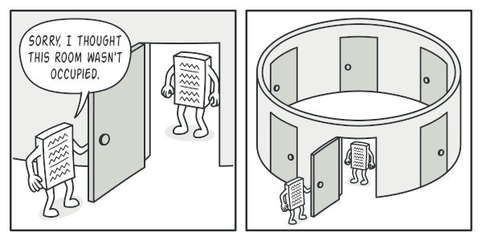
Endava Tech Courses
OCTOBER @22
SINGLETON METHOD
Provides a global access point to the instance
When to Use Singleton Design Pattern
For resources that are expensive to create (like database connection objects);
It's good practice to keep all loggers as Singletons which increases performance;
Classes which provide access to configuration settings for the application;
Classes that contain resources that are accessed in shared mode
02 — Singleton method
ELENA HAJDEU-CHICAROS – XENIA DAMANCIUC

Slide 7


Endava Tech Courses
OCTOBER @22
SINGLETON METHOD
Guaranties that it is the only instance of the object in the whole app (a single database object shared by all the app).
May implement delayed instantiating of the object.
It is initialized only when it’s requested the first time.
Multithreading issues.
Always needs mock-objects in order to be tested in unit-tests.
02 — Singleton method
ELENA HAJDEU-CHICAROS – XENIA DAMANCIUC

Slide 8
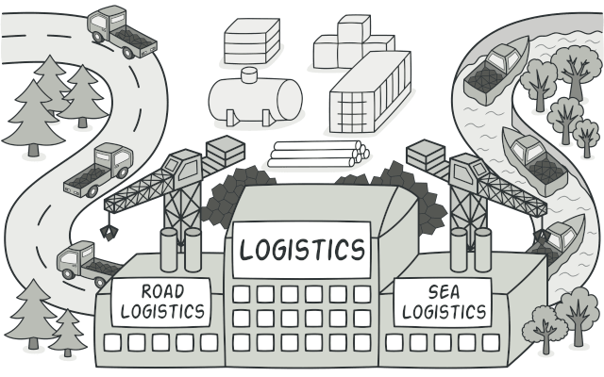
Endava Tech Courses
OCTOBER @22
FACTORY METHOD
Defines an interface for creating an object, but let subclasses decide which class to instantiate
When to Use Factory Method Design Pattern
When the implementation of an interface or an abstract class is expected to change frequently;
When the current implementation cannot comfortably accommodate new change;
When the initialization process is relatively simple, and the constructor only requires a handful of parameters;
03 — Factory method
ELENA HAJDEU-CHICAROS – XENIA DAMANCIUC

Slide 9
Endava Tech Courses
OCTOBER @22
FACTORY METHOD
You can use this pattern when you don’t know the types and dependencies your objects will have to work with.
When you want to allow people to extend your library / framework as well as their internal components.
When you want to save system resources by reusing existing objects instead of recreating them each time.
It’s easier to add new “Products” into your factory.
It is easier to maintain this kind of structure because the creational code is all located in one place.
Once your application is getting bigger it may become harder to maintain it as the more “products” you have to produce in your factory, the more subclasses of your factory you have to implement.
03 — Factory method
ELENA HAJDEU-CHICAROS – XENIA DAMANCIUC

Slide 10
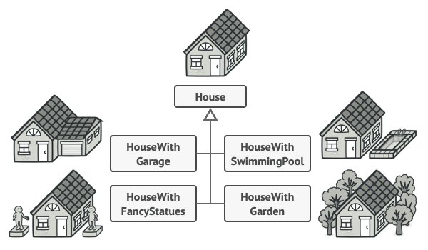

Endava Tech Courses
OCTOBER @22
BUILDER METHOD
When the complexity of creating object increases, the Builder pattern can separate out the instantiation process by using another object (a builder) to construct the object.
When to Use Builder Pattern
When the process involved in creating an object is extremely complex, with lots of mandatory and optional parameters;
When an increase in the number of constructor parameters leads to a large list of constructors;
When client expects different representations for the object that's constructed
04 — Builder method
ELENA HAJDEU-CHICAROS – XENIA DAMANCIUC

Slide 11
Endava Tech Courses
OCTOBER @22
BUILDER METHOD
Use this pattern when you want to get rid of “kilometer” length constructor.
Use it when you want your service to create different types of the same products. (Wooden / Stone houses)
Offers flexibility as you can totally interact with the object creation process. (Builder structure looks like a step-by-step plan)
As we are progressing with the app itself, and so with the service, it rises the complexity of the code, again, depending on how much derivations of the main object you defined.
04 — Builder method
ELENA HAJDEU-CHICAROS – XENIA DAMANCIUC

Slide 12
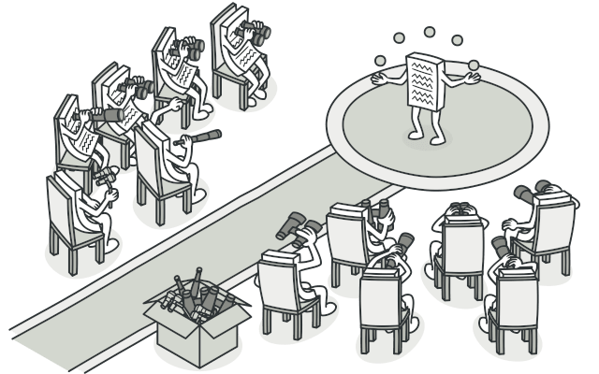
Endava Tech Courses
OCTOBER @22
OBSERVER METHOD
Is a behavioral design pattern that lets you define a subscription mechanism to notify multiple objects about any events that happen to the object they’re observing
05 — Observer method
ELENA HAJDEU-CHICAROS – XENIA DAMANCIUC

Slide 13
Endava Tech Courses
OCTOBER @22
OBSERVER METHOD
It supports the principle of loose coupling between objects that interact with each other.
It allows sending data to other objects effectively without any change in the Subject or Observer classes.
Observers can be added/removed at any point in time
If not correctly implemented the Observer can add complexity and lead to inadvertent performance issues.
In software application, notifications can, at times, be undependable and result in race conditions or inconsistency.
05 — Observer method
ELENA HAJDEU-CHICAROS – XENIA DAMANCIUC

Slide 14


Endava Tech Courses
October 2022
Useful links
https://www.baeldung.com/design-patterns-series
https://refactoring.guru/design-patterns
THANK YOU!
Hajdeu-Chicaros ELENA
Damanciuc XENIA

